Slide 1
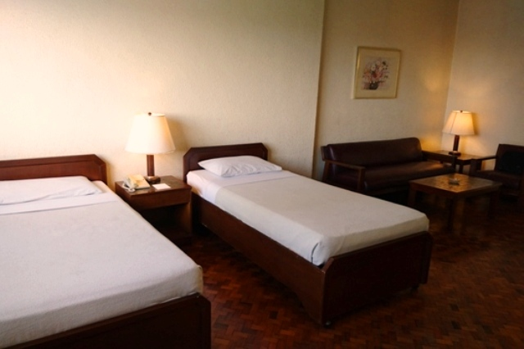
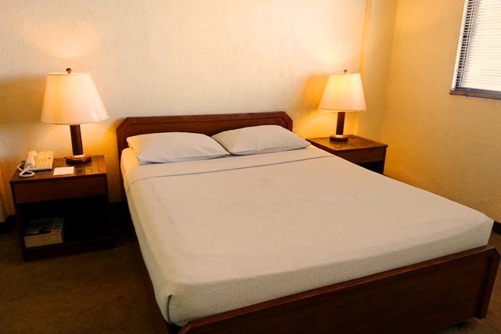
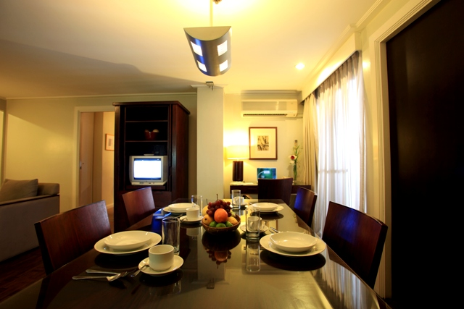

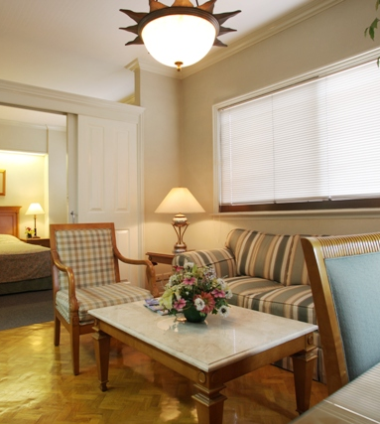
Hotel Amenities
Foreign currency exchange
Safety deposit boxes
24 hour standby generator
Luggage storage
Round – the – clock security
Room Amenities
Kitchen & Equipments
Cable Programming
Telephone with IDD/NDD access and voice mail
Remote Control Colored Television
Hot & Cold Shower
Individual air-condition unit
Bathtub for Executive Suites

Slide 2
