Slide 1

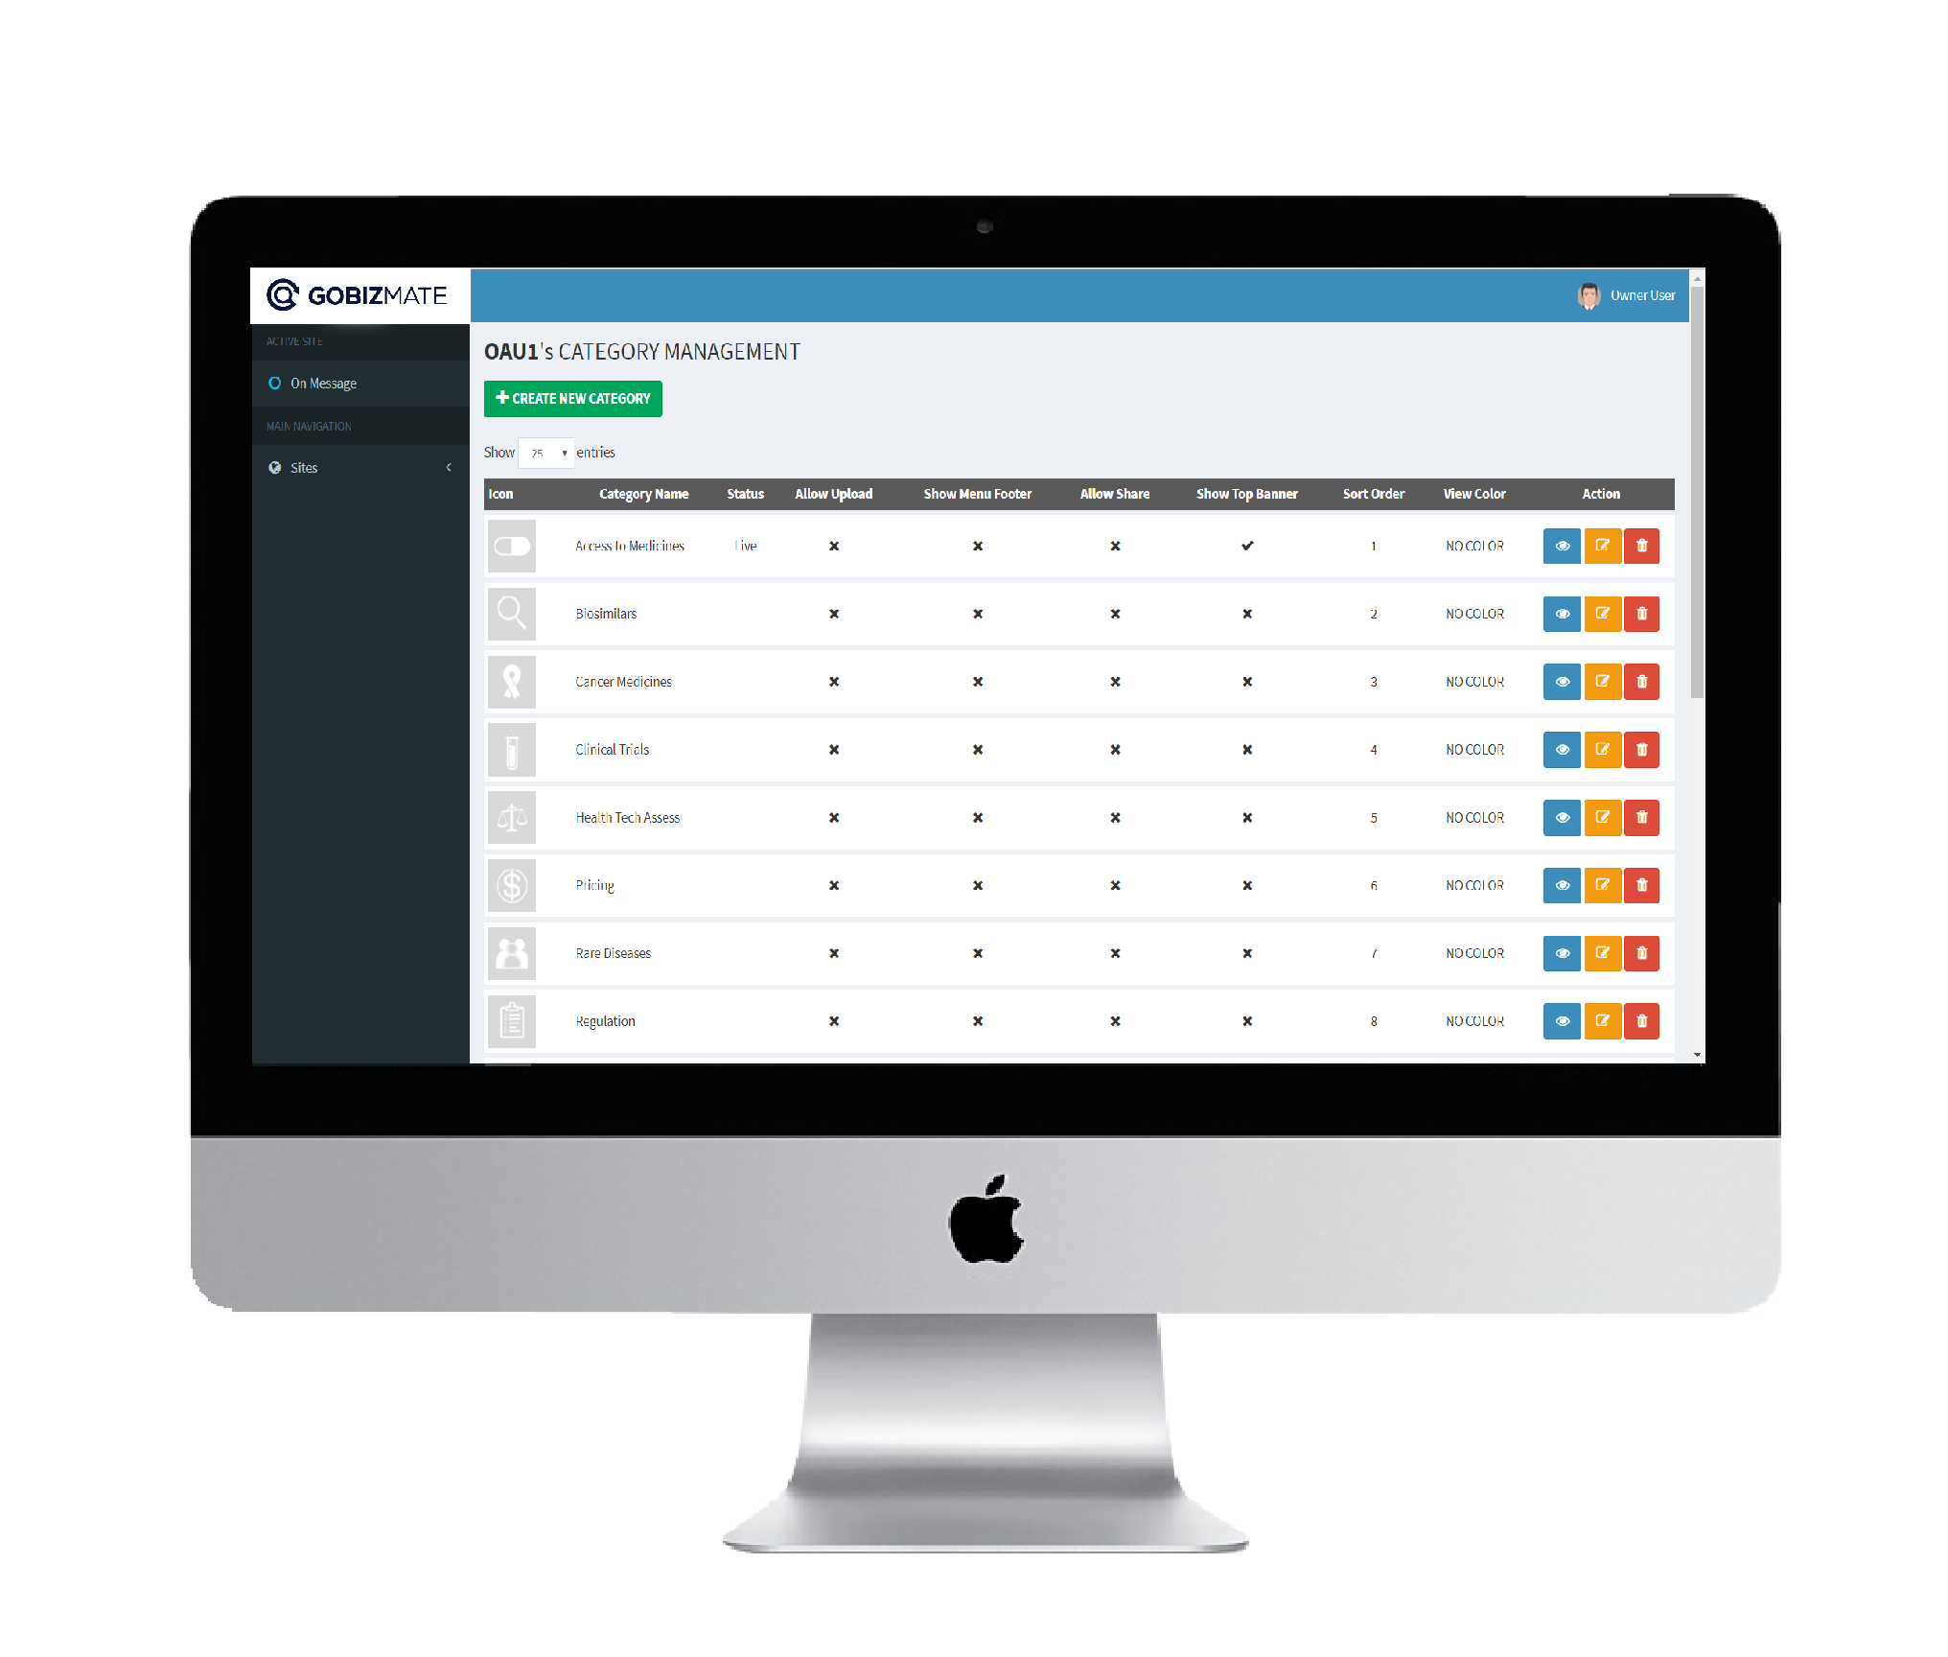





ACTIVE SITE
MAIN NAVIGATION
+ CREATE NEW CATEGORY
Sites
All Sites
Categories
Articles
CMS USER GUIDE

Slide 2

TABLE OF CONTENTS
Getting Started
About Our CMS Service
Getting An Account
Access To CMS
CMS Login Page
CMS Home Page
CMS Category Page
CMS Sub Category Page
CMS Articles Page

Slide 3
TABLE OF CONTENTS
Categories
Creating A New Category
Editing An Existing Category
Deleting An Existing Category
Articles
Article Types
Supported File Types
Creating A New Article
Editing An Existing Article
Deleting An Existing Article

Slide 4
ACTIVE SITE
MAIN NAVIGATION
+ CREATE NEW CATEGORY
Sites
All Sites
Categories
Articles
ABOUT OUR CMS SERVICE

Slide 5
ABOUT OUR CMS SERVICE
ACTIVE SITE
MAIN NAVIGATION
Categories
Articles
Sites
All Sites
Show more Details
Show more Details
Categories
Articles
Appzmate provides a hosted content management system (CMS).
It is easy to use, centrally supported with different functions and features that help users to manage their app contents on the go.
At its simplest, CMS is an acronym for a “Content Management System”.

Slide 6
ACTIVE SITE
MAIN NAVIGATION
+ CREATE NEW CATEGORY
Sites
All Sites
Categories
Articles
GETTING AN ACCOUNT

Slide 7
GETTING AN ACCOUNT
As part of promotional period for this new exciting app offering, we provide a community app to all interested companies and organizations which will allow you to share your information to public and maintain your mobile app presence.
Other features will be explained when one of our customer support contacts you. If you are interested to have your own App in Appstore please inform us by filling up the form from the link below.
It will only take within 24 hours to make your app in our community version to become available, after we verified and confirm your details submitted we will send you your account details as soon as your app is ready.
To get an account with appzmate simple Visit
http://www.sysdatahub.com/customer-registration-for-new-app/
Or visit
www.appzmate.com
And fill up the Customer Registration Form.

Slide 8
ACTIVE SITE
MAIN NAVIGATION
+ CREATE NEW CATEGORY
Sites
All Sites
Categories
Articles
ACCESS TO CMS

Slide 9




ACCESS TO CMS
APPZMATE | LOGIN
cms.emobishare.com:842
CMS LINK: http://cms.emobishare.com:842
Use the link above in order to access the appzmate cms

Slide 10
ACTIVE SITE
MAIN NAVIGATION
+ CREATE NEW CATEGORY
Sites
All Sites
Categories
Articles
CMS PAGES

Slide 11
CMS LOGIN
Sign In
Username
Password
SIGN IN
Appzmate CMS requires User credentials. Only those who has Valid Username and Password can access the CMS.
After successful Login user will be redirected to CMS Homepage where user can see his/her handled site/s and allow user to configure app contents like categories and articles.

Slide 12
CMS HOMEPAGE
2
7
1
ACTIVE SITE
8
2
3
MAIN NAVIGATION
Categories
Articles
Sites
9
4
All Sites
Show more Details
Show more Details
5
Categories
Articles
6
BUTTON FUNCTIONS
BUTTON NO. | BUTTON NAME | BUTTON FUNCTIONS
1 | Appzmate Logo | Redirects User To Home Page
2 | Active Site Name | Let Users Know What Site Is Being Configured
3 | Sites Button | A Collapsible Button That Shows Users List Of Site Handled.
4 | Handled Site Name | A Collapsible Button That Show Site Settings Like Category And Article.
5 | Categories Button | Redirects User To Category Page
6 | Articles Button | Redirects User To Articles Page
7 | Profile Dropdown | A Drop Down Button That Shows The Logout Button
8 | Site Name | Shows The Active Site Name
9 | Article Panel | Another Way Of Accessing The Site Articles Page
10 | Category Panel | Another Way Of Accessing The Site Category Page
10

Slide 13
CMS CATEGORY PAGE
2
ACTIVE SITE
MAIN NAVIGATION
+ CREATE NEW CATEGORY
Sites
1
All Sites
Categories
Articles
3
4
5
BUTTON FUNCTIONS
2
BUTTON NO. | BUTTON NAME | BUTTON FUNCTIONS
1 | CREATE NEW CATEGORY BUTTON | Redirects To Create New Category Form Page
2 | CATEGORY LIST TABLE | Show Category List And Information
3 | BLUE BUTTON | Show Sub Categories Inside The Category.
4 | YELLOW BUTTON | Used To Edit The Category.
5 | RED BUTTON | Used To Delete Category

Slide 14
CMS SUB CATEGORY PAGE
2
ACTIVE SITE
RETURN
1
MAIN NAVIGATION
2
Sites
+ CREATE NEW SUB CATEGORY
3
All Sites
Categories
Articles
4
5
6
7
BUTTON NO. | BUTTON NAME | BUTTON FUNCTIONS
1 | RETURN BUTTON | Return Users To Main Category Page
2 | CATEGORY NAME | Shows What Category Is Being Configured
3 | CREATE NEW SUB CATEGORY CONTENT | Redirects To New Sub Category Form Page.
4 | CATEGORY SUBCATEGORY TABLE | Shows List Of Category Subcategories
5 | CATEGORY ARTICLES NAME | Show Category Articles Title
6 | CATEGORY ARTICLES TABLE | Show List Of Article Inside The Category.

Slide 15
CMS ARTICLES PAGE
2
ACTIVE SITE
1
MAIN NAVIGATION
+ CREATE NEW ARTICLE
2
Sites
All Sites
3
Categories
Articles
4
5
BUTTON NO. | BUTTON NAME | BUTTON FUNCTIONS
1 | SITE ARTICLE NAME | show what site articles are being previewed.
2 | CREATE NEW ARTICLE BUTTON | redirects user to new article page
3 | FILTER DROPDOWNS | help users to locate articles easily
4 | ARTCILES TABLE | show list of site articles
5 | PREVIEW BUTTON | show article details preview

Slide 16
ACTIVE SITE
MAIN NAVIGATION
+ CREATE NEW CATEGORY
Sites
All Sites
Categories
Articles
CATEGORIES

Slide 17
ACTIVE SITE
MAIN NAVIGATION
+ CREATE NEW CATEGORY
Sites
All Sites
Categories
Articles
CREATING CATEGORIES

Slide 18
CREATING NEW CATEGORY | STEP 1
2
ACTIVE SITE
MAIN NAVIGATION
Categories
Articles
Sites
All Sites
Show more Details
Show more Details
Categories
Articles
STEP 1
Click The CATEGORY PANEL or the CATEGORIES in the left main navigation.
User will be redirected to the CATEGORY PAGE

Slide 19
CREATING NEW CATEGORY | STEP 2
2
ACTIVE SITE
+ CREATE NEW CATEGORY
MAIN NAVIGATION
+ CREATE NEW CATEGORY
Sites
All Sites
Categories
Articles
STEPS 2
Click The NEW CATEGORY BUTTON.
User will be redirected to NEW CATEGORY PAGE

Slide 20
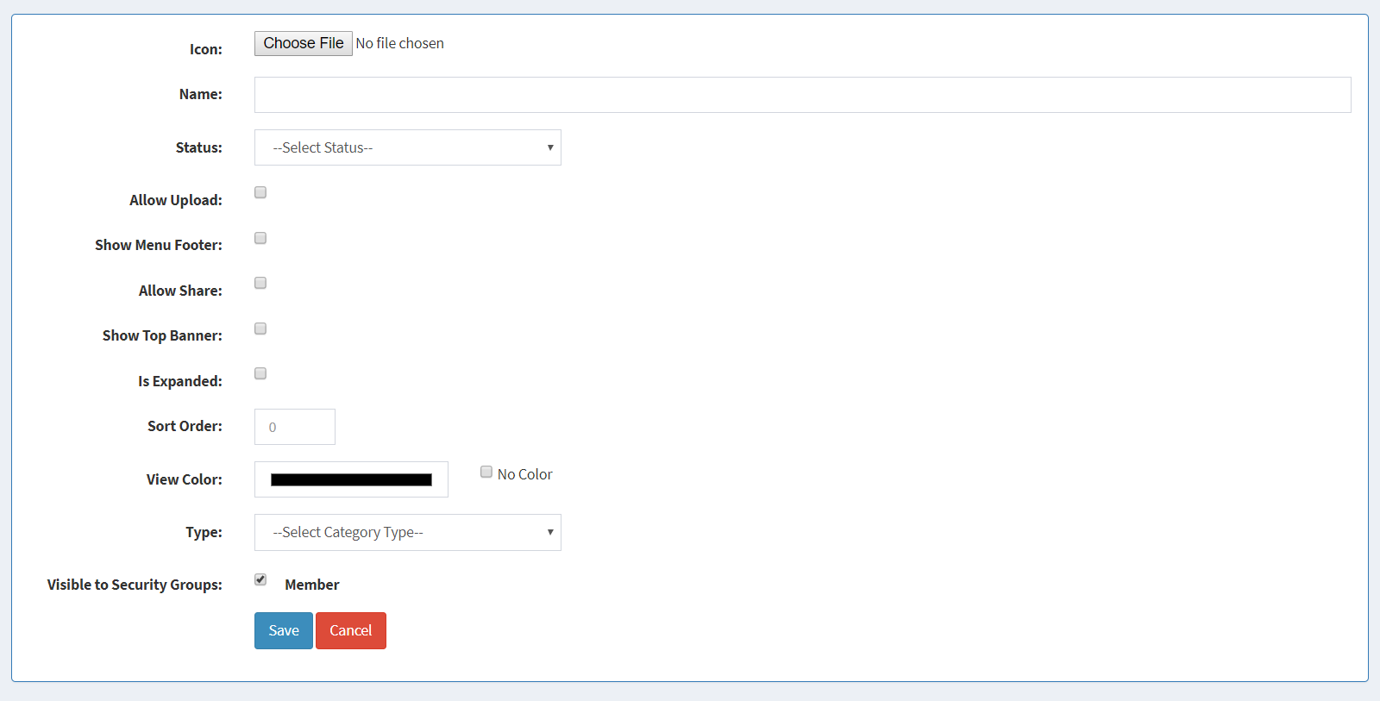
CREATING NEW CATEGORY | STEP 3
2
ACTIVE SITE
MAIN NAVIGATION
Sites
All Sites
Categories
Articles
STEPS 3
Fill up the NEW CATEGORY FORM.

Slide 21
CREATING NEW CATEGORY | STEP 3
2
FORM DESCRIPTION
ICON | Upload Category Icon
NAME | Category Name
STATUS | Category Status LIVE - Visible TEST - Not Visible On The App NEW – Not Visible On The App TURN OFF - Not Visible On The App
ALLOW UPLOAD | Allow Users In The App To Upload Files Inside The Category.
SHOW MENU FOOTER | Hide/Show Menu Footer
ALLOW SHARE | Allow Users To Share The Articles Inside The Category
SHOW TOP BANNER | Hide/Show Top Banner
IS EXPANDED | Auto Expand Folders Inside The Category
SORT ORDER | Used To Order Categories In The App Main Screen
VIEW COLOR | Used To Change The Category Inpage Screen Color
TYPE | Used To Specify If Category Is Going To Be A Folder Or An Article. Folder Type – Category As Folder ARTICLE – Automatically Open Article After Clicking The Category.
VISIBLE TO SECURITY GROUP | Enable Admin To Hide / Show Category By Security Group.

Slide 22
CREATING NEW CATEGORY | STEP 4
2
ACTIVE SITE
MAIN NAVIGATION
Sites
All Sites
Categories
Articles
STEPS 4
Click the SAVE BUTTON.
Category will be added in the category list table and user will be redirected
to category page.

Slide 23
ACTIVE SITE
MAIN NAVIGATION
+ CREATE NEW CATEGORY
Sites
All Sites
Categories
Articles
EDITING CATEGORIES

Slide 24
EDITING CATEGORY | STEP 1
2
ACTIVE SITE
MAIN NAVIGATION
Categories
Articles
Sites
All Sites
Show more Details
Show more Details
Categories
Articles
STEP 1
Click The CATEGORY PANEL or the CATEGORIES in the left main navigation.
User will be redirected to the CATEGORY PAGE

Slide 25
EDITING CATEGORY | STEP 2
2
ACTIVE SITE
MAIN NAVIGATION
+ CREATE NEW CATEGORY
Sites
All Sites
Categories
Articles
STEPS 2
Click The ORANGE BUTTON beside the category to be configured.
User will be redirected to EDIT CATEGORY PAGE

Slide 26
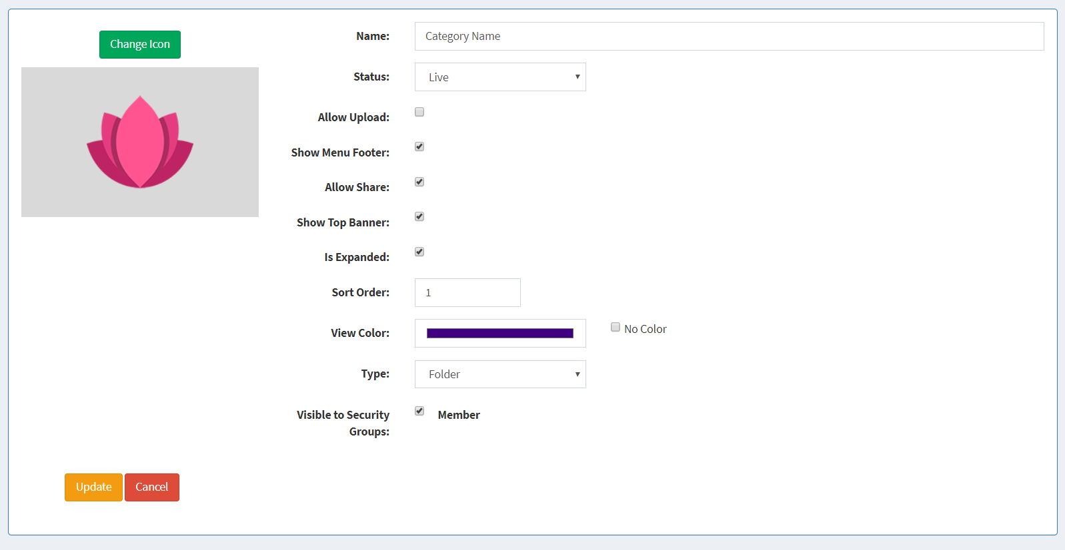
EDITING CATEGORY | STEP 3
2
ACTIVE SITE
MAIN NAVIGATION
Sites
All Sites
Categories
Articles
STEPS 3
Edit The CATEGORY FORM.

Slide 27
EDITNG CATEGORY | STEP 3
2
FORM DESCRIPTIONS
CHANGE ICON BUTTON | Used To Change The Category Icon
NAME | Used To Change The Category Name
STATUS | Used To Change The Category Status.
ALLOW UPLOAD | Used To Change The Upload Enabling/Disabling.
SHOW MENU FOOTER | Used To Hide/Show Menu Footer
ALLOW SHARE | Allow Users To Share The Articles Inside The Category
SHOW TOP BANNER | Hide/Show Top Banner
IS EXPANDED | Used To Enable/Disable Auto Collapse/Expand Of Folder Files Inside The Category.
SORT ORDER | Used To Change The Category Order In The Main Page Screen.
VIEW COLOR | Used To Change The Category Inpage Background Color.
TYPE | Used To Change The Category Type.
VISIBLE TO SECURITY GROUP | Used To Change The Category Visibility Depending On Their Security Group.

Slide 28
EDITING CATEGORY | STEP 4
2
ACTIVE SITE
MAIN NAVIGATION
Sites
All Sites
Categories
Articles
STEPS 4
Click The UPDATE BUTTON
Category will be update and user will be redirected to category page.

Slide 29
ACTIVE SITE
MAIN NAVIGATION
+ CREATE NEW CATEGORY
Sites
All Sites
Categories
Articles
DELETING CATEGORIES

Slide 30
DELETING CATEGORY | STEP 1
2
ACTIVE SITE
MAIN NAVIGATION
Categories
Articles
Sites
All Sites
Show more Details
Show more Details
Categories
Articles
STEP 1
Click The CATEGORY PANEL or the CATEGORIES in the left main navigation.
User will be redirected to the CATEGORY PAGE

Slide 31
DELETING CATEGORY | STEP 2
2
ACTIVE SITE
MAIN NAVIGATION
+ CREATE NEW CATEGORY
Sites
All Sites
Categories
Articles
STEPS 2
Click The RED BUTTON beside the category to be configured.
A CONFIRMATION MODAL will appear over the screen

Slide 32
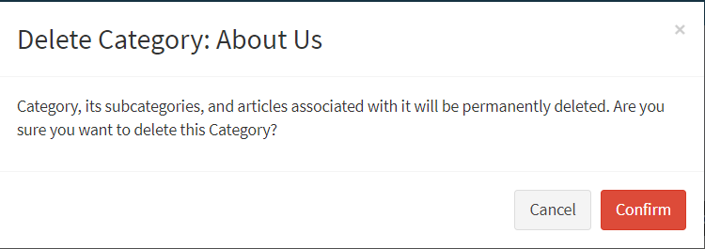
DELETING CATEGORY | STEP 3
2
ACTIVE SITE
MAIN NAVIGATION
+ CREATE NEW CATEGORY
Sites
All Sites
Categories
Articles
STEPS 3
Confirm Category deletion by clicking the CONFIRM BUTTON.
Category will be removed from the category table list.

Slide 33
ACTIVE SITE
MAIN NAVIGATION
+ CREATE NEW CATEGORY
Sites
All Sites
Categories
Articles
CREATING SUB CATEGORIES

Slide 34
CREATING SUB CATEGORY | STEP 1
2
ACTIVE SITE
MAIN NAVIGATION
Categories
Articles
Sites
All Sites
Show more Details
Show more Details
Categories
Articles
STEP 1
Click The CATEGORY PANEL or the CATEGORIES in the left main navigation.
User will be redirected to the CATEGORY PAGE

Slide 35
CREATING SUB CATEGORY | STEP 2
2
ACTIVE SITE
MAIN NAVIGATION
+ CREATE NEW CATEGORY
Sites
All Sites
Categories
Articles
STEPS 2
Click The BLUE BUTTON beside the category to have a sub category inside.
User will be redirected to subcategory page.

Slide 36
CREATING SUB CATEGORY | STEP 3
2
ACTIVE SITE
RETURN
MAIN NAVIGATION
+ CREATE NEW SUB CATEGORY
Sites
+ CREATE NEW SUB CATEGORY
All Sites
Categories
Articles
STEPS 2
Click The CREATE NEW SUB CATEGORY BUTTON..
User will be redirected to new subcategory page.

Slide 37
CREATING NEW CATEGORY | STEP 4
2
ACTIVE SITE
MAIN NAVIGATION
Sites
All Sites
Categories
Articles
STEPS 4
Fill up the NEW SUB CATEGORY FORM.

Slide 38
CREATING NEW CATEGORY | STEP 5
2
FORM DESCRIPTION
ICON | Upload Category Icon
NAME | Category Name
STATUS | Category Status LIVE - Visible TEST - Not Visible On The App NEW – Not Visible On The App TURN OFF - Not Visible On The App
ALLOW UPLOAD | Allow Users In The App To Upload Files Inside The Category.
SHOW MENU FOOTER | Hide/Show Menu Footer
ALLOW SHARE | Allow Users To Share The Articles Inside The Category
SHOW TOP BANNER | Hide/Show Top Banner
IS EXPANDED | Auto Expand Folders Inside The Category
SORT ORDER | Used To Order Categories In The App Main Screen
VIEW COLOR | Used To Change The Category Inpage Screen Color
TYPE | Used To Specify If Category Is Going To Be A Folder Or An Article. Folder Type – Category As Folder ARTICLE – Automatically Open Article After Clicking The Category.
VISIBLE TO SECURITY GROUP | Enable Admin To Hide / Show Category By Security Group.

Slide 39
CREATING NEW CATEGORY | STEP 6
2
ACTIVE SITE
MAIN NAVIGATION
Sites
All Sites
Categories
Articles
STEPS 6
Click the SAVE BUTTON.
Sub Category will be added in the sub category list table and user will be redirected to sub category page.

Slide 40
ACTIVE SITE
MAIN NAVIGATION
+ CREATE NEW CATEGORY
Sites
All Sites
Categories
Articles
EDITING SUB CATEGORIES

Slide 41
EDITING SUB CATEGORY | STEP 1
2
ACTIVE SITE
MAIN NAVIGATION
Categories
Articles
Sites
All Sites
Show more Details
Show more Details
Categories
Articles
STEP 1
Click The CATEGORY PANEL or the CATEGORIES in the left main navigation.
User will be redirected to the CATEGORY PAGE

Slide 42
EDITING SUB CATEGORY | STEP 2
2
ACTIVE SITE
MAIN NAVIGATION
+ CREATE NEW CATEGORY
Sites
All Sites
Categories
Articles
STEPS 2
Click The BLUE BUTTON beside the category to have a sub category inside.
User will be redirected to subcategory page.

Slide 43
EDITING SUB CATEGORY | STEP 3
2
ACTIVE SITE
RETURN
MAIN NAVIGATION
+ CREATE NEW SUB CATEGORY
Sites
All Sites
Categories
Articles
STEPS 2
Click The ORANGE BUTTON..
User will be redirected to Edit Subcategory Page.

Slide 44
EDITING CATEGORY | STEP 4
2
ACTIVE SITE
MAIN NAVIGATION
Sites
All Sites
Categories
Articles
STEPS 4
Edit The SUB CATEGORY FORM.

Slide 45
EDITNG SUB CATEGORY | STEP 4
2
FORM DESCRIPTIONS
CHANGE ICON BUTTON | Used To Change The Category Icon
NAME | Used To Change The Category Name
STATUS | Used To Change The Category Status.
ALLOW UPLOAD | Used To Change The Upload Enabling/Disabling.
SHOW MENU FOOTER | Used To Hide/Show Menu Footer
ALLOW SHARE | Allow Users To Share The Articles Inside The Category
SHOW TOP BANNER | Hide/Show Top Banner
IS EXPANDED | Used To Enable/Disable Auto Collapse/Expand Of Folder Files Inside The Category.
SORT ORDER | Used To Change The Category Order In The Main Page Screen.
VIEW COLOR | Used To Change The Category Inpage Background Color.
TYPE | Used To Change The Category Type.
VISIBLE TO SECURITY GROUP | Used To Change The Category Visibility Depending On Their Security Group.

Slide 46
EDITING SUB CATEGORY | STEP 5
2
ACTIVE SITE
MAIN NAVIGATION
Sites
All Sites
Categories
Articles
STEPS 5
Click The UPDATE BUTTON
Sub Category will be update and user will be redirected to sub category page.

Slide 47
ACTIVE SITE
MAIN NAVIGATION
+ CREATE NEW CATEGORY
Sites
All Sites
Categories
Articles
DELETING SUB CATEGORIES

Slide 48
DELETING SUB CATEGORY | STEP 1
2
ACTIVE SITE
MAIN NAVIGATION
Categories
Articles
Sites
All Sites
Show more Details
Show more Details
Categories
Articles
STEP 1
Click The CATEGORY PANEL or the CATEGORIES in the left main navigation.
User will be redirected to the CATEGORY PAGE

Slide 49
DELETING SUB CATEGORY | STEP 2
2
ACTIVE SITE
MAIN NAVIGATION
+ CREATE NEW CATEGORY
Sites
All Sites
Categories
Articles
STEPS 2
Click The BLUE BUTTON beside the category to have a sub category inside.
User will be redirected to subcategory page.

Slide 50
DELETING SUB CATEGORY | STEP 3
2
ACTIVE SITE
RETURN
MAIN NAVIGATION
+ CREATE NEW SUB CATEGORY
Sites
All Sites
Categories
Articles
STEPS 3
Click The RED BUTTON beside the subcategory to be deleted..
A confirmation modal wil appear in the screen..

Slide 51
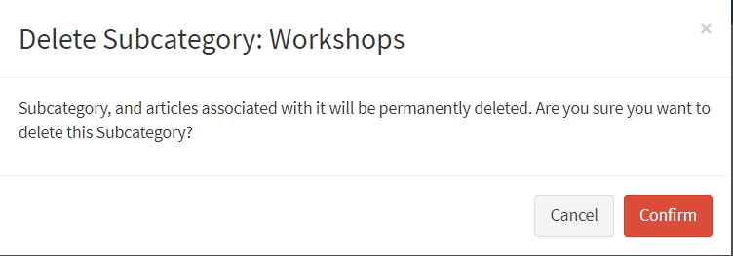
DELETING SUB CATEGORY | STEP 4
2
ACTIVE SITE
RETURN
MAIN NAVIGATION
+ CREATE NEW SUB CATEGORY
Sites
All Sites
Categories
Articles
STEPS 4
Click The CONFIRM BUTTON.
Subcategory and other files connected to the subcategory will be deleted.

Slide 52
ACTIVE SITE
MAIN NAVIGATION
+ CREATE NEW CATEGORY
Sites
All Sites
Categories
Articles
ARTICLES

Slide 53
ACTIVE SITE
MAIN NAVIGATION
+ CREATE NEW CATEGORY
Sites
All Sites
Categories
Articles
ARTICLES TYPES

Slide 54
ARTICLE TYPES
2
TEXT FILE
FILE BROWSE
DIRECT TEXT
this file type only preview a short description of the article inside the category/subcategory on the app.
DIRECT TEXT FULL
this file type preview a full description of the article inside the category/subcategory on the app.
used if the file to be uploaded is a .TXT file extension
used if the file to be uploaded is a multimedia files / Office files or PDF Files.
used if the article to be created will use a WYSIWYG Editor. (HTML CODES / Customized Text and images)
used if the article to be created will use a WYSIWYG Editor. (HTML CODES / Customized Text and images)

Slide 55
ARTICLE TYPES
2
LINK–
EXTERNAL LINK
LOGIN LINK
GEO LOCATION
CALENDAR EVENT
LINKED ARTICLE
used if the article to be created is an existing URL page or Website.
used if you want to load the LINK ARTICLE outside the App (Browser).
used if the Link Article you want to create requires a user login after loading the page.
used if you want to create a GEO MAP Article.
used if you want to create a Calendar article File.
used if you want to create a new article and link it to an existing article.

Slide 56
ACTIVE SITE
MAIN NAVIGATION
+ CREATE NEW CATEGORY
Sites
All Sites
Categories
Articles
SUPPORTED FILE TYPES

Slide 57
SUPPORTED FILE TYPES
IMAGE FILES
.PNG Files
.JPEG FILES
. JPG Files
. PNG Files
VIDEO FILES
.MP4 Files
OFFICE FILES
.dotx Files
.ppt Files
.xlsx Files
DOCUMENT FILES
.PDF Files
.TXT Files
LINKS
Website Url Links
Customized Links
WYSIWYG EDITOR
Custom texts
Embedded Images
HTML Codes
2

Slide 58
ACTIVE SITE
MAIN NAVIGATION
+ CREATE NEW CATEGORY
Sites
All Sites
Categories
Articles
CREATING ARTICLES

Slide 59
CREATING NEW ARTICLE | STEP 1
2
ACTIVE SITE
MAIN NAVIGATION
Categories
Articles
Sites
All Sites
Show more Details
Show more Details
Categories
Articles
STEP 1
Click The ARTICLES PANEL or the ARTICLES in the left main navigation.
User will be redirected to the ARTICLES PAGE

Slide 60
CREATING NEW ARTICLE | STEP 2
2
ACTIVE SITE
ACTIVE SITE
+ CREATE NEW ARTICLE
MAIN NAVIGATION
+ CREATE NEW ARTICLE
MAIN NAVIGATION
Categories
Articles
Sites
Sites
All Sites
All Sites
Show more Details
Show more Details
Categories
Categories
Articles
Articles
STEP 2
Click The CREATE NEW ARTICLE BUTTON..
User will be redirected to the NEW ARTICLE PAGE

Slide 61
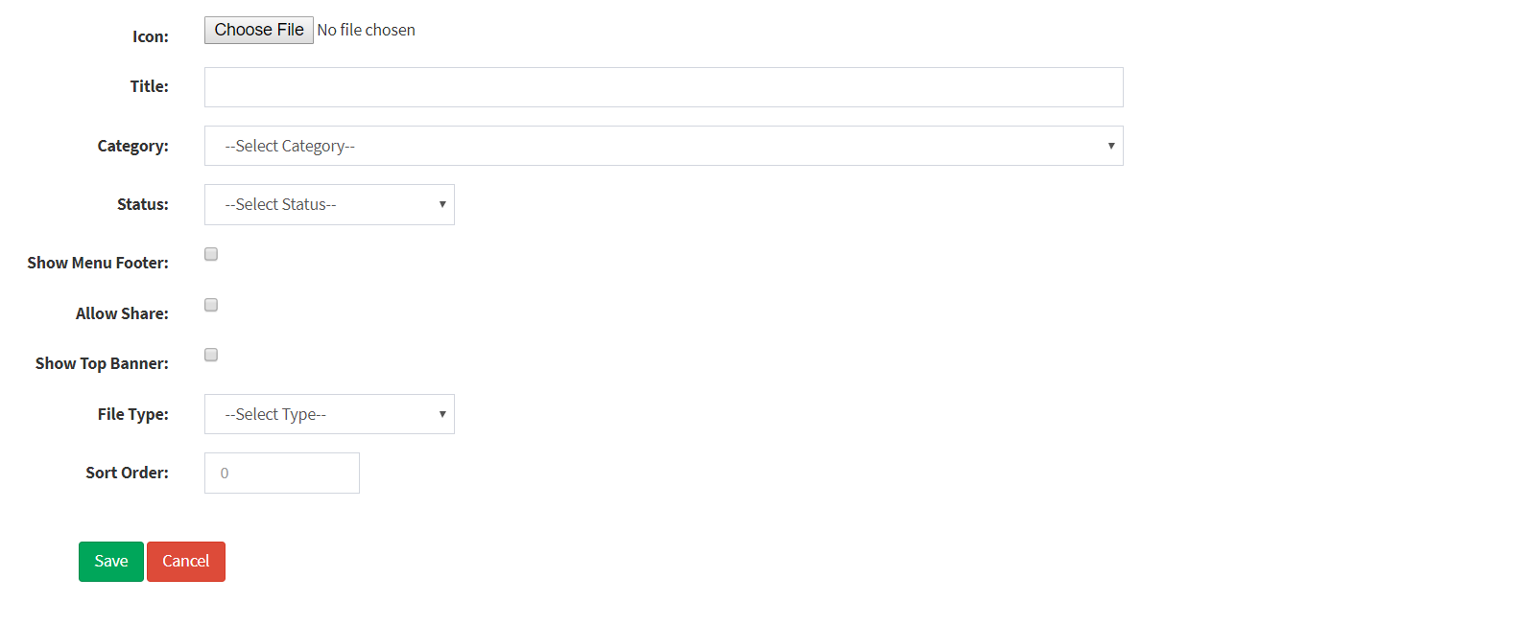
CREATING NEW ARTICLE | STEP 3
2
ACTIVE SITE
MAIN NAVIGATION
Sites
All Sites
Categories
Articles
STEPS 3
Fill up the NEW ARTICLE FORM.

Slide 62
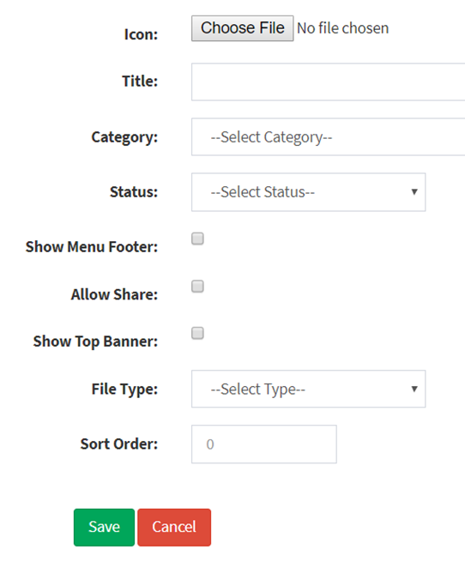
CREATING NEW ARTICLE | STEP 3
2
FORM DESCRIPTION
ICON | Upload Article Icon
TITLE | Article Name
CATEGORY | Location Where Article Will Be Grouped
STATUS | Article Status LIVE - Visible TEST - Not Visible On The App NEW – Not Visible On The App TURN OFF - Not Visible On The App
SHOW MENU FOOTER | Hide/Show Menu Footer In The Article Page
ALLOW SHARE | Used To Allow/Disable Users To Share The Articles
SHOW TOP BANNER | Hide/Show Top Banner In The Article Page
FILE TYPE | Used To Choose What File Type Will Be Uploaded.
SORT ORDER | Used To Order Articles In The App Inside The Category Or Sub Category.

Slide 63
CREATING NEW ARTICLE | STEP 4
2
ACTIVE SITE
MAIN NAVIGATION
Sites
All Sites
Categories
Articles
STEPS 4
Click the SAVE BUTTON.
Article will be added to the Article table list and user will be redirected to Articles Page..

Slide 64
ACTIVE SITE
MAIN NAVIGATION
+ CREATE NEW CATEGORY
Sites
All Sites
Categories
Articles
EDITING ARTICLES

Slide 65
EDITING ARTICLE | STEP 1
2
ACTIVE SITE
MAIN NAVIGATION
Categories
Articles
Sites
All Sites
Show more Details
Show more Details
Categories
Articles
STEP 1
Click The ARTICLES PANEL or the ARTICLES in the left main navigation.
User will be redirected to the ARTICLES PAGE

Slide 66
EDITING ARTICLE | STEP 2
2
ACTIVE SITE
ACTIVE SITE
MAIN NAVIGATION
+ CREATE NEW ARTICLE
MAIN NAVIGATION
Categories
Articles
Sites
Sites
All Sites
All Sites
Show more Details
Show more Details
Categories
Categories
Articles
Articles
STEP 2
Click The BLUE BUTTON..
User will be redirected to the ARTICLE DETAILS PAGE

Slide 67
EDITING ARTICLE | STEP 3
2
ACTIVE SITE
ACTIVE SITE
MAIN NAVIGATION
RETURN
MAIN NAVIGATION
Categories
Articles
Sites
Sites
All Sites
All Sites
Categories
Categories
Articles
Articles
Edit
STEP 3
Click The EDIT BUTTON..
User will be redirected to the EDIT ARTICLE PAGE

Slide 68
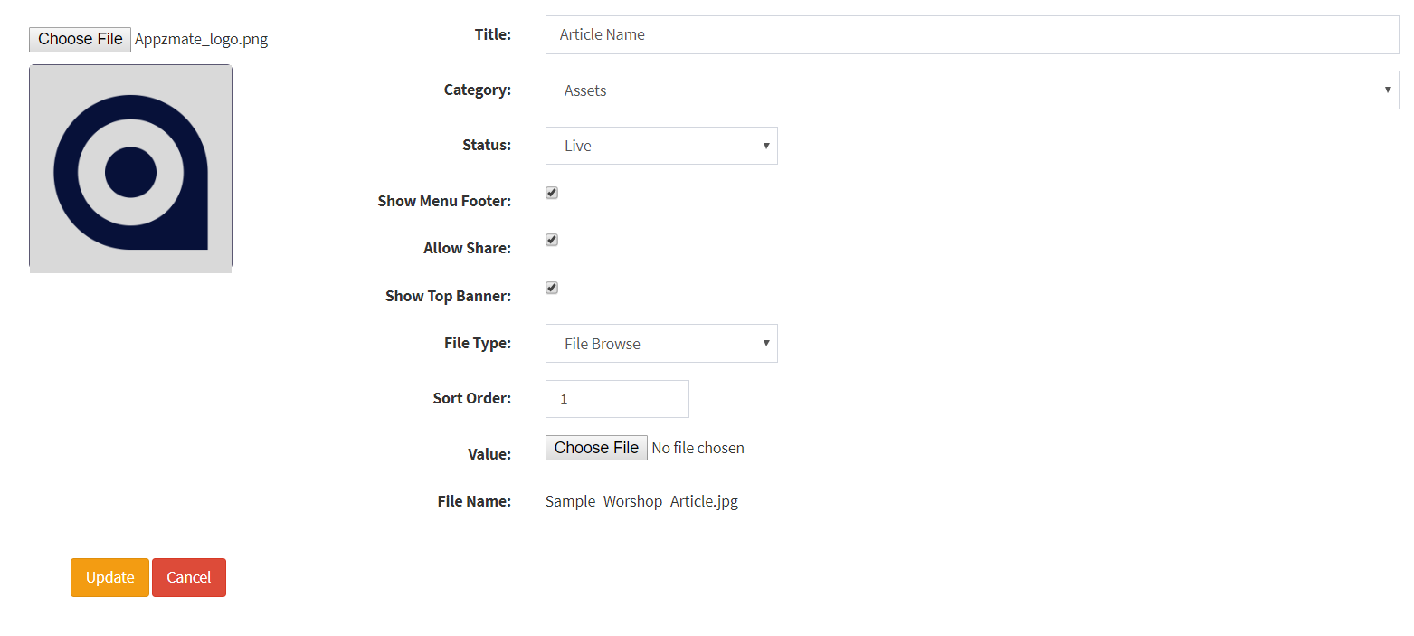
EDITING ARTICLE | STEP 4
2
ACTIVE SITE
ACTIVE SITE
MAIN NAVIGATION
MAIN NAVIGATION
Categories
Articles
Sites
Sites
All Sites
All Sites
Categories
Categories
Articles
Articles
STEP 4
EDIT Article Details.

Slide 69
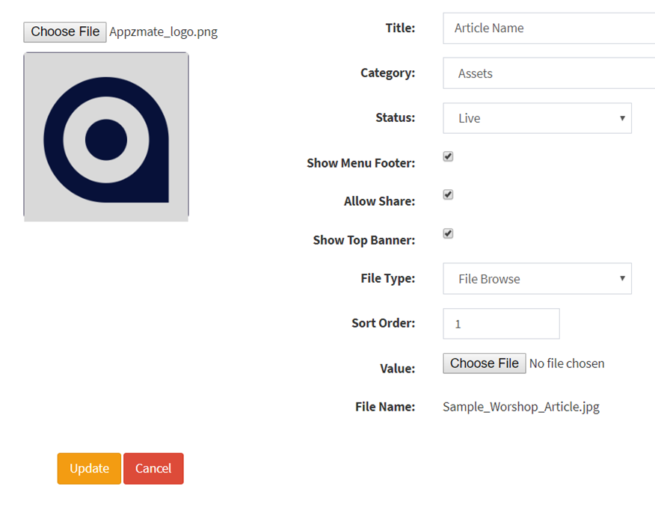
EDITING ARTICLE | STEP 4
2
FORM DESCRIPTION
CHOOSE ICON | Upload Article Icon
TITLE | Article Name
CATEGORY | Location Where Article Will Be Grouped
STATUS | Article Status LIVE - Visible TEST - Not Visible On The App NEW – Not Visible On The App TURN OFF - Not Visible On The App
SHOW MENU FOOTER | Hide/Show Menu Footer In The Article Page
ALLOW SHARE | Used To Allow/Disable Users To Share The Articles
SHOW TOP BANNER | Hide/Show Top Banner In The Article Page
FILE TYPE | Used To Choose What File Type Will Be Uploaded.
SORT ORDER | Used To Order Articles In The App Inside The Category Or Sub Category. VALUE – used to change the file Uploaded. FILE NAME – name of existing article File

Slide 70
EDITING ARTICLE | STEP 5
2
ACTIVE SITE
ACTIVE SITE
MAIN NAVIGATION
MAIN NAVIGATION
Categories
Articles
Sites
Sites
All Sites
All Sites
Categories
Categories
Articles
Articles
STEP 5
Click The UPDATE BUTTON.
Changes in the article will be updated and user will be redirected to the
Articles page..

Slide 71
ACTIVE SITE
MAIN NAVIGATION
+ CREATE NEW CATEGORY
Sites
All Sites
Categories
Articles
DELETING ARTICLES

Slide 72
EDITING ARTICLE | STEP 1
2
ACTIVE SITE
MAIN NAVIGATION
Categories
Articles
Sites
All Sites
Show more Details
Show more Details
Categories
Articles
STEP 1
Click The ARTICLES PANEL or the ARTICLES in the left main navigation.
User will be redirected to the ARTICLES PAGE

Slide 73
EDITING ARTICLE | STEP 2
2
ACTIVE SITE
ACTIVE SITE
MAIN NAVIGATION
+ CREATE NEW ARTICLE
MAIN NAVIGATION
Categories
Articles
Sites
Sites
All Sites
All Sites
Show more Details
Show more Details
Categories
Categories
Articles
Articles
STEP 2
Click The BLUE BUTTON..
User will be redirected to the ARTICLE DETAILS PAGE

Slide 74
EDITING ARTICLE | STEP 3
2
ACTIVE SITE
ACTIVE SITE
MAIN NAVIGATION
RETURN
MAIN NAVIGATION
Categories
Articles
Sites
Sites
All Sites
All Sites
Categories
Categories
Articles
Articles
Edit
STEP 3
Click The RED BUTTON..
A confirmation modal will appear in the Screen.

Slide 75
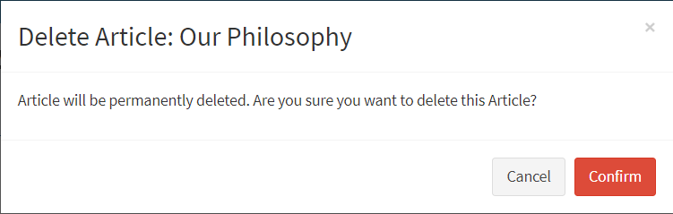
EDITING ARTICLE | STEP 3
2
ACTIVE SITE
ACTIVE SITE
MAIN NAVIGATION
RETURN
MAIN NAVIGATION
Categories
Articles
Sites
Sites
All Sites
All Sites
Categories
Categories
Articles
Articles
Edit
STEP 3
Click The CONFIRM BUTTON..
Article will be deleted and user will be redirected to the articles page..

Slide 76
APPZMATE USER GUIDE
2
The End
©appzmate 2018

