Slide 1

PHASE 2 -1: SAF ENHANCEMENTS

Slide 2
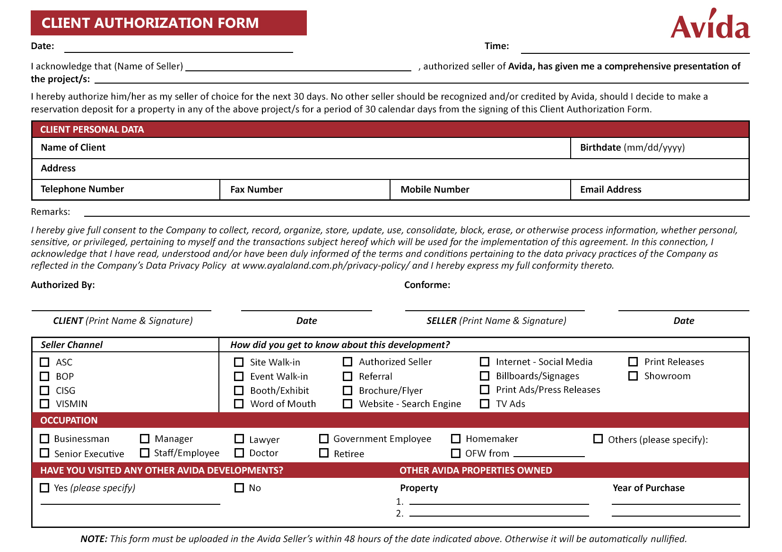
NEW FORM: CLIENT AUTHORIZATION FORM (CAF)

Slide 3
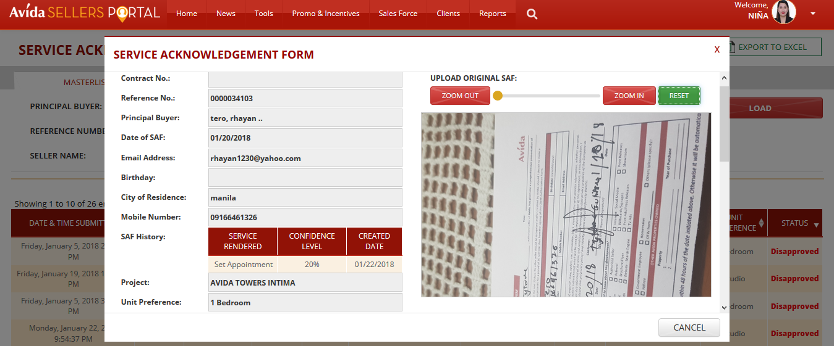
Changes (CLIENT/PROJECT DETAILS)
1. Change to Client Authorization Form
2. Make a required field
3. CAF History

Slide 4
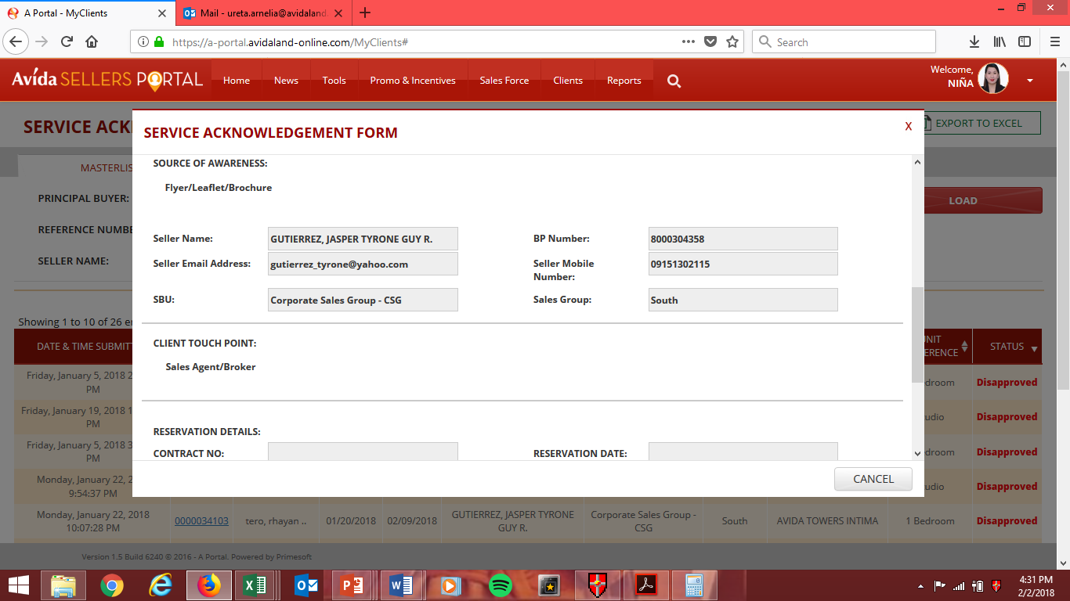
Current Appearance: SAF (SOURCE OF AWARENESS/CLIENT TOUCHPOINT)
4. Change to “How did you get to know about this development?”
5. Make it “tick-able” and use options on CAF.
6. Change to “Occupation”
7. Provide CAF options and make it “tick-able”

Slide 5
Other Requests
Provide e-mail notification to sellers for:
Approved CAFs that will include validation period
Disapproved CAFs and reason/s for disapproval
Reminder that CAF is about to expire
2. Make CAF validation from 21 to 30 calendar days upon uploading and approval.
3. Provide auto – rejection feature for CAFs being uploaded that are more than 2 days from CAF date.

Slide 6
Other Requests
4. Flipping of uploaded CAF image.
5. For downloadable Excel report (data to be included):
Date and Time Submitted
Reference Number
Principal Buyer
Date of CAF
Validity
Seller Name
SBU

Slide 7
Other Requests
5. For downloadable Excel report (data to be included):
Sales Group
Project
Unit Preference
Confidence Level
Client Touchpoint
Occupation
Have you visited any other Avida Development
If Yes – Project Name
Other Avida Properties Owned
Status

