Slide 1
Capstone Project - The Battle of the Neighborhoods
Clustering European Cities

Slide 2
Introduction
How can we cluster biggest cities of Europe?
Get 30 biggest cities of Europe and use museum type data. Data:
Foursquare
Wikipedia
Museum type can present characteristics of the cities

Slide 3
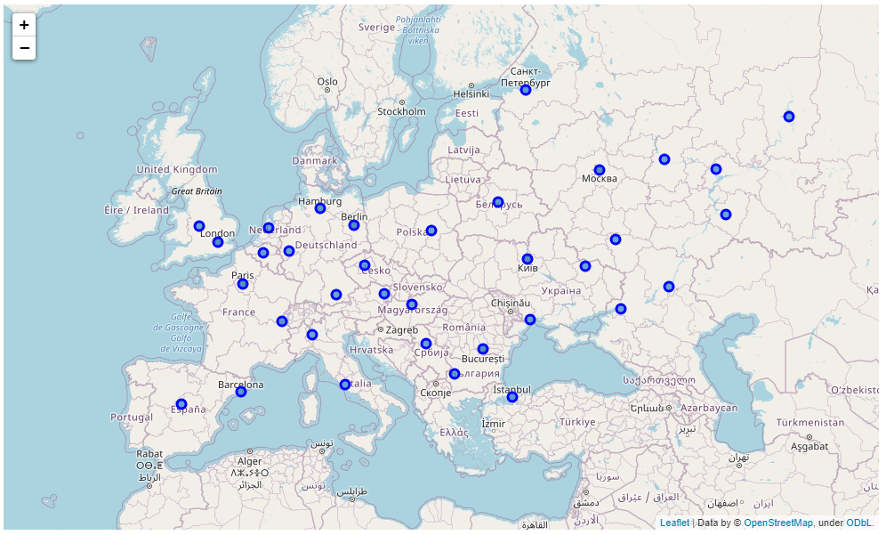
Data
Maps shows biggest cities
Wikipedia used for finding most populated European cities

Slide 4
Methodology
Get
Get data from Wikipedia and Foursquare
Apply
Apply k-means clustering
Analyze
Analyze results

Slide 5
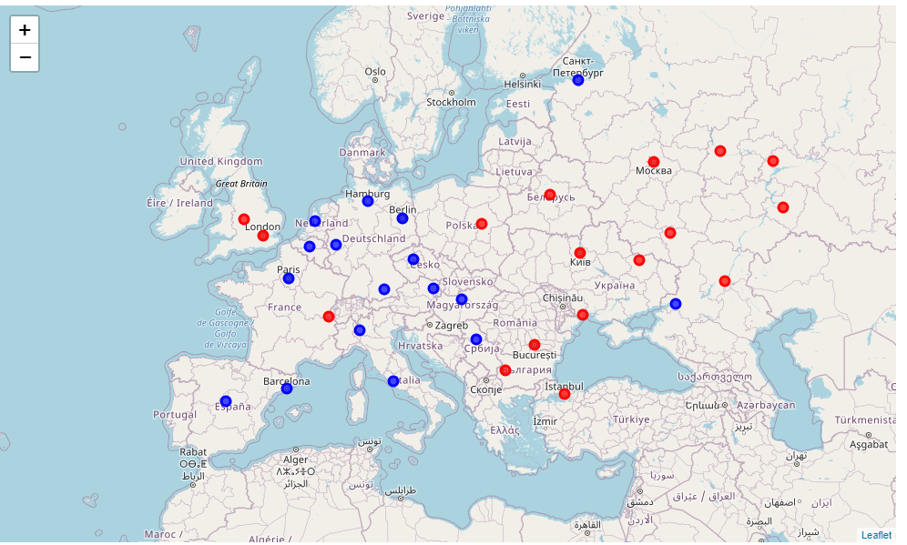
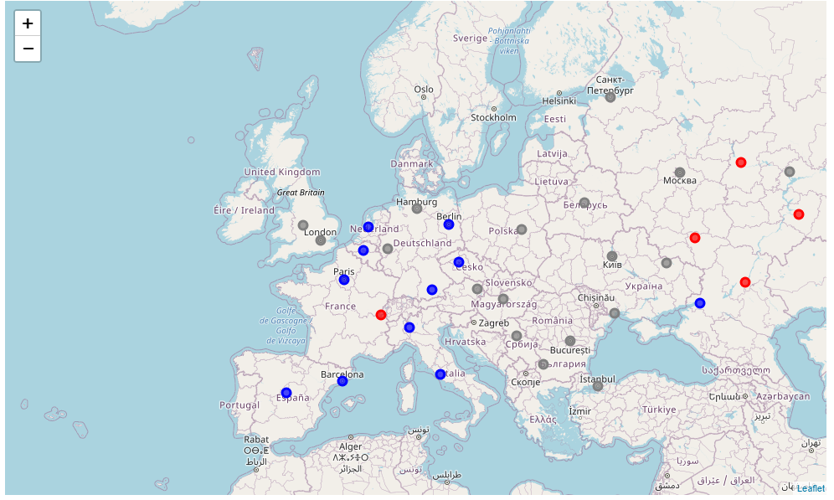
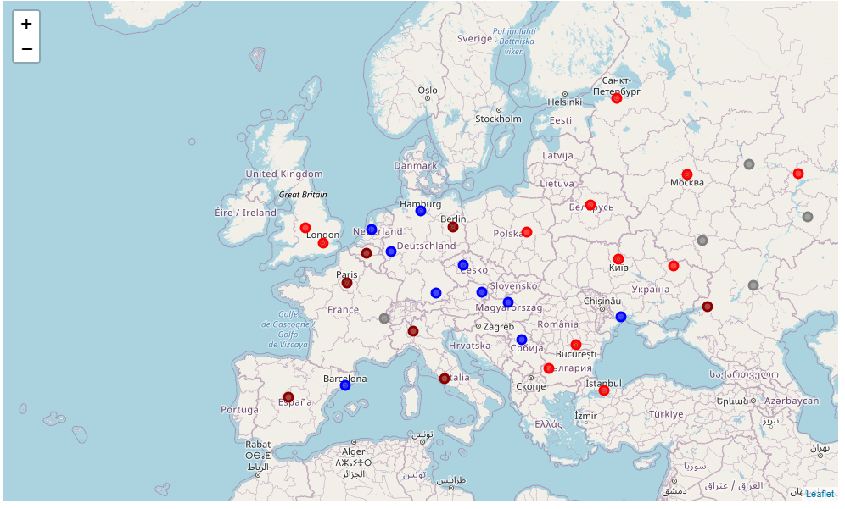
Analysis
2 clusters
3 clusters
4 clusters

Slide 6

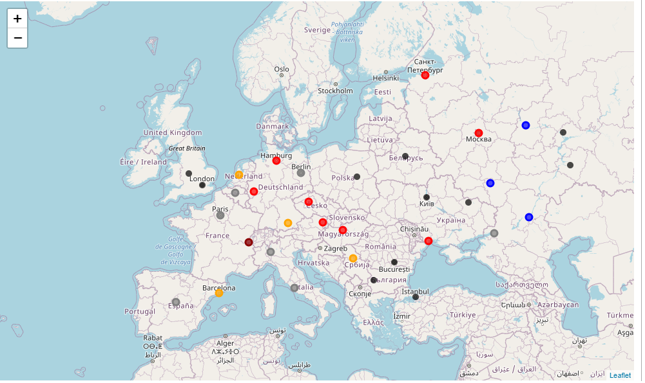
Analysis
5 clusters
6 clusters

Slide 7
Results and Conclusion
A wrong sample in east France, shall be ignored
East-West difference
Similarities of biggest metropoles (e.g. Istanbul-London)
Same country samples behave similar except Barcelona - Madrid

