Slide 1
SMU Campus Navigation APP
CSCI3475
for CHI 2016 Student Design Project

Slide 2

More than 8 out of 10 persons with disabilities use aids and assistive devices
“
Having the appropriate aids can enable an individual to participate more fully in society. In 2012, 81.3% of persons with disabilities reported using some kind of aid or assistive device.
“
statcan.gc.ca

Slide 3


Existing App and Research
WheelMate lets wheelchair users to locate wheelchair-accessible toilets and parking spaces. The WheelMate app currently has more than 30,000 locations across 45 countries - and more are being added every day. Almost 7000 people have downloaded the app.

Slide 4
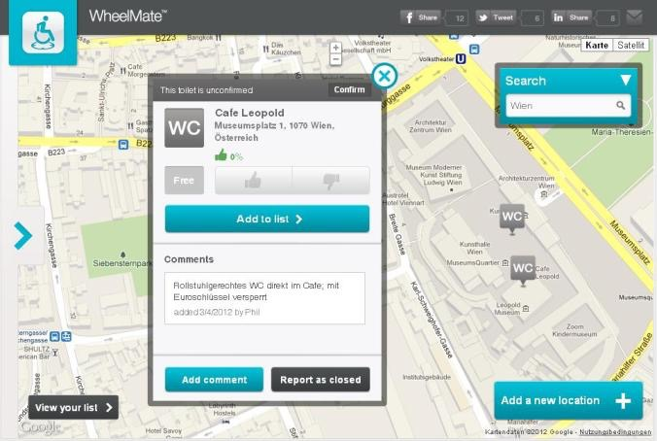

Slide 5
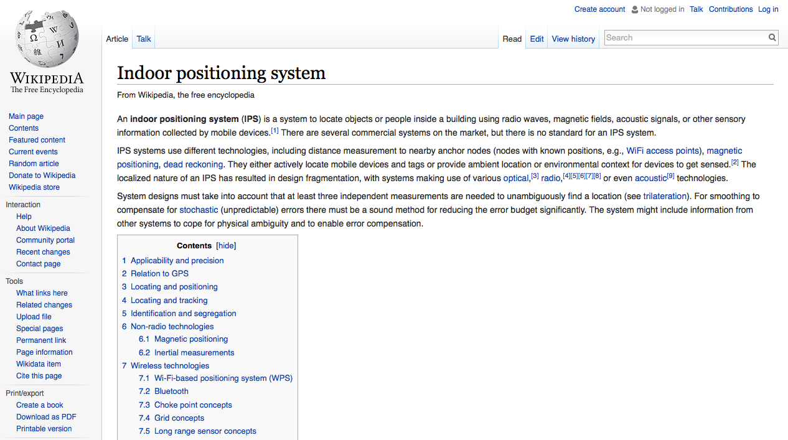
Indoor positioning system

Slide 6
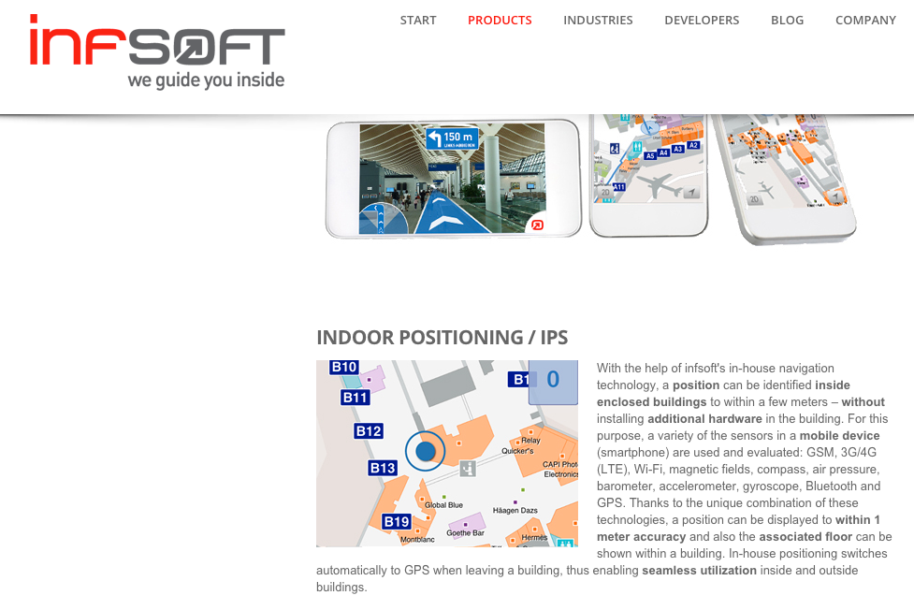

Slide 7
SMU Students with mobility disabilities
Visitors of SMU campus
TARGET
Staffs of Fred Smithers Centre

Slide 8

How will this app be useful for SMU students?
Navigation on campus is the most common complaint by the students with mobility disability
especially in McNally and when finding elevators and automatic doors
Smithers Centre

Slide 9
Using this app:
Student with mobility can find the shortest route to a point they are interested in with the ability to view elevators and automatic doors
Student will be able to view all points of interest on campus (washrooms, cafes, labs, etc)
Students will be able to share suggestions that will improve their experience on campus
Students will be able to view SMU news, security info and the Smithers Center contract information
Students will be able to local the parking lots

Slide 10
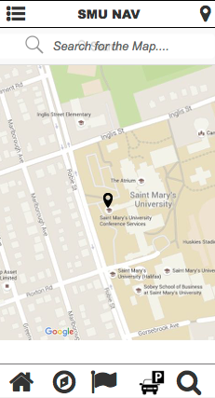
- shows a map that where you are (with a search bar)
- NearMe function shows the point of interests near you
Home Page

Slide 11
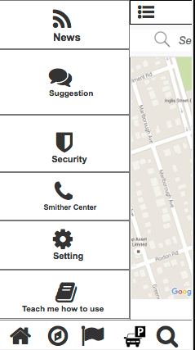
Hamburger Menu
1. News
News list
Press would show detail of the news
press to like
press to comment
press to share
2. Suggestion
Suggestion list
Down vote and up vote the suggestion from others
Comment others’ suggestions
3. Emergence Information
Shows the security time table and their number
4. Smither Centre
Shows the information of the people in Smither centre
5. Setting
Can adjust the light, font, and turn to night mode
6. Teach me how to use
Have a video to show how to use the App

Slide 12
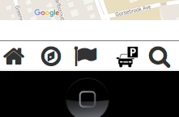
Navigation Bar (5 buttons)
1. Navigation
Input the location and the destination, and then, the algorithm would calculate the best option(safe and quick) for you
2. Point Of Interest
Choose your point of interest, then the map would show all the location of your choice
3. Parking
Shows you the available parking spot
4. Global Search

Slide 13
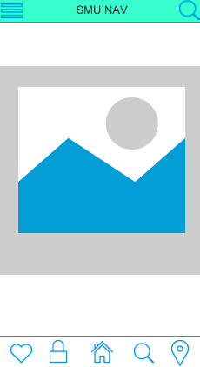
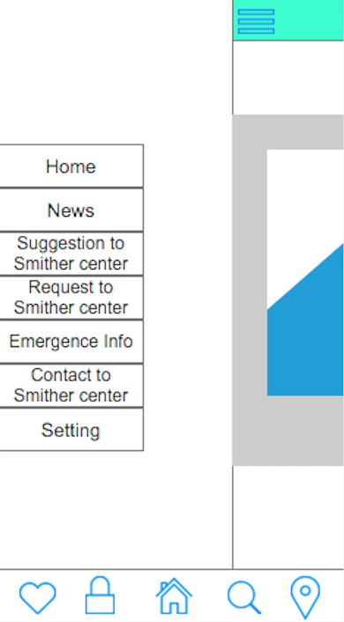
COMPARISON
1st prototype
Final prototype

Slide 14
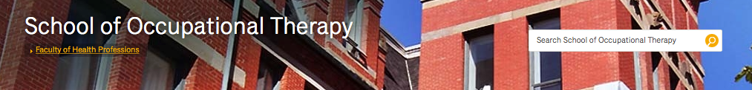
Dalhousie University’s School of Occupational Therapy
They can satisfy almost every request of students with disabilities.
No complaints.
Accessible campus.
Have on-campus events for people with disabilities every year.

