Slide 1

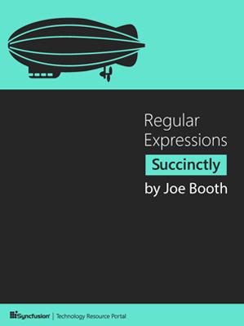

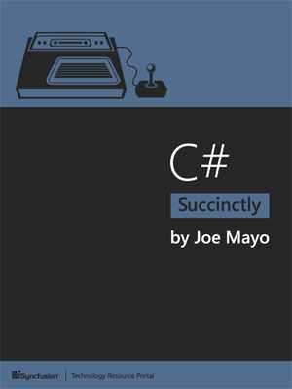
Subject 1
Rules in programming &
Object-oriented programming

Slide 3
Introducing C# and .NET
C# is a general purpose, object-oriented, component-based programming language. As a general purpose language, you have a number of ways to apply C# to accomplish many different tasks.
.NET is a platform that allowing developers to create many types of applications. C# is one of the .NET languages, which also includes Visual Basic, F#, C++, and more.

Slide 4
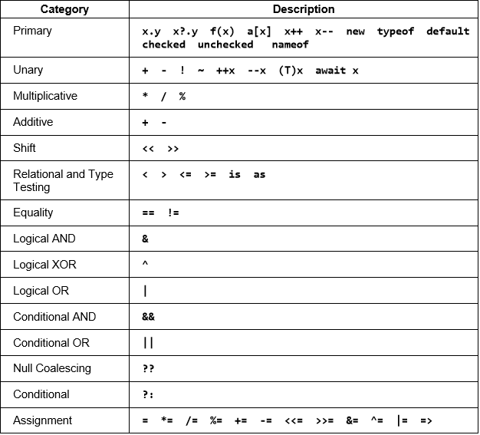
Coding Expressions and Statements
Operators:

Slide 5
Method and Properties
Method | Properties
Has parameter | No parameter
No get/set | Has get/set
When calling: method_name(); | When calling: properties_name;
Has void type | No void type
The similarity: have content.

Slide 6
Method and Properties
Exception Handling - try-catch final block

Slide 7
Object-Oriented Programming
4 major principles:
Inheritance
Encapsulation
Abstraction
Polymorphism

Slide 8
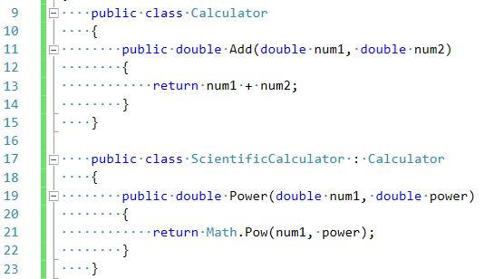
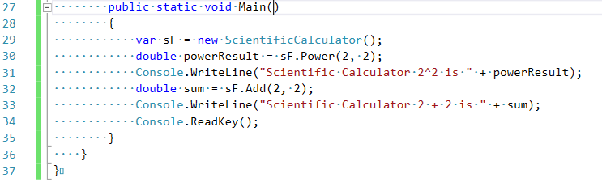
Inheritance
Inheritance defines a relationship between two classes where a derived class can reuse members of a base class.
Example:

Slide 9
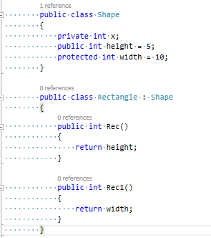
Encapsulation
Access modifiers:
public
private
protected
internal
protected internal
Example:

Slide 10
Abstraction
Abstract | Interface
- Doesn't support multiple inheritance. | - Supports multiple inheritance.
- Abstract class can have protected , public and public abstract methods | - Interface can have only public abstract methods i.e. by default
- Abstract class can extend only one class or one abstract class. | - Interface can extend any number of interfaces.
The similarity: can not initialize any method

Slide 11
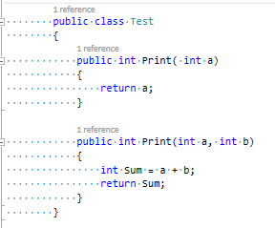
Polymorphism
Polymorphism is the same name but different method parameter

Slide 12
Handling Delegate, Event, and Lambda
What is Delegate?
Delegate is a reference data types (reference type) used to encapsulate a method with parameters and return types defined. We can pack any method in an appropriate delegate.
Delegate often used to create the event and the callback function for the program.
Example:

Slide 13
Handling Delegate, Event, and Lambda
What is a event?
One of the most common applications of the delegate is a event. Each event is actually a delegate.
Example:

Slide 14
Handling Delegate, Event, and Lambda
Introducing Lambda Expression
Lambda expression is considered to be a valuable improvements from version C # 2.0 to C # 3.0.
A lambda is a nameless method.
Just like methods, lambdas can have parameters, a body, and can return values.
Example:

Slide 15
Working with Collections and Generics
Using Collections
.NET collection classes let you work with data in many different ways. Instead of an array, you can use a List. If you need a first-in first-out set of items, you can use a Queue. If you need to work with items that have unique IDs, you can use a Dictionary. With generics, you can build your own collection to manage data any way that you need.

Slide 16
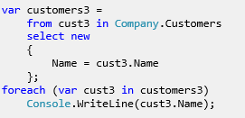
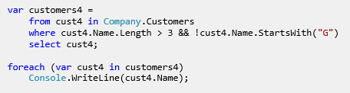
Query Object With LinQ
Querying Collections
Filtering Data

Slide 17
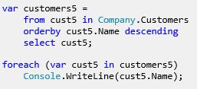
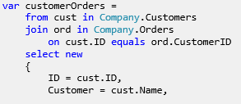
Query Object With LinQ
Ordering Collections
Joining Objects

Slide 18
Making Your Code Asynchronous
C# has two keywords that support async: async and await. Decorating a method with the async modifier says that the method can contain async code. You use the await keyword on a Task to start an async operation.
Returning void or Task

Slide 19
This book serves to process research topics in programming principles.
written by Joe Booth.

Slide 20
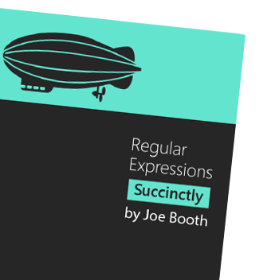
Some important chapters
Text Processing (chapter 1)
Character Sets (chapter 3)
Regex Tester Program II (chapter 8)
Cleaning Data with Regular Expressions (chapter 13)

Slide 21
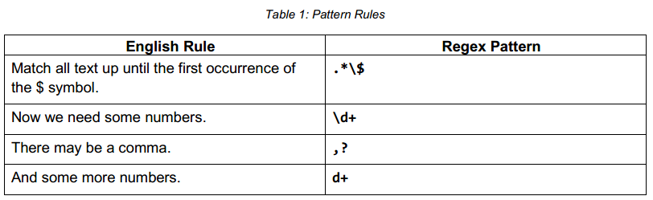
Text Processing
Patterns – Design Patterns
Building Pattern

Slide 22
Character Sets
Some examples :
Social Security Number :
[0-9][0-9][0-9][-][0-9][0-9][-][0-9][0-9][0-9][0-9].
Ex: 000-00-0000
ZIP+4 code :
\d\d\d\d\d[-\s][0-9][0-9][0-9][0-9]
Ex : 00000-0000
Euro price :
[\u20AC]\d\d\.[0-9] [0-9]
Ex : €00,00

Slide 23
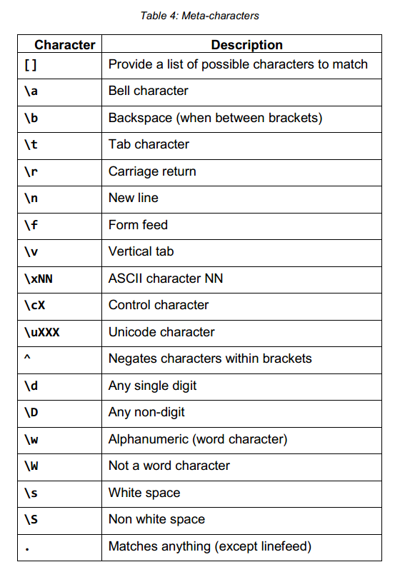
Character Sets
Summary :
Literal characters
Metacharacters (table 4)

Slide 24
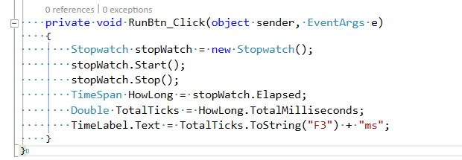
Regex Tester Program II
One of the most out standing features of Chapter is Timing
Using the stopwatch to report how long the engine processes
This will allow to try various optimization to make the regex run quicker

Slide 25
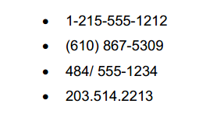
Cleaning Data with Regular Expression
Often, programmers will be asked to “clean up” or normalize data coming into a system.
expressions can be a very useful tool in a programmer’s toolbox when faced with such a task.
Ex : Format phone number

Slide 26
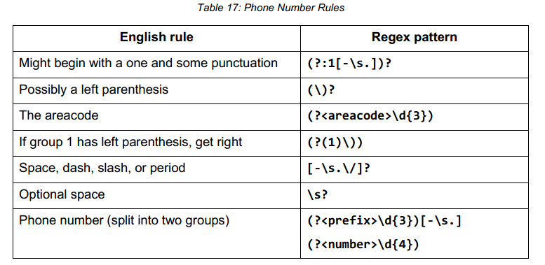
Cleaning Data with Regular Expression
Phone Numbers :
Our phone number regex is described below.
People’s Names :
Names are notoriously difficult to handle, because of the tremendous variety of names. We are going to look at a simple name parser. It will handle common titles, such as Dr, Miss, Mrs, etc.

Slide 28
Why SOLID
SOLID principles help programmers write better and cleaner code
Readable - While writing code, give meaningful names to your classes, methods, functions, and module names. Ex: ValidForCharactersOnly
Tesable – It reduces the time needed for debugging code
Design pattern - if the same project is well managed, following patterns and principles, your life is easier while you’re fixing or enhancing the project

Slide 29
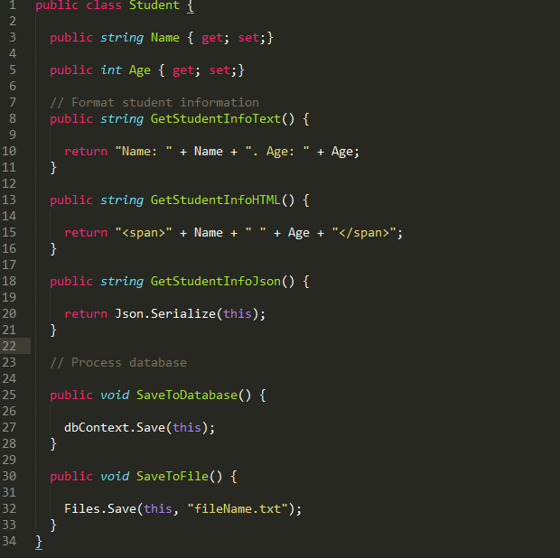
Single Responsibility Principle
A class should have a single responsibility
Before formating

Slide 30
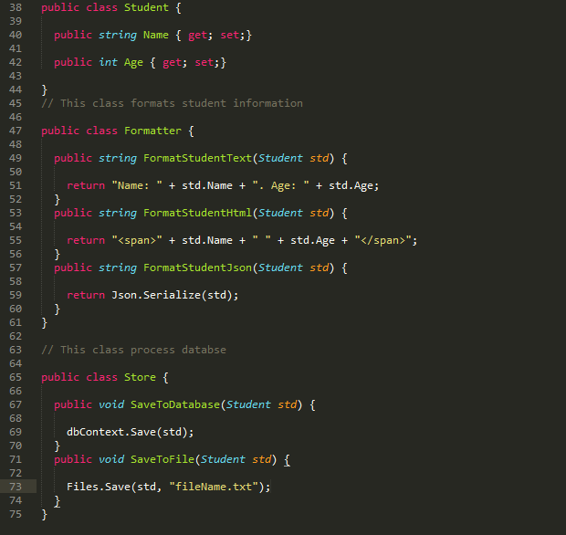
Single Responsibility Principle
A class should have a single responsibility
After formating

Slide 31
Open-Closed Principle
Software entities (classes, modules, functions, etc.) should be open for extension, but closed for modification.
Once a class has been written, it should not allow anyone to make changes. No one should be able to go back and amend the class code in order to implement new functionalities

Slide 32
Liskov Substitution Principle
A dependent object should be able to use any object of type parent object

Slide 33
Interface Segregation Principle
- A smaller interface is recommended. If an interface has one method, there will be only one place to change if we need to change the code. However, in the case of interfaces with more methods, there might be more reasons for change.

Slide 34
Dependency Inversion Principle
- Put simply, this addresses loose coupling. With the help of DIP, we can write code that does not depend upon concrete classes.

Slide 35
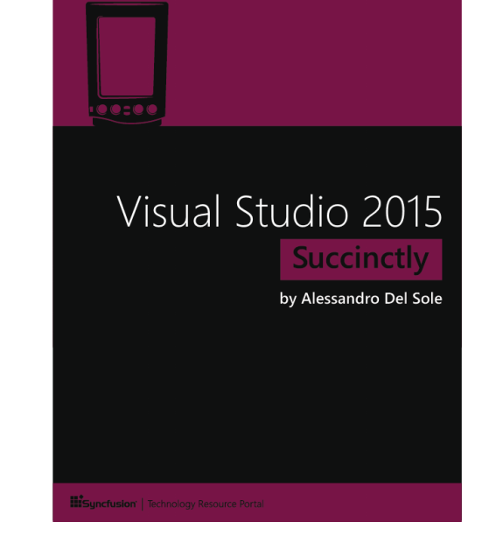
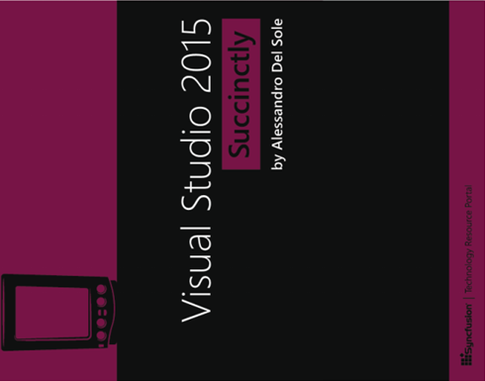

Slide 36
Introduction
Visual 2015 version still focuses on increasing deverloper productivity by improving the code editor, debugging tools, Azure integration with other services requiring a MS account and much more.
VS 2015 provides support to new strategies at MS, such as Windows 10, open-sourcing .NET, and building cross-platform apps for mobile devices.
Editions: Enterprise, Professional, and the free Community Edition.
With VS 2015 you can add multiple MS accounts for singing into the development environment and synchronizing settings.

Slide 37
Shared Project
Shared project was first introduced in VS 2013 Update 2 for Universal Windows apps. It allows sharing code, assets, and resources across multiple project types:
Console, Windows Forms, and Windows Presentation Foundation.
Windows Store 8.1 apps and Windows Phone 8.1 apps.
Windows Phone 8.0/8.1 Silverlight apps.
Portable Class Libraries.
With shared projects, you can write C#/VB code once and share it to multiple projects in your solution, and you can easily share XAML resources like styles, and data templates, as well as assets such as image files

Slide 38
Touch Gestures
Touch already worked in previous versions but the IDE was not optimized
In Visual Studio 2015, you can:
Double-tap a word or an identifier to select it.
Press and hold on screen to open the context menu.
Tap the margin of the code editor to select the corresponding line of code.
Tap and hold anywhere on the code editor’s surface to scroll up and down.
“Pinch and zoom” to zoom in and out with two fingers.
Only use on touch-enabled devices such as tablets or laptops.

Slide 39
Touch Gestures
Touch already worked in previous versions but the IDE was not optimized
In Visual Studio 2015, you can:
Double-tap a word or an identifier to select it.
Press and hold on screen to open the context menu.
Tap the margin of the code editor to select the corresponding line of code.
Tap and hold anywhere on the code editor’s surface to scroll up and down.
“Pinch and zoom” to zoom in and out with two fingers.
Only use on touch-enabled devices such as tablets or laptops.

Slide 40
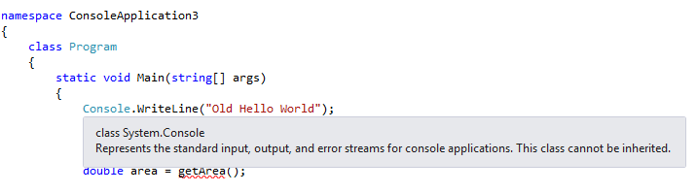
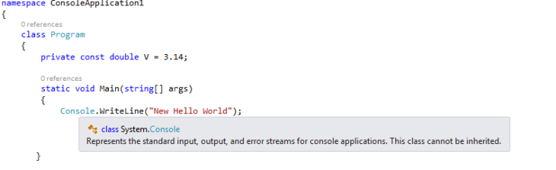
Colorized Tooltips
VS 13
VS 15

Slide 41
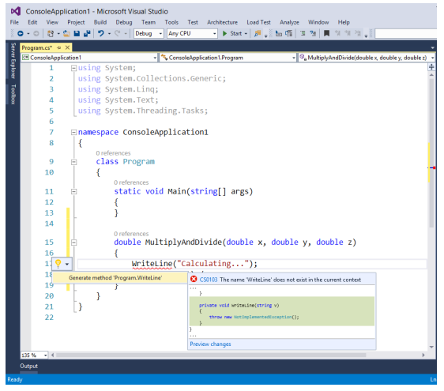
Light Bulbs and Quick Actions

Slide 42
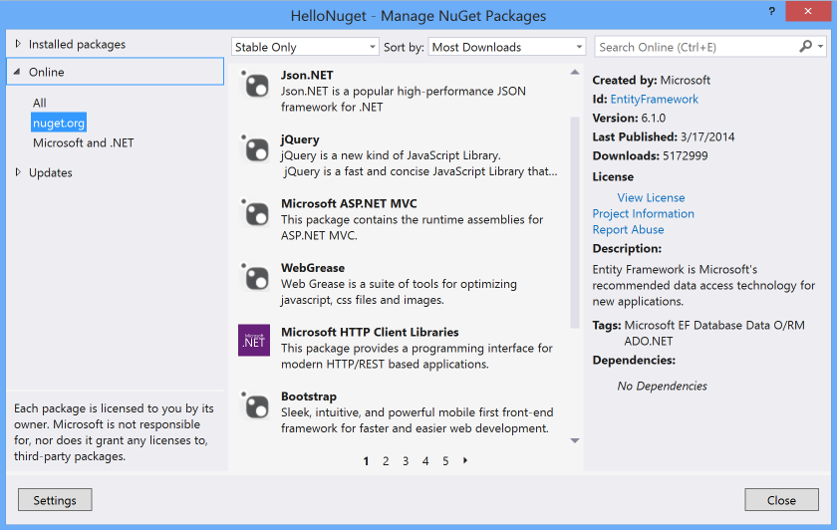
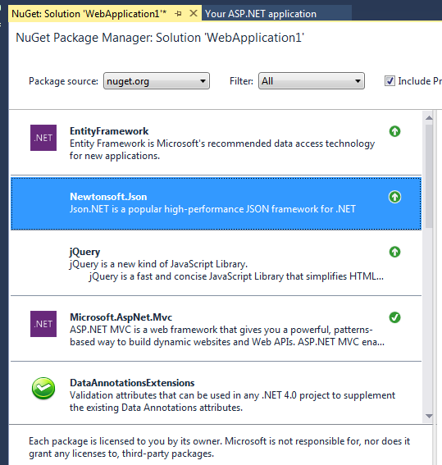
Nuget Package
VS 13
VS 15

Slide 43
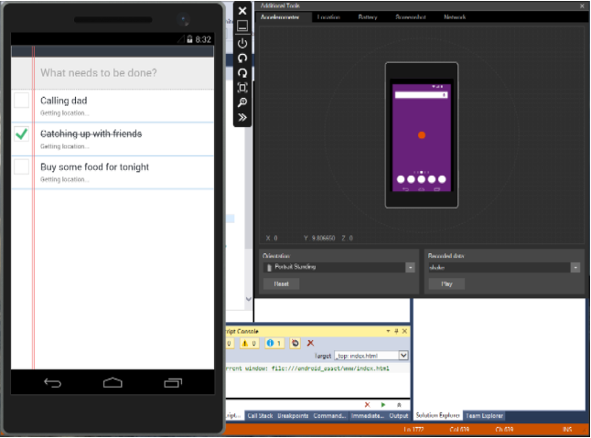
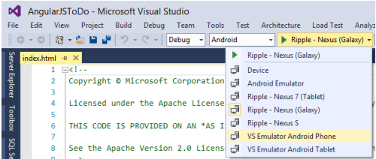
Cross-platform
Cross-platform apps for Windows, Windows Phone, Android 2.3.3 and later, and iOS (6, 7, and 8) using Apache Cordova and the integrated Visual Studio Tools for Apache Cordova

Slide 44
Error List
The limit of 100 messages has been removed and now the window shows the full list of errors.
Support for lambda expression debugging by using the Watch
Visual Studio 2015 introduces a new feature called PerfTips (Performance Tooltips), which shows how long it takes to run a specific piece of code while debugging

Slide 45
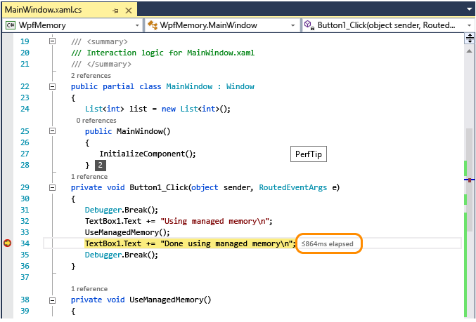
Error List

Slide 46

ASP.NET MVC

Slide 47
Why MVC?
- Lý do tại sao dùng MVC? Write here
- MVC có những ứu điểm gì mà người dùng lại chọn MVC?
WEBFORM | MVC
Web Form syntax only | Supports mutil syntaxes(razor or default)
Master Pages | Layouts
User Control | Partial view
Server Control | HTML helper

Slide 48
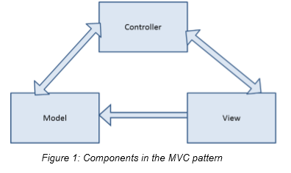
Conceptual Overview
MVC and its variant patterns (MVP, Passive View, etc.) separate a web app into three distinct areas: the model, the view, and the controller.

Slide 49
Conceptual Overview
Model: The model is the data that the app uses
Controller: the controller houses most of the app’s logic which ties the three pieces together
View: the view is the user interface (UI)

Slide 50
Principles
Following these guiding principles will help ensure that we stay out: (Trang 9)
The model should be a simple object with read and write
properties to support a single view.
The view should focus on standards-based markup.
Logic in the view should be limited to user interaction and
not include business logic.
Controllers should not know anything about how the data in
the model is manipulated in the view.
Controllers should not know anything about how the data is
persisted beyond the model.

Slide 51
MVC Says Hello World
Introducing Models
Value Substitution
Code Blocks
HTML Helpers
Layouts
Sections

Slide 52


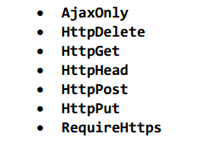


The World Says Hello Back
Model binding
Validation
Editor (Render ra kiểu HTML5)
TextBoxFor (Interger type)
EditorFor (Interger type)

Slide 53
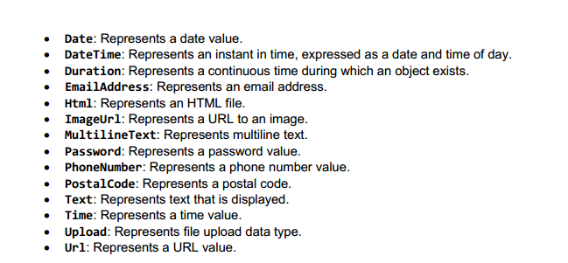

MVC Says Hello World
Editors bases on datatype
(nghĩa là quy định kiểu dữ liệu nhập vào)

Slide 54
Don’t Trust Everything the World Says
Essential Validators
Validating with Regular Expressions
Remote Validators
MetadataTypeAttribute

Slide 55
MVC Meets jQuery
NuGet Package Manager
NNuGet is designed to make it easier to manage external libraries such as jQuery, and has been available in Visual Studio since Visual Studio 2010. You can access it from the Tools menu in Visual Studio. uGet Package Manager
Download Part of the Page after the Page has Loaded
For example, we might wait to download the menu until after the page has loaded. We might have advertising along the side that we want the user to see but not have to wait on. In both cases, we want to trigger an AJAX call at the appropriate point to ensure this happens as expected.

Slide 56
MVC Meets jQuery
Retrieve Help Text When the User Triggers the Request
This scenario is similar to the one we just created for showing advertisements; the main difference is that the AJAX call is now triggered by the user rather than automatically. Usually the user will click a trigger that will be used to initiate the action. Delete an Item from a Grid
Delete an Item from a Grid
In each case, we need to call an action in the controller, passing the id for the item clicked. The controller will update the back end to remove the item from the list of items to display. When the AJAX call is finished, we will use jQuery to remove the item from the display.

Slide 57
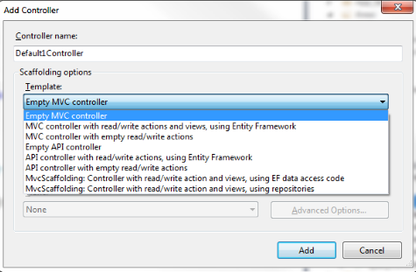
MVC Scaffolding
Controllers
When you create a new controller, you can specify a template in the scaffolding options. So far, we have stayed with the default empty controller, but there are other built-in options available.

Slide 58
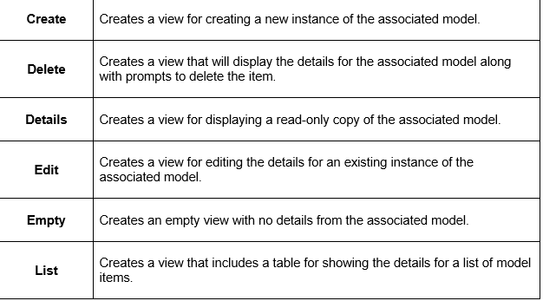
MVC Scaffolding
Views
The scaffolding templates for views are much more modest. Specify a model and then select from one of six actions.

Slide 59

ASP.NET
It was first released in 2002.
Technological development of web-based applications. (WebForm).
ASP stands for Active Server Page.
Is a component of the .NET Framework.

Slide 60
Advantage
Compatible with many different types of browsers.
Data access using ADO.NET technology. (.NET Framework).
High security.
Easy to maintain and read because Code and UI is separated.
ASP using two program languages VB.NET or C#.

Slide 61
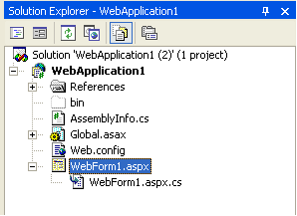
Struct ASP.NET
UI: including a file contains HTML, XML or server control. This file is a Page and extension is .aspx
Code Behind : is a file code separate and extension is .VB (if use Visual Basic Language) and .CS ( if use C#).

Slide 62
Syntax
Declare element HTML in ASP.NET.
<Tag name runat=“server” attribute=“value” ….>
Process on server: <% %>
User Custom Control (UCC): (*.ascx). (not contain <HTML>,<Body>,<Form>)
Top of page <%@Register ....
When appent UCC to aspx page, you should tag <%@Register....%> after tag <%@ Page....%>
Master Page

Slide 63
Object
Declare element HTML in ASP.NET.
<Tag name runat=“server” attribute=“value” ….>
Process on server: <% %>
User Custom Control (UCC): (*.ascx). (not contain <HTML>,<Body>,<Form>)
Top of page <%@Register ....
When appent UCC to aspx page, you should tag <%@Register....%> after tag <%@ Page....%>
Master Page

Slide 64

Microsoft Visual Studio 2013 is the new version of the popular integrated development environment for building modern, high-quality applications for a number of platforms such as Windows, the web, Microsoft cloud, tablets running Windows 8, and Windows Phone devices.

Slide 65
Some featured content
Code Editor Improvements
Visual Studio 2013 for the web and Windows Azure
New and Enhanced Tools for Debugging
Visual Studio 2013 for Windows 8.1

Slide 66
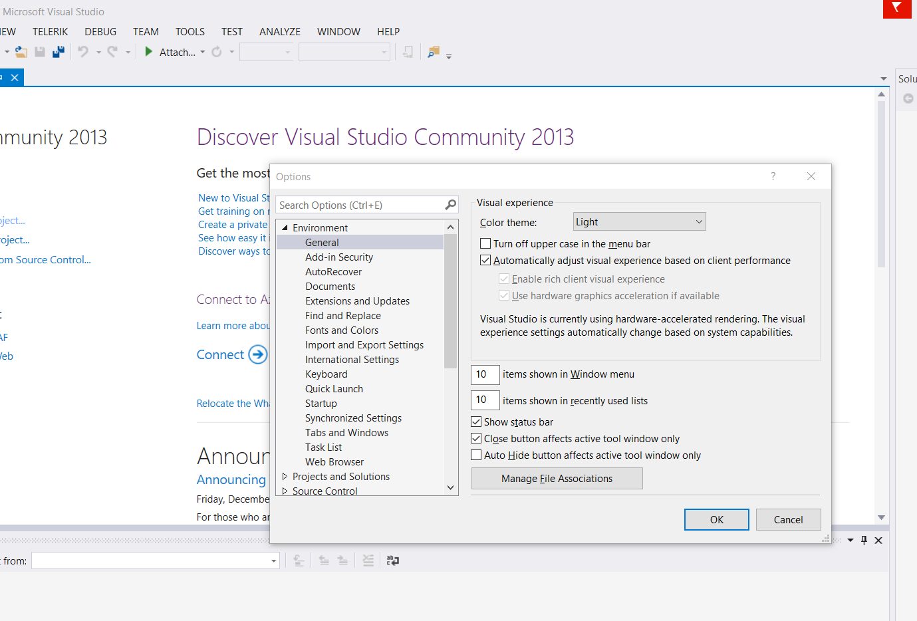
Some featured content
Synchronized settings :
Tools menu --> options--> the Synchronized Settings --> The Options dialog appear
Synchronization conflicts :
For various reasons, synchronization across multiple machines can occasionally fail.
in this case, turn synchronization off and then sign out. Next, sign in again and turn synchronization on again.

Slide 67
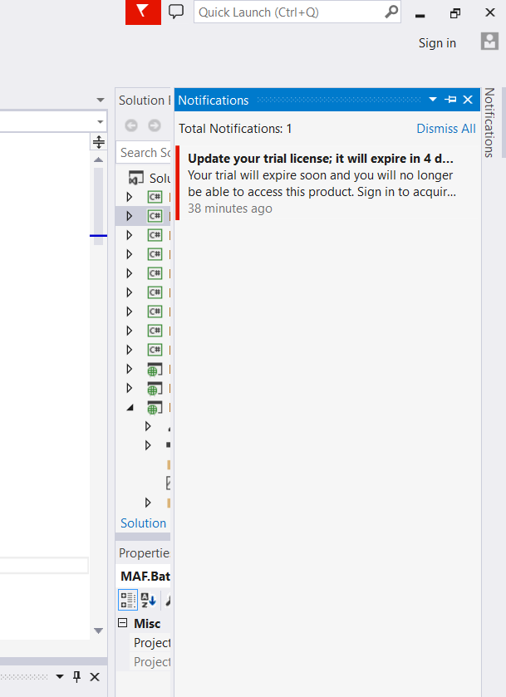
Some featured content
Notifications Hub :
Visual Studio 2013 introduces a new concept of notifications.
The goal is keeping the developer informed about product updates, extension updates, documentation updates, license issues, problems with the Microsoft Account, unresolved conflicts, and other errors.

Slide 68

Code Editor Improvements
The code editor in Visual Studio 2013 is one of the areas of the IDE where Microsoft made many investments.
This chapter describes new features in the code editor that will help you be more productive when writing code.

Slide 69
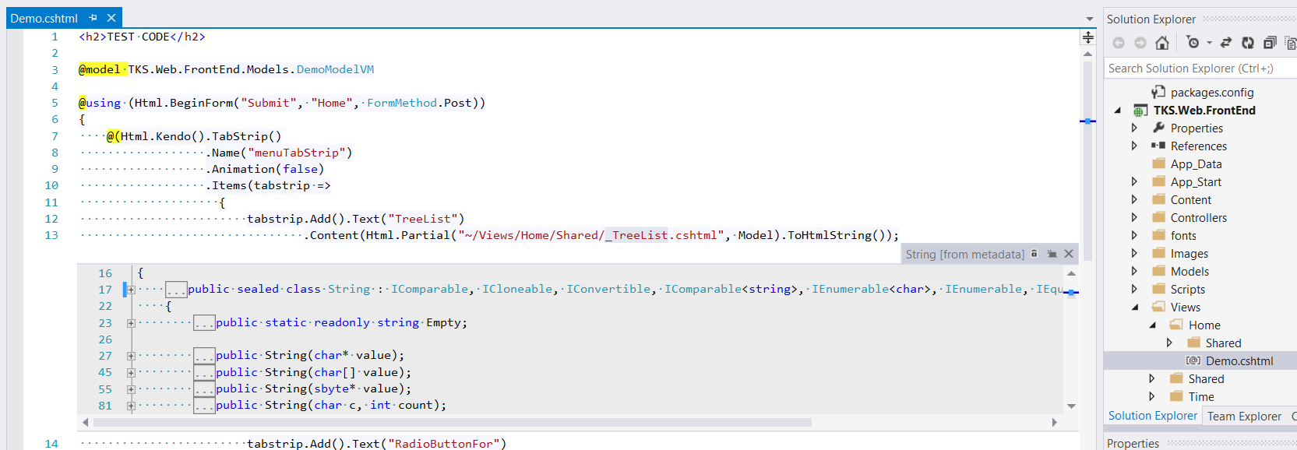
Code Editor Improvements
Peek Definition :
Peek Definition is a new feature that you can use to see and edit the definition of a class or class member inside a popup shown within the active code editor window.
inside a popup shown within the active code editor

Slide 70
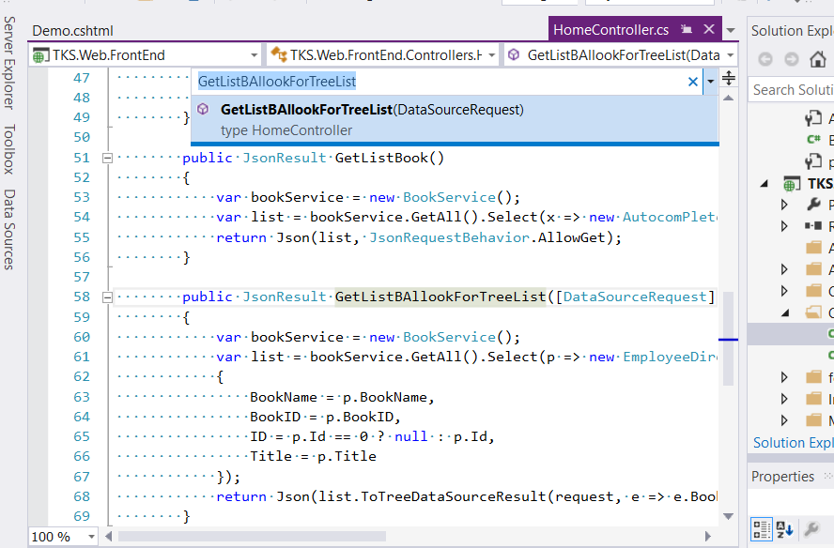
Code Editor Improvements
Navigate To
Another key feature of Visual Studio 2013. With this feature, you can easily find the definition of a type. Figure demonstrates how Visual Studio 2013 shows types and members that contain the name selected in the code editor.
placing the cursor on the type and then pressing CTRL + ,

Slide 71
Visual Studio 2013 for the web and Windows Azure
What’s new in the IDE for ASP.NET
Visual Studio 2013 introduces new tools and updates the existing environment for web development with ASP.NET.
This chapter focuses on the most important features that you must know, as they will change the way you create web applications.

Slide 72
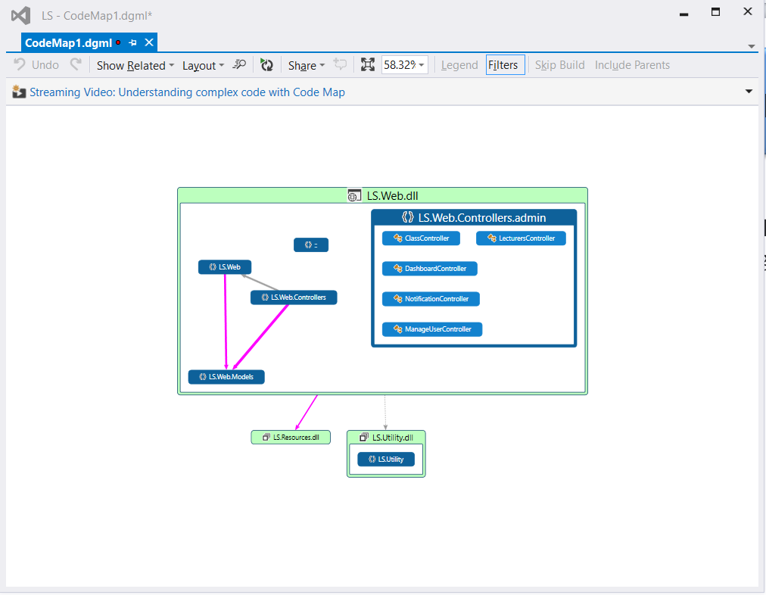

Visual Studio 2013 for the web and Windows Azure
Code Map debugging
Another interesting addition to Visual Studio 2013 is Code Map. Actually, Code Map is available in Visual Studio 2012 with Update 1, but now the tool is integrated in the IDE
method call in the Code Map, as represented in Figure

