Slide 1
FACT//DUEL
The 1v1 knowledge duel, rebuilt for a daily habit loop.
SEED ROUND — SEPTEMBER 2026
A 1v1 sports-and-science knowledge duel, built as a daily habit before it is built as a business.
A head-to-head duel on sports and science, designed as a 3-4 minute unit against the 3.1-3.5 minute median mobile session (GameAnalytics estimate).
Playable now in a browser at https://occult-kranti.github.io/fact-duel/: no install, no account, no server, 54 sample questions.
Zero users outside a private playtest. Zero revenue. Stated here so it is never a discovery later.
Raising about $1.2M for 18 months to buy one thing: the retention data this deck does not have.
Confidential. Prepared for the named recipient only; not for distribution or publication. Every number carries its source. Figures marked (P) are a plan, not a forecast. FACT//DUEL has no users and no revenue.
September 2026
Notes:
YC/Hale's rule for a title page is legible, simple, obvious. DocSend estimates 26 seconds on the company-purpose section (third-party estimate, numbers.md §4.6), so this page does exactly two jobs: name the thing, and pre-empt the only question that matters. Say the zero out loud in the first fifteen seconds of any meeting. DocSend's strongest negative finding, quoted as published: "VCs spend 80 percent more time evaluating the traction of companies that didn't raise money successfully" (third-party estimate) — that is a finding about companies that did not raise, not about decks, and it is why the ambiguity is removed on page one. The ask applies YC's $15k-per-engineer-per-month rule of thumb to our own four-engineer plan: 4 x $15,000 x 18 = $1,080,000, rounded up to a raise of about $1.2M inside YC's $500k-$1.5M band (numbers.md §4.5). YC's own worked example is five engineers (15k x 5 x 18 = $1.35mm); the four-engineer headcount is ours, not YC's, and the $15k figure is YC's undated editorial rule of thumb, very likely understated today — that caveat is on slide 14 and should be volunteered, not defended. The 3-4 minute duel is a design target set against GameAnalytics' median session, not an observed FACT//DUEL session length: we have never measured one (numbers.md §5.15). Since 13 September 2026 the product is publicly playable in a browser with no install and no account (numbers.md §7.2), so the link is on page one and is the fastest way for a reader to check every product claim in this deck for themselves — it serves the static build published from the repository's own Pages workflow, and it is live once the repository owner has pointed Pages at the gh-pages branch. Two-device friend duels need a server and are disabled in that build, with an on-screen notice. Publishing the link changes nothing about the zeroes on the line below it: no accounts, no users, no revenue. Add founder name and contact details before sending; do not add anything else.
SOURCES
- FACT//DUEL internal: public/product/investor/numbers.md — status paragraph and §5.15 (company disclosure)
- https://www.ycombinator.com/library/4A-a-guide-to-seed-fundraising
- https://www.ycombinator.com/library/4T-how-to-design-a-better-pitch-deck
- https://www.gameanalytics.com/reports/2026-mobile-pc-gaming-benchmarks
- https://web.archive.org/web/20260622084020/https://www.docsend.com/blog/what-vcs-really-want-to-see-inside-your-seed-deck/
- https://web.archive.org/web/20240302210508/https://www.docsend.com/blog/what-vcs-really-want-to-see-inside-your-seed-deck/
- FACT//DUEL internal: public/product/investor/numbers.md §7.1 and §7.2 (company disclosure)

Slide 2
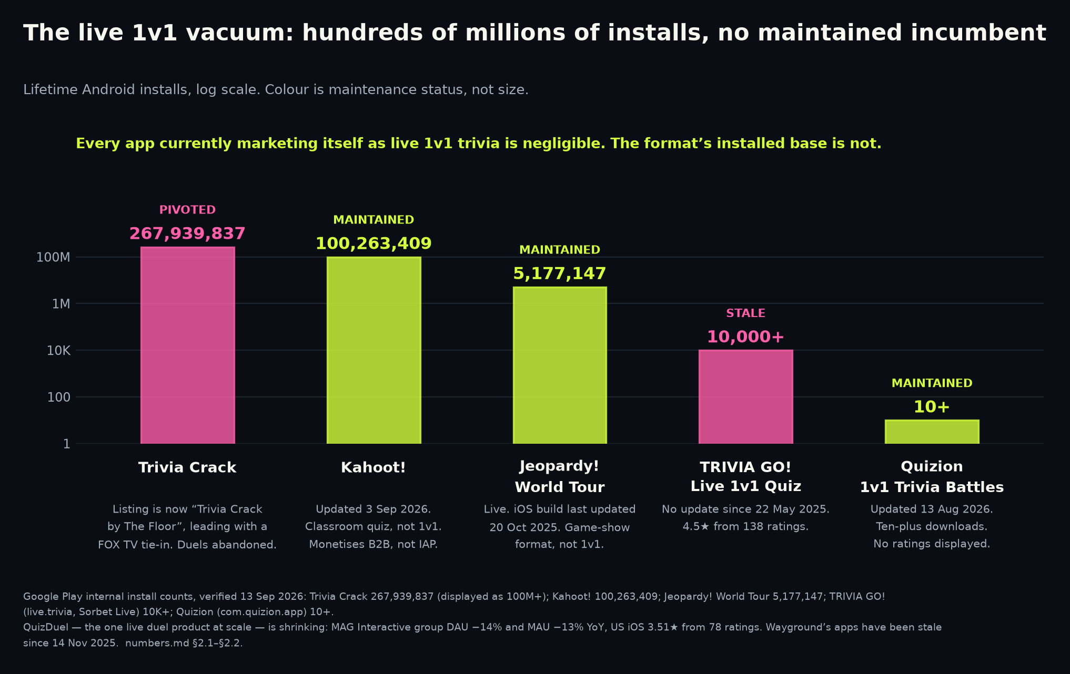
A format with hundreds of millions of lifetime installs, and essentially no maintained incumbent.
THE PROBLEM — THE VACUUM
Trivia Crack: 267,939,837 lifetime Android installs per Google Play's internal store data, displayed publicly as 100M+ — installs, not users.
Its Play listing is now retitled around a FOX TV tie-in: the largest lifetime install base in the category has left the duel.
QuizDuel's owner MAG Interactive: nine-month average group DAU -14% and MAU -13% YoY (Sep 2025 - May 2026); for Q3 alone, -12% and -9%.
QuizDuel itself is live and maintained — iOS build updated 10 Sep 2026 — and tiny in the US: 3.51 stars from 78 US iOS ratings.
Everything else marketing itself as live 1v1: Quizion, 10+ downloads (updated 13 Aug 2026); TRIVIA GO!, 10K+, no update since 22 May 2025.
The format proved demand at scale and has essentially no maintained incumbent. That gap is the entire reason to keep reading.
Sources: Google Play — Trivia Crack listing · MAG Interactive — Q3 2025/26 interim report · Apple lookup API — QuizDuel listing (US storefront) · Apple lookup API — QuizDuel listing
Google Play — Quizion listing · Google Play — TRIVIA GO! listing
2
Notes:
CRV asks for a traction teaser in the first two or three slides. We have no traction, so the credibility hook has to be evidence instead: this slide plus slide 3. Every line is store data or a filed interim report, verified 13 Sep 2026, not an analyst estimate. Caveats to volunteer rather than be caught on: 267,939,837 is Google Play's own internal lifetime install count and the store itself displays only '100M+'; it is installs, not users; and the widely-quoted '600 million downloads' for Trivia Crack is PR-originated and does not survive checking (numbers.md §5.4), so we deliberately use the smaller, verifiable number. Do not say the category is unmaintained or abandoned — it is not. QuizDuel ships builds (10 Sep 2026), Quizion's listing was updated 13 Aug 2026 and Psych!'s Android build on 26 May 2026. The defensible claim is the one numbers.md §2.2 makes: the 1v1 duel format has an installed-base history in the hundreds of millions and essentially no maintained incumbent. MAG's DAU and MAU are group-level across its whole portfolio rather than QuizDuel standalone, and they are nine-month averages for Sep 2025 to May 2026; the quarter alone is milder, at -12% and -9%, and the slide says both. Expect the obvious challenge: 'maybe the format is dead for a reason.' The answer is slide 3, and the honest version is that we agree the reason exists and we have named it.
SOURCES
- https://play.google.com/store/apps/details?id=com.etermax.preguntados.lite&hl=en_US&gl=US
- https://storage.mfn.se/8d863483-ccc8-4f02-b0c5-d37d899b23e8/mag-interim-report-eng-2025-26-q3.pdf
- https://itunes.apple.com/lookup?id=1484354626&country=us
- https://itunes.apple.com/lookup?id=1484354626&country=de
- https://play.google.com/store/apps/details?id=com.quizion.app&hl=en_US
- https://play.google.com/store/apps/details?id=live.trivia&hl=en_US

Slide 3
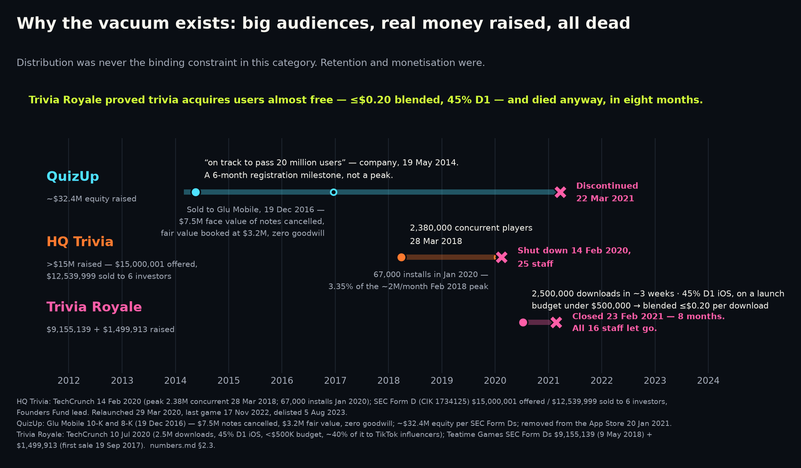
It did not die of distribution. It died of monetisation and long-tail retention.
THE GRAVEYARD
Trivia Royale: 2.5M downloads in about three weeks on a launch budget under $500,000 — a blended $0.20 or less per download, organic and viral included. Company-reported to TechCrunch, not audited.
45% day-one iOS retention, around 30 minutes of use a day — both company-reported to TechCrunch, not audited. Closed eight months after launch.
HQ Trivia: 2.38M peak concurrent (28 Mar 2018), then roughly 67,000 monthly installs in Jan 2020, about 3% of the ~2M/month Feb 2018 rate (Sensor Tower estimates).
It did not end there: bought and relaunched 29 Mar 2020, last official game 17 Nov 2022, removed from both stores 5 Aug 2023.
QuizUp: about $32.4M of equity raised; sold to Glu in 2016 for $7.5M of cancelled notes, booked at $3.2M fair value.
Near-free acquisition and elite D1 were necessary and demonstrably not sufficient. Distribution was never the binding constraint here — monetisation and long-tail retention were.
Sources: TechCrunch — Trivia Royale, 2.5M downloads in 3 weeks · TechCrunch — HQ Trivia shuts down · TechCrunch — HQ Trivia peak concurrent record · SEC 10-K — Glu Mobile FY2016 (QuizUp mark)
SEC 8-K — Glu Mobile / QuizUp acquisition
3
Notes:
This is the slide that decides whether an investor trusts the rest of the deck. Trivia Royale is the cleanest natural experiment in the category: built by QuizUp's own founder, it took 2.5M downloads at a blended $0.20 or less each on a launch budget under $500,000 (about 40% of it to TikTok influencers), it reported 45% day-one iOS retention, and it was gone in eight months because revenue was insufficient and funding talks collapsed. Caveats that belong on the page and not only here: the download count, the budget and the 45% D1 are all Teatime Games statements to TechCrunch — press reports, not filings, not audited; the $0.20 is blended cost per download including organic and viral, not a paid CPI; and both HQ Trivia install figures are rounded Sensor Tower modelled estimates, which is why the slide says about 3% rather than a ratio to three significant figures. Do not present 45% D1 as a percentile placement against a benchmark: it is iOS-only and company-reported, while the GameAnalytics medians are measured on iOS and Android app-store installs, so the comparison is not like-for-like (numbers.md §5.14). HQ Trivia's story does not stop in February 2020 — the franchise was bought, relaunched on 29 Mar 2020, played its last official game on 17 Nov 2022 and was delisted from both stores on 5 Aug 2023 — say so before an investor who knows the history says it for you. Glu's $3.2M fair-value mark on QuizUp is the honest ceiling to attach to a large unmonetised trivia audience, and the ~$32.4M of Plain Vanilla equity behind it comes from the SEC filings. The takeaway to say out loud: any pitch in this category that leads with 'we will go viral' is arguing the case that was already settled and ignoring the case that killed everyone. If asked what we would do differently, do not answer with features — answer with slide 4.
SOURCES
- https://techcrunch.com/2020/07/10/how-thor-fridrikssons-trivia-royale-earned-2-5m-downloads-in-3-weeks/
- https://techcrunch.com/2020/02/14/hq-trivia-shuts-down/
- https://techcrunch.com/2018/08/14/hq-trivia-apple-tv/
- https://www.sec.gov/Archives/edgar/data/1366246/000155837017001621/gluu-20161231x10k.htm
- https://www.sec.gov/Archives/edgar/data/1366246/000155837016010604/gluu-20161215x8k.htm

Slide 4
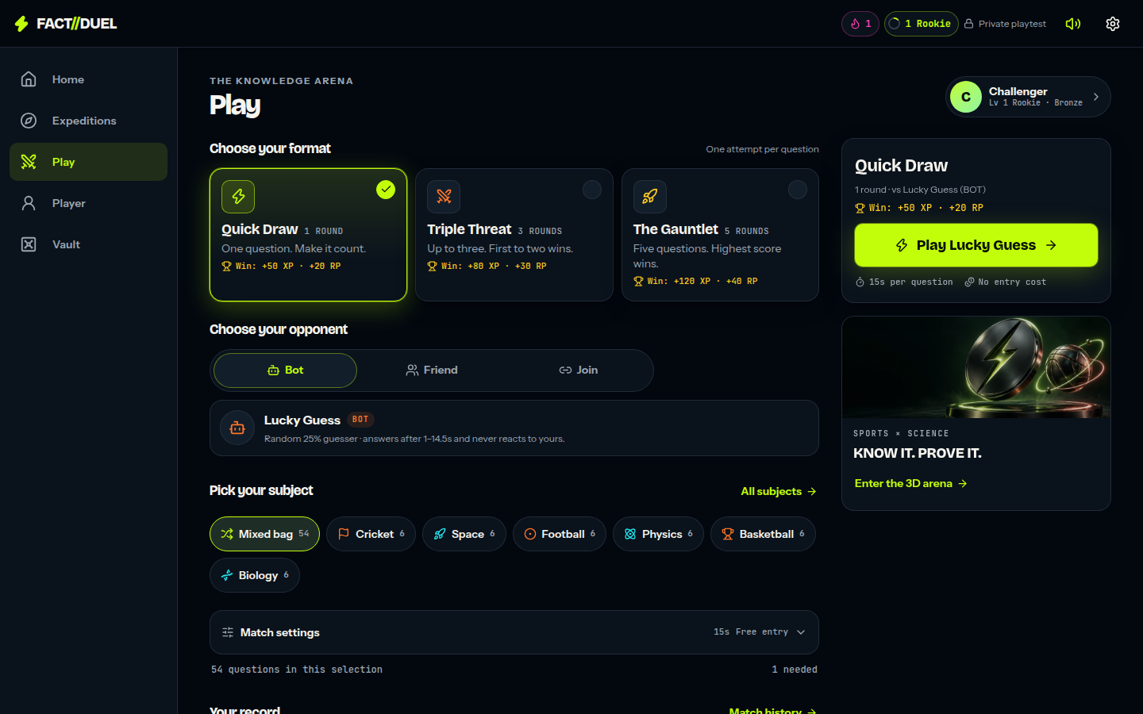
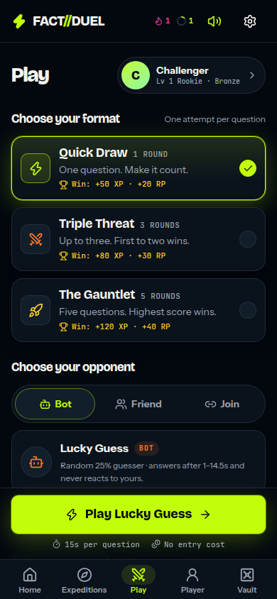
So the bet is sequencing: build the habit loop first, prove retention, then monetise.
THE SOLUTION
GameAnalytics estimates the median mobile game session at 3.1-3.5 min and North America at 3.64 min (CY2025, iOS and Android installs — not web).
A duel is designed as a 3-4 minute unit. The app now records sessions and engaged time, but with no players we have measured no session length of our own (numbers.md §5.15, §7.1).
Around the duel, product description rather than audited fact: XP and levels, day streaks, daily quests, achievements, a device-local rank, gems, cosmetics.
Solo expeditions and a static event calendar are intended to cover the days when nobody wants a live opponent. No retention benefit has been measured.
Zero revenue today (numbers.md status paragraph, §5.15). Monetisation is sequenced last by choice, and that choice is unproven.
The comparables on slide 3 failed on monetisation and long-tail retention. Retention is the gate; monetisation is downstream of a number we do not have.
Choosing a format and an opponent. The practice opponent carries a BOT badge (app/screens/play/opponent-picker.tsx).
The same choice on a phone.
Sources: GameAnalytics — 2026 Mobile & PC Gaming Benchmarks · FACT//DUEL internal — numbers.md §3.2, status paragraph and §5.15 · FACT//DUEL internal — repository — product code, unaudited
FACT//DUEL internal — numbers.md §7.1 and §7.2
4
Notes:
The session-length line is a design argument, not a traction claim, and the slide now says so on its face: GameAnalytics' 2026 benchmark set (16,000+ games, nine regions, iOS and Android, calendar year 2025) estimates the median session at 3.1-3.5 minutes and North America at 3.64 minutes across 4.23 sessions a day — all of it measured on app-store installs rather than on the web, which numbers.md §5.14 calls the single largest methodological risk in the model. We have measured no session length of our own: since 13 September 2026 the app records session count and engaged time per device (lib/analytics.mjs, numbers.md §7.1), but there are no players, so there is nothing to report — the recorder exists, the sample does not. The loop around the duel is product description taken from our own repository, not an audited inventory and not a retention claim: do not attach a retention benefit to any of these mechanics, because we have not measured one: the instrument that would measure it shipped on 13 September 2026, and what is missing now is players rather than the ability to count them. Nothing in the evidence base shows that deferring monetisation avoids this category's failure mode — §2.3 says the comparables died of monetisation and long-tail retention, and sequencing is our response to that, untested. The honest claim is sequencing discipline, not novelty: we are copying a known-good loop rather than inventing one. Files an investor can open for the product description: lib/progression.mjs, lib/expeditions.mjs, lib/events-data.mjs, app/screens/play/opponent-picker.tsx.
SOURCES
- https://www.gameanalytics.com/reports/2026-mobile-pc-gaming-benchmarks
- FACT//DUEL internal: public/product/investor/numbers.md §3.2, status paragraph and §5.15 (company disclosure)
- FACT//DUEL internal: repository — product code, unaudited
- FACT//DUEL internal: public/product/investor/numbers.md §7.1 and §7.2 (company disclosure)

Slide 5
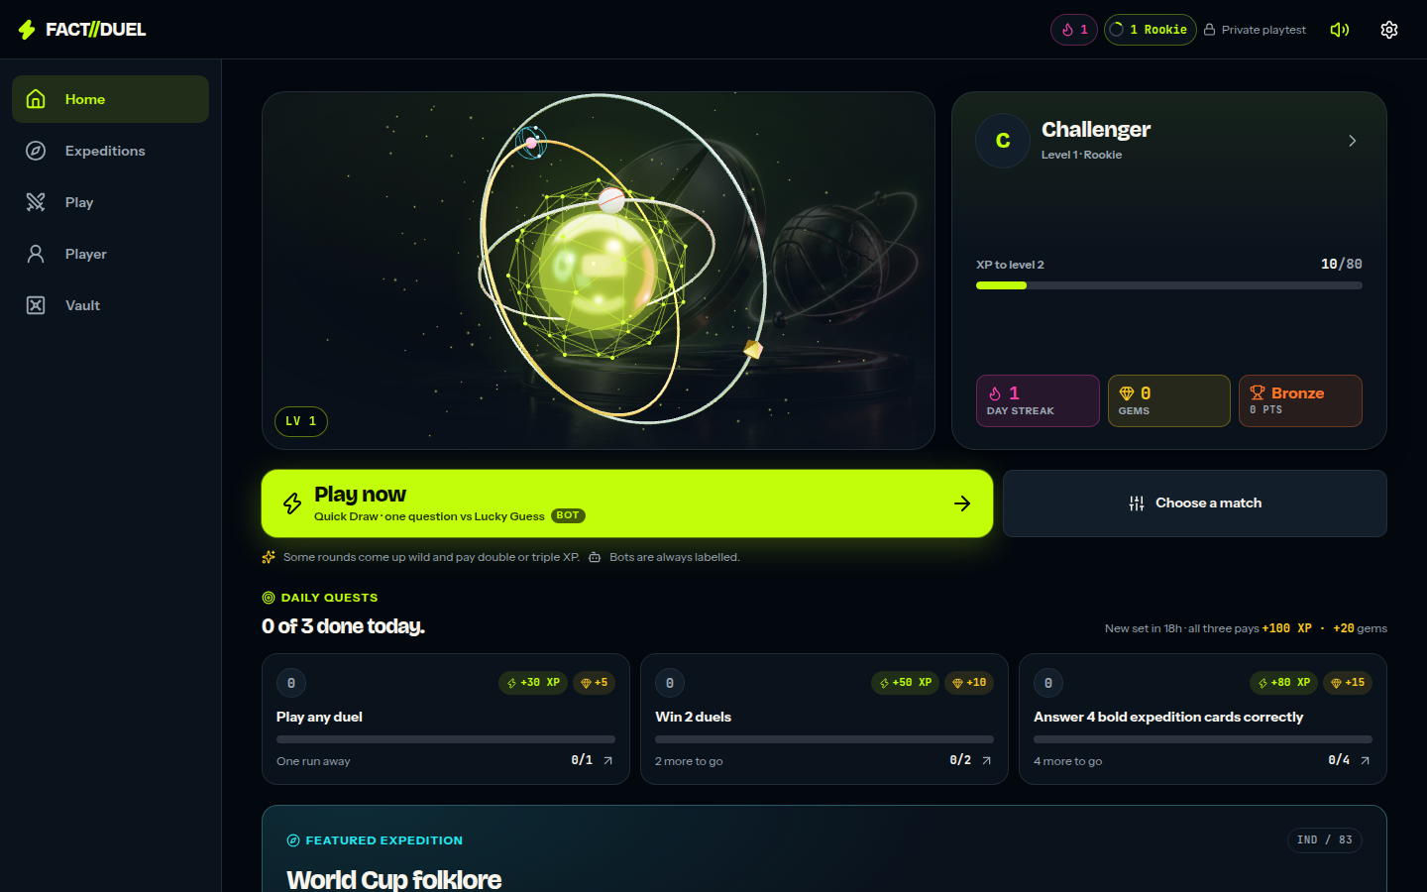
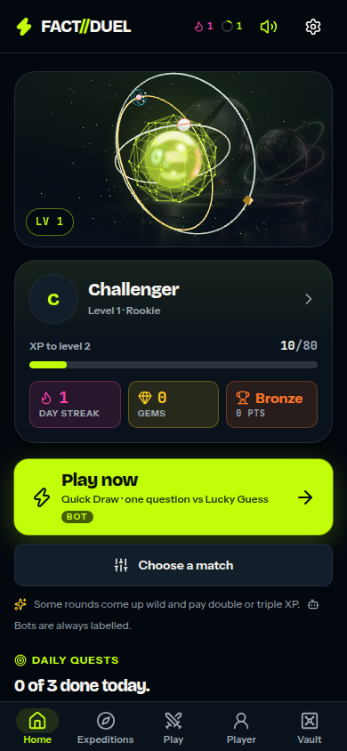
Playable now in a browser — no install, no account, no server. A full duel in about fifteen seconds.
PRODUCT — PLAY IT, DO NOT TAKE OUR WORD FOR IT
Open https://occult-kranti.github.io/fact-duel/ on a phone or a laptop: no download, no signup, no server call.
Fifteen seconds: pick a mode, answer the first question, finish a complete bot duel and see the result screen.
The static build carries bot duels in all three modes, expeditions, discovery, the vault, the passport, the events calendar and the limited modes (numbers.md §7.2).
Two-device friend duels genuinely need a server and are disabled in that build, with an on-screen notice saying so.
Progression stays device-local with no accounts, and /analytics shows the player their own record with JSON and CSV export and erase (§7.1).
The practice opponent carries a BOT badge in the opponent picker. A full opponent-integrity answer is milestone 5 in numbers.md §4.4 — it ships before monetisation.
54 sample questions, zero users, zero revenue: nothing on this page is a traction claim.
Home: level and XP, day streak, gems, Arena Rank, the day's quests, one-tap duel.
Home on a phone.
Sources: FACT//DUEL internal — numbers.md — status paragraph, §4.4 and §7.1-§7.2 · FACT//DUEL internal — repository — product code, unaudited · DocSend — per-section dwell times
5
Notes:
Product is the second-longest dwell in DocSend's per-section estimates at 59 seconds (third-party estimate, numbers.md §4.6), and this is now the only slide in the deck an investor can verify without us: hand over the link and stop talking. Do it live if the room allows — https://occult-kranti.github.io/fact-duel/, on a phone, one thumb, a complete bot duel in about fifteen seconds (numbers.md §7.2). The build behind it is `pnpm build:static`, which keeps the real duel engine and replaces only the storage beneath it; differential tests run each scenario against both the in-memory store and the real D1-backed store and compare every return value, every thrown error and the rows left behind, which is why the offline build is presented as the same game rather than a demo of it. The link is served by the repository's own Pages workflow from the gh-pages branch and is live once the repository owner has pointed Pages at that branch — check it yourself the morning of a meeting rather than assuming. Volunteer the boundaries before they are found: two-device friend duels need a server and are disabled in that build with an on-screen notice; progression is device-local, so a cleared browser clears the profile; there are still no accounts. On opponents: the practice opponent carries a BOT badge in the opponent picker (app/screens/play/opponent-picker.tsx), and the full answer to 'is my opponent real' is milestone five in numbers.md §4.4, which ships before monetisation. Do not assert anything about how the bot is implemented, how progression is stored or how the transport is sized that an investor cannot open the repository and check for themselves — after Skillz v. AviaGames this is the area where an unverifiable claim does the most damage. Playable is not released and it is certainly not traction: zero users, zero revenue, 54 sample questions, and the traction slide says so in the same words.
SOURCES
- FACT//DUEL internal: public/product/investor/numbers.md — status paragraph, §4.4 and §7.1-§7.2 (company disclosure)
- FACT//DUEL internal: repository — product code, unaudited
- https://web.archive.org/web/20260622084020/https://www.docsend.com/blog/what-vcs-really-want-to-see-inside-your-seed-deck/

Slide 6
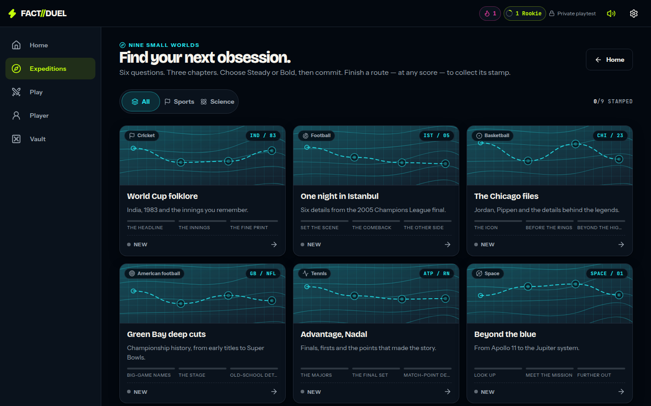
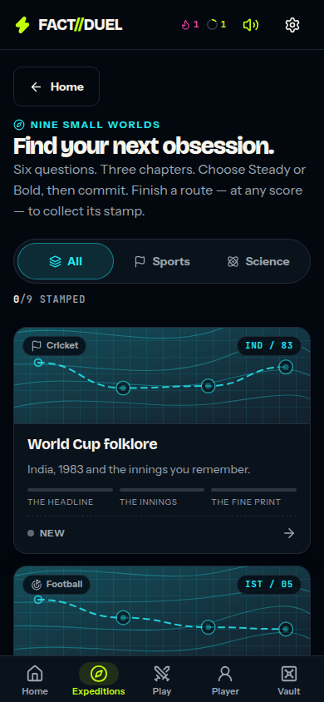
Solo routes and a static event calendar are built for the days without a duel.
PRODUCT — THE NON-DUEL SURFACE
Solo expeditions are short untimed routes with a Steady-or-Bold risk choice locked in before each answer (lib/expeditions.mjs).
Limited-time modes are derived from the calendar: one opens on a real fixture or announcement and closes when its window closes (lib/events.mjs).
The calendar is static and hand-checked, and the date it was last verified is printed in the app. No live feed, no scores API, no rights deal (lib/events-data.mjs).
No cadence and no retention effect is claimed for any of it. The instrument that would measure one shipped on 13 Sep 2026; the players it needs have not (numbers.md §7.1).
The graveyard died of monetisation and long-tail retention (§2.3). This surface is our untested answer to the second of those.
The bank is 54 sample questions today. Growing it is milestone 4: a target and a production rate we have not set yet.
Expeditions: short untimed routes, a Steady-or-Bold choice, a stamp for finishing one.
Expeditions on a phone.
Sources: FACT//DUEL internal — numbers.md — status paragraph and §5.15 · FACT//DUEL internal — numbers.md §2.3, §4.3 and §4.4 · FACT//DUEL internal — repository — product code, unaudited
FACT//DUEL internal — numbers.md §7.1 and §7.2
6
Notes:
The strategic point of this slide is a hypothesis, not a finding, and it is now a falsifiable one: since 13 September 2026 the app records per-device active days and engaged time (numbers.md §7.1), so once there is a cohort we can say whether the non-duel surface earns a return visit instead of arguing that it should. numbers.md §2.3 concludes that the binding constraints in this category were monetisation and long-tail retention rather than distribution, and nothing in the evidence base identifies an 'empty day' as the cause of any shutdown; this surface is our untested answer to the long-tail half of that diagnosis. Be precise about what is not here: no live feed, no results service, and no partnership with any league, broadcaster or rights holder — none is claimed anywhere in this deck. The calendar is hand-assembled and the date it was last checked is printed in the app (lib/events-data.mjs, app/screens/events-screen.tsx), which is the part an investor can verify without taking our word for it. We have no content production cost, no curation rate and no vendor quote anywhere in the evidence base, so do not describe the calendar as cheap or low-risk: describe it as unpriced. State 54 plainly rather than saying 'a growing bank' — §4.4 milestone 4 requires us to state 54, then set a target and a production rate, and we have set neither. There is no content line in the use of funds: §4.5 funds four engineers and nothing else.
SOURCES
- FACT//DUEL internal: public/product/investor/numbers.md — status paragraph and §5.15 (company disclosure)
- FACT//DUEL internal: public/product/investor/numbers.md §2.3, §4.3 and §4.4 (company disclosure)
- FACT//DUEL internal: repository — product code, unaudited
- FACT//DUEL internal: public/product/investor/numbers.md §7.1 and §7.2 (company disclosure)

Slide 7
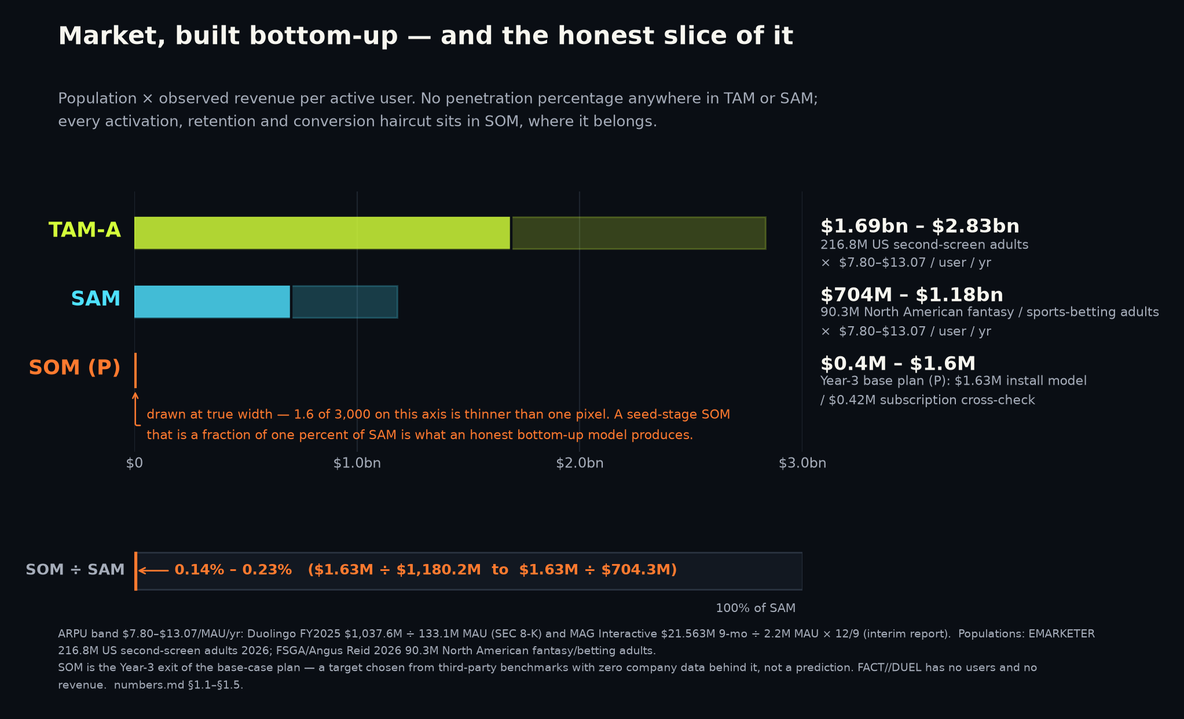
TAM-A $1.69bn – $2.83bn, sized bottom-up from one population forecast and two filings.
MARKET
EMARKETER forecasts 216.8M US adults — 80.6% of the adult population — using a smartphone as a second screen in 2026 (forecast published April 2026).
216.8M x $7.80-$13.07 revenue per active user per year = TAM-A $1.69bn - $2.83bn. An upper bound: no activation, retention or conversion discount is applied.
Neither end is reported by anyone; both are derived. Low: Duolingo FY2025 revenue ÷ the 133.1M MAU reported at 31 Dec 2025 — a ratio Duolingo does not publish.
High: MAG Interactive nine-month group net sales ÷ group MAU, annualised — group-level across its whole portfolio, unaudited interim, not QuizDuel standalone.
Sources: EMARKETER — second-screen engagement during live sport · SEC — Duolingo FY2025 shareholder letter · MAG Interactive — Q3 2025/26 interim report
7
Notes:
This slide gets 29 seconds in DocSend's per-section estimates, so it carries one number and one arithmetic line and nothing else. The method note — Paul Graham's definition used literally, x customers x $y per year, with no penetration percentage anywhere in TAM or SAM, which is a16z's toothbrush failure case avoided — and the FSGA participation research now sit on appendix slide 17, where their figures actually appear. Three things to say before being asked. First, 216.8M is an EMARKETER forecast for full-year 2026, published April 2026: a modelled projection of second-screen behaviour generally, not a count, and not a live-sport-only population. Second, neither end of the ARPU band is reported by anybody — $7.80 is Duolingo's FY2025 revenue divided by the 133.1M MAU reported at 31 December 2025, a ratio Duolingo does not publish and one that mixes a full-year flow with a period-end stock, and $13.07 is MAG Interactive's nine-month group net sales divided by group MAU and annualised, from an unaudited interim report covering its whole portfolio rather than QuizDuel. Third, TAM-A is an upper bound with no activation, retention or conversion discount applied; Graham's own framing is that investors do not expect you to collect it. SAM ($704M-$1.18bn) and SOM — 0.14%-0.23% of SAM, labelled (P) on the chart and in appendix slide 17 — are a chosen target with zero company data behind them, never a projection. We deliberately exclude Europe, Latin America and every science-audience bloc, which makes the number smaller: say so, it is a credibility asset. One line worth saying: two paid research firms size game-based learning 3.93x apart for the identical year, so no vendor top-down number can discipline this plan.
SOURCES
- https://www.emarketer.com/content/second-screen-engagement-during-live-sports
- https://www.sec.gov/Archives/edgar/data/1562088/000162828026012246/q4fy25duolingo12-31x25shar.htm
- https://storage.mfn.se/8d863483-ccc8-4f02-b0c5-d37d899b23e8/mag-interim-report-eng-2025-26-q3.pdf

Slide 8
Why now: the duel has no maintained incumbent, and a habit loop passed $1bn of total revenue.
WHY NOW
Trivia Crack's listing is now built around a FOX TV tie-in. The largest lifetime Android install base in the category — 267,939,837 installs, Google Play's own count — has pivoted away from duels.
Duolingo, a habit app built on a streak/XP/quest loop, passed $1bn of total revenue: $1,037.6M in FY2025, with 12.2M paid subscribers at year-end 2025.
On US iOS in CY2025, AppTweak estimates trivia has the lowest page-view-to-install rate of about 38 categories: 5.2% against an 8.56% all-category average.
On Google Play the same pass puts trivia above average: 19.8% against 16.15%. Both were read from AppTweak chart data in our own verification pass and are flagged for re-confirmation (§5.2).
A web-first product has no iOS product page at all — an argument, not a measured advantage: we have no verified web-first conversion benchmark of any kind (§5.14).
Nothing here depends on a new technology. It depends on a 1v1 duel format with no maintained incumbent.
Sources: Google Play — Trivia Crack listing · SEC — Duolingo FY2025 shareholder letter · AppTweak — US store conversion benchmarks, CY2025 · FACT//DUEL internal — numbers.md §3.5, §5.2 and §5.14
8
Notes:
Least-read slide in the deck at 23 seconds in DocSend's estimates, so it makes one point: the timing argument is behavioural and competitive, not technological. Resist any temptation to invent an AI or platform-shift narrative — we do not have one, and a fabricated one is the fastest way to lose a reader. The store-conversion figures need their caveats attached in the same breath as the numbers, not after them: they are AppTweak estimates, US-only, calendar year 2025, App Store only, established during our own verification pass rather than taken from the original claim (which turned out to be inverted — the 8.2% iOS figure in circulation is wrong), and numbers.md §6 marks the row re-confirm before use. They are also platform-split: trivia converts worst on iOS and above average on Google Play, and the slide says both rather than quoting the flattering half. The web-first line is an argument and not a measured advantage; §5.14 says we have no verified benchmark for web-first retention, acquisition cost or payer conversion. On Duolingo, use the FY2025 pair — $1,037.6M of total revenue with 12.2M paid subscribers against 133.1M MAU at year-end — and do not mix in the 30 June 2026 figures, which belong to slide 10. $1,037.6M is total revenue: nothing in the evidence base breaks out subscription revenue, so do not attribute the whole of it to subscriptions. And say 'no maintained incumbent in the live 1v1 duel', not 'an unattended category': QuizDuel, Quizion and Psych! all ship builds.
SOURCES
- https://play.google.com/store/apps/details?id=com.etermax.preguntados.lite&hl=en_US&gl=US
- https://www.sec.gov/Archives/edgar/data/1562088/000162828026012246/q4fy25duolingo12-31x25shar.htm
- https://www.apptweak.com/
- FACT//DUEL internal: public/product/investor/numbers.md §3.5, §5.2 and §5.14 (company disclosure)

Slide 9
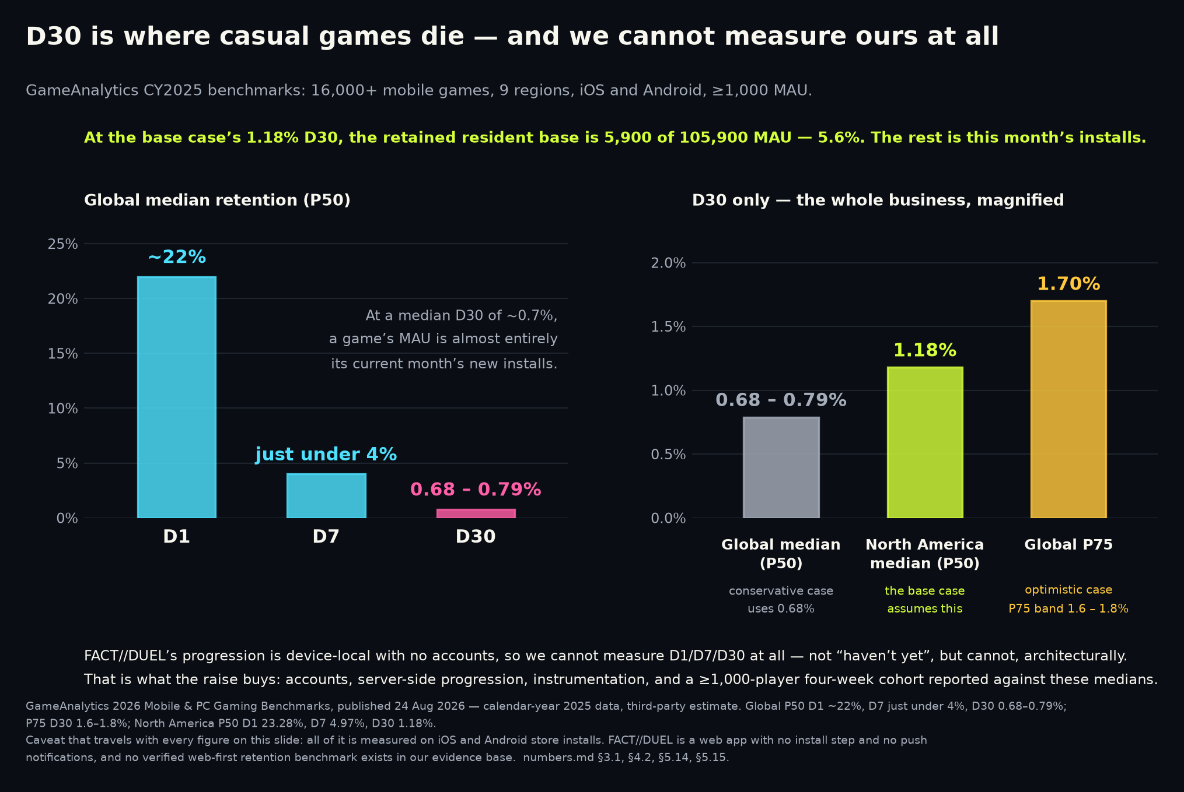
Zero users. Zero revenue. No cohort. The instrument that measures retention is built, tested and shipped — the round buys the cohort to point it at.
TRACTION — STATED PLAINLY
No users outside a private playtest, no revenue, no cohort, 54 sample questions. Nothing on this page is a traction claim.
Shipped 13 Sep 2026: install day, active days, sessions, engaged time and per-device D1/D7/D30, with a player-facing /analytics screen, JSON and CSV export and erase (24 tests, numbers.md §7.1).
Also shipped: an opt-in anonymous daily ping whose report is aggregate-only, with buckets under five devices suppressed — a cohort rate becomes computable the day there are players (20 tests).
One device can only ever answer yes, no, or not-yet. A rate needs a cohort; that is what is missing, and that is what the round buys.
Milestone 1 existed because nothing was measurable without accounts. Measurement landed without them, so milestones 1 and 2 are de-risked from build-then-measure to simply run the cohort.
Milestone 2 — publish D1/D7/D30 against GameAnalytics estimates (16,000+ mobile games, iOS and Android, CY2025): NA medians 23.28% / 4.97% / 1.18%.
Target — beat that 4.97% NA median D7 on a cohort of at least 1,000 players. The benchmark is measured on app-store installs and we are a web app, so transfer is unproven.
Milestones 4-6 are untouched: grow the bank from 54 questions, ship an opponent-integrity answer before monetisation, validate exactly one monetisation route.
Sources: FACT//DUEL internal — numbers.md — status paragraph, §4.4 and §7.1 · FACT//DUEL internal — repository — product code, unaudited · GameAnalytics — 2026 Mobile & PC Gaming Benchmarks
DocSend — what VCs want inside a seed deck
9
Notes:
DocSend's finding is that VCs spend 80 percent more time evaluating the traction of companies that didn't raise money successfully: a vague traction slide invites the inspection that kills the round, so the honest move is to state zero and move on. Say it in one sentence and do not soften it — no waitlist presented as users, no playtest presented as a cohort, no pilot presented as revenue, and the shipped measurement layer presented as a capability rather than a result. What changed on 13 September 2026 is documented in numbers.md §7.1 and it retires this deck's previous claim that retention was unmeasurable in principle: the app now records install day, active days, session count, engaged time and four in-app counters per device and computes that device's own D1/D7/D30, returning true, false, or null while a window is still open, so an unfinished window can never read as a miss; there is a player-facing /analytics screen with JSON and CSV export and erase; and an opt-in anonymous daily ping (cohort-ping / cohort-report) makes a cohort rate computable, with an aggregate-only report, no per-device row, and every bucket describing fewer than five devices suppressed. Twenty-four tests cover the device-local module and twenty the cohort endpoints. State the deliberate limitation before anyone finds it: one device is a sample of one and can only ever produce a boolean; the app never computes a rate from a single device and the screen says so in its own copy. So the sentence to say out loud is the instrument is built, the cohort is what the round buys. On the milestones: §4.4's milestone one was 'ship accounts and server-side progression' because nothing was measurable without them, and measurement arrived without accounts — that is a de-risking of milestones one and two, not their completion, and accounts remain unbuilt. The three GameAnalytics medians are a vendor benchmark — 16,000+ mobile games, nine regions, iOS and Android, calendar year 2025, published 24 Aug 2026 — labelled as estimates on the slide face, and every one of them is measured on app-store installs while we are a browser product with no install step and no push notifications. numbers.md §5.14 calls that the single largest methodological risk in the model and §7.3 confirms it still stands; slide 12 carries it as a named risk, alongside the fact that an opt-in cohort is a consenting-device denominator rather than a whole-population one. The chart plots only the benchmark bars: there is no FACT//DUEL retention bar because there is still no FACT//DUEL retention number. The remaining milestones' supporting figures — the Skillz v. AviaGames verdict, Sporcle's $43.99/yr and the 9% MAU-to-paid target — are sourced on slides 12 and 10, where they are printed, rather than here. Appendix G documents the measurement design in full for anyone who wants to interrogate it.
SOURCES
- FACT//DUEL internal: public/product/investor/numbers.md — status paragraph, §4.4 and §7.1 (company disclosure)
- FACT//DUEL internal: repository — product code, unaudited
- https://www.gameanalytics.com/reports/2026-mobile-pc-gaming-benchmarks
- https://web.archive.org/web/20240302210508/https://www.docsend.com/blog/what-vcs-really-want-to-see-inside-your-seed-deck/

Slide 10
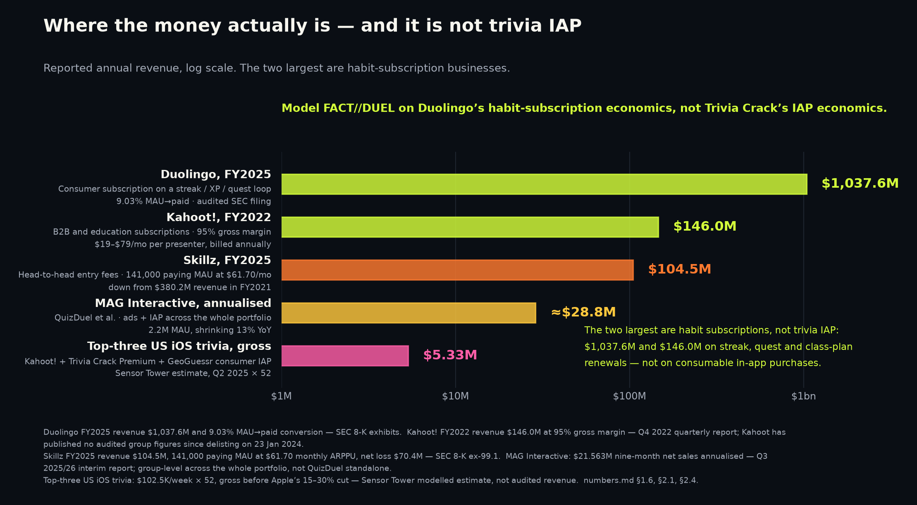
We copy the habit subscription, not trivia IAP — and here is the cross-check that keeps us honest.
BUSINESS MODEL
Trivia IAP is the dead end: Sensor Tower estimates the top three true trivia apps on US iOS at ~$102.5K in their peak weeks of Q2 2025, and ~$90K by quarter end.
Those are modelled estimates of gross consumer spend before Apple's 15-30% cut, not audited or company-reported revenue — and they are Q2 2025, not current.
Habit subscriptions are not the dead end: Duolingo took $1,037.6M of FY2025 revenue at a 9.17% FY2025 MAU-to-paid ratio (12.2M of 133.1M).
Kahoot collected $146.0M in FY2022 at a 95% gross margin — but from B2B/education subscriptions, and FY2022 is its last comparable year before going private.
Our cross-check at base-case Year-3 scale (P): 105,900 MAU x 9.03% x $43.99 = $420,666 (P). The install-economics route gives $1,630,517 (P) — 3.88x more.
So we present $0.4M - $1.6M (P). $43.99 is Sporcle's annual price; 9.03% is derived from Duolingo's filed subscriber and MAU counts at 30 Jun 2026. Neither is ours.
That base-case scale (P) rests on chosen inputs: Year-3 install volume and 20% monthly churn have no company data behind them.
Sources: Sensor Tower — Q2 2025 US iOS trivia revenue (est.) · SEC — Duolingo FY2025 shareholder letter · SEC — Duolingo Q2 FY2026 10-Q (user counts at 30 Jun 2026)
SEC — Duolingo Q2 FY2026 shareholder letter · Kahoot! — Q4 2022 quarterly report · Sporcle — Orange membership pricing · AppsFlyer — State of App Monetization 2026
GameAnalytics — 2026 Mobile & PC Gaming Benchmarks · FACT//DUEL internal — numbers.md §4.1-§4.3
10
Notes:
This is the longest-dwell slide in a seed deck at 64 seconds in DocSend's estimates, so it is the densest page here and the one to rehearse hardest. The argument in one breath: the category does monetise, just not as consumer trivia IAP. Sensor Tower's Q2 2025 US iOS estimates put Kahoot at a $38.5K/week peak in mid-June falling to $28.2K, Trivia Crack Premium at about $33K and GeoGuessr at $31K falling to $28.7K — about $102.5K a week if you stack the peaks, and about $90K a week on quarter-end values. Do not annualise the stacked peak as though it were a run rate, and say out loud that these are modelled estimates of gross spend before Apple's commission, and that they are more than a year old. Against that: Kahoot collected $146.0M in FY2022 at a 95% gross margin, but through per-presenter B2B and education subscriptions at $19-$79 a month, which is not a consumer habit subscription and should not be presented as one; and Duolingo collects over a billion dollars a year of total revenue from a streak-and-quest loop mechanically the same shape as ours, converting 9.17% of MAU to paid across FY2025 and 9.03% at 30 June 2026. Neither ratio is filed as a ratio: both are our own arithmetic on separately disclosed subscriber and MAU counts. The cross-check is the point of the slide and it argues against us: at base-case Year-3 MAU of 105,900 (P), a Duolingo-rate subscription at Sporcle's price yields $420,666 (P) while our install-economics model yields $1,630,517 (P), a 3.88x divergence, which is why the honest Year-3 band is $0.4M-$1.6M (P) and not $1.6M. In the conservative case the two routes land within 8% of each other, which is the reason to trust the conservative case and distrust the base case. Two ceilings to state before being asked: base-case revenue per MAU of $15.40/yr (P) already exceeds both real anchors (MAG $13.07, Duolingo $7.80), and break-even blended cost per install is $1.36 (P) in the base case against Trivia Royale's sourced $0.20 or less — necessary, and demonstrably not sufficient. We have no verified CAC or genre ARPDAU benchmark and we will not quote one. All scenario figures are (P): plans built on third-party benchmarks, with zero company data behind them, and the Year-3 install volume and the 20% monthly churn are flagged in numbers.md §4.2 as chosen assumptions with no source at all.
SOURCES
- https://sensortower.com/blog/2025-q2-ios-top-5-trivia%20games-revenue-us-604118ed241bc16eb8b8453a
- https://www.sec.gov/Archives/edgar/data/1562088/000162828026012246/q4fy25duolingo12-31x25shar.htm
- https://www.sec.gov/Archives/edgar/data/1562088/000162828026053603/duol-20260630.htm
- https://www.sec.gov/Archives/edgar/data/1562088/000162828026053299/q2fy26duolingo6-30x26share.htm
- https://kahoot.com/files/2023/02/4Q22_Kahoot_quarterly_report.pdf
- https://www.sporcle.com/memberships/
- https://www.appsflyer.com/resources/reports/app-marketing-monetization-report/
- https://www.gameanalytics.com/reports/2026-mobile-pc-gaming-benchmarks
- FACT//DUEL internal: public/product/investor/numbers.md §4.1-§4.3

Slide 11
Scale without maintenance, or maintenance without scale: in the live 1v1 duel, nobody holds both.
LANDSCAPE
Of the products that own the installed base, the one that ran the duel has left it; the rest never ran one.
Skillz FY2021 to FY2025: monthly ARPPU essentially flat — $61.75 (derived) to $61.70 (stated) — while paying MAU fell from 513,000 to 141,000.
Competitive-play users monetise extraordinarily well per payer and churn extraordinarily hard — in a real-money cash-tournament product, and Skillz has never been profitable.
Our axis is being the maintained 1v1 duel, with a long-tail loop built to earn a return visit. That is untested; the cohort the round buys is what tests it.
Product | Scale (metric as stated) | Money | Live 1v1 duel? | Latest signal
Trivia Crack (etermax) | 267,939,837 lifetime Android installs (Play internal; store shows 100M+) | ~$33K/wk, Trivia Crack Premium, US iOS gross, Q2 2025 (est.) | Pivoted away | Listing retitled around a FOX TV tie-in
MAG Interactive (owner of QuizDuel) | 2.2M group MAU, 9-mo avg to May 2026, -13% YoY | $21.563M group net sales, 9 months to May 2026 | Duel — live status not verified | iOS build updated 10 Sep 2026; 3.51 stars / 78 US ratings
Kahoot! | 100,263,409 lifetime Android installs | $146.0M FY2022, 95% gross margin, B2B/education | No — classroom/B2B | Private since 23 Jan 2024; Play build 3 Sep 2026
Wayground (ex-Quizizz) | 10M+ Android installs | $31.5M Series B; ~$44M across disclosed rounds, no valuation | No | iOS app last updated 14 Nov 2025
Quizion / TRIVIA GO! | 10+ / 10K+ Android downloads | None disclosed | Yes | Quizion updated 13 Aug 2026; TRIVIA GO! stale since 22 May 2025
FACT//DUEL | Zero users | Zero revenue | Yes — bot practice opponent | Publicly playable in a browser, 54 sample questions
Sources: Google Play — Trivia Crack listing · Sensor Tower — Q2 2025 US iOS trivia revenue (est.) · MAG Interactive — Q3 2025/26 interim report · Apple lookup API — QuizDuel listing (US storefront)
Apple lookup API — QuizDuel listing · Google Play — Kahoot! listing · Kahoot! — Q4 2022 quarterly report · Oslo Børs — Kahoot! delisting notice · PR Newswire — Quizizz $31.5M Series B
Apple lookup API — Wayground listing · Google Play — Quizion listing · Google Play — TRIVIA GO! listing · SEC 8-K — Skillz FY2025 results · SEC 8-K — Skillz FY2022 results (FY2021 peak)
11
Notes:
Competition gets 34 seconds in DocSend's estimates, so the table has to do the work and the bullets only frame it. Putting our own row in with zeroes is deliberate: it is the row an investor would otherwise add themselves, and the zeroes are unchanged by the product having become publicly playable on 13 September 2026 (numbers.md §7.2) — playable is not users. Read the column headings literally — lifetime installs are cumulative store installs, not users and not an active base, and Trivia Crack's 267,939,837 is Google Play's internal count against a store display of '100M+'. Caveats: Trivia Crack's weekly figure is a Sensor Tower modelled estimate for the Trivia Crack Premium SKU in Q2 2025, not disclosed revenue and not current; MAG's MAU and net sales are group-level across its whole portfolio and the MAU figure is a nine-month average for Sep 2025 to May 2026, which is why the row is labelled MAG Interactive rather than QuizDuel; nothing in the evidence base establishes whether QuizDuel's duel is live or turn-based, so the cell says the status is not verified; Kahoot has published no audited consolidated group figures since delisting on 23 Jan 2024, so FY2022 is the last comparable full year and the parent-only Norwegian statutory accounts are not group results; Wayground's $44M is a sum across disclosed rounds of which only the $31.5M Series B has a source URL in our evidence base, and the frequently-cited ~$300M valuation appears in no primary source and is deliberately absent. Both large-base rows that say 'No' never ran a 1v1 duel at all, which is why the first bullet says the one that ran it has left it rather than that they all walked away. Skillz is the adjacent warning and it cuts both ways: revenue fell from $380.2M to $104.5M and paying MAU from 513,000 to 141,000 while monthly ARPPU held at about $62, and the company posted net losses of $187.9M in FY2021 and $70.4M in FY2025 — per-payer monetisation is not the same thing as a profitable business, and Skillz is a real-money cash-tournament product, which a free knowledge duel is not.
SOURCES
- https://play.google.com/store/apps/details?id=com.etermax.preguntados.lite&hl=en_US&gl=US
- https://sensortower.com/blog/2025-q2-ios-top-5-trivia%20games-revenue-us-604118ed241bc16eb8b8453a
- https://storage.mfn.se/8d863483-ccc8-4f02-b0c5-d37d899b23e8/mag-interim-report-eng-2025-26-q3.pdf
- https://itunes.apple.com/lookup?id=1484354626&country=us
- https://itunes.apple.com/lookup?id=1484354626&country=de
- https://play.google.com/store/apps/details?id=no.mobitroll.kahoot.android&hl=en_US&gl=US
- https://kahoot.com/files/2023/02/4Q22_Kahoot_quarterly_report.pdf
- https://newsweb.oslobors.no/message/608893
- https://www.prnewswire.com/news-releases/quizizz-gains-momentum-raises-31-5-million-to-motivate-every-student-301322655.html
- https://itunes.apple.com/lookup?id=1160249042&country=us
- https://play.google.com/store/apps/details?id=com.quizion.app&hl=en_US
- https://play.google.com/store/apps/details?id=live.trivia&hl=en_US
- https://www.sec.gov/Archives/edgar/data/1801661/000180166126000019/q425skillzex991-earningsre.htm
- https://www.sec.gov/Archives/edgar/data/1801661/000180166123000003/ex991_fy22q4-8xkxearningsr.htm
- FACT//DUEL internal: public/product/investor/numbers.md — status paragraph and §5.15 (company disclosure)
- FACT//DUEL internal: public/product/investor/numbers.md §7.1 and §7.2 (company disclosure)

Slide 12
The risks that emptied this category are the first two on this list, and they set the milestones.
RISKS
Long-tail retention. Trivia Royale reported 45% D1 iOS — company-stated to TechCrunch, not audited — and closed eight months after launch, on 23 Feb 2021.
Global median D30 across 16,000+ mobile games is 0.68-0.79% (GameAnalytics est., CY2025); the North American median is 1.18%.
Opponent integrity. Skillz won a $42.9M jury verdict against AviaGames for willful patent infringement (9 Feb 2024); trial evidence showed bots run against paying humans.
Benchmark transfer. Every retention, session and per-install monetisation benchmark in our model is measured on app-store installs, not web. Our own instrument is now the route to a web-first number (§5.14, §7.3).
Measurement selection. The cohort rate comes only from devices that opt in to the anonymous daily ping, so its denominator is consenting devices, not all of them. We will publish it as exactly that.
Content depth. 54 sample questions is a demo bank. The ask funds four engineers and no separate content line; the target and production rate are still to be set (§4.4).
Model honesty. Our base case (P) implicitly out-monetises a 9.03%-conversion subscription at Sporcle's $43.99/yr by 3.88x. We flag it, not hide it.
Sources: TechCrunch — Trivia Royale, 2.5M downloads in 3 weeks · GameAnalytics — 2026 Mobile & PC Gaming Benchmarks · SEC 10-K — Skillz FY2023 (Skillz v. AviaGames)
Sporcle — Orange membership pricing · SEC — Duolingo Q2 FY2026 shareholder letter · FACT//DUEL internal — numbers.md §2.3, §4.3 and §4.4 · FACT//DUEL internal — numbers.md §3.5, §5.2 and §5.14
FACT//DUEL internal — numbers.md §7.1 and §7.2
12
Notes:
Each risk has a named response rather than a reassurance. Long-tail retention: the structural fact is that at a median D30 of 0.68-0.79% a game's MAU is almost entirely the current month's new installs — in our own base case the retained resident base is 5,900 of 105,900 MAU (P), 5.6% — so retention is not a metric in this category, it is the business, and that is why the entire raise is pointed at it. Note that the 0.68-0.79% band is GameAnalytics' global all-genre median, not a trivia-specific figure, and that the model's base case uses the North American 1.18%. Trivia Royale's 45% D1 is a company statement to TechCrunch, not audited; its closure was announced on 23 Feb 2021 (numbers.md §2.3). Opponent integrity: the $42.9M award was a jury verdict for willful infringement of a Skillz platform patent, not damages awarded for running bots — the bots named 'Cucumbers' and 'Guides' were trial evidence — and it is a verdict rather than a collected settlement. Our own answer to it is milestone five in numbers.md §4.4: an opponent-integrity answer ships before monetisation. Do not describe bot internals that an investor cannot verify in the repository. Benchmark transfer is the largest methodological risk in the whole model and is stated rather than buried: we have no verified benchmark for web-first game retention, web-first acquisition cost or web-first payer conversion, numbers.md §7.3 confirms §5.14 stands unchanged, and the cohort the round buys is what replaces the assumption with data — our own instrument is now the route to a web-first number rather than a request for one. Measurement selection is a risk we are raising against ourselves rather than waiting to be asked about: the cohort report is built on an opt-in anonymous daily ping (numbers.md §7.1), so its denominator is devices that consented, an opt-in sample is not a whole-population one, and the honest presentation of the first cohort number names the consent rate next to the retention rate. Do not offer a correction factor: we have no evidence base for one. The countervailing design choices are worth saying in the same breath — aggregate-only reporting, no per-device row, and suppression of any bucket describing fewer than five devices — because they are the reason the ping can be opt-in and anonymous at all, and appendix G documents them. Note the scope — it is every benchmark in numbers.md §3; Duolingo's 9.03% MAU-to-paid and Sporcle's $43.99/yr web price are not store-measured. Content depth: there is no separate content budget in §4.5, which funds four engineers and nothing else, and §4.4 milestone 4 still requires us to set a target and a production rate. If an investor adds a risk we have not listed, that is a good outcome — write it down and answer it in the follow-up, not on the spot.
SOURCES
- https://techcrunch.com/2020/07/10/how-thor-fridrikssons-trivia-royale-earned-2-5m-downloads-in-3-weeks/
- https://www.gameanalytics.com/reports/2026-mobile-pc-gaming-benchmarks
- https://www.sec.gov/Archives/edgar/data/1801661/000180166124000100/sklz-20231231.htm
- https://www.sporcle.com/memberships/
- https://www.sec.gov/Archives/edgar/data/1562088/000162828026053299/q2fy26duolingo6-30x26share.htm
- FACT//DUEL internal: public/product/investor/numbers.md §2.3, §4.3 and §4.4 (company disclosure)
- FACT//DUEL internal: public/product/investor/numbers.md §3.5, §5.2 and §5.14 (company disclosure)
- FACT//DUEL internal: public/product/investor/numbers.md §7.1 and §7.2 (company disclosure)

Slide 13
TO BE COMPLETED BY THE FOUNDER
TEAM
TO BE COMPLETED BY THE FOUNDER. No team member, hire, advisor, partner or customer is claimed in this deck.
The plan (P) budgets four engineers at YC's $15,000/engineer/month rule of thumb over 18 months = $1,080,000 (numbers.md §4.5) — a rule of thumb, not a measured 2026 cost base.
This slide must name those four, with agreement in writing, before the deck is sent.
Roles the milestone list requires: backend — accounts, server-side progression and the cohort service behind the shipped measurement layer; client and game engineering for the duel and progression surfaces.
Content and question production is an unbudgeted role beyond the four-engineer line; the target and production rate are still to be set (§4.4, milestone 4).
Founder background — TO BE COMPLETED BY THE FOUNDER.
Sources: FACT//DUEL internal — numbers.md §4.4 and §4.5 · Y Combinator — A guide to seed fundraising · Y Combinator — How to design a better pitch deck · DocSend — per-section dwell times
13
Notes:
This slide is intentionally unfinished and must not be filled in by anyone but the founder. YC's own framing is that investors invest in teams, not slides, and one of the 17 DON'Ts in its seed fundraising guide is 'Be dishonest in any way' — this deck's whole credibility strategy is that every claim survives checking, so no advisor, hire, partner or customer appears anywhere in it until one is real and has agreed in writing. The role list is derived from the funded milestones rather than from an org chart: milestone one is the account and analytics layer, which is why backend leads the list. Content and question production is named because §4.4 requires it, but it is not funded by the ask arithmetic, which covers four engineers and nothing else — do not present it as a costed hire. The four-engineer, 18-month shape is a plan built on YC's undated $15k-per-engineer-per-month rule of thumb, which slide 14 flags as very likely understated today. DocSend estimates 38 seconds on the team section (third-party estimate, numbers.md §4.6); a blank placeholder sent to an investor spends all 38 of them badly, so the deck is not sendable until this page is real.
SOURCES
- FACT//DUEL internal: public/product/investor/numbers.md §4.4 and §4.5
- https://www.ycombinator.com/library/4A-a-guide-to-seed-fundraising
- https://www.ycombinator.com/library/4T-how-to-design-a-better-pitch-deck
- https://web.archive.org/web/20260622084020/https://www.docsend.com/blog/what-vcs-really-want-to-see-inside-your-seed-deck/

Slide 14
About $1.2M for 18 months, to buy the one number this deck does not have.
THE ASK
$1,080,000
6.98%
5.00%
4 engineers x $15,000/month x 18 months (YC's own arithmetic)
dilution: $1.2M into a $17.2M post-money (Carta Q3 2025 median)
dilution: $1.2M into a $24.0M post-money (Carta Q4 2025 high)
4 engineers x $15,000/month x 18 months = $1,080,000 (P). Raising about $1.2M (P), inside YC's $500k-$1.5M band.
$15,000 is YC's own rule of thumb for an all-in engineer month — undated editorial guidance, not a measured or inflation-indexed 2026 cost base.
Illustrative, not a price: at Carta's Q3 2025 median seed pre-money of $16.0M, $1.2M into $17.2M post would be 6.98% dilution (P).
YC's full sentence: 'as little as 10%... is wonderful, but most rounds will require up to 20% dilution and you should try to avoid more than 25%.'
It buys: a published D1/D7/D30 cohort of 1,000+ players; growth of the bank from its current 54 questions, to a target and rate we must still set.
It no longer has to buy the measurement layer: that shipped on 13 Sep 2026, tested, with a player-facing screen and an aggregate-only cohort report (numbers.md §7.1).
Plus an opponent-integrity answer and one validated monetisation route. Then we come back with data, not benchmarks.
Sources: Y Combinator — A guide to seed fundraising · Carta — State of Private Markets, Q3 2025 · Crunchbase — US seed funding, 2025 · FACT//DUEL internal — numbers.md §4.4, §4.5 and §5.8
FACT//DUEL internal — numbers.md §7.1 and §7.3
14
Notes:
The ask uses YC's structure — N months x team x cost = $X, with dilution against a published median — and the arithmetic is shown so it can be checked in the 32 seconds this slide gets. Caveats to volunteer rather than defend. YC's $15,000 per engineer per month and its $500k-$1.5M band are undated editorial rules of thumb, not measured or inflation-indexed 2026 figures, and are very likely understated today; we use the structure and expect to substitute a current, defensible cost base once the team on slide 13 is real. Both the $1,080,000 and the ~$1.2M are therefore marked (P). Carta's $16.0M is the Q3 2025 median seed pre-money, up 14% YoY, in a quarter with about 17% down rounds; the 6.98% is what a $1.2M round would cost at that median, which is an illustration rather than a price, and it is an optimistic illustration — Crunchbase reports that more than half of 2025 US seed dollars went into rounds of $10M or larger, so that median is set by rounds an order of magnitude bigger than this ask. We do not quote Carta's Q4 2025 all-time-high post-money: our evidence base contains no primary Carta Q4 2025 source, the figure is all-sector with no consumer split, and Carta's own Q1 2026 note says early-stage primary valuations softened (numbers.md §5.8). Quote YC's dilution sentence in full — the second half, that most rounds require up to 20%, is the part that makes 6.98% unremarkable rather than exceptional. On the question bank: state 54 as the baseline and say plainly that the target and production rate are still to be set (§4.4 milestone 4), rather than promising 'a larger bank'. The one change since the last version of this deck is a de-risking rather than a result: the measurement layer no longer has to be built with this money, because it shipped on 13 September 2026 (numbers.md §7.1), so the round buys the cohort rather than the instrument. Say it in one sentence and do not inflate it — there is still no cohort, no rate and no revenue, and §7.3 is explicit that every figure in §4 remains a plan. Base-case Year-1 revenue of $101,907 (P) is immaterial to runway and should be described that way — the raise buys 18 months to produce the retention data we do not have, which is the entire thesis of the round. No detailed financial model belongs in this conversation: a16z, YC and CRV all put three-to-five-year projections in the appendix or the data room, and ours is in appendix slide 16 where it can be interrogated rather than performed.
SOURCES
- https://www.ycombinator.com/library/4A-a-guide-to-seed-fundraising
- https://carta.com/data/state-of-private-markets-q3-2025/
- https://news.crunchbase.com/venture/average-seed-funding-amounts-deals-grew-2025/
- FACT//DUEL internal: public/product/investor/numbers.md §4.4, §4.5 and §5.8
- FACT//DUEL internal: public/product/investor/numbers.md §7.1 and §7.3 (company disclosure)

Slide 15
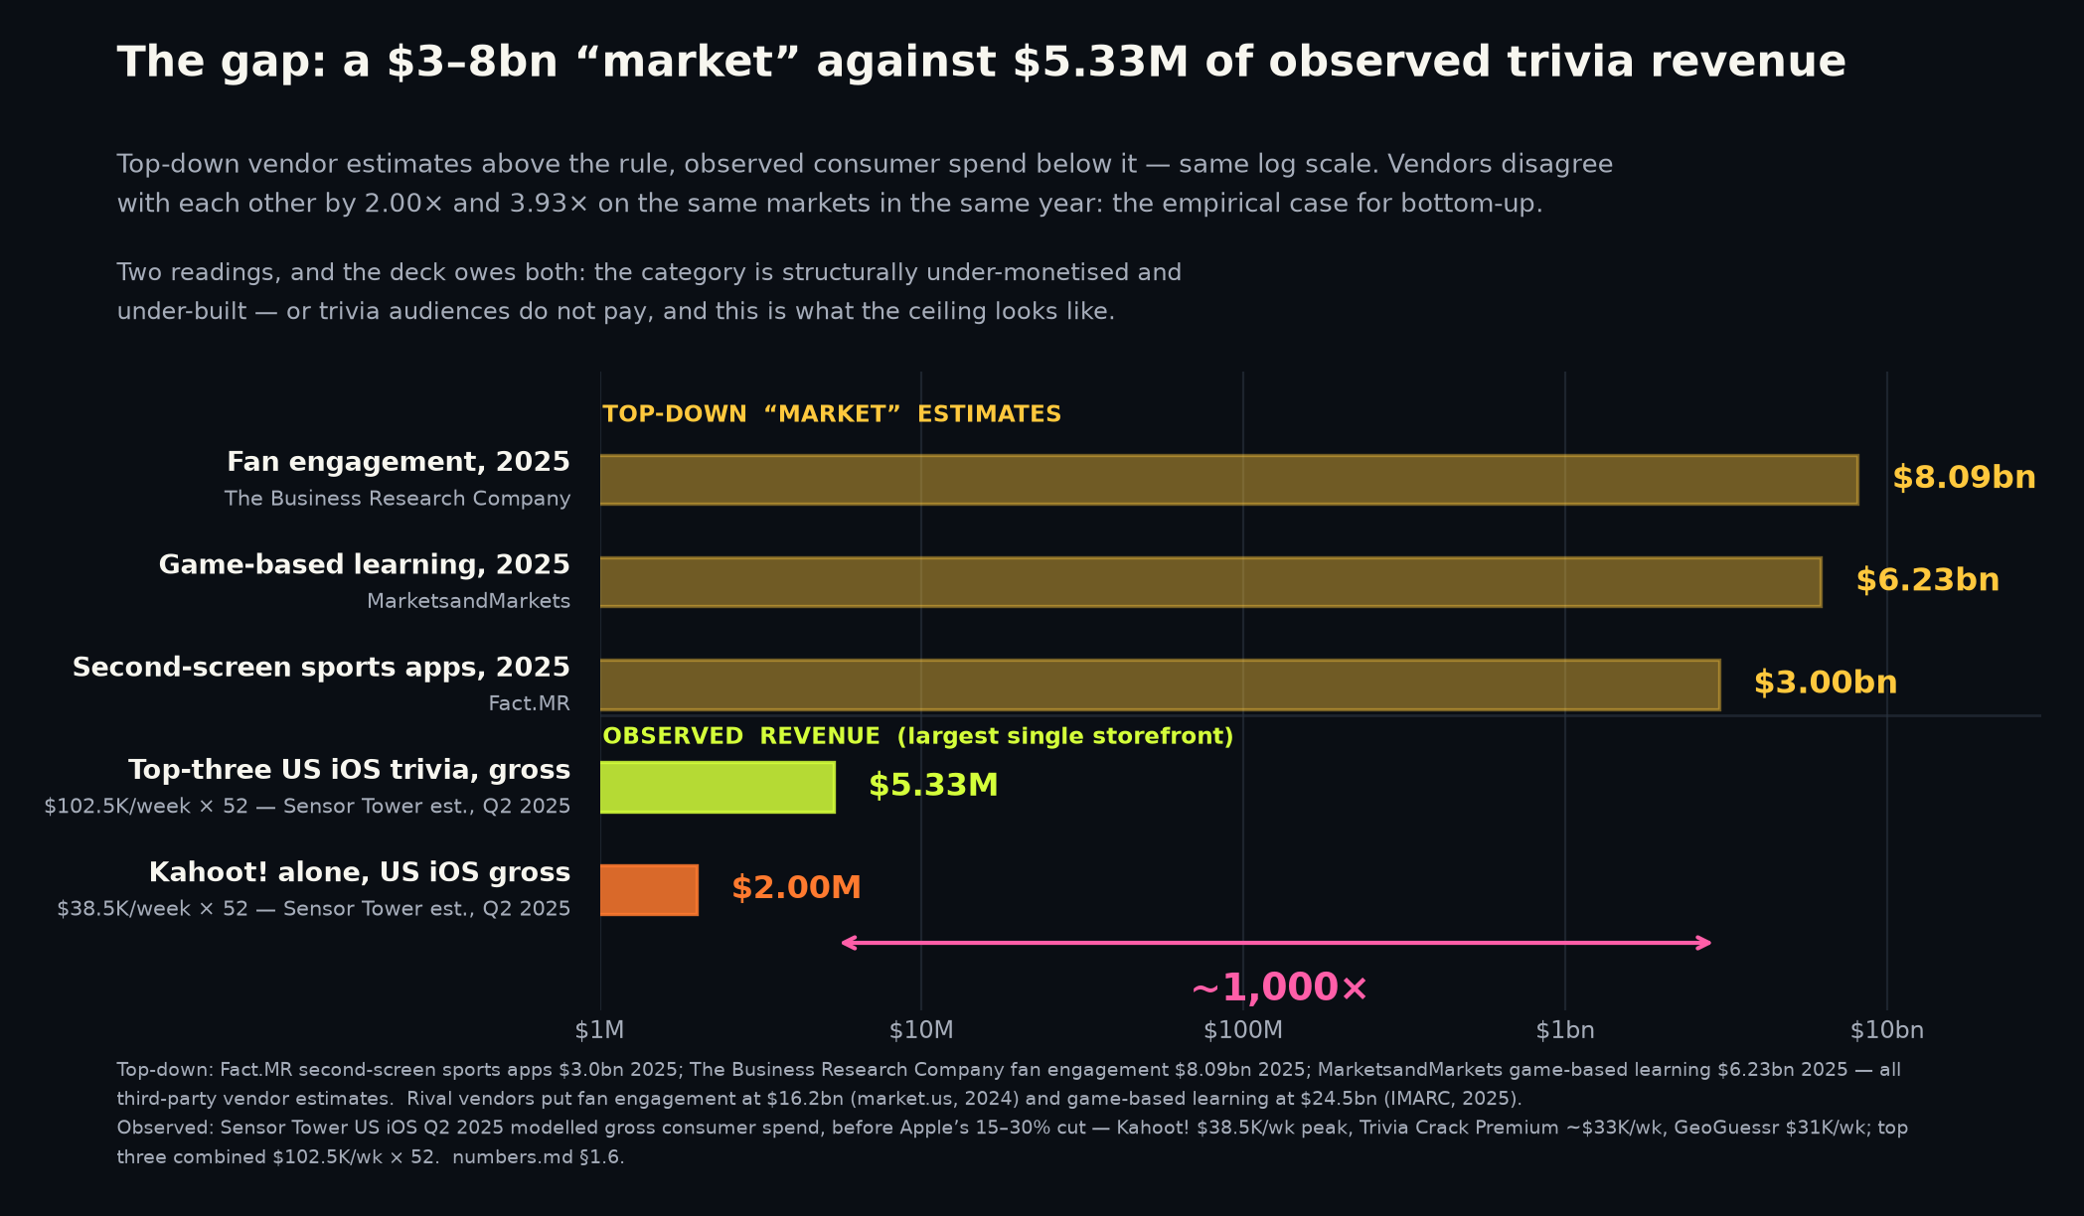
Appendix A — the ~1,000x gap between the category's claimed size and its observed revenue.
APPENDIX — MARKET STRUCTURE
Top-down vendors size the nearest categories at $3.0bn (second-screen sports apps) to $8.09bn (fan engagement).
Observed: Sensor Tower estimates those three at ~$102.5K in their peak weeks of Q2 2025 (~$5.33M/yr if sustained). The gap is roughly three orders of magnitude.
Thesis reading: the category is structurally under-monetised — 267,939,837 lifetime Trivia Crack installs, duels abandoned.
Risk reading: trivia audiences do not pay and this is the ceiling. HQ, QuizUp and Trivia Royale all died with audiences.
The reconciliation is slide 10: the category monetises through habit subscriptions, not consumer trivia IAP.
Sources: Fact.MR — second-screen sports apps market · The Business Research Company — fan engagement · market.us — fan engagement market · MarketsandMarkets — game-based learning
IMARC — game-based learning · Sensor Tower — Q2 2025 US iOS trivia revenue (est.) · Google Play — Trivia Crack listing · Sensor Tower — State of Mobile 2026
15
Notes:
Present both readings and let the investor pick; a deck that only presents the thesis reading of a 1,000x gap has not understood it. The vendor disagreement is itself evidence: IMARC sizes game-based learning at $24.5bn for the same year MarketsandMarkets sizes it at $6.23bn, a 3.93x spread, and market.us sizes fan engagement at 2.00x The Business Research Company's figure. When two paid research firms differ by four times on the same market in the same year, neither number can discipline a business plan, which is the empirical case for the bottom-up construction on slide 7. Note also that our own TAM-A of $1.69-2.83bn sits below the top-down range, because we count only US second-screen adults at observed per-user revenue while the vendors count sponsorship, ticketing, merchandising and B2B platform spend we will never touch. All Sensor Tower figures are modelled estimates of gross consumer spend, before Apple's 15-30% cut.
SOURCES
- https://www.factmr.com/report/second-screen-sports-apps-market
- https://www.thebusinessresearchcompany.com/report/fan-engagement-global-market-report
- https://market.us/report/fan-engagement-market/
- https://www.marketsandmarkets.com/Market-Reports/game-based-learning-market-169115901.html
- https://www.imarcgroup.com/game-based-learning-market
- https://sensortower.com/blog/2025-q2-ios-top-5-trivia%20games-revenue-us-604118ed241bc16eb8b8453a
- https://play.google.com/store/apps/details?id=com.etermax.preguntados.lite&hl=en_US&gl=US
- https://www.sensortower.com/blog/state-of-mobile-2026

Slide 16
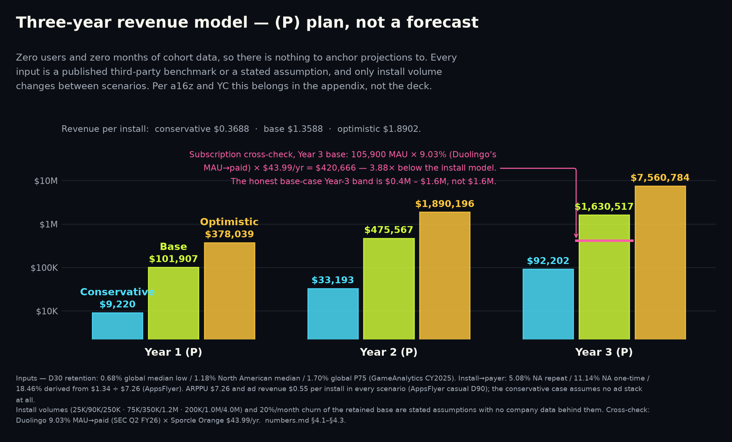
Appendix B — three-year scenarios, all figures (P): plans built on third-party benchmarks.
APPENDIX — THE MODEL
One model, three input sets. Only D30 retention, payer rate and install volume change between scenarios.
Install volumes are chosen assumptions with no company data behind them. That is stated, not softened.
Even the optimistic case assumes only median casual per-install monetisation; all optimism sits in volume.
Subscription cross-check: conservative agrees within 8%; base diverges 3.88x; optimistic 5.26x.
Break-even blended cost per install: $0.37 / $1.36 / $1.89. Trivia Royale's was under $0.20 — and it still died.
Scenario (P) | Y3 installs | Rev / install | Y3 revenue | Y3 steady MAU | Subscription cross-check
Conservative | 250,000 | $0.3688 | $92,202 | 21,542 | $85,570 — agrees within 8%
Base | 1,200,000 | $1.3588 | $1,630,517 | 105,900 | $420,666 — 3.88x divergence
Optimistic | 4,000,000 | $1.8902 | $7,560,784 | 361,667 | $1,436,647 — 5.26x divergence
Sources: GameAnalytics — 2026 Mobile & PC Gaming Benchmarks · AppsFlyer — State of App Monetization 2026 · SEC — Duolingo Q2 FY2026 shareholder letter · Sporcle — Orange membership pricing
TechCrunch — Trivia Royale, 2.5M downloads in 3 weeks · a16z — The Insider's Guide to Data Rooms · FACT//DUEL internal — numbers.md §4.1-§4.3
16
Notes:
This page exists only because someone asked for it. a16z lists detailed three-to-five-year projections among the things not to include, wants 12-18 month milestones instead, and its anchoring rule cannot even be satisfied here because we have no historical data to anchor to — which is itself the most honest sentence on the page. Inputs, all third-party: D30 retention of 0.68% / 1.18% / 1.70% (global median low, North American median, global P75 from GameAnalytics); install-to-payer of 5.08% / 11.14% / 18.46% (AppsFlyer NA repeat payer, NA one-time payer, and a derived $1.34/$7.26 ratio used only as an optimistic ceiling and labelled derived); ARPPU held at AppsFlyer's casual D90 $7.26 in all three; ad revenue per install $0.00 in the conservative case because we are a web app with no mediation stack today. Monthly churn of the retained base is fixed at 20% across all scenarios — an unsourced modelling assumption, held constant so it cannot flatter any scenario. Three stress tests all point the same way: the conservative case is genuinely conservative, and the base case is not. Base-case revenue per MAU of $15.40 exceeds both real anchors (MAG $13.07, Duolingo $7.80), so any scenario that out-monetises Duolingo per active user is a ceiling and not a target. Per-MAU revenue also looks high partly because high churn makes annual installs about 11x steady-state MAU — throughput, not intensity.
SOURCES
- https://www.gameanalytics.com/reports/2026-mobile-pc-gaming-benchmarks
- https://www.appsflyer.com/resources/reports/app-marketing-monetization-report/
- https://www.sec.gov/Archives/edgar/data/1562088/000162828026053299/q2fy26duolingo6-30x26share.htm
- https://www.sporcle.com/memberships/
- https://techcrunch.com/2020/07/10/how-thor-fridrikssons-trivia-royale-earned-2-5m-downloads-in-3-weeks/
- https://a16z.com/the-insiders-guide-to-data-rooms-what-to-know-before-you-raise/
- FACT//DUEL internal: public/product/investor/numbers.md §4.1-§4.3

Slide 17
Appendix C — TAM, SAM and SOM in full, including the number we chose not to put on the slide.
APPENDIX — MARKET SIZING
No penetration percentage appears anywhere in TAM or SAM. Every haircut lives in SOM, where it belongs.
TAM-B adds the 1bn+ global cricket bloc but applies US ARPU to a South Asian population — directional only.
Newzoo contradicts that directly: APAC generated $95.0bn of 2025 games revenue against North America's $54.0bn.
Excluded on purpose: Europe, Latin America, and every science-audience bloc. Followers and visits are not people.
SOM is 0.14%-0.23% of SAM. A seed-stage SOM that is a fraction of one percent is what honest arithmetic produces.
Layer | Population | x ARPU | Result | Source of population
TAM-A (on the slide) | 216.8M US second-screen adults | $7.80 - $13.07 | $1.69bn - $2.83bn | EMARKETER, 2026
SAM | 90.3M NA fantasy/betting adults | $7.80 - $13.07 | $704M - $1.18bn | FSGA / Angus Reid, 2026
SOM (P) | ~106,000 steady-state MAU | base-case model | $0.4M - $1.6M (P) | Chosen Year-3 plan target
TAM-B (appendix only) | 1,216.8M incl. cricket bloc | $7.80 - $13.07 | $9.49bn - $15.90bn | ICC, 1bn+ fans aged 16-69
Sources: EMARKETER — second-screen engagement during live sport · FSGA / Angus Reid 2026 — participation research · FSGA 2025 — next-generation engagement research
ICC — global cricket market research · Nielsen — 2025 Global Sports Report · Newzoo — Global Games Market 2025 · Paul Graham — How to convince investors · a16z — 16 More Startup Metrics
17
Notes:
Two flaws to disclose before anyone finds them. First, a nesting inconsistency: TAM-A is US-only at 216.8M while SAM includes Canada at 90.3M (82.8M US plus about 7.5M Canadian), so roughly 7.5M people sit in SAM but not TAM-A. It is immaterial and it is flagged rather than smoothed over. Second, TAM-B is in this deck only as an upper bound with its own refutation attached. Why SAM is genuinely addressable rather than merely large, both from FSGA 2026: 66% of 13-20-year-old season-long fantasy players update lineups daily, with an average starting age of 14 and a $100 median annual spend, and 51% of participants do both fantasy and betting, up from 49%. That is a daily-habit, already-spending, competitively-motivated audience — the behavioural profile a 1v1 duel is built for. Nielsen's '51% of people globally are fans of football' is deliberately not converted to a headcount because we have no verified population denominator for it; we use only its 62M US soccer fans and the ICC's 1bn+ cricket figure. Aggregator fan-base numbers circulating for other sports failed verification and are excluded.
SOURCES
- https://www.emarketer.com/content/second-screen-engagement-during-live-sports
- https://members.thefsga.org/news/Details/new-fsga-research-details-growing-role-of-ai-prediction-markets-in-fantasy-sports-and-sports-betting-341850
- https://members.thefsga.org/news/Details/new-fsga-research-highlights-industry-stability-and-next-generation-growth-in-fantasy-sports-and-sports-betting-305937
- https://www.icc-cricket.com/media-releases/first-global-market-research-project-unveils-more-than-one-billion-cricket-fans
- https://www.nielsen.com/news-center/2025/the-future-of-sport-nielsens-2025-report-reveals-growth-drivers/
- https://newzoo.com/articles/global-games-market-2025
- https://paulgraham.com/convince.html
- https://a16z.com/16-more-startup-metrics/

Slide 18
Appendix D — the graveyard in full, with capital raised and what it ended up worth.
APPENDIX — WHAT HAPPENED BEFORE
Every row is from a filing or contemporaneous reporting. No estimate in this table is ours.
The pattern: large audiences, cheap acquisition, no durable day-30 behaviour and no working price.
QuizUp's $3.2M fair-value mark is the honest ceiling for a large unmonetised trivia audience.
Skillz is the live adjacent case: the money is real, and so is the churn.
Product | Peak | Capital | Ending
HQ Trivia | 2.38M concurrent players, 28 Mar 2018 | $12,539,999 sold of $15,000,001 offered | 67,000 installs in Jan 2020; shut 14 Feb 2020, 25 staff
QuizUp | ~20M users claimed 19 May 2014; 1bn+ matches | ~$32.4M equity per SEC Form Ds | Sold to Glu for $7.5M of cancelled notes, booked at $3.2M
Trivia Royale | 2.5M downloads in ~3 weeks; 45% D1 iOS | $9,155,139 + $1,499,913 per SEC Form Ds | Closed 23 Feb 2021, eight months after launch, 16 staff
Skillz (live, adjacent) | FY2021: $380.2M revenue, 513,000 paying MAU | Public (NYSE: SKLZ) | FY2025: $104.5M revenue, 141,000 paying MAU
Sources: TechCrunch — HQ Trivia shuts down · SEC Form D — HQ Trivia · SEC 10-K — Glu Mobile FY2016 (QuizUp mark) · SEC 8-K — Glu Mobile / QuizUp acquisition
TechCrunch — Trivia Royale, 2.5M downloads in 3 weeks · SEC Form D — Teatime Games (Trivia Royale) · SEC 8-K — Skillz FY2022 results (FY2021 peak) · SEC 8-K — Skillz FY2025 results
18
Notes:
Precision notes that matter if challenged. QuizUp's '20 million users' is a company statement from 19 May 2014 describing a six-month registration milestone, not a measured peak — we quote it as claimed, attributed and dated. HQ Trivia's decline figure is the comparison of 67,000 installs in January 2020 against roughly 2 million a month in February 2018, which is about 3% — both figures are rounded Sensor Tower estimates, so we do not quote a ratio to three significant figures; it relaunched on 29 Mar 2020, played its last game on 17 Nov 2022 and was delisted from stores on 5 Aug 2023. Trivia Royale's 45% D1 and sub-$500,000 budget are company statements to TechCrunch, not audited, and the sub-$0.20 per download is blended including organic and viral rather than a paid CPI. Skillz's monthly ARPPU was $61.75 in FY2021 (derived) and $61.70 in FY2025 (stated) — essentially flat while the paying base fell 73%, which is the cleanest available evidence that competitive-play users monetise well and churn hard.
SOURCES
- https://techcrunch.com/2020/02/14/hq-trivia-shuts-down/
- https://www.sec.gov/Archives/edgar/data/1734125/000173412518000001/xslFormDX01/primary_doc.xml
- https://www.sec.gov/Archives/edgar/data/1366246/000155837017001621/gluu-20161231x10k.htm
- https://www.sec.gov/Archives/edgar/data/1366246/000155837016010604/gluu-20161215x8k.htm
- https://techcrunch.com/2020/07/10/how-thor-fridrikssons-trivia-royale-earned-2-5m-downloads-in-3-weeks/
- https://www.sec.gov/Archives/edgar/data/1717682/000171768218000001/primary_doc.xml
- https://www.sec.gov/Archives/edgar/data/1801661/000180166123000003/ex991_fy22q4-8xkxearningsr.htm
- https://www.sec.gov/Archives/edgar/data/1801661/000180166126000019/q425skillzex991-earningsre.htm

Slide 19
Appendix E — what we do not know, and what would settle each of it.
APPENDIX — LIMITS OF THE EVIDENCE
Every number about FACT//DUEL: no DAU, no D1/D7/D30 rate, no session length, no conversion, no CAC, no LTV, no revenue. The measurement layer shipped; the players did not (§7.1).
Whether app-store benchmarks transfer to a web product with no install step and no push notifications. They may not.
CAC or CPI for trivia in 2025-26: no verified benchmark of any kind exists in our evidence base.
Genre ARPDAU: the circulated bands failed verification as citation laundering and are excluded from this deck.
Whether consumer trivia can monetise at scale at all. Our own paid cohort is what settles it, and the round buys it.
Sources: FACT//DUEL internal — numbers.md §5 (failed verification and unresolved items) · MAG Interactive — Q3 2025/26 interim report · TechCrunch — Trivia Royale, 2.5M downloads in 3 weeks
AppTweak — US store conversion benchmarks, CY2025 · FACT//DUEL internal — numbers.md §7.1 and §7.3
19
Notes:
This page is a credibility instrument, not an apology. Specific exclusions an investor may expect to see and will not: no genre ARPDAU band (traced to one consultant's blog, relabelled as a benchmark by a secondary source; the only company-reported figure in our base is MAG Interactive's 9.0 US cents group ARPDAU for the nine months to May 2026); no Trivia Crack '600 million downloads' or '150 million active users' (PR-originated, and the second describes etermax company-wide); no ~$300M Wayground valuation (no primary source); no Sensor Tower puzzle-genre revenue figures (gated report, secondary summary, and the framing is wrong twice over); no IPM figures for trivia (gated, unverified); and no aggregator global fan-base counts, one of which is contradicted by the sport's own governing body. On store conversion we corrected a claim in our own favour's opposite direction and kept the correction. The single largest methodological risk is benchmark transfer to web, and the only thing that resolves it is our own instrumented cohort — which is what the raise funds.
SOURCES
- FACT//DUEL internal: public/product/investor/numbers.md §5 (failed verification and unresolved items)
- https://storage.mfn.se/8d863483-ccc8-4f02-b0c5-d37d899b23e8/mag-interim-report-eng-2025-26-q3.pdf
- https://techcrunch.com/2020/07/10/how-thor-fridrikssons-trivia-royale-earned-2-5m-downloads-in-3-weeks/
- https://www.apptweak.com/
- FACT//DUEL internal: public/product/investor/numbers.md §7.1 and §7.3 (company disclosure)

Slide 20
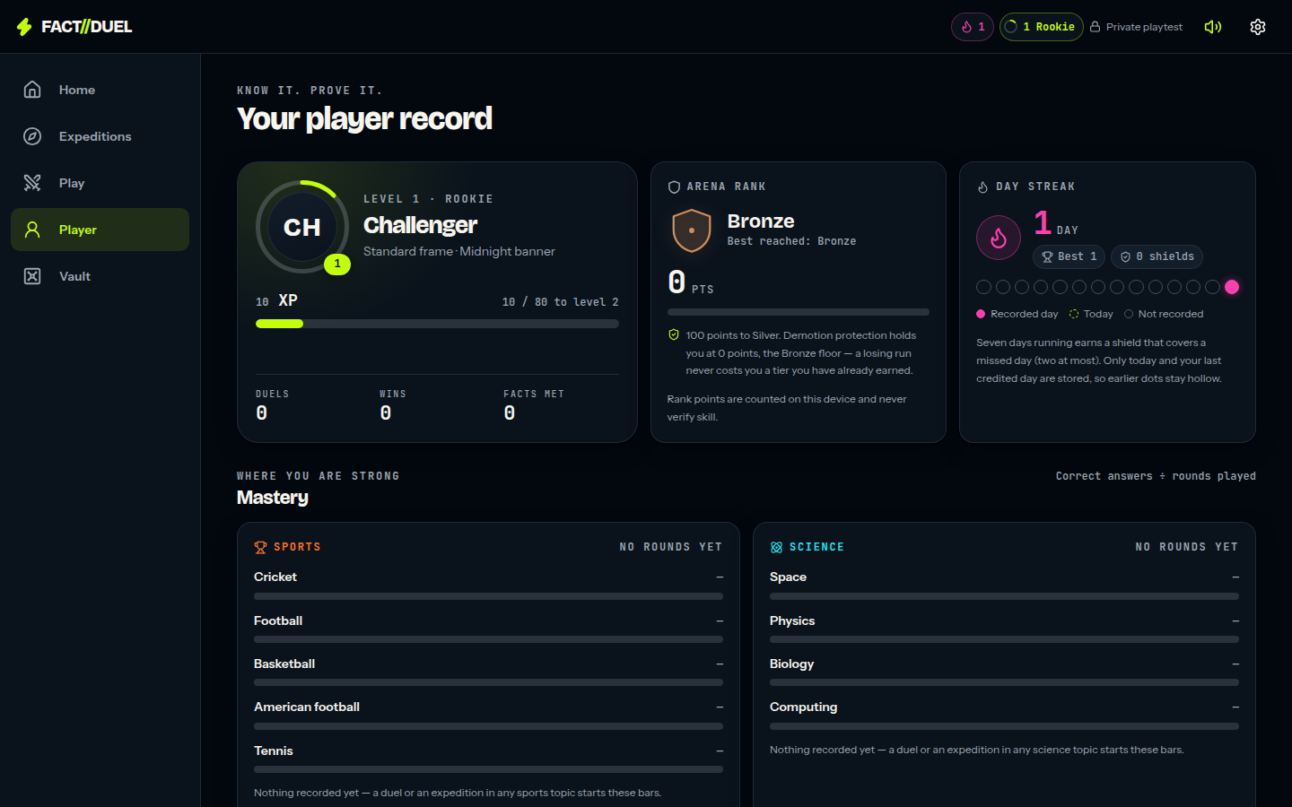
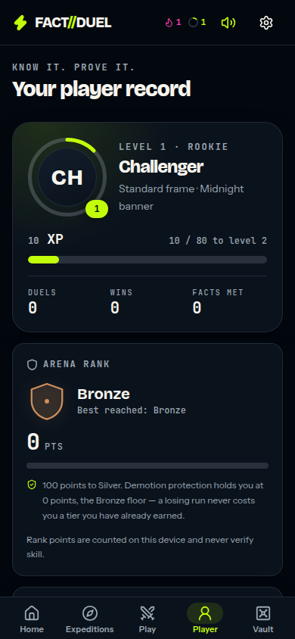
Appendix F — the shipped surfaces, for anyone who would rather play it than read about it.
APPENDIX — PRODUCT
Player record, badges, stamps and the Locker: the long-tail progression surface, all of it device-local.
Every visual effect is generated at runtime — procedural audio with no audio files, and 3D loaded lazily.
Every action works without WebGL; reduced-motion settings override the effects layer toward less motion.
None of this is a ranked or verified record, and none of it is sent to a server. Reset clears it.
Play it rather than reading about it: https://occult-kranti.github.io/fact-duel/ — no install, no account, no server, no request to us.
The player record: level and XP, Arena Rank, day streak, mastery — all device-local.
The record on a phone.
Sources: FACT//DUEL internal — numbers.md — status paragraph, §7.1 and §7.2 · FACT//DUEL internal — repository — product code, unaudited
20
Notes:
Open the link rather than describing the product a third time; since 13 September 2026 it costs nothing to hand over, because the build is public, runs entirely in the browser and needs no install, no account and no server (numbers.md §7.2). Be exact about what it is and is not: there are no accounts and no server-side progression, the bank is 54 sample questions, two-device friend duels are disabled in that build with an on-screen notice, it produces no retention data on its own, and nobody who opens it is a user in any sense this deck would count. The link is served from the repository's own Pages workflow and is live once the repository owner has pointed Pages at the gh-pages branch, so check it the morning of a meeting rather than assuming. Appendix G covers what the app does measure and what it deliberately does not. If asked about engineering rigour, the repository's own release record is the place to point — it lists the automated regression suites, the TypeScript and production-build gates, and, just as importantly, the checks that were not performed, including physical-device play, assistive-technology evaluation and any WAN or capacity testing. Quote specific counts from that record only if you have re-read it that day.
SOURCES
- FACT//DUEL internal: public/product/investor/numbers.md — status paragraph, §7.1 and §7.2 (company disclosure)
- FACT//DUEL internal: repository — product code, unaudited

Slide 21
Appendix G — how retention is measured, what is deliberately not measured, and why the rate still needs players.
APPENDIX — THE MEASUREMENT LAYER
Per device: install day, active days, session count, engaged time, and four counters — duel rounds, matches, expedition cards, quests (lib/analytics.mjs, 24 tests).
Per device: D1 / D7 / D30 as true, false, or null while the window is still open. A test asserts that an unfinished window can never read as a miss.
One device is a sample of one. No export is shaped like a rate, and the screen says so in its own copy — a rate needs a cohort.
Privacy: no third-party SDK, nothing personal, and the analytics module makes no network call. The player sees the whole record at /analytics and can export it as JSON or CSV, or erase it.
The cohort rate comes from an opt-in anonymous daily ping (cohort-ping / cohort-report, table cohort_days, 20 tests). The report is aggregate-only: no per-device row, and buckets under five devices are suppressed.
What none of this gives us today: a retention rate. That needs players. The instrument is what shipped; the cohort is what the round buys.
Sources: FACT//DUEL internal — numbers.md §7.1 and §7.3 · FACT//DUEL internal — repository — product code, unaudited
21
Notes:
This page exists so that the claim on slide 9 can be interrogated rather than believed. It is numbers.md §7.1 in slide form and it should be read as a design, not as a result. The device-local half is a pure module with no storage, no network call and no third-party SDK, which is why the privacy properties are checkable by reading one file rather than by trusting a vendor: it records install day, the days the device was active, session count under a stated inactivity threshold that the app names on screen, engaged time counted only while the app is on screen, and four in-app counters, then answers whether this device came back on day 1, 7 or 30. Both of those conventions are chosen rather than standard and the app names them on screen; say so before someone asks how a session is defined. The null return is the part worth dwelling on with a numerate investor — a window that has not finished reads as null rather than as a miss, which is the single easiest way to flatter or wreck an early retention number, and a test asserts it. The cohort half is the only part that can ever produce a rate, it is opt-in, the identifier is anonymous, the report can return no per-device row by construction, and any bucket describing fewer than five devices is suppressed rather than rounded — which is also a real limit on how early the first number can be published, and it is deliberate. The corresponding weakness is on slide 12 as a named risk: an opt-in denominator is consenting devices, not all devices, and the first published cohort figure has to carry its consent rate next to it. Twenty-four tests cover the device module and twenty the cohort endpoints; quote those two counts only, because they are the two that numbers.md §7.1 records. Finally, the honest close: none of this is traction and none of it is a number. §7.3 is explicit that there are still no users, no revenue, no cohort, no CAC, no LTV and no ARPDAU, and that every figure in §4 remains a plan.
SOURCES
- FACT//DUEL internal: public/product/investor/numbers.md §7.1 and §7.3 (company disclosure)
- FACT//DUEL internal: repository — product code, unaudited

Slide 22
Appendix H — the whole model on one page. Every figure is (P).
APPENDIX — THE MODEL, YEAR BY YEAR
Revenue(year) = Installs x [ payer rate x ARPPU ] + Installs x ad revenue per install.
Steady-state MAU = monthly installs + ( monthly installs x D30 / monthly churn ), churn fixed at 20%.
There is nothing to mark (A): zero users and zero months of cohort data, so nothing here is an actual.
Annual installs run about 11x steady-state MAU. Revenue per MAU is throughput, not intensity.
Scenario (P) | Year | Installs | $ / install | Revenue | Monthly installs | Steady MAU | Rev / MAU / yr
Conservative | Y1 | 25,000 | $0.3688 | $9,220 | 2,083 | 2,154 | $4.28
Conservative | Y2 | 90,000 | $0.3688 | $33,193 | 7,500 | 7,755 | $4.28
Conservative | Y3 | 250,000 | $0.3688 | $92,202 | 20,833 | 21,542 | $4.28
Conservative | 3-yr | 365,000 | — | $134,615 | — | — | —
Base | Y1 | 75,000 | $1.3588 | $101,907 | 6,250 | 6,619 | $15.40
Base | Y2 | 350,000 | $1.3588 | $475,567 | 29,167 | 30,888 | $15.40
Base | Y3 | 1,200,000 | $1.3588 | $1,630,517 | 100,000 | 105,900 | $15.40
Base | 3-yr | 1,625,000 | — | $2,207,992 | — | — | —
Optimistic | Y1 | 200,000 | $1.8902 | $378,039 | 16,667 | 18,083 | $20.91
Optimistic | Y2 | 1,000,000 | $1.8902 | $1,890,196 | 83,333 | 90,417 | $20.91
Optimistic | Y3 | 4,000,000 | $1.8902 | $7,560,784 | 333,333 | 361,667 | $20.91
Optimistic | 3-yr | 5,200,000 | — | $9,829,019 | — | — | —
Sources: GameAnalytics — 2026 Mobile & PC Gaming Benchmarks · AppsFlyer — State of App Monetization 2026 · FACT//DUEL internal — numbers.md §4.1-§4.3
22
Notes:
This is §4.3 of numbers.md reproduced in full, so that anyone who wants to check the arithmetic can do it on the page instead of asking for a spreadsheet. Two things to say before they are asked. First, the only thing that changes between scenarios is three inputs — D30 retention, install-to-payer rate and install volume; the model itself is identical, ARPPU is held at AppsFlyer's casual D90 $7.26 in all three, and monthly churn of the retained base is held at 20% everywhere so it cannot flatter one case. Second, the install volumes are chosen assumptions with no company data behind them, which is why appendix I lists them as assumptions rather than inputs. Revenue per MAU rises across scenarios only because higher churn makes annual installs about 11x steady-state MAU — that is throughput, not better monetisation, and it is the reason the subscription cross-check on slide 10 exists.
SOURCES
- https://www.gameanalytics.com/reports/2026-mobile-pc-gaming-benchmarks
- https://www.appsflyer.com/resources/reports/app-marketing-monetization-report/
- FACT//DUEL internal: public/product/investor/numbers.md §4.1-§4.3

Slide 23
Appendix I — every input, every assumption, and which of them has no source.
APPENDIX — INPUTS AND ASSUMPTIONS
Two rows in this table are not sourced: monthly churn, and the install volumes. Both are labelled.
The 18.46% payer rate is arithmetic on two published AppsFlyer figures, used only as a ceiling.
Break-even blended cost per install: $0.37 / $1.36 / $1.89 (P). Trivia Royale's was under $0.20.
Base-case revenue per MAU of $15.40 exceeds MAG's $13.07 and Duolingo's $7.80. A ceiling, not a target.
Input | Conservative | Base | Optimistic | Where it comes from
D30 retention | 0.68% | 1.18% | 1.70% | GameAnalytics CY2025: global median low / NA median / global P75
Install to payer | 5.08% | 11.14% | 18.46% | AppsFlyer: NA repeat payer / NA one-time payer / derived $1.34 / $7.26
ARPPU (D90) | $7.26 | $7.26 | $7.26 | AppsFlyer casual games D90 ARPPU
Ad revenue per install | $0.00 | $0.55 | $0.55 | AppsFlyer casual D90 IAA ARPU; $0.00 assumes no mediation stack, which is today's state
Monthly churn of retained base | 20% | 20% | 20% | Assumption, unsourced. Held constant so it cannot flatter a scenario
Installs Y1 / Y2 / Y3 | 25K / 90K / 250K | 75K / 350K / 1.2M | 200K / 1.0M / 4.0M | Assumptions. No company data behind them
Sources: GameAnalytics — 2026 Mobile & PC Gaming Benchmarks · AppsFlyer — State of App Monetization 2026 · TechCrunch — Trivia Royale, 2.5M downloads in 3 weeks
SEC — Duolingo FY2025 shareholder letter · MAG Interactive — Q3 2025/26 interim report · FACT//DUEL internal — numbers.md §4.1-§4.3
23
Notes:
The point of showing the inputs separately from the outputs is that an investor can replace any one of them and re-run the model without our help. Even the optimistic case assumes only median casual per-install monetisation — AppsFlyer's own $1.34 IAP plus $0.55 ad revenue — so all of the optimism sits in install volume and none of it in monetisation quality. The derived 18.46% payer rate is arithmetic on two published figures that may rest on different samples and windows, and it sits well above the 11.14% North American 30-day figure, which is why it is used only as a ceiling and labelled derived. The conservative case carries $0.00 of ad revenue because we are a web app with no mediation stack today. On break-even cost per install: Trivia Royale's sourced blended figure of under $0.20 is inside all three of ours, and that company still died with 2.5M downloads and 45% D1, so clearing break-even is necessary and demonstrably not sufficient.
SOURCES
- https://www.gameanalytics.com/reports/2026-mobile-pc-gaming-benchmarks
- https://www.appsflyer.com/resources/reports/app-marketing-monetization-report/
- https://techcrunch.com/2020/07/10/how-thor-fridrikssons-trivia-royale-earned-2-5m-downloads-in-3-weeks/
- https://www.sec.gov/Archives/edgar/data/1562088/000162828026012246/q4fy25duolingo12-31x25shar.htm
- https://storage.mfn.se/8d863483-ccc8-4f02-b0c5-d37d899b23e8/mag-interim-report-eng-2025-26-q3.pdf
- FACT//DUEL internal: public/product/investor/numbers.md §4.1-§4.3

Slide 24
Appendix J — every source cited in this deck, and what kind of evidence it is.
APPENDIX — SOURCE REGISTER (1 OF 4)
64 distinct sources across 21 slides. Full URLs are in the speaker notes of every slide.
Kind key: audited filing, company disclosure, third-party estimate, analyst estimate, press report.
Nothing in this deck rests on a source that is not on this list, and nothing on this list is ours.
Source | Kind | Cited on
FACT//DUEL internal — numbers.md — status paragraph and §5.15 | internal (company disclosure) | 1, 6, 11
Y Combinator — A guide to seed fundraising | company disclosure | 1, 13, 14
Y Combinator — How to design a better pitch deck | company disclosure | 1, 13
GameAnalytics — 2026 Mobile & PC Gaming Benchmarks | third-party estimate | 1, 4, 9, 10, 12, 16
DocSend — per-section dwell times | third-party estimate | 1, 5, 13
DocSend — what VCs want inside a seed deck | third-party estimate | 1, 9
FACT//DUEL internal — numbers.md §7.1 and §7.2 | internal (company disclosure) | 1, 4, 6, 11, 12
Google Play — Trivia Crack listing | company disclosure | 2, 8, 11, 15
MAG Interactive — Q3 2025/26 interim report | company disclosure | 2, 7, 11, 19
Apple lookup API — QuizDuel listing (US storefront) | company disclosure | 2, 11
Apple lookup API — QuizDuel listing | company disclosure | 2, 11
Google Play — Quizion listing | company disclosure | 2, 11
Google Play — TRIVIA GO! listing | company disclosure | 2, 11
TechCrunch — Trivia Royale, 2.5M downloads in 3 weeks | press report | 3, 12, 16, 18, 19
TechCrunch — HQ Trivia shuts down | press report | 3, 18
TechCrunch — HQ Trivia peak concurrent record | press report | 3
24
Notes:
Read this page alongside appendix E. The kinds matter more than the count: an audited filing and a vendor's modelled estimate are not the same evidence, and the deck says which is which every time it uses one. Where a figure is a modelled estimate — every Sensor Tower number, every GameAnalytics and AppsFlyer benchmark, the AppTweak conversion figures — it is labelled as an estimate on the slide that carries it. Full URLs for this page:
- FACT//DUEL internal — numbers.md — status paragraph and §5.15
FACT//DUEL internal: public/product/investor/numbers.md — status paragraph and §5.15 (company disclosure)
- Y Combinator — A guide to seed fundraising
https://www.ycombinator.com/library/4A-a-guide-to-seed-fundraising
- Y Combinator — How to design a better pitch deck
https://www.ycombinator.com/library/4T-how-to-design-a-better-pitch-deck
- GameAnalytics — 2026 Mobile & PC Gaming Benchmarks
https://www.gameanalytics.com/reports/2026-mobile-pc-gaming-benchmarks
- DocSend — per-section dwell times
https://web.archive.org/web/20260622084020/https://www.docsend.com/blog/what-vcs-really-want-to-see-inside-your-seed-deck/
- DocSend — what VCs want inside a seed deck
https://web.archive.org/web/20240302210508/https://www.docsend.com/blog/what-vcs-really-want-to-see-inside-your-seed-deck/
- FACT//DUEL internal — numbers.md §7.1 and §7.2
FACT//DUEL internal: public/product/investor/numbers.md §7.1 and §7.2 (company disclosure)
- Google Play — Trivia Crack listing
https://play.google.com/store/apps/details?id=com.etermax.preguntados.lite&hl=en_US&gl=US
- MAG Interactive — Q3 2025/26 interim report
https://storage.mfn.se/8d863483-ccc8-4f02-b0c5-d37d899b23e8/mag-interim-report-eng-2025-26-q3.pdf
- Apple lookup API — QuizDuel listing (US storefront)
https://itunes.apple.com/lookup?id=1484354626&country=us
- Apple lookup API — QuizDuel listing
https://itunes.apple.com/lookup?id=1484354626&country=de
- Google Play — Quizion listing
https://play.google.com/store/apps/details?id=com.quizion.app&hl=en_US
- Google Play — TRIVIA GO! listing
https://play.google.com/store/apps/details?id=live.trivia&hl=en_US
- TechCrunch — Trivia Royale, 2.5M downloads in 3 weeks
https://techcrunch.com/2020/07/10/how-thor-fridrikssons-trivia-royale-earned-2-5m-downloads-in-3-weeks/
- TechCrunch — HQ Trivia shuts down
https://techcrunch.com/2020/02/14/hq-trivia-shuts-down/
- TechCrunch — HQ Trivia peak concurrent record
https://techcrunch.com/2018/08/14/hq-trivia-apple-tv/

Slide 25
Appendix J — every source cited in this deck, and what kind of evidence it is.
APPENDIX — SOURCE REGISTER (2 OF 4)
Continued. Kinds are taken from the fact-check register, not assigned by us.
Source | Kind | Cited on
SEC 10-K — Glu Mobile FY2016 (QuizUp mark) | third-party estimate | 3, 18
SEC 8-K — Glu Mobile / QuizUp acquisition | press report | 3, 18
FACT//DUEL internal — numbers.md §3.2, status paragraph and §5.15 | internal (company disclosure) | 4
FACT//DUEL internal — repository — product code, unaudited | internal (company disclosure) | 4, 5, 6, 9, 20, 21
FACT//DUEL internal — numbers.md — status paragraph, §4.4 and §7.1-§7.2 | internal (company disclosure) | 5
FACT//DUEL internal — numbers.md §2.3, §4.3 and §4.4 | internal (company disclosure) | 6, 12
EMARKETER — second-screen engagement during live sport | third-party estimate | 7, 17
SEC — Duolingo FY2025 shareholder letter | audited filing | 7, 8, 10
AppTweak — US store conversion benchmarks, CY2025 | third-party estimate | 8, 19
FACT//DUEL internal — numbers.md §3.5, §5.2 and §5.14 | internal (company disclosure) | 8, 12
FACT//DUEL internal — numbers.md — status paragraph, §4.4 and §7.1 | internal (company disclosure) | 9
Sensor Tower — Q2 2025 US iOS trivia revenue (est.) | third-party estimate | 10, 11, 15
SEC — Duolingo Q2 FY2026 10-Q (user counts at 30 Jun 2026) | company disclosure | 10
SEC — Duolingo Q2 FY2026 shareholder letter | company disclosure | 10, 12, 16
Kahoot! — Q4 2022 quarterly report | company disclosure | 10, 11
Sporcle — Orange membership pricing | company disclosure | 10, 12, 16
25
Notes:
Source register, continued. Full URLs for this page:
- SEC 10-K — Glu Mobile FY2016 (QuizUp mark)
https://www.sec.gov/Archives/edgar/data/1366246/000155837017001621/gluu-20161231x10k.htm
- SEC 8-K — Glu Mobile / QuizUp acquisition
https://www.sec.gov/Archives/edgar/data/1366246/000155837016010604/gluu-20161215x8k.htm
- FACT//DUEL internal — numbers.md §3.2, status paragraph and §5.15
FACT//DUEL internal: public/product/investor/numbers.md §3.2, status paragraph and §5.15 (company disclosure)
- FACT//DUEL internal — repository — product code, unaudited
FACT//DUEL internal: repository — product code, unaudited
- FACT//DUEL internal — numbers.md — status paragraph, §4.4 and §7.1-§7.2
FACT//DUEL internal: public/product/investor/numbers.md — status paragraph, §4.4 and §7.1-§7.2 (company disclosure)
- FACT//DUEL internal — numbers.md §2.3, §4.3 and §4.4
FACT//DUEL internal: public/product/investor/numbers.md §2.3, §4.3 and §4.4 (company disclosure)
- EMARKETER — second-screen engagement during live sport
https://www.emarketer.com/content/second-screen-engagement-during-live-sports
- SEC — Duolingo FY2025 shareholder letter
https://www.sec.gov/Archives/edgar/data/1562088/000162828026012246/q4fy25duolingo12-31x25shar.htm
- AppTweak — US store conversion benchmarks, CY2025
https://www.apptweak.com/
- FACT//DUEL internal — numbers.md §3.5, §5.2 and §5.14
FACT//DUEL internal: public/product/investor/numbers.md §3.5, §5.2 and §5.14 (company disclosure)
- FACT//DUEL internal — numbers.md — status paragraph, §4.4 and §7.1
FACT//DUEL internal: public/product/investor/numbers.md — status paragraph, §4.4 and §7.1 (company disclosure)
- Sensor Tower — Q2 2025 US iOS trivia revenue (est.)
https://sensortower.com/blog/2025-q2-ios-top-5-trivia%20games-revenue-us-604118ed241bc16eb8b8453a
- SEC — Duolingo Q2 FY2026 10-Q (user counts at 30 Jun 2026)
https://www.sec.gov/Archives/edgar/data/1562088/000162828026053603/duol-20260630.htm
- SEC — Duolingo Q2 FY2026 shareholder letter
https://www.sec.gov/Archives/edgar/data/1562088/000162828026053299/q2fy26duolingo6-30x26share.htm
- Kahoot! — Q4 2022 quarterly report
https://kahoot.com/files/2023/02/4Q22_Kahoot_quarterly_report.pdf
- Sporcle — Orange membership pricing
https://www.sporcle.com/memberships/

Slide 26
Appendix J — every source cited in this deck, and what kind of evidence it is.
APPENDIX — SOURCE REGISTER (3 OF 4)
Continued. Kinds are taken from the fact-check register, not assigned by us.
Source | Kind | Cited on
AppsFlyer — State of App Monetization 2026 | third-party estimate | 10, 16
FACT//DUEL internal — numbers.md §4.1-§4.3 | internal (company disclosure) | 10, 16
Google Play — Kahoot! listing | company disclosure | 11
Oslo Børs — Kahoot! delisting notice | company disclosure | 11
PR Newswire — Quizizz $31.5M Series B | press report | 11
Apple lookup API — Wayground listing | company disclosure | 11
SEC 8-K — Skillz FY2025 results | company disclosure | 11, 18
SEC 8-K — Skillz FY2022 results (FY2021 peak) | audited filing | 11, 18
SEC 10-K — Skillz FY2023 (Skillz v. AviaGames) | press report | 12
FACT//DUEL internal — numbers.md §4.4 and §4.5 | internal (company disclosure) | 13
Carta — State of Private Markets, Q3 2025 | third-party estimate | 14
Crunchbase — US seed funding, 2025 | press report | 14
FACT//DUEL internal — numbers.md §4.4, §4.5 and §5.8 | internal (company disclosure) | 14
FACT//DUEL internal — numbers.md §7.1 and §7.3 | internal (company disclosure) | 14, 19, 21
Fact.MR — second-screen sports apps market | third-party estimate | 15
The Business Research Company — fan engagement | third-party estimate | 15
26
Notes:
Source register, continued. Full URLs for this page:
- AppsFlyer — State of App Monetization 2026
https://www.appsflyer.com/resources/reports/app-marketing-monetization-report/
- FACT//DUEL internal — numbers.md §4.1-§4.3
FACT//DUEL internal: public/product/investor/numbers.md §4.1-§4.3
- Google Play — Kahoot! listing
https://play.google.com/store/apps/details?id=no.mobitroll.kahoot.android&hl=en_US&gl=US
- Oslo Børs — Kahoot! delisting notice
https://newsweb.oslobors.no/message/608893
- PR Newswire — Quizizz $31.5M Series B
https://www.prnewswire.com/news-releases/quizizz-gains-momentum-raises-31-5-million-to-motivate-every-student-301322655.html
- Apple lookup API — Wayground listing
https://itunes.apple.com/lookup?id=1160249042&country=us
- SEC 8-K — Skillz FY2025 results
https://www.sec.gov/Archives/edgar/data/1801661/000180166126000019/q425skillzex991-earningsre.htm
- SEC 8-K — Skillz FY2022 results (FY2021 peak)
https://www.sec.gov/Archives/edgar/data/1801661/000180166123000003/ex991_fy22q4-8xkxearningsr.htm
- SEC 10-K — Skillz FY2023 (Skillz v. AviaGames)
https://www.sec.gov/Archives/edgar/data/1801661/000180166124000100/sklz-20231231.htm
- FACT//DUEL internal — numbers.md §4.4 and §4.5
FACT//DUEL internal: public/product/investor/numbers.md §4.4 and §4.5
- Carta — State of Private Markets, Q3 2025
https://carta.com/data/state-of-private-markets-q3-2025/
- Crunchbase — US seed funding, 2025
https://news.crunchbase.com/venture/average-seed-funding-amounts-deals-grew-2025/
- FACT//DUEL internal — numbers.md §4.4, §4.5 and §5.8
FACT//DUEL internal: public/product/investor/numbers.md §4.4, §4.5 and §5.8
- FACT//DUEL internal — numbers.md §7.1 and §7.3
FACT//DUEL internal: public/product/investor/numbers.md §7.1 and §7.3 (company disclosure)
- Fact.MR — second-screen sports apps market
https://www.factmr.com/report/second-screen-sports-apps-market
- The Business Research Company — fan engagement
https://www.thebusinessresearchcompany.com/report/fan-engagement-global-market-report

Slide 27
Appendix J — every source cited in this deck, and what kind of evidence it is.
APPENDIX — SOURCE REGISTER (4 OF 4)
Continued. Kinds are taken from the fact-check register, not assigned by us.
Source | Kind | Cited on
market.us — fan engagement market | third-party estimate | 15
MarketsandMarkets — game-based learning | third-party estimate | 15
IMARC — game-based learning | third-party estimate | 15
Sensor Tower — State of Mobile 2026 | third-party estimate | 15
a16z — The Insider's Guide to Data Rooms | company disclosure | 16
FSGA / Angus Reid 2026 — participation research | third-party estimate | 17
FSGA 2025 — next-generation engagement research | third-party estimate | 17
ICC — global cricket market research | company disclosure | 17
Nielsen — 2025 Global Sports Report | third-party estimate | 17
Newzoo — Global Games Market 2025 | third-party estimate | 17
Paul Graham — How to convince investors | company disclosure | 17
a16z — 16 More Startup Metrics | company disclosure | 17
SEC Form D — HQ Trivia | press report | 18
SEC Form D — Teatime Games (Trivia Royale) | press report | 18
FACT//DUEL internal — numbers.md §5 (failed verification and unresolved items) | internal (company disclosure) | 19
FACT//DUEL internal — numbers.md — status paragraph, §7.1 and §7.2 | internal (company disclosure) | 20
27
Notes:
Source register, continued. Full URLs for this page:
- market.us — fan engagement market
https://market.us/report/fan-engagement-market/
- MarketsandMarkets — game-based learning
https://www.marketsandmarkets.com/Market-Reports/game-based-learning-market-169115901.html
- IMARC — game-based learning
https://www.imarcgroup.com/game-based-learning-market
- Sensor Tower — State of Mobile 2026
https://www.sensortower.com/blog/state-of-mobile-2026
- a16z — The Insider's Guide to Data Rooms
https://a16z.com/the-insiders-guide-to-data-rooms-what-to-know-before-you-raise/
- FSGA / Angus Reid 2026 — participation research
https://members.thefsga.org/news/Details/new-fsga-research-details-growing-role-of-ai-prediction-markets-in-fantasy-sports-and-sports-betting-341850
- FSGA 2025 — next-generation engagement research
https://members.thefsga.org/news/Details/new-fsga-research-highlights-industry-stability-and-next-generation-growth-in-fantasy-sports-and-sports-betting-305937
- ICC — global cricket market research
https://www.icc-cricket.com/media-releases/first-global-market-research-project-unveils-more-than-one-billion-cricket-fans
- Nielsen — 2025 Global Sports Report
https://www.nielsen.com/news-center/2025/the-future-of-sport-nielsens-2025-report-reveals-growth-drivers/
- Newzoo — Global Games Market 2025
https://newzoo.com/articles/global-games-market-2025
- Paul Graham — How to convince investors
https://paulgraham.com/convince.html
- a16z — 16 More Startup Metrics
https://a16z.com/16-more-startup-metrics/
- SEC Form D — HQ Trivia
https://www.sec.gov/Archives/edgar/data/1734125/000173412518000001/xslFormDX01/primary_doc.xml
- SEC Form D — Teatime Games (Trivia Royale)
https://www.sec.gov/Archives/edgar/data/1717682/000171768218000001/primary_doc.xml
- FACT//DUEL internal — numbers.md §5 (failed verification and unresolved items)
FACT//DUEL internal: public/product/investor/numbers.md §5 (failed verification and unresolved items)
- FACT//DUEL internal — numbers.md — status paragraph, §7.1 and §7.2
FACT//DUEL internal: public/product/investor/numbers.md — status paragraph, §7.1 and §7.2 (company disclosure)

