Slide 1
The 2nd-derivative (SDP) approach to phytoplankton pigments from hyperspectral Rrs
Reproduction, critique and alternatives, with uncertainty
Claude (Opus 5.5) for J. Xavier Prochaska · EPFT-UP · October 2026
Report: reports/SDP_Claude_Report.md

Slide 2
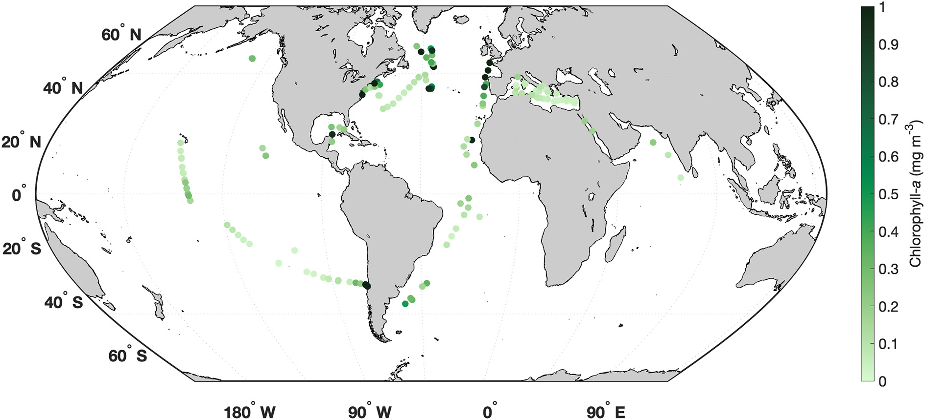
Why: PFTs from hyperspectral ocean color
• Phytoplankton functional types (PFTs) are what ecosystem and carbon models need
• Multispectral color gives chlorophyll, not composition
• PACE OCI now delivers global hyperspectral Rrs
• SDP (Kramer et al. 2022) is the leading derivative method; NASA ships an OCI notebook (oci_sdp)
• Training set: 145 global HPLC + Rrs matchups, 8 campaigns
Kramer et al. 2022, Fig. 1 (training matchups)

Slide 3
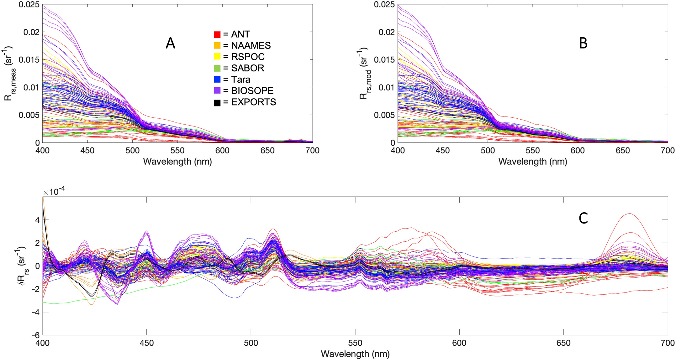
What SDP does
• Fit a GSM-like model to Rrs (Tchla, a_dg, b_bp)
• Residual δRrs = Rrs − Rrs_mod
• Second derivative δRrs″ (1 nm)
• PCR: z-score, PCs by inner CV, 100 random 75/25 splits
• Output: 13 HPLC pigment concentrations
Kramer et al. 2022, Fig. 2: (A) Rrs, (B) Rrs_mod, (C) δRrs

Slide 4
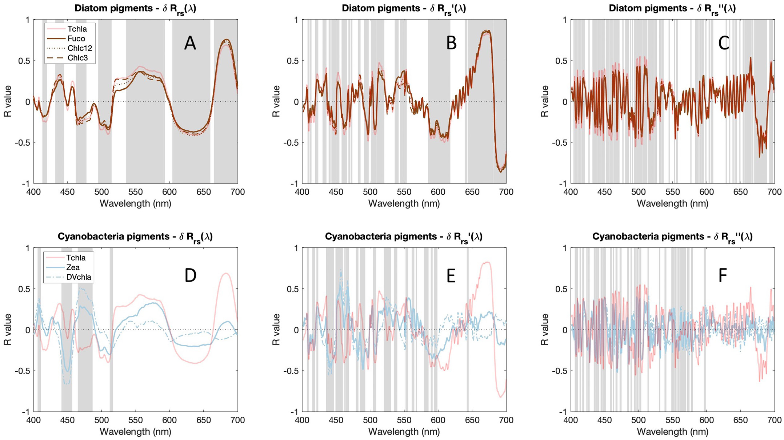
Why derivatives? Pigment features in δRrs
• Pigment–spectrum correlations sharpen from δRrs to δRrs′ to δRrs″
• Lineage: Catlett & Siegel 2018 used a_ph′, a_ph″ with PCR
• Their argument: pigment covariance makes communities retrievable
Kramer et al. 2022, Fig. 5

Slide 5
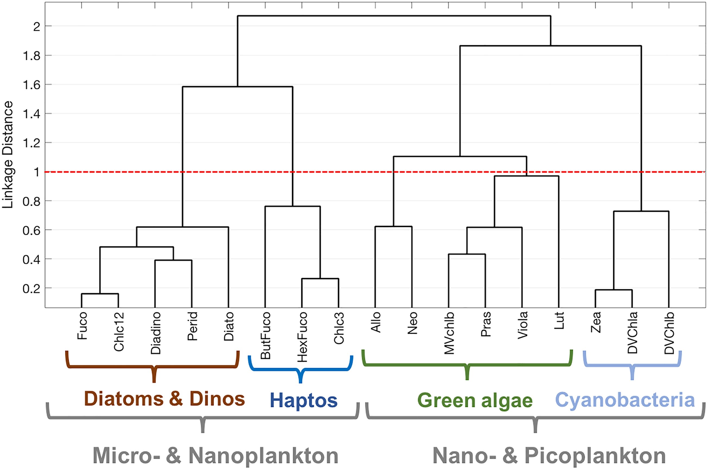
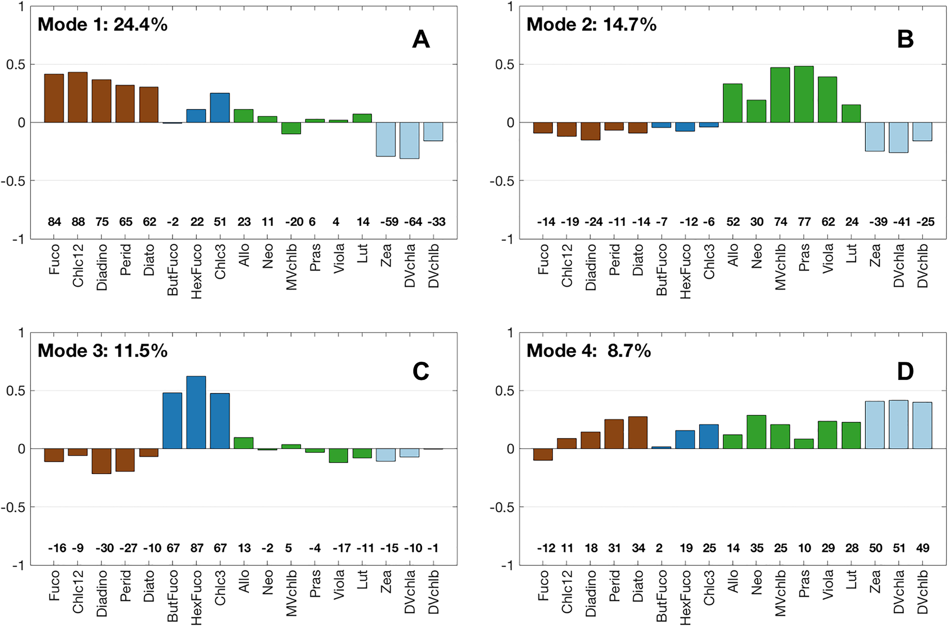
What HPLC itself can resolve
• Globally 4 pigment groups (diatoms + dinos merge); 4–6 locally
• Leading EOF: diatoms/dinos vs picophytoplankton (24%)
Kramer & Siegel 2019 (4,480 samples), Figs. 3–4

Slide 6
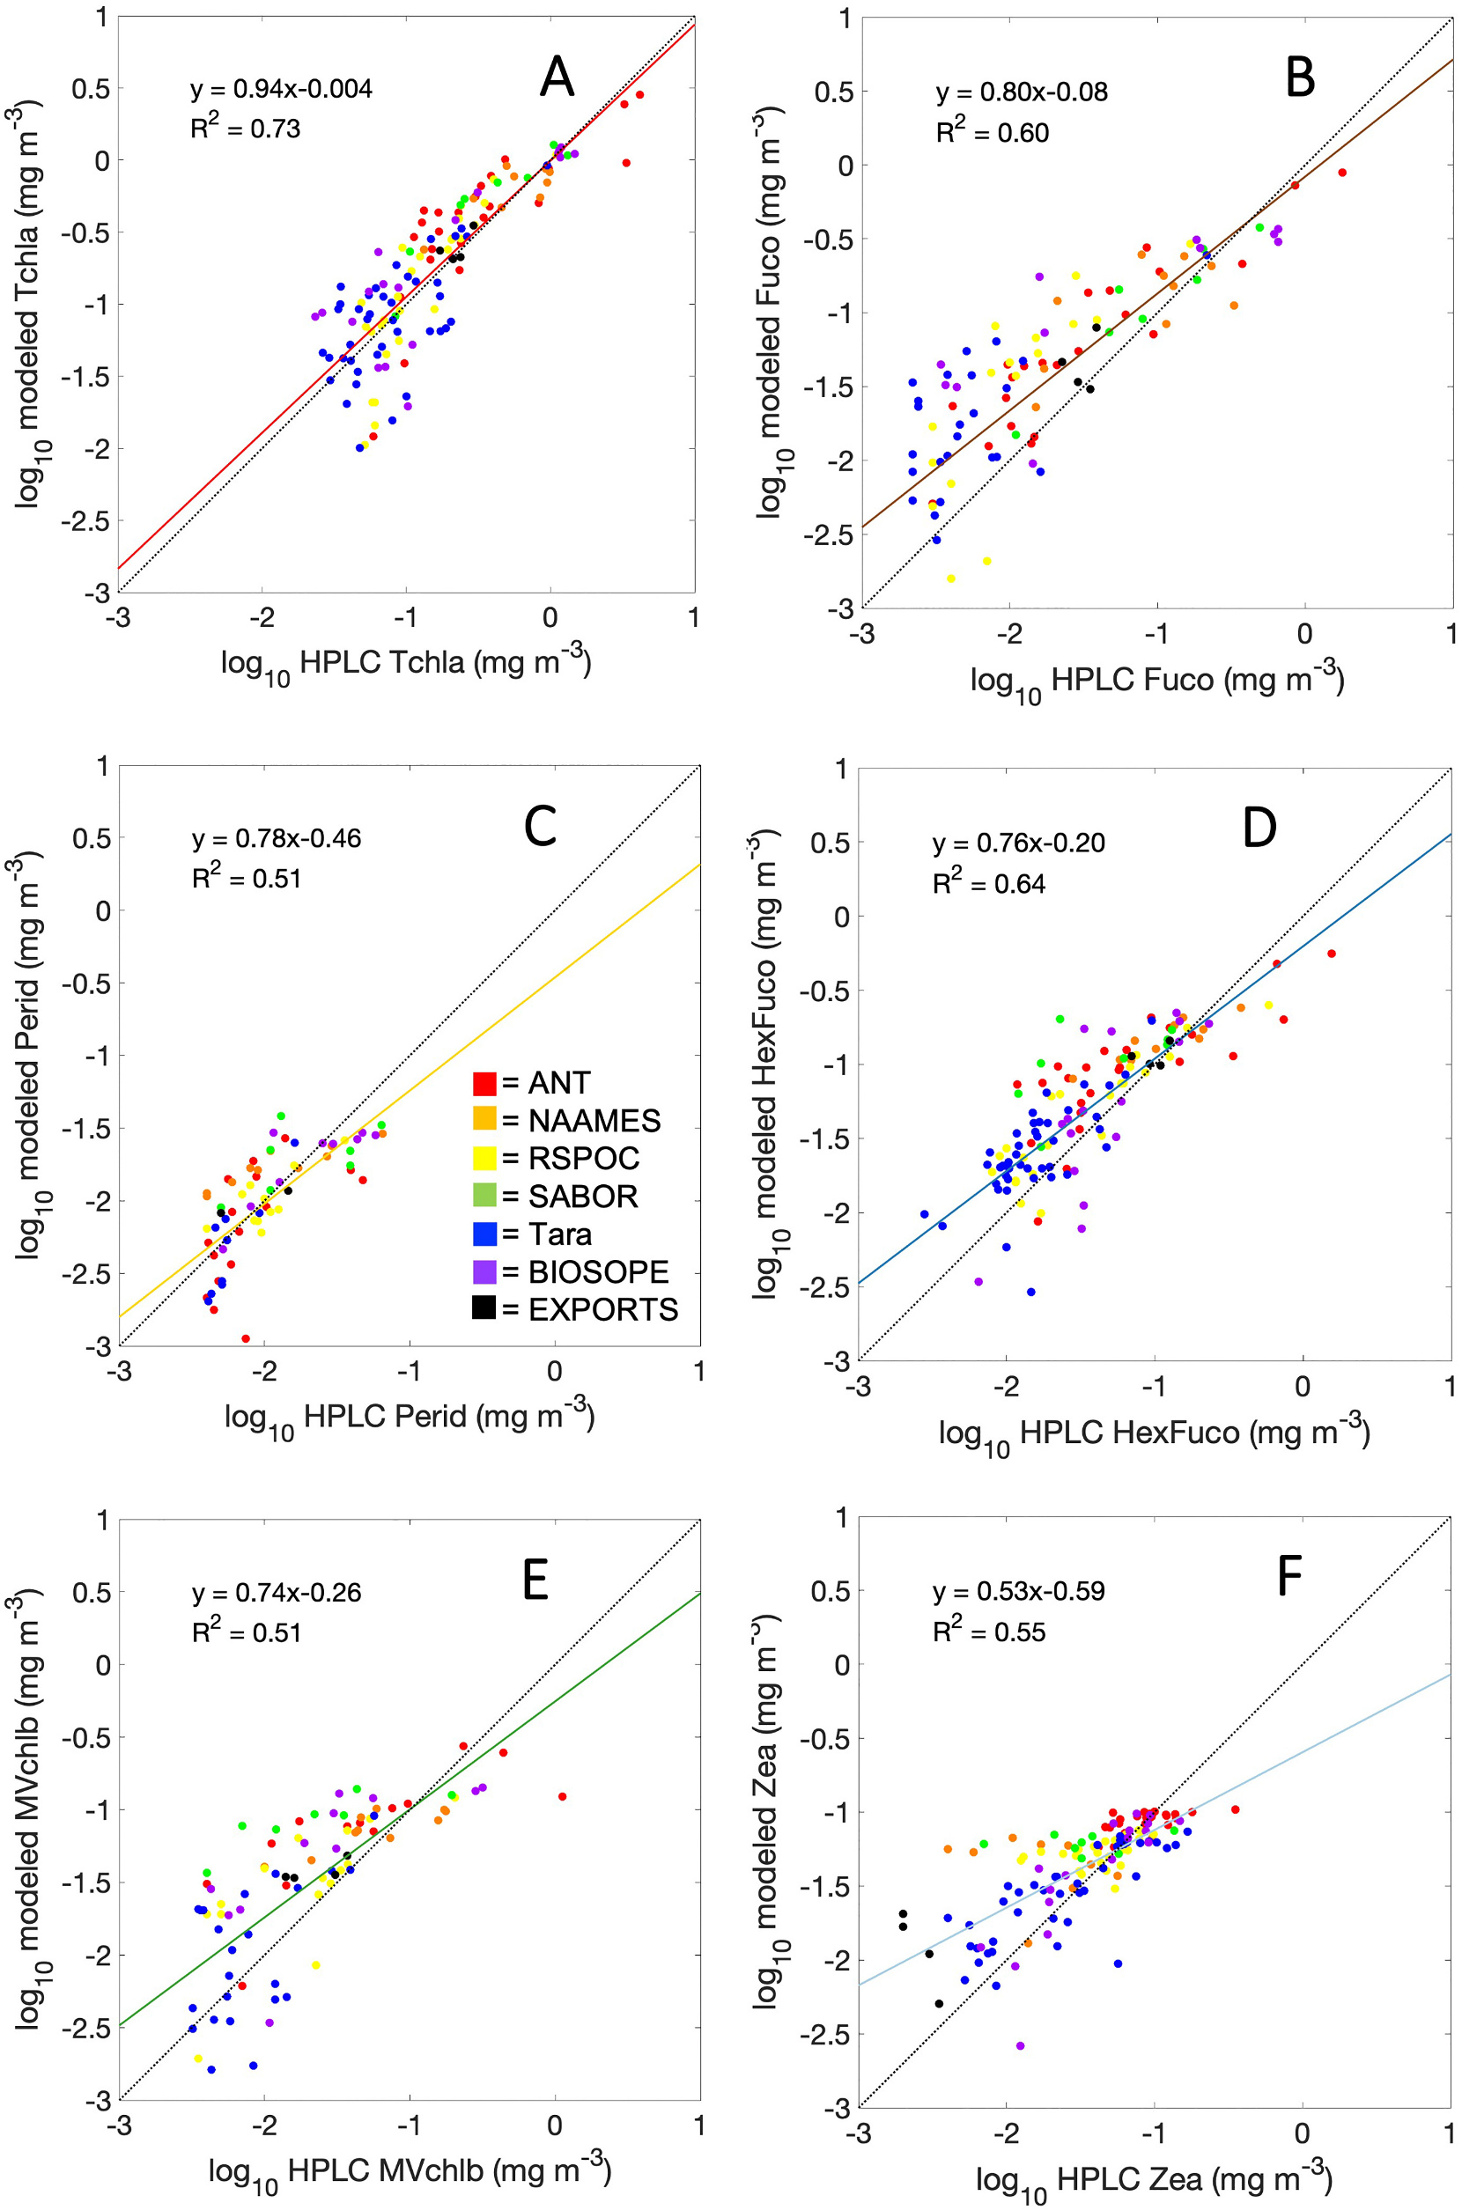
What SDP claims (2022)
• Validation R² 0.37–0.72 for 13 pigments (Table 2)
• 1–5 nm sampling is enough; 10 nm degrades
• The 5 HPLC pigment groups re-emerge from modelled pigments
• Validated on random 75/25 splits; no chlorophyll-only baseline
Kramer et al. 2022, Fig. 6

Slide 7
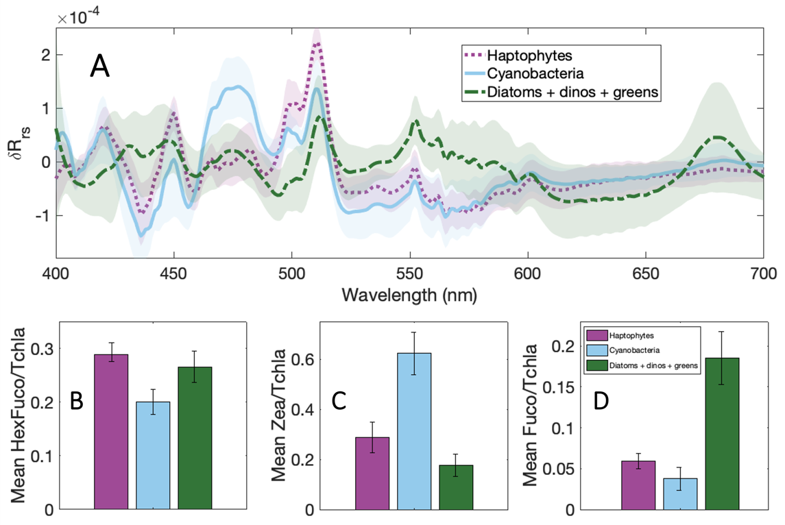
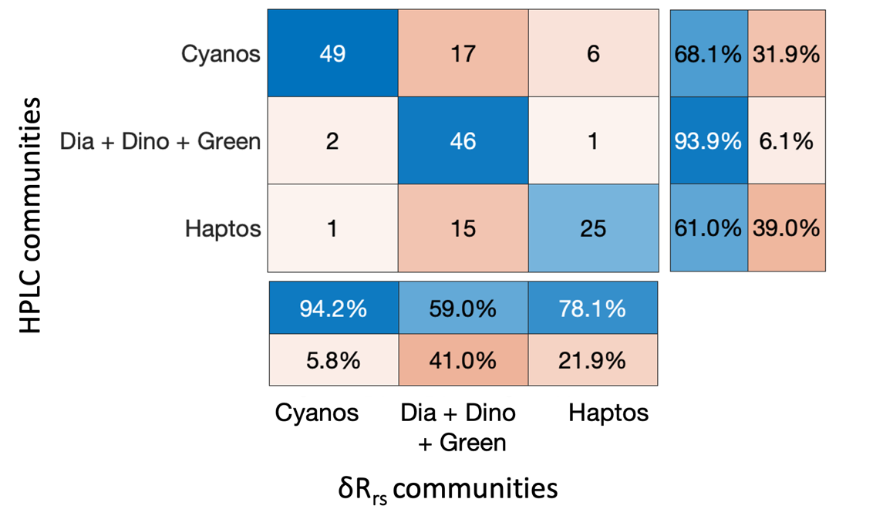
2024: δRrs defines optical communities
• 145 + 17 EXPORTS-NA samples; 3 δRrs communities vs 3 HPLC communities
• 74% of samples assigned to matching communities; same at 5 nm
Kramer et al. 2024, Fig. 1 (left) and Fig. 3 (right)

Slide 8
How we tested it
• Data: PANGAEA 937536 (145 samples), SHA-256 pinned; Kramer's MATLAB code and the Python port at pinned commits
• Re-derived independently in Python (epft_up/sdp/), then checked against both codes
• Two tests for every model:
  – skill above a 2-parameter Tchla-only null (pigment = a·Tchla^b)
  – skill under leave-one-campaign-out (LOCO), not only random splits
• Then: maths of the derivative, alternatives, Bayesian uncertainty, PACE-like noise, an independent campaign (EXPORTS-NA 2021)
• Every number traces to a script (13 scripts, 100 tests)

Slide 9
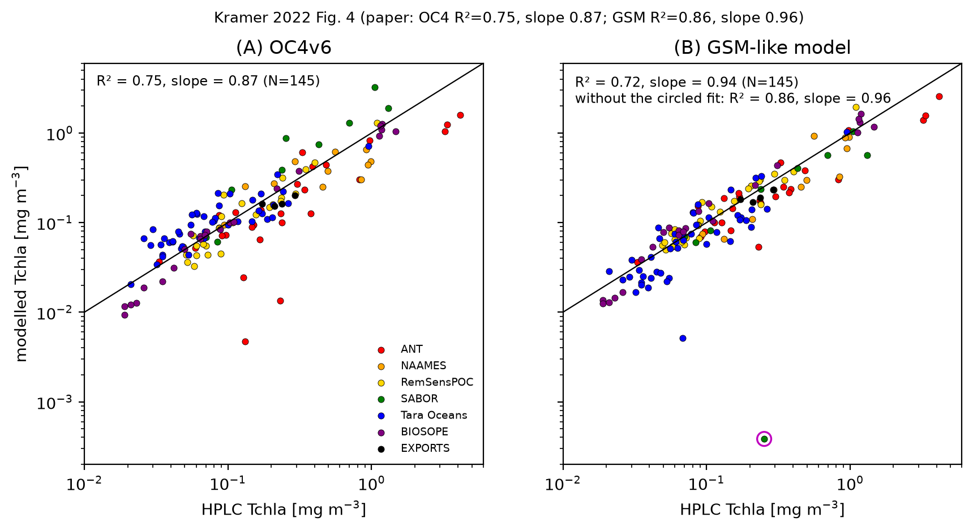
Reproduction 1: the GSM residual
• OC4: y = 0.873x − 0.138, R² 0.746 (paper 0.87, 0.75)
• GSM: slope 0.961, R² 0.864, as the paper, once one degenerate SABOR fit is dropped
• Python port δRrs agrees below the deposit's rounding
• Paper typos fixed from the code (S_dg sign, η ratio)
this work, §4.1

Slide 10
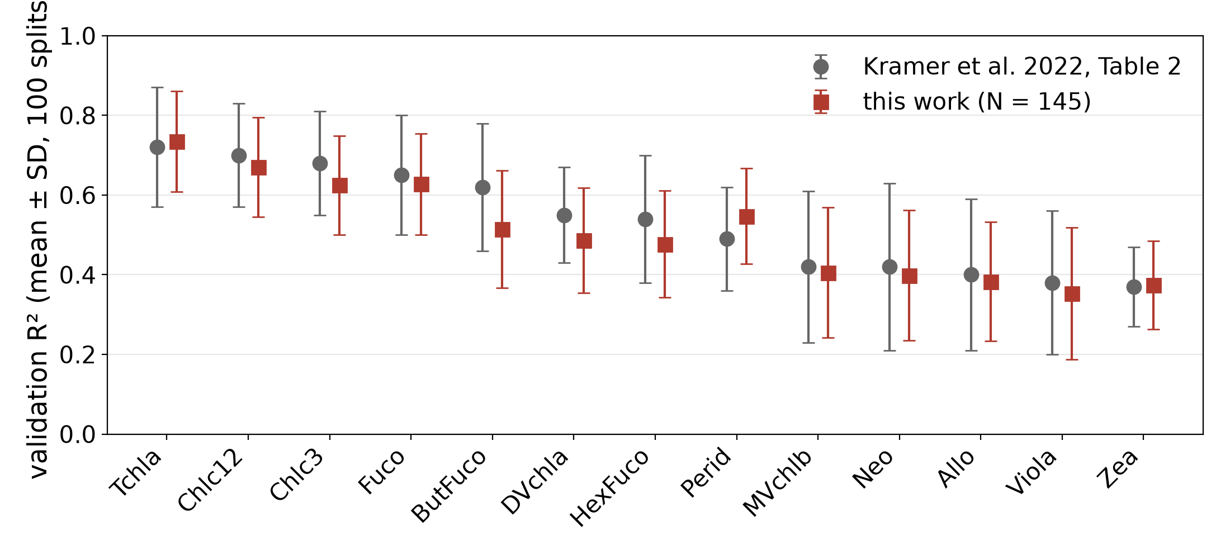
Reproduction 2: Table 2
• All 13 R² within one quoted SD of the paper
• Kramer's own trained coefficients reproduce on our δRrs″
• Open: our Fig. 6 slopes are 0.02–0.23 lower (same R²)
this work, §4.2 (pcr_summary.json)

Slide 11
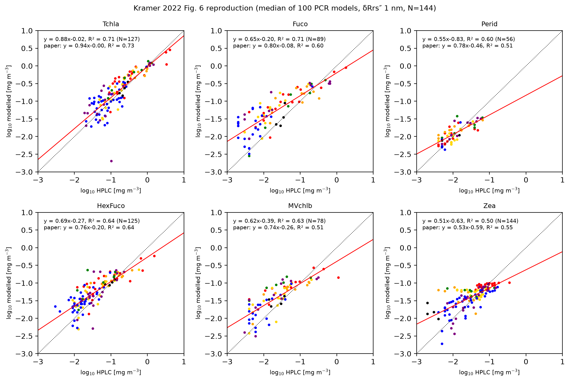
Reproduction 3: Fig. 6 and the pigment groups
• Measured ratios give the paper's 5 groups exactly; modelled ones only loosely, and depend on how zeros are handled
this work, §4.2

Slide 12
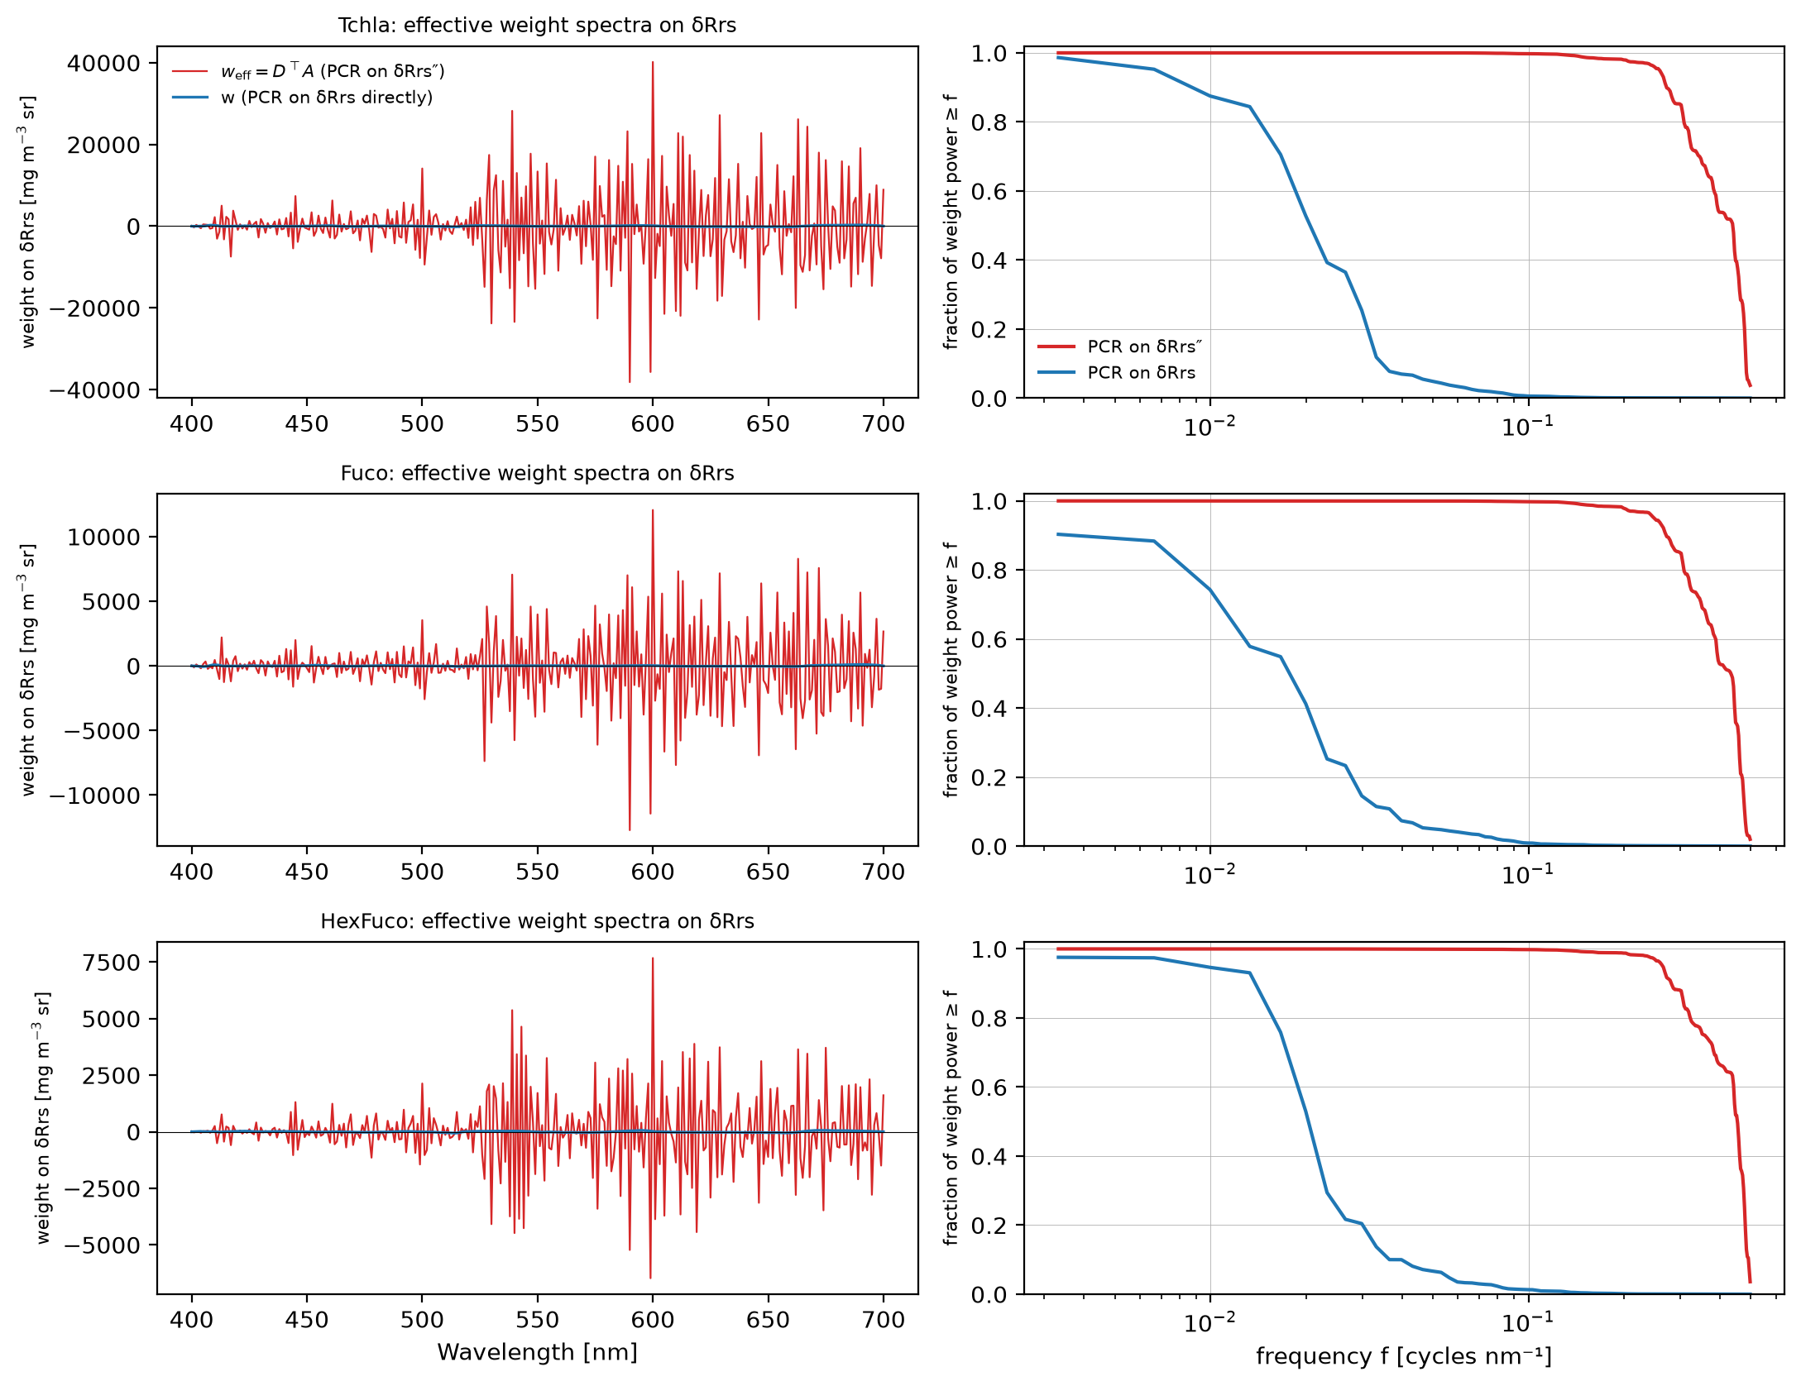
The derivative is a fixed linear operator
• p̂ = Aᵀ(Dx) = (DᵀA)ᵀx: a PCR on δRrs″ is a linear model on δRrs
• It cannot add information; it only changes the prior
• 99.7% of the effective weight power is at periods < 10 nm
• Absorption features are 10–40 nm wide
this work, §5.1

Slide 13
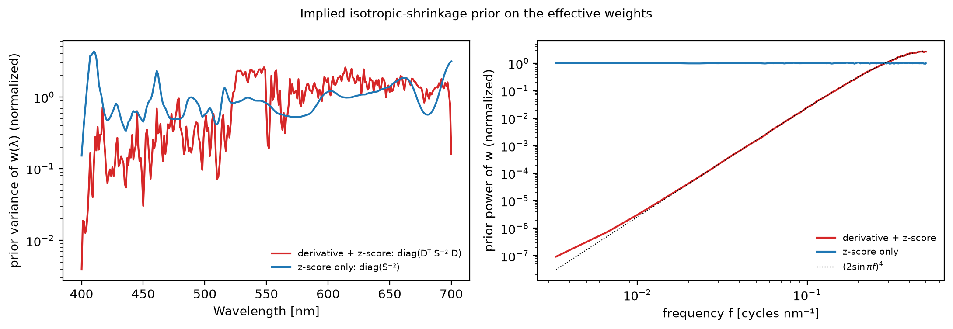
… and it implies an anti-smooth prior
• Derivative + z-score + shrinkage ⇒ Cov(w) ∝ DᵀS⁻²D: ≈5300× more prior power at high than at low frequency
• Largest weights forced into the red, where the signal is weakest
this work, §5.1

Slide 14
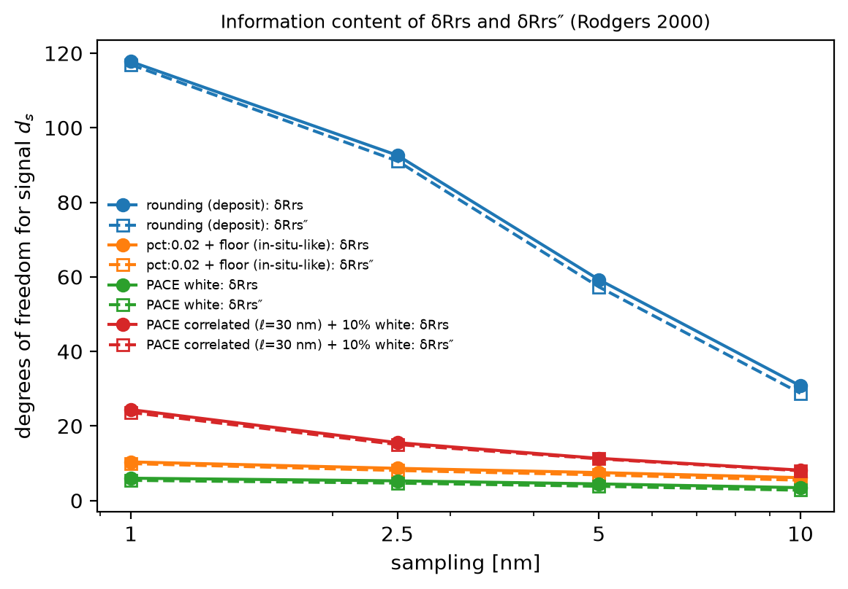
Noise: information content and amplification
• Degrees of freedom for signal: ~10 (2% in situ), ~6 (PACE white), not 300
• 1 → 5 nm costs ≈ 25%; noise matters more than resolution
• PACE white noise: SDP Tchla noise = 11.6× natural SD of Tchla (0.83× for weights fit on δRrs)
this work, §5.2

Slide 15
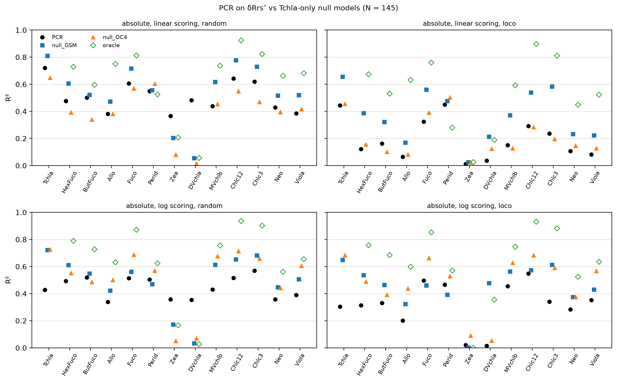
Skill beyond chlorophyll?
• A power law in GSM Tchla beats SDP for 11 of 13 pigments
• Only DVchla and Zea (cyanobacteria) beat it, in random splits
• Ratios implied by SDP's products: R² 0.02–0.09
this work, §6.1

Slide 16
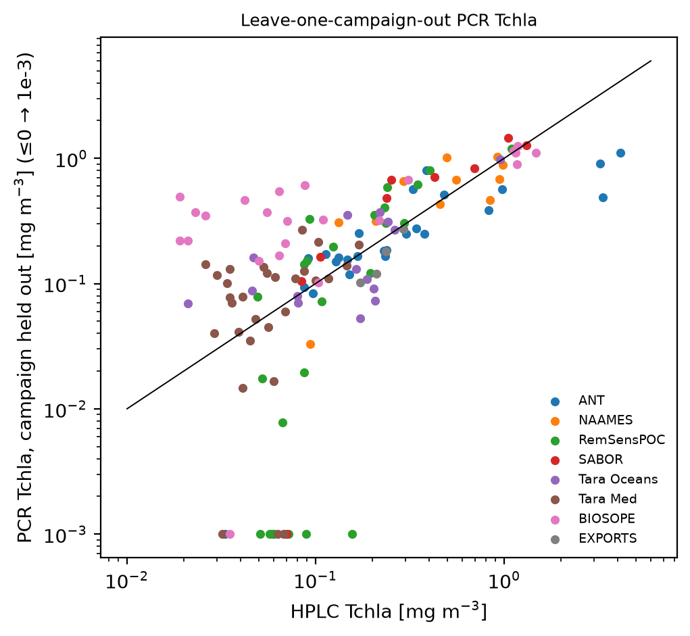
Leakage: hold out a whole campaign
• SDP Tchla R² 0.72 → 0.44 under LOCO; null 0.66
• Roughly half of SDP's skill is within-cruise similarity
• No ratio beats the null significantly out of campaign
this work, §6.2

Slide 17
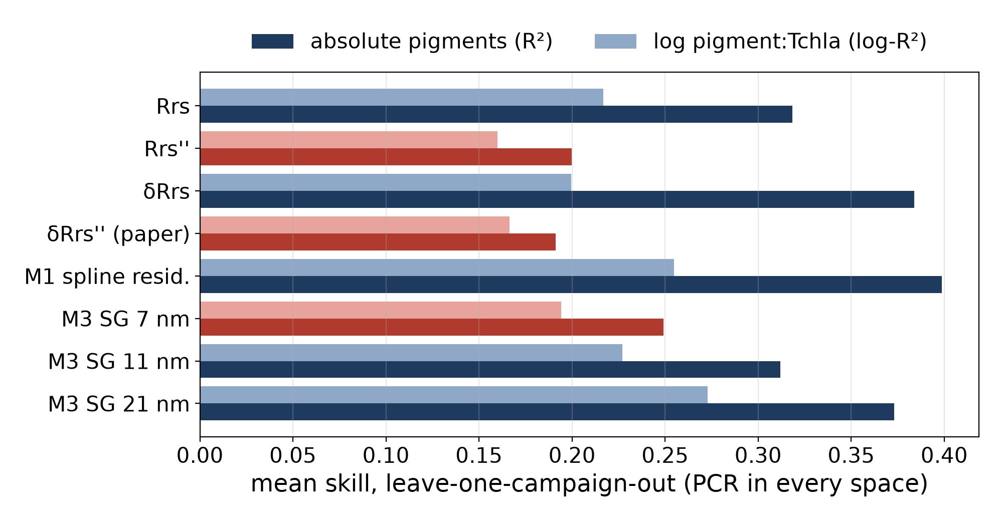
What the residual buys — and what the derivative costs
• Red bars: finite-difference spaces — worst out of campaign
• Same information without differentiating: ~2× better
• Empirical spline residual (M1) ≈ GSM residual: the NOMAD baseline is not what helps
• Wider Savitzky–Golay windows transfer better
this work, §6.3 (source_spaces_summary.csv)

Slide 18
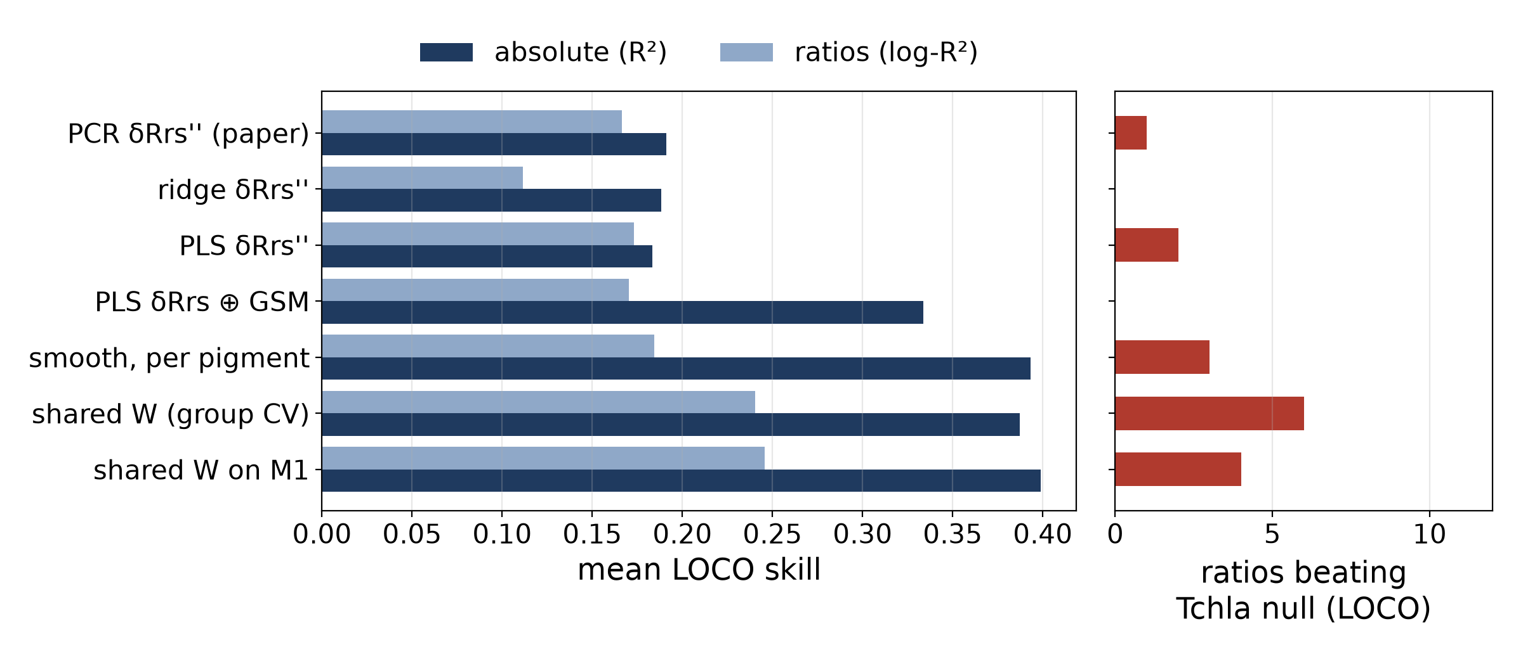
Alternative: a shared, smooth, noise-aware weighting
• One low-rank W for all pigments on δRrs ⊕ GSM parameters
• Penalty: noise variance + smoothness; rank by leave-campaign-out
• Changing only the estimator (ridge, PLS) does nothing
• Sharing across pigments lifts the ratios: 6 beat the null out of campaign (PCR: 1)
this work, §7 (weighting_summary.csv)

Slide 19
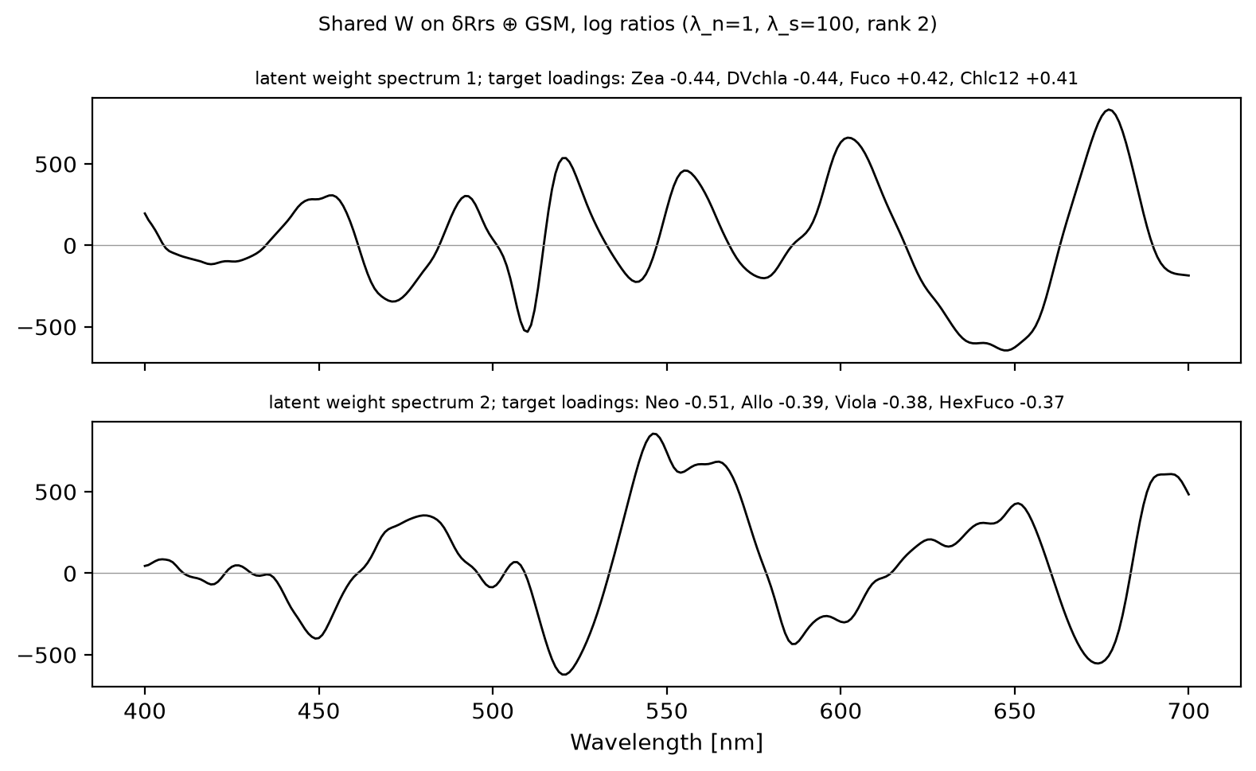
Only two compositional axes transfer
• Latent 1 ≈ diatom ↔ cyanobacteria = Kramer & Siegel EOF mode 1
• Latent 2: green algae / haptophytes. Weight sits at 10–40 nm scales
this work, §7.3 (left); Kramer & Siegel 2019 Fig. 4 (right)

Slide 20
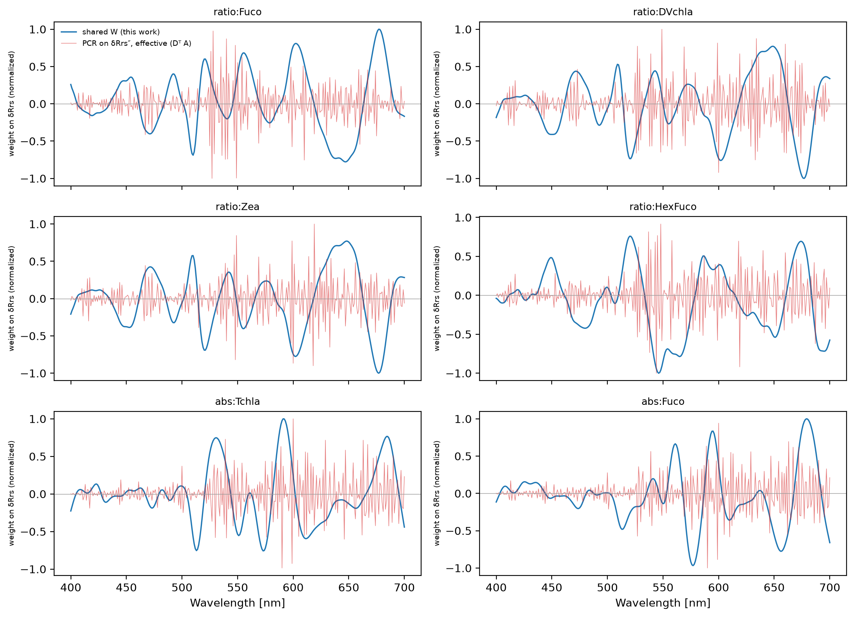
Which wavelengths carry the weight
• Shared W: no power at periods < 10 nm (PCR: 99.7%)
• ≈ 46% of the weight at 600–700 nm for Fuco, Zea, DVchla, Chlc12
• Lobes at the Chl red peak / 683 nm fluorescence and Chl c, phycobilin bands (suggestive)
this work, §7.4

Slide 21
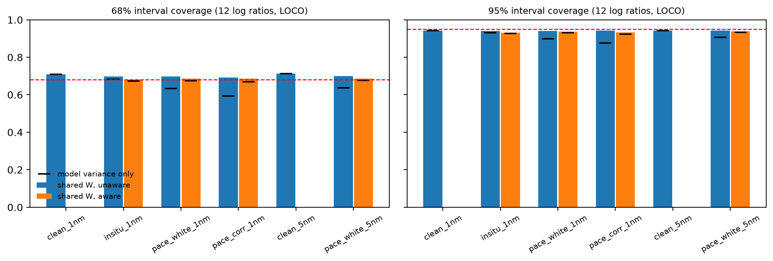
Calibrated intervals out of campaign
• Bayesian shared W, cross-fitted, Monte Carlo noise through the GSM: 68/95% coverage 0.71/0.94, flat PIT (report §8.2)
• Without input-noise propagation, coverage drops under PACE noise
this work, §8.2

Slide 22
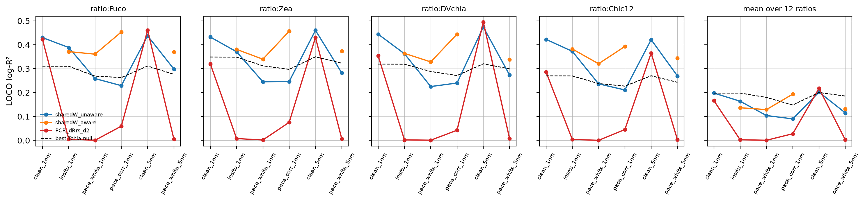
Degradation: in situ → PACE noise, 1 → 5 nm
• SDP's PCR: R² ≈ 0 under any realistic noise
• Noise-aware shared W, PACE white: Fuco:Tchla R² 0.36 (null 0.27), ±0.33 dex; 5 nm sampling costs nothing
this work, §8.3

Slide 23
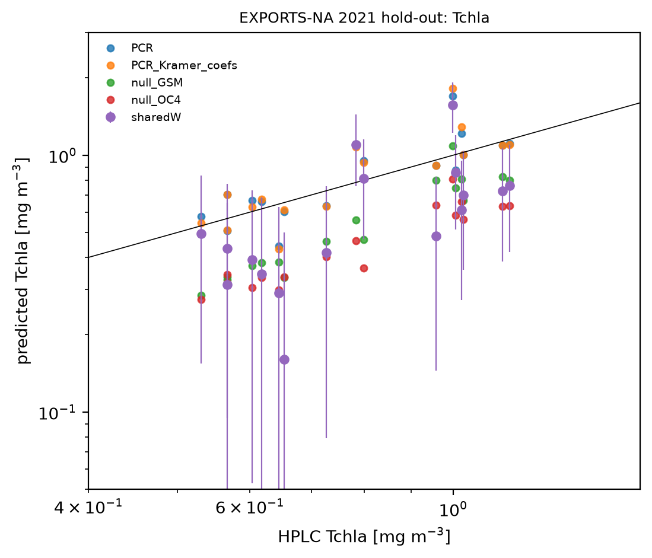
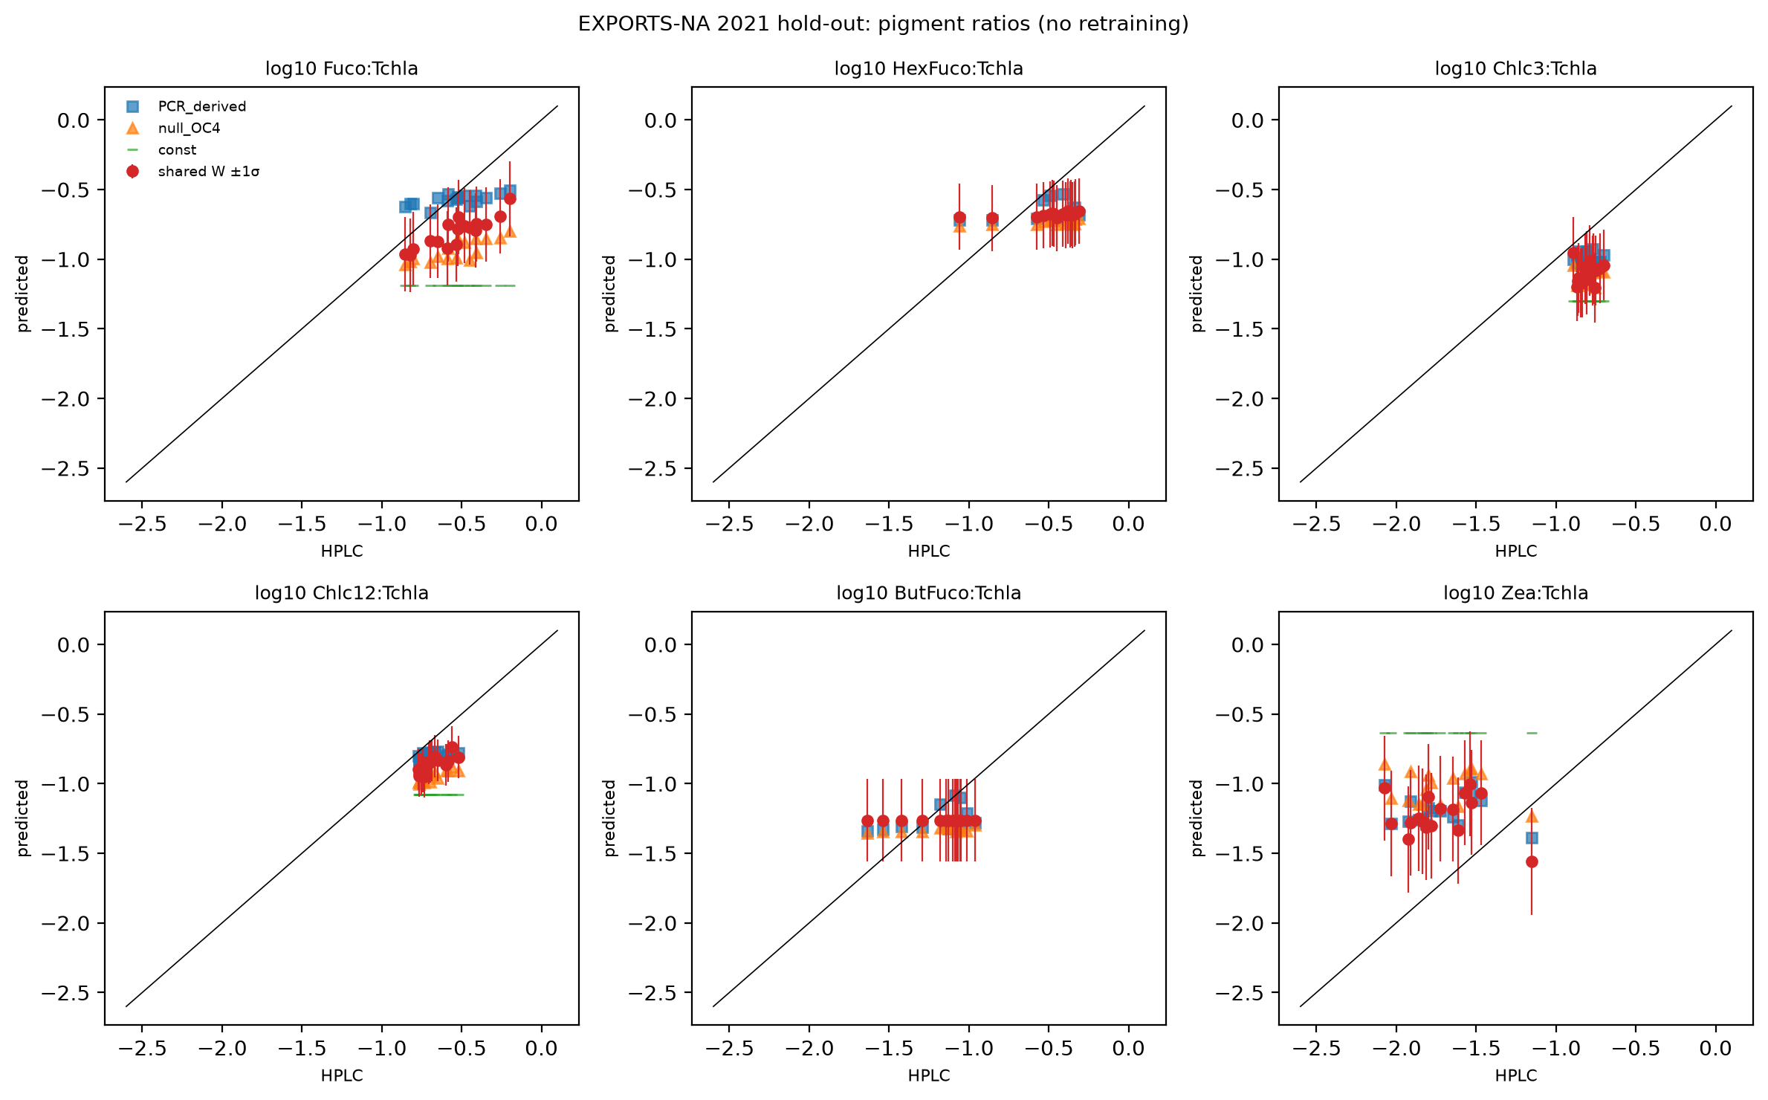
Independent campaign: EXPORTS-NA 2021 (17 samples)
• SDP gets the bloom's diatom pigment levels right (nulls biased low by 0.6 dex), but over-predicts trace pigments by 0.5–1.1 dex
• One campaign = one draw from the LOCO spread; 68% intervals miss the campaign bias
this work, §9

Slide 24
What we found
• SDP reproduces from public data and code
• The 2nd derivative is a prior, not information: anti-smooth, noise amplifying (≥10×)
• Most of SDP's skill is chlorophyll and within-campaign similarity
• Hyperspectral Rrs does carry composition: ~two smooth (10–40 nm) axes transfer between campaigns
• A shared, smooth, noise-aware W with calibrated intervals beats the null for Fuco, Zea, DVchla, Chlc12 ratios
• At PACE noise: SDP has no skill; the aware W keeps a modest edge

Slide 25
Recommendations
• Always report skill against a Tchla-only null and a held-out campaign
• Target log pigment:Tchla ratios; shared low-rank W on δRrs (or M1)
• Add a between-campaign variance term to the intervals
• Data: raw (unsmoothed) spectra + uncertainties; more campaigns (El Hourany 237 stations, PACE-era matchups)
• Fix the a_w smoothing mismatch in the forward model
• Concentrations: censored log-normal likelihood (Tom Jordan)

Slide 26
What PACE OCI application would require
• An OCI noise model split into white and smooth parts (Rrs_unc gives only the diagonal)
• Training spectra convolved to OCI bands, not pre-smoothed; same for a_w, A, B
• Handle fluorescence (683 nm), Raman and gas bands that δRrs keeps
• Validate on PACE-era matchups against both baselines, and against NASA's SDP product
• Per-pixel intervals + campaign term; stated averaging footprint
• SDP coefficients at OCI white noise: ≥ 135 pixels averaged just to reach one natural SD

Slide 27
Provenance and references
• Code: epft_up/sdp/; scripts: scripts/sdp/ (run order in report §10.4)
• Checks: scripts/sdp/report_provenance.py — 34/34 headline numbers verified
• This deck: scripts/sdp/make_slides.py
• Kramer, Siegel, Maritorena & Catlett 2022, RSE 270, 112879
• Kramer et al. 2024, Opt. Express 32, 34482
• Kramer & Siegel 2019, JGR Oceans; Catlett & Siegel 2018, JGR Oceans
• El Hourany & Kramer 2026 (preprint); Lange et al. 2020, Opt. Express

