Slide 1
Spectral wiggles in WATERHYPERNET
Phase 0a report: what one VEIT sequence tells us about the E and L spectral response functions
HYPSTAR 122304 · VEIT · 2026-06-04 08:45 (SEQ20260604T084543)
J. Xavier Prochaska · UC Santa Cruz · 29 September 2026
Notes:
Phase 0a covers the single VEIT sequence Kevin sent. Everything here is one sequence from one instrument: a lead, not a result. Phase 0b repeats it on the ~150 requested sequences.

Slide 2
Two explanations for the wiggles in ρw
H1
Interpolation (Kevin)
H2
SRF mismatch (ours)
E and L sit on different grids
Linear interpolation of Ed onto the L grid mis-represents the Fraunhofer lines
E and L take different optical paths
Different line widths leave the lines in L/E, whatever the interpolation
Both are tested on one code path: a generalised Ruddick et al. (2023) eq. 14
Notes:
Kevin's eq. 14 uses the E SRF on both sides, so it fixes grid offsets but not a width mismatch. Putting the L-SRF-convolved model in the numerator handles both; equal SRFs recover eq. 14, and a flat model recovers linear interpolation.

Slide 3
What Phase 0a built
1
Read
L1A/L1C/L2A readers, checked against the processor (whn_l1a)
2
Fit lines
Gaussian fits of 13 solar lines in E, Ld, Lu; FWHM(λ) models (srf)
3
Template SRF
TSIS-1 HSRS × Gaussian SRF in 10 nm windows (refspec, srf)
4
Budget
Residual line structure vs the H1 and H2 predictions
Phase 0b pipeline (tasks 9–13) written and tested on VEIT; waiting on the L1A delivery
Notes:
All code is in the hypernet package: srf.py, whn_l1a.py, whn_srf.py, refspec.py, and the Phase 0 scripts in hypernet/wiggles/. 55 tests pass.

Slide 4
Four things the VEIT files taught us
vza < 90
interpolated
is the water view (Lu): vza is measured from nadir
L1C Ld: the two sky series, interpolated to the water-view time
0
5 % vs 0.4 %
every L1C u_rel_random value: a placeholder, not an uncertainty
broadband scan-to-scan change vs per-pixel noise
Notes:
The first-look scripts had Ld and Lu swapped; the plan table headers are corrected. Because the scan scatter is broadband, raw std/sqrt(N) overstates the per-pixel error 7-14x; we use scatter after removing a smooth scale per scan.

Slide 5
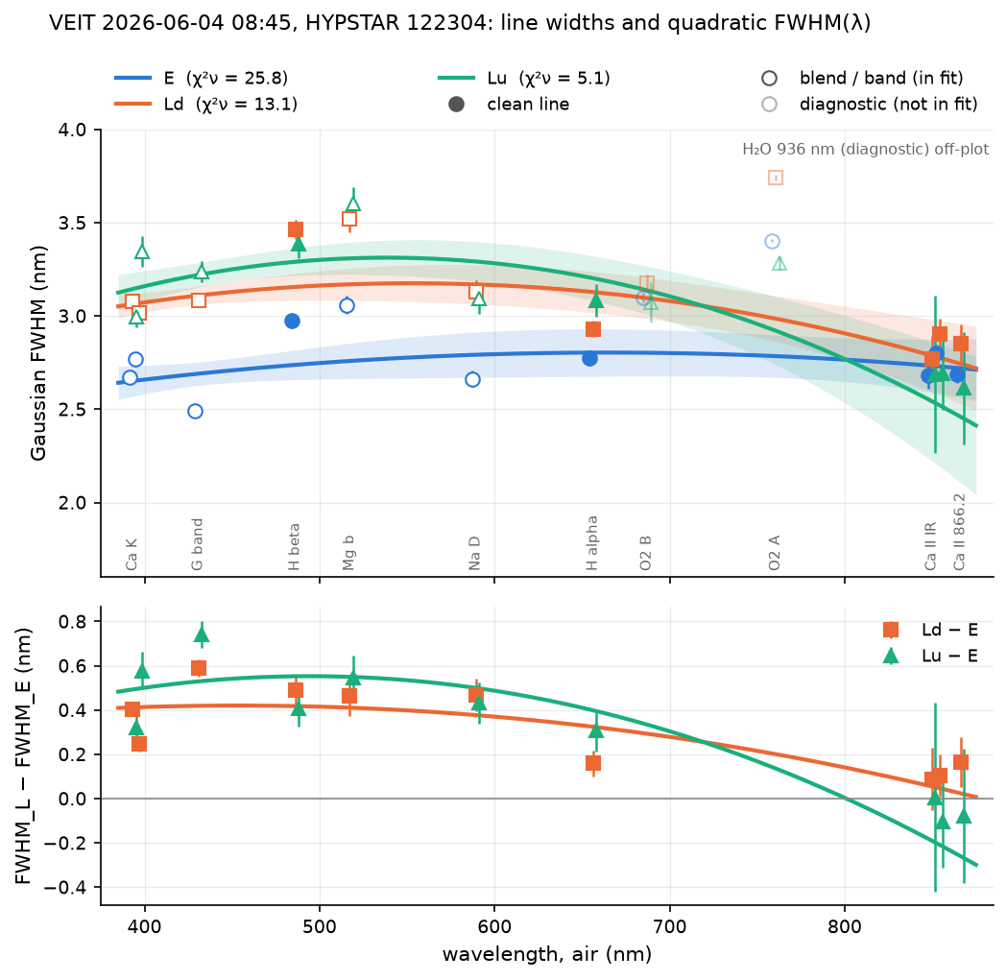
L lines are wider than E lines (task 5)
Ld − E: +0.4 to +0.6 nm from 430 to 590 nm, each line at 5–15σ
The gap closes to the red: ~0.1 nm at Ca II 854–866
Ld and Lu agree: one L SRF
Notes:
Gaussian fits of each solar line in the mean E, Ld and Lu spectra, weighted by the flattened scan scatter. Filled symbols are clean lines, open ones blends. The quadratic fits have chi2_nu 5-26 because each line has its own intrinsic width.

Slide 6
Gaussian line widths, FWHM in nm (task 5)
Line | E | Ld | Lu | Ld − E | Signif.
Ca K 393 | 2.67 | 3.08 | 2.99 | +0.41 ± 0.03 | 12σ
G band 431 | 2.49 | 3.08 | 3.24 | +0.59 ± 0.04 | 15σ
Hβ 486 | 2.98 | 3.46 | 3.38 | +0.49 ± 0.06 | 8σ
Mg b 517 | 3.06 | 3.52 | 3.60 | +0.46 ± 0.09 | 5σ
Na D 589 | 2.66 | 3.13 | 3.09 | +0.47 ± 0.08 | 6σ
Hα 656 | 2.77 | 2.93 | 3.08 | +0.16 ± 0.06 | 3σ
Ca II 854 | 2.80 | 2.90 | 2.69 | +0.11 ± 0.10 | 1σ
Ca II 866 | 2.69 | 2.85 | 2.61 | +0.16 ± 0.11 | 1σ
These widths include each line's own profile; the template fit removes it
Notes:
Mean spectra of 6 scans per channel. Errors from curve_fit with absolute sigma = flattened scan-to-scan error of the mean. Ld is the sky view, Lu the water view.

Slide 7
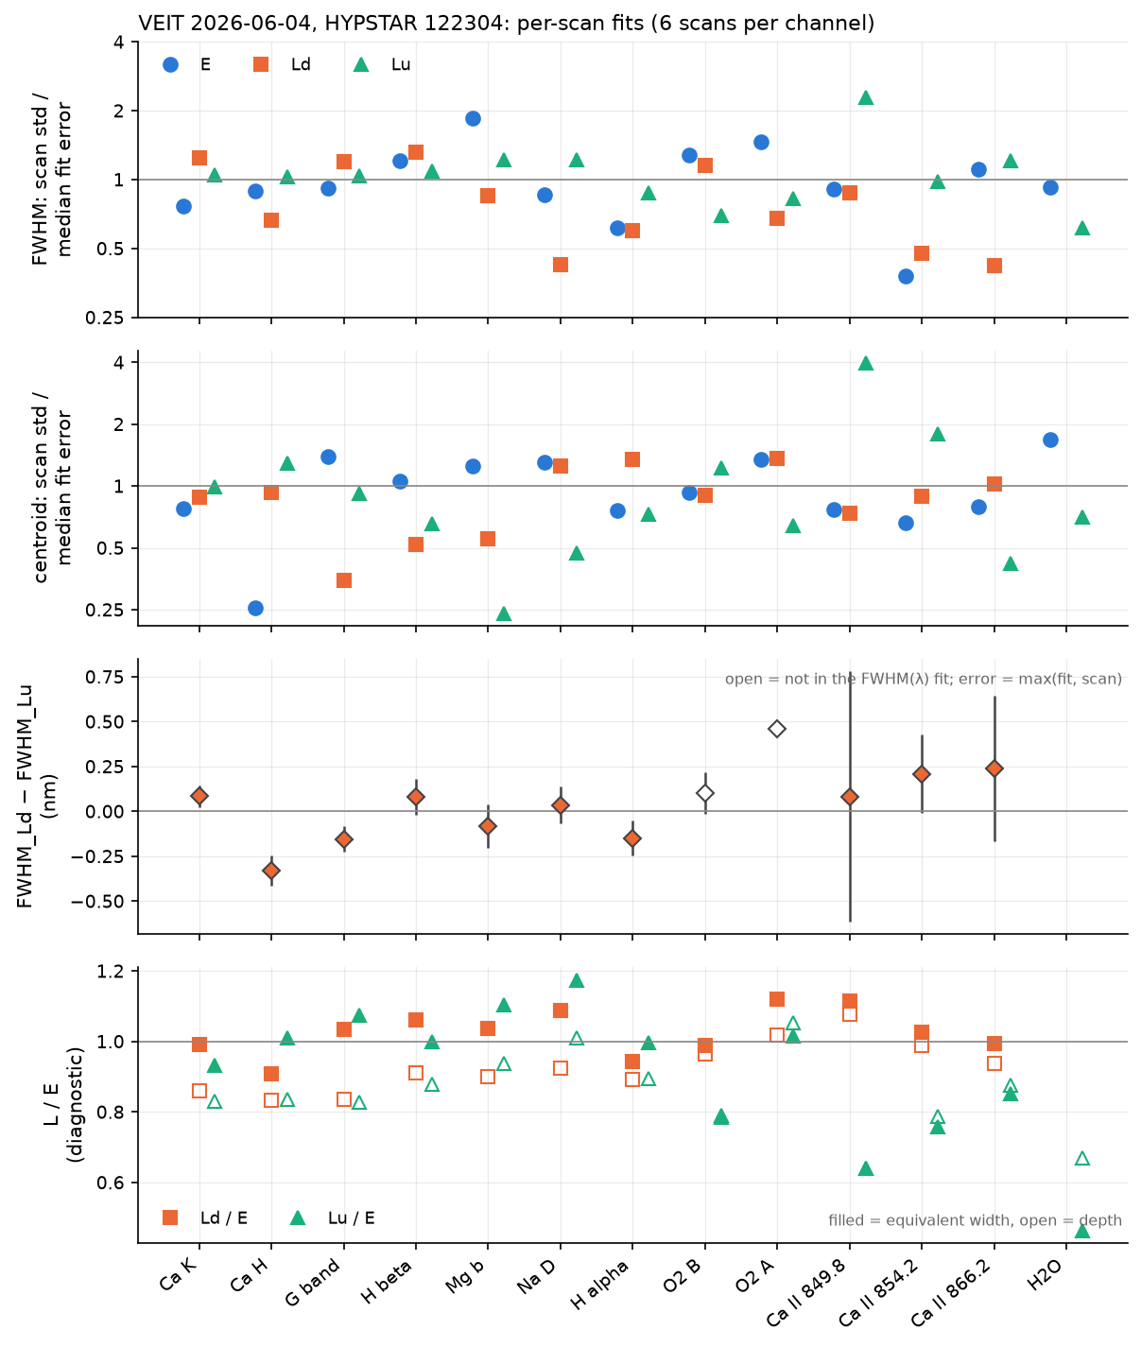
Per-scan fits check the errors (task 6)
Scan spread ≈ fit error: the error model is right
Widths steady between the two sky series, 50 s apart
Ld = Lu to about 0.1 nm at the clean lines
L lines 10–17 % shallower, but same equivalent width: resolution, not Ring
Notes:
Every line fitted in each of the 6 scans per channel. Panels: FWHM and centroid scan std over median fit error; Ld minus Lu FWHM; L/E depth (open) and equivalent width (filled). Lu is 0.16-0.33 nm wider at Ca H and the G band, plausibly water-leaving content; Ld is the reference L channel.

Slide 8
Scan scatter, Ld vs Lu, and the Ring check (task 6)
Line | Ld scan std / fit err | Ld − Lu (nm) | Depth Ld/E | EW Ld/E
Ca K 393 | 1.2 | +0.08 ± 0.06 | 0.86 | 0.99
G band 431 | 1.2 | -0.15 ± 0.07 | 0.84 | 1.03
Hβ 486 | 1.3 | +0.08 ± 0.10 | 0.91 | 1.06
Mg b 517 | 0.8 | -0.08 ± 0.12 | 0.90 | 1.04
Na D 589 | 0.4 | +0.04 ± 0.10 | 0.92 | 1.09
Hα 656 | 0.6 | -0.15 ± 0.10 | 0.89 | 0.94
Ca II 854 | 0.5 | +0.21 ± 0.22 | 0.99 | 1.03
Ca II 866 | 0.4 | +0.24 ± 0.41 | 0.94 | 0.99
EW Ld/E ≈ 1: a wider SRF lowers depth but keeps equivalent width
Notes:
Ring filling-in would lower both depth and equivalent width. EW ratios of 0.94-1.09 leave room for at most a few per cent of filling. In Lu the red EW ratios fall to 0.64-0.85, suggesting an additive line-free component there (stray light or dark).

Slide 9
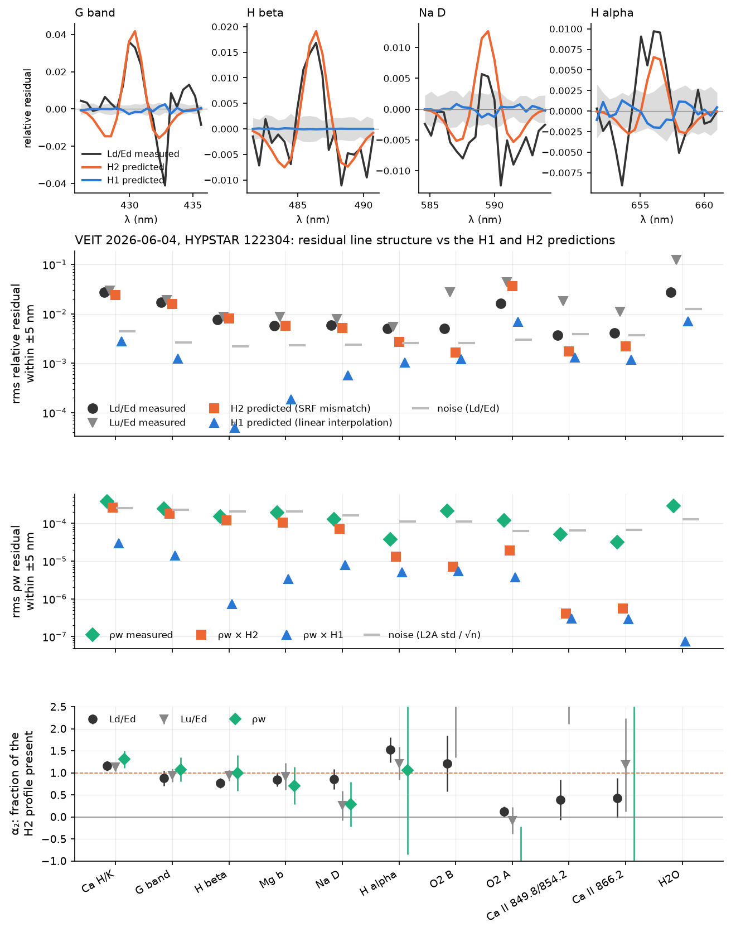
H2 accounts for the line structure (task 7)
Measured Ld/Ed residual matches the H2 prediction in size and shape
H1 is ~9× smaller and has the opposite sign
ρw follows H2 from Ca H/K to Na D
Notes:
Top: residual profiles in Ld/Ed with the H1 (linear minus cubic interpolation) and H2 (E line re-observed at the L width, equivalent width conserved) predictions. Then rms per line for the ratios and for rho_w, and alpha2, the fraction of the H2 profile present.

Slide 10
Fraction of the H2 profile present, α₂
0.93
1.01
1.08
± 0.06 Ld / Ed
± 0.07 Lu / Ed
± 0.13 ρw
1 = the SRF width mismatch alone explains the feature
Caveat: partly circular, since H2 is built from fits to the same spectra
Notes:
Weighted means over the SRF lines. What it establishes: the residual is what the width difference gives with equivalent width conserved (no Ring needed), the rho_w wiggle has the H2 shape, and interpolation has the wrong sign. The independent tests are the Phase 1 twin experiment and the Phase 3 correction.

Slide 11
rms residual within ±5 nm of each line (task 7)
Line | Measured Ld/Ed | H2 predicted | H1 predicted | α₂ Ld/Ed | α₂ ρw
Ca H/K 395 | 2.7e-02 | 2.4e-02 | 2.7e-03 | 1.16 ± 0.11 | 1.31 ± 0.20
G band 431 | 1.7e-02 | 1.6e-02 | 1.3e-03 | 0.88 ± 0.17 | 1.08 ± 0.28
Hβ 486 | 7.7e-03 | 8.0e-03 | 4.9e-05 | 0.77 ± 0.12 | 0.99 ± 0.40
Mg b 517 | 5.8e-03 | 5.7e-03 | 1.8e-04 | 0.84 ± 0.15 | 0.71 ± 0.42
Na D 589 | 5.8e-03 | 5.1e-03 | 5.6e-04 | 0.86 ± 0.23 | 0.29 ± 0.50
Hα 656 | 5.0e-03 | 2.7e-03 | 1.0e-03 | 1.52 ± 0.28 | 1.06 ± 1.91
H2 matches the measured residual; H1 falls 10–100× short
Notes:
Relative residual after a linear continuum through the pixels 5-7 nm from the line. Measured quantities are exactly those the processor divides: Ld interpolated in time over Ed linearly interpolated onto the L grid.

Slide 12
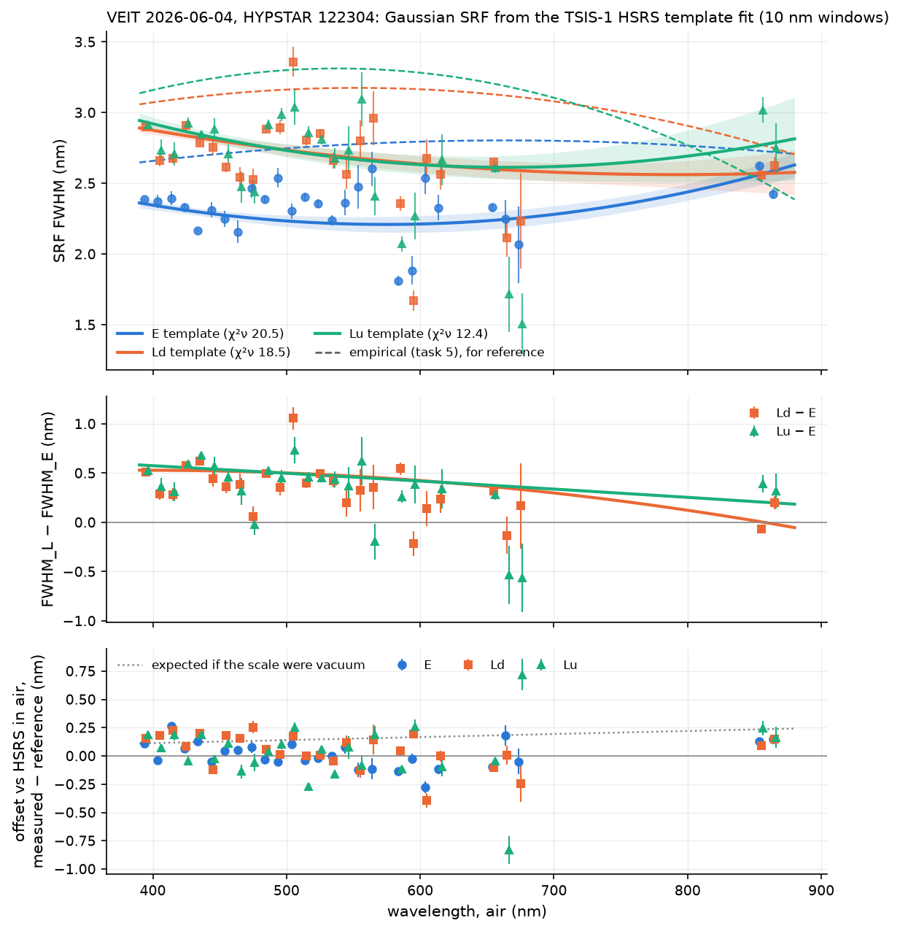
The SRF itself, from TSIS-1 HSRS (task 3b)
λ (nm) | E | Ld | Ld − E
400 | 2.35 | 2.88 | +0.53 ± 0.04
500 | 2.23 | 2.74 | +0.50 ± 0.06
600 | 2.21 | 2.64 | +0.42 ± 0.08
700 | 2.28 | 2.58 | +0.30 ± 0.09
850 | 2.55 | 2.57 | +0.02 ± 0.15
E ≈ 2.3 nm; Ld 0.5 nm wider in the blue
Ld − E offset +0.045 ± 0.011 nm
Notes:
HSRS v2 in air convolved with a Gaussian SRF, fitted in 27 windows of 10 nm over 390-880 nm with telluric bands excluded. Constrained over 390-680 and 850-870 nm only. The empirical widths were 0.3-0.5 nm too large. These models are shipped as hypernet/data/veit_srf_model.json for Phase 1.

Slide 13
Gate G0 on this one sequence
a
E = L?
b
SRF stable?
c
Offset?
No: H2 stays
Needs the data
Relative: no
Ld − E = 0.5 nm at 400–550 nm
Stable within one sequence; Phase 0b tests SZA, sky, season, recalibration
L − E = +0.045 nm; the absolute scale waits on air vs vacuum
Criteria: (a) FWHM_E = FWHM_L; (b) spread < 0.2 nm; (c) offset > 0.1 nm
Notes:
G0(a): if FWHM_E = FWHM_L on most instruments, drop H2. G0(b): spread below 0.2 nm across SZA, sky, season and no unexplained jump at recalibration means a per-instrument SRF table. G0(c): offsets above 0.1 nm mean a wavelength recalibration first. On the air scale all three channels are within 0.1 nm.

Slide 14
Next
Run Phase 0b on the ~150 requested sequences when they arrive
Phase 1 twin experiment with the template SRFs
From Kevin: cal files, lab line-spread data, air or vacuum?
Look into a possible additive signal in the red of Lu
Notes:
The data request has been sent. The delivery runs through phase0b_index, phase0b_fit_all, phase0b_stability, phase0b_budget and phase0b_calfiles, then gate G0.

