Slide 1
Spectral wiggles in WATERHYPERNET
Phase 1: a twin experiment. Which interpolation removes which wiggle, and what does it do to real features?
Synthetic HYPSTAR scenes · 25 sky and water states · 2 instruments · 16 cases · 5 methods
J. Xavier Prochaska · UC Santa Cruz · 5 October 2026
Notes:
Phase 1 tests the interpolation methods on synthetic data where the truth is known, before any correction touches real WATERHYPERNET spectra. It closes with gate G1, which sets the default method for Phase 2.

Slide 2
Why a twin experiment first
H1
Grid offset (Kevin)
H2
SRF mismatch (ours)
E and L sample different wavelengths; linear interpolation of Ed onto the L grid misplaces the Fraunhofer lines
E sees the lines through a narrower SRF than L, so the lines survive in L/E however Ed is interpolated
Real ρw has no truth to compare against, and real features (fluorescence, Raman, gas-band peaks) look like wiggles
A twin has a known truth, so every method can be scored, and its failure modes mapped, before Phase 3 applies it to data
Notes:
Phase 0 measured the SRFs and found H2 on the narrow-E instruments. Phase 1 asks which correction fixes it, how robust that correction is, and how much reduction Phase 3 should expect on real data.

Slide 3
Three ways to put Ed on the L grid
linear
E(λL) = (1 − w) Eᵢ + w Eᵢ₊₁
The processor today (paper eqs. 11–12)
ruddick2023
E(λL) = Emod⊗SRF_E(λL) × [interpolated E / Emod⊗SRF_E]
Paper eq. 14: corrects the grid offset (H1)
srf
E(λL) = Emod⊗SRF_L(λL) × [interpolated E / Emod⊗SRF_E]
This work: L SRF in front, so H1 and H2
Emod: a 0.01 nm model irradiance. With SRF_L = SRF_E, srf is eq. 14; with a flat Emod, it is linear. Cubic and sinc are nulls.
Notes:
The bracket is the measured-over-model ratio, which is smooth if the model is good, so it is interpolated linearly. Eq. 14 multiplies by the model seen through the E SRF, so it restores E-width lines on the L grid; dividing L by that still leaves the width mismatch. The srf form uses the L SRF in front.

Slide 4
How the twin is built
1
Irradiance
TSIS-1 HSRS × HITRAN O₂/H₂O × O₃ on a 0.01 nm grid, direct and diffuse air masses
2
Smooth fields
OSOAA at 5 nm: direct/diffuse Ed, sky Ld, Lw; SZA 30/50/70 (+ a VEIT-like 40°), two aerosol loads, four waters
3
Scene
Ed, Ld, Lw at 0.01 nm, with chlorophyll fluorescence and water Raman as controls
4
Instrument
Gaussian SRFs from the Release 2 fits, the real 1536/1538-pixel grids, VEIT per-scan noise
5
Score
ρw from each method; rms of ρw″ − ρw″_true within ±5 nm of ten lines
Notes:
OSOAA has no gas absorption, so the split into a high-resolution irradiance times smooth radiative-transfer fields is clean. The full twin (25 scenes x 2 instruments x 16 cases x 5 methods) runs in about a minute on 12 cores. ρw″ is the second difference with h = 1 nm, as in Ruddick et al. (2023).

Slide 5
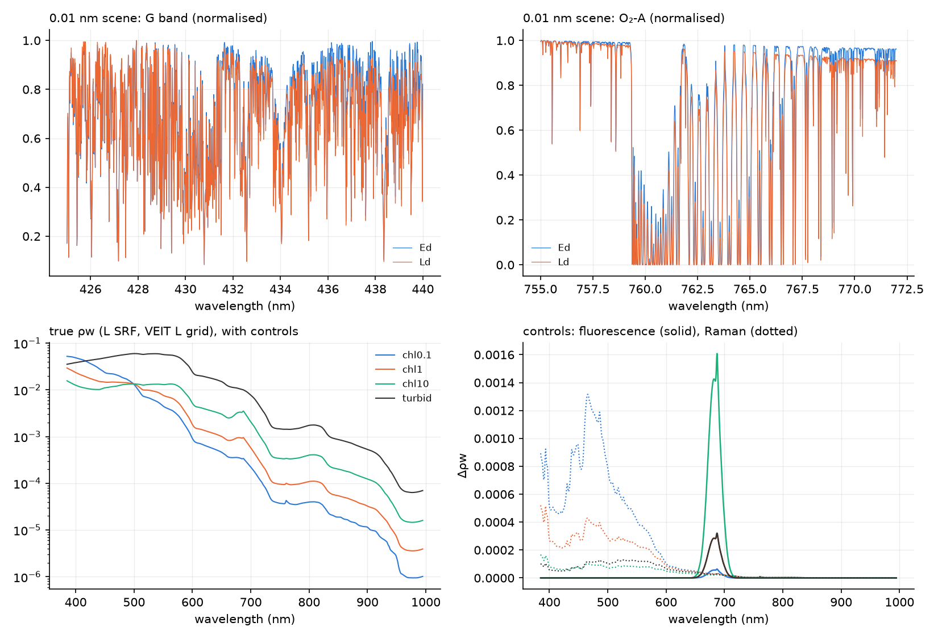
A twin scene, and the features we must not erase
683 nm
fluorescence: a 25 nm peak with no Fraunhofer structure
O₂-A, O₂-B
Raman and fluorescence are emitted below the atmosphere, so ρw peaks in the gas bands
Notes:
Top: the 0.01 nm Ed and Ld at the G band and O2-A. Bottom: true ρw for the four waters and the two controls. A correction that smooths these peaks away would be removing real signal.

Slide 6
Two instruments, sixteen cases
122304 narrow-E: FWHM_L − FWHM_E ≈ 0.5 nm (also 122302, 120242)
122305 E ≈ L within 0.07 nm (also 121222, 121231, 122303)
Case | What changes
(i) | grid offset only, equal SRFs: H1 alone
(ii) / (iii) | SRF mismatch alone / offset + mismatch: H2
(iv) | E wavelength error: shift ±0.1, ±0.3 nm; stretch ±0.1 nm
(v) | correction told FWHM_E or FWHM_L ±0.3 nm
(vi) | wrong Emod: SZA + 10°, water vapour × 2, low aerosol
(vii) | VEIT per-scan noise, mean of 6 scans
Notes:
The SRFs are the clear-sky medians of the Release 2 template fits (Phase 0 task 8c). Each case runs on all 25 scenes. Cases iv to vi ask what happens when the correction is told something wrong; vii asks whether the gain survives noise.

Slide 7
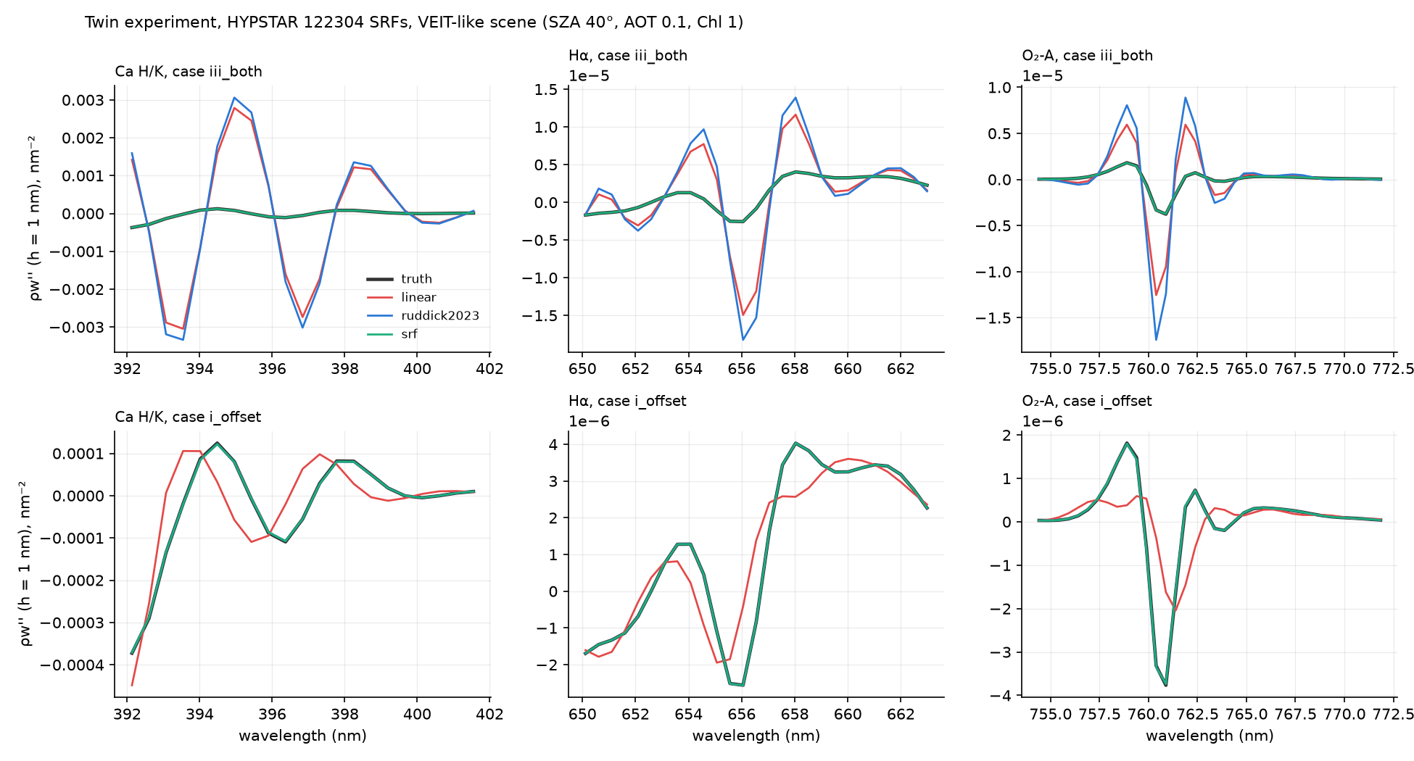
What the methods do at Ca H/K, Hα and O₂-A
6×
linear error vs the true line structure, case (iii), 122304
srf = truth
green lies on black in (iii); ruddick2023 tracks linear
(i) small
offset alone: 5.6×10⁻⁶, 4 % of the mismatch error
Notes:
Top row: case iii (offset plus mismatch). Bottom row: case i (offset only). In case i every model-based method, and even cubic, removes the error; in case iii only srf does.

Slide 8
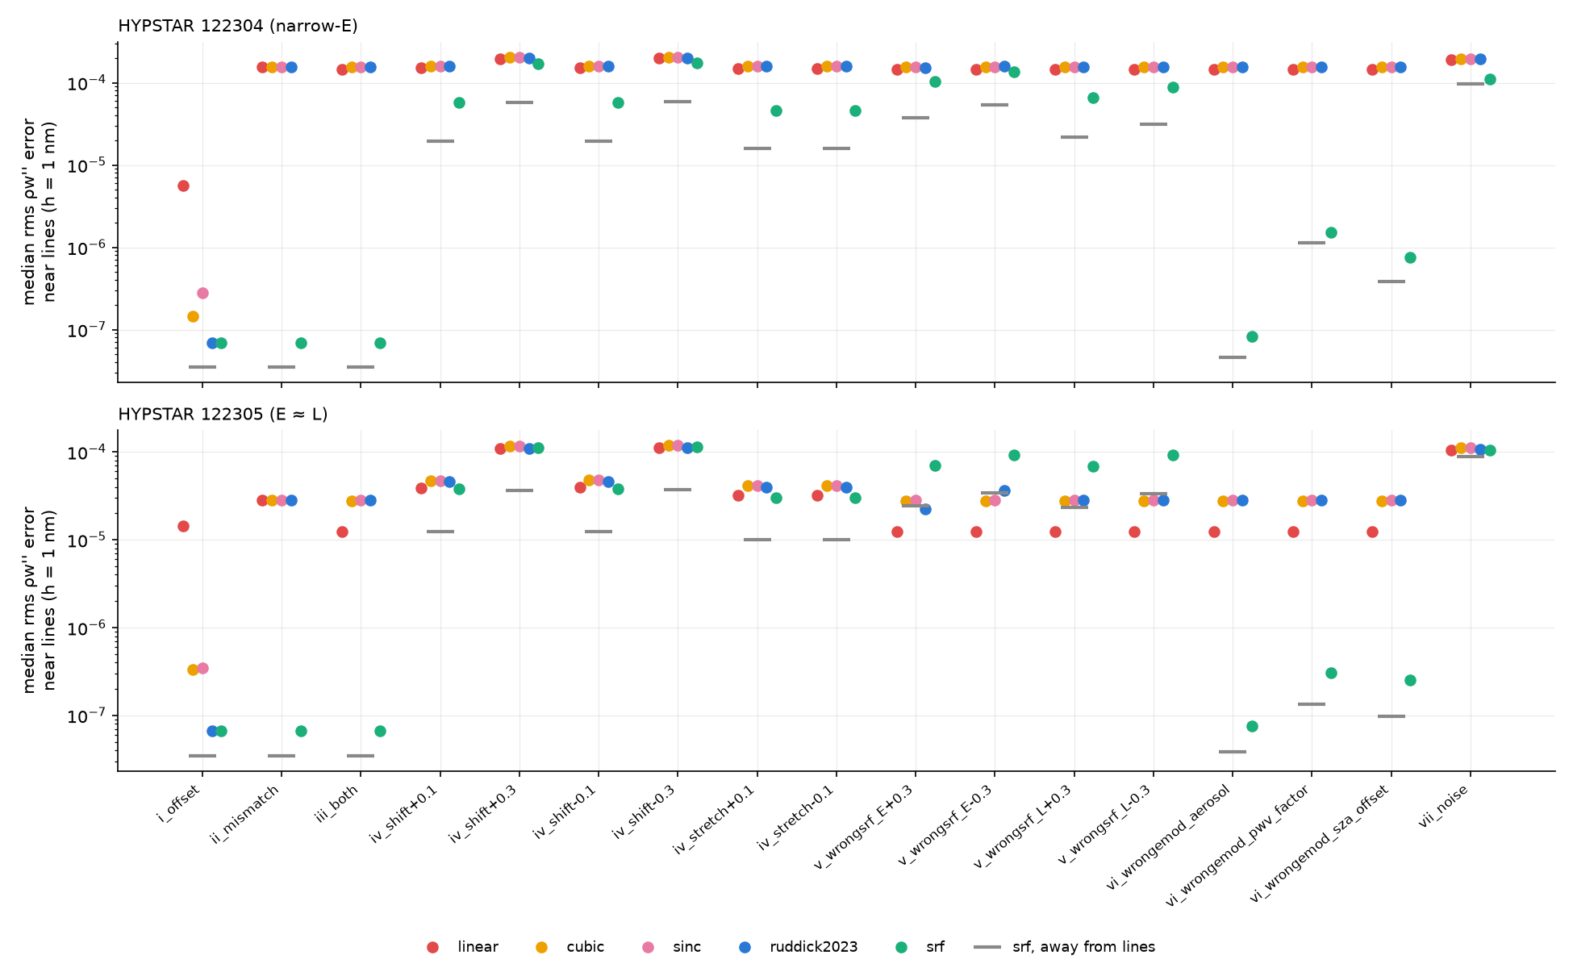
Every case, every method
Median rms ρw″ error near the lines (h = 1 nm). Grey bars: srf away from the lines.
Notes:
Top: 122304, narrow-E. Bottom: 122305, E about L. Green (srf) drops by orders of magnitude in i to iii and vi; the cases that hurt it are iv (wavelength error) and v (wrong SRF width).

Slide 9
Narrow-E (122304): srf fixes it, eq. 14 does not
Case | linear error | ruddick2023 | srf
(i) grid offset only | 5.6×10⁻⁶ | 99 % | 99 %
(ii) SRF mismatch only | 1.5×10⁻⁴ | 0 % | 100 %
(iii) offset + mismatch | 1.4×10⁻⁴ | −6 % | 100 %
(iv) E λ shift 0.1 nm | 1.5×10⁻⁴ | −6 % | 62 %
(iv) E λ shift 0.3 nm | 1.9×10⁻⁴ | −3 % | 13 %
(v) FWHM_E off 0.3 nm | 1.4×10⁻⁴ | −9 % | 6 %
(vi) Emod PWV × 2 | 1.4×10⁻⁴ | −6 % | 99 %
(vii) VEIT noise | 1.9×10⁻⁴ | −4 % | 45 %
Reductions relative to linear; error = median rms ρw″ − ρw″_true near the lines, h = 1 nm. True line structure: 2.6×10⁻⁵.
Notes:
Ruddick2023 cannot fix a width mismatch: it removes 0 % in ii and makes iii slightly worse. srf removes essentially all of it, is robust to a wrong model irradiance, and is sensitive to the E wavelength scale and the SRF widths. With noise the line error falls to the away-from-lines level: line/away 1.70 for linear, 1.14 for srf.

Slide 10
E ≈ L (122305): little to fix, and easy to break
1.2×10⁻⁵
100 %
linear error in (iii): already below the true line structure (2.6×10⁻⁵)
srf reduction when told the right SRFs
6–8×
−128 %
srf error vs linear when an SRF width is 0.3 nm off
ruddick2023 in (iii): linear's smoothing hid part of the mismatch
H1 alone gives 0.08 % rms ρw error near the lines, offset + residual mismatch 0.46 %. The 0.5–2 % floor seen on these instruments needs something else.
Notes:
On E about L instruments the correction gains nothing measurable and can do harm if the SRFs are slightly wrong. This is why Phase 2 applies srf only above a width-difference threshold. The twin also says the grid offset (H1) cannot explain the unexplained floor Phase 0 found on these instruments: candidates are the Ring effect in Ld, SRF shape, or the wavelength scale. The metrics differ, so this is indicative.

Slide 11
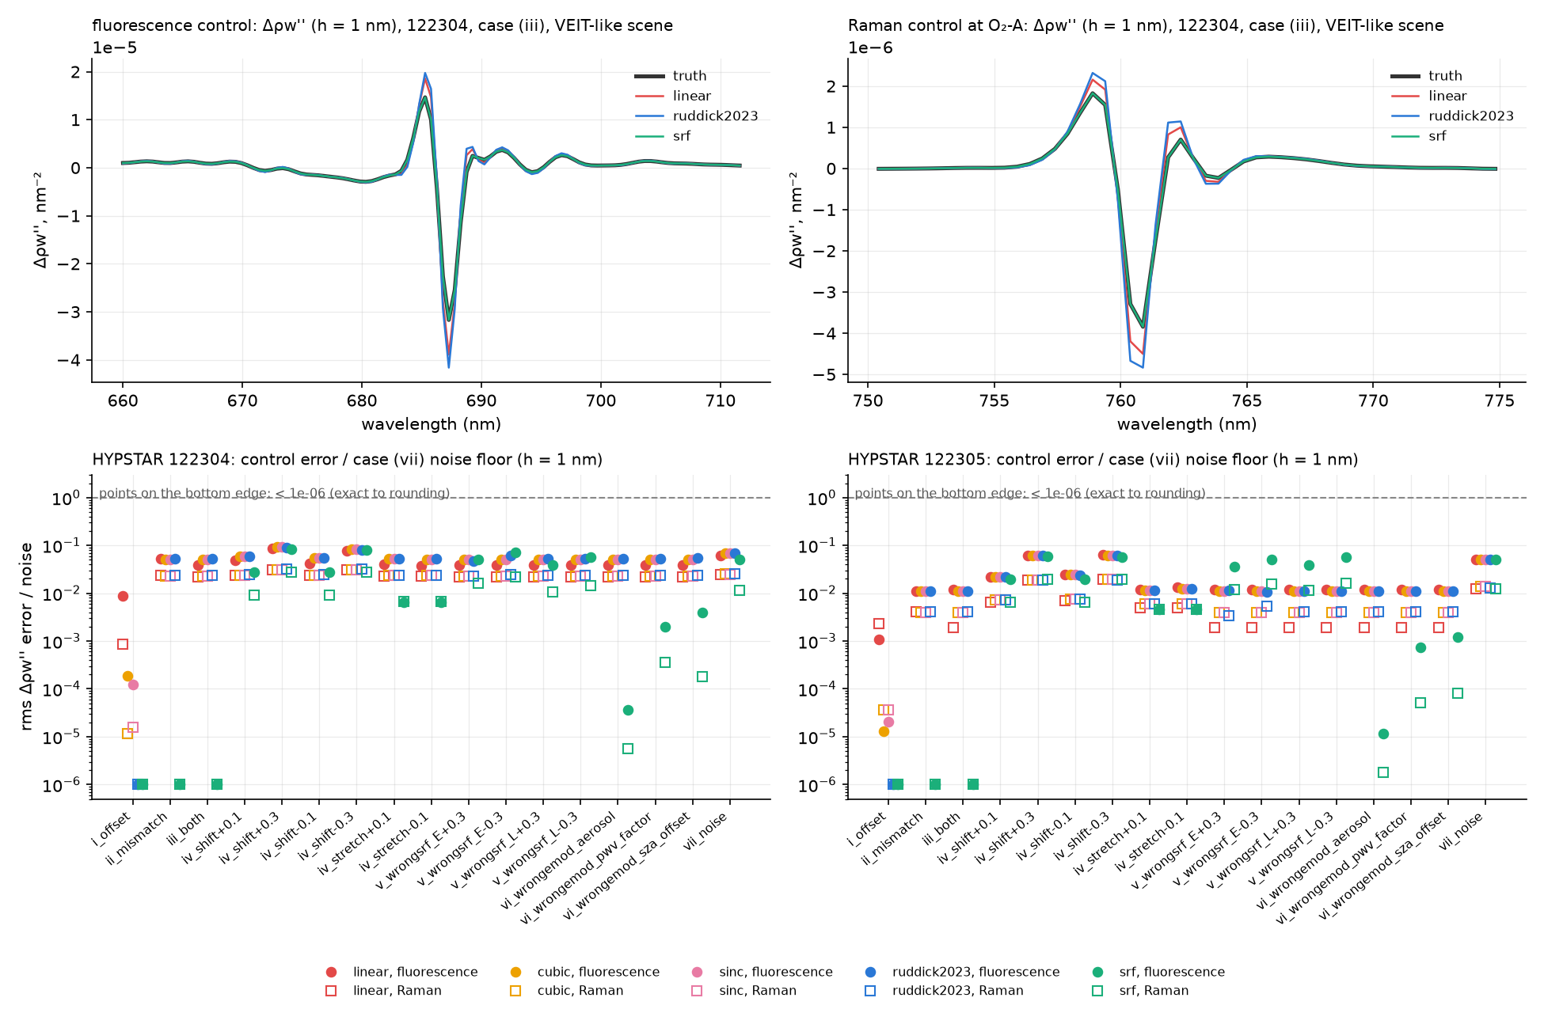
srf restores the controls; the others distort them
122304 (iii) | fluor. | Raman
linear | 22 % | 44 %
ruddick2023 | 31 % | 46 %
srf | 0 % | 0 %
Change in each control's ρw″, as a fraction of the control itself
No method moves a control by more than 0.20 of the noise floor
But the controls are themselves below one sequence's noise (0.17, 0.05)
Notes:
Each scene is composed with both controls, without fluorescence and without Raman; a method sees a control as the difference. Ed is the same, so only the irradiance error at the lines distorts it, and both controls peak in the O2 bands where that error is largest. The G1 control wording was sharpened for this reason.

Slide 12
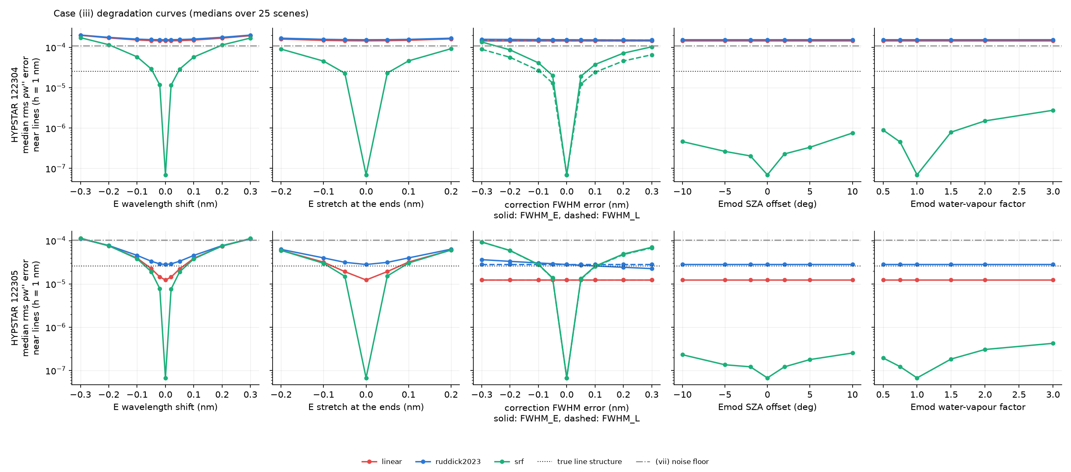
How srf degrades
Case (iii) with one error swept; medians over 25 scenes. Top 122304, bottom 122305.
Notes:
The model irradiance can be quite wrong (SZA off by 10 degrees, water vapour off by a factor 3) because only its line shapes matter. The E wavelength scale and the SRF widths are what count. On 122304 srf is never worse than linear; on 122305 it is, once an SRF is a few tenths of a nm off.

Slide 13
What srf needs to keep 80 % (122304)
≤ 0.05 nm
≲ 0.07 nm
E wavelength scale vs the model (shift: 80 %; 0.1 nm → 62 %, 0.3 nm → 13 %)
FWHM_E error (0.05 nm → 86 %, 0.1 nm → 73 %)
≲ 0.1 nm
≥ 98 %
FWHM_L error (0.1 nm → 82 %)
kept with the Emod at SZA ± 10° or water vapour × 0.5–3
Phase 0: SRFs stable to 0.01–0.06 nm (meets the width tolerances); a dispersion trend > 0.1 nm at the ends (does not meet the wavelength one).
Notes:
The SRF tolerances are met by per-instrument tables. The wavelength tolerance is the binding one, so Phase 2 adds a fit of a shift and stretch of E against the reference solar spectrum (task 4b).

Slide 14
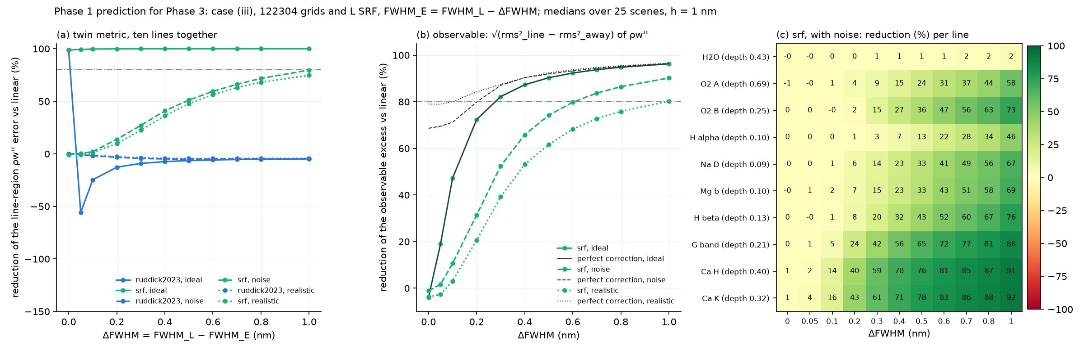
Prediction for Phase 3
Phase 3 has no truth, so G3 uses the observable excess √(rms²near − rms²away) of ρw″
Per line, the gain follows signal-to-noise: Ca H/K best, H₂O and O₂-A noise-limited
Notes:
Case iii on the 122304 grids, with the E SRF narrower than L by 0 to 1 nm. Three scenarios: ideal, VEIT noise, and noise plus 0.05 nm errors in the wavelength scale and FWHM_E. The perfect-correction curve is the ceiling: real line structure leaves an excess of its own.

Slide 15
The yardstick for gate G3
srf, one sequence, h = 1 nm | 0.1 nm | 0.2 nm | 0.3 nm | 0.5 nm | 0.7 nm | 1 nm
noise only | 11 % | 31 % | 52 % | 74 % | 84 % | 90 %
+ 0.05 nm λ and FWHM errors | 3 % | 21 % | 39 % | 62 % | 73 % | 80 %
perfect correction | 71 % | 80 % | 87 % | 92 % | 94 % | 96 %
Reduction of the observable excess vs linear, by FWHM_L − FWHM_E. At the narrow-E 0.5 nm: 60–75 %. Below 0.1 nm: little to gain.
Per line at 0.5 nm (noise only):
Ca K 78 % · G band 65 % · Hβ 43 % · Na D 33 % · O₂-B 36 % · O₂-A 24 % · Hα 13 % · H₂O 1 %
Notes:
Averaging N sequences lowers the noise and moves the result toward the noise-free curve, which is close to 100 %. h = 5 nm is dominated by real structure, so it is not a useful G3 metric.

Slide 16
Gate G1: passed for narrow-E instruments
1
> 80 % in (ii)–(iii)
srf ~100 % on both instruments
Pass
2
Graceful in (iv)–(vi)
narrow-E: yes, within the tolerances; E ≈ L: no
Pass*
3
Controls kept
srf exact in (iii); never worse than linear
Pass
4
Does eq. 14 alone pass (iii)?
0 % in (ii), −6 % in (iii)
No: H2 needed
Phase 2 default: srf where FWHM_L − FWHM_E ≥ 0.15 nm, linear otherwise
Notes:
* conditional on the E wavelength scale to 0.05 nm and the SRF widths to 0.07 to 0.1 nm. The 0.15 nm threshold is where srf breaks even with linear under realistic knowledge errors. Full report: claude_prompts/wiggles/gate_G1.md.

Slide 17
Open concerns and next steps
Open concerns
Phase 2
E wavelength scale: the binding requirement
E SRFs need the L1A delivery (L2 widths read ~0.1 nm wide)
Gaussian SRFs only; Ring and the Lu NIR excess are outside the twin
The E ≈ L floor is still unexplained
Harden interpolate_ed_to_l, with the 0.15 nm rule
Fit E's wavelength shift and stretch (task 4b)
SRF table, punpy uncertainties, processor snippet
Non-Gaussian SRF twin check (task 9b)
Notes:
Phase 3 then applies the corrections to the requested sequences and judges them against the yardstick on slide 15 (gate G3). Phase 0 tasks 9 to 14, and so gate G0, still wait on Kevin's L1A delivery.

