Slide 1


An introduction!
Standardised analysis of acoustic telemetry data
from animals moving through receiver arrays
Hugo Flávio
@hugomflavio
Methods in Ecology and Evolution
doi: 10.1111/2041-210X.13503

Slide 2
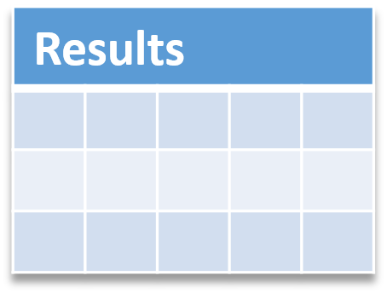

From data to results
We have…
We want…
?
Data
10.1111/2041-210X.13503

Slide 3
From data to results
We have…
We want…
The problems
?
Data
How to apply the same rules for each fish?
How to account for study area variability?
How to systematically detect and remove erroneous data?
How to make the analysis reproducible?
10.1111/2041-210X.13503

Slide 4
From data to results
We have…
We want…
?
Data
The problems
How to apply the same rules for each fish?
How to “pack” your data?
How to account for study area variability?
How to systematically detect and remove erroneous data?
How to make the analysis reproducible?
10.1111/2041-210X.13503

Slide 5
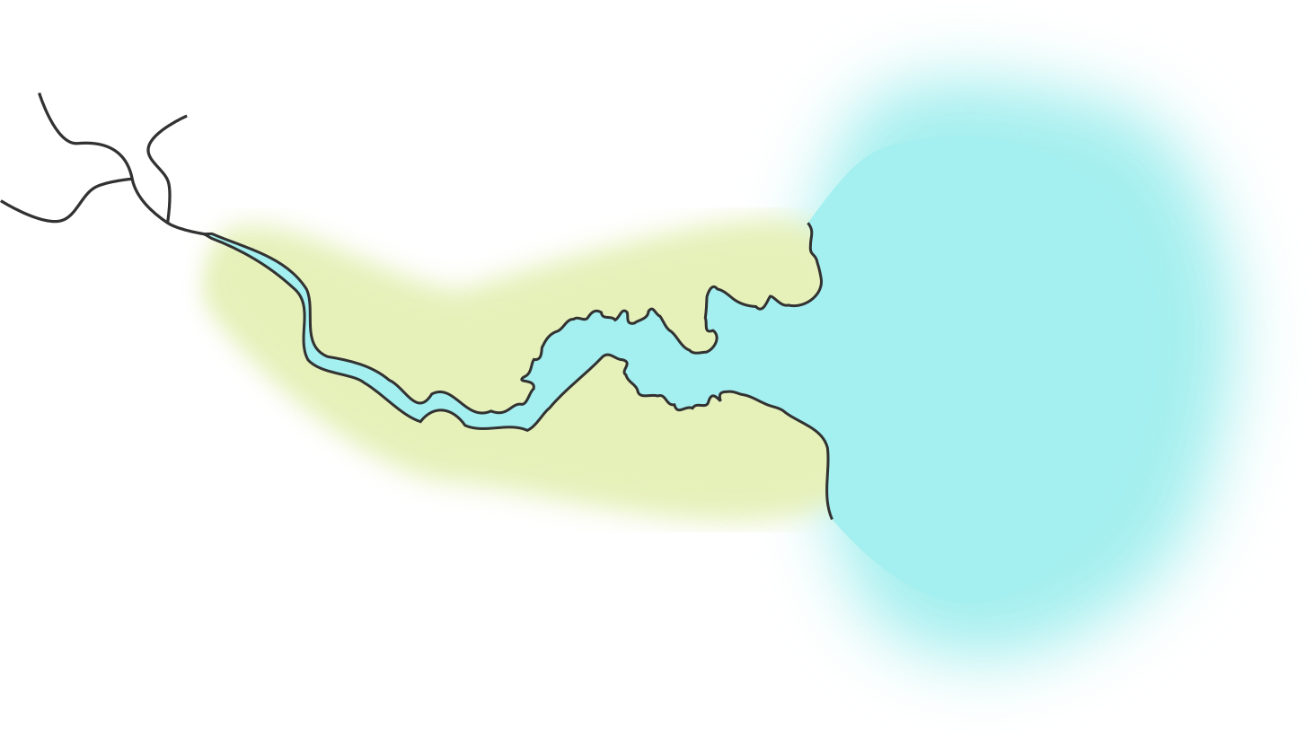


Packing your data
What makes a study?
A map
Tagged animals
Receivers
10.1111/2041-210X.13503

Slide 6
Packing your data
What makes a study?
A map
Tagged animals
Receivers
10.1111/2041-210X.13503

Slide 7
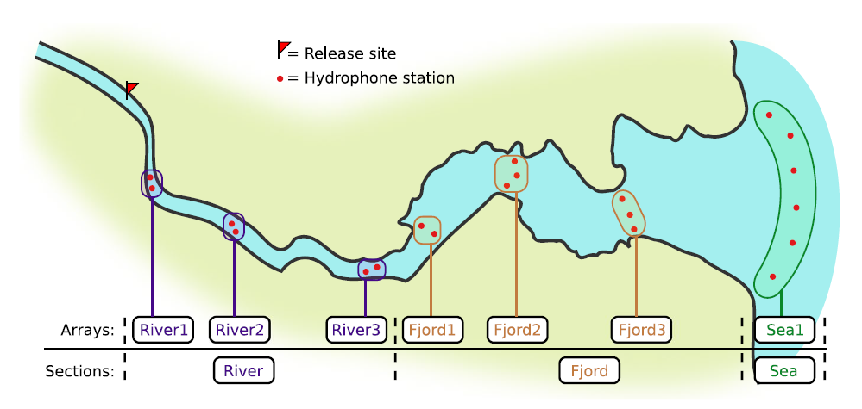
Packing your data
What makes a study?
Stations fit into Arrays, which fit into Sections
10.1111/2041-210X.13503

Slide 8
Packing your data
What makes a study?
spatial.csv
Station.name | Type | Array | Section | …
Station 1 | Hydrophone | River1 | River | …
Old Bridge | Hydrophone | River2 | River | …
Harbour 1 | Hydrophone | Fjord1 | Fjord | …
Harbour 2 | Hydrophone | Fjord1 | Fjord | …
… | … | … | … | …
Red Flag | Release | River1 | (empty) | …
10.1111/2041-210X.13503

Slide 9
Packing your data
What makes a study?
spatial.csv
A map
Tagged animals
Receivers
10.1111/2041-210X.13503

Slide 10
Packing your data
What makes a study?
spatial.csv
A map
Tagged animals
Receivers
10.1111/2041-210X.13503

Slide 11
Packing your data
What makes a study?
Origin
Biological information
Length
Samples
Signal
Tag
information
+
Release information
Code space
Battery life
Location
Time
10.1111/2041-210X.13503

Slide 12
Packing your data
What makes a study?
Tagged animals
biometrics.csv
Signal | Release.date | Release.site | Group | Length | …
1234 | 2020-02-23 10:50 | Red Flag | Wild | 120 | …
1235 | 2020-02-23 10:50 | Red Flag | Wild | 124 | …
1236 | 2020-02-23 10:50 | Red Flag | Stocked | 141 | …
… | … | … | … | … | …
spatial.csv
10.1111/2041-210X.13503

Slide 13
Packing your data
What makes a study?
spatial.csv
A map
biometrics.csv
Tagged animals
Receivers
10.1111/2041-210X.13503

Slide 14
Packing your data
What makes a study?
spatial.csv
A map
biometrics.csv
Tagged animals
Receivers
10.1111/2041-210X.13503

Slide 15
Packing your data
What makes a study?
Serial
Number
Where?
Offload
Files
Deployments
+
When?
10.1111/2041-210X.13503

Slide 16
Packing your data
What makes a study?
Receivers
deployments.csv
Receiver | Station.name | Start | Stop
112233 | Station 1 | 2020-01-20 10:00 | 2020-11-23 10:00
781 | Old Bridge | 2020-01-20 11:00 | 2020-11-23 11:00
122095 | Harbour 2 | 2020-01-21 10:00 | 2020-11-24 10:30
… | … | … | …
spatial.csv
10.1111/2041-210X.13503

Slide 17




Packing your data
What makes a study?
Receivers
detections folder
offload1.csv
offload2.csv
detections/
offload3.csv
10.1111/2041-210X.13503

Slide 18
Packing your data
What makes a study?
spatial.csv
A map
deployments.csv
biometrics.csv
Tagged animals
Receivers
detections/
10.1111/2041-210X.13503

Slide 19
Packing your data
What makes a study?
spatial.csv
A map
deployments.csv
biometrics.csv
Tagged animals
Receivers
detections/
10.1111/2041-210X.13503

Slide 20

R package actel
biometrics.csv
spatial.csv
Survival
A
B
deployments.csv
Results
R package
detections/
10.1111/2041-210X.13503

Slide 21
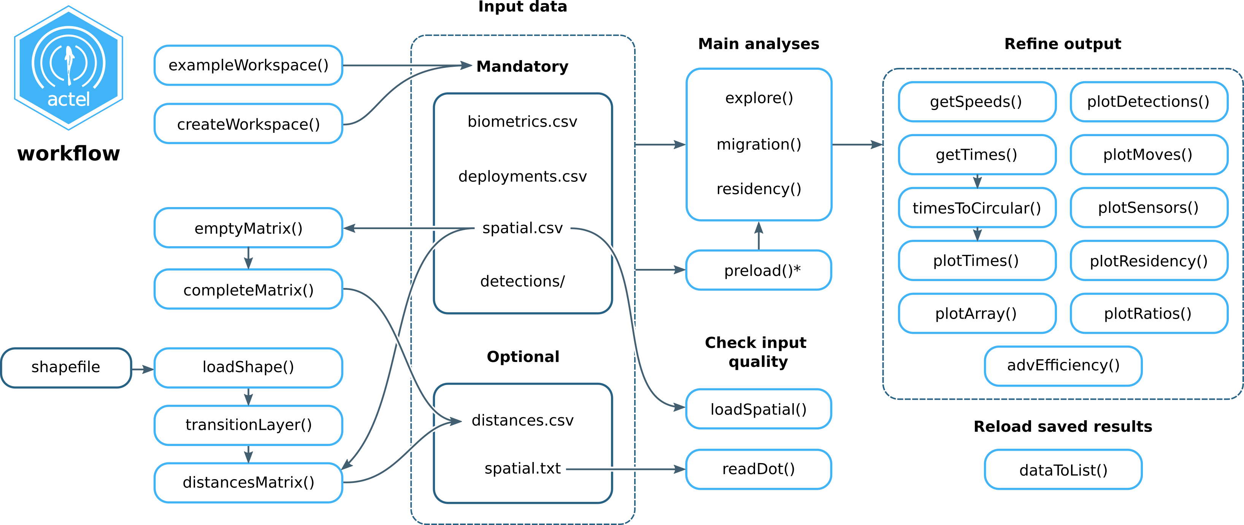
R package actel
10.1111/2041-210X.13503

Slide 22

R package actel
Any questions or doubts?
10.1111/2041-210X.13503

Slide 23
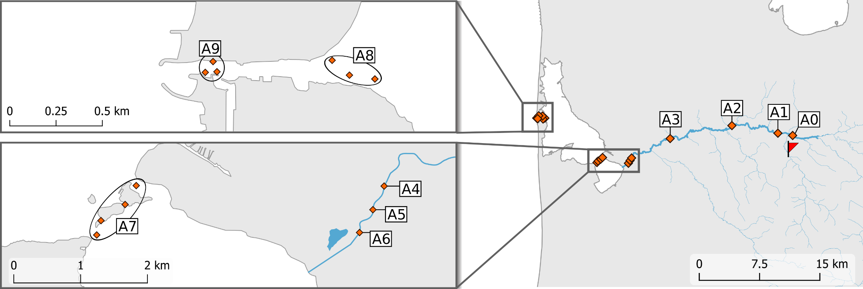
Let’s try it out!
function
exampleWorkspace()
actel’s example dataset
Atlantic salmon smolts
10.1111/2041-210X.13503

Slide 24
Movements
Detections
Timestamp | Receiver | Transmitter
2018-01-01 12:01:01 | Receiver1 | A11-1111-1111
2018-01-01 12:01:02 | Receiver1 | A22-2222-2222
2018-01-01 12:01:03 | Receiver1 | A22-2222-2222
2018-01-01 12:01:04 | Receiver2 | A11-1111-1111
2018-01-01 12:01:05 | Receiver2 | A22-2222-2222
A11-1111-1111
Timestamp | Receiver | Transmitter
2018-01-01 12:01:01 | Receiver1 | A11-1111-1111
2018-01-01 12:01:04 | Receiver2 | A11-1111-1111
A22-2222-2222
Timestamp | Receiver | Transmitter
2018-01-01 12:01:02 | Receiver1 | A22-2222-2222
2018-01-01 12:01:03 | Receiver1 | A22-2222-2222
2018-01-01 12:01:05 | Receiver2 | A22-2222-2222
10.1111/2041-210X.13503

Slide 25
Movements
Detections
A11-1111-1111
Timestamp | Receiver
2018-01-01 12:01:01 | Receiver1
2018-01-01 12:01:02 | Receiver1
2018-01-01 12:01:03 | Receiver2
2018-01-01 14:01:04 | Receiver2
2018-01-01 14:11:05 | Receiver3
E.1
Same array?
Yes
< 1 hour interval?
Yes
(max.interval)
10.1111/2041-210X.13503

Slide 26
Movements
Detections
A11-1111-1111
Timestamp | Receiver
2018-01-01 12:01:01 | Receiver1
2018-01-01 12:01:02 | Receiver1
2018-01-01 12:01:03 | Receiver2
2018-01-01 14:01:04 | Receiver2
2018-01-01 14:11:05 | Receiver3
E.1
Same array?
Yes
< 1 hour interval?
Yes
10.1111/2041-210X.13503

Slide 27
Movements
Detections
A11-1111-1111
Timestamp | Receiver
2018-01-01 12:01:01 | Receiver1
2018-01-01 12:01:02 | Receiver1
2018-01-01 12:01:03 | Receiver2
2018-01-01 14:01:04 | Receiver2
2018-01-01 14:11:05 | Receiver3
E.1
Same array?
Yes
< 1 hour interval?
No!
10.1111/2041-210X.13503

Slide 28
Movements
Detections
A11-1111-1111
Timestamp | Receiver
2018-01-01 12:01:01 | Receiver1
2018-01-01 12:01:02 | Receiver1
2018-01-01 12:01:03 | Receiver2
2018-01-01 14:01:04 | Receiver2
2018-01-01 14:11:05 | Receiver3
E.1
E.2
Same array?
No!
< 1 hour interval?
Yes
10.1111/2041-210X.13503

Slide 29
Movements
Detections
A11-1111-1111
Timestamp | Receiver
2018-01-01 12:01:01 | Receiver1
2018-01-01 12:01:02 | Receiver1
2018-01-01 12:01:03 | Receiver2
2018-01-01 14:01:04 | Receiver2
2018-01-01 14:11:05 | Receiver3
A11-1111-1111
Array | n | First time | Last time | …
River1 | 3 | 2018-01-01 12:01:01 | 2018-01-01 12:01:03 | …
River1 | 1 | 2018-01-01 14:01:04 | 2018-01-01 14:01:04 | …
River2 | 1 | 2018-01-01 14:11:05 | 2018-01-01 14:11:05 | …
E.1
E.2
E.3
Movement events!
10.1111/2041-210X.13503

Slide 30
Movement quality checks
Movements
Minimum detections
Jumping arrays
Movement
quality checks
Impassables
Speed
Inactiveness
Valid movements
migration() and residency()
have some more checks
10.1111/2041-210X.13503

Slide 31
Movement quality checks
arguments
minimum.detections
max.interval
1) Minimum detections
”If the tag only has 1 movement event with less than n detections, discard the tag”
NOT applicable for:
Multiple movement events with sum(detections) < n
10.1111/2041-210X.13503

Slide 32
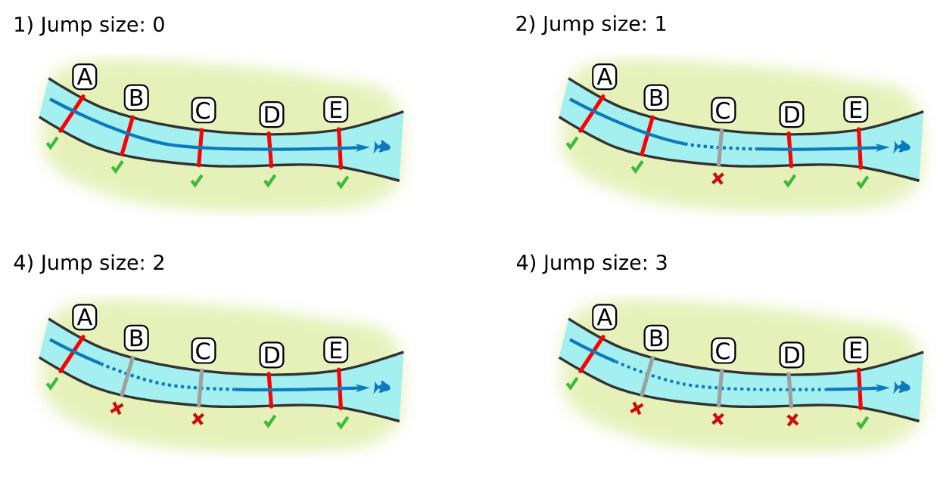
Movement quality checks
arguments
jump.warning
jump.error
2) Jumping arrays
10.1111/2041-210X.13503

Slide 33
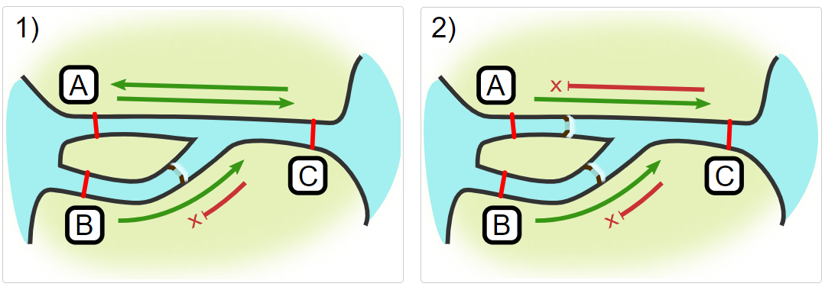
Movement quality checks
3) Impassables
*Requires a spatial.txt file
(we will get into that)
10.1111/2041-210X.13503

Slide 34
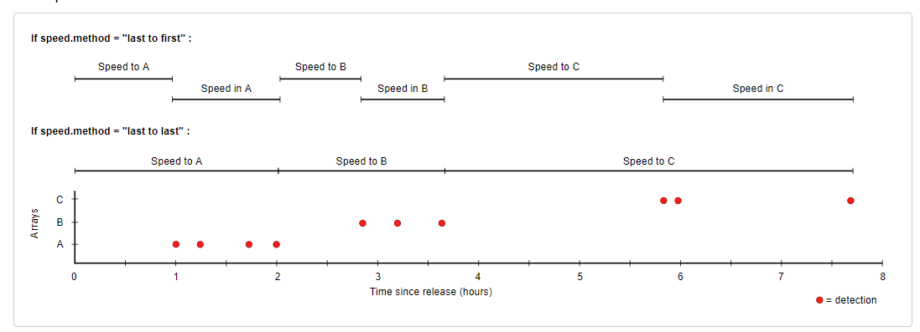
Movement quality checks
arguments
speed.warning
speed.error
4) Speed
speed.method
*Requires a distances.csv file
(we will get into that)
10.1111/2041-210X.13503

Slide 35
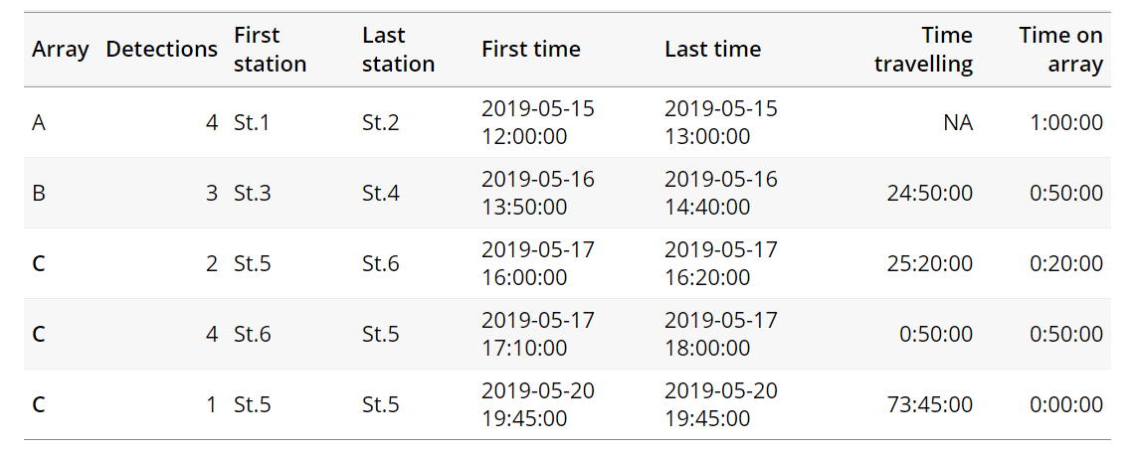
Movement quality checks
arguments
inactive.warning
inactive.error
5) Inactiveness
Works better with a distances.csv file
10.1111/2041-210X.13503

Slide 36
R package actel
Any questions or doubts?
10.1111/2041-210X.13503

Slide 37
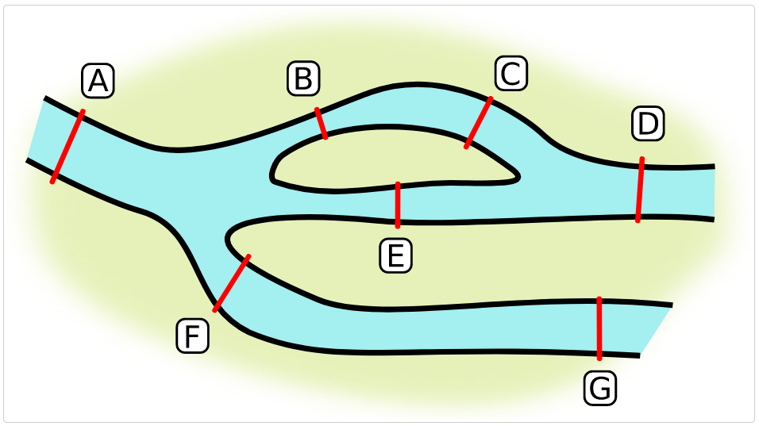
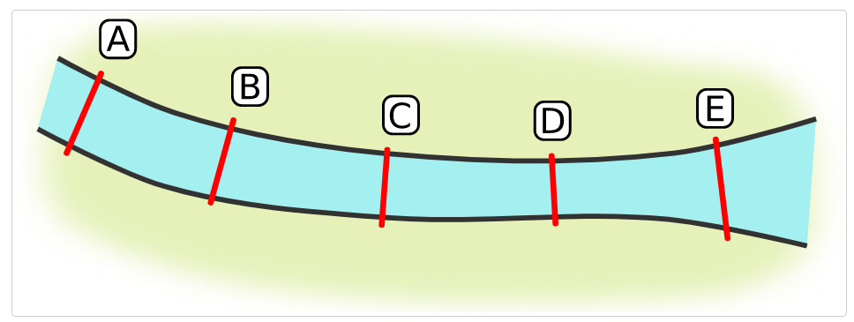
Optional files
function
readDot()
spatial.txt
Not all study areas come with the same shape
Some are nice and simple
others… not so much
”Where can my animal be detected next?”
10.1111/2041-210X.13503

Slide 38
Optional files
function
readDot()
spatial.txt
Not all study areas come with the same shape
Some are nice and simple
others… not so much
”Where will my animal be detected next?”
10.1111/2041-210X.13503

Slide 39
Optional files
function
readDot()
spatial.txt
Not all study areas come with the same shape
Some are nice and simple
others… not so much
Linear
NON-linear
(spatial.txt not required)
(spatial.txt required)
10.1111/2041-210X.13503

Slide 40
Optional files
function
readDot()
spatial.txt
A -- B -- C -- D
A -- E -- D
A -- F -- G
B -- E -- F
B -- F
C -- E
A -- B -- C -- D -- E
Things get a bit more complex in migration(), but we won’t cover that here…
10.1111/2041-210X.13503

Slide 41
Optional files
function
readDot()
spatial.txt
A -- B
A -- C
B -> C
A -- B
A -> C
B -> C
10.1111/2041-210X.13503

Slide 42
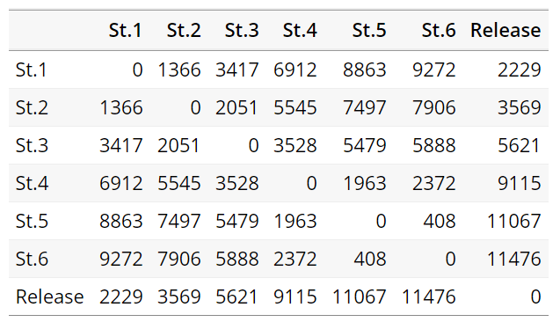
Optional files
functions
loadShape()
distances.csv
transitionLayer()
distancesMatrix()
A matrix with the distances
between each spatial point.
10.1111/2041-210X.13503

Slide 43
Optional files
functions
loadShape()
distances.csv
transitionLayer()
distancesMatrix()
shapefile
+
loadShape()
spatial.csv
water raster
transitionLayer()
T. layer
distancesMatrix()
+
spatial.csv
distances matrix
10.1111/2041-210X.13503

Slide 44
R package actel
Any questions or doubts?
10.1111/2041-210X.13503

Slide 45
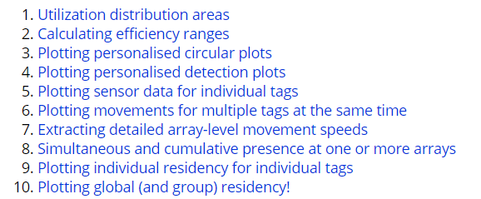
Post-analysis functions
Extracting data and getting fancy plots
vignette("f-0_post_functions", "actel")
10.1111/2041-210X.13503

Slide 46
Thank you for participating!
Any final questions?
Hugo Flávio
@hugomflavio

