Slide 1
CA Drifter Deployment Summary
Alison Laferriere
9/27/25

Slide 2


February 2023: San Diego
Two drifters successfully completed multiple dives to 250m
Drifter #4:
  48-hour mission
  250m depth
  12-hour surface intervals
  drifted ~0.5-2.3 km during each dive
Drifter #5:
  completed a 24-hour mission
  12-hour intervals
  drifted ~0.3-2 km during each dive
Two vector sensors were tested
  Drifter #4: M-35 (2-D)
  Drifter #5: VS-209 (3-D)
Evaluated new ”Surface Interval” state – which enables the drifter to surface for a GPS fix after a specified time interval and then dive again
Deployed

Slide 3
February 2023: San Diego

Slide 4
June 2023: San Diego
Three drifters were deployed simultaneously
Drifter #4, #5, and #6:
  24-hour missions
  250-meter depths
  12-hour surface intervals
  drifted ~4-9 km during each dive
Each drifter was equipped with a USBL, enabling ranging between drifters
Two vector sensors were tested
  Drifter #4: M-35 (2-D)
  Drifter #5,#6: VS-209 (3-D)
Updates were made to the drifter state machine to maximize time in hibernation mode and to reduce self noise caused by the drifter pump
Deployed

Slide 5
June 2023: San Diego

Slide 6
September 2023: San Diego
One drifter was deployed
Drifter #6:
  72-hour mission
  250-meter depth
  24-hour surface intervals
  got stuck at 75 m attempting to perform the first surface interval
  drifted 28 km
One vector sensors was tested
  VS-209 (3-D)
Deployed

Slide 7
January 2024: San Diego
Two drifters were deployed simultaneously
Drifter #5:
  72-hour mission
  Two dives to 100m, one to 300m
  24-hour surface intervals
  Drifted ~8-14 km each dive
  thermistor string
Drifter #6:
  72-hour mission
  One dive to 100m, then stuck at surface
  Drifted 11 km during the dive
  Drifted 25 km at surface
Each drifter was equipped with a USBL, enabling ranging between drifters
Both had VS-209 (3-D) vector sensors
Deployed

Slide 8
January 2024: San Diego

Slide 9
May 2024: San Diego
One drifters was deployed
Drifter #5:
  72-hour mission
  One dive to 100m for 48 hours – drifted 12 km
  Surface interval then dove to 300m, aborted after 10 hours (early GTR release) – drifted 2 km
  VS-209 (3-D) vector sensor
  deployed with a thermistor string and ADCP
Deployed

Slide 10
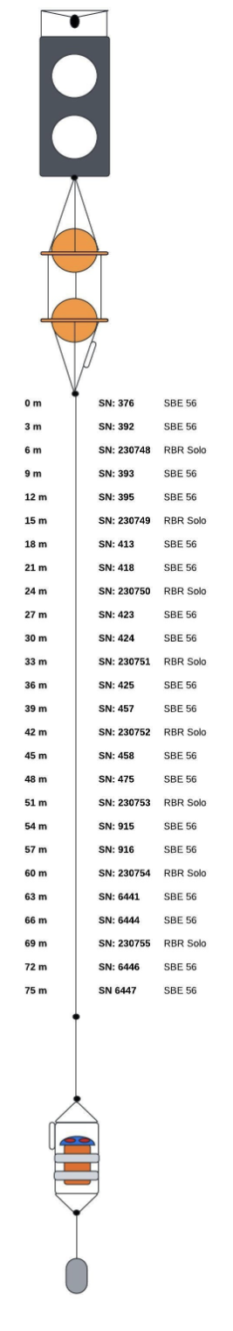
May 2024 – ADCP test

