Slide 1
BLU-RZBRY

Slide 3
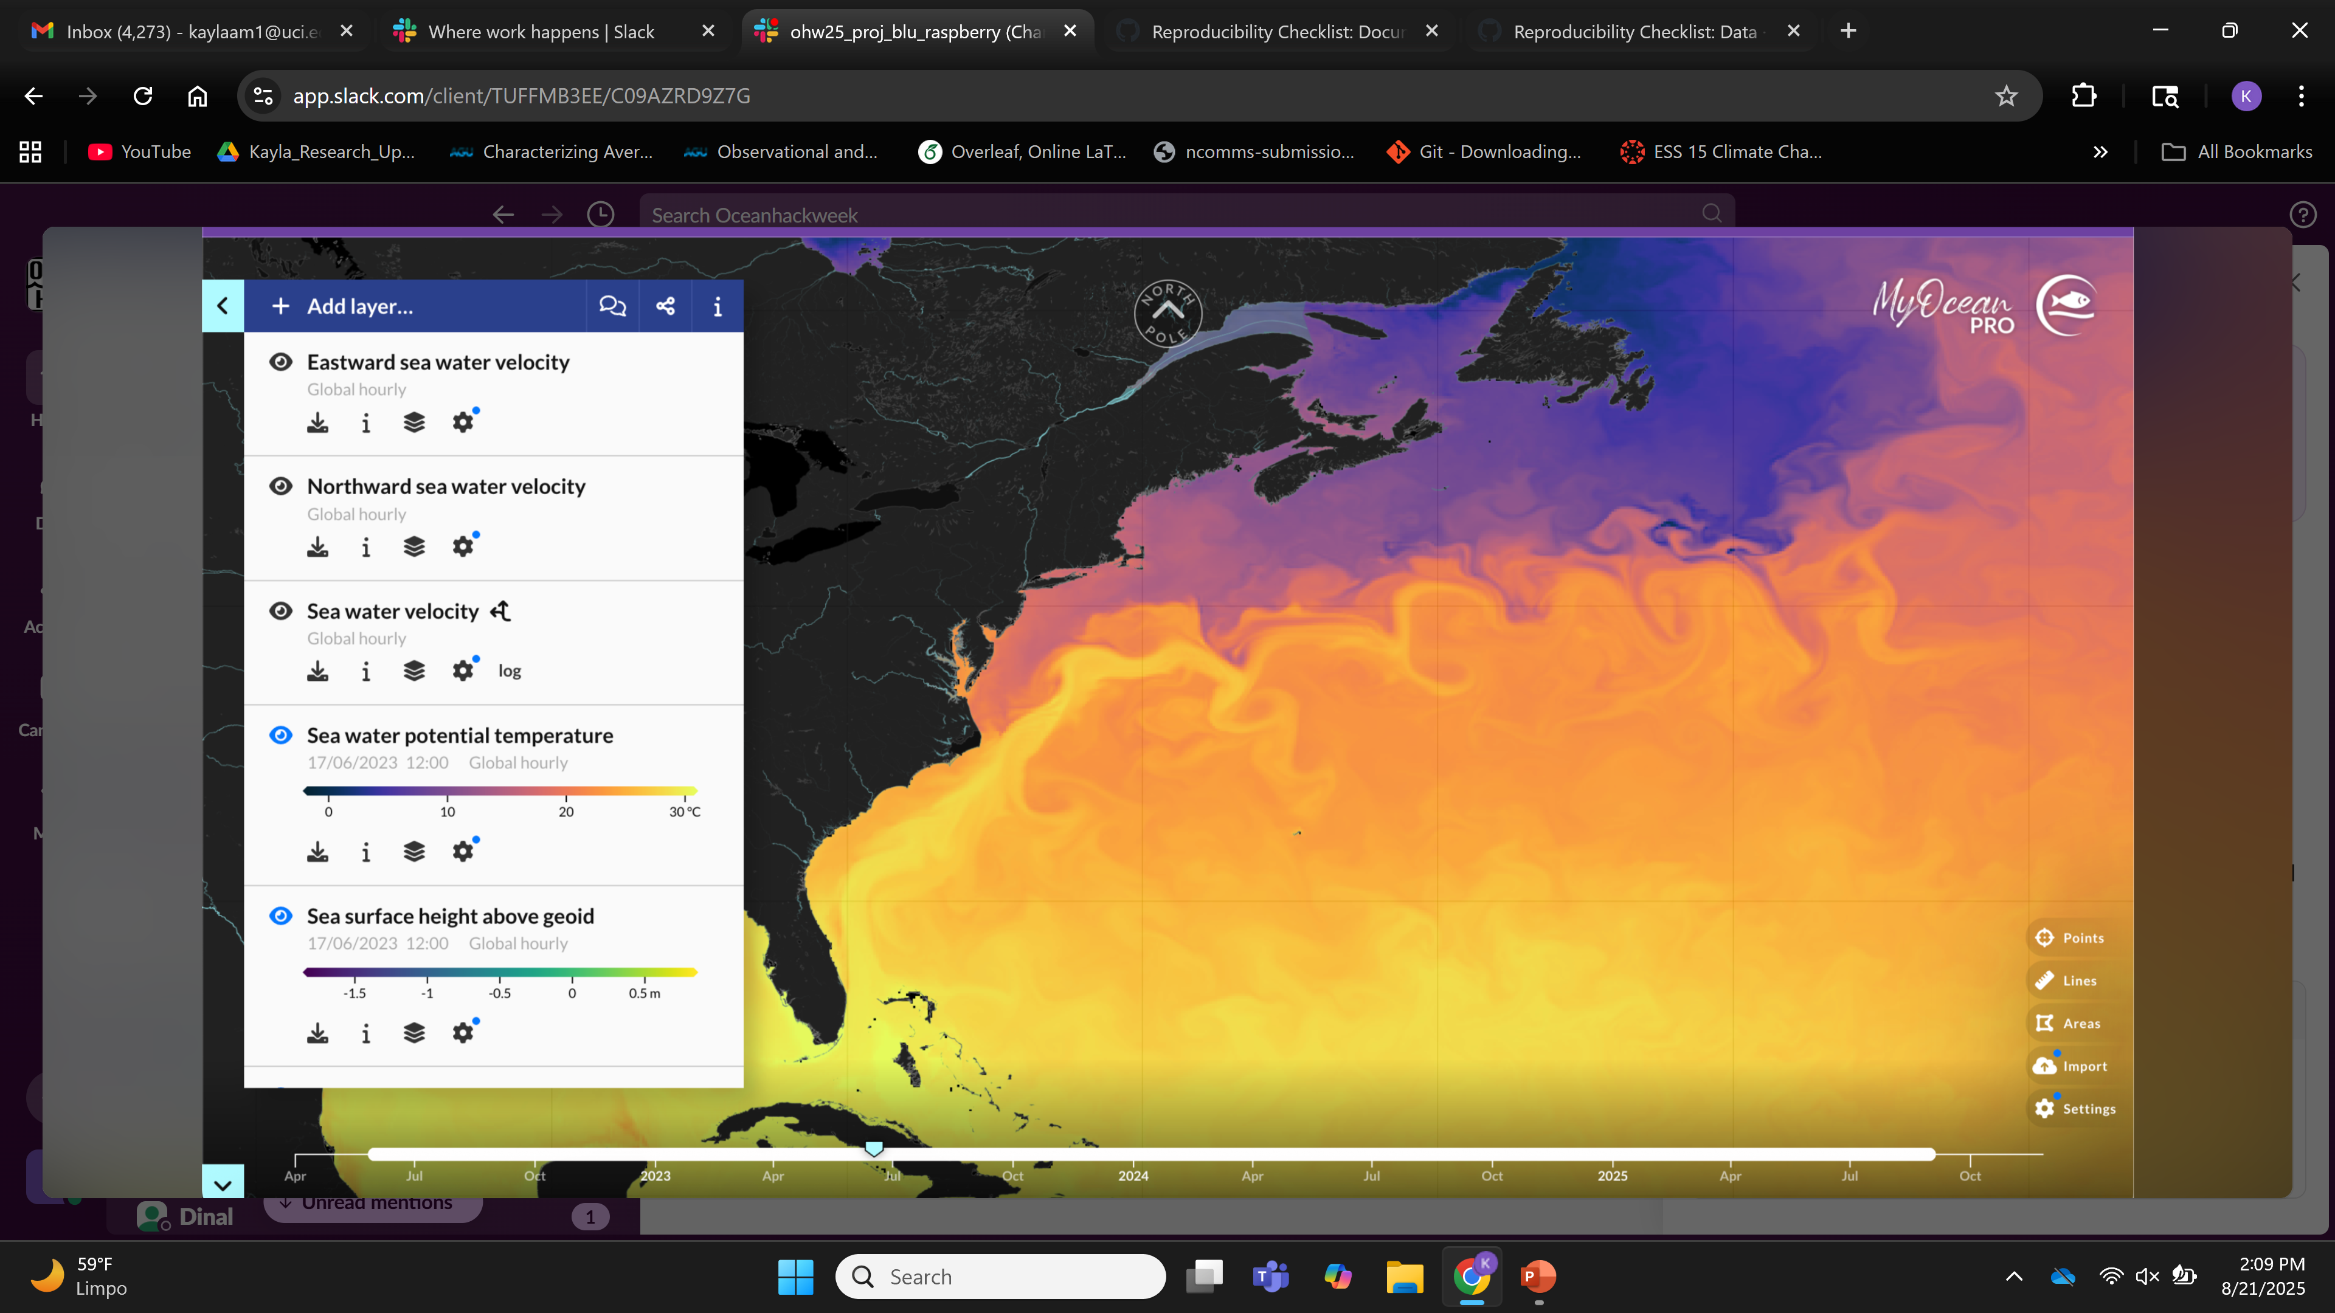
Transect across North Atlantic
Chooses an optimal path from
possible paths
Profiles upper 1000m of ocean

Slide 4
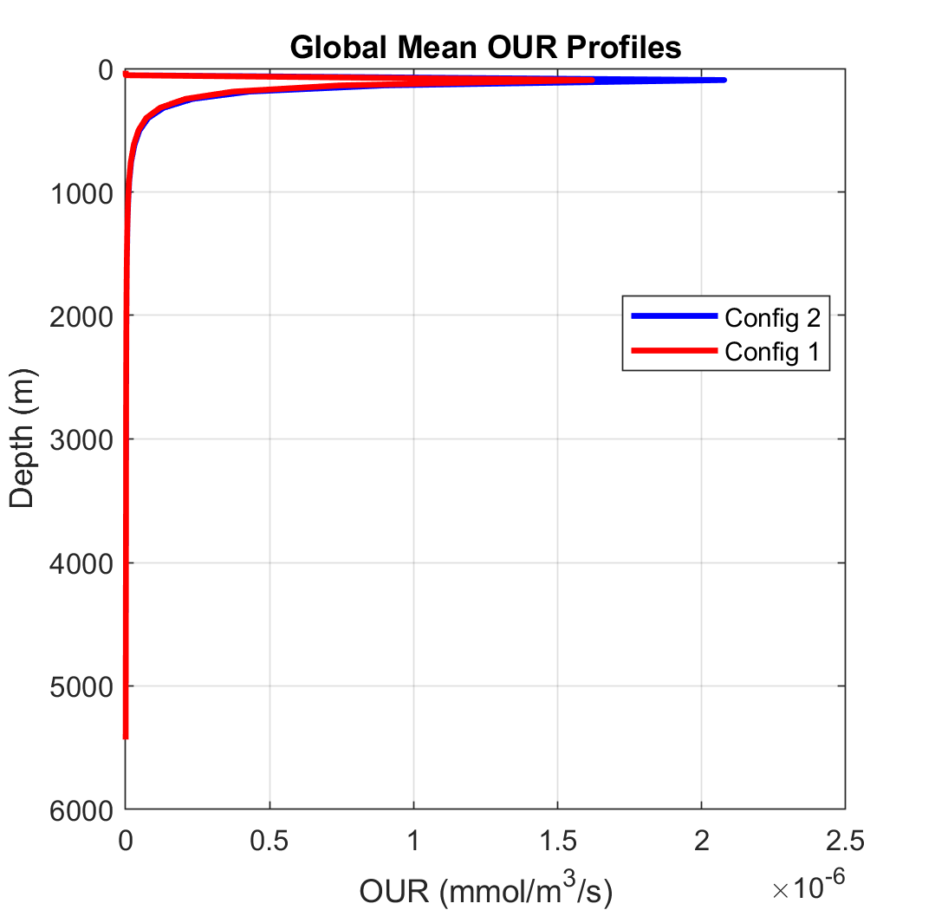
Oxygen Utilization Rate (OUR) is a quantity of great interest for oceanographers, marine biogeochemists, and climate modelers.
OUR measures oxygen consumption by microbial respiration/decomposition.
Can be used to reconstruct organic carbon fluxes, detect magnitude/timing of phytoplankton & algae blooms, monitor microbial activity
- Can also be used to reconstruct organic carbon export by the Biological Carbon Pump using oxygen-to-carbon stoichiometry and mass balance.
Optimal Path: downstream (along current) for efficiency, upstream (against current) when anomalous OUR is detected.
Goal → Determine origin of OUR anomaly
Could locate HABs, monitor phytoplankton blooms, changes in microbial populations/activity, (& distinguish between these)
Assimilated model data**

Slide 5
Goal → Retrieve robust profiles of OUR across a transect of an ocean basin (e.g. North Atlantic) using a new AUV following a real-time optimal path.
The AUV collects oxygen observations and is integrated with supplemental model data to infer quantities of interest (like OUR).
Optimal Path: downstream (along current) for efficiency, upstream (against current) when anomalous OUR is detected.
Goal → Determine origin of OUR anomaly
Could locate HABs, monitor phytoplankton blooms, changes in microbial populations/activity, (& distinguish between these)
Assimilated model data**

Slide 6
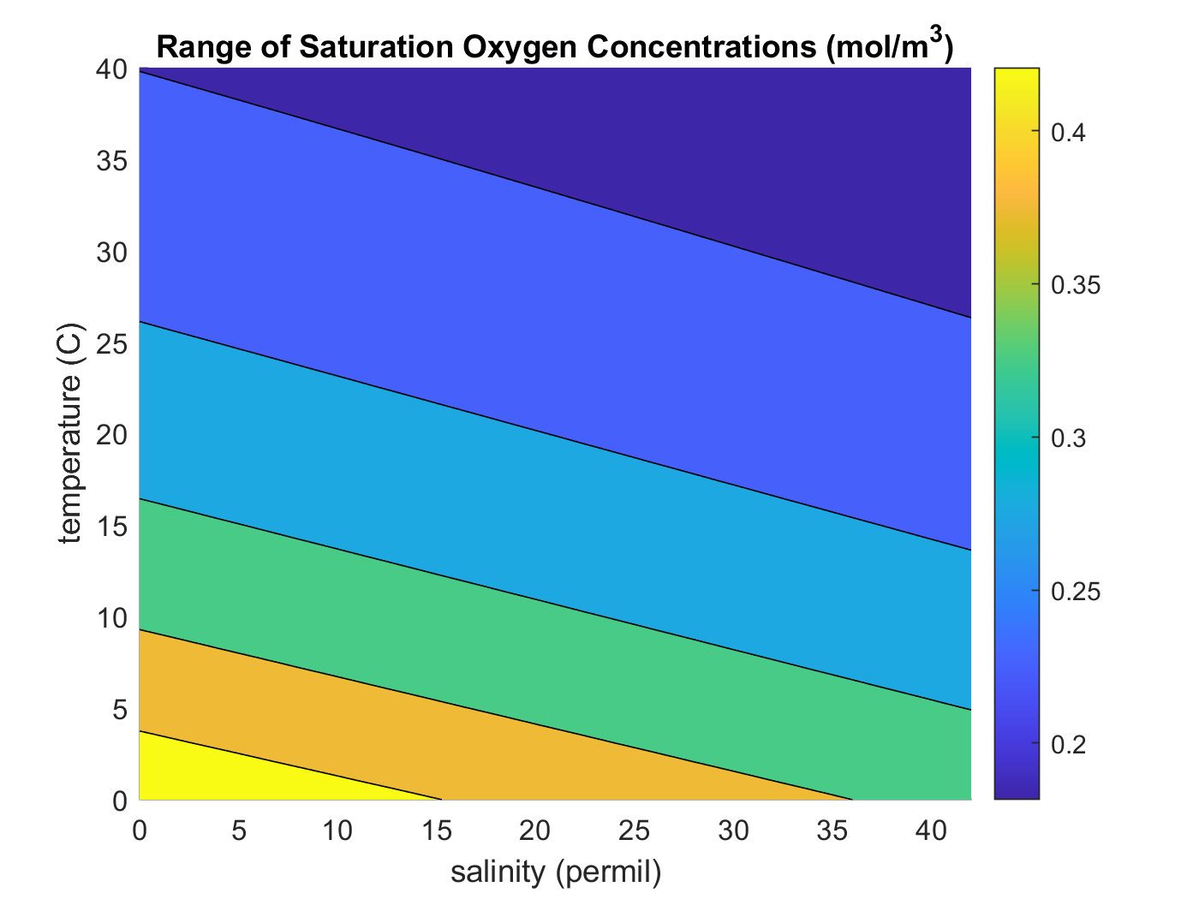
Oxygen Utilization Rate (OUR) measures oxygen consumption by microbial respiration/decomposition.
OUR = AOU
water age
Apparent Oxygen Utilization (AOU) : [O_{2 sat}] – [O_{2 observed}]
units: mmol [dO] m⁻³ s⁻¹
AOU → difference between oxygen conc at solubility & oxygen conc measured in water with the same physical/chemical properties (e.g. temp, salinity).
AOU < 0: theoretical, would indicate oxygen production, but when water is oversaturated with oxygen, it quickly bubbles up out of the water column & outgasses into atmosphere

Slide 7
Oxygen Utilization Rate (OUR) measures oxygen consumption by microbial respiration/decomposition.
OUR = AOU
water age
Apparent Oxygen Utilization (AOU) : [O_{2 sat}] – [O_{2 observed}]
units: mmol [dO] m⁻³ s⁻¹
AOU > 0 : Less oxygen than “expected”, due to biological processes (indicator of heterotrophic respiration of sinking organic matter)
AOU = 0 : fully saturated
AOU < 0: theoretical, would indicate oxygen production, but when water is oversaturated with oxygen, it quickly bubbles up out of the water column & outgasses into atmosphere

Slide 8
Optimal Path: AUV will choose what point to navigate to next by considering gradients in temperature and salinity.
Scheme could substitute any variable provided by the high-resolution model (ROMS)
Purpose: this approach catches features of interest rather than just vertical movement up and down.

Slide 9


Solve for average water mass age using OCIM
Source Term
(age increases by one for each timestep)
Thus, a increases by 1 every 1 year.
Compute average “age” $a$of water parcels in the model grid using the OCIM tracer transport matrix (mean time since the water parcels were last in contact w/ the surface).
Sink Term
(age returns to 0 when water returns to the surface)
$$u$$
Velocity vector
Diffusive term
← Operator restoring a to zero when water parcel returns to surface
$$K$$
OUR = AOU
water age
$$\frac{∂a}{∂t}+∇∙\left(ua+K∙∇ a \right)=1−Ra$$
$$R$$
Change in age
Transport
Sources minus Sinks
$$∇∙\left(u+K∙∇ \right)$$
advective-diffusive flux divergence operator (model transport matrix)

Slide 10


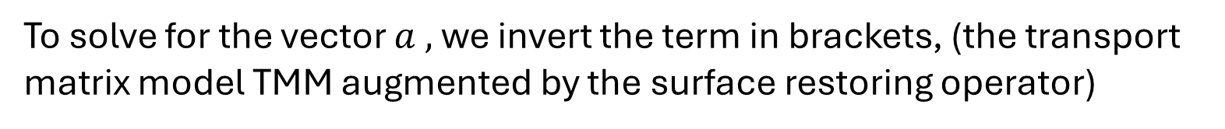
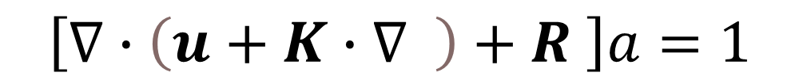
Solve for average water mass age using OCIM
Steady state implies that the change in age with time, $\frac{∂a}{∂t}$ = 0
Eventually, the rate of renewal will be balanced w/ the rate water parcels age in the deeper ocean. Thus, the equation becomes:
0
$$\frac{∂a}{∂t}+∇∙\left(ua+K∙∇ a \right)=1−Ra$$
$$\left[∇∙\left(u+K∙∇ \right)+R \right]a=1$$
To solve for the vector $a ,$we invert the term in brackets, (the transport matrix model TMM augmented by the surface restoring operator)

Slide 11
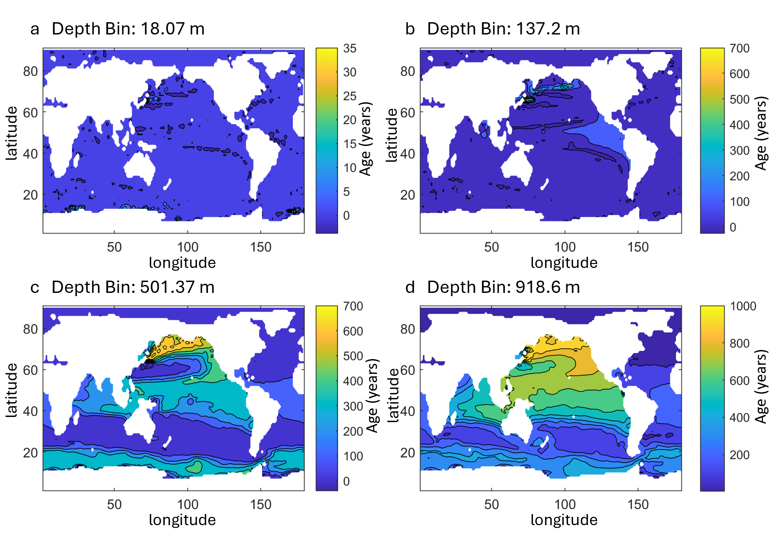
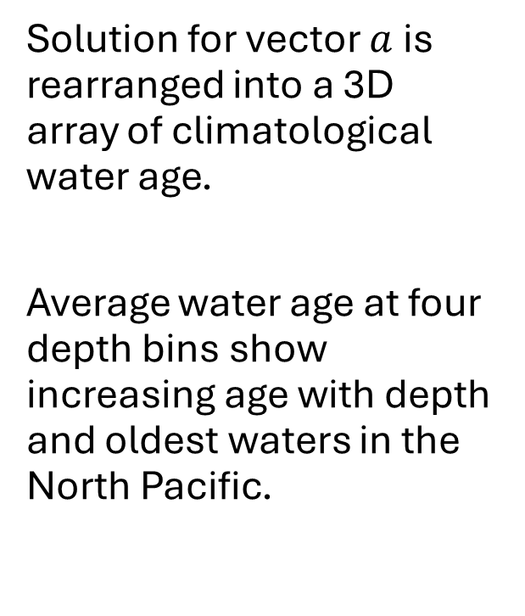
Solve for average water mass age using OCIM
Solution for vector $a$is rearranged into a 3D array of climatological water age.
Average water age at four depth bins show increasing age with depth and oldest waters in the North Pacific.

