Slide 1
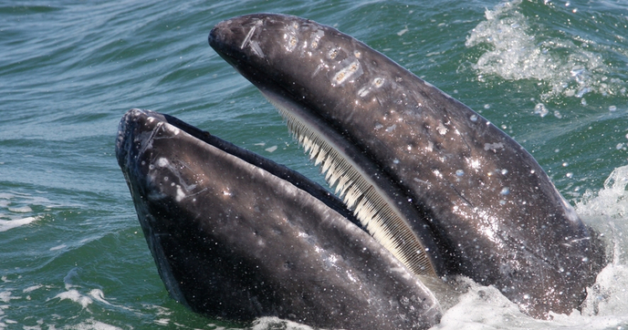
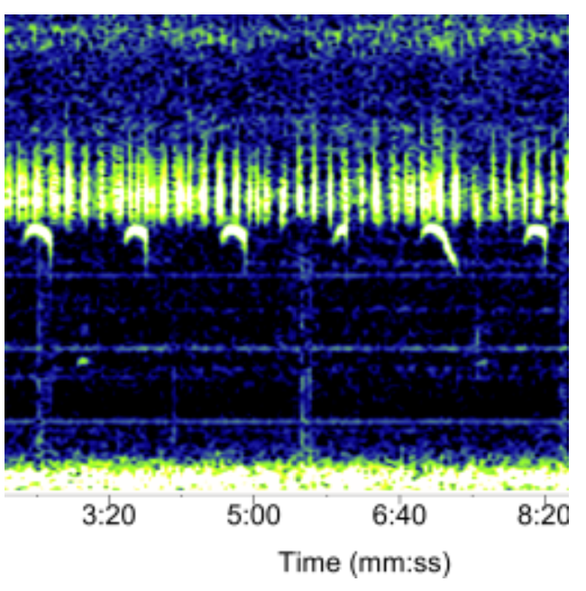
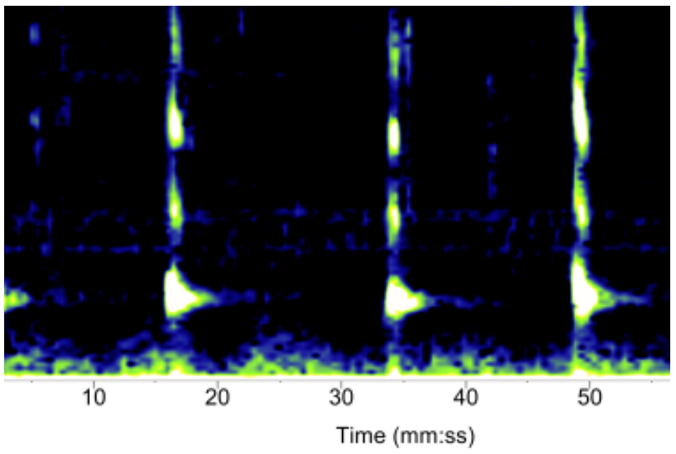
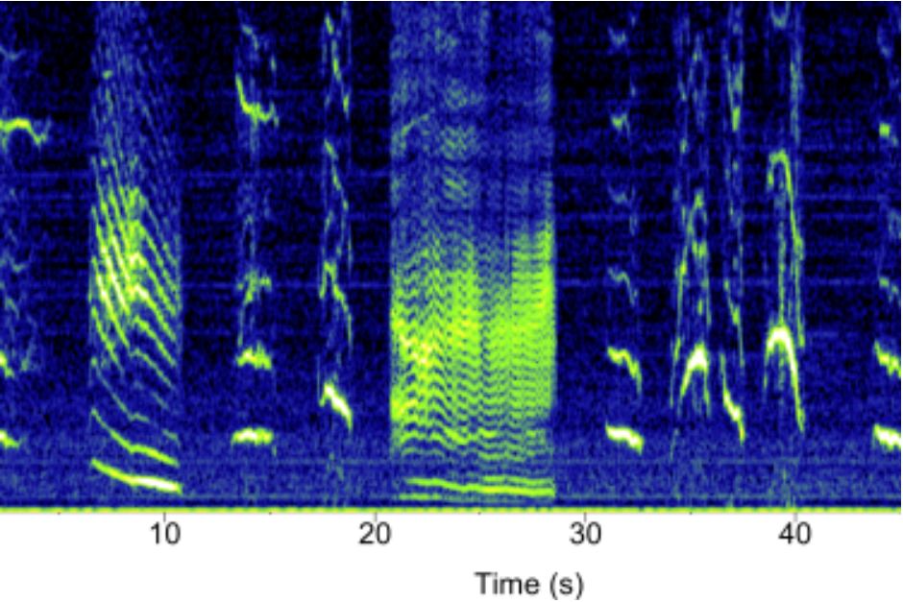
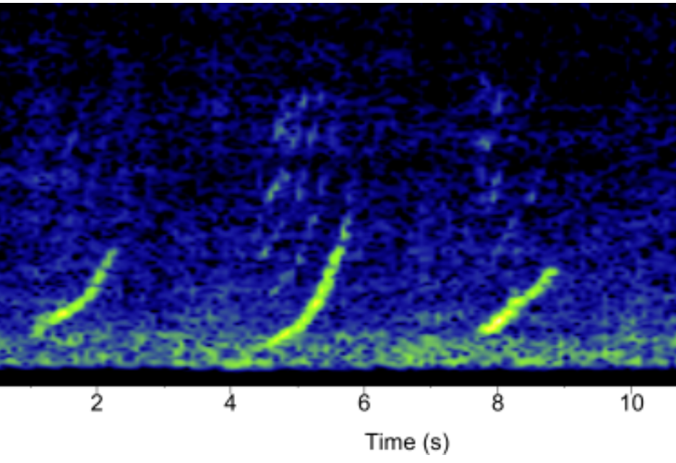
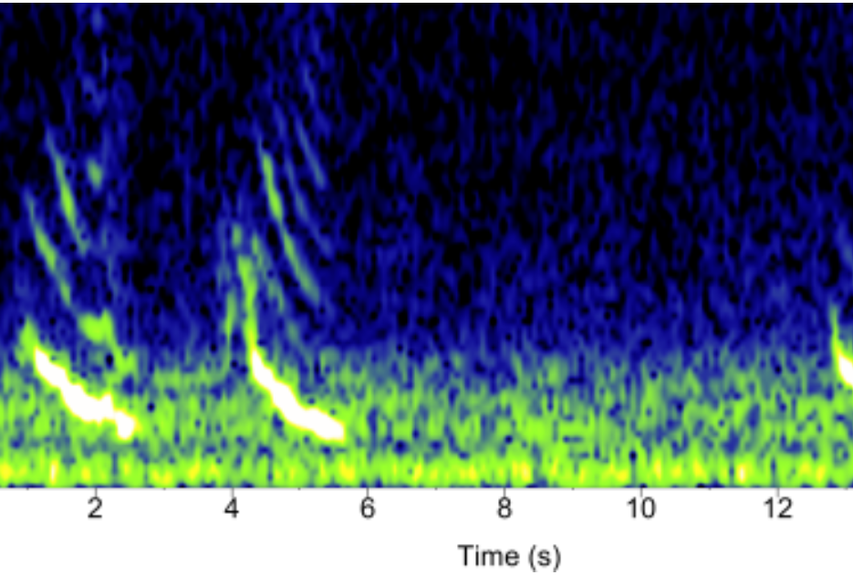
MYSTICETES
What are they?
Fishfinders and echosounders are active acoustic tools used to locate fish, measure depth, and map seafloor features.
How do they communicate?
Why does it matter?
They emit short, high-frequency sound pulses and record echoes reflected from fish and other underwater objects.
Baleen whales play a major role in marine ecosystems. By consuming large quantities of prey and redistributing nutrients through their waste, they enhance ocean productivity. When they die, their bodies sink to the seafloor, transporting and storing carbon for decades or longer, helping regulate Earth’s climate.
Sample Signals
(a) Blue Whale
(b) Fin Whale
(c) Humpback Whale
(d) Right Whale
(e) Sei Whale
Acoustic signals made by various mysticetes. All spectrograms and sounds courtesy of NOAA. (NOAA [National Oceanic and Atmospheric Administration]. Passive Acoustics Group. 2021. Dele_NOAA_04. https://www.fisheries.noaa.gov/national/science-data/sounds-ocean)

