Slide 1
Team Chatty Project
By: Sonal Periwal
Alex Su
Anjela Orlanes
Ocean Lu

Slide 2
Ideas for Implementing Message Passing - Server side
Server:
The server runs an infinite loop to keep accepting incoming client requests.
When a new request has been accepted, it assigns the client’s socket to a new thread which will handle the client’s incoming messages.
The server will also send out a welcoming message to the new client, as well as update other clients of a new chat member.
When an incoming message has been received, the server will then broadcast the message to all clients currently in the chat.
If that message is just a period (‘.’), then the server will disconnect the user instead and send out a notification to other chat clients.
Client:
This thread has an infinite loop while the user still wants to be a part of the chat
The loop will keep reading input from the user
If the string read is not to quit, it will then broadcast the message to all other users

Slide 3
Ideas for Implementing Message Passing - Client side
Client Handler: Starts Client program. Connects to Chat Server via Server hostname and IP address. Once TCP connection has been established, runs a thread that will read input from the Server and display it to all clients, and a thread that will read input from the user and send it to the server. Two separate threads are needed because if one thread is waiting for user input, it cannot read in input from the server. So, two threads allow messages to be read and displayed simultaneously.
Client:
Create a Client object with the hostname and port number. Establish a Socket Connection.
Start ReadServerInput Thread- Runs in an infinite loop until client disconnects. Uses an InputStreamReader and BufferedReader to read input from the Server and display it to the console.
Start ReadUserInput Thread- Reads and sends input from user to Server until User types “.” Asks and stores username and uses an OutputStream and Printwriter to receive input from the client and send it to the server.

Slide 4
Server Pseudocode
Server class: Vector to store active clients (static Vector<ClientThread> clientList = new Vector<>(); ) Main: Server socket listening on port # Running infinite loop for getting client request (while (true)) { Accept incoming request (socket.accept();) Create a thread for the client and assign its socket
Start Client thread
Broadcast message:
For client in clientList:
Send message to client
ClientThread class:
run(): While (true):
Read message from user
If the message is a period ‘.’
quit
Else
Broadcast the message

Slide 5
Client Pseudocode
Client:
Main:
Create Client Object(hostname, port)
execute() Execute:
Establish socket connection
Start ReadServerInput Thread
Start ReadUserInput Thread
Setter/Getter Client Username
ReadServerInput:
Initialize Input Stream
run():
while(true)
If client getUserName exists, print name + response
ReadUserInput:
Initialize Output Stream
run():
Enter name and set clientName
While user input != “.”
readLine and write to outputStream

Slide 6
Task Allocation
Server- Alex Su
UserThread- Anjela Orlanes
Client- Ocean Lu
ReadServerInput / ReadUserInput Threads- Sonal Periwal
EC- Everyone

Slide 7
Current Status
Planning and Designing ✔
Implementation ✔

Slide 8
Slide Breaker

Slide 9
Description of Design - Server side
ChattyServer:
The server runs an infinite loop to keep accepting incoming client requests.
When a new request has been accepted, it assigns the client’s socket to a new server thread which will handle the client’s incoming messages.
The server will also send out a welcoming message to the new client, as well as update other clients of a new chat member.
When an incoming message has been received, the server will then broadcast the message to all clients currently in the chat.
If that message is just a period (‘.’), then the server will disconnect the user instead and send out a notification to other chat clients.
Server Thread:
This thread has an infinite loop while the user still wants to be a part of the chat
The loop will keep reading input from the user and appending it to the queue of messages to be sent
If the string read is not to quit, it will then broadcast the message to all other users]
Broadcast Thread
This thread will have an infinite loop that continually checks if there are messages in the queue to output to all users

Slide 10
Description of Design - Client side
ChattyClient: Starts Client program. Connects to ChattyServer via Server hostname and IP address. Once TCP connection has been established, runs a thread that will read input from the Server and display it to all clients, and a thread that will read input from the user and send it to the server. Two separate threads are needed because if one thread is waiting for user input, it cannot read in input from the server. So, two threads allow messages to be read and displayed simultaneously.
Client:
Create a ChattyClient object with the hostname and port number. Establish a Socket Connection.
Start InputThread (server input)- Runs in an infinite loop until client disconnects. Uses an InputStreamReader and BufferedReader to read input from the Server and display it to the console.
Start OutputThread (output to server)- Reads and sends input from user to Server until User types “.” Asks and stores username and uses an OutputStream and Printwriter to receive input from the client and send it to the server.

Slide 11
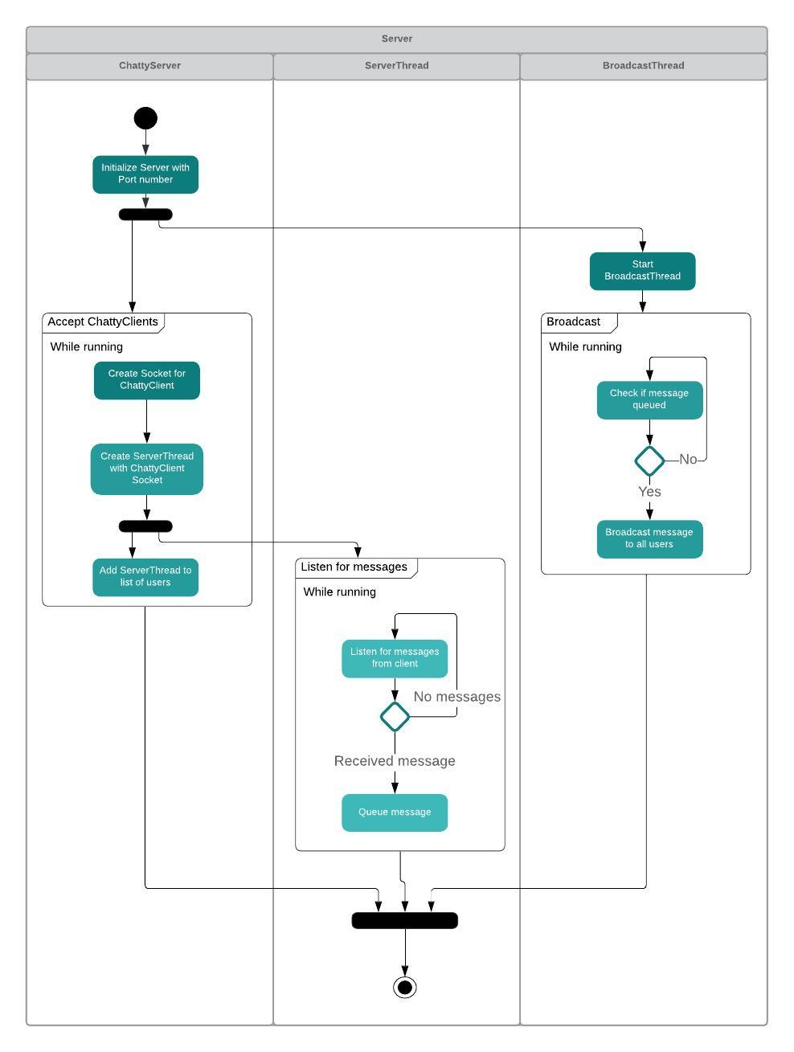
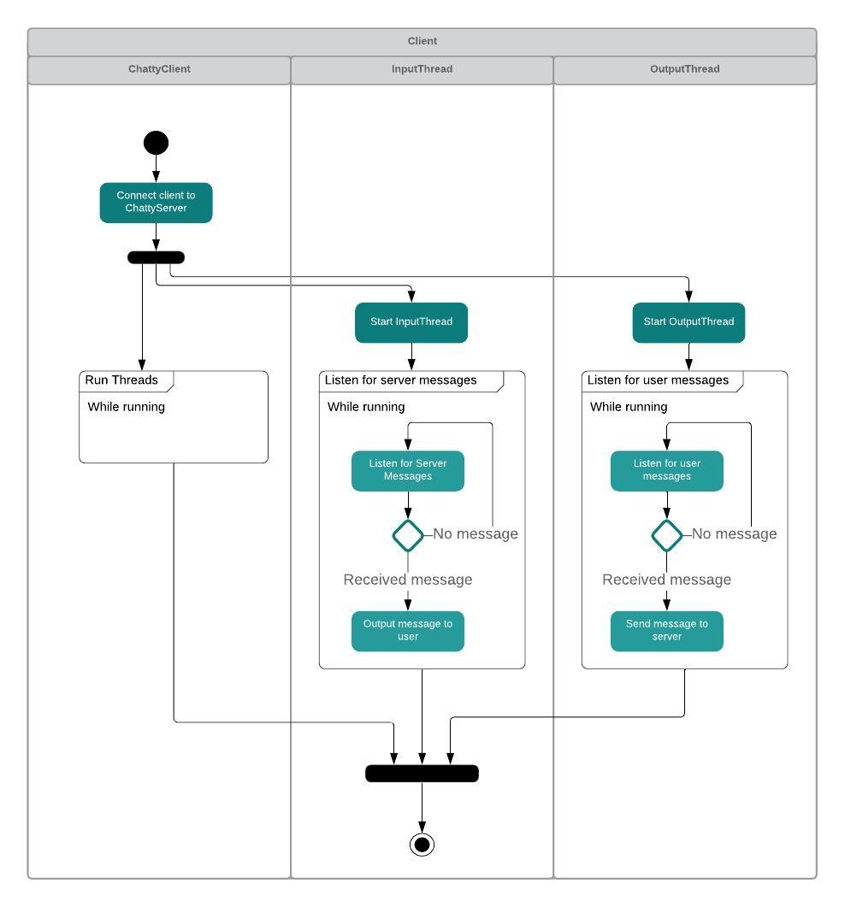
Activity
Diagrams

Slide 12
Activity
Diagram
- Server

Slide 13
Activity
Diagram
- Client

Slide 14
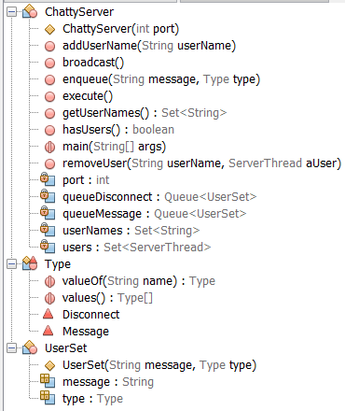
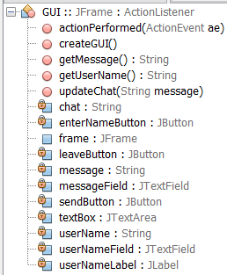
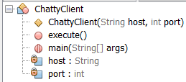

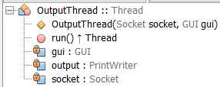
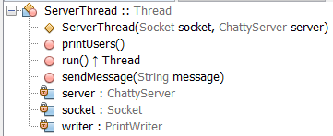

UML

Slide 15
Details of Implementation
ChattyServer/BroadcastThread: Handles client connections, and enqueuing/dequeuing process. Continual call to broadcast() from BroadcastThread
ChattyClient: Establishes client, respective GUI and Input/Output threads, and connects socket to host/port InputThread: Calls updateChat() in GUI to update to latest message received from the server
OutputThread: Do-while loop to handle and timestamp messages from GUI, then send to ServerThread for further processing
ServerThread: Formats message from OutputThread and enqueues messages to ChattyServer to be broadcasted. Sends message to InputThread from broadcast() in ChattyServer. Handles different messages such as entering users, exiting users, and regular chatting.
GUI: Java Swing to create a graphical interface for chat. Added listeners on buttons to indicate actions sending message, inputting username, or leaving chat. Function updateChat() used to display updated chat received from InputThread.

Slide 16
Description of Features
Timestamp: Display time integrity in message sending
Queue for message broadcasting: Insurance for simultaneous messaging to ensure messages to not be dropped
Queue for user disconnection: Prioritizes the event that user has disconnected. This makes it so that they do not have to receive other messages before disconnecting, and respects the time event of disconnection
GUI: Use of Java Swing to create an organized, intuitive, and user-friendly view of chat. Cleaner presentation than console.

