Slide 1

Cs4650: Assignment 2: analysis
By: Ocean Lu

Slide 2
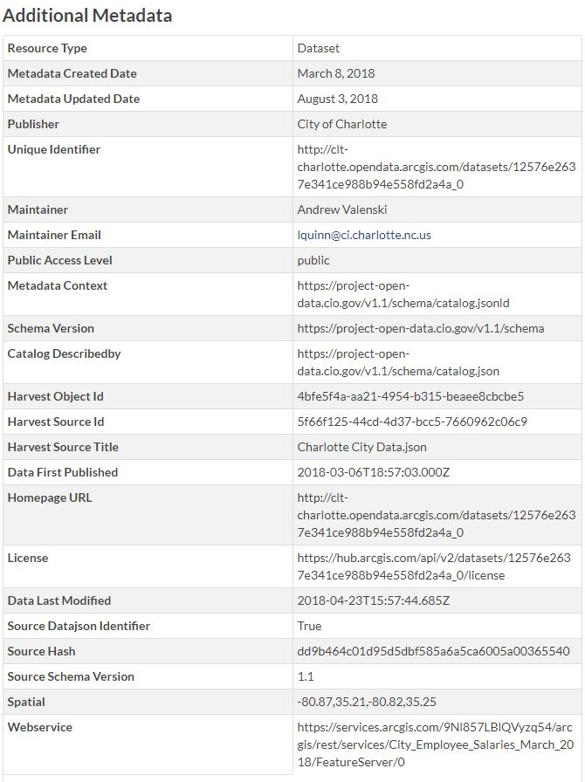
Data Description
The data displays employee salary and hourly rate information as maintained and stored in the Charlotte Human Resources management system
The file is named City_Employee_Salaries_March_2018.csv, although other formats have been given (ArcGIS Open Dataset, Esri Rest API, GeoJSON, API Endpoint, Landing Page
URL: https://catalog.data.gov/dataset/city-employee-salaries-march-2018

Slide 3
Step-By-Step Analysis
Please reference the python file

Slide 4
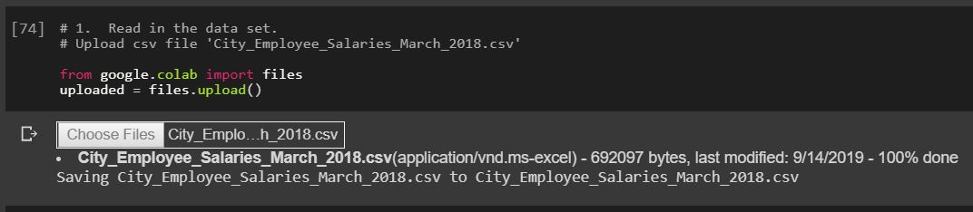
Step 1: Read Data
I uploaded the file onto google drive so that it is easier to work with when it comes to calling columns and rows
It was important to note that I had to compile this specific code when updating correctly and had to delete previous versions when I needed to display “null” values (task # 7)

Slide 5
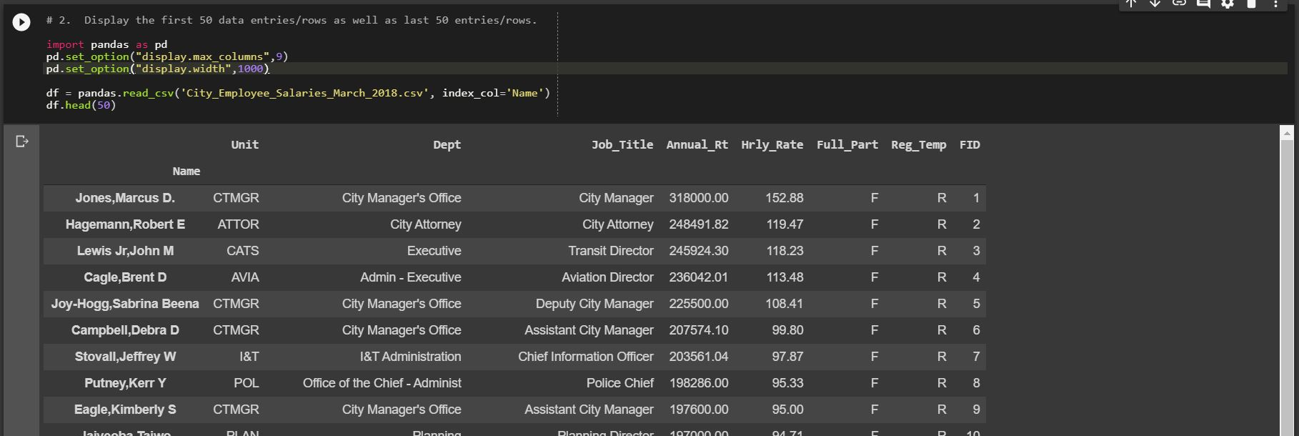
Step 2: Display Data
Displaying the data was relatively easy with the .head() function, I used this print as a comparison for later tasks

Slide 6
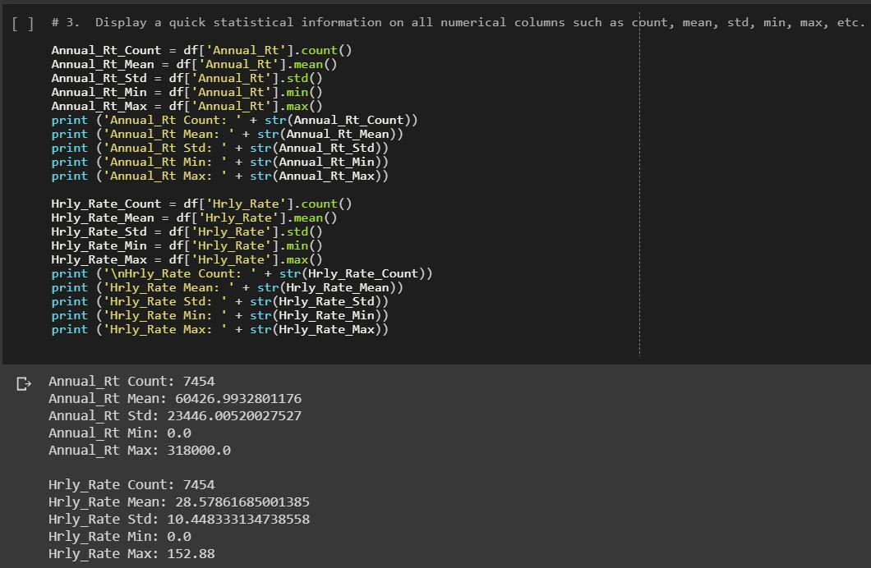
Step 3: Display Statistics
There was a .describe() function you could use to code this particular task, but I decided to use other features

Slide 7
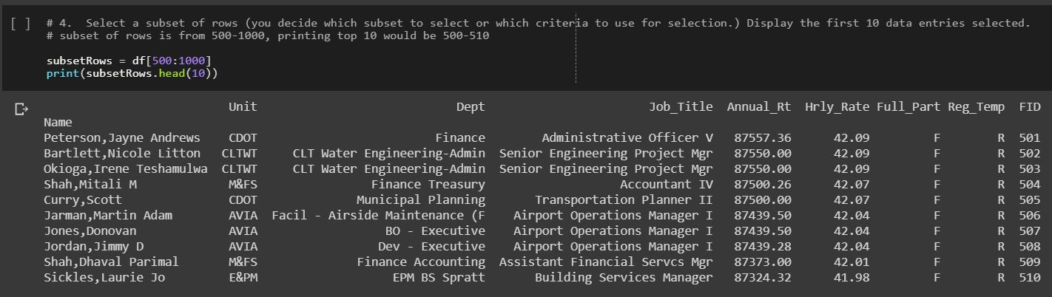
Step 4: Subset of rows
The wording of this was relatively difficult to understand, but in understanding what “subset” was, I decided to pick between the values of 500-1000, and have the top 10 printed, resulting from 500-510 instead of to 1000

Slide 8
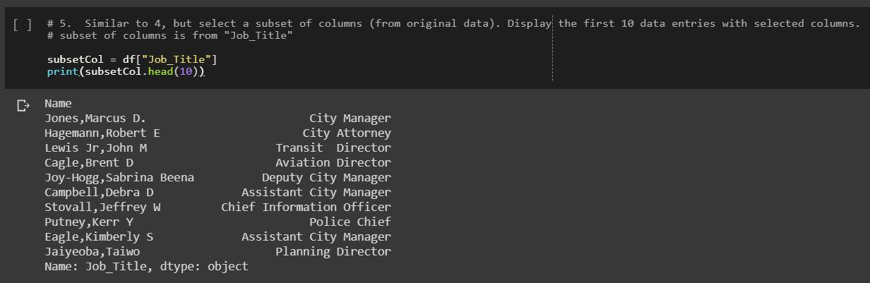
Step 5: Subset of Columns
This was easier to understand, I picked a specific column and displayed the first 10 rows with only that column visible

Slide 9
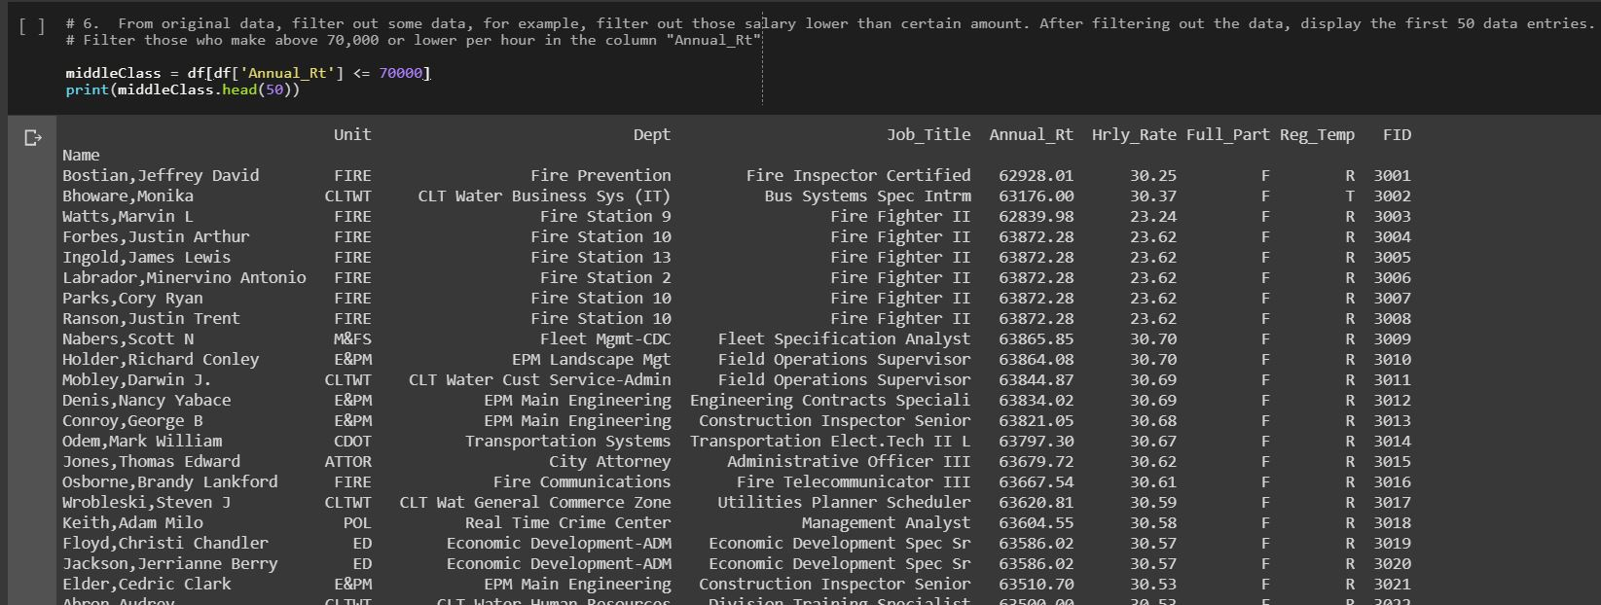
Step 6: Filter Data
I filtered out the middle-class salary income and lower

Slide 10
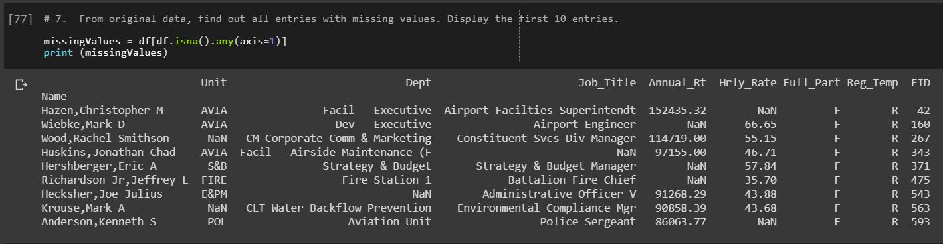
Step 7: Filter Null Data
For this step, I had to go and delete data (11 entries), as it was a complete data set and upload it (task #1)

Slide 11
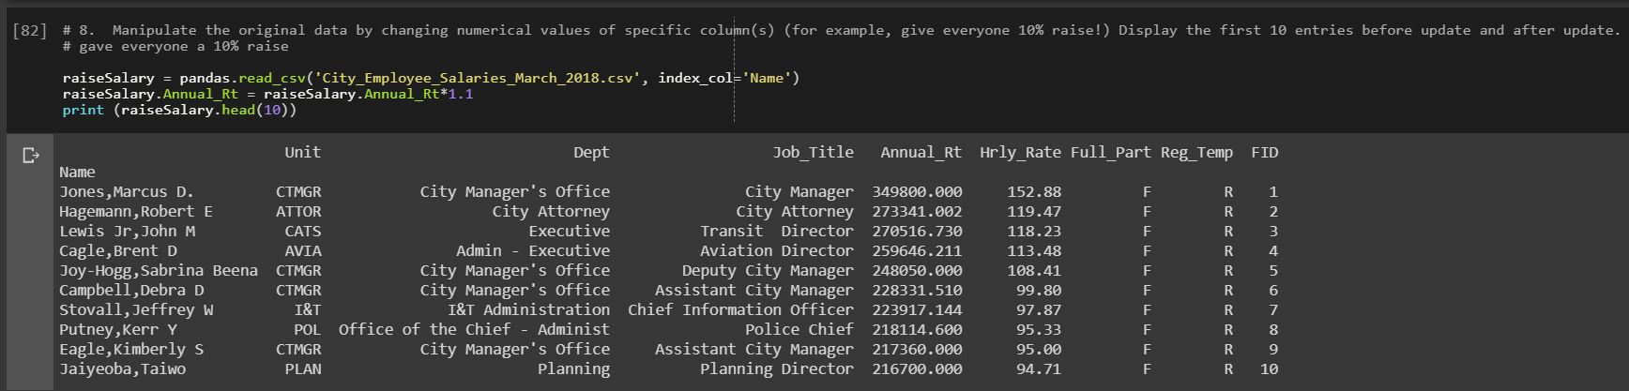
Step 8: Editing Data
I edited the annual rate, but not the hourly rate. This was then compared to the data I had previously, showing I had only edited annual rate

Slide 12
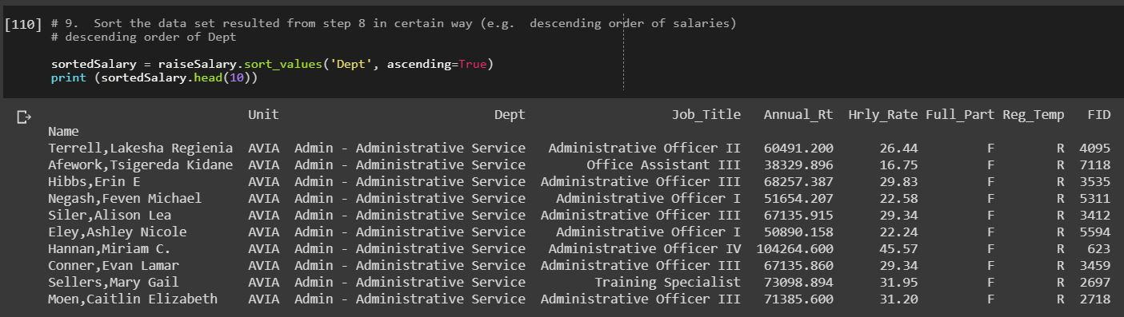
Step 9: Sorting Data
Sorted the salary (from task # 8) based on department. Because the dataset already had salary decreasing, I decided to change it to ascending values

Slide 13
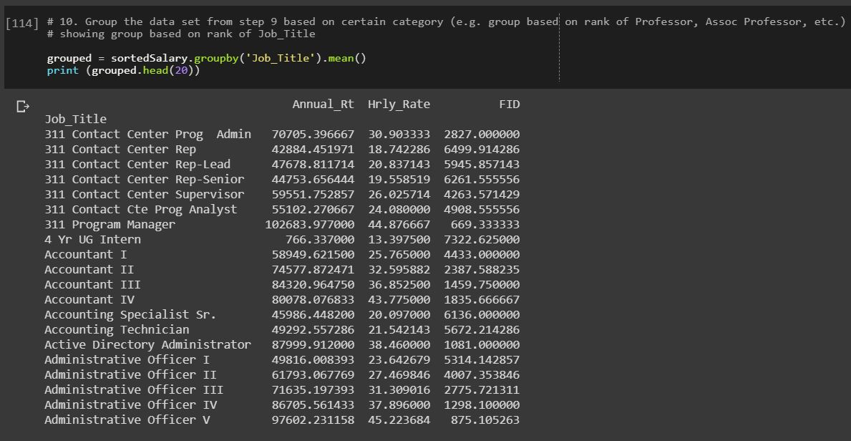
Step 10: Grouping Data
There was no specific amount required to display, so I picked 20 just so we can see the iteration of ranks

Slide 14
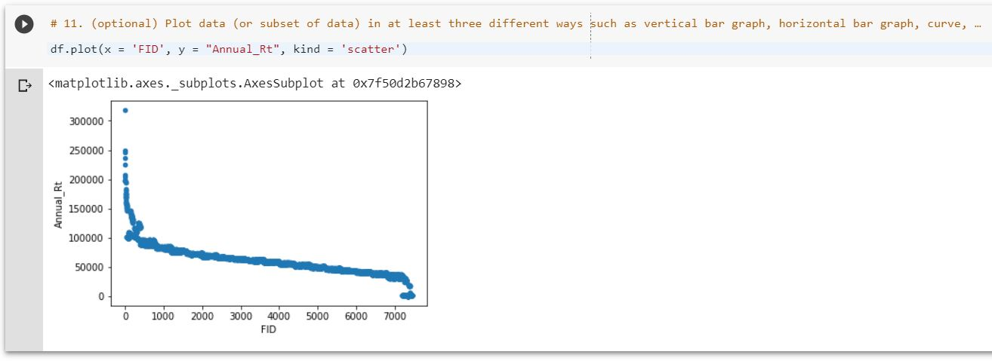
Step 11: Display Data
x was the ID descending from highest salary, y was the annual rate (it is difficult to see the values in dark mode)
There is so much data (7455) that it looks almost like a line graph even though it is displayed as scatter graph

Slide 15
Thank you
Please free to reach out if you have any questions!

