Slide 1




CYBER SECURITY HACKATHON 2025
Elliot
Elliot
Team Name - Elliot
Problem Statement – Child Centric Cyber Safety: "Cyber Tales"
College Name - VIT Bhopal
Leader’s: Sahil Garje
Contact Number : 7498097130
Email Id : sahilgarje@gmail.com

Slide 2

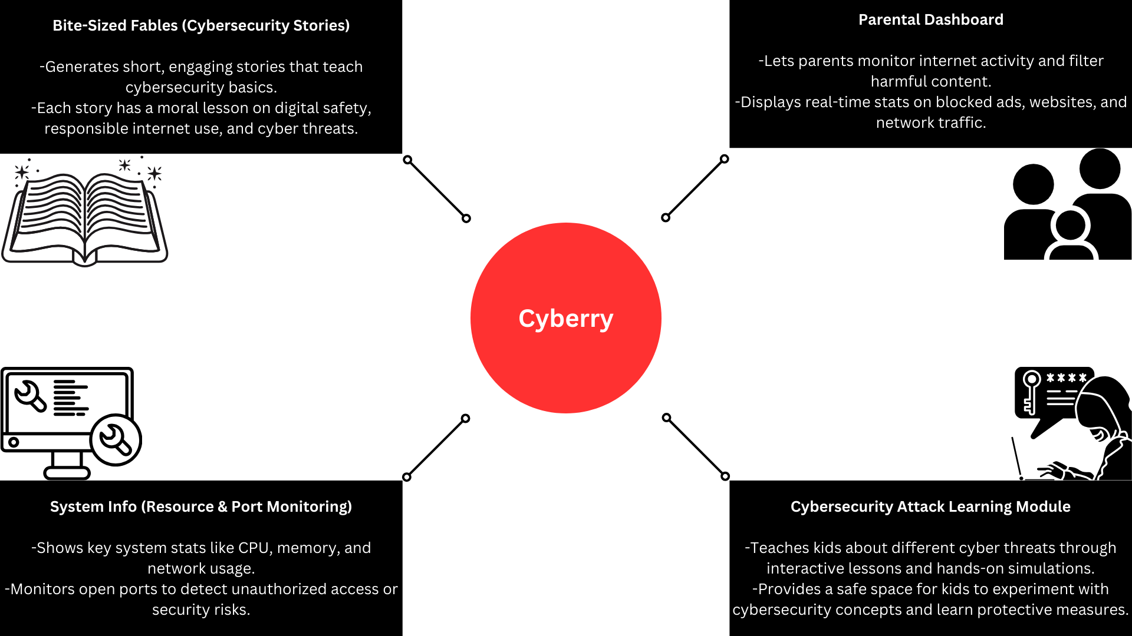
CYBER SECURITY HACKATHON 2025
Elliot
Notes:
f

Slide 3
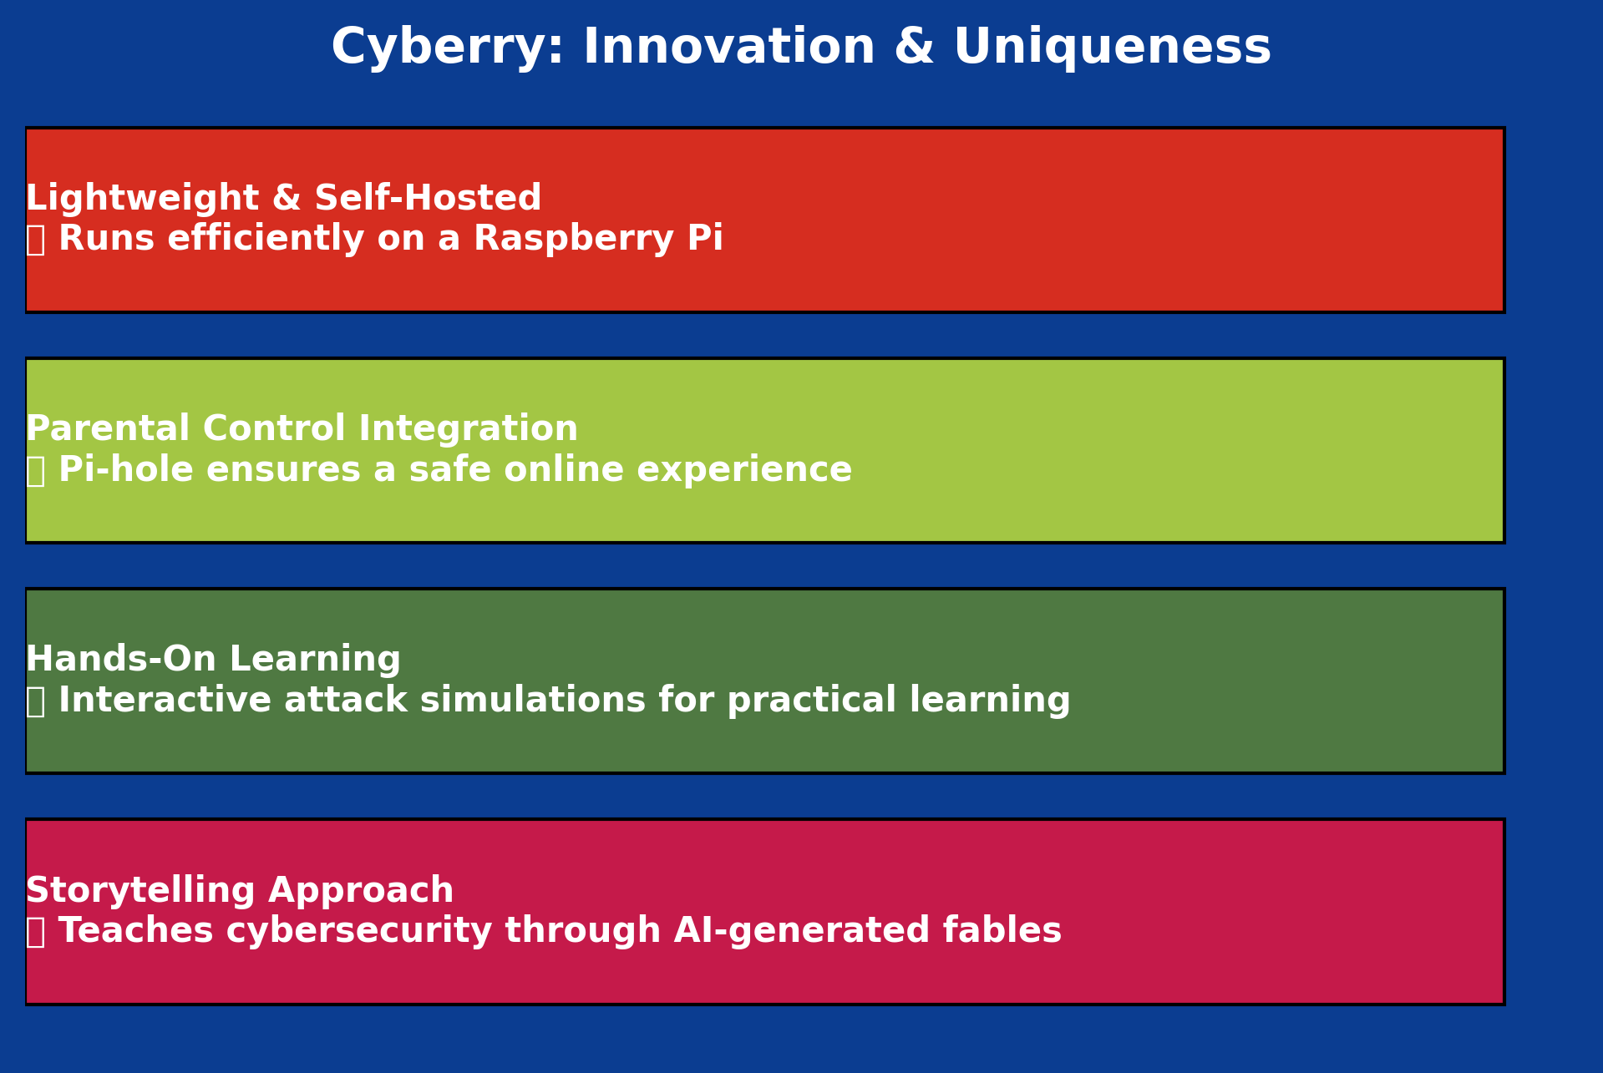
CYBER SECURITY HACKATHON 2025
Elliot

Slide 4

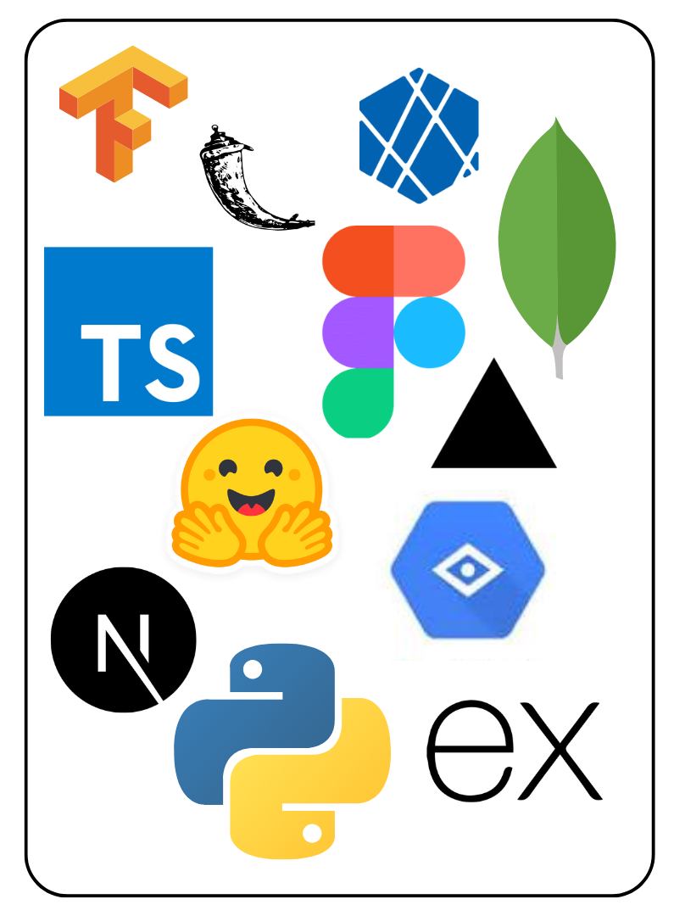
CYBER SECURITY HACKATHON 2025
Elliot
AI: LLama (locally, 3.2:1B works on raspberry pi well!) and Gemini API
Backend: Flask
Frontend: HTML, CSS, JS and Bootstrap
Hosting: Raspberry Pi 5 (self hosted)
Misc.: Pi-hole, camera module, microcontroller, other sensors.

Slide 5

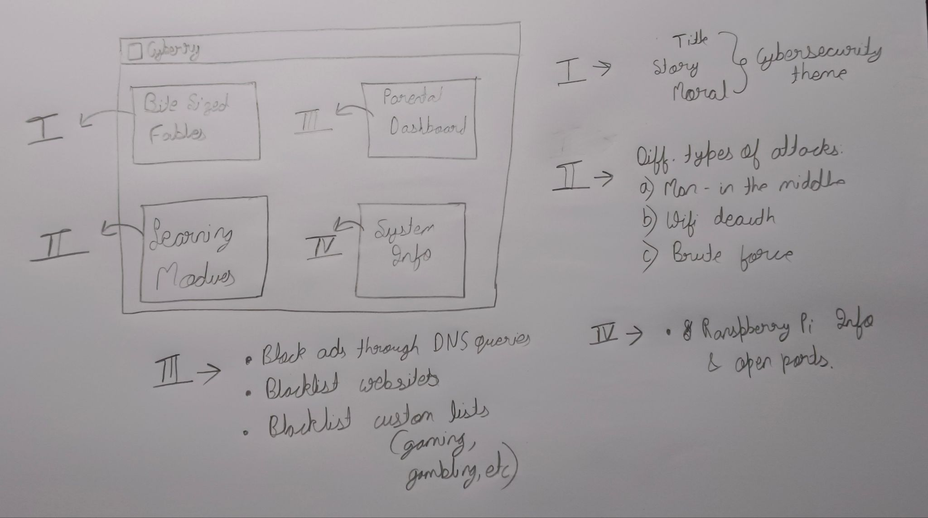
CYBER SECURITY HACKATHON 2025
Elliot

Slide 6
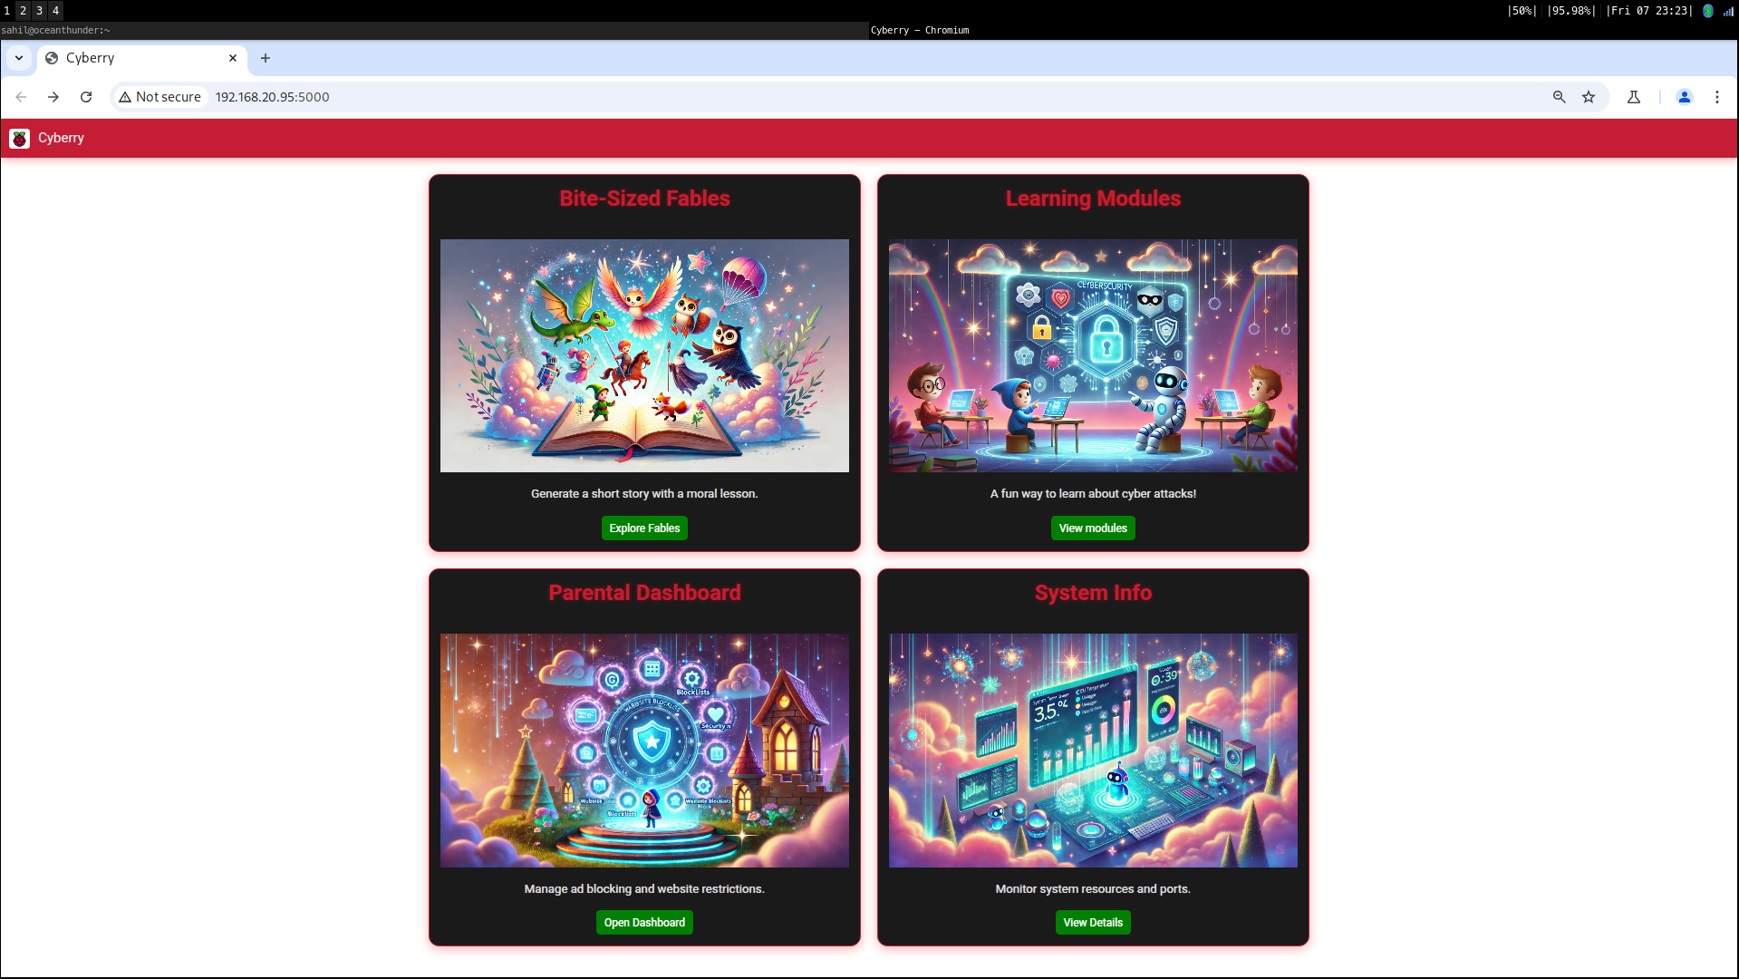
CYBER SECURITY HACKATHON 2025
Elliot

Slide 7
CYBER SECURITY HACKATHON 2025
Elliot
Feasibility:
Technical | Works on Raspberry Pi with lightweight AI models (LLaMA) and self hosted web ui on pi!
Market | Growing demand for child-friendly cybersecurity education.
Financial | Low-cost implementation using open-source tools. Pi is a very cheap computer! Good for learning linux and servers

Slide 8
CYBER SECURITY HACKATHON 2025
Elliot
Challenges:
Technical | Running AI-generated stories on Raspberry Pi without lag. Llama 3.2:1B and 3B are fine but 7b can be considerable slow
Market | Convincing parents of the need for cybersecurity education.
Financial | Users need a Raspberry Pi, which could be a barrier. Considering most see raspberry pi as an addition rather than main PC.

Slide 9

CYBER SECURITY HACKATHON 2025
Elliot
01
Children (8-16 years old)
Learn about cybersecurity threats (phishing, MITM attacks, brute force, etc.) in a fun, interactive way.
IMPACT AND BENEFITS
02
Parents & Guardians
Gain better control over children's internet exposure.
03
Educational Institutions
Schools can integrate Cyber Tales into digital literacy programs.

Slide 10
CYBER SECURITY HACKATHON 2025
Elliot
https://docs.pi-hole.net/
https://www.raspberrypi.com/documentation/
https://en.wikipedia.org/wiki/Man-in-the-middle_attack
https://en.wikipedia.org/wiki/Wi-Fi_deauthentication_attack
https://en.wikipedia.org/wiki/Password_cracking

