Slide 1
Introduction to Cassandra

Slide 2
Overview

Slide 3
Influential Papers
BigTable
Strong consistency
Sparse map data model
GFS, Chubby, et al
Dynamo
O(1) distributed hash table (DHT)
BASE (aka eventual consistency)
Basically Available Soft-state Eventual consistency
Client tunable consistency/availability

Slide 4
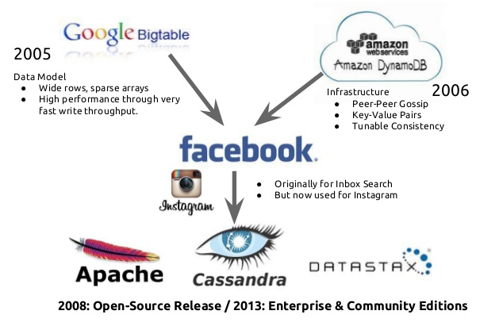
Cassandra History

Slide 5
NoSQL
HBase
MongoDB
Riak
Voldemort
Neo4J
Cassandra
Hypertable
HyperGraphDB
Memcached
Tokyo Cabinet
Redis
CouchDB

Slide 6
NoSQL Big Data
HBase
MongoDB
Riak
Voldemort
Neo4J
Cassandra
Hypertable
HyperGraphDB
Memcached
Tokyo Cabinet
Redis
CouchDB

Slide 7
CAP Theorem “Pick Two”
CP
AP
Bigtable
Hypertable
HBase
Dynamo
Voldemort
Cassandra

Slide 8
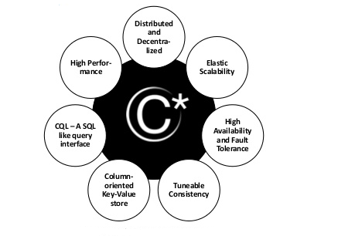
Key features

Slide 9
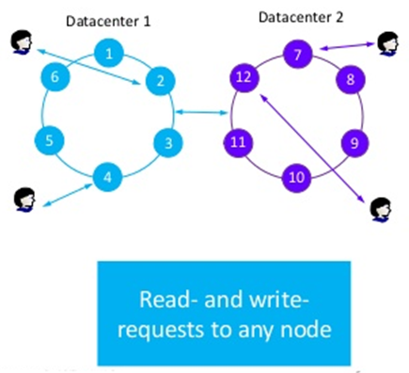
Distributed and Decentralized
Distributed: running on many nodes, all nodes are equal.
Data is organized in a Distributed Hash Table.
Decentralized: No single point failure.
No master node, peer to peer, using gossip protocol
Single Cassandra cluster may run across geographically dispersed data centers
No fail-over during maintenance or software upgrade.

Slide 10
Partition and Replica Placement
Partitioning
Replica Placement
Random
128bit namespace, (MD5)
Good distribution
Order Preserving
Tokens determine namespace
Natural order (lexicographical)
Range / cover queries
SimpleSnitch
Default
N-1 successive nodes
RackInferringSnitch
Infers DC/rack from IP
PropertyFileSnitch
Configured w/ a properties file

Slide 11
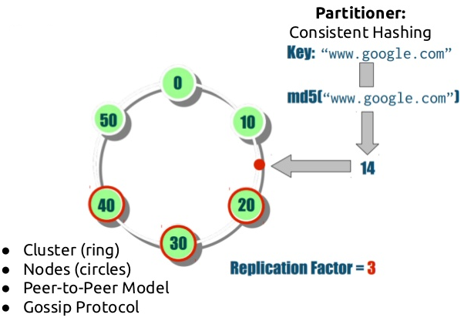
Partition (Consistent Hashing)

Slide 12
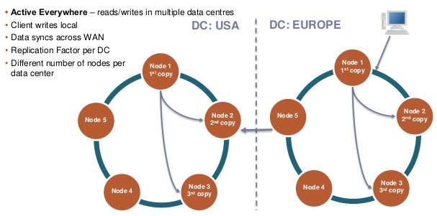
Replication across Data Center

Slide 13
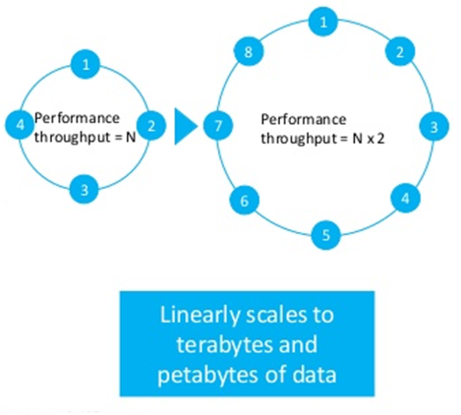
Elastic Scalability
Cassandra scales horizontally,
Adding of nodes increase performance throughput linearly.
Increase / decrease node happen seamlessly.

Slide 14
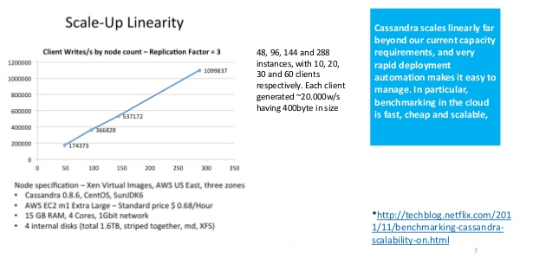
Scaling Benchmark by Netflix*

Slide 15
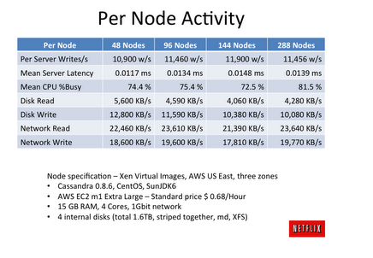
Netflix Performance Test

Slide 16
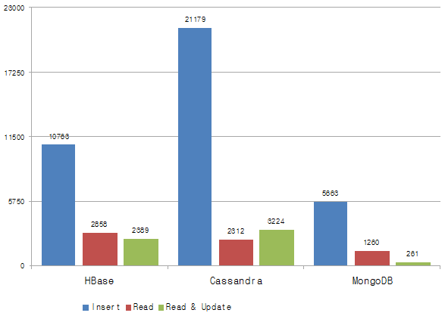
Benchmark from 2011 (Cassandra 0.7.4)*

Slide 17
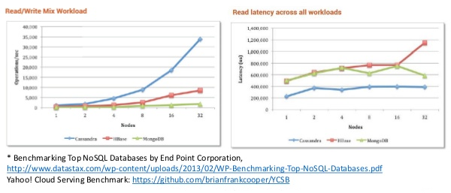
Benchmark from 2013 (Cassandra 1.1.6)*

Slide 18
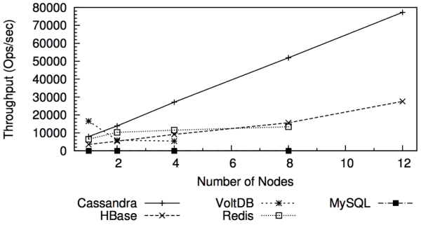
Mixed read write(2011)

Slide 19
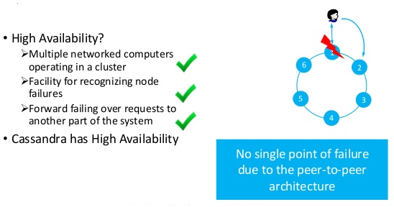
High Availability and Fault Tolerance

Slide 20
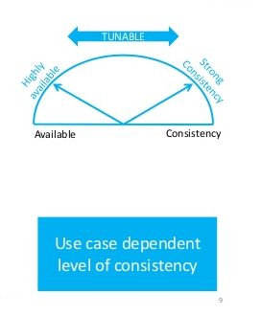
Tunable Data Consistency
Can choose between strong and eventual consistency
Can be done per-operation basis, and adjustable for read and write with different consistency level.
Conflicts are resolved during reads, as focus lies on write-performance.
Handles multi-data center operations

Slide 21
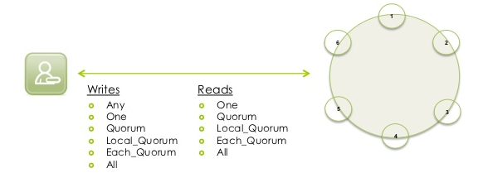
Consistency Level on Read / Write

Slide 22
Choose Consistency Level
Write |  | Read
Level | Description | Level | Description
ANY | 1 replica (including Hinted Handoff)
ONE | 1 replica | ONE | 1st response
QUORUM | (N / 2) +1 replicas | QUORUM | (N / 2) +1
LOCAL_QUORUM | (N / 2) + 1 replicas in local data center | LOCAL_QUORUM | (N / 2) +1 replicas in local data center
EACH_QUORUM | (N / 2) +1 replicas in each data center | EACH_QUORUM | (N / 2) +1 replicas in each data center
ALL | All replicas | ALL | All replicas
R + W > N

Slide 23
The dynamo paper
#1
RF = 3
CL = One
#6
#2
Coordinator
#5
#3
Client
#4

Slide 24
The dynamo paper
#1
RF = 3
CL = Quorum
#6
#2
Coordinator
#5
#3
Client
#4

Slide 25
The dynamo paper
#1
RF = 3
CL = One
+ hint
#6
#2
Coordinator
#5
#3
Client
#4

Slide 26
The dynamo paper
#1
RF = 3
CL = One
Read repair
#6
#2
Coordinator
#5
#3
Client
#4

Slide 27
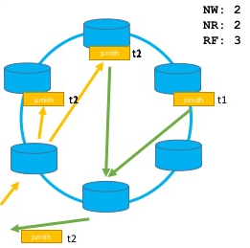
When do we have strong consistency?
Simple Formula:
(nodes_written+ nodes_read) >replication_factor
Ensures that a read always reflects the most recent write
If not: Weak consistency --> Eventually consistent

Slide 28
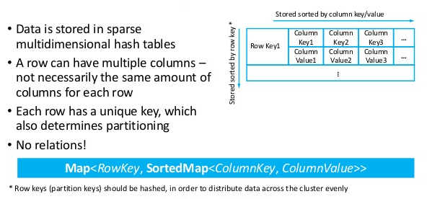
Column-oriented Key-Value Store

Slide 29
High Performance
Optimized from the ground up for high throughput
All disk writes are sequential, append only operations
No reading before writing
Cassandra’s threading-concept is optimized for running on multiprocessor/ multicore machines
Optimized for writing, but fast reads are possible as well

Slide 30
Data Compression
Uses Google’s Snappy data compression algorithm
Compresses data on a per column family level
Internal tests at DataStax show up to 80%+ compression of raw data
No performance penalty (and some increases in overall performance due to less physical I/O)!

Slide 31
Cassandra Storage
Write
Memtable
Flushed on time/size trigger
Memory
Disk
Commit Log
SSTable
SSTable
SSTable
SSTable
Immutable

Slide 32
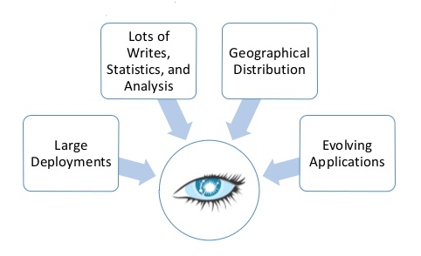
When do we need these features?

Slide 33
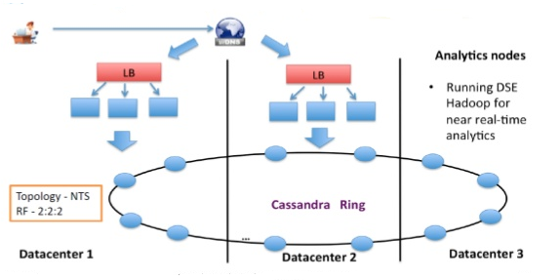
Cassandra/Hadoop Deployment

Slide 34
Cassandra @ Apple
Cassandra Nodes:75,000+
Data Size: 10s of PetaBytes
Ops / sec: in the millions
Largest Cluster: 1000+
Versions: 1.2.x and 2.0.x

Slide 35
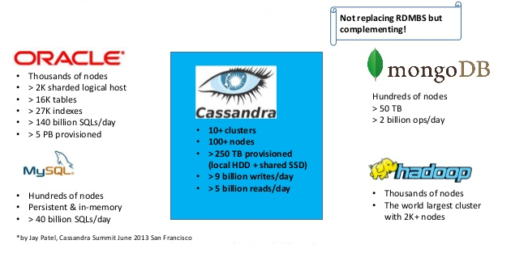
eBay Data Infrastructure

Slide 36
eBay Data Infrastructure
Application/Use Case
Why Cassandra?
Time-series data and real-time insights
Fraud detection & prevention
Quality Click Pricing for affiliates
Order & Shipment Tracking
…
Server metrics collection
Taste graph-based next-gen recommendation system
Social Signals on eBay Product & Item pages
Multi-Datacenter (active-active)
No SPOF
Easy to scale
Write performance
Distributed Counters

Slide 37

Who is using Cassandra

Slide 38
Data Model

Slide 39
Cassandra Data model (hierarchical views)
Key space (schema)
Table (column familiar)
Row
Partition key (part of primary key)
Static columns
Clustering key(part of primary key)
columns

Slide 40
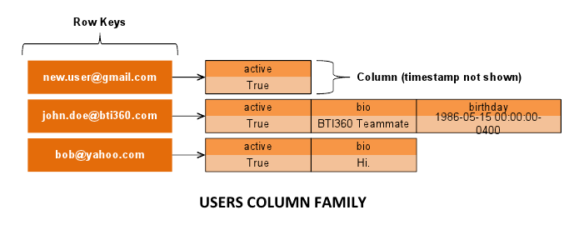
Cassandra Data model (hierarchical views)

Slide 41

The big table paper
Column Family
Row Key
Column
Column
Column
Row Key
Column
Column
Column
Row Key
Column
Column
Column
we can have billions of rows

Slide 42
Column Family
ColumnFamily
Associates records of a similar kind
Record-level Atomicity
Indexed
Column
Basic unit of storage

Slide 43
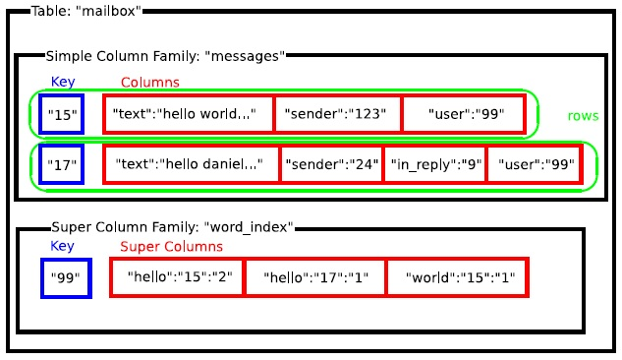
Example

Slide 44
Per-column timestamp-based conflict resolution
{
column: foo, value: bar, timestamp: 1000
}
{
column: foo, value: zing, timestamp: 1001
}
bigger timestamp

Slide 45
CQL
CQL = Cassandra query language

Slide 46
What is CQL
CQL is SQL minus joins, minus subqueries, plus collections
Plus user types, plus tuple types
Introduces a schema to Cassandra
Familiar syntax
Easy to understand
DML operations are atomic

Slide 47
Cassandra Data Model
Access by key
no access by arbitrary WHERE clause
Duplicate data (it’s ok!)
Aggregate data
Build application maintained indexes

Slide 48
Difference with RDBMS in Data Modeling
RDBMS driven by
No SQL driven by
How can I store something right?
What answers do I have?
How can I access something right?
What questions do I have?

Slide 49
Data Modeling Basics
Work top-down. Think about:
What does the application do?
What are the access pattern?
https://de.slideshare.net/planetcassandra/cassandra-day-sv-2014-fundamentals-of-apache-cassandra-data-modeling
https://de.slideshare.net/planetcassandra/data-modeling-with-travis-price

Slide 50
CQL commands
DDL
DML
CREATE TABLE
ALTER TABLE
DROP TABLE
INSERT
UPDATE
DELETE
SELECT
GROUP related modifications
(INSERT, UPDATE, DELETE)
Atomic operation

Slide 51
CQL types
Scalar
Collection
boolean, int (32bit), bigint (64bit),
float, double,
decimal ("BigDecimal"),
varint ("BigInteger"),
ascii, text (= varchar), blob,
inet, timestamp, uuid, timeuuid
list <foo>, set <foo>, map <foo , bar>
Time to live (TTL)
Counters
Secondary Indexes
user types (C* 2.1) are composite types with named fields
tuple types (C* 2.1) are unstructured lists of values

Slide 52
CQL examples
CREATE KEYSPACE packagetracker WITH REPLICATION = { 'class' :
'SimpleStrategy', 'replication_factor' : 1 };
CREATE KEYSPACE packagetracker WITH REPLICATION = { 'class' :
'NetworkTopologyStrategy', 'dc1' : 2, 'dc2' : 2};
CREATE TABLE events (
package_id text,
status_timestamp timestamp,
location text,
notes text,
PRIMARY KEY (package_id, status_timestamp)
);

Slide 53
CQL examples
CREATE TYPE address (
street text,
zip int,
city text);
CREATE TABLE users (
username text,
addresses map<text, address>,
...);
INSERT INTO (id, name) VALUES ('key', 'value');
CREATE TABLE users (
id uuid PRIMARY KEY,
name text,
state text,
birth_date int,
email_addresses set<text>
);
UPDATE users
SET email_address = email_address + {‘jbellis@gmail.com’, ‘jbellis@datastax.com’};
SELECT * FROM USERS WHERE username = ‘jbellis’;

Slide 54
API

Slide 55
Column
name
byte[]
Queried against (predicates)
Determines sort order
value
byte[]
Opaque to Cassandra
timestamp
long
Conflict resolution (Last Write Wins)

Slide 56
Column Comparators
Bytes
UTF8
TimeUUID
Long
LexicalUUID
Composite (third-party)
http://github.com/edanuff/CassandraCompositeType

Slide 57
Idiomatic Client Libraries
Pelops, Hector (Java)
Pycassa (Python)
Cassandra (Ruby)
Others …
http://github.com/edanuff/CassandraCompositeType

Slide 58
Code Example
Python

Slide 59
Pycassa – Python Client API
# creating a connection
from pycassa import connect
hosts = ['host1:9160', 'host2:9160']
client = connect('Keyspace1', hosts)
# creating a column family instance
from pycassa import ColumnFamily
cf = ColumnFamily(client, “Standard1”)
# reading/writing a column
cf.insert('key1', {'name': 'value'})
print cf.get('key1')['name']
https://github.com/jhseu/pycassa

Slide 60
Address Book – Setup
# conf/cassandra.yaml
keyspaces:
- name: AddressBook
column_families:
- name: Addresses
compare_with: BytesType
rows_cached: 10000
keys_cached: 50
comment: 'No comment'

Slide 61
Adding an entry
key = uuid()
columns = {
'first': 'Eric',
'last': 'Evans',
'email': 'eevans@rackspace.com',
'city': 'San Antonio',
'zip': 78250
}
addresses.insert(key, columns)

Slide 62
Fetching a record
# fetching the record by key
record = addresses.get(key)
# accessing columns by name
zipcode = record['zip']
city = record['city']

Slide 63
Indexing (manual)
# conf/cassandra.yaml
keyspaces:
- name: AddressBook
column_families:
- name: Addresses
compare_with: BytesType
rows_cached: 10000
keys_cached: 50
comment: 'No comment'
- name: ByCity
compare_with: UTF8Type

Slide 64
Updating the index
key = uuid()
columns = {
'first': 'Eric',
'last': 'Evans',
'email': 'eevans@rackspace.com',
'city': 'San Antonio',
'zip': 78250
}
addresses.insert(key, columns)
byCity.insert('San Antonio', {key: ''})

Slide 65
Indexing (auto)
# conf/cassandra.yaml
keyspaces:
- name: AddressBook
column_families:
- name: Addresses
compare_with: BytesType
rows_cached: 10000
keys_cached: 50
comment: 'No comment'
column_metadata:
- name: city
index_type: KEYS

Slide 66
Querying the Index
from pycassa.index import create_index_expression
from pycassa.index import create_index_clause
e = create_index_expression('city', 'San Antonio')
clause = create_index_clause([e])
results = address.get_indexed_slices(clause)
for (key, columns) in results.items():
print “%(first)s %(last)s” % columns

Slide 67
Timeseries
# conf/cassandra.yaml
keyspaces:
- name: Sites
column_families:
- name: Stats
compare_with: LongType

Slide 68
Logging values
# time as long (milliseconds since epoch)
tstmp = long(time() * 1e6)
stats.insert('org.apache', {tstmp: value})

Slide 69
Slicing
begin = long(start * 1e6)
stats.get_range('org.apache',
column_start=begin)
end = long((start + 86400) * 1e6)
stats.get_range(start='org.apache',
finish='org.debian',
column_start=begin,
column_finish=end)

Slide 70
Cassandra Community
http://cassandra.apache.org/
http://planetcassandra.org/
https://www.slideshare.net/planetcassandra/presentations
https://de.slideshare.net/DataStax/presentations
https://www.youtube.com/user/PlanetCassandra
https://www.youtube.com/user/DataStax
http://www.datastax.com/dev/blog/
http://www.datastax.com/docs/
https://academy.datastax.com/planet-cassandra//cassandra-training/

Slide 71
Backup slides

Slide 72
Cassandra 2.0

Slide 73
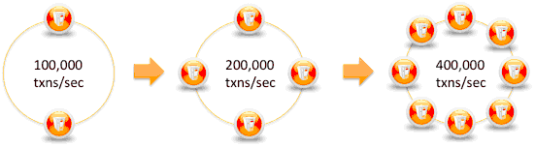
Apache Cassandra 2.0
Based on Big Table & Dynamo
High Performance
Reliable / Available
Massively Scalable
Easy To Use
Developer Productivity Focused

Slide 74
What’s new in C* 2.0
Finalized some legacy items
CQL Improvements
Lightweight Transactions
Triggers
Compaction Improvements
Eager Retries
More, More, More!!!

Slide 75
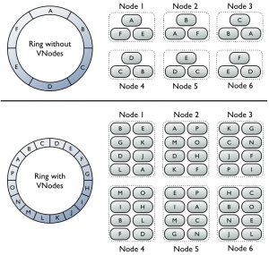
Virtual Nodes are the default

Slide 76
CQL Improvements
Support for multiple prepared statements in batch
Prepared statement for the consistency level, timestamp and ttl
Add cursor API/auto paging to the native CQL protocol
Support indexes on composite column components
ALTER TABLE to DROP a column
Column alias in SELECT statement
SASL (Simple Authentication and Security Layer ) support for improved authentication
Conditional DDL - Conditionally tests for the existence of a table, keyspace, or index before issuing a DROP or CREATE statement using IF EXISTS or IF NOT EXISTS
Support for an empty list of values in the IN clause of SELECT, UPDATE, and DELETE commands, useful in Java Driver applications when passing empty arrays as arguments for the IN clause
Imports and exports CSV (comma-separated values) data to and from Cassandra 1.1.3 and higher.
COPY table_name ( column, ...)
FROM ( 'file_name' | STDIN ) or TO ( 'file_name' | STDOUT )
WITH option = 'value' AND ...

Slide 77
Lightweight Transactions – Why?
Cassandra can provide strong consistency with quorum reads & writes
A write must be written to the commit log and memory table on a quorum of replica nodes.
Quorum = (replication_factor / 2) + 1 (rounded down to a whole number)
This is sometimes not enough when transactions need to be handled in sequence (linearized) or when operating concurrently achieve the expected results without race conditions.
"Strong" consistency is not enough to prevent race conditions. The classic example is user account creation: we want to ensure usernames are unique, so we only want to signal account creation success if nobody else has created the account yet. But naive read-then-write allows clients to race and both think they have a green light to create.

Slide 78
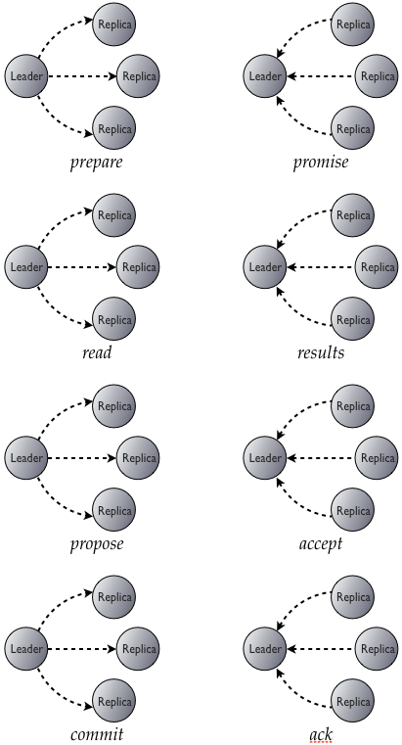
Lightweight Transactions - "when you really need it," not for all your updates.
Prepare: the coordinator generates a ballot (timeUUID in our case) and asks replicas to (a) promise not to accept updates from older ballots and (b) tell us about the most recent update it has already accepted.
Read: we perform a read (of committed values) between the prepare and accept phases. RETURNS HERE IF CAS failure
Accept: if a majority of replicas reply, the coordinator asks replicas to accept the value of the highest proposal ballot it heard about, or a new value if no in-progress proposals were reported.
Commit (Learn): if a majority of replicas acknowledge the accept request, we can commit the new value.
The coordinator sends a commit message to all replicas with the ballot and value.
Because of Prepare & Accept, this will be the highest-seen commit ballot. The replicas will note that, and send it with subsequent promise replies. This allows us to discard acceptance records for successfully committed replicas, without allowing incomplete proposals to commit erroneously later on.
1 second default timeout for total of above operations configured in cas_contention_timeout_in_ms
For more details on exactly how this works, look at the code ☺ https://github.com/apache/cassandra/blob/cassandra-2.0.1/src/java/org/apache/cassandra/service/StorageProxy.java#L202

Slide 79
Lightweight Transactions How do we use it?
Is isolated to the “partition key” for a CQL3 table
INSERT
IF NOT EXISTS
i.e. INSERT INTO users (username, email, full_name) values (‘hellocas', cas@updateme.com', ‘Hello World CAS', 1) IF NOT EXISTS;
UPDATE
IF column = some_value
IF map[column] = some_value
The some_value is what you read or expected the value to be prior to your change
i.e. UPDATE inventory set orderHistory[(now)] = uuid, total[wharehouse13] = 7 where itemID = uuid IF map[wherehouse13] = 8;
Conditional updates are not allowed in batches
The columns updated do NOT have to be the same as the columns in the IF clause.

Slide 80
Trigger (Experimental)
Experimental = Expect the API to change and your triggers to have to be refactored in 2.1 … provide feedback to the community if you use this feature its how we make C* better!!!
Asynchronous triggers is a basic mechanism to implement various use cases of asynchronous execution of application code at database side. For example to support indexes and materialized views, online analytics, push-based data propagation.
Basically it takes a RowMutation that is occurring and allows you to pass back other RowMutation(s) you also want to occur ☺
triggers on counter tables are generally not supported (counter mutations are not allowed inside logged batches for obvious reasons – they aren’t idempotent).

Slide 81
Trigger Example
https://github.com/apache/cassandra/tree/trunk/examples/triggers
RowKey:ColumnName:Value to Value:ColumnName:RowKey
10214124124 – username = to joestein – username = 10214124124
CREATE TRIGGER test1 ON "Keyspace1"."Standard1" EXECUTE ('org.apache.cassandra.triggers.InvertedIndex');
Basically we are returning a row mutation from within a jar so we can do anything we want pretty much
public Collection<RowMutation> augment(ByteBuffer key, ColumnFamily update) {
List<RowMutation> mutations = new ArrayList<RowMutation>();
for (ByteBuffer name : update.getColumnNames()) {
RowMutation mutation = new RowMutation(properties.getProperty("keyspace"), update.getColumn(name).value());
mutation.add(properties.getProperty("columnfamily"), name, key, System.currentTimeMillis());
mutations.add(mutation);
}
return mutations;
}

Slide 82
Improved Compaction
During compaction, Cassandra combines multiple data files to improve the performance of partition scans and to reclaim space from deleted data.
SizeTieredCompactionStrategy: The default compaction strategy. This strategy gathers SSTables of similar size and compacts them together into a larger SSTable This strategy is best suited for column families with insert-mostly workloads that are not read as frequently. This strategy also requires closer monitoring of disk utilization because (as a worst case scenario) a column family can temporarily double in size while a compaction is in progress..
LeveledCompactionStrategy: Introduced in Cassandra 1.0, this strategy creates SSTables of a fixed, relatively small size (5 MB by default) that are grouped into levels. Within each level, SSTables are guaranteed to be non-overlapping. Each level (L0, L1, L2 and so on) is 10 times as large as the previous. This strategy is best suited for column families with read-heavy workloads that also have frequent updates to existing rows. When using this strategy, you want to keep an eye on read latency performance for the column family. If a node cannot keep up with the write workload and pending compactions are piling up, then read performance will degrade for a longer period of time….

Slide 83
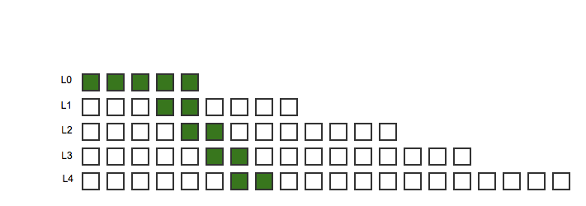
Leveled Compaction – in theory
Reads are through a small amount of files making it performant
Compaction happens fast enough for the new L0 tier coming in

Slide 84
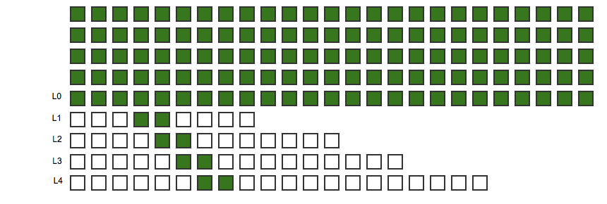
Leveled Compaction – high write load
This will cause read latency using level compaction when the tiered compaction can’t keep up with the writes coming in

Slide 85
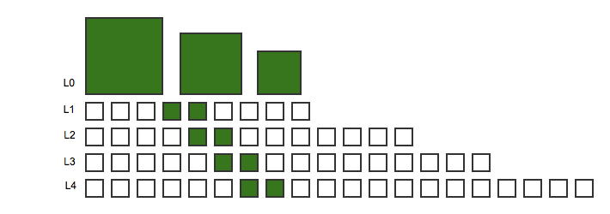
Leveled Compaction
Hybrid – best of both worlds ☺

Slide 86
Eager Retries
Speculative execution for reads
Keeps metrics of read response times to nodes
Avoid query timeouts by sending redundant requests to other replicas if too much time elapses on the original request
ALWAYS
99^{th (Default)}
X percentile
X ms
NONE

Slide 87
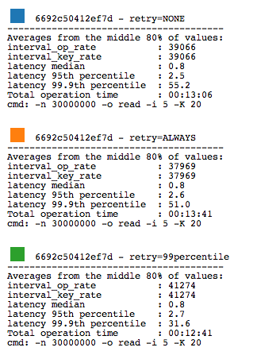
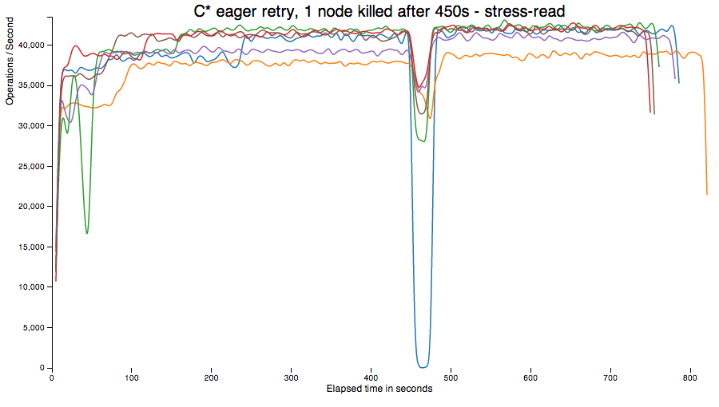
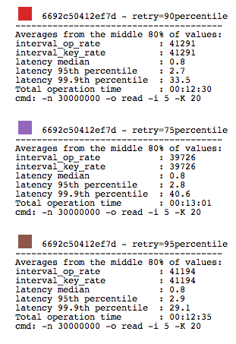
Eager Retries – in action
The JIRA for this test

Slide 88
More, More, More!!!
The java heap and GC has not been able to keep pace with the heap to data ratio with the structures that C* has that can be cleaned up with manual garbage collection…. This was done initially started in 1.2 and finished up in 2.0.
New commands to disable background compactions nodetool disableautocompaction and nodetool enableautocompaction
Auto_bootstrapping of a single-token node with no initial_token
Timestamp condition eliminates sstable seeks with sstable holding min/max timestamp for each file skipping unnecessary files
Thrift users got a major bump in performance using a LMAX disruptor implementation
Java 7 is now required
Level compaction information is moved into the sstables
Streaming has been rewritten – better control, traceability and performance!
Removed row level bloom filters for columns
Row reads during compaction halved … doubling the speed

