Slide 1
Multi-Threading
Huanmin Wu, Microsoft

Slide 2
Multithreading Benefits
Respond to user input while performing long computing.
Paralleling tasking, some use CPU, some are doing intensive I/O.
Leverage multiple CPUs or multicores.

Slide 3
Multithreading Costs
More complex design
Context Switching Overhead
Increased Resource Consumption

Slide 4
Processing and Threading
Processing | Threading
Two programs execute concurrently. eg. Typing in MS-WORD and listening the song. | Single program perform two or more task simultaneously. For eg. we will saving the file and order to print the file.
Running Heavyweight tasks. eg. Run the Java compiler at the same time that you are using a text editor. | Running the Lightweight tasks. eg: text editor can format text at the same time that it is printing.
Separate address space. | Shares the address space
Inter-process communication is expensive and limited. | Interthread communication is inexpensive. Switching between one thread to another is easy.

Slide 5
Concurrency Model
Parallel Workers
Assembly Line
Functional Parallelism

Slide 6
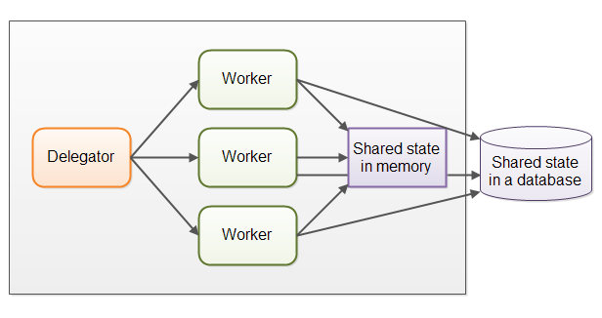
Parallel Workers
Shared State Can Get Complex
Stateless Workers
Job Ordering is Nondeterministic

Slide 7
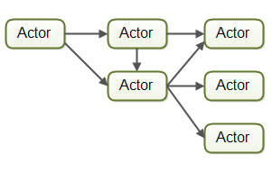
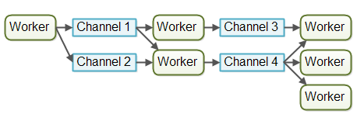
Assembly Line
Reactive, Event Driven Systems
Vert.x, Akka, Node.JS (JavaScript)
Actor vs Channel
No Shared State
Stateful Workers
Better Hardware Conformity
Job Ordering is Possible
But hard to see which function is executed by which code

Slide 8
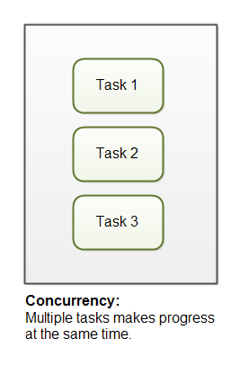
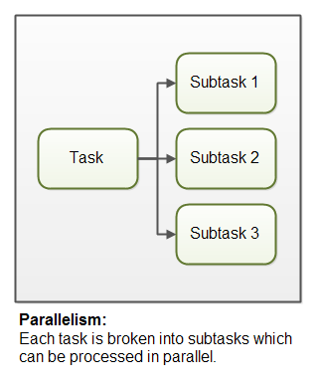
Concurrency vs Parallelism

Slide 9
thread States
This slide applies to the process abstraction too, or, more precisely, to the main thread of a process.
active
ready or
running
User TCB
user
stack
sleep
wait
wakeup
signal
blocked
kernel TCB
wait
kernel
stack
When a thread is blocked its TCB is placed on a sleep queue of threads waiting for a specific wakeup event.
Program

Slide 10
Thread Priority
Thread priorities are integers that specify the relative priority of one thread to another.
As an absolute value, a priority is meaningless;
A thread can voluntarily relinquish control. This is done by explicitly yielding, sleeping, or blocking on pending I/O. In this scenario, all other threads are examined, and the highest priority thread that is ready to run is given the CPU.
A thread can be preempted by a higher-priority thread. In this case, a lower-priority thread that does not yield the processor is simply preempted – no matter what it is doing – by a higher priority thread. Basically, as soon as a higher-priority thread wants to run, it does. This is called preemptive multitasking.

Slide 11
Race Condition
public class Counter {
protected long count = 0;
public void add(long value){
this.count = this.count + value;
}
}
this.count = 0;
A: Reads this.count into a register (0)
B: Reads this.count into a register (0)
B: Adds value 2 to register
B: Writes register value (2) back to memory. this.count now equals 2
A: Adds value 3 to register
A: Writes register value (3) back to memory. this.count now equals 3

Slide 12
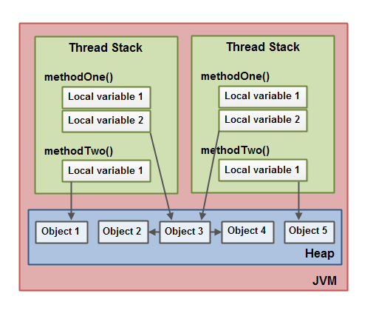
Thread Safety
If a resource is created, used and disposed within the control of the same thread, and never escapes the control of this thread, the use of that resource is thread safe.

Slide 13
Locking and blocking
H
T
If thread T attempts to acquire a lock that is busy (held), T must spin and/or block until the lock is free. T enters the kernel (via syscall) to block. When the lock holder H releases, H enters the kernel (via syscall) to wakeup a waiting thread (e.g., T).
A
A
R
running
R
yield
preempt
Note: H can block too, perhaps for some other resource! H doesn’t implicitly release the lock just because it blocks. Many students get that idea somehow.
sleep
dispatch
blocked
ready
wakeup
STOP
wait

Slide 14


Locking a critical section
The threads may run the critical section in either order, but the schedule can never enter the grey region where both threads execute the section at the same time.
load
add
store
mx->Acquire();
x = x + 1;
mx->Release();
☑
R
x=x+1
load
add
store
mx->Acquire();
x = x + 1;
mx->Release();
A
x=x+1
A
R
Holding a shared mutex prevents competing threads from entering a critical section protected by the shared mutex (monitor). At most one thread runs in the critical section at a time.

Slide 15
Synchronization
Synchronization is where we want to allow only one thread to access the shared resource.
1. To prevent thread interference.
2. To prevent consistency problem.
Synchronized method is used to lock an object for any shared resource.

Slide 16
Synchronization Example
public class TwoSums {
private int sum1 = 0;
private int sum2 = 0;
public void add(int val1, int val2){
synchronized(this){
this.sum1 += val1;
this.sum2 += val2;
}
}
}
public class TwoSums {
private int sum1 = 0;
private int sum2 = 0;
private Integer sum1Lock = new Integer(1);
private Integer sum2Lock = new Integer(2);
public void add(int val1, int val2){
synchronized(this.sum1Lock){
this.sum1 += val1;
}
synchronized(this.sum2Lock){
this.sum2 += val2;
}
}
}

Slide 17
Immutable object
public class ImmutableValue{
private int value = 0;
public ImmutableValue(int value){
this.value = value;
}
public int getValue(){
return this.value;
}
public ImmutableValue add(int valueToAdd){
return new ImmutableValue(this.value + valueToAdd);
}
}

Slide 18
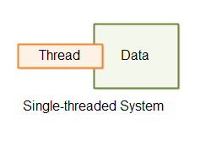
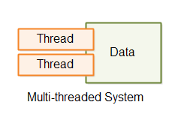
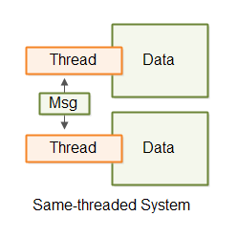
Thread with Local Data

Slide 19
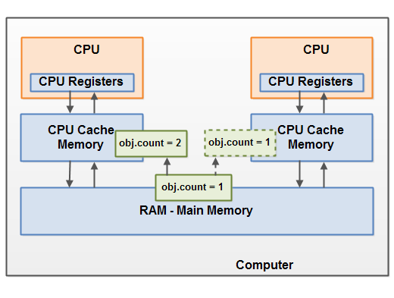
Visibility on Shared Objects

Slide 20
The first thing to understand about memory behavior on multi-core systems
Cores must see a “consistent” view of shared memory for programs to work properly. But what does it mean?
Synchronization accesses tell the machine that ordering matters: a happens-before relationship exists. Machines always respect that.
Modern machines work for race-free programs.
Otherwise, all bets are off. Synchronize!
W(x)=1
OK
R(y)
1
The most you should assume is that any memory store before a lock release is visible to a load on a core that has subsequently acquired the same lock.
T1
pass lock
M
T2
W(y)=1
OK
R(x)
0??

Slide 21
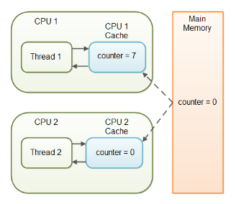
Volatile Keyword
The Java volatile Visibility Guarantee
public class SharedObject {
public volatile int counter = 0;
}
The Java volatile Happens-Before Guarantee
Reads from and writes to other variables cannot be reordered to occur after a write to a volatile variable.
Reads from and writes to other variables cannot be reordered to occur before a read of a volatile variable.
Notes:
The Java volatile Visibility Guarantee
The Java volatile keyword is intended to address variable visibility problems. By declaring the countervariable volatile all writes to the counter variable will be written back to main memory immediately. Also, all reads of the counter variable will be read directly from main memory.
The Java volatile Happens-Before Guarantee
To address the instruction reordering challenge, the Java volatile keyword gives a "happens-before" guarantee, in addition to the visibility guarantee. The happens-before guarantee guarantees that:
Reads from and writes to other variables cannot be reordered to occur after a write to a volatilevariable, if the reads / writes originally occurred before the write to the volatile variable. The reads / writes before a write to a volatile variable are guaranteed to "happen before" the write to the volatile variable. Notice that it is still possible for e.g. reads / writes of other variables located after a write to a volatile to be reordered to occur before that write to the volatile. Just not the other way around. From after to before is allowed, but from before to after is not allowed.
Reads from and writes to other variables cannot be reordered to occur before a read of a volatilevariable, if the reads / writes originally occurred after the read of the volatile variable. Notice that it is possible for reads of other variables that occur before the read of a volatile variable can be reordered to occur after the read of the volatile. Just not the other way around. From before to after is allowed, but from after to before is not allowed.
The above happens-before guarantee assures that the visibility guarantee of the volatile keyword are being enforced.
volatile is Not Always Enough
Even if the volatile keyword guarantees that all reads of a volatile variable are read directly from main memory, and all writes to a volatile variable are written directly to main memory, there are still situations where it is not enough to declare a variable volatile.
In the situation explained earlier where only Thread 1 writes to the shared counter variable, declaring the counter variable volatile is enough to make sure that Thread 2 always sees the latest written value.
In fact, multiple threads could even be writing to a shared volatile variable, and still have the correct value stored in main memory, if the new value written to the variable does not depend on its previous value. In other words, if a thread writing a value to the shared volatile variable does not first need to read its value to figure out its next value.
As soon as a thread needs to first read the value of a volatile variable, and based on that value generate a new value for the shared volatile variable, a volatile variable is no longer enough to guarantee correct visibility. The short time gap in between the reading of the volatile variable and the writing of its new value, creates an race condition where multiple threads might read the same value of the volatile variable, generate a new value for the variable, and when writing the value back to main memory - overwrite each other's values.
The situation where multiple threads are incrementing the same counter is exactly such a situation where a volatile variable is not enough. The following sections explain this case in more detail.
Imagine if Thread 1 reads a shared counter variable with the value 0 into its CPU cache, increment it to 1 and not write the changed value back into main memory. Thread 2 could then read the same countervariable from main memory where the value of the variable is still 0, into its own CPU cache. Thread 2 could then also increment the counter to 1, and also not write it back to main memory.

Slide 22
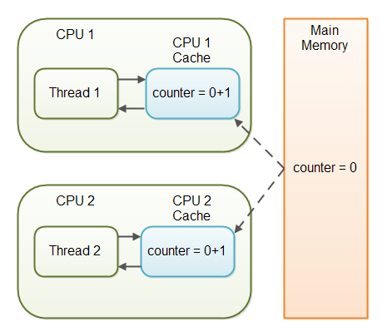
Volatile is not Enough
Read and update will still cause out of sync
Notes:
The Java volatile Visibility Guarantee
The Java volatile keyword is intended to address variable visibility problems. By declaring the countervariable volatile all writes to the counter variable will be written back to main memory immediately. Also, all reads of the counter variable will be read directly from main memory.
The Java volatile Happens-Before Guarantee
To address the instruction reordering challenge, the Java volatile keyword gives a "happens-before" guarantee, in addition to the visibility guarantee. The happens-before guarantee guarantees that:
Reads from and writes to other variables cannot be reordered to occur after a write to a volatilevariable, if the reads / writes originally occurred before the write to the volatile variable. The reads / writes before a write to a volatile variable are guaranteed to "happen before" the write to the volatile variable. Notice that it is still possible for e.g. reads / writes of other variables located after a write to a volatile to be reordered to occur before that write to the volatile. Just not the other way around. From after to before is allowed, but from before to after is not allowed.
Reads from and writes to other variables cannot be reordered to occur before a read of a volatilevariable, if the reads / writes originally occurred after the read of the volatile variable. Notice that it is possible for reads of other variables that occur before the read of a volatile variable can be reordered to occur after the read of the volatile. Just not the other way around. From before to after is allowed, but from after to before is not allowed.
The above happens-before guarantee assures that the visibility guarantee of the volatile keyword are being enforced.
volatile is Not Always Enough
Even if the volatile keyword guarantees that all reads of a volatile variable are read directly from main memory, and all writes to a volatile variable are written directly to main memory, there are still situations where it is not enough to declare a variable volatile.
In the situation explained earlier where only Thread 1 writes to the shared counter variable, declaring the counter variable volatile is enough to make sure that Thread 2 always sees the latest written value.
In fact, multiple threads could even be writing to a shared volatile variable, and still have the correct value stored in main memory, if the new value written to the variable does not depend on its previous value. In other words, if a thread writing a value to the shared volatile variable does not first need to read its value to figure out its next value.
As soon as a thread needs to first read the value of a volatile variable, and based on that value generate a new value for the shared volatile variable, a volatile variable is no longer enough to guarantee correct visibility. The short time gap in between the reading of the volatile variable and the writing of its new value, creates an race condition where multiple threads might read the same value of the volatile variable, generate a new value for the variable, and when writing the value back to main memory - overwrite each other's values.
The situation where multiple threads are incrementing the same counter is exactly such a situation where a volatile variable is not enough. The following sections explain this case in more detail.
Imagine if Thread 1 reads a shared counter variable with the value 0 into its CPU cache, increment it to 1 and not write the changed value back into main memory. Thread 2 could then read the same countervariable from main memory where the value of the variable is still 0, into its own CPU cache. Thread 2 could then also increment the counter to 1, and also not write it back to main memory.

Slide 23
Java Volatile Keyword
public class MyClass {
private int years;
private int months
private volatile int days;
public int totalDays() {
int total = this.days;
total += months * 30;
total += years * 365;
return total;
}
public void update(int years, int months, int days){
this.years = years;
this.months = months;
this.days = days;
}
}

Slide 24
Monitor
Every Java object has a built-in internal "lock".
A thread can "wait" on an object's lock, causing it to pause.
A “wait” will release the lock
Another thread can "notify" on an object's lock, unpausing any other thread(s) that are currently waiting on that lock.
An implementation of monitors, a classic concurrency construct.
These methods are not often used directly; but they are used internally by other concurrency constructs.
method | description
notify() | unblocks one random thread waiting on this object's lock
notifyAll() | unblocks all threads waiting on this object's lock
wait() wait(ms) | causes the current thread to wait (block) on this object's lock, indefinitely or for a given # of ms

Slide 25
Monitor problem
Missed Signals
If a thread calls notify() before the thread to signal has called wait(), the signal will be missed by the waiting thread.
Spurious Wakeups
For inexplicable reasons it is possible for threads to wake up even if notify() and notifyAll() has not been called. This is known as spurious wakeups. Wakeups without any reason.
Wait on a string constants
public class MyWaitNotify{
String myMonitorObject = "";
public void doWait(){
synchronized(myMonitorObject){
...
}
}
public void doNotify(){
synchronized(myMonitorObject){
...
}
}
}

Slide 26
Monitor Example
public class MyWaitNotify3{
MonitorObject myMonitorObject = new MonitorObject();
boolean wasSignalled = false;
public void doWait(){
synchronized(myMonitorObject){
while(!wasSignalled){
try{
myMonitorObject.wait();
} catch(InterruptedException e){...}
}
//clear signal and continue running.
wasSignalled = false;
}
}
public void doNotify(){
synchronized(myMonitorObject){
wasSignalled = true;
myMonitorObject.notify();
}
}
}

Slide 27
Dining Philosophers
N processes share N resources
resource requests occur in pairs w/ random think times
hungry philosopher grabs fork
...and doesn’t let go
...until the other fork is free
...and the linguine is eaten
4
A
1
D
B
3
C
2
while(true) {
Think();
AcquireForks();
Eat();
ReleaseForks();
}

Slide 28
Resource Graph or Wait-for Graph
A vertex for each process and each resource
If process A holds resource R, add an arc from R to A.
If process A is waiting for R, add an arc from A to R.
The system is deadlocked iff the wait-for graph has at least one cycle.
A
A grabs fork 1
and
waits for fork 2.
B grabs fork 2
and
waits for fork 1.
1
2
B

Slide 29
Deadlock vs. starvation
A deadlock is a situation in which a set of threads are all waiting for another thread to move.
But none of the threads can move because they are all waiting for another thread to do it.
Deadlocked threads sleep “forever”: the software “freezes”. It stops executing, stops taking input, stops generating output. There is no way out.
Starvation (also called livelock) is different: some schedule exists that can exit the livelock state, and the scheduler may select it, even if the probability is low.

Slide 30
Four Conditions for Deadlock
Four conditions must be present for deadlock to occur:
1. Non-preemption of ownership. Resources are never taken away from the holder.
2. Exclusion. A resource has at most one holder.
3. Hold-and-wait. Holder blocks to wait for another resource to become available.
4. Circular waiting. Threads acquire resources in different orders.

Slide 31
Dealing with Deadlock
1. Ignore it. Do you feel lucky?
2. Detect and recover. Check for cycles and break them by restarting activities (e.g., killing threads).
3. Prevent it. Break any precondition.
Keep it simple. Avoid blocking with any lock held.
Acquire nested locks in some predetermined order.
Acquire resources in advance of need; release all to retry.
Avoid “surprise blocking” at lower layers of your program.
4. Avoid it.
Deadlock can occur by allocating variable-size resource chunks from bounded pools: google “Banker’s algorithm”.

Slide 32

Starvation
The reader/writer lock example illustrates starvation: under load, a writer might be stalled forever by a stream of readers.
Example: a one-lane bridge or tunnel.
Wait for oncoming car to exit the bridge before entering.
Repeat as necessary…
Solution: some reader must politely stop before entering, even though it is not forced to wait by oncoming traffic.
More code…
More complexity…

Slide 33
Java Synchronized Blocks
Synchronized Instance Methods
public synchronized void add(int value){
this.count += value;
}
Synchronized Static Methods
public static synchronized void add(int value){
count += value;
}
Synchronized Blocks in Instance Methods
public void add(int value){
synchronized(this){
this.count += value;
}
}

Slide 34

Semaphore
Now we introduce a new synchronization object type: semaphore.
A semaphore is a hidden atomic integer counter with only increment (V) and decrement (P) operations.
Decrement blocks iff the count is zero.
Semaphores handle all of your synchronization needs with one elegant but confusing abstraction.
V-Up
int sem
P-Down
if (sem == 0) then
until a V
wait

Slide 35
Monitor == mutex+CV
A monitor has a mutex to protect shared state, a set of code sections that hold the mutex, and a condition variable with wait/signal primitives.
At most one thread runs in the monitor at a time.
A thread may wait in the monitor, allowing another thread to enter.
A thread may signal in the monitor.
Signal means: wake one waiting thread, if there is one, else do nothing.
The awakened thread returns from its wait and reenters the monitor.
state
P1()
(enter)
ready
to enter
P2()
signal()
signal()
P3()
P4()
wait()
waiting
(blocked)
wait()

Slide 36
Using condition variables
In typical use a condition variable is associated with some logical condition or predicate on the state protected by its mutex.
E.g., queue is empty, buffer is full, message in the mailbox.
Note: CVs are not variables. You can associate them with whatever data you want, i.e, the state protected by the mutex.
A caller of CV wait must hold its mutex (be “in the monitor”).
This is crucial because it means that a waiter can wait on a logical condition and know that it won’t change until the waiter is safely asleep.
Otherwise, another thread might change the condition and signal before the waiter is asleep! Signals do not stack! The waiter would sleep forever: the missed wakeup or wake-up waiter problem.
The wait releases the mutex to sleep, and reacquires before return.
But another thread could have beaten the waiter to the mutex and messed with the condition: loop before you leap!

Slide 37
Other Multithreading Concept
Atomic Variables
Based on SWAP and Compare, read and update happened in one cycle.
Async Task
Fire thread and then wait them to complete.
Concurrent Data Structure.
Thread safe collection, with or without lock

Slide 38
Take AWAY TODAY
Synchronized Method
Lock and Mutex
Monitor and Condition Variable
Volatile
Atomic Variables
Concurrent Data Structure

Slide 39
Synchronization Example

Slide 40
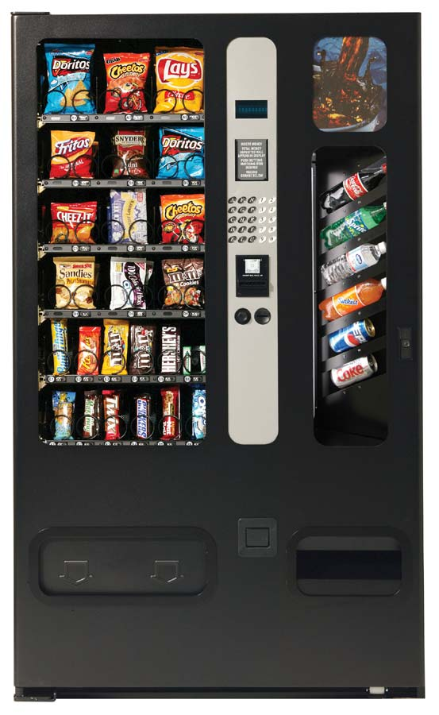



Example: the soda/HFCS machine
Soda drinker
(consumer)
Delivery person
(producer)
Vending machine
(buffer)

Slide 41
Producer-consumer problem
Pass elements through a bounded-size shared buffer
Producer puts in (must wait when full)
Consumer takes out (must wait when empty)
Synchronize access to buffer
Elements pass through in order
Examples
Unix pipes: cpp | cc1 | cc2 | as
Network packet queues
Server worker threads receiving requests
Feeding events to an event-driven program

Slide 42
Solving producer-consumer
What are the variables/shared state?
Soda machine buffer
Number of sodas in machine (≤ MaxSodas)
Locks?
1 to protect all shared state (sodaLock)
Mutual exclusion?
Only one thread can manipulate machine at a time
Ordering constraints?
Consumer must wait if machine is empty (CV hasSoda)
Producer must wait if machine is full (CV hasRoom)

Slide 43
Producer-consumer code
consumer () {
lock (sodaLock)
while (numSodas == 0) {
wait (sodaLock,hasSoda)
}
take a soda from machine
signal (hasRoom)
unlock (sodaLock)
}
producer () {
lock (sodaLock)
while(numSodas==MaxSodas){
wait (sodaLock, hasRoom)
}
add one soda to machine
signal (hasSoda)
unlock (sodaLock)
}
Mx
CV1
Mx
CV2
CV2
CV1

Slide 44
Producer-consumer code
consumer () {
lock (sodaLock)
while (numSodas == 0) {
wait (sodaLock,hasSoda)
}
take a soda from machine
signal(hasRoom)
unlock (sodaLock)
}
producer () {
lock (sodaLock)
while(numSodas==MaxSodas){
wait (sodaLock, hasRoom)
}
fill machine with soda
broadcast(hasSoda)
unlock (sodaLock)
}
The signal should be a broadcast if the producer can produce more than one resource, and there are multiple consumers.
lpcox slide edited by chase

Slide 45
Variations: one CV?
consumer () {
lock (sodaLock)
while (numSodas == 0) {
wait (sodaLock,hasRorS)
}
take a soda from machine
signal (hasRorS)
unlock (sodaLock)
}
producer () {
lock (sodaLock)
while(numSodas==MaxSodas){
wait (sodaLock,hasRorS)
}
add one soda to machine
signal (hasRorS)
unlock (sodaLock)
}
Is it possible to have a producer and consumer both waiting?
max=1, cA and cB wait, pC adds/signals, pD waits, cA wakes

Slide 46
Variations: one CV?
consumer () {
lock (sodaLock)
while (numSodas == 0) {
wait (sodaLock,hasRorS)
}
take a soda from machine
broadcast (hasRorS)
unlock (sodaLock)
}
producer () {
lock (sodaLock)
while(numSodas==MaxSodas){
wait (sodaLock,hasRorS)
}
add one soda to machine
broadcast (hasRorS)
unlock (sodaLock)
}
Use broadcast instead of signal: safe but slow.

Slide 47



Prod.-cons. with semaphores
Same before-after constraints
If buffer empty, consumer waits for producer
If buffer full, producer waits for consumer
Semaphore assignments
mutex (binary semaphore)
fullBuffers (counts number of full slots)
emptyBuffers (counts number of empty slots)

Slide 48
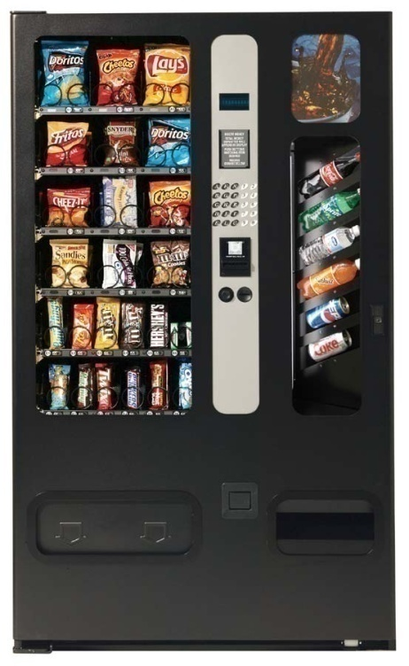
Prod.-cons. with semaphores
Initial semaphore values
Mutual exclusion
sem mutex (1)
Machine is initially empty
sem fullBuffers (0)
sem emptyBuffers (MaxSodas)

Slide 49
Prod.-cons. with semaphores
Semaphore fullBuffers(0),emptyBuffers(MaxSodas)
consumer () {
one less full buffer
down (fullBuffers)
take one soda out
one more empty buffer
up (emptyBuffers)
}
producer () {
one less empty buffer
down (emptyBuffers)
put one soda in
one more full buffer
up (fullBuffers)
}
Semaphores give us elegant full/empty synchronization.
Is that enough?

Slide 50
Prod.-cons. with semaphores
Semaphore mutex(1),fullBuffers(0),emptyBuffers(MaxSodas)
consumer () {
down (fullBuffers)
down (mutex)
take one soda out
up (mutex)
up (emptyBuffers)
}
producer () {
down (emptyBuffers)
down (mutex)
put one soda in
up (mutex)
up (fullBuffers)
}
Use one semaphore for fullBuffers and emptyBuffers?

Slide 51
Prod.-cons. with semaphores
Semaphore mutex(1),fullBuffers(0),emptyBuffers(MaxSodas)
consumer () {
down (mutex)
down (fullBuffers)
take soda out
up (emptyBuffers)
up (mutex)
}
producer () {
down (mutex)
down (emptyBuffers)
put soda in
up (fullBuffers)
up (mutex)
}
1
2
Does the order of the down calls matter?
Yes. Can cause “deadlock.”
Does the order of the up calls matter?
Not for correctness (possible efficiency issues).

Slide 52
Prod.-cons. with semaphores
Semaphore mutex(1),fullBuffers(0),emptyBuffers(MaxSodas)
consumer () {
down (fullBuffers)
down (mutex)
take soda out
up (mutex)
up (emptyBuffers)
}
producer () {
down (emptyBuffers)
down (mutex)
put soda in
up (mutex)
up (fullBuffers)
}
What about multiple consumers and/or producers?
Doesn’t matter; solution stands.

Slide 53
Prod.-cons. with semaphores
Semaphore mtx(1),fullBuffers(1),emptyBuffers(MaxSodas-1)
consumer () {
down (fullBuffers)
down (mutex)
take soda out
up (mutex)
up (emptyBuffers)
}
producer () {
down (emptyBuffers)
down (mutex)
put soda in
up (mutex)
up (fullBuffers)
}
What if 1 full buffer and multiple consumers call down?
Only one will see semaphore at 1, rest see at 0.

Slide 54
Monitors vs. semaphores
// Monitors
lock (mutex)
while (condition) {
wait (CV, mutex)
}
unlock (mutex)
// Semaphores
down (semaphore)
Where are the conditions in both?
Which is more flexible?
Why do monitors need a lock, but not semaphores?
When are semaphores appropriate?
When shared integer maps naturally to problem at hand
(i.e. when the condition involves a count of one thing)

Slide 55
Multithreading in JAVA

Slide 56
JAVA Threads Methods
Java has built in thread support for Multithreading
currentThread | Start | setPriority
yield | run | getPriority
sleep | stop | suspend
resume | getId | isAlive
getState | wait | Join
setName | getName

Slide 57
Create Thread
Thread Subclass
public class MyThread extends Thread {
public void run(){
System.out.println("Thread running");
}
}
MyThread myThread = new MyThread();
myTread.start();
Runnable Interface Implementation
public class MyRunnable implements Runnable
{
public void run(){
System.out.println("Runnable running");
}
}
Notes:
There are other syntax to create thread
1. Thread thread = new Thread(){ public void run(){ System.out.println("Thread Running"); } } thread.start();
2. Runnable myRunnable = new Runnable(){ public void run(){ System.out.println("Runnable running"); } }
3. Runnable runnable = () -> { System.out.println("Lambda Runnable running"); };

Slide 58
Thread Name
Thread thread = new Thread("New Thread") {
public void run(){
System.out.println("run by: " + getName());
}
};
thread.start();
System.out.println(thread.getName());
MyRunnable runnable = new MyRunnable();
Thread thread = new Thread(runnable, "New Thread");
thread.start();
System.out.println(thread.getName());
String threadName = Thread.currentThread().getName();

Slide 59
Stop a Thread
public class MyRunnable implements Runnable {
private boolean doStop = false;
public synchronized void doStop() {
this.doStop = true;
}
private synchronized boolean keepRunning() {
return this.doStop == false;
}
@Override
public void run() {
while(keepRunning()) {
// keep doing what this thread should do.
System.out.println("Running");
try {
Thread.sleep(3L * 1000L);
} catch (InterruptedException e) {
e.printStackTrace();
}
}
}
}

Slide 60
Java Thread Local
Thread Local Variables
java.lang.ThreadLocal can be used for storing independent data for each Thread (thread-localvariables)
All Threads share the same ThreadLocal instance, but every Thread only 'sees' data belonging to it
Can be used for storing such things, as User ID, Transaction ID, etc which are handled by current Thread.
Thread Local Methods
set(...) - sets the thread-local variable
get() - retrieves the previously set thread-local variable
private ThreadLocal<String> myThreadLocal = new ThreadLocal<String>();
myThreadLocal.set("Hello ThreadLocal");
String threadLocalValue = myThreadLocal.get();
private ThreadLocal myThreadLocal = new ThreadLocal<String>() {
@Override protected String initialValue() {
return "This is the initial value";
}
};

Slide 61
classes for locking
Class/interface | description
Lock | an interface for controlling access to a shared resource
ReentrantLock | a class that implements Lock
ReadWriteLock | like Lock but separates read operations from writes
Condition | a particular shared resource that can be waited upon; conditions are acquired by asking for one from a Lock

Slide 62
Thread Sleeping
public class BetterRunnable implements Runnable {
@Override
public void run() {
while(!Thread.currentThread().isInterrupted()){
//Heavy operation
try {
Thread.sleep(5000);
} catch (InterruptedException e) {
// this is because interrupt state reset
Thread.currentThread().interrupt();
}
//Other operation
}
}
}
The sleep( ) method causes the thread from which it is called to suspend execution for the specified period of milliseconds. Its general form is shown here:
static void sleep(long milliseconds)
throws InterruptedException
The number of milliseconds to suspend is specified in milliseconds. This method may throw an InterruptedException.

Slide 63
Time and Task
Timer and TimerTask
In java.util can be used to schedule task at intervals or delays
schedule(), next task will only run after previous one finish.
scheduleAtFixedRate(), next task is not impacted by previous one.

Slide 64
SIMPLE Lock
lock.lock();
try{
//do critical section code, which may throw exception
} finally {
lock.unlock();
}

Slide 65
Lock Reentrance
public class Lock{
boolean isLocked = false;
Thread lockedBy = null;
int lockedCount = 0;
public synchronized void lock()
throws InterruptedException{
Thread callingThread = Thread.currentThread();
while(isLocked && lockedBy != callingThread){
wait();
}
isLocked = true;
lockedCount++;
lockedBy = callingThread;
}
public synchronized void unlock(){
if(Thread.curentThread() == this.lockedBy){
lockedCount--;
if(lockedCount == 0){
isLocked = false;
notify();
}
}
}
...
}

Slide 66
Reader/Writer Lock
class SharedLock {
AcquireRead(); /* shared mode */
AcquireWrite(); /* exclusive mode */
ReleaseRead();
ReleaseWrite();
}
A reader/write lock or SharedLock is a new kind of “lock” that is similar to our old definition:
supports Acquire and Release primitives
assures mutual exclusion for writes to shared state
But: a SharedLock provides better concurrency for readers when no writer is present.

Slide 67
Reader/Writer Lock Illustrated
If each thread acquires the lock in exclusive (*write) mode, SharedLock functions exactly as an ordinary mutex.
Multiple readers may hold
the lock concurrently in shared mode.
A_{r}
A_{r}
A_{w}
R_{r}
R_{r}
Writers always hold the lock in exclusive mode, and must wait for all readers or writer to exit.
R_{w}
mode read write max allowed
shared yes no many
exclusive yes yes one
not holder no no many

Slide 68
Limitations of the SharedLock Implementation
This implementation has weaknesses discussed in [Birrell89].
spurious lock conflicts (on a multiprocessor): multiple waiters contend for the mutex after a signal or broadcast.
Solution: selective signal reader or writer.
spurious wakeups
ReleaseWrite awakens writers as well as readers.
Solution: add a separate condition variable for writers.
starvation
How can we be sure that a waiting writer will ever pass its acquire if faced with a continuous stream of arriving readers?

Slide 69
Read Write LOCK
public class ReadWriteLock{
private int readers = 0;
private int writers = 0;
private int writeRequests = 0;
public synchronized void lockRead() throws InterruptedException{
while(writers > 0 || writeRequests > 0){
wait();
}
readers++;
}
public synchronized void unlockRead(){
readers--;
notifyAll();
}
public synchronized void lockWrite() throws InterruptedException{
writeRequests++;
while(readers > 0 || writers > 0){
wait();
}
writeRequests--;
writers++;
}
public synchronized void unlockWrite() throws InterruptedException{
writers--;
notifyAll();
}
}
Notes:
Read / Write Lock Reentrance
The ReadWriteLock class shown earlier is not reentrant. If a thread that has write access requests it again, it will block because there is already one writer - itself. Furthermore, consider this case:
Thread 1 gets read access.
Thread 2 requests write access but is blocked because there is one reader.
Thread 1 re-requests read access (re-enters the lock), but is blocked because there is a write request
In this situation the previous ReadWriteLock would lock up - a situation similar to deadlock. No threads requesting neither read nor write access would be granted so.
To make the ReadWriteLock reentrant it is necessary to make a few changes. Reentrance for readers and writers will be dealt with separately.
Read Reentrance
To make the ReadWriteLock reentrant for readers we will first establish the rules for read reentrance:
A thread is granted read reentrance if it can get read access (no writers or write requests), or if it already has read access (regardless of write requests).
To determine if a thread has read access already a reference to each thread granted read access is kept in a Map along with how many times it has acquired read lock. When determing if read access can be granted this Map will be checked for a reference to the calling thread. Here is how the lockRead() and unlockRead() methods looks after that change:
public class ReadWriteLock{ private Map<Thread, Integer> readingThreads = new HashMap<Thread, Integer>(); private int writers = 0; private int writeRequests = 0; public synchronized void lockRead() throws InterruptedException{ Thread callingThread = Thread.currentThread(); while(! canGrantReadAccess(callingThread)){ wait(); } readingThreads.put(callingThread, (getAccessCount(callingThread) + 1)); } public synchronized void unlockRead(){ Thread callingThread = Thread.currentThread(); int accessCount = getAccessCount(callingThread); if(accessCount == 1){ readingThreads.remove(callingThread); } else { readingThreads.put(callingThread, (accessCount -1)); } notifyAll(); } private boolean canGrantReadAccess(Thread callingThread){ if(writers > 0) return false; if(isReader(callingThread) return true; if(writeRequests > 0) return false; return true; } private int getReadAccessCount(Thread callingThread){ Integer accessCount = readingThreads.get(callingThread); if(accessCount == null) return 0; return accessCount.intValue(); } private boolean isReader(Thread callingThread){ return readingThreads.get(callingThread) != null; } } As you can see read reentrance is only granted if no threads are currently writing to the resource. Additionally, if the calling thread already has read access this takes precedence over any writeRequests.
Write Reentrance
Write reentrance is granted only if the thread has already write access. Here is how the lockWrite() and unlockWrite() methods look after that change:
public class ReadWriteLock{ private Map<Thread, Integer> readingThreads = new HashMap<Thread, Integer>(); private int writeAccesses = 0; private int writeRequests = 0; private Thread writingThread = null; public synchronized void lockWrite() throws InterruptedException{ writeRequests++; Thread callingThread = Thread.currentThread(); while(! canGrantWriteAccess(callingThread)){ wait(); } writeRequests--; writeAccesses++; writingThread = callingThread; } public synchronized void unlockWrite() throws InterruptedException{ writeAccesses--; if(writeAccesses == 0){ writingThread = null; } notifyAll(); } private boolean canGrantWriteAccess(Thread callingThread){ if(hasReaders()) return false; if(writingThread == null) return true; if(!isWriter(callingThread)) return false; return true; } private boolean hasReaders(){ return readingThreads.size() > 0; } private boolean isWriter(Thread callingThread){ return writingThread == callingThread; } } Notice how the thread currently holding the write lock is now taken into account when determining if the calling thread can get write access.
Read to Write Reentrance
Sometimes it is necessary for a thread that have read access to also obtain write access. For this to be allowed the thread must be the only reader. To achieve this the writeLock() method should be changed a bit. Here is what it would look like:
public class ReadWriteLock{ private Map<Thread, Integer> readingThreads = new HashMap<Thread, Integer>(); private int writeAccesses = 0; private int writeRequests = 0; private Thread writingThread = null; public synchronized void lockWrite() throws InterruptedException{ writeRequests++; Thread callingThread = Thread.currentThread(); while(! canGrantWriteAccess(callingThread)){ wait(); } writeRequests--; writeAccesses++; writingThread = callingThread; } public synchronized void unlockWrite() throws InterruptedException{ writeAccesses--; if(writeAccesses == 0){ writingThread = null; } notifyAll(); } private boolean canGrantWriteAccess(Thread callingThread){ if(isOnlyReader(callingThread)) return true; if(hasReaders()) return false; if(writingThread == null) return true; if(!isWriter(callingThread)) return false; return true; } private boolean hasReaders(){ return readingThreads.size() > 0; } private boolean isWriter(Thread callingThread){ return writingThread == callingThread; } private boolean isOnlyReader(Thread thread){ return readers == 1 && readingThreads.get(callingThread) != null; } } Now the ReadWriteLock class is read-to-write access reentrant.
Write to Read Reentrance
Sometimes a thread that has write access needs read access too. A writer should always be granted read access if requested. If a thread has write access no other threads can have read nor write access, so it is not dangerous. Here is how the canGrantReadAccess() method will look with that change:
public class ReadWriteLock{ private boolean canGrantReadAccess(Thread callingThread){ if(isWriter(callingThread)) return true; if(writingThread != null) return false; if(isReader(callingThread) return true; if(writeRequests > 0) return false; return true; } } Fully Reentrant ReadWriteLock
Below is the fully reentran ReadWriteLock implementation. I have made a few refactorings to the access conditions to make them easier to read, and thereby easier to convince yourself that they are correct.
public class ReadWriteLock{ private Map<Thread, Integer> readingThreads = new HashMap<Thread, Integer>(); private int writeAccesses = 0; private int writeRequests = 0; private Thread writingThread = null; public synchronized void lockRead() throws InterruptedException{ Thread callingThread = Thread.currentThread(); while(! canGrantReadAccess(callingThread)){ wait(); } readingThreads.put(callingThread, (getReadAccessCount(callingThread) + 1)); } private boolean canGrantReadAccess(Thread callingThread){ if( isWriter(callingThread) ) return true; if( hasWriter() ) return false; if( isReader(callingThread) ) return true; if( hasWriteRequests() ) return false; return true; } public synchronized void unlockRead(){ Thread callingThread = Thread.currentThread(); if(!isReader(callingThread)){ throw new IllegalMonitorStateException("Calling Thread does not" + " hold a read lock on this ReadWriteLock"); } int accessCount = getReadAccessCount(callingThread); if(accessCount == 1){ readingThreads.remove(callingThread); } else { readingThreads.put(callingThread, (accessCount -1)); } notifyAll(); } public synchronized void lockWrite() throws InterruptedException{ writeRequests++; Thread callingThread = Thread.currentThread(); while(! canGrantWriteAccess(callingThread)){ wait(); } writeRequests--; writeAccesses++; writingThread = callingThread; } public synchronized void unlockWrite() throws InterruptedException{ if(!isWriter(Thread.currentThread()){ throw new IllegalMonitorStateException("Calling Thread does not" + " hold the write lock on this ReadWriteLock"); } writeAccesses--; if(writeAccesses == 0){ writingThread = null; } notifyAll(); } private boolean canGrantWriteAccess(Thread callingThread){ if(isOnlyReader(callingThread)) return true; if(hasReaders()) return false; if(writingThread == null) return true; if(!isWriter(callingThread)) return false; return true; } private int getReadAccessCount(Thread callingThread){ Integer accessCount = readingThreads.get(callingThread); if(accessCount == null) return 0; return accessCount.intValue(); } private boolean hasReaders(){ return readingThreads.size() > 0; } private boolean isReader(Thread callingThread){ return readingThreads.get(callingThread) != null; } private boolean isOnlyReader(Thread callingThread){ return readingThreads.size() == 1 && readingThreads.get(callingThread) != null; } private boolean hasWriter(){ return writingThread != null; } private boolean isWriter(Thread callingThread){ return writingThread == callingThread; } private boolean hasWriteRequests(){ return this.writeRequests > 0; } }

Slide 70
Read / Write Lock Reentrance(1)
public class ReadWriteLock{
private Map<Thread, Integer> readingThreads =
new HashMap<Thread, Integer>();
private int writeAccesses = 0;
private int writeRequests = 0;
private Thread writingThread = null;
public synchronized void lockRead() throws InterruptedException{
Thread callingThread = Thread.currentThread();
while(! canGrantReadAccess(callingThread)){
wait();
}
readingThreads.put(callingThread,
(getReadAccessCount(callingThread) + 1));
}
private boolean canGrantReadAccess(Thread callingThread){
if( isWriter(callingThread) ) return true;
if( hasWriter() ) return false;
if( isReader(callingThread) ) return true;
if( hasWriteRequests() ) return false;
return true;
}

Slide 71
Read / Write Lock Reentrance(2)
public synchronized void unlockRead(){
Thread callingThread = Thread.currentThread();
if(!isReader(callingThread)){
throw new IllegalMonitorStateException("Calling Thread does not" +
" hold a read lock on this ReadWriteLock");
}
int accessCount = getReadAccessCount(callingThread);
if(accessCount == 1){ readingThreads.remove(callingThread); }
else { readingThreads.put(callingThread, (accessCount -1)); }
notifyAll();
}
public synchronized void lockWrite() throws InterruptedException{
writeRequests++;
Thread callingThread = Thread.currentThread();
while(! canGrantWriteAccess(callingThread)){
wait();
}
writeRequests--;
writeAccesses++;
writingThread = callingThread;
}

Slide 72
Read / Write Lock Reentrance(3)
public synchronized void unlockWrite() throws InterruptedException{
if(!isWriter(Thread.currentThread()){
throw new IllegalMonitorStateException("Calling Thread does not" +
" hold the write lock on this ReadWriteLock");
}
writeAccesses--;
if(writeAccesses == 0){
writingThread = null;
}
notifyAll();
}
private boolean canGrantWriteAccess(Thread callingThread){
if(isOnlyReader(callingThread)) return true;
if(hasReaders()) return false;
if(writingThread == null) return true;
if(!isWriter(callingThread)) return false;
return true;
}
private int getReadAccessCount(Thread callingThread){
Integer accessCount = readingThreads.get(callingThread);
if(accessCount == null) return 0;
return accessCount.intValue();
}

Slide 73
Read / Write Lock Reentrance(4)
private boolean hasReaders(){
return readingThreads.size() > 0;
}
private boolean isReader(Thread callingThread){
return readingThreads.get(callingThread) != null;
}
private boolean isOnlyReader(Thread callingThread){
return readingThreads.size() == 1 &&
readingThreads.get(callingThread) != null;
}
private boolean hasWriter(){
return writingThread != null;
}
private boolean isWriter(Thread callingThread){
return writingThread == callingThread;
}
private boolean hasWriteRequests(){
return this.writeRequests > 0;
}
}

Slide 74
Starvation and Fairness
Causes of Starvation
Threads with high priority swallow all CPU time from threads with lower priority
Threads are blocked indefinitely waiting to enter a synchronized block
Threads waiting on an object (called wait() on it) remain waiting indefinitely
Implementing Fairness
Using Locks Instead of Synchronized Blocks
Implement a queue based fair lock.
Fair Lock will hurt performance.

Slide 75
Dead Lock
Simple Example
Thread 1 locks A, waits for B
Thread 2 locks B, waits for A.
Complicated Example
Thread 1 locks A, waits for B
Thread 2 locks B, waits for C
Thread 3 locks C, waits for D
Thread 4 locks D, waits for A
Dead Lock prevention
Lock Ordering
Lock Timeout
Deadlock Detection

Slide 76
Dead Lock
public class TreeNode {
TreeNode parent = null;
List children = new ArrayList();
public synchronized void addChild(TreeNode child){
if(!this.children.contains(child)) {
this.children.add(child);
child.setParentOnly(this);
}
}
public synchronized void addChildOnly(TreeNode child){
if(!this.children.contains(child){
this.children.add(child);
}
}
public synchronized void setParent(TreeNode parent){
this.parent = parent;
parent.addChildOnly(this);
}
public synchronized void setParentOnly(TreeNode parent){
this.parent = parent;
}
}

Slide 77
Nested Monitor Lockout
public class Lock{
protected MonitorObject monitorObject = new MonitorObject();
protected boolean isLocked = false;
public void lock() throws InterruptedException{
synchronized(this){
while(isLocked){
synchronized(this.monitorObject){
this.monitorObject.wait();
}
}
isLocked = true;
}
}
public void unlock(){
synchronized(this){
this.isLocked = false;
synchronized(this.monitorObject){
this.monitorObject.notify();
}
}
}
}
In nested monitor lockout, Thread 1 is holding a lock A, and waits for a signal from Thread 2. Thread 2 needs the lock A to send the signal to Thread 1.

Slide 78
Slipped Conditions
public class Lock {
private boolean isLocked = true;
public void lock(){
synchronized(this){
while(isLocked){
try{
this.wait();
} catch(InterruptedException e){
//do nothing, keep waiting
}
}
}
// break here?
synchronized(this){
isLocked = true;
}
}
public synchronized void unlock(){
isLocked = false;
this.notify();
}
}
What a thread is preempted right after the first block?

Slide 79
Fair Lock(1)
public class FairLock {
private boolean isLocked = false;
private Thread lockingThread = null;
private List<QueueObject> waitingThreads =
new ArrayList<QueueObject>();
public void lock() throws InterruptedException{
QueueObject queueObject = new QueueObject();
boolean isLockedForThisThread = true;
synchronized(this){
waitingThreads.add(queueObject);
}
while(isLockedForThisThread){
synchronized(this){
isLockedForThisThread =
isLocked || waitingThreads.get(0) != queueObject;
if(!isLockedForThisThread){
isLocked = true;
waitingThreads.remove(queueObject);
lockingThread = Thread.currentThread();
return;
}
}
try{
queueObject.doWait();
}catch(InterruptedException e){
synchronized(this) { waitingThreads.remove(queueObject); }
throw e;
} } }

Slide 80
Fair Lock(2)
public synchronized void unlock(){
if(this.lockingThread != Thread.currentThread()){
throw new IllegalMonitorStateException(
"Calling thread has not locked this lock");
}
isLocked = false;
lockingThread = null;
if(waitingThreads.size() > 0){
waitingThreads.get(0).doNotify();
}
}
}
public class QueueObject {
private boolean isNotified = false;
public synchronized void doWait() throws InterruptedException {
while(!isNotified){
this.wait();
}
this.isNotified = false;
}
public synchronized void doNotify() {
this.isNotified = true;
this.notify();
}
public boolean equals(Object o) {
return this == o;
}
}

Slide 81
Monitor
Every Java object has a built-in internal "lock".
A thread can "wait" on an object's lock, causing it to pause.
A “wait” will release the lock
Another thread can "notify" on an object's lock, unpausing any other thread(s) that are currently waiting on that lock.
An implementation of monitors, a classic concurrency construct.
These methods are not often used directly; but they are used internally by other concurrency constructs.
method | description
notify() | unblocks one random thread waiting on this object's lock
notifyAll() | unblocks all threads waiting on this object's lock
wait() wait(ms) | causes the current thread to wait (block) on this object's lock, indefinitely or for a given # of ms

Slide 82
Mutex and Semaphore
public class Example {
private int value = 0;
private final Semaphore mutex = new Semaphore(1)
public int getNextValue() throws InterruptedException {
try {
mutex.acquire();
return value++;
} finally {
mutex.release();
}
}
}
Semaphore
No synchronized lock is called.
availablePermits(); acquire(); semaphore.release();
No Mutex, using Semaphore(1)

Slide 83
Semaphores(1)
public class BoundedSemaphore {
private int signals = 0;
private int bound = 0;
public BoundedSemaphore(int upperBound){
this.bound = upperBound;
}
public synchronized void release() throws InterruptedException{
while(this.signals == bound) wait();
this.signals++;
this.notify();
}
public synchronized void acquire() throws InterruptedException{
while(this.signals == 0) wait();
this.signals--;
this.notify();
}
}
The release() method sends a signal which is stored internally in the Semaphore. The acquire() method waits for a signal. When received the signal flag is cleared again, and the acquire() method exited.

Slide 84
Semaphores(2)
public class SendingThread {
Semaphore semaphore = null;
public SendingThread(Semaphore semaphore){
this.semaphore = semaphore;
}
public void run(){
while(true){
//do something, then signal
this.semaphore.release();
}
}
}
public class RecevingThread {
Semaphore semaphore = null;
public ReceivingThread(Semaphore semaphore){
this.semaphore = semaphore;
}
public void run(){
while(true){
this.semaphore.acquire();
//receive signal, then do something...
}
}
}

Slide 85
Semaphores(3)
Semaphore semaphore = new Semaphore(5);
SendingThread sender = new SendingThread(semaphore);
ReceivingThread receiver = new ReceivingThread(semaphore);
receiver.start();
sender.start();

Slide 86
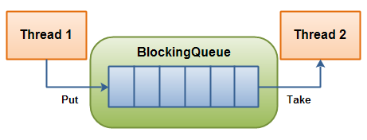
Blocking Queue(1)
A blocking queue is a queue that blocks when you try to dequeue from it and the queue is empty, or if you try to enqueue items to it and the queue is already full.
It is also known as producer and consumer scenario.
Notes:
The Java volatile Visibility Guarantee
The Java volatile keyword is intended to address variable visibility problems. By declaring the countervariable volatile all writes to the counter variable will be written back to main memory immediately. Also, all reads of the counter variable will be read directly from main memory.
The Java volatile Happens-Before Guarantee
To address the instruction reordering challenge, the Java volatile keyword gives a "happens-before" guarantee, in addition to the visibility guarantee. The happens-before guarantee guarantees that:
Reads from and writes to other variables cannot be reordered to occur after a write to a volatilevariable, if the reads / writes originally occurred before the write to the volatile variable. The reads / writes before a write to a volatile variable are guaranteed to "happen before" the write to the volatile variable. Notice that it is still possible for e.g. reads / writes of other variables located after a write to a volatile to be reordered to occur before that write to the volatile. Just not the other way around. From after to before is allowed, but from before to after is not allowed.
Reads from and writes to other variables cannot be reordered to occur before a read of a volatilevariable, if the reads / writes originally occurred after the read of the volatile variable. Notice that it is possible for reads of other variables that occur before the read of a volatile variable can be reordered to occur after the read of the volatile. Just not the other way around. From before to after is allowed, but from after to before is not allowed.
The above happens-before guarantee assures that the visibility guarantee of the volatile keyword are being enforced.
volatile is Not Always Enough
Even if the volatile keyword guarantees that all reads of a volatile variable are read directly from main memory, and all writes to a volatile variable are written directly to main memory, there are still situations where it is not enough to declare a variable volatile.
In the situation explained earlier where only Thread 1 writes to the shared counter variable, declaring the counter variable volatile is enough to make sure that Thread 2 always sees the latest written value.
In fact, multiple threads could even be writing to a shared volatile variable, and still have the correct value stored in main memory, if the new value written to the variable does not depend on its previous value. In other words, if a thread writing a value to the shared volatile variable does not first need to read its value to figure out its next value.
As soon as a thread needs to first read the value of a volatile variable, and based on that value generate a new value for the shared volatile variable, a volatile variable is no longer enough to guarantee correct visibility. The short time gap in between the reading of the volatile variable and the writing of its new value, creates an race condition where multiple threads might read the same value of the volatile variable, generate a new value for the variable, and when writing the value back to main memory - overwrite each other's values.
The situation where multiple threads are incrementing the same counter is exactly such a situation where a volatile variable is not enough. The following sections explain this case in more detail.
Imagine if Thread 1 reads a shared counter variable with the value 0 into its CPU cache, increment it to 1 and not write the changed value back into main memory. Thread 2 could then read the same countervariable from main memory where the value of the variable is still 0, into its own CPU cache. Thread 2 could then also increment the counter to 1, and also not write it back to main memory.

Slide 87
Blocking Queue(2)
public class BlockingQueue {
private List queue = new LinkedList();
private int limit = 10;
public BlockingQueue(int limit){
this.limit = limit;
}
public synchronized void enqueue(Object item)
throws InterruptedException {
while(this.queue.size() == this.limit) {
wait();
}
if(this.queue.size() == 0) {
notifyAll();
}
this.queue.add(item);
}
public synchronized Object dequeue()
throws InterruptedException{
while(this.queue.size() == 0){
wait();
}
if(this.queue.size() == this.limit){
notifyAll();
}
return this.queue.remove(0);
}
}

Slide 88
Producer and Consumer(1)
import java.util.concurrent.locks.Condition;
import java.util.concurrent.locks.Lock;
import java.util.concurrent.locks.ReentrantLock;
public class BoundedBuffer {
private final String[] buffer;
private final int capacity;
private int front;
private int rear;
private int count;
private final Lock lock = new ReentrantLock();
private final Condition notFull = lock.newCondition();
private final Condition notEmpty = lock.newCondition();
public BoundedBuffer(int capacity) {
super();
this.capacity = capacity;
buffer = new String[capacity];
}

Slide 89
Producer and Consumer(2)
public void deposit(String data) throws InterruptedException {
lock.lock();
try {
while (count == capacity) {
notFull.await();
}
buffer[rear] = data;
rear = (rear + 1) % capacity;
count++;
notEmpty.signal();
} finally {
lock.unlock();
}
}
public String fetch() throws InterruptedException {
lock.lock();
try {
while (count == 0) {
notEmpty.await();
}
String result = buffer[front];
front = (front + 1) % capacity;
count--;
notFull.signal();
return result;
} finally {
lock.unlock();
}
}
}

Slide 90
Producer and Consumer(3)
Note
The two methods are protected with the lock to ensure mutual exclusion
Then we use two conditions variables. One to wait for the buffer to be not empty and an other one to wait for the buffer to be not full.
We wrapped the await operation on a while loop. This is to avoid signal stealers problem that can occurs when using Signal & Continue

Slide 91
Example: event/request queue
worker loop
We can synchronize an event queue with a mutex/CV pair.
Protect the event queue data structure itself with the mutex.
handler
Handle one event, blocking as necessary.
dispatch
Incoming event
queue
handler
threads waiting on CV
When handler is complete, return to worker pool.
Workers wait on the CV for next event if the event queue is empty. Signal the CV when a new event arrives. This is a producer/consumer problem.
handler

Slide 92
Thread Pool(1)
public class ThreadPool {
private BlockingQueue taskQueue = null;
private List<PoolThread> threads = new ArrayList<PoolThread>();
private boolean isStopped = false;
public ThreadPool(int noOfThreads, int maxNoOfTasks){
taskQueue = new BlockingQueue(maxNoOfTasks);
for(int i=0; i<noOfThreads; i++){
threads.add(new PoolThread(taskQueue));
}
for(PoolThread thread : threads){
thread.start();
}
}
public synchronized void execute(Runnable task) throws Exception{
if(this.isStopped) throw
new IllegalStateException("ThreadPool is stopped");
this.taskQueue.enqueue(task);
}
public synchronized void stop(){
this.isStopped = true;
for(PoolThread thread : threads){
thread.doStop();
}
}
}

Slide 93
Thread Pool(2)
public class PoolThread extends Thread {
private BlockingQueue taskQueue = null;
private boolean isStopped = false;
public PoolThread(BlockingQueue queue){
taskQueue = queue;
}
public void run(){
while(!isStopped()){
try{
Runnable runnable = (Runnable) taskQueue.dequeue();
runnable.run();
} catch(Exception e){
//log or otherwise report exception,
//but keep pool thread alive.
}
}
}
public synchronized void doStop(){
isStopped = true;
this.interrupt(); //break pool thread out of dequeue() call.
}
public synchronized boolean isStopped(){
return isStopped;
}
}

Slide 94
Executors and Thread Pools
private final class StringTask implements Callable<String> {
public String call(){
//Long operations
return "Run";
}
}
ExecutorService threadPool = Executors.newFixedThreadPool(4);
CompletionService<String> pool = new ExecutorCompletionService<String>(threadPool);
for(int i = 0; i < 10; i++){
pool.submit(new StringTask());
}
for(int i = 0; i < 10; i++){
String result = pool.take().get();
//Compute the result
}
threadPool.shutdown();

Slide 95
Most default data structure are not thread safe
By default, the class in Collection library is not thread safe.
In both Java and C#, we have a special set of synchronized or thread-safe collection class.
Java
Collections.synchronizedCollection… [javadoc]
C#
System.Collections.Concurrent
In C++, you may need to DIY.
simultaneous reads of the same object are OK
simultaneous read/writes of different objects are OK
Most of the thread safe classes are implemented by CAS technology.

Slide 96
Fine-grained critical sections
index | 0 | 1 | 2 | 3 | 4 | 5 | 6 | 7 | 8 | 9
value
11
24
7
49
54
14
Technically, the shared resource is the linked list in the given hash bucket elements[h], not the entire hash table array.
What if the set could lock just that bucket?
If my thread is updating bucket h, other threads that wanted to read/write other hash buckets besides h could still do so.
Example:
lock bucket 4
still okay to read bucket 7

Slide 97
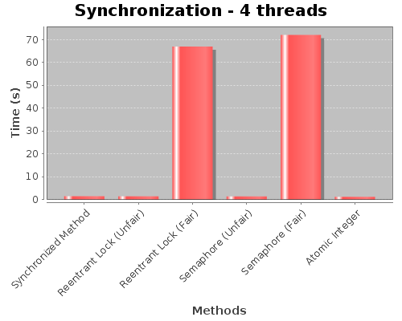
Benchmark

Slide 98
Spinlock
Spinlocks provide mutual exclusion among cores without blocking.
int s = 0;
lock() {
while (s == 1)
{};
ASSERT (s == 0);
s = 1;
}
unlock ();
ASSERT(s == 1);
s = 0;
}
Global spinlock variable
Busy-wait until lock is free.
Race to acquire.
Two (or more) cores see s == 0.
Spinlocks are useful for lightly contended critical sections where there is no risk that a thread is preempted while it is holding the lock, i.e., in the lowest levels of the kernel.

Slide 99
We need an atomic “toehold”
To implement safe mutual exclusion, we need support for some sort of “magic toehold” for synchronization.
The lock primitives themselves have critical sections to test and/or set the lock flags.
Safe mutual exclusion on multicore systems requires some hardware support: atomic instructions
Examples: test-and-set, compare-and-swap, fetch-and-add.
These instructions perform an atomic read-modify-write of a memory location. We use them to implement locks.
If we have any of those, we can build higher-level synchronization objects like monitors or semaphores.
Note: we also must be careful of interrupt handlers….
They are expensive, but necessary.

Slide 100
Atomic instructions: Test-and-Set
Spinlock::Acquire () {
while(held);
held = 1;
}
Wrong
load 4(SP), R2 ; load “this”
busywait:
load 4(R2), R3 ; load “held” flag
bnz R3, busywait ; spin if held wasn’t zero
store #1, 4(R2) ; held = 1
Right
load 4(SP), R2 ; load “this”
busywait:
tsl 4(R2), R3 ; test-and-set this->held
bnz R3, busywait ; spin if held wasn’t zero
One example: tsl
test-and-set-lock
(from an old machine)
load
test
store
load
test
store
Problem: interleaved load/test/store.
Solution: TSL atomically sets the flag and leaves the old value in a register.

Slide 101
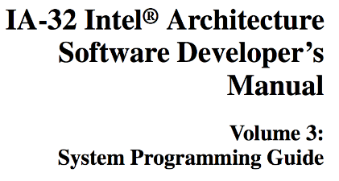
Spinlock: IA32
Idle the core for a contended lock.
^{Spin_Lock:}
CMP lockvar, 0 ;Check if lock is free
^{JE Get_Lock}
PAUSE ; Short delay
^{JMP Spin_Lock}
^{Get_Lock:}
^{MOV EAX, 1}
XCHG EAX, lockvar ; Try to get lock
CMP EAX, 0 ; Test if successful
^{JNE Spin_Lock}
Atomic exchange to ensure safe acquire of an uncontended lock.
XCHG is a variant of compare-and-swap: compare x to value in memory location y; if x == *y then set *y = z. Report success/failure.

Slide 102
Spinlock and Mutex
Spinlock | Mutex
Continuously retry until succeed. Light weight execution, but waste CPU time. | Go to sleep if not able to acquire the lock, and wake up when mutex available. Sleep and wait up is expensive, more than 2000 cycles.
Make sense on multi-cores, when locks are held for short time. Does not work well on single core. | Good for locks held for a long time (slow device) or for single core system.

Slide 103
Compare and Set
public static class MyLock {
private AtomicBoolean locked = new AtomicBoolean(false);
public boolean lock() {
return locked.compareAndSet(false, true);
}
}
import java.util.concurrent.atomic.AtomicLong;
public class AtomicCounter {
private AtomicLong count = new AtomicLong(0);
public void inc() {
boolean updated = false;
while(!updated){
long prevCount = this.count.get();
updated = this.count.compareAndSet(prevCount, prevCount + 1);
}
}
public long count() {
return this.count.get();
}
}

Slide 104
Atomic Variables
public class AtomicCounter {
private final AtomicInteger value = new AtomicInteger(0);
public int getValue(){
return value.get();
}
public int getNextValue(){
return value.incrementAndGet();
}
public int getPreviousValue(){
return value.decrementAndGet();
}
}

Slide 105
Lock-Free Linked List
Race condition
Thread Safe
template
void slist<T>::push_front(T t)
{
auto p = new Node;
p->t = t;
p->next = head; head = p;
}
template
void slist<T>::push_front(T t) {
auto p = new Node;
p->t = t;
p->next = head;
while (!head.compare_exchange_weak(p->next, p))
{}
}

Slide 106
Thread Safe Stack(1)
public String pop(){
while(true){
Element oldHead = head.get();
//The stack is empty
if(oldHead == null){
return null;
}
Element newHead = oldHead.next;
//Trying to set the new element as the head
if(head.compareAndSet(oldHead, newHead)){
return oldHead.value;
}
}
}
public class Stack {
private final AtomicReference<Element> head = new AtomicReference<Element>(null);
public void push(String value){
Element newElement = new Element(value);
while(true){
Element oldHead = head.get();
newElement.next = oldHead;
//Trying to set the new element as the head
if(head.compareAndSet(oldHead, newElement)){
return;
}
}
}

Slide 107
Thread Safe Stack(2)
private static final class Element {
private final String value;
private Element next;
private Element(String value) {
this.value = value;
}
}
}

Slide 108
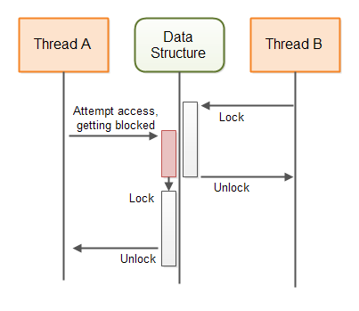
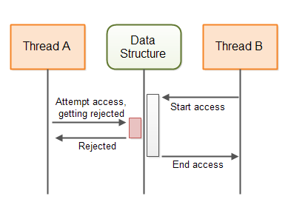
blocking vs NO BLOCKING
No Blocking Benefit
No Deadlocks
No Thread Suspension
Reduced Thread Latency

Slide 109
Sharing Intended Modifications
Some data structure are too big to be swapped, in this case you may need intended modification.
Instead of copying and modifying the whole shared data structure, a thread can share its intended modification of the shared data structure. The process for a thread wanting to make a modification to the shared data structure then becomes:
Check if another thread has submitted an intended modification to the data structure.
If no other thread has submitted an intended modification, create an intended modification (represented by an object) and submit that intended modification to the data structure (using a compare-and-swap operation).
Carry out the modification of the shared data structure.
Remove the reference to the intended modification to signal to other threads that the intended modification has been carried out.
We do not lock the shared data structure.

Slide 110
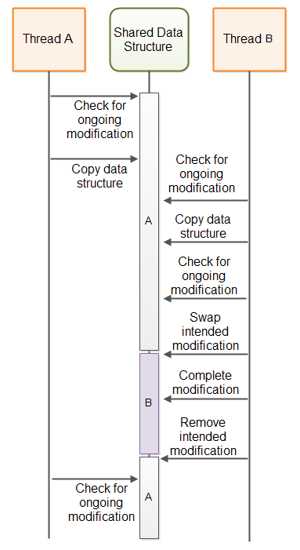
ABA Problem
A common solution to the A-B-A problem is to not just swap a pointer to an intended modification object, but to combine the pointer with a counter, and swap pointer + counter using a single compare-and-swap operation.

Slide 111
Non-Blocking Template(1)
import java.util.concurrent.atomic.AtomicBoolean;
import java.util.concurrent.atomic.AtomicStampedReference;
public class NonblockingTemplate {
public static class IntendedModification {
public AtomicBoolean completed =
new AtomicBoolean(false);
}
private AtomicStampedReference<IntendedModification>
ongoingMod =
new AtomicStampedReference<IntendedModification>(null, 0);
//declare the state of the data structure here.
public void modify() {
while(!attemptModifyASR());
}

Slide 112
Non-Blocking Template(2)
public boolean attemptModifyASR(){
boolean modified = false;
IntendedModification currentlyOngoingMod =
ongoingMod.getReference();
int stamp = ongoingMod.getStamp();
if(currentlyOngoingMod == null){
//copy data structure state - for use in intended modification
//prepare intended modification
IntendedModification newMod =
new IntendedModification();
boolean modSubmitted =
ongoingMod.compareAndSet(null, newMod, stamp, stamp + 1);
if(modSubmitted){
//complete modification via a series of compare-and-swap operations.
//note: other threads may assist in completing the compare-and-swap operations, so some CAS may fail
modified = true;
}
} else {
//attempt to complete ongoing modification, so the data structure is freed up
//to allow access from this thread.
modified = false;
}
return modified;
}
}

Slide 113
Synchronized collections
Collections.synchronizedCollection(coll)
Collections.synchronizedList(list)
Collections.synchronizedMap(map)
Collections.synchronizedSet(set)
Set<String> words = new HashSet<String>();
words = Collections.synchronizedSet(words);
Java provides thread-safe collection wrappers via static methods in the Collections class.
These are essentially the same as wrapping each operation on the collection in a synchronized block.
Simpler, but less efficient, than the preceding code.

Slide 114
Concurrent collections
class ConcurrentHashMap<K, V> implements Map<K, V>
class ConcurrentLinkedDeque<E> implements Deque<E>
class ConcurrentSkipListSet<E> implements Set<E>
class CopyOnWriteArrayList<E> implements List<E>
These classes are generally faster than using a synchronized version of the normal collections because multiple threads can use them at the same time, to a degree.
hash map: one thread in each hash bucket at a time
deque: one thread modifying each end of the deque (front/back)
...

Slide 115
Multi-Threading in C++

Slide 116
C++ Threading
POSIX pthread
Only apply for UNIX
Windows Threading
C++ 11 Threading, OS independent

Slide 117
Start Thread
#include <iostream>
#include <utility>
#include <thread>
#include <chrono>
void f1(int n) {…}
void f2(int& n) {…}
class foo
{
public:
void bar() { … }
};
int main()
{
int n = 0;
foo f;
std::thread t1; // t1 is not a thread
std::thread t2(f1, n + 1); // pass by value
std::thread t3(f2, std::ref(n)); // pass by reference
std::thread t4(std::move(t3)); // t4 is now running f2(). t3 is no longer a thread
std::thread t5(&foo::bar, &f); // t5 runs foo::bar() on object f
std::thread t6([]{...}); // lambda function
t2.join();
t4.join();
t5.join();
std::cout << "Final value of n is " << n << '\n';
std::cout << "Final value of foo::n is " << f.n << '\n’;
}

Slide 118
What you expect the result?
struct Counter {
int value;
Counter() : value(0){}
void increment(){
++value;
}
};
int main(){
Counter counter;
std::vector<std::thread> threads;
for(int i = 0; i < 5; ++i){
threads.push_back(std::thread([&counter](){
for(int i = 0; i < 100; ++i){
counter.increment();
}
}));
}
for(auto& thread : threads){
thread.join();
}
std::cout << counter.value << std::endl;
return 0;
}

Slide 119
The increment is not atomic
The result from the above query is not necessary 500 as expected, but will be something like:442, 500,477,400,422, 487
The problem is that the incrementation is not an atomic operation. As a matter of fact, an incrementation is made of three operations:
Read the current value of value
Add one to the current value
Write that new value to value
The threads may run in the follow case
Thread 1 : read the value, get 0, add 1, so value = 1, Thread 2 : read the value, get 0, add 1, so value = 1
Thread 1 : write 1 to the field value and return 1, Thread 2 : write 1 to the field value and return 1
Solutions
Semaphores, Atomic variable, Monitor, Condition codes.

Slide 120
Mutex and Lock
struct ConcurrentCounter {
std::mutex mutex;
Counter counter;
void increment(){
mutex.lock();
counter.increment();
mutex.unlock();
}
};
struct ConcurrentSafeCounter {
std::mutex mutex;
Counter counter;
void increment(){
std::lock_guard<std::mutex> guard(mutex);
counter.increment();
}
};

Slide 121
Recursive Mutex
struct Complex {
std::recursive_mutex mutex;
int i;
Complex() : i(0) {}
void mul(int x){
std::lock_guard<std::recursive_mutex> lock(mutex);
i *= x;
}
void div(int x){
std::lock_guard<std::recursive_mutex> lock(mutex);
i /= x;
}
void both(int x, int y){ mul(x); div(y); }
};

Slide 122
Condition variables(1)
Condition variable must be bundled with unique lock.
struct BoundedBuffer {
int* buffer;
int capacity， front，rear，count;
std::mutex mutex;
std::condition_variable not_full;
std::condition_variable not_empty;
BoundedBuffer(int capacity) : capacity(capacity), front(0), rear(0), count(0) {
buffer = new int[capacity];
}
~BoundedBuffer(){
delete[] buffer;
}

Slide 123
Condition variables (2)
void deposit(int data){
std::unique_lock<std::mutex> lock(mutex);
not_full.wait(lock, [this](){return count != capacity; });
buffer[rear] = data;
rear = (rear + 1) % capacity;
++count;
lock.unlock();
not_empty.notify_one();
}
int fetch(){
std::unique_lock<std::mutex> lock(mutex);
not_empty.wait(lock, [this](){return count != 0; });
int result = buffer[front];
front = (front + 1) % capacity;
--count;
lock.unlock();
not_full.notify_one();
return result;
}
};

Slide 124
Producer and Comsumer
void consumer(int id, BoundedBuffer& buffer){
for(int i = 0; i < 50; ++i){
int value = buffer.fetch();
std::cout << "Consumer " << id << " fetched " << value << std::endl; std::this_thread::sleep_for(std::chrono::milliseconds(250));
}
}
void producer(int id, BoundedBuffer& buffer){
for(int i = 0; i < 75; ++i){
buffer.deposit(i);
std::cout << "Produced " << id << " produced " << i << std::endl; std::this_thread::sleep_for(std::chrono::milliseconds(100));
}
}
int main(){
BoundedBuffer buffer(200);
std::thread c1(consumer, 0, std::ref(buffer));
std::thread c2(consumer, 1, std::ref(buffer));
std::thread c3(consumer, 2, std::ref(buffer));
std::thread p1(producer, 0, std::ref(buffer));
std::thread p2(producer, 1, std::ref(buffer));
c1.join();
c2.join();
c3.join();
p1.join();
p2.join();
return 0;
}

Slide 125
Condition Variable Trap
Lost wakeup: The phenomenon of the lost wakeup is that the sender sends its notification before the receiver gets to its wait state. The consequence is that the notification is lost. The C++ standard describes condition variables as a simultaneous synchronization mechanism: "The condition_variable class is a synchronization primitive that can be used to block a thread, or multiple threads at the same time, ...". So the notification gets lost, and the receiver is waiting and waiting and ... .
Spurious wakeup: It may happen that the receiver wakes up, although no notification happened. At a minimum POSIX Threads and the Windows API can be victims of these phenomena.
Don’t wait without a condition

Slide 126
Atomic Type
The implementation is based on compare and exchange
#include< atomic>
struct AtomicCounter
{
std::atomic<int> value;
AtomicCounter(int init_val) {
value.store(init_val);
}
int increment() {
return ++value;
};
int decrement() {
return --value;
};
int get() {
return value.load();
};
int exchange(int v) {
return value.exchange(v);
};
};

Slide 127
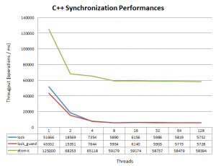
Benchmark

Slide 128
Future
Future is how C++ implement async task
##include <thread>
#include <future>
#include <iostream>
#include <chrono>
#include <vector>
int main(){
std::vector<std::future<size_t>> futures;
for (size_t i = 0; i < 10; ++i) { futures.emplace_back(std::async(std::launch::async, [](size_t param) { std::this_thread::sleep_for(std::chrono::seconds(param));
return param;
}, i));
}
std::cout << "Start querying" << std::endl;
for (auto &future : futures) {
std::cout << future.get() << std::endl;
}
return 0;
}

Slide 129
Future and Promise
Future and Promise allow you access shared data between threads
#include <iostream>
#include <thread>
#include <future>
void initiazer(std::promise<int> * promObj)
{
std::cout<<"Inside Thread"<<std::endl; promObj->set_value(35);
}
int main()
{
std::promise<int> promiseObj;
std::future<int> futureObj = promiseObj.get_future();
std::thread th(initiazer, &promiseObj);
std::cout<<futureObj.get()<<std::endl;
th.join();
return 0;
}

Slide 130
Multi-Threading in C#

Slide 131
Thread Class
using System.Threading* .
Thread class contains some important static members.
Static Properties
Name, Priority, CurrentThread, IsAlive, ThreadState, IsBackground
Static Methods
Sleep(), Start(), Abort(), Suspend(), Resume(), Join()

Slide 132
Start a Thread (1)
class ThreadTest {
bool done;
static void Main() {
// Create a common instance
ThreadTest t1 = new ThreadTest();
new Thread (t1.Go).Start();
t1.Join();
}
// Note that Go is now an instance method
void Go() {
if (!done) {
done = true; Console.WriteLine ("Done");
}
}
}
class ThreadTest {
static bool done; // shared between all threads
static object locker = new object();
static void Main() {
Thread t = new Thread (Go);
t.Start();
t.Join();
}
static void Go() {
lock(locker); {
if (!done) {
done = true; Console.WriteLine ("Done"); }
}
}
}

Slide 133
Start a Thread (2)
class ThreadTest {
bool done;
static void Main() {
// Create a thread
Thread t = new Thread(delegate() {
Console.WriteLine ("Done");
});
t.Start();
t.Join();
}
class ThreadTest {
static void Main() {
Thread t = new Thread (Go);
t.Start(true);
t.Join();
}
static void Go(object upperCase) {
bool upper = (bool)uppercase;
Console.WriteLine (upper ? “HELLO!“ : “hello!”);
}

Slide 134
Foreground and Background
Background thread will exit when main thread ends, but foreground thread will stay alive.
But in any case, please prepare the exception handling.
Application.ThreadException += HandleError;
class PriorityTest {
static void Main (string[] args)
{
Thread worker = new Thread (delegate() { Console.ReadLine(); });
if (args.Length > 0) worker.IsBackground = true;
worker.Start();
}
}

Slide 135
Synchronization Essentials(1)
Simple Blocking Method
Construct | Purpose
Sleep | Blocks for a given time period
Join | Wait for another thread to finish
Locking Constructor
Construct | Purpose | Cross- Process? | Speed
lock | Ensures just one thread can access a resource, or section of code. | No | fast
Mutex | Ensures just one thread can access a resource or code. | Yes | moderate
Semaphore | Ensures not more than a specified number of threads can access a resource, or section of code. | Yes | moderate

Slide 136
Synchronization Essentials(2)
Signaling Constructors
Construct | Purpose | Cross- Process? | Speed
EventWaitHandle | Allow a thread to wait until it receives a signal from another thread. | yes | fast
Wait and Pulse* | Allow a thread to wait until a custom blocking condition is met. | Yes | moderate
Non-Blocking Synchronization Constructs
Construct | Purpose | Cross- Process? | Speed
Interlocked* | To perform simple non-blocking atomic operations. | yes | very fast
volatile* | To allow safe non-blocking access to individual fields outside of a lock | Yes | very fast

Slide 137
Sleep
// Block for 30 seconds
static void Main() {
Thread.Sleep (0); // relinquish CPU time-slice
Thread.Sleep (1000); // sleep for 1000 ms
// sleep for 1 hour
Thread.Sleep (TimeSpan.FromHours (1));
// sleep until interrupted
Thread.Sleep (Timeout.Infinite);
}
class Program {
static void Main() {
Thread t = new Thread (delegate() {
try {
Thread.Sleep (Timeout.Infinite);
}
catch (ThreadInterruptedException) {
Console.Write ("Forcibly ");
}
Console.WriteLine ("Woken!");
});
t.Start();
t.Interrupt();
}
}

Slide 138
Lock Mechanism
class ThreadSafe {
static object locker = new object();
static int val1, val2;
static void Go() {
lock (locker) {
if (val2 != 0) Console.WriteLine (val1 / val2);
val2 = 0;
}
}
}
Lock statement is a shortcut for call Monitor.Enter() and Monitor.Exit() in a try-finally block.
Lock can be called nested in the same thread.
Lock itself is very fast, but overuse lock may impact concurrency.

Slide 139
Block
When a thread waits or pauses as a result of using the constructs listed in the tables above, it's said to be blocked. Once blocked, a thread immediately relinquishes its allocation of CPU time, adds WaitSleepJoin to its ThreadState property, and doesn’t get re-scheduled until unblocked. Unblocking happens in one of four ways (the computer's power button doesn't count!):
by the blocking condition being satisfied
by the operation timing out (if a timeout is specified)
by being interrupted via Thread.Interrupt
by being aborted via Thread.Abort

Slide 140
Thread Programming Strategy (quick and dirty)
Lock the Object or Method
Have it stateless
Use thread-safe class
But this will not help in some scenarios:
if (!myList.Contains (newItem)) myList.Add (newItem);
Use thread-safe clas
Static member should be thread-safe, instance may not.

Slide 141
Thread Priority
Thread Priority Setting
public enum ThreadPriority
{ Lowest, BelowNormal, Normal, AboveNormal, Highest }
Process Class
Process.GetCurrentProcess().PriorityClass = ProcessPriorityClass.High;
The highest process class is RealTime, it means the process is never interrupted.

Slide 142
Exception Handling
public static void Main() {
new Thread (Go).Start();
}
static void Go() {
try {
...
throw null; // this exception will get caught below
...
}
catch (Exception ex) {
Typically log the exception, and/or signal another thread that we've come unstuck
...
}
static class Program {
static void Main() {
Application.ThreadException += HandleError;
Application.Run (new MainForm());
}
static void HandleError (object sender,
ThreadExceptionEventArgs e) {
Log exception, then either exit the app or continue...
}
}

Slide 143
Thread State
ThreadState is a bitwise combination of zero or one members from each layer.
the running / blocking / aborting status
the background/foreground status (ThreadState.Background)
the progress towards suspension via the deprecated Suspend method (ThreadState.SuspendRequested and ThreadState.Suspended)
Thread.IsAlive

Slide 144
Event Handler
class AcknowledgedWaitHandle {
static EventWaitHandle ready = new AutoResetEvent (false);
static EventWaitHandle go = new AutoResetEvent (false);
static volatile string task;
static void Main() {
new Thread (Work).Start();
// Signal the worker 5 times
for (int i = 1; i <= 3; i++) {
ready.WaitOne(); // First wait until worker is ready
task = "a".PadRight (i, 'h'); // Assign a task
go.Set(); // Tell worker to go!
}
// Tell the worker to end using a null-task
ready.WaitOne(); task = null; go.Set();
}
static void Work() {
while (true) {
ready.Set(); // Indicate that we're ready
go.WaitOne(); // Wait to be kicked off...
if (task == null) return; // Gracefully exit
Console.WriteLine (task);
}
}
}
Output:
ah
ahh
ahhh

Slide 145
Auto Reset Event Handler
An AutoResetEvent allow only one thread pass through.
A thread waits, or blocks, at the gate by calling WaitOne and a ticket is inserted by calling the Set method. If a number of threads call WaitOne, a queue builds up behind the gate.
Any (unblocked) thread with access to the AutoResetEvent object can call Set on it to release one blocked thread.
If Set is called when no thread is waiting, the handle stays open for as long as it takes until some thread to call WaitOne. This behavior helps avoid a race condition.
However calling Set repeatedly on a gate at which no-one is waiting doesn't allow a whole party through when they arrive: only the next thread is let through and the extra tickets are "wasted".

Slide 146
Using event handler across processes
The event handler can have a name so used across processes.
EventWaitHandle wh = new EventWaitHandle (false, EventResetMode.Auto,
"MyCompany.MyApp.SomeName");

Slide 147
Producer/Consumer Queue(1)
using System;
using System.Threading;
using System.Collections.Generic;
class ProducerConsumerQueue : IDisposable {
EventWaitHandle wh = new AutoResetEvent (false);
Thread worker;
object locker = new object();
Queue<string> tasks = new Queue<string>();
public ProducerConsumerQueue() {
worker = new Thread (Work);
worker.Start();
}
public void EnqueueTask (string task) {
lock (locker) tasks.Enqueue (task);
wh.Set();
}
public void Dispose() {
EnqueueTask (null); // Signal the consumer to exit.
worker.Join(); // Wait for the consumer's thread to finish.
wh.Close(); // Release any OS resources.
}

Slide 148
Producer/Consumer Queue(2)
void Work() {
while (true) {
string task = null;
lock (locker)
if (tasks.Count > 0) {
task = tasks.Dequeue();
if (task == null) return;
}
if (task != null) {
Console.WriteLine ("Performing task: " + task);
Thread.Sleep (1000); // simulate work...
}
else
wh.WaitOne(); // wait tasks
} } }
class Test {
static void Main() {
using (ProducerConsumerQueue q = new ProducerConsumerQueue()) {
q.EnqueueTask ("Hello");
for (int i = 0; i < 10; i++) q.EnqueueTask ("Say " + i);
q.EnqueueTask ("Goodbye!");
}
// Exiting the using statement calls q's Dispose method, which enqueues a null task and waits until the consumer finishes.
}
}

Slide 149
Producer/Consumer Queue(3)
Output:
Performing task: Hello
Performing task: Say 1
Performing task: Say 2
Performing task: Say 3
...
...
Performing task: Say 9
Goodbye!

Slide 150
Mutex
Mutex is almost redundant with lock
class OneAtATimePlease {
// Use a name unique to the application (eg include your company URL)
static Mutex mutex = new Mutex (false, "oreilly.com OneAtATimeDemo");
static void Main() {
// Wait 5 seconds if contended – in case another instance
// of the program is in the process of shutting down.
if (!mutex.WaitOne (TimeSpan.FromSeconds (5), false)) {
Console.WriteLine ("Another instance of the app is running. Bye!");
return;
}
try {
Console.WriteLine ("Running - press Enter to exit");
Console.ReadLine();
}
finally { mutex.ReleaseMutex(); } }}

Slide 151
Semaphore
A Semaphore with a capacity of one is similar to a Mutex or lock, except that the Semaphore has
no "owner" – it's thread-agnostic. Any thread can call Release on a Semaphore, while with Mutex
and lock, only the thread that obtained the resource can release it.
class SemaphoreTest {
static Semaphore s = new Semaphore (3, 3); // Available=3; Capacity=3
static void Main() {
for (int i = 0; i < 10; i++) new Thread (Go).Start();
}
static void Go() {
while (true) {
s.WaitOne();
Thread.Sleep (100); // Only 3 threads can get here at once
s.Release();
} } }

Slide 152
Wait functions
SignalAndWait
it calls WaitOne on one WaitHandle, while calling Set on another WaitHandle – in an atomic operation.
WaitHandle.SignalAndWait (wh1, wh2);
WaitHandle.WaitAny
waits for any one of an array of wait handles;
WaitHandle.WaitAll
waits on all of the given handles.
Monitor.Wait / Monitor.Pulse
.NET framework provides a more advanced signaling mechanism for when Wait Handles are awkward or unsuitable

Slide 153
Synchronization Contexts
[Synchronization]
public class AutoLock : ContextBoundObject {
public void Demo() {
Console.Write ("Start...");
Thread.Sleep (1000);
Console.WriteLine ("end");
}
public void Test() {
new Thread (Demo).Start();
new Thread (Demo).Start();
new Thread (Demo).Start();
Console.ReadLine();
}
public static void Main() {
new AutoLock().Test();
}}

Slide 154
Dead Lock
[Synchronization]
public class Deadlock : ContextBoundObject {
public DeadLock Other;
public void Demo() { Thread.Sleep (1000); Other.Hello(); }
void Hello() { Console.WriteLine ("hello"); }
}
public class Test {
static void Main() {
Deadlock dead1 = new Deadlock();
Deadlock dead2 = new Deadlock();
dead1.Other = dead2;
dead2.Other = dead1;
new Thread (dead1.Demo).Start();
dead2.Demo();
}
}

Slide 155
Reentrancy
A thread-safe method is sometimes called reentrant, because it can be preempted part way through its execution, and then called again on another thread.
It is done by adding a parameter to synchronization.
[Synchronization(true)]
Considered as dangerous as it unleash the very complications of multithreading one is trying to avoid in the first place.

Slide 156
Non-Blocking Synchronization Constructs*
Construct | Purpose | Cross- Process? | Speed
Interlocked* | To perform simple non-blocking atomic operations. | Yes | moderate
volatile* | To allow safe non-blocking access to individual fields outside of a lock. | yes | moderate
Note: *Assume share memory

Slide 157
Atomicity and Interlocked
class Program {
static long sum;
static void Main() {
// Simple increment/decrement operations:
Interlocked.Increment (ref sum); // 1
Interlocked.Decrement (ref sum); // 0
// Add/subtract a value:
Interlocked.Add (ref sum, 3); // 3
// Read a 64-bit field:
Console.WriteLine (Interlocked.Read (ref sum)); // 3
// Write a 64-bit field while reading previous value:
// (This prints "3" while updating sum to 10)
Console.WriteLine (Interlocked.Exchange (ref sum, 10)); // 10
// Update a field only if it matches a certain value (10):
Interlocked.CompareExchange (ref sum, 123, 10); // 123
}
}

Slide 158
Volatile Variables
On a multi-processor machine, if the thread scheduler assigns the two threads different CPUs. The variable can be cached in CPU registers to improve performance, with a potential delay before their updated values are written back to memory. And when the CPU registers are written back to memory, it’s not necessarily in the order they were originally updated.
This caching can be resolved by Thread.VolatileRead and Thread.VolatileWrite to read and write to the fields. VolatileRead means “read the latest value”; VolatileWrite means “write immediately to memory”. The same functionality can be achieved more elegantly by declaring the field with the volatile modifier:
class ThreadSafe {
// Always use volatile read/write semantics:
volatile static bool endIsNigh, repented;
...
Volatility is relevant only to primitive integral (and unsafe pointer) types – other types are not cached in CPU registers and cannot be declared with the volatile keyword.
If you use lock, then no need to declare volatile.

Slide 159
Monitor

Slide 160
Wait and Pulse
class X {
< Blocking Fields ... >
object locker = new object();
... SomeMethod {
...
... whenever I want to BLOCK based on the blocking fields:
lock (locker)
while (! blocking fields to my liking )
Monitor.Wait (locker);
... whenever I want to ALTER one or more of the blocking fields:
lock (locker) {
alter blocking field(s)
Monitor.Pulse (locker);
} } }

Slide 161
Producer/Consumer Queue(1)
using System;
using System.Threading;
using System.Collections.Generic;
public class TaskQueue : IDisposable {
object locker = new object();
Thread[] workers;
Queue<string> taskQ = new Queue<string>();
public TaskQueue (int workerCount) {
workers = new Thread [workerCount];
// Create and start a separate thread for each worker
for (int i = 0; i < workerCount; i++)
(workers [i] = new Thread (Consume)).Start();
}
public void Dispose() {
// Enqueue one null task per worker to make each exit.
foreach (Thread worker in workers) EnqueueTask (null);
foreach (Thread worker in workers) worker.Join();
}
public void EnqueueTask (string task) {
lock (locker) {
taskQ.Enqueue (task);
Monitor.PulseAll (locker);
}
}

Slide 162
Producer/Consumer Queue(2)
void Consume() {
while (true) {
string task;
lock (locker) {
while (taskQ.Count == 0) Monitor.Wait (locker);
task = taskQ.Dequeue();
}
if (task == null) return; // This signals our exit
Console.Write (task);
Thread.Sleep (1000); // Simulate time-consuming task
}
}
}
static void Main() {
using (TaskQueue q = new TaskQueue (2)) {
for (int i = 0; i < 10; i++)
q.EnqueueTask (" Task" + i);
Console.WriteLine ("Enqueued 10 tasks");
Console.WriteLine ("Waiting for tasks to complete...");
}
// Exiting the using statement runs TaskQueue's Dispose method,
// which shuts down the consumers, after all outstanding tasks
// have completed.
Console.WriteLine ("\r\nAll tasks done!");
}

Slide 163
Producer/Consumer Queue(3)
Output
Enqueued 10 tasks
Waiting for tasks to complete...
Task1 Task0 (pause...) Task2 Task3 (pause...) Task4 Task5 (pause...)
Task6 Task7 (pause...) Task8 Task9 (pause...)
All tasks done!

Slide 164
Two-way Signaling(1)
public class Acknowledged {
object locker = new object();
bool ready;
bool go;
public void NotifyWhenReady() {
lock (locker) {
// Wait if the worker's already busy with a previous job
while (!ready) Monitor.Wait (locker);
ready = false;
go = true;
Monitor.PulseAll (locker);
}
}
public void AcknowledgedWait() {
// Indicate that we're ready to process a request
lock (locker) { ready = true; Monitor.Pulse (locker); }
lock (locker) {
while (!go) Monitor.Wait (locker); // Wait for a "go" signal
go = false; Monitor.PulseAll (locker); // Acknowledge signal
}
Console.WriteLine ("Wassup?"); // Perform task
}
}

Slide 165
Two-way Signaling(2)
public class Test {
static Acknowledged a = new Acknowledged();
static void Main() {
new Thread (Notify5).Start(); // Run two concurrent
new Thread (Notify5).Start(); // notifiers...
Wait10(); // ... and one waiter.
}
static void Notify5() {
for (int i = 0; i < 5; i++)
a.NotifyWhenReady();
}
static void Wait10() {
for (int i = 0; i < 10; i++)
a.AcknowledgedWait();
}
}
Wassup?
Wassup?
Wassup?
(repeated ten times)

Slide 166
Advanced Topic
Apartments and Windows Forms
BackgroundWorker
ReaderWriterLockSlim / ReaderWriterLock
Used in SQL 2 Phase Lock
Thread Pooling
Asynchronous Delegates
Timers
Local Storage

Slide 167
System Internal

Slide 168
Synchronization objects
OS kernel API offers multiple ways for threads to block and wait for some event.
Details vary, but in general they wait for a specific event on some kernel object: a synchronization object.
I/O completion
wait*() for child process to exit
blocking read/write on a producer/consumer pipe
message arrival on a network channel
sleep queue for a mutex, CV, or semaphore, e.g., Linux “futex”
get next event/request on a poll set
wait for a timer to expire

Slide 169
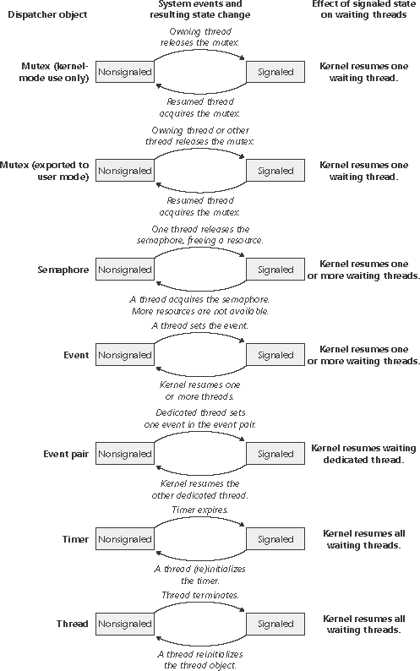

Windows synchronization objects
They all enter a signaled state on some event, and revert to an unsignaled state after some reset condition. Threads block on an unsignaled object, and wakeup (resume) when it is signaled.

Slide 170
Blocking
This slide applies to the process abstraction too, or, more precisely, to the main thread of a process.
When a thread is blocked on a synchronization object (a mutex or CV) its TCB is placed on a sleep queue of threads waiting for an event on that object.
active
ready or
running
sleep
wait
wakeup
signal
blocked
How to synchronize thread queues and sleep/wakeup inside the kernel?
Interrupts drive many wakeup events.
kernel TCB
wait
sleep queue
ready queue

Slide 171
Inside the kernel
A trap or fault handler may suspend (sleep) the current thread, leaving its state (call frames) on its kernel stack and a saved context in its TCB.
syscall traps
faults
sleep queue
ready queue
interrupts
The TCB for a blocked thread is left on a sleep queue for some synchronization object. A later event/action may wakeup the thread.

Slide 172
Wakeup from interrupt handler
trap or fault
return to user mode
sleep queue
ready queue
sleep
wakeup
switch
interrupt
Examples?
Note: interrupt handlers do not block: typically there is a single interrupt stack for each core that can take interrupts. If an interrupt arrived while another handler was sleeping, it would corrupt the interrupt stack.

Slide 173
Wakeup from interrupt handler
trap or fault
return to user mode
sleep queue
ready queue
sleep
wakeup
switch
interrupt
How should an interrupt handler wakeup a thread? Condition variable signal? Semaphore V?

Slide 174
Interrupts
An arriving interrupt transfers control immediately to the corresponding handler (Interrupt Service Routine).
ISR runs kernel code in kernel mode in kernel space.
Interrupts may be nested according to priority.
high-priority
ISR
executing thread
low-priority
handler (ISR)

Slide 175
Interrupt priority: rough sketch
N interrupt priority classes
When an ISR at priority p runs, CPU blocks interrupts of priority p or lower.
Kernel software can query/raise/lower the CPU interrupt priority level (IPL).
Defer or mask delivery of interrupts at that IPL or lower.
Avoid races with higher-priority ISR by raising CPU IPL to that priority.
e.g., BSD Unix spl*/splx primitives.
Summary: Kernel code can enable/disable interrupts as needed.
low
spl0
splnet
splbio
splimp
clock
high
splx(s)
BSD example
int s;
s = splhigh();
/* all interrupts disabled */
splx(s);
/* IPL is restored to s */

Slide 176
What ISRs do
Interrupt handlers:
bump counters, set flags
throw packets on queues
…
wakeup waiting threads
Wakeup puts a thread on the ready queue.
Use spinlocks for the queues
But how do we synchronize with interrupt handlers?

Slide 177
Spinlocks in the kernel
We have basic mutual exclusion that is very useful inside the kernel, e.g., for access to thread queues.
Spinlocks based on atomic instructions.
Can synchronize access to sleep/ready queues used to implement higher-level synchronization objects.
Don’t use spinlocks from user space! A thread holding a spinlock could be preempted at any time.
If a thread is preempted while holding a spinlock, then other threads/cores may waste many cycles spinning on the lock.
That’s a kernel/thread library integration issue: fast spinlock synchronization in user space is a research topic.
But spinlocks are very useful in the kernel, esp. for synchronizing with interrupt handlers!

Slide 178
Synchronizing with ISRs
Interrupt delivery can cause a race if the ISR shares data (e.g., a thread queue) with the interrupted code.
Example: Core at IPL=0 (thread context) holds spinlock, interrupt is raised, ISR attempts to acquire spinlock….
That would be bad. Disable interrupts.
executing thread (IPL 0) in kernel mode
int s;
s = splhigh();
/* critical section */
splx(s);
disable interrupts for critical section

Slide 179
Recap: threads on the metal
An OS implements synchronization objects using a combination of elements:
Basic sleep/wakeup primitives of some form.
Sleep places the thread TCB on a sleep queue and does a context switch to the next ready thread.
Wakeup places each awakened thread on a ready queue, from which the ready thread is dispatched to a core.
Synchronization for the thread queues uses spinlocks based on atomic instructions, together with interrupt enable/disable.
The low-level details are tricky and machine-dependent.
The atomic instructions (synchronization accesses) also drive memory consistency behaviors in the machine, e.g., a safe memory model for fully synchronized race-free programs.
Watch out for interrupts! Disable/enable as needed.

Slide 180
Managing threads: internals
A running thread may invoke an API of a synchronization object, and block.
The code places the current thread’s TCB on a sleep queue, then initiates a context switch to another ready thread.
running
If a thread is ready then its TCB is on a ready queue. Scheduler code running on an idle core may pick it up and context switch into the thread to run it.
yield
preempt
sleep
dispatch
blocked
wakeup
ready
STOP
wait
sleep
wakeup
dispatch
running
running
sleep queue
ready queue

Slide 181
Sleep/wakeup: a rough idea
Thread.Sleep(SleepQueue q) {
lock and disable interrupts;
this.status = BLOCKED;
q.AddToQ(this);
next = sched.GetNextThreadToRun();
Switch(this, next);
unlock and enable;
}
Thread.Wakeup(SleepQueue q) {
lock and disable;
q.RemoveFromQ(this);
this.status = READY;
sched.AddToReadyQ(this);
unlock and enable;
}
This is pretty rough. Some issues to resolve:
What if there are no ready threads?
How does a thread terminate?
How does the first thread start?
Synchronization details vary.

Slide 182
What cores do
Idle loop
scheduler
getNextToRun()
pause
idle
nothing?
get thread
put thread
sleep
exit
got thread
ready queue
(runqueue)
timer
quantum expired
switch in
switch out
run thread

Slide 183
Switching out
What causes a core to switch out of the current thread?
Fault+sleep or fault+kill
Trap+sleep or trap+exit
Timer interrupt: quantum expired
Higher-priority thread becomes ready
…?
switch in
switch out
run thread
Note: the thread switch-out cases are sleep, forced-yield, and exit, all of which occur in kernel mode following a trap, fault, or interrupt. But a trap, fault, or interrupt does not necessarily cause a thread switch!

Slide 184
Example: Unix Sleep (BSD)
sleep (void* event, int sleep_priority)
{
struct proc *p = curproc;
int s;
s = splhigh(); /* disable all interrupts */
p->p_wchan = event; /* what are we waiting for */
p->p_priority -> priority; /* wakeup scheduler priority */
p->p_stat = SSLEEP; /* transition curproc to sleep state */
INSERTQ(&slpque[HASH(event)], p); /* fiddle sleep queue */
splx(s); /* enable interrupts */
mi_switch(); /* context switch */
/* we’re back... */
}
Illustration Only

Slide 185
Thread context switch
switch out
switch in
address space
0
common runtime
x
program
code library
data
R0
CPU
(core)
1. save registers
Rn
x
y
PC
y
stack
SP
registers
2. load registers
stack
high

Slide 186
/*
* Save context of the calling thread (old), restore registers of
* the next thread to run (new), and return in context of new.
*/
switch/MIPS (old, new) {
old->stackTop = SP;
save RA in old->MachineState[PC];
save callee registers in old->MachineState
restore callee registers from new->MachineState
RA = new->MachineState[PC];
SP = new->stackTop;
return (to RA)
}
This example (from the old MIPS ISA) illustrates how context switch saves/restores the user register context for a thread, efficiently and without assigning a value directly into the PC.

Slide 187
Example: Switch()
Save current stack pointer and caller’s return address in old thread object.
switch/MIPS (old, new) {
old->stackTop = SP;
save RA in old->MachineState[PC];
save callee registers in old->MachineState
restore callee registers from new->MachineState RA = new->MachineState[PC];
SP = new->stackTop;
return (to RA)
}
Caller-saved registers (if needed) are already saved on its stack, and restored automatically on return.
Switch off of old stack and over to new stack.
Return to procedure that called switch in new thread.
RA is the return address register. It contains the address that a procedure return instruction branches to.

Slide 188
What to know about context switch
The Switch/MIPS example is an illustration for those of you who are interested. It is not required to study it. But you should understand how a thread system would use it (refer to state transition diagram):
Switch() is a procedure that returns immediately, but it returns onto the stack of new thread, and not in the old thread that called it.
Switch() is called from internal routines to sleep or yield (or exit).
Therefore, every thread in the blocked or ready state has a frame for Switch() on top of its stack: it was the last frame pushed on the stack before the thread switched out. (Need per-thread stacks to block.)
The thread create primitive seeds a Switch() frame manually on the stack of the new thread, since it is too young to have switched before.
When a thread switches into the running state, it always returns immediately from Switch() back to the internal sleep or yield routine, and from there back on its way to wherever it goes next.

Slide 189
Contention on ready queues
A multi-core system must protect put/get on the ready/run queue(s) with spinlocks, as well as disabling interrupts.
On average, the frequency of access is linear with number of cores.
What is the average wait time for the spinlock?
To reduce contention, an OS may partition the machine and have a separate queue for each partition of N cores.
wakeup
put
get thread to dispatch
get
put
force-yield
quantum expire or preempt
ready queue
(runqueue)

Slide 190
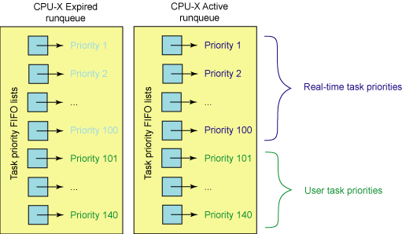
Per-CPU ready queues (“runqueue”)
lock per runqueue
preempt on queue insertion
recalculate priority on expiration
Let’s talk about priority, which is part of the larger story of CPU scheduling.

Slide 191
Separation of policy and mechanism
syscall trap/return
fault/return
system call layer: files, processes, IPC, thread syscalls
fault entry: VM page faults, signals, etc.
thread/CPU/core management: sleep and ready queues
memory management: block/page cache
policy
sleep queue
ready queue
policy
I/O completions
interrupt/return
timer ticks

Slide 192
Processor allocation policy
The key issue is: how should an OS allocate its CPU resources among contending demands?
We are concerned with resource allocation policy: how the OS uses underlying mechanisms to meet design goals.
Focus on OS kernel : user code can decide how to use the processor time it is given.
Which thread to run on a free core? GetNextThreadToRun
For how long? How long to let it run before we take the core back and give it to some other thread? (timeslice or quantum)
What are the policy goals?

Slide 193
Scheduler Policy Goals
Response time or latency, responsiveness
How long does it take to do what I asked? (R)
Throughput
How many operations complete per unit of time? (X)
Utilization: what percentage of time does each core (or each device) spend working? (U)
Fairness
What does this mean? Divide the pie evenly? Guarantee low variance in response times? Freedom from starvation? Serve the clients who pay the most?
Meet deadlines and reduce jitter for periodic tasks (e.g., media)

Slide 194
A simple policy: FCFS
The most basic scheduling policy is first-come-first-served (FCFS), also called first-in-first-out (FIFO).
FCFS is just like the checkout line at the QuickiMart.
Maintain a queue ordered by time of arrival.
GetNextToRun selects from the front (head) of the queue.
wakeup
put
runqueue
get thread to dispatch
get
put
force-yield
quantum expire or preempt
head
tail

Slide 195
Evaluating FCFS
How well does FCFS achieve the goals of a scheduler?
Throughput. FCFS is as good as any non-preemptive policy.
….if the CPU is the only schedulable resource in the system.
Fairness. FCFS is intuitively fair…sort of.
“The early bird gets the worm”…and everyone is fed…eventually.
Response time. Long jobs keep everyone else waiting.
Consider service demand (D) for a process/job/thread.
D=1
D=2
D=3
Gantt
Chart
D=3
D=2
D=1
3
5
6
Time
tail
CPU
R = (3 + 5 + 6)/3 = 4.67

Slide 196
Preemptive FCFS: Round Robin
Preemptive timeslicing is one way to improve fairness of FCFS.
If job does not block or exit, force an involuntary context switch after each quantum Q of CPU time.
FCFS without preemptive timeslicing is “run to completion” (RTC).
FCFS with preemptive timeslicing is called round robin.
D=3
D=2
D=1
FCFS-RTC
round robin
3+ε
5
6
Q=1
R = (3 + 5 + 6 + ε)/3 = 4.67 + ε
In this case, R is unchanged by timeslicing.
Is this always true?
Context switch
time = ε

Slide 197
Evaluating Round Robin
D=5
D=1
R = (5+6)/2 = 5.5
R = (2+6 + ε)/2 = 4 + ε
Response time. RR reduces response time for short jobs.
For a given load, wait time is proportional to the job’s total service demand D.
Fairness. RR reduces variance in wait times.
But: RR forces jobs to wait for other jobs that arrived later.
Throughput. RR imposes extra context switch overhead.
Degrades to FCFS-RTC with large Q.
Notes:
Linux determines timeslice dynamically on a per-process basis based on priority.

Slide 198
Overhead and goodput
Context switching is overhead: “wasted effort”. It is a cost that the system imposes in order to get the work done. It is not actually doing the work.
This graph is obvious. It applies to so many things in computer systems and in life.
Q/(Q+ε)
1
100%
Efficiency
or goodput
What percentage of the time is the busy resource doing useful work?
Q ε
Quantum Q

Slide 199
Minimizing Response Time: SJF (STCF)
Shortest Job First (SJF) is provably optimal if the goal is to minimize average-case R.
Also called Shortest Time to Completion First (STCF) or Shortest Remaining Processing Time (SRPT).
Example: express lanes at the MegaMart
Idea: get short jobs out of the way quickly to minimize the number of jobs waiting while a long job runs.
Intuition: longest jobs do the least possible damage to the wait times of their competitors.
D=1
D=2
D=3
1
3
6
R = (1 + 3 + 6)/3 = 3.33

Slide 200
CPU dispatch and ready queues
In a typical OS, each thread has a priority, which may change over time. When a core is idle, pick the (a) thread with the highest priority. If a higher-priority thread becomes ready, then preempt the thread currently running on the core and switch to the new thread. If the quantum expires (timer), then preempt, select a new thread, and switch

Slide 201
Priority
Most modern OS schedulers use priority scheduling.
Each thread in the ready pool has a priority value (integer).
The scheduler favors higher-priority threads.
Threads inherit a base priority from the associated application/process.
User-settable relative importance within application
Internal priority adjustments as an implementation technique within the scheduler.
How to set the priority of a thread?
How many priority levels? 32 (Windows) to 128 (OS X)

Slide 202
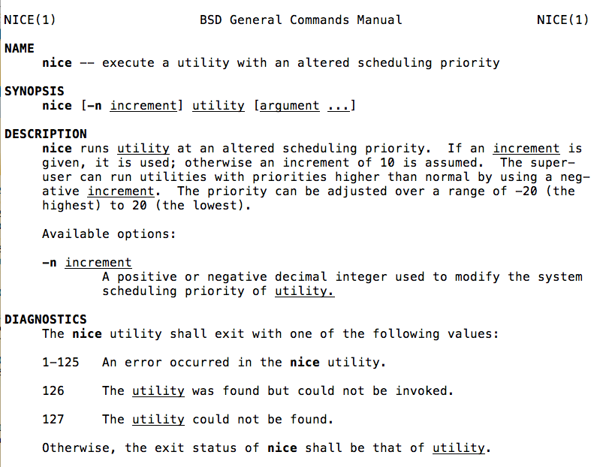

Slide 203
Per-CPU ready queues
On most architectures, a find-first-bit-set instruction is used to find the highest priority bit set in one of five 32-bit words (for the 140 priorities).

Slide 204
Two Schedules for CPU/Disk
1. Naive Round Robin
5
5
1
1
4
CPU busy 25/37: U = 67%
Disk busy 15/37: U = 40%
2. Add internal priority boost for I/O completion
33% improvement in utilization
When there is work to do,
U == efficiency. More U means better throughput.
CPU busy 25/25: U = 100%
Disk busy 15/25: U = 60%

Slide 205
Estimating Time-to-Yield
How to predict which job/task/thread will have the shortest demand on the CPU?
If you don’t know, then guess.
Weather report strategy: predict future D from the recent past.
Don’t have to guess exactly: we can do well by using adaptive internal priority.
Common technique: multi-level feedback queue.
Set N priority levels, with a timeslice quantum for each.
If thread’s quantum expires, drop its priority down one level.
“Must be CPU bound.” (mostly exercising the CPU)
If a job yields or blocks, bump priority up one level.
“Must be I/O bound.” (blocking to wait for I/O)

Slide 206
Example: a recent Linux rev
Tasks are determined to be I/O-bound or CPU-bound based on an interactivity heuristic. A task's interactiveness metric is calculated based on how much time the task executes compared to how much time it sleeps. Note that because I/O tasks schedule I/O and then wait, an I/O-bound task spends more time sleeping and waiting for I/O completion. This increases its interactive metric.

Slide 207
Multilevel Feedback Queue
Many systems (e.g., Unix variants) implement internal priority using a multilevel feedback queue.
Multilevel. Separate queue for each of N priority levels.
Use RR on each queue; look at queue i-1 only if queue i is empty.
Feedback. Factor previous behavior into new job priority.
I/O bound jobs
high
jobs holding resouces
jobs with high external priority
GetNextToRun selects job
at the head of the highest
priority queue: constant time, no sorting
low
CPU-bound jobs
ready queues
indexed by priority
Priority of CPU-bound
jobs decays with system
load and service received.
Notes:
Linux uses a bitmap priority array to figure which queues are populated. X86 provides a find-first-set-bit instruction.
That is the vaunted Linux “O(1)” scheduler.

Slide 208
Thread priority in other queues
The scheduling problem applies to sleep queues as well.
Which thread should get a mutex next? Which thread should wakeup on a CV signal/notify or sem.V?
Should priority matter?
What if a high-priority thread is waiting for a resource (e.g., a mutex) held by a low-priority thread?
This is called priority inversion.

Slide 209
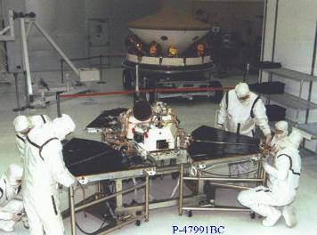
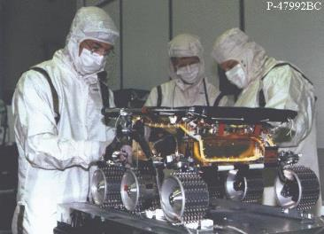
Mars Pathfinder
Mission
Demonstrate new landing techniques
parachute and airbags
Take pictures
Analyze soil samples
Demonstrate mobile robot technology
Sojourner
Major success on all fronts
Returned 2.3 billion bits of information
16,500 images from the Lander
550 images from the Rover
15 chemical analyses of rocks & soil
Lots of weather data
Both Lander and Rover outlived their design life
Broke all records for number of hits on a website!!!
© 2001, Steve Easterbrook

Slide 210
Pathfinder had Software Errors
Symptoms: software did total systems resets and some data was lost each time
Symptoms noticed soon after Pathfinder started collecting meteorological data
Cause
3 Process threads, with bus access via mutual exclusion locks (mutexes):
High priority: Information Bus Manager
Medium priority: Communications Task
Low priority: Meteorological Data Gathering Task
Priority Inversion:
Low priority task gets mutex to transfer data to the bus
High priority task blocked until mutex is released
Medium priority task pre-empts low priority task
Eventually a watchdog timer notices Bus Manager hasn’t run for some time…
Factors
Very hard to diagnose and hard to reproduce
Need full tracing switched on to analyze what happened
Was experienced a couple of times in pre-flight testing
Never reproduced or explained, hence testers assumed it was a hardware glitch
© 2001, Steve Easterbrook

Slide 211
Internal Priority Adjustment
Continuous, dynamic, priority adjustment in response to observed conditions and events.
Adjust priority according to recent usage.
Decay with usage, rise with time (multi-level feedback queue)
Boost threads that already hold resources that are in demand.
e.g., internal sleep primitive in Unix kernels
Boost threads that have starved in the recent past.
May be visible/controllable to other parts of the kernel

Slide 212
Real Time/Media
Real-time schedulers must support regular, periodic execution of tasks (e.g., continuous media).
E.g., OS X has four user-settable parameters per thread:
Period (y)
Computation (x)
Preemptible (boolean)
Constraint (<y)
Can the application adapt if the scheduler cannot meet its requirements?
Admission control and reflection
Provided for completeness

Slide 213
What’s a race?
Suppose we execute program P.
The machine and scheduler choose a schedule S
S is a partial order of events.
The events are loads and stores on shared memory locations, e.g., x.
Suppose there is some x with a concurrent load and store to x.
Then P has a race.
A race is a bug. The behavior of P is not well-defined.

Slide 214
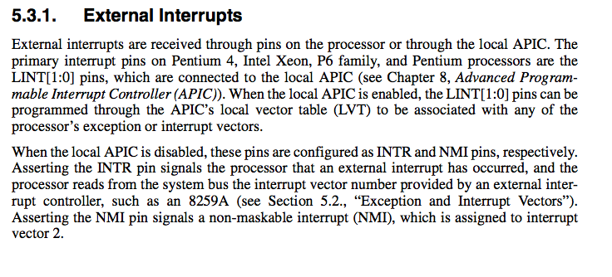
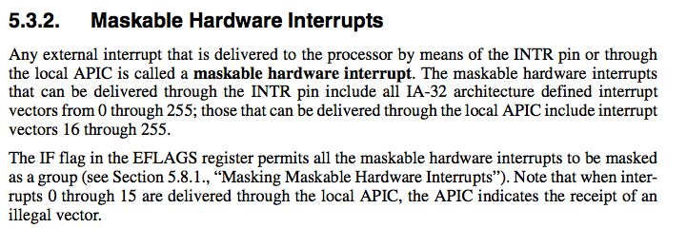
Obviously this is just example detail from a particular machine (IA32): the details aren’t important.

Slide 215
reference
https://baptiste-wicht.com/categories/java.html
http://tutorials.jenkov.com/java-concurrency/index.html
http://www.albahari.com/nutshell/

