Slide 1

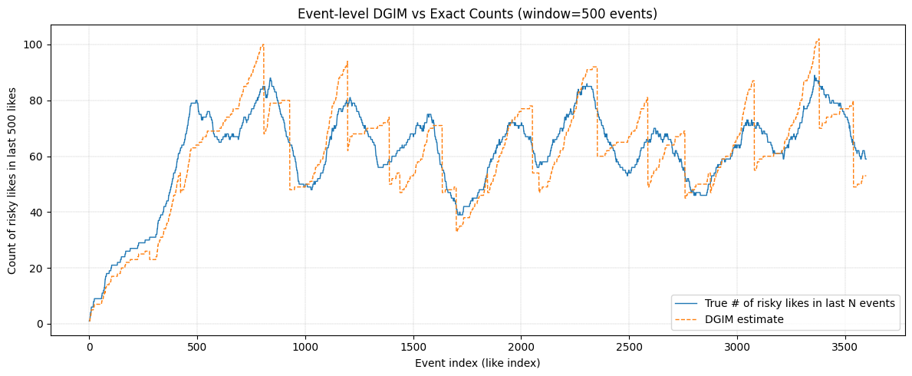
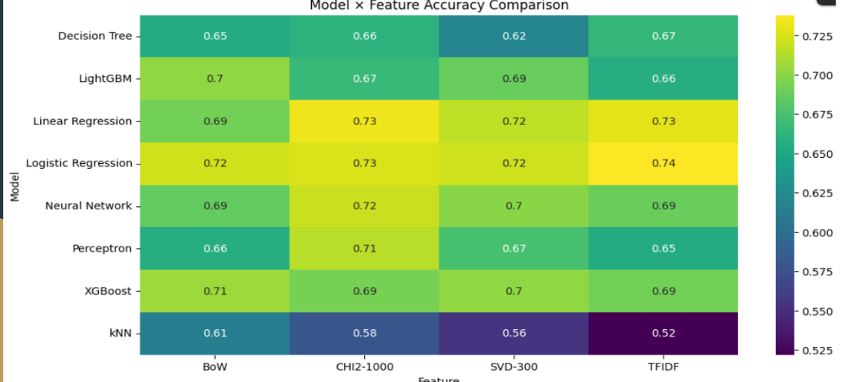
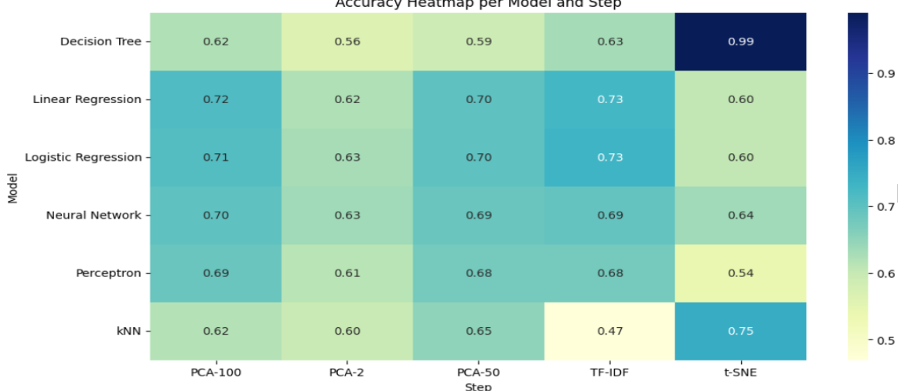

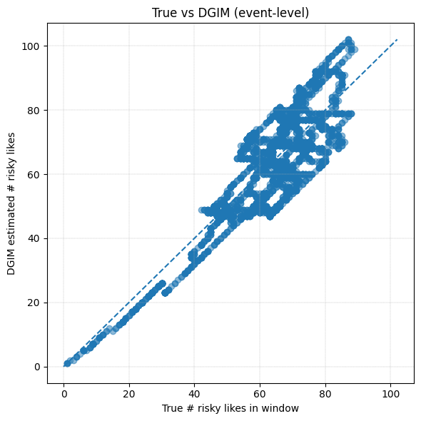
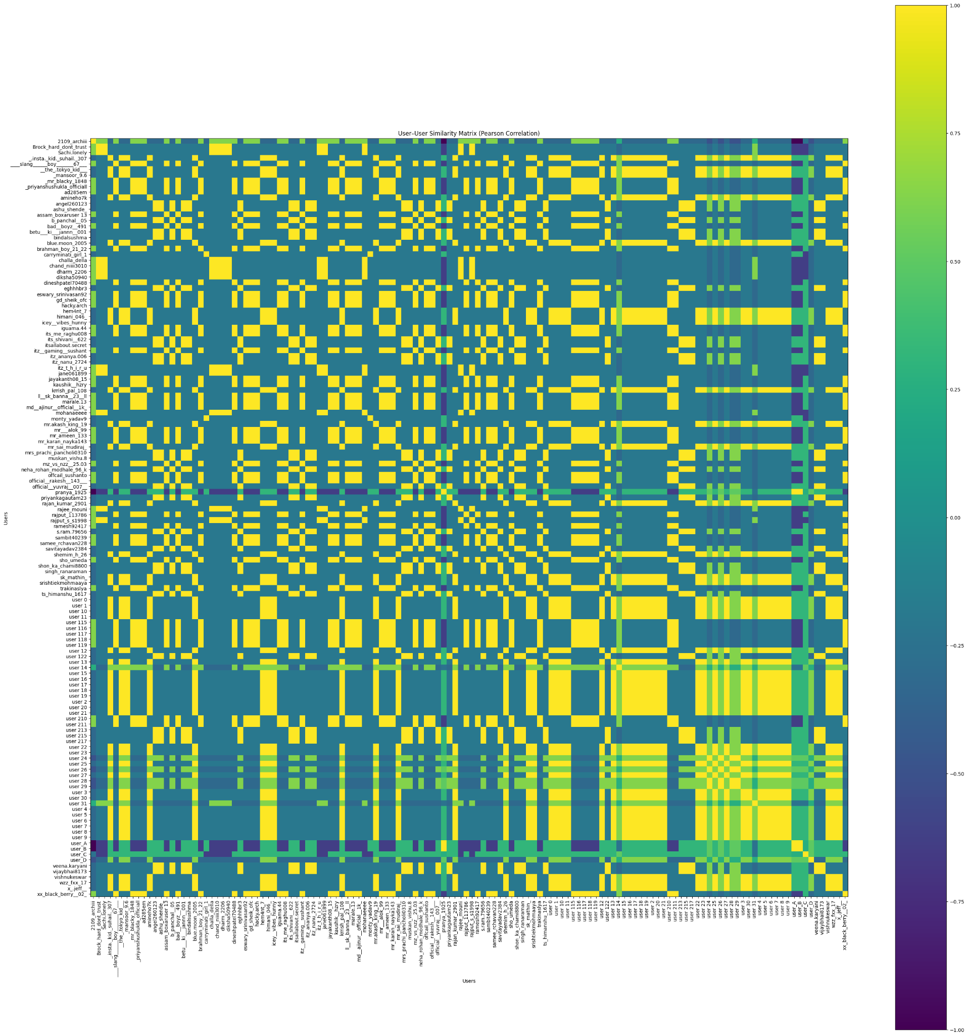
A Comparative Study of Classical Models, Feature Spaces, and Reduced-Dimension Techniques for Suicide Detection on Social Media with Geolocation
Choudari Harshitha Reddy (220010015)
Prakriti Tripati (220120014)
Introduction & Motivation
Methodology
Results
Motivation
Suicide rates are rising globally, and early detection through social media can enable timely intervention.
Text classification performance depends heavily on both the model and the feature space.
Understanding which representations work best is crucial for building accurate crisis-detection systems.
Geolocation of posts adds real-world value by helping identify high-risk regions.
This can be used by emergency response teams and healthcare officials to save lives.
Our goal is to answer:
Which feature space yields the best performance for classical ML models?
Does dimensionality reduction (PCA, t-SNE) preserve sufficient information for classification?
How do boosting models compare to classical linear baselines?
Can an ensemble improve over the best single model?
How can we improve geolocation accuracy from text?
How can we best detect suicidal ideation across different social media platforms?
Which measure of similarity is best for the Instagram dataset?
Can we apply the various techniques learnt in class to analyse these datasets?
Dataset:
Suicide Detection Dataset (Kaggle): https://www.kaggle.com/datasets/nikhileswarkomati/suicide-watch
(Size: 13,742 posts)
Reddit API (100 posts).
Instagram posts.(6 posts, 134 users) .
Also experimented with X API but found it unsuitable for this context, as most suicide-related posts were in the third person.)
For the DGIM algorithm, we synthetically modelled the stream of risky likes. For the demo, we used a stream of 240 hours with a window size of 24 hours.
Scan the QR code to see the visualized geolocations in an interactive map for the Suicide Detection dataset:
Feature Spaces tested:
  TF–IDF
  Bag of Words (BoW)
  Chi²-selected TF–IDF (CHI2-1000)
  SVD-300
  Models tested:
  Logistic Regression
  Linear Regression
  Neural Network
  kNN
  Decision Tree
  Perceptron
  XGBoost
  LightGBM
  en_core_web_sm (Spacy),
  all-MiniLM-L6-v2 (Sentence Transformer),
  BloomFilter,
  user-user Collaborative Filtering,
  Reservoir Sampling, Sliding Window, and DGIM.
  Reduced Features:
  PCA-2,50,100
  TF-IDF
  T-SNE
  Stratified sampling
Blending Ensemble: Combined predictions from Logistic, NN. Text → Cleaning → Vectorization → Model → Prediction
Results (Model vs Feature Space)
Best overall model: Logistic Regression + TF-IDF Highest ROC-AUC, F1, and accuracy
Dataset is highly linearly separable in TF-IDF space
CHI2-1000 performs nearly as well, proving reduced vocabularies still retain strong signals.
Boosting models (XGBoost, LightGBM) perform well but do not outperform linear baselines.
SVD-300 offers a good trade-off between low dimension and performance.
BoW is reasonable but consistently weaker than TF-IDF and CHI2.
kNN and Decision Tree perform worst in all feature spaces → unsuitable for sparse text.
Results (Dimensionality Reduction & Visualizations)
Dimensionality Reduction Effects
PCA-50 gives the best reduced-dimension result but still significantly below TF-IDF and CHI2.
PCA-2, PCA-100 show performance drops due to information loss.
t-SNE performs the worst for classification, confirming it is only suitable for visualization.
Ensemble
LR + Neural Network: Accuracy = 0.701, F1 = 0.740 ROC = 0.795
Improves recall but does NOT outperform TF-IDF Logistic Regression alone, showing linear models already capture most decision boundaries.
DGIM at the event level is useful for modelling posts as data streams as can be seen in figure below:
Experimental Setup
Conclusion & Future Work
Experimental Setup
Hardware: Colab CPU runtime
Training: 80/20 split with SMOTE oversampling
Evaluation Metrics:
  Accuracy
  F1 Score
  ROC-AUC
TF-IDF with Logistic Regression is the strongest combination.
High-dimensional sparse features (>30k dims) greatly outperform compressed or dense representations.
PCA and t-SNE drastically hurt classifier performance.
Boosting models are strong but cannot beat linear modelson sparse text.
Ensemble blending adds stability but not peak performance.
Geolocation + NER successfully identifies crisis clusters, allowing actionable insights.
Future Work
Apply transformer-based models (RoBERTa, DistilBERT) for deeper semantic understanding.
Improve geolocation with neural geoparsers or multilingual city dictionaries.
Expand cross-platform analysis (TikTok, YouTube comments).
Incorporate temporal modeling for suicidal ideation trend detection.
Design real-time risk scoring using streaming algorithms (DGIM, sliding windows).
Objectives
Compare classical ML models across feature spaces (TF-IDF, BoW, CHI2-1000, SVD-300).
Evaluate the impact of dimensionality reduction (PCA, t-SNE) on classification.
Analyze performance of boosting models vs. linear baselines.
Test whether ensemble blending improves predictive quality.
Apply geolocation and NER to map crisis hotspots.
Evaluate suicidal content across Reddit, X, and Instagram.
Compare user-user similarity metrics for Instagram data.
References
Suicide Detection Dataset (Kaggle): https://www.kaggle.com/datasets/nikhileswarkomati/suicide-watch
SpaCy NER Documentation
scikit-learn API
LightGBM & XGBoost libraries
Manning et al., "Foundations of Statistical NLP"
Reddit/Twitter/Instagram terms of use for academic research
Knowledge-aware Assessment of Severity of Suicide Risk for Early Intervention | The World Wide Web Conference
midas-research/sismo-wsdm: Code release for "Towards Ordinal Suicide Ideation Detection on Social Media", WSDM 2021.
Pearson’s coefficient gives the best user-user similarity matrix:

