Slide 1
A Comparative Study of Classical Models, Feature Spaces, and Reduced-Dimension Techniques for Suicide Detection on Social Media with Geolocation
Harshitha, Prakriti

Slide 2
Motivation
Suicide rates are rising globally, and early detection through social media can enable timely intervention.
Text classification performance depends heavily on both the model and the feature space.
Understanding which representations work best is crucial for building accurate crisis-detection systems.
Geolocation of posts adds real-world value by helping identify high-risk regions.
Furthermore, most datasets for suicide classification are supervised and have labels, so we also experimented with unsupervised real time data .
We wanted to formulate the problem in different ways such as finding users who are connected to each other and determine similarity in the amount of risky suicidal posts they liked.
In the reddit posts extracted, we tried to classify them not just into two classes(suicidal vs. non-suicidal) but into three classes (based on risk-level).
Many related papers use labelled datasets with multiple risk levels and categories of suicide. Our methods can be extended to apply to them as well as real life unlabelled data.

Slide 3
Objectives
Compare classical ML models across feature spaces (TF-IDF, BoW, CHI2-1000, SVD-300).
Evaluate the impact of dimensionality reduction (PCA, t-SNE) on classification.
Analyze performance of boosting models vs. linear baselines.
Test whether ensemble blending improves predictive quality.
Apply geolocation and NER to map crisis hotspots.
Evaluate suicidal content across Reddit, X, and Instagram.
Compare user-user similarity metrics for Instagram data.

Slide 4
Dataset & Experimental Setup
Dataset
Suicide Detection Dataset (13,472 posts)
  suicide (7,791) vs non-suicide (5,681)
Train/Test Split: 80/20 stratified
Reddit API (100 posts).
Instagram posts (6 posts, 134 users) .
Also experimented with X API but found it unsuitable for this context, as most suicide-related posts were in the third person.)
For the DGIM algorithm, we synthetically modelled the stream of risky likes. For the demo, we used a stream of 240 hours with a window size of 24 hours
Preprocessing
Lowercasing, punctuation removal
Tokenization + stopword removal
TF-IDF, BoW, CHI2 feature selection ,SVD-300 latent semantic compression
PCA (2, 50, 100 dims), t-SNE (2D, subset of 1000)

Slide 5
Methodology
Models Evaluated
Linear: Logistic Regression, Linear Regression (thresholded), Perceptron
Neural Network
Tree-Based: Decision Tree
Distance-Based: kNN
Boosting: XGBoost, LightGBM
Ensemble: Logistic Regression + Neural Network
NLP Tools: SpaCy NER, Sentence Transformers, VADER, TextBlob
Streaming Models: DGIM, Sliding Window
CF: User-user similarity (cosine, Pearson, Jaccard, Hamming, Euclidean

Slide 6
Bag of Words (BoW)
TF-IDF (Term Frequency – Inverse Document Frequency)
A basic text-to-numbers method that converts each document into a vector based on word counts.
Build a vocabulary of all words in the dataset
e.g., ["suicide", "help", "depressed", "today", …]
For each document, count how many times each word appears.
The result is a sparse vector of counts.
Example:
Sentence: "I feel very depressed today"
Vocabulary index:
depressed → 1
today → 1
others → 0
Pros: simple, fast, classical models love it (SVM, NB).
Cons:
No importance weighting
High dimensional
Doesn’t understand meaning
A weighted BoW — instead of simple counts, it weighs words by importance.
Common words (“the”, “is”) get low weight
Rare but important words (“suicide”, “self-harm”) get high weight
Why it is better than BoW:
Removes noise + highlights informative words → higher accuracy.

Slide 7
Chi-Square (χ²) Feature Selection
SVD-300 (Truncated SVD )
A statistical test used to pick the most important features that strongly relate to the target label.
χ² checks how strongly a word relates to a label
(e.g., “suicide”, “kill myself” more related to positive class)
Removes words with little/no discriminative power
Keeps only the top k best features
(e.g., top 1,000 or 2,000 words)
Models train faster
Less overfitting
Better accuracy with small datasets
Dimensionality reduction applied on TF-IDF.
SVD = Singular Value Decomposition
Truncated SVD keeps only the top 300 latent dimensions.
Converts huge sparse TF-IDF vectors (10,000+ features)
Into a dense 300-dimensional embedding
It captures topics in data.
Example: keywords “sad”, “depressed”, “unhappy” → might map to the same latent dimension.
Why 300?
Common research choice
Removes noise
Reduces model size and training time
Often increases accuracy for linear models (SVM, LR)

Slide 8
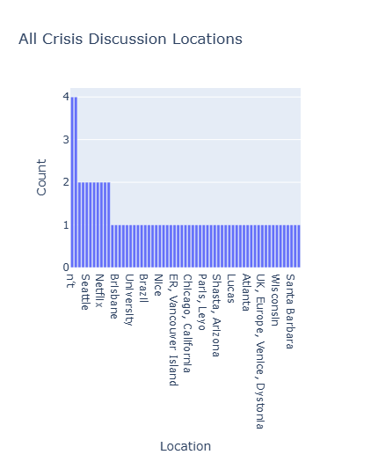
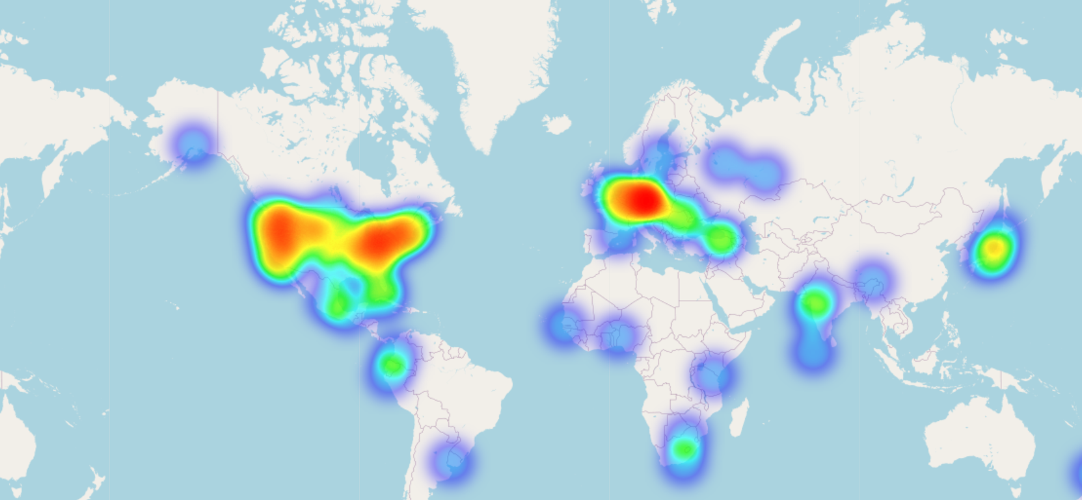
Geolocation Pipeline
SpaCy NER → city extraction
Pretrained transformer for improved detection
Manual city whitelist (population>500 cities) + blacklist of incorrect predictions
Heatmap of crisis locations
Example on the Suicide Detection Dataset we get:
Link: https://prakriti16.github.io/SDM_Project/

Slide 9
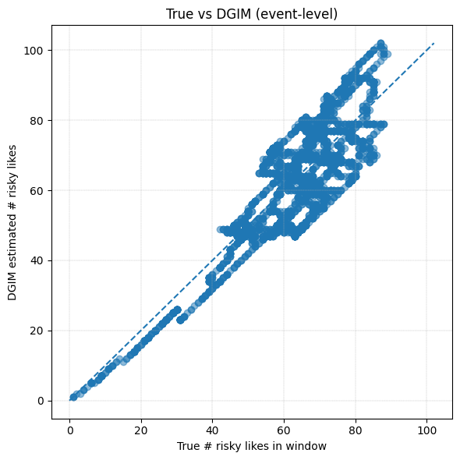
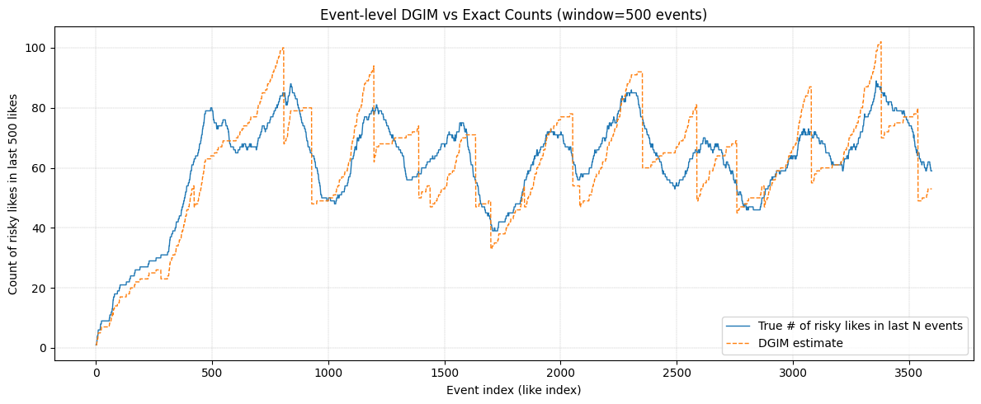
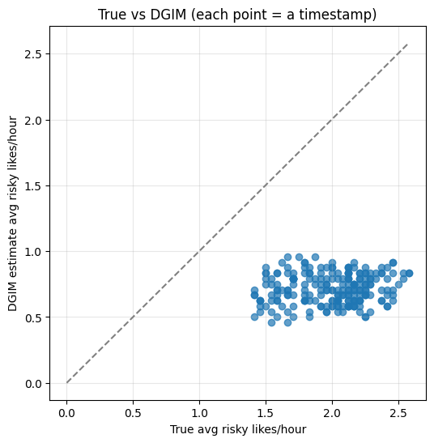
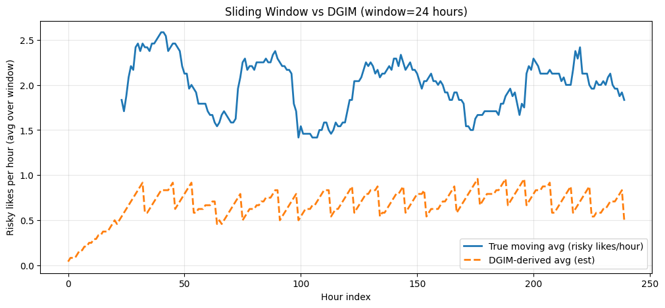
DGIM Algorithm
Error metrics:
MAE: 7.211 (events)
RMSE: 8.555
Mean rel error: 0.122
Error metrics:
MAE: 1.2746 (avg risky likes/hour)
RMSE: 1.3087
Mean relative error: 0.633

Slide 10
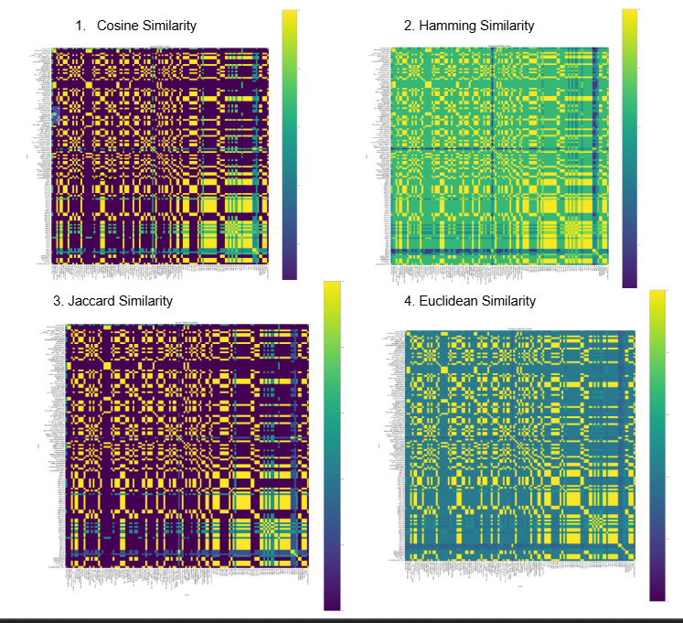
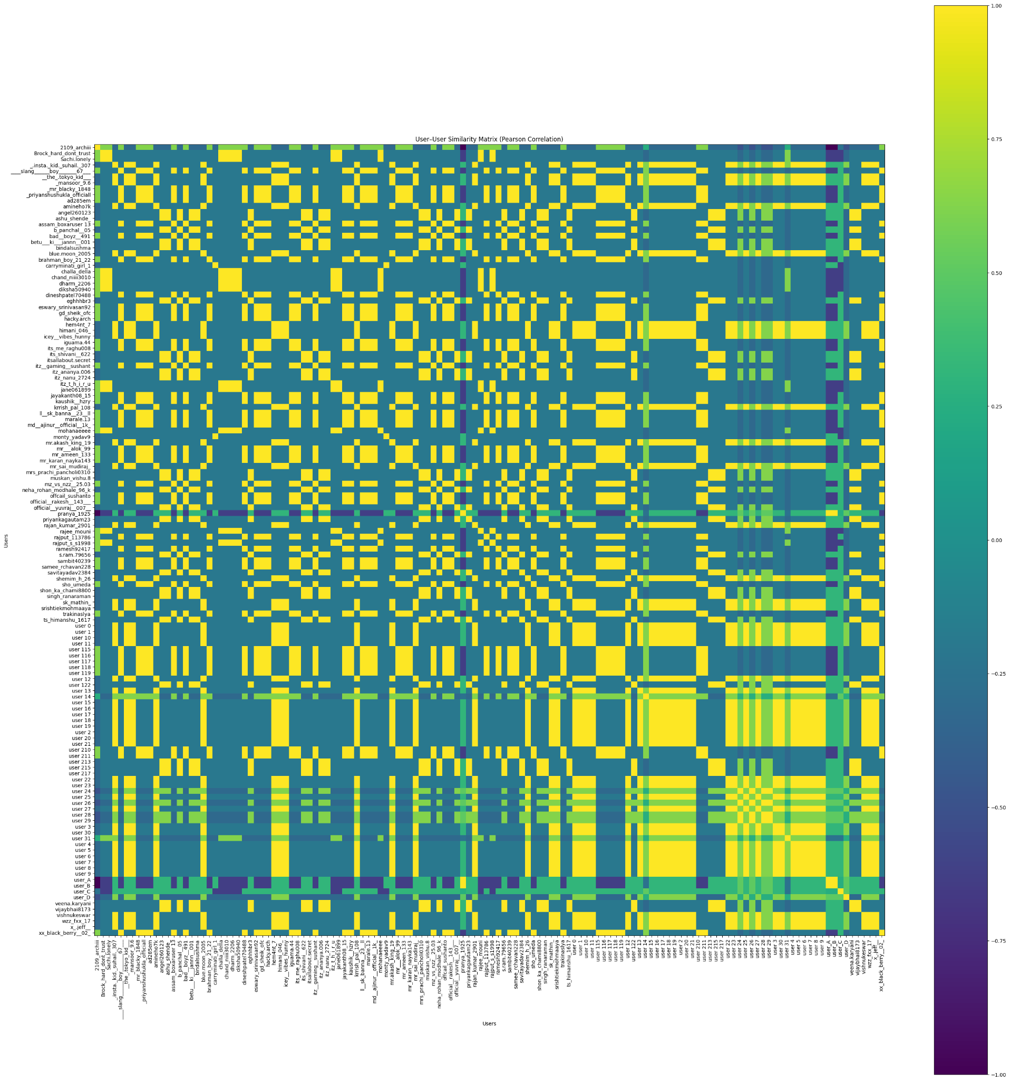
Similarity Scores
https://colab.research.google.com/drive/1v9FbS_bR2rho6b8K_V0-ZAd5I7yz0bxR?usp=sharing

Slide 11
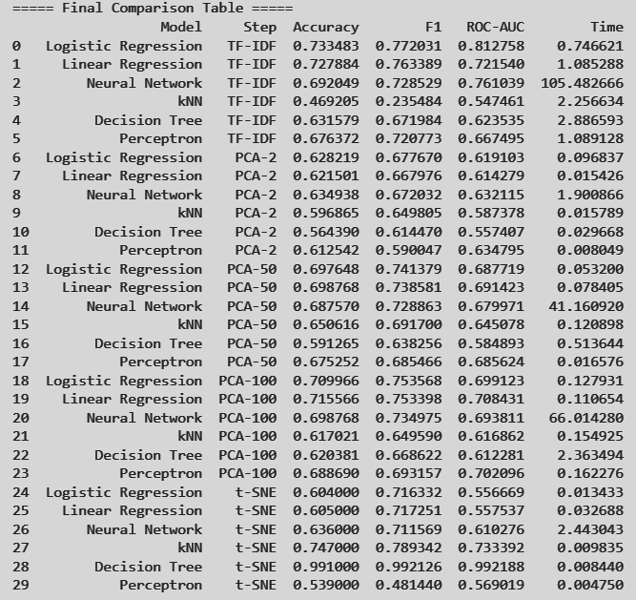
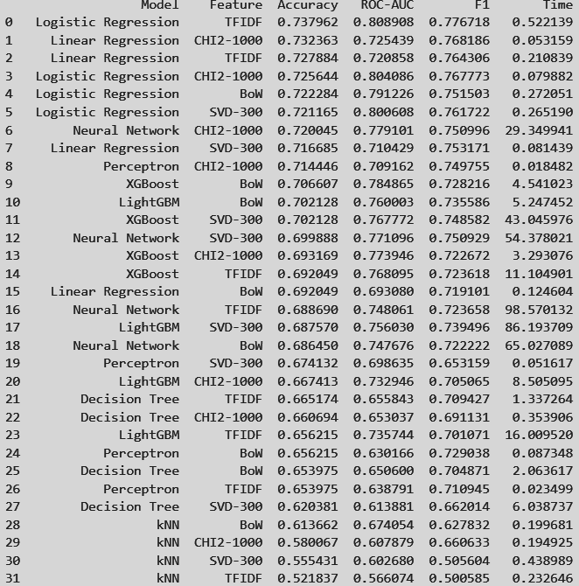

Slide 12
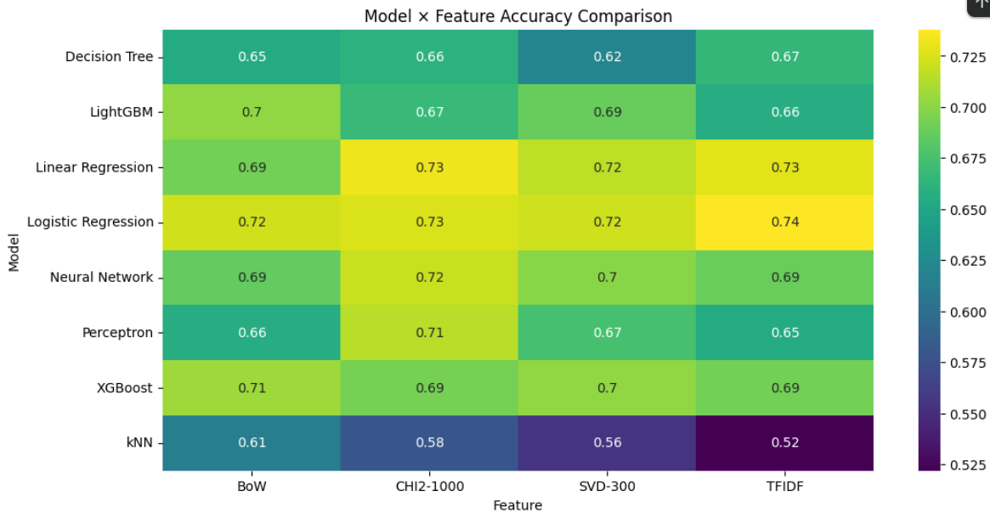

Slide 13
Results (Model vs Feature Space)
Best overall model: Logistic Regression + TF-IDF
  Highest ROC-AUC, F1, and accuracy
  Dataset is highly linearly separable in TF-IDF space
CHI2-1000 performs nearly as well, proving reduced vocabularies still retain strong signals.
Boosting models (XGBoost, LightGBM) perform well but do not outperform linear baselines.
SVD-300 offers a good trade-off between low dimension and performance.
BoW is reasonable but consistently weaker than TF-IDF and CHI2.
kNN and Decision Tree perform worst in all feature spaces → unsuitable for sparse text.

Slide 14
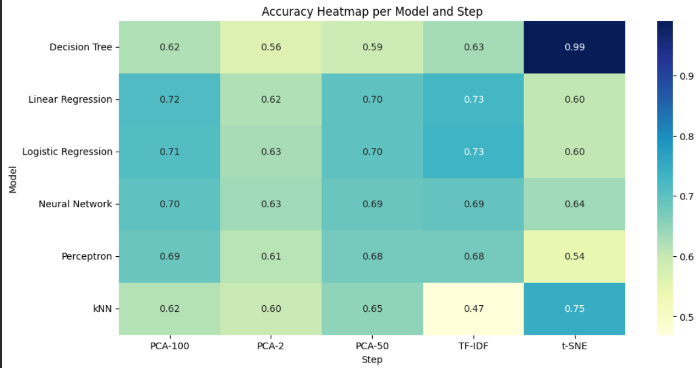

Slide 15
Results (Dimensionality Reduction & Visualizations)
Dimensionality Reduction Effects
PCA-50 gives the best reduced-dimension(accuracy-time) result but still significantly below TF-IDF and CHI2.
PCA-2 show performance drops due to information loss.
t-SNE performs the worst for classification, confirming it is only suitable for visualization.(except for kNN,decision Tree )
Ensemble
LR + Neural Network: Accuracy = 0.701, F1 = 0.740 ROC = 0.795
Improves recall but does NOT outperform TF-IDF Logistic Regression alone, showing linear models already capture most decision boundaries.

Slide 16
Conclusion
TF-IDF with Logistic Regression is the strongest combination.
High-dimensional sparse features (>30k dims) greatly outperform compressed or dense representations.
PCA and t-SNE drastically hurt classifier performance.
Boosting models are strong but cannot beat linear models on sparse text.
Ensemble blending adds stability but not peak performance.
Geolocation + NER successfully identifies crisis clusters, allowing actionable insights.

Slide 17
Future Work
Using BoW to predict similarity between reddit posts and predict for unlabelled data
Apply transformer-based models (RoBERTa, DistilBERT) for deeper semantic understanding.
Improve geolocation with neural geoparsers or multilingual city dictionaries.
Expand cross-platform analysis (TikTok, YouTube comments).
Incorporate temporal modeling for suicidal ideation trend detection.
Design real-time risk scoring using streaming algorithms (DGIM, sliding windows).

Slide 18
References
Suicide Detection Dataset (Kaggle): https://www.kaggle.com/datasets/nikhileswarkomati/suicide-watch
SpaCy NER Documentation
scikit-learn API
LightGBM & XGBoost libraries
Manning et al., "Foundations of Statistical NLP"
Reddit/Twitter/Instagram terms of use for academic research
Knowledge-aware Assessment of Severity of Suicide Risk for Early Intervention | The World Wide Web Conference
midas-research/sismo-wsdm: Code release for "Towards Ordinal Suicide Ideation Detection on Social Media", WSDM 2021.
Suicide ideation detection from online social media: A multi-modal feature based technique - ScienceDirect
Predicting acute suicidal ideation on Instagram using ensemble machine learning models - ScienceDirect

