Slide 1




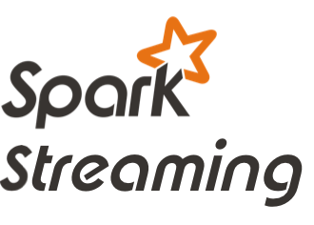



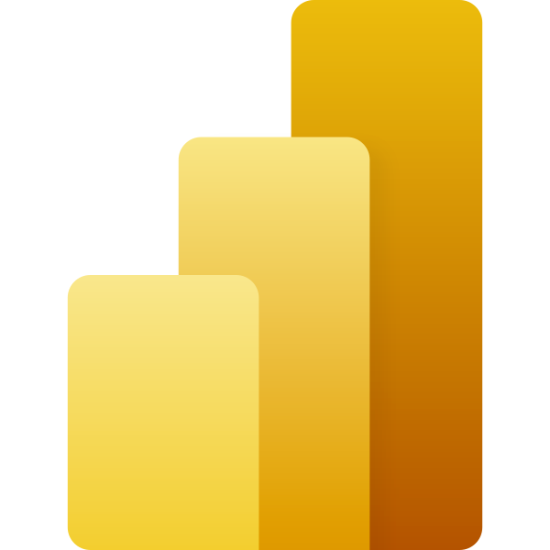

Real-Time Ingestion and Analysis of Financial Transactions
/Multi-GNN

