Slide 1

TrustMe
Putting the Trust into Credit

Slide 2


Amanda Jensen
27 years old
Single
Nurse
1m DKK home loan
Needs car for work commute

Slide 3

Problem
Lack of feedback
Lack of transparency
Data collection is inefficient

Slide 4


Value Proposition
For loan applicants, TrustMe is a credit scoring platform that provides transparency into your credit assessment.
For banks that commit large resources to data collection, TrustMe provides analysed & standardised credit information.

Slide 5
The Solution

Slide 6
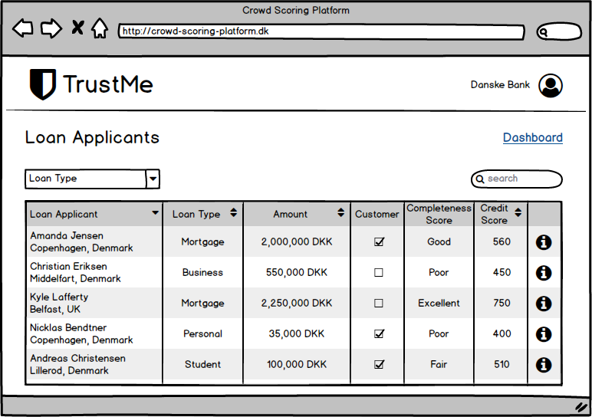

Slide 7
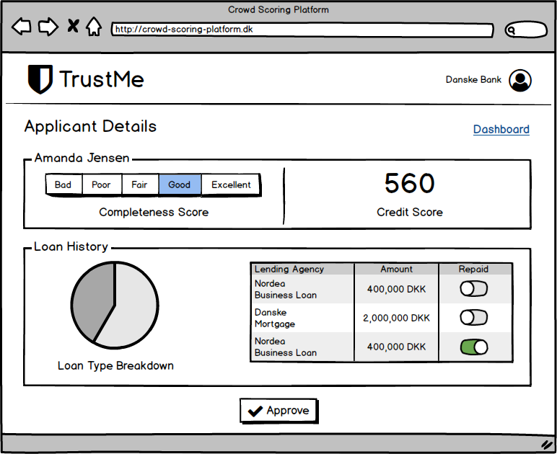

Slide 8








Business Model

Slide 9



Global Team
Søren
Majid
Steven

Slide 10
Value Add
Credit Applicant
Transparent process (trust)
Improve credit score
Actionable feedback
Reusable information
Better borrowing rates
More understanding of credit assessment/score
Credit Provider
Qualified leads
Applicant datasets
Standardised data/scoring
Remove “shutting the door” to potential customers
Reduce loan default rates

Slide 11
The Roadmap: Going forward
2017
2018
2019
Validate value proposition
Develop proof of concept
Establish partnerships
Develop Minimum Viable Product
Platform available for the public
Get first access points to Lending agencies and insurance companies

