Slide 1
British Airways Customer Reviews Analysis

Slide 2
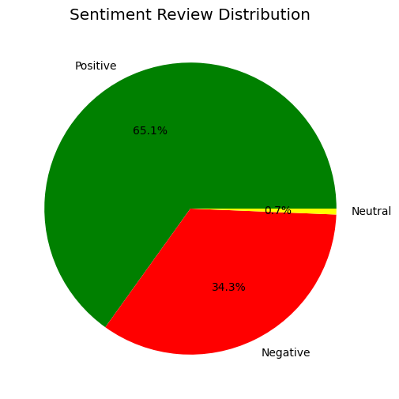
Sentiment Analysis
Sentiment Distribution
Positive: 1302 reviews
Negative: 685 reviews
Neutral: 13 reviews

Slide 3
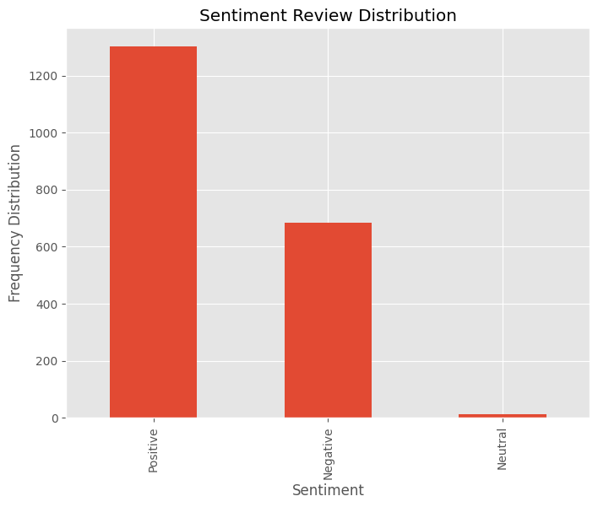
Bar Chart Presentation

Slide 4

Keyword Extraction
Common Keywords in Reviews

Slide 5
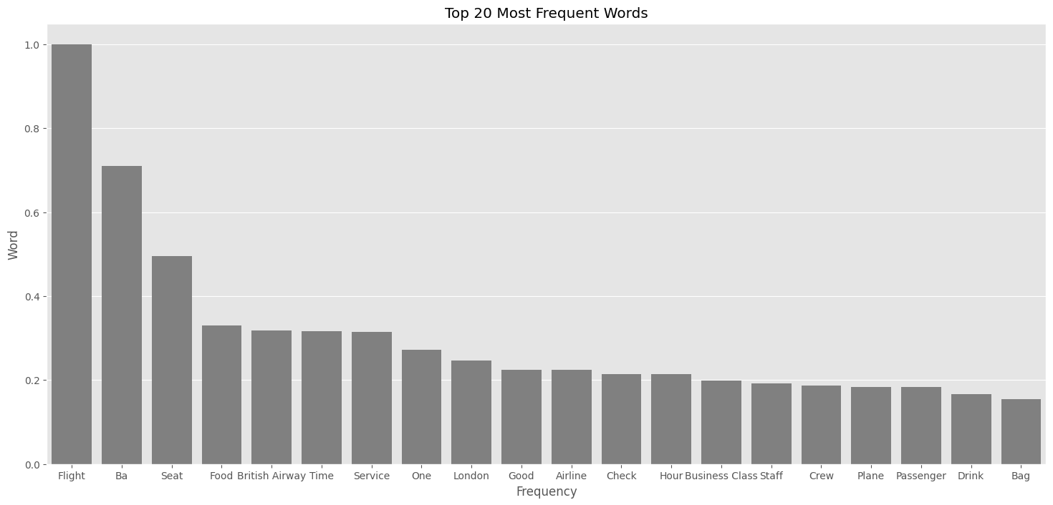

Slide 6
Summary Statistics
Summary Metrics
Average Sentiment: 0.07
Average Review Length: 903.47 characters

