Slide 1
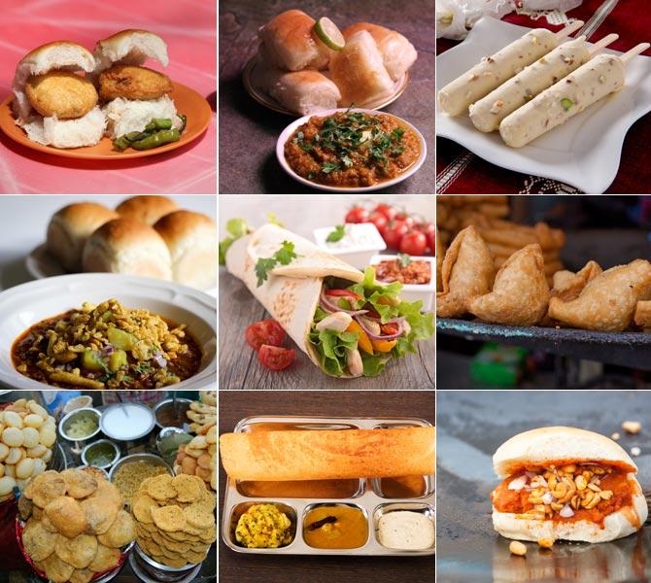
Course:
IBM Applied Data Science Capstone
Survey for opening Food Joint in Mumbai Neighbourhoods, India
By: Vishal Ochani
Aug 2020

Slide 2
Business Problem
This Capstone is intended to analyse and fetch the appropriate location in Mumbai’s Neighbourhood which will be suitable to open a food joint for business man who don’t want to invest huge amount as required to start Restaurants but still want to earn well.
Basically need is for small food joint, food truck, take away counters etc.
To Find:
Proper Area with lot of crowd, will make sure the food joints will make a quite good business.

Slide 3
Target Audience
Business minded people those who are interested to do side hustle on weekends.
Young college students who wants to try their luck in food business.
People who can cook very well but are low on budget.
People who make pickles and other preserved food stuff at home and want to sell it.
People who want to expand their food chains in different areas can start off with small investment, it will make it clear if their food is accepted in different areas.

Slide 4
Data
Data Requirement:
List of Mumbai’s Neighbourhood:
This will help to identify the neighbouring areas with which further analysis can be done
Latitude and Longitude of Neighbouring areas:
This is required to plot areas on map and also for getting the venues in these areas.
Venues in each Neighbourhood:
This is the most important data, as this will get the insights of the places where crowd is attracted.

Slide 5
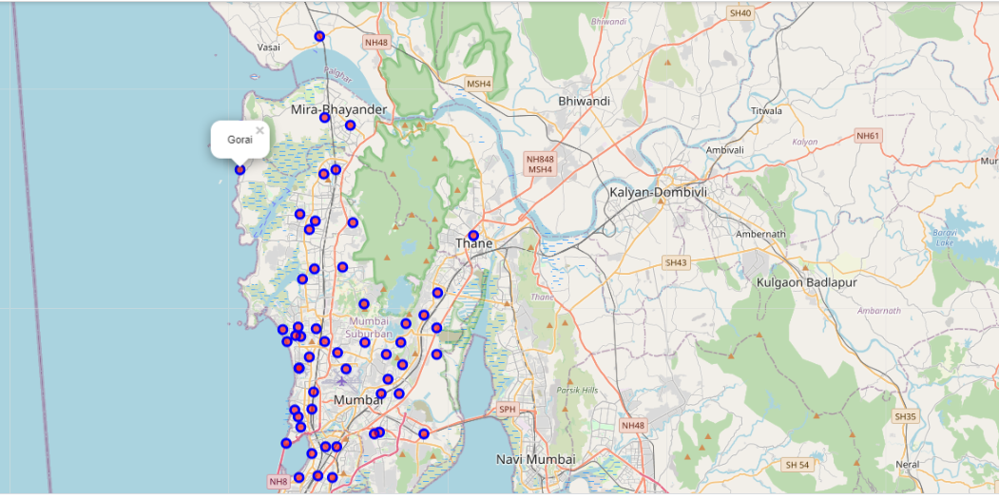
Data
Data Extraction:
Wikipedia: To get the list of neighbouring areas of Mumbai along with its Latitude and Longitude, it will be extracted by using python web scrapping ( using pandas) (https://en.wikipedia.org/wiki/List_of_neighbourhoods_in_Mumbai)
Foursquare.com: This site will help us to extract venues for each neighbouring area, data will be extracted by using foursquare API, below is the plotted map of Mumbai

Slide 6
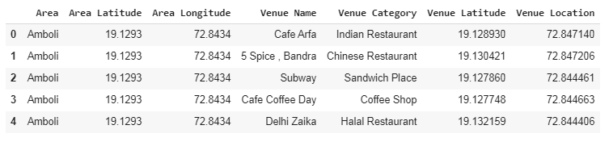
Data
Data Usage:
Once we extract the data, we will merge Wikipedia and Foursquare data mentioned and make the DataFrame using pandas
Now we will have Neighbouring Area and Venue category along with their co-ordinates, sample data shown below

Slide 7
Methodology
We are intended to explore the venues in nearby Areas of Mumbai
Usually in any place the huge number of crowd will be on below locations:
Public Transport ( Bus/Train Station)
Tourist place
Parks/Gardens
Will Analyse the Public transport and already available food joints in the particular area, so as to arrive at accurate conclusion
Our focus will be to extract the crowd attracting places and make the cluster out of those places using KMeans clustering algorithm and to conclude which clusters/Area are best suitable for food joint
Here we will use Clustering, since it will have different areas clubbed together based on the similarities, then it will be easy to check which all areas have more number of tourist places and public transport and help to identify appropriate location for food joint.

Slide 8
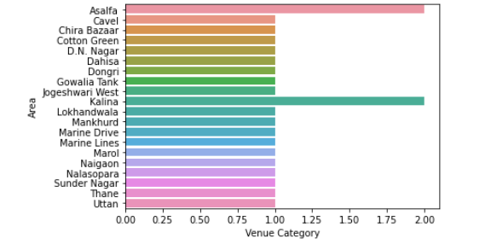
Exploratory Analysis
Area wise count of Public Transport
We have filtered the data frame having all the Station bus/train
Then we have grouped the filtered data by Area on count of station in each Area
The Graph shows the Area vs Station count and Venue category here is public transport.
Areas namely Kalina and Asalfa have more than 1 Station, this will be useful for conclusion once we have clusters
Station count

Slide 9
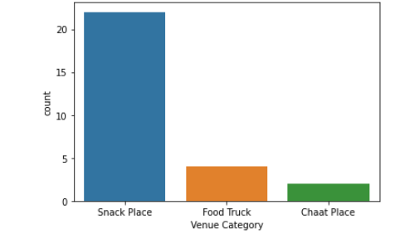
Exploratory Analysis
Already Available Food Joints
In the data frame there are already places that has the food joints which we are exploring for
Filtered data frame having food joints only
Lest count the different type of food Joints, to check which type of food Joint has great potential
There is great potential for Food Truck and Chaat place

Slide 10
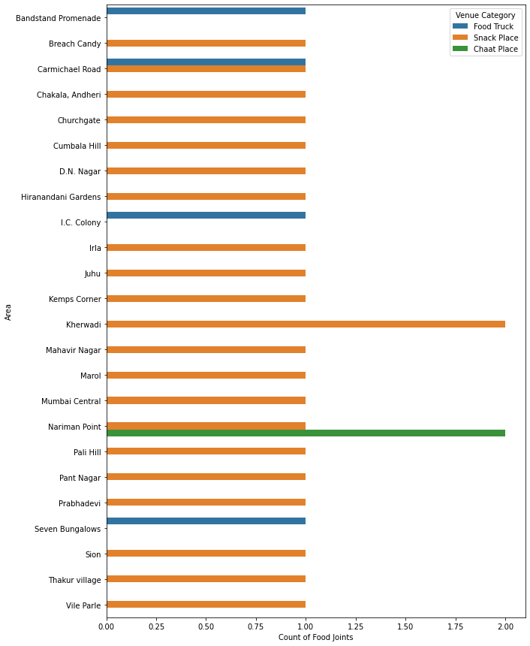
Exploratory Analysis
Area wise food joint count
We can find the area wise count of food joint by filtering the data frame to have food joint and groupby with Area
This will help to understand which area has competition and areas of potential business
Nariman Point and Charmichael Road are the areas with 2 Food joints, will keep these area under observation in clusters. Rest areas have good opportunity.

Slide 11
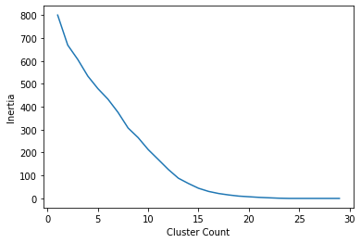
Statistical Inference:
Optimum number of clusters
We will use Inertia and Elbow method to identify the number of clusters
Inertia is the sum of squared error for each cluster. Therefore the smaller the inertia the denser the cluster
As per the Elbow method the number of cluster at the elbow where it starts just changing the curve is the optimum value
It seems 14 is the optimum value of cluster, as at this value elbow is formed

Slide 12
Result
Cluster 0:
Has only Two areas has tourist place (Beach) those are Juhu and Vile Parle
Cluster 1: Has more areas compared to cluster 0 which can attract crowd
There are Beaches, Bus station and playground, both the areas in cluster 1 are good for Food Joint as both of them don't have any food joint
Cluster 4: It has Station only, meaning people looking for part time food business
Suitable Areas: Kalina and Lokhandwala
Cluster 6: One of the Area Gowalia Tank looks attractive, as it has Bus Station, Park, Museum
Cluster 9: It has Station only, , meaning people looking for part time food business
Suitable Areas: All areas have Station, area to be selected as per crowd by exploring it for few days
Cluster 10: Seems to have good tourist and crowd attracting places, it has
Beach, Boating and Arts venue and it has good potential for Food joint

Slide 13
Recommendation
Cluster 0 is ruled out as it has only beaches, meaning little less crowded as tourist have beaches in other areas as well with few more attraction and also in rainy seasons there will be no business in beach areas.
Cluster 1 and 10 has beaches, boating, bus station and playground, both of these cluster looks very lucrative as they have multiple crowding attracting places, one or the other places will keep generating business in all seasons
Cluster 4 and 9 are good bet for part time food business, this is really great for those who don’t want to put their all-time in food business and are interested in side hustle or it may be useful for women to do both business as well as be home maker.
Cluster 6 as standalone looked good but compared to other cluster this isn’t much interesting as it has Museum and Station compared to others will have low crowd.

Slide 14
Conclusion
As our intention was to find out the best location to have food joint, we wanted to have areas with good crowd so that business can grow and people roaming or visiting such places get benefits of having delicious food at very lower rates
Cluster 1 and Cluster 10 are best suited for Full time business.
Food Joint recommendation for Full time business goes to Cluster 10 and Area is Bandstand Promenade
Cluster 4 and Cluster 9 are having good number of Public Transports are best suited for part time business
Food Joint Recommendation goes to Cluster 4's Area Kalina and Asalfa as both has two station each.
Bonus recommendation is to focus on “Food Truck” in both as they are very less in number and are movable

Slide 15
