Slide 1
Haskell
Kelly Ochikubo

Slide 2
About Haskell
Purely functional
Expressions only
No side-effects
Statically typed, Type Inference
sum :: Int -> Int -> Int -- optional sum x y = x + y
sum 3 4
sum 2 “string” -- type error
Lazy evaluation
Elegant and powerful but the trade off is overhead
Notes:
Purely Functional
No statements or instructions, only expressions which cannot mutate variables, no side-effects
Statically Typed, Type Inference
Every expression has a type, which is determined at compile time. All the types composed together by the function application have ot match up, if they don’t, program is rejected by compiler
Lazy
Functions don’t evaluate their arguments
Expression are not evaluated when they are bound to variables, but their evaluation is deferred until their results are needed by other computations
Overhead
Memory usage is unpredictable
Has to keep track of what was evaluated

Slide 3
List Comprehensions
Z₁₀ = {0, 1, 2, 3, 4, 5, 6, 7, 8, 9}
In Haskell: [0..9]
Z₅ x Z₃ = {(0,0),(0,1),(0,2),(1,0),(1,1),(1,2),(2,0),(2,1), (2,2),(3,0),(3,1),(3,2),(4,0),(4,1),(4,2)}
In Haskell: [(x,y) | x <- [0..4], y <- [0..2]]

Slide 4
Higher-Order Functions (HOF)
Functions are first-class objects
Functions in Haskell can take a function as a parameter and return functions as return values
map :: (a -> b) -> [a] -> [b]
Applies the function (a->b) to each element in the list [a] and returns a new list [b]

Slide 5
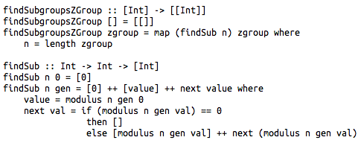
Project Code - HOF and Recursion
Notes:
Define functions within functions
Lazy evaluation
HOF
Recursion

Slide 6
Group Theory
Project Demonstration
Z_{n} and Z_{a} x Z_{b}

Slide 7
Challenges
Purely functional
Previously only worked with imperative languages
Code from scratch
Creating and implementing algorithms
Haskell libraries
Pro: really powerful
Con: can be difficult to use without a good understanding of the language
Recursion
No loops for iteration

