Slide 1



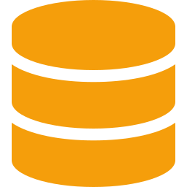


BOS Onboarding Pipeline
From source material to live business observability — one chain, six stages
01
02
03
04
05
06
SOURCES
CAPTURE
VALIDATE
LOAD
FACTORY
DEPLOY
Docs, code,
ops history
▶
49 questions,
cited answers
▶
Structure,
quality gate
▶
Atomic ingest
to BOS app
▶
Profile →
Grafana JSON
▶
Live panels,
real telemetry
OUTPUT
OUTPUT
OUTPUT
OUTPUT
OUTPUT
OUTPUT
Raw inputs
SUD (YAML)
Approved SUD
Service profile
Dashboard JSON
Business dashboard
ACCEPTANCE Service owner can answer “is my business healthy?” with confidence — not “did the dashboard deploy.”

Slide 2
The Service Profile is the Contract
Upstream stages produce it. Downstream factories consume it. The data model decouples both.
UPSTREAM
DOWNSTREAM
produces the profile
consumes the profile
THE CONTRACT
Capture
Dashboard factory
Service Profile
Live · today
SUD from sources
stakeholders
Alert factory
Validate
signals + SLOs
Same model
Quality gate
business impacts
Runbook factory
traceability + provenance
Same model
Load
Atomic ingest
Playbook factory
Same model
WHY IT MATTERS The factory never sees raw sources. Add a new output type without touching capture or validation.

