Slide 1


Why Developer Laptop Security Is Key to Securing Your CI/CD Pipeline
Laptop to Cloud Security
Saurabh Wadhwa
Sr. Solutions Engineer

Slide 2

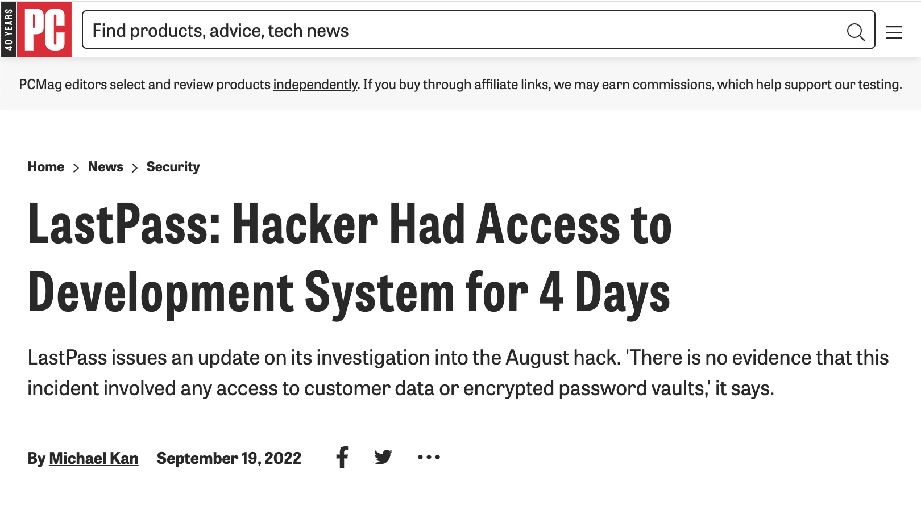
Agenda
DevSecOps for Your Developer Ecosystem
1
Security at the Developer Laptop
2

Slide 3


















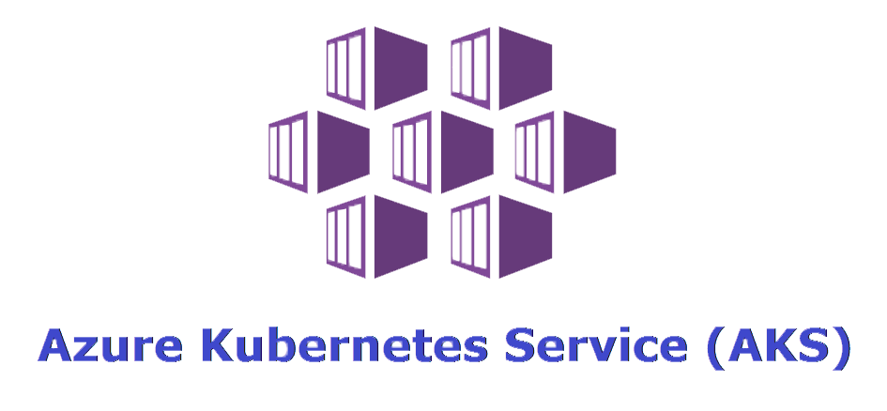









Securing Your Innovation Pipeline
Development
CI/CD
Control Plane
Data Plane
Code Development
Node 1
Developer
Laptop
Build and Test
Registry Scanning
Container
Orchestration
Container
Runtime
Node 2
CI / CD Tool
Registry
Code Pull
Git Repository
Node 3
Notes:
1- this is a lot going on, I just want to highlight how we silo our pipeline from a security perspective
2- for example, lets look only at the right half here. In runtime you have the control plane layer and the data plane layer. So in control plane you have orchestration and runtime services but from a security perspective this data is often completely separate from running nodes in the data layer.
3 - this is the same for pre-production where often we silo the testing and registry stage from the code development and developer laptop monitoring
4 - this is important, because for example an attacker performs container escape…. they go from a node in the data plane to the control plane and from there can go deeper into your infra

Slide 4
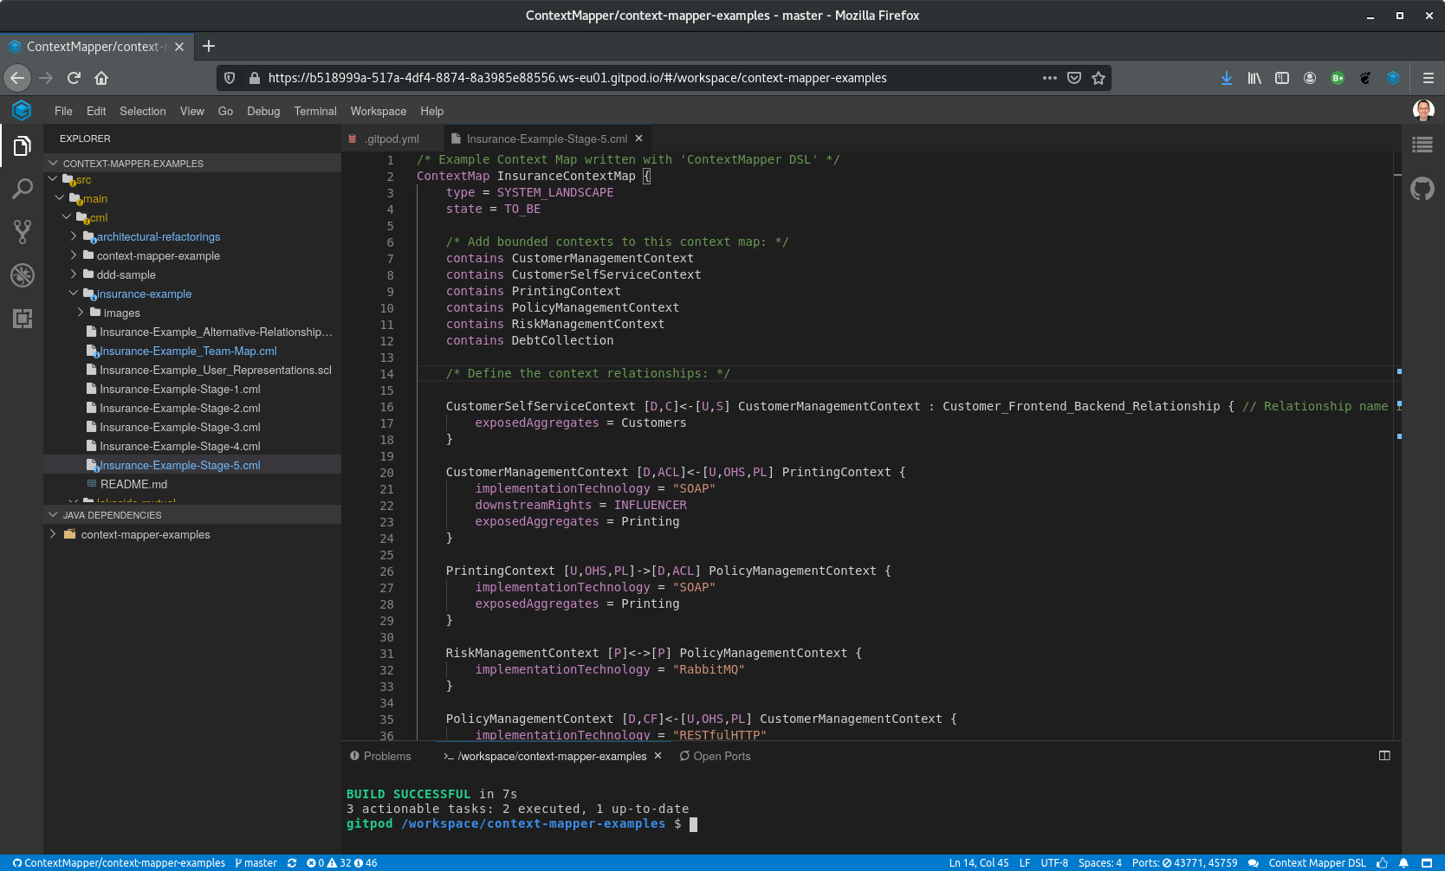



Security at the Developer Laptop
Audit for vulnerable software packages or malicious Chrome extensions
Dynamic trust scores for zero-trust access
Detect and protect against malicious behavior
Notes:
1- attacks targeting developers are on the rise, we see headlines everyday of new breaches targeting developers or development tools.
A key reason for this is that devs do the groundwork on building software and will often have administrator privileges across various systems. That's something attackers can exploit to move laterally around networks and gain access to their end goal. Take for example the Dropbox data breach.
2- this is because developer laptops are extremely valuable and have lots of privileged access
3- so to protect developers, we want good security that enables them to do their job and doesnt hamper innovation
4 - go through bullet points

Slide 5
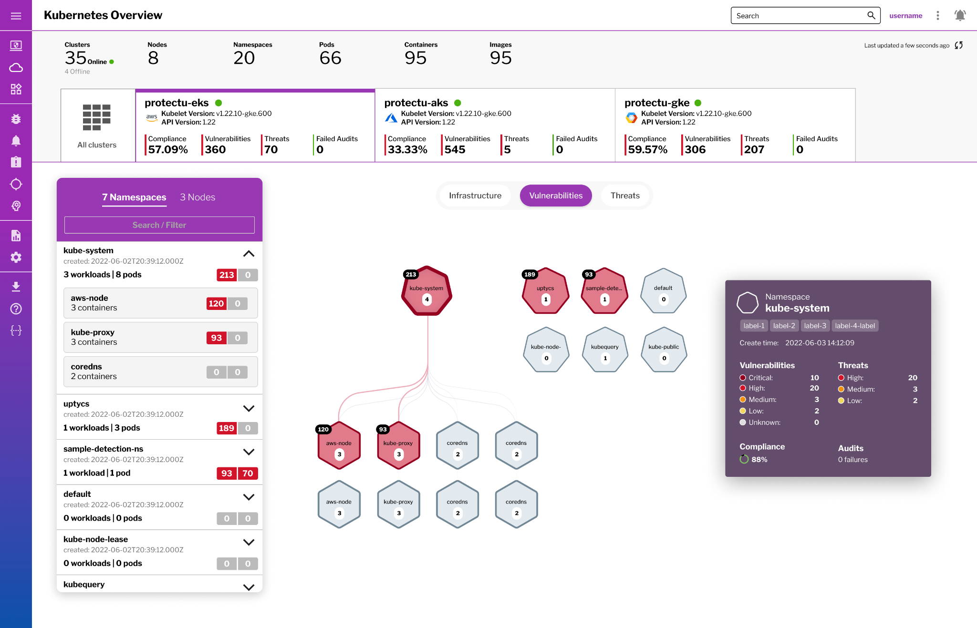
Thank You!
Join us at the Uptycs Booth to talk more!
Thursday @ 3:50pm - Security that Enables:
Breaking Down Silos in the CI/CD Ecosystem
Notes:
To wrap up, I would like to point out is that the attackers don’t think in silos and neither should security practitioners like you .
And second, that we need good security for our developers that helps them remove roadblocks but does not hamper innovation.

