Slide 1

Python FINAL PRESENTATION
Bradley Wadas

Slide 2
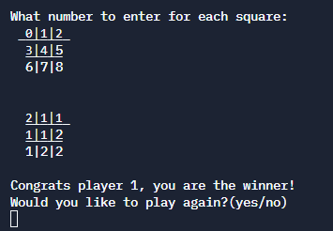
Tic Tac Toe

Slide 3
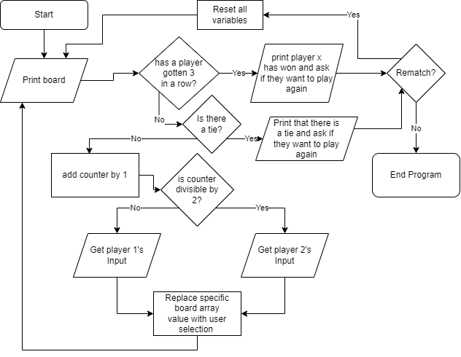
Flow chart
I first made a very primitive flowchart before I started coding
This allows me to visualize what the code should look like before I start.

Slide 4
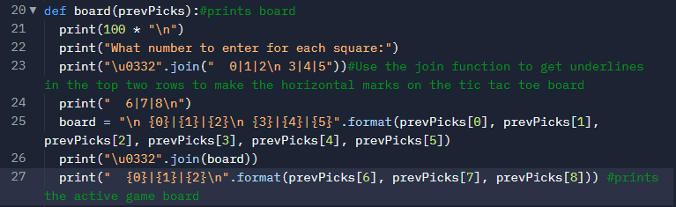
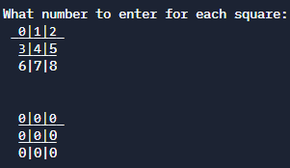
The Board Function
Keeping the board in the same place
Underlining numbers to get horizontal lines replicating a normal Tic Tac Toe board
Formatting the text so it uses the prevPicks list

Slide 5
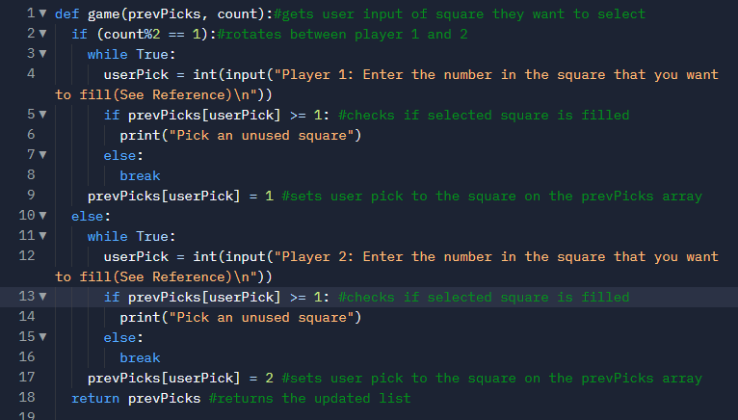
Game Function
Use of count to rotate players
Can't overtake a filled square

Slide 6
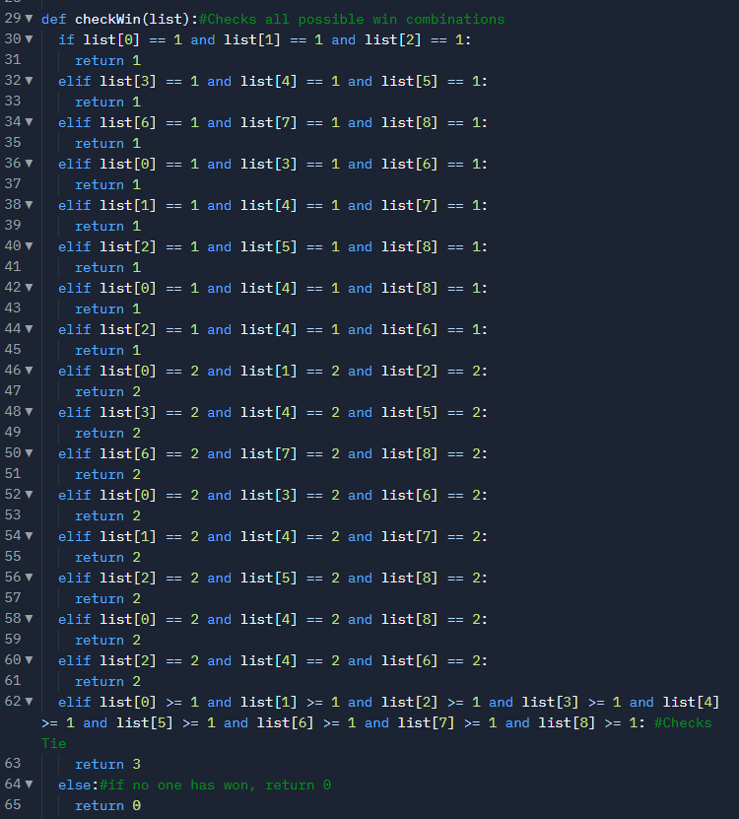
Check Win Function
Goes through all possible combinations for both players
Checks for a tie AFTER function checks for win

Slide 7
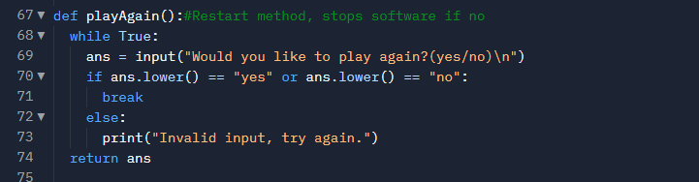
Play Again Function
Simple Function that asks users if they want to play again

Slide 8
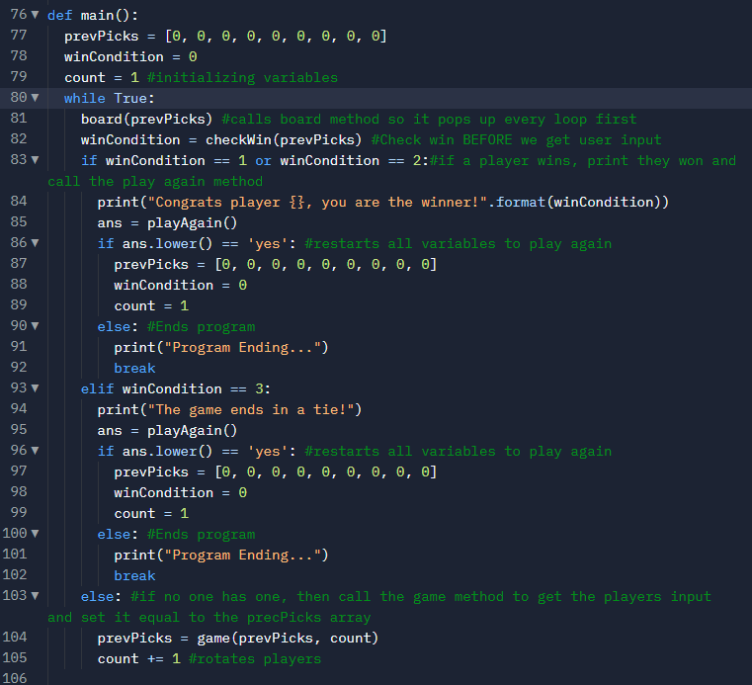
Main Function
Infinite loop until the program ends
First calls board method
Then checks if win or tie has happened
Lastly calls game Function to get user inputs

Slide 9
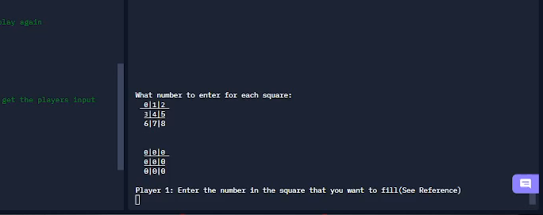
What a normal playthrough would look like

