Slide 1




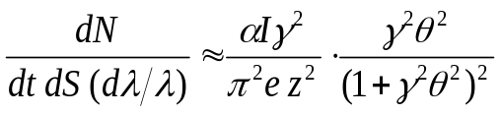
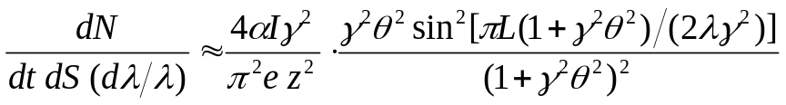
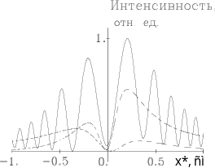


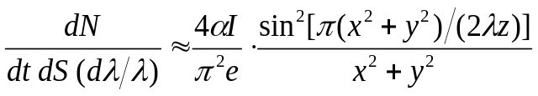
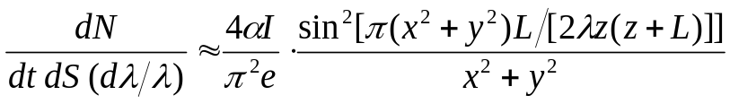
ER (/TR) Approximate Analytical Formulae
L
z
A
e⁻
P(x,y,z)
x
B
z
Numerical Illustrations
y
Far Field
8
11

10
6
11

10
4
11
One BM Edge (A):

10
2
11

10
-7.5
-5
-2.5
2.5
5
7.5
10
x
,
mm
Two BM Edges (B):
Near Field
One BM Edge (A):
6
10
10

10
5
10

10
4
10

10
3
10

10
2
10
Two BM Edges (B):

10
1
10

x
,
mm
-40
-20
20
40

