Slide 1
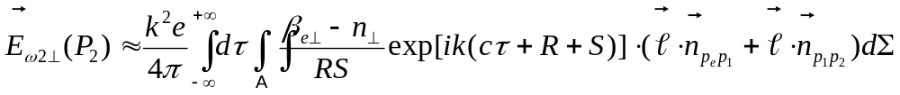
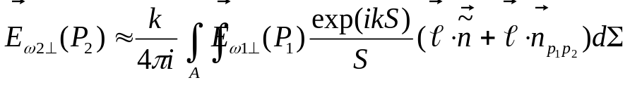

Wavefront Propagation in the Case of
Full Transverse Coherence
Kirchhoff Integral Theorem applied to Spontaneous Emission by One Electron
Σ
V
e
-
P₂ (x₂,y₂,z₂)
P_{e} (x_{e},y_{e},z_{e})
A
Valid at large observation angles;
Is applicable to complicated cases of diffraction inside vacuum chamber
Z
R
S
Y
P₁ (x₁,y₁,z₁)
X
Huygens-Fresnel Principle
Fourier Optics
Free Space:
(between parallel planes perpendicular to optical axis)
Assumption of small angles
“Thin” Optical Element:
“Thick” Optical Element:
(propagation from transverse plane before the element to a transverse plane just after it)
Implemented in SRW for Python in 2012;
Currently used for simulation of NSLS-II PX and spectral microscopy beamlines
Benchmarking against experimental data is required

