Slide 1
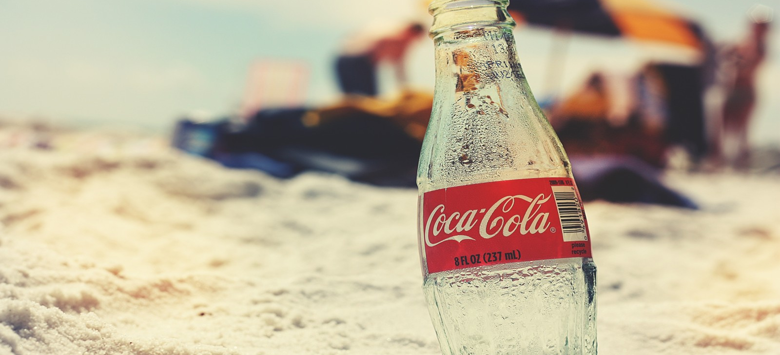
CocaCola Presentation
James Rogers Ochwa Jr.
May 2025

Slide 2
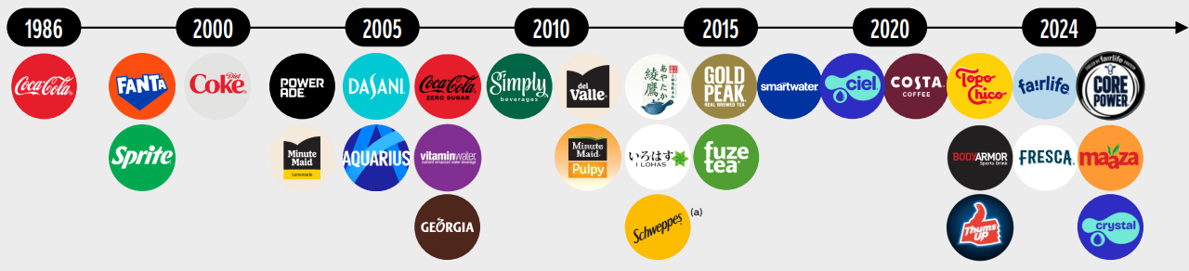
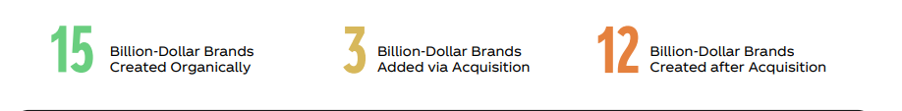
Company overview
Brand Empire Built, Not Bought: 90% of Billion-Dollar Brands Created Organically or Grown Post-Acquisition
30 BILLION-DOLLAR BRANDS
Source: Coca Cola- Investor Relations Overview

Slide 3
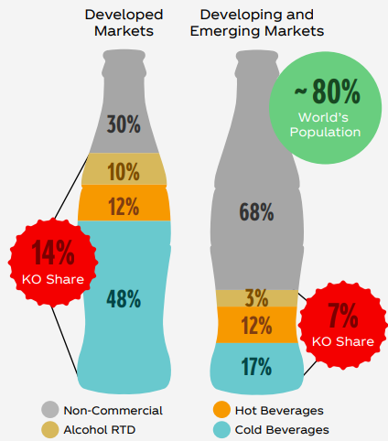
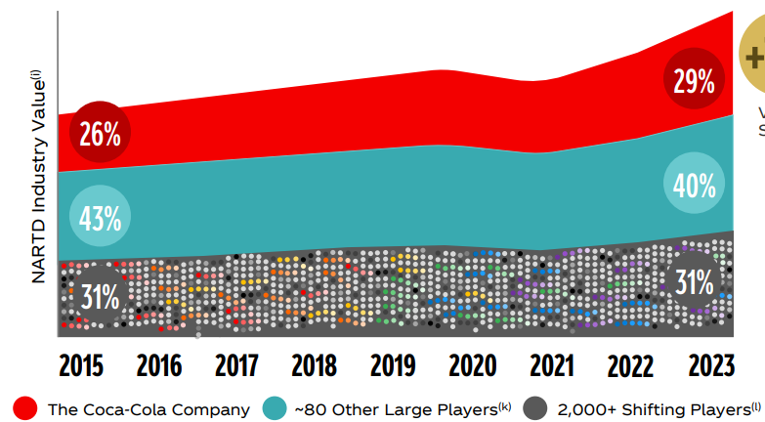
Company overview
Consistent Market Share Gains Against Competitors and Growth Potential in Emerging Economies
Strengthening Leadership in a Fragmented Industry
Capture Untapped Industry
Source: Coca Cola- Investor Relations Overview

Slide 4
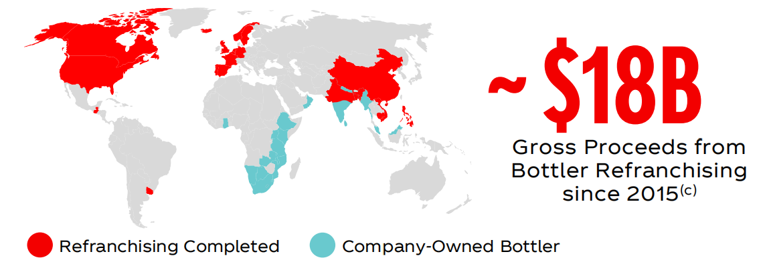
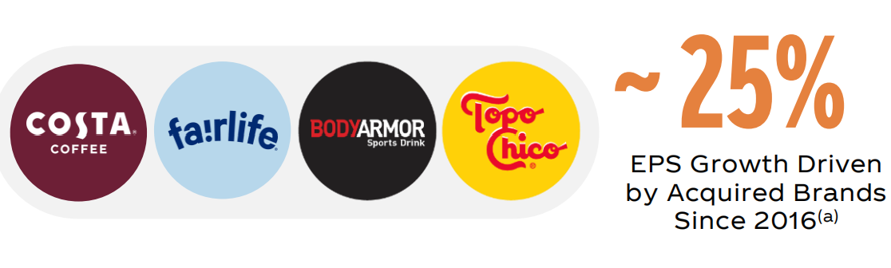
Company overview
Value-Driven Acquisitions and Bottler Refranchising Strategy Supporting EPS Growth and Operational Focus
Acquisitions
Divestitures
The acquisitions of brands such as Costa, fairlife and BODYARMOR have contributed approximately 25% of earnings per share growth since 2016, demonstrating its forward-looking strategy in the functional and high-end beverage markets
Since 2015, the company has been promoting the divestiture of its global bottling business, generating a cumulative revenue of approximately 18 billion US dollars and significantly enhancing regional operational efficiency.
Source: Coca Cola- Investor Relations Overview

Slide 5
Company overview
Global Diversification Driving Balanced Growth and Mitigating Regional Risks
Unit Case Volume
Net Revenues
Operating Income
Bottling Investments
13%
Bottling Investments
3%
Asia Pacific
12%
Asia Pacific
13%
Europe, Middle East & Africa
29%
Asia Pacific
24%
Europe, Middle East & Africa
26%
Europe, Middle East & Africa
23%
33.7 B
$46.9 B
North America
39%
$14.1 B
North America
34%
North America
18%
Latin America
29%
Latin America
13%
Latin America
24%
Latin America and Europe, Middle East and Africa each accounted for 29% with strong growth
The Asia-Pacific region accounted for 24% and performed steadily
North America accounts for only 18% and is a mature market with limited growth
North America has the highest proportion (39%), with high unit selling prices and strong profit margins
Although Latin America has a high sales volume, revenue only accounts for 13% and the pricing is relatively low
The Asia-Pacific region accounts for only 12%, and there are challenges in pricing or structure
North America contributes 34% and is the most core source of profit
Latin America accounts for 24%. Although the revenue is low, the profit is not weak
Bottled investment accounts for only 3%, and its profitability is relatively weak
Source: Coca Cola- Investor Relations Overview

Slide 6
Investment Thesis
Iconic Brand Portfolio, Predictable Earnings, Asset-Light Model, and Durable Competitive Advantage
Iconic Brand Portfolio & Market Leadership
Coca-Cola owns one of the world’s most valuable beverage portfolios, leading in soft drinks, juices, and hydration. Its brand strength ensures pricing power and strong consumer loyalty across global markets.
2. Resilient, Predictable, and Growing Earnings Base
With over 60 years of uninterrupted dividend payments, Coca-Cola's earnings profile is marked by stability and consistency. The essential nature of its products, combined with geographic and category diversification, supports recurring revenues across all economic cycles.
3. Scalable, Asset-Light Franchised Operating Model Coca-Cola’s unique franchise system allows it to focus on brand development and concentrate production, while bottling partners manage capital-intensive distribution. This asset-light structure supports high operating margins, strong free cash flow, and global scalability.
4. Durable Competitive Advantage
The company benefits from decades of scale, supply chain integration, local market penetration, and global distribution capabilities. Its moat is reinforced by unmatched brand equity, embedded infrastructure, and the high cost of replicating its reach and systems.

Slide 7
Financial Overview & Revenue Outlook
Coca-Cola’s Financial Growth Trajectory: 2024–2029
Revenue Growth
23%
Expected to reach ~$57B by 2029, driven by consistent EPS and Net Income growth.
2024 YoY growth: +3%; Organic revenue growth: +12% (pricing + volume).
2024
2029
COGS as a % net revenue
37.9%
37.7%
Resilient top-line performance reflects Coca-Cola’s strong brand equity and consistent global demand.
Rising input and operational costs are mitigated by revenue growth, maintaining margin stability.
2022-2024
(average)
2029
Source: Coca Cola 10-K and group projections
Notes:
● Resilient top-line performance reflects Coca-Cola’s strong brand equity and consistent global demand.
● Rising input and operational costs are mitigated by revenue growth, maintaining margin stability.
● Enhanced operating leverage contributes to improved operating and net profit margins over time.
● The income statement illustrates disciplined cost control, scalable growth, and sustained earnings momentum.

Slide 8
Growth Metrics & CAGR Analysis
Sustainable Growth: CAGR Trends Across Key Metrics
Compound Annual Growth Rate Performance
● EPS Growth: Reflects operational efficiency and strong capital allocation, boosting investor returns.
● EBIT Expansion: Indicates core profitability and effective cost management.
● Long-Term Outlook: These trends support compounding value, margin improvement, and sustainable growth.
Compound Annual Growth Rate (CAGR) chart projects a balanced 5-5.5% annual growth from 2022-2029 across key metrics like Revenue, EPS, and EBIT, reflecting sustainable long-term expansion while maintaining cost efficiency.
Source: Coca Cola 10-K and group projections
Notes:
Let’s start with the Income Statement on the left. This chart projects key metrics from 2022 to 2029, including Revenue, EPS, Net Income, EBIT, Operating Expenses, and COGS. We expect Revenue to grow steadily, reaching approximately $65 billion by 2029, up from $45 billion in 2022. This growth is mirrored across other metrics, with EPS and Net Income also showing consistent upward trends, reflecting our ability to enhance profitability while managing costs effectively. Operating Expenses and COGS are projected to rise in line with revenue, ensuring we maintain operational efficiency as we scale.
Next, let’s look at the Compound Annual Growth Rate (CAGR) at the bottom. Over the 2022–2029 period, we anticipate a CAGR of around 5% for Revenue, EPS, and Net Income, with EBIT and Operating Expenses growing at a slightly lower rate of 4%. This balanced growth underscores our disciplined approach to expanding revenue while optimizing costs, positioning us for sustainable long-term value creation.
Finally, the Cash Flow chart on the right provides insight into our financial flexibility. From 2022 to 2029, we project stable cash flows across key areas: Working Capital, CAPEX, Cash Flows from Investing, and Financing Activities. Notably, our Total Change in Cash and Cash Equivalents remains positive, ensuring liquidity to support dividends, investments, and strategic initiatives. While CAPEX and financing activities show some fluctuations, our overall cash position remains robust, reflecting Coca-Cola’s ability to generate consistent cash flows to fuel future growth.

Slide 9

Free Cash Flow & Capital Allocation
Financial Stability Through Strong Cash Flows
YEAR | 2022 | 2023 | 2024 | 2025 | 2026 | 2027 | 2028 | 2029
Cash flows from operating activities | 11,018.0 | 11,599.0 | 6,805.0 | 10,066.7 | 13,327.6 | 14,015.1 | 15,407.4 | 16,268.2
Cash flows from investing activities | (763.0) | (3,349.0) | 2,524.0 | (285.4) | (3,705.1) | (462.7) | (431.9) | (3,824.8)
Cash flows from financing activities | (10,250.0) | (8,310.0) | (6,910.0) | (8,076.2) | (10,718.1) | (9,919.9) | (10,561.8) | (11,918.3)
Total change in cash and cash equivalents | (200.0) | (133.0) | 1,796.0 | 1,082.1 | (1,178.6) | 3,009.5 | 3,790.7 | (97.9)
Robust Operating Cash Flows: Operating cash flow grows from $11.0B in 2022 to $16.3B by 2029
Capital Allocation: Despite volatility in investing and financing flows, free cash flow remains strong, allowing for continued dividends and share repurchases.
Capital Efficiency Maintained: Consistent CAPEX (~$2.1B range) sustains long-term growth without compromising cash reserves.
Cash Resilience Despite Outflows: Financing outflows are offset by inflows from operations, with net positive cash changes in key years (2024, 2025, 2027, 2028).
Source: Coca Cola 10-K and group projections
Notes:
Let’s start with the Income Statement on the left. This chart projects key metrics from 2022 to 2029, including Revenue, EPS, Net Income, EBIT, Operating Expenses, and COGS. We expect Revenue to grow steadily, reaching approximately $65 billion by 2029, up from $45 billion in 2022. This growth is mirrored across other metrics, with EPS and Net Income also showing consistent upward trends, reflecting our ability to enhance profitability while managing costs effectively. Operating Expenses and COGS are projected to rise in line with revenue, ensuring we maintain operational efficiency as we scale.
Next, let’s look at the Compound Annual Growth Rate (CAGR) at the bottom. Over the 2022–2029 period, we anticipate a CAGR of around 5% for Revenue, EPS, and Net Income, with EBIT and Operating Expenses growing at a slightly lower rate of 4%. This balanced growth underscores our disciplined approach to expanding revenue while optimizing costs, positioning us for sustainable long-term value creation.
Finally, the Cash Flow chart on the right provides insight into our financial flexibility. From 2022 to 2029, we project stable cash flows across key areas: Working Capital, CAPEX, Cash Flows from Investing, and Financing Activities. Notably, our Total Change in Cash and Cash Equivalents remains positive, ensuring liquidity to support dividends, investments, and strategic initiatives. While CAPEX and financing activities show some fluctuations, our overall cash position remains robust, reflecting Coca-Cola’s ability to generate consistent cash flows to fuel future growth.

Slide 10
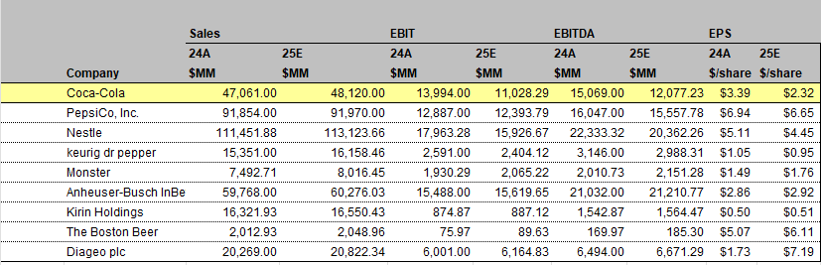
Comparable Company Analysis
Non-Alcoholic: PepsiCo, Inc., Nestle, keurig dr pepper and Monster
Alcohic: Anheuser-Busch InBev, Kirin Holdings, The Boston Beer and Diageo plc
Source:10-K

Slide 11
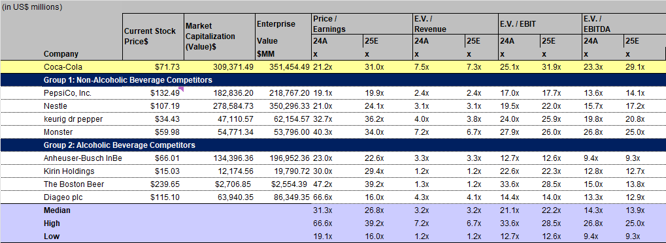
Comparable Company Analysis
Non-Alcoholic: PepsiCo, Inc., Nestle, keurig dr pepper and Monster
Alcohic: Anheuser-Busch InBev, Kirin Holdings, The Boston Beer and Diageo plc
Source:10-K
Notes:
PepsiCo’s stock price is nearly double Coca-Cola’s, but its market capitalization is lower . This suggests Coca-Cola has more shares outstanding, diluting the per-share price, while PepsiCo’s higher stock price reflects a lower share count or higher investor valuation per share

Slide 12
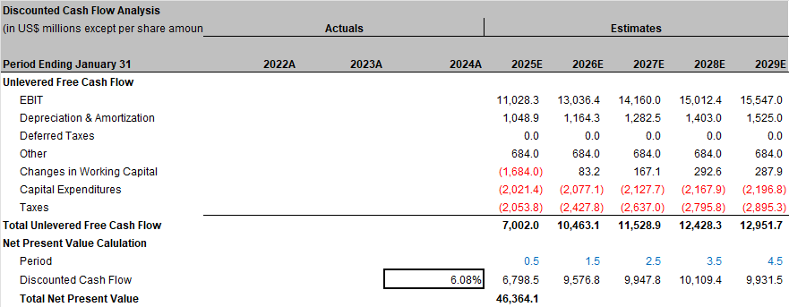
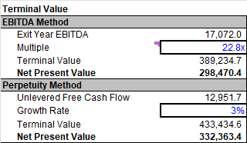
Valuation – DCF Analysis
Valuation based on mid-year convention, 3.0% perpetuity growth, and a 22.8x exit multiple applied to adjusted EBITDA, aligned with market expectations

Slide 13
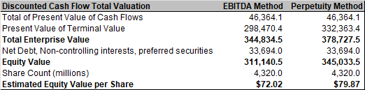
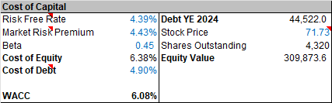
Valuation – DCF Analysis
Cost of debt estimated using the current market yield on Coca-Cola’s 6-year bonds. Both DCF methods indicate moderate upside potential relative to the current share price.

Slide 14
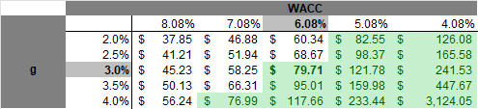

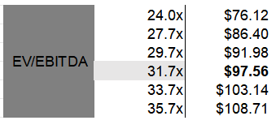
Valuation – Sensitivity Analysis
Valuation outputs under DCF scenarios using varying discount rates, growth assumptions, and exit multiples — with 24x reflecting the market-implied multiple.

Slide 15
Valuation – Football field
Valuation ranges derived from DCF and market multiples suggest upside potential relative to current share price
~71.7 $
Current price

Slide 16
Recommendation
Valuation suggests moderate upside potential, supported by strong fundamentals, resilient cash flow, and consistent market positioning
Current Price: $71.73
Target price: $79.87
Upside: 11.35%
BUY IT ！！

Slide 17
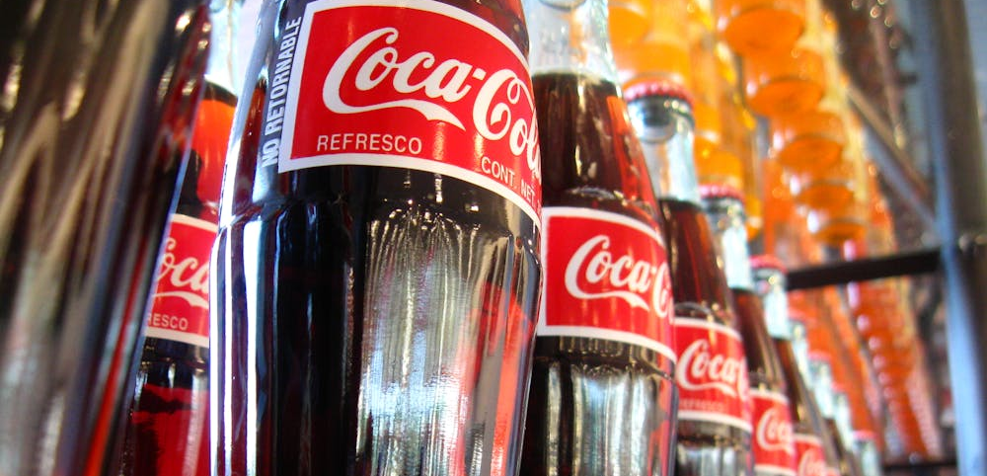
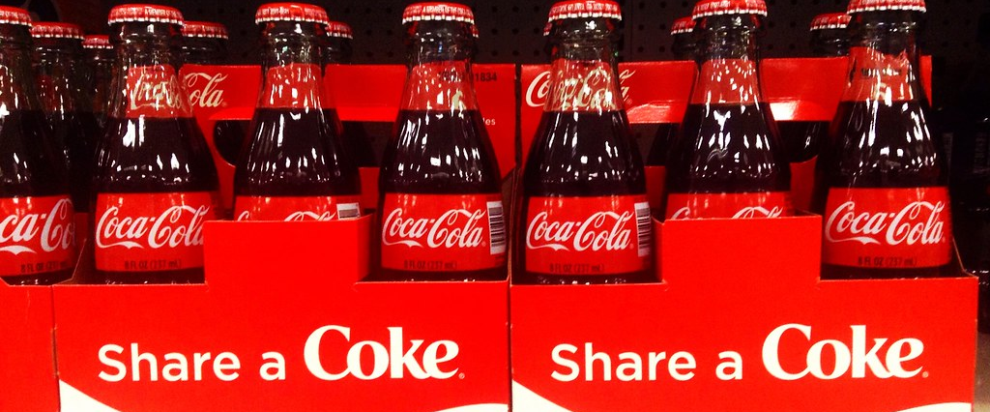
Q&A

Slide 18
Appendix

