Slide 1
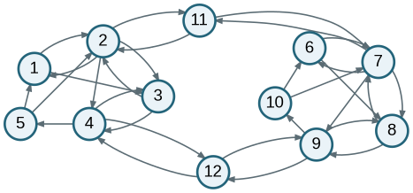
Advanced Network Analysis
Random Graphs as a Baseline for Network Inference
From “what does this network look like?” to “is this structure surprising?”
Olga Chyzh · www.olgachyzh.com

Slide 2
Today’s question
Which features of the observed friendship network would be unlikely if edges formed independently?
1
Describe the observed network
2
Define an independence baseline
3
Simulate networks from the baseline
4
Compare observed vs. simulated features
Advanced Network Analysis · Random Graphs
2

Slide 3
Observed friendship network
Do some students receive many nominations?
Are friendships reciprocated?
Do friends of friends tend to be friends?
Are there groups or clusters?
The goal is not just to describe these patterns. It is to ask whether they are more structured than chance.
Advanced Network Analysis · Random Graphs
3

Slide 4
Translate visual patterns into network statistics
Visual pattern
Network statistic
Social interpretation
An edge exists
Edges / density
How common ties are
i → j and j → i
Mutual ties / reciprocity
Friendship is returned
Friends of friends become friends
Triangles / closure
Local clustering
Some actors receive many ties
In-stars / indegree
Popularity or prestige
Some actors send many ties
Out-stars / outdegree
Activity or expansiveness
These statistics become diagnostics: which patterns can a simple random graph reproduce?
Advanced Network Analysis · Random Graphs
4

Slide 5
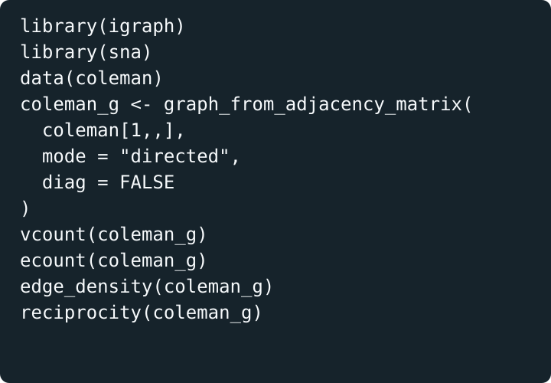
Load and describe the observed network
Quantity
Value
Meaning
N
73
students
m
243
directed friendship nominations
Density
0.046
4.6% of possible directed ties are present
Reciprocity
0.510
many ties are reciprocated
Question: Is 0.510 reciprocity high for a network this sparse?
Advanced Network Analysis · Random Graphs
5

Slide 6
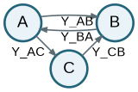
What would “random” mean for a network?
Erdős–Rényi directed graph: G(N, p)
For every possible directed edge i → j:
Yᵢⱼ ~ Bernoulli(p)
Assumption 1: every potential edge has the same probability p.
Assumption 2: edges are independent of one another.
This rules out reciprocity, popularity, clustering, and group structure by design.
Advanced Network Analysis · Random Graphs
6

Slide 7
Estimate the baseline edge probability
Directed network, no self-ties:
Matched by construction
Not matched by construction
Possible edges = N(N − 1)
= 73 × 72 = 5,256
Expected edges
Reciprocity
p̂ = observed edges / possible edges
= 243 / 5,256 = 0.046
Expected density
Triangles / clustering
Degree distribution
Communities
The fitted random graph reproduces the observed density in expectation.
Advanced Network Analysis · Random Graphs
7

Slide 8
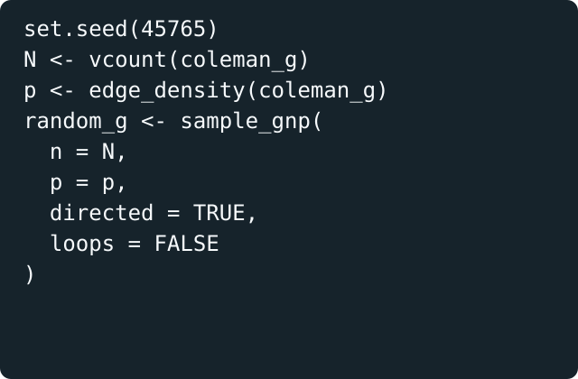
Simulate one random graph
ALGORITHM
Start with N unconnected actors.
For every ordered pair i ≠ j, flip a biased coin.
Set Yᵢⱼ = 1 with probability p̂ = 0.046.
Otherwise set Yᵢⱼ = 0.
This code draws one possible network from the Erdős–Rényi baseline.
Advanced Network Analysis · Random Graphs
8

Slide 9
One draw from G(N, p) will not exactly match m
The model is calibrated so that:
E[M] = N(N − 1)p = 5,256 × 0.046 = 243
243 is the expected number of edges, not a constraint on every simulated network.
Next: compare features other than density.
In one simulation, the random graph had 232 edges. That is not a coding error.
Advanced Network Analysis · Random Graphs
9

Slide 10
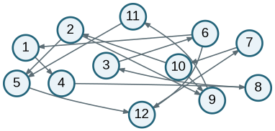
Observed network vs. one random graph
Observed friendship network
One ER random graph
Look for: reciprocal pairs, local closure, hubs, and clusters—not just the number of edges.
Advanced Network Analysis · Random Graphs
10

Slide 11
Random graph vs observed network
Statistic
Observed
One ER simulation
Interpretation
Density
0.046
0.044
Similar by construction
Edges
243
232
Close, but not exact
Reciprocity
0.510
0.034
Observed network is far more reciprocal
Matching density alone does not reproduce a core social process: reciprocated friendship.
Advanced Network Analysis · Random Graphs
11

Slide 12
One simulation is not a reference distribution
Every random graph draw is different.
A single comparison could be unusually high or low.
We need many simulated networks to learn what values are typical.
Then we ask where the observed statistic falls in that distribution.
Inferential logic: observed statistic vs. simulated reference distribution.
Advanced Network Analysis · Random Graphs
12

Slide 13
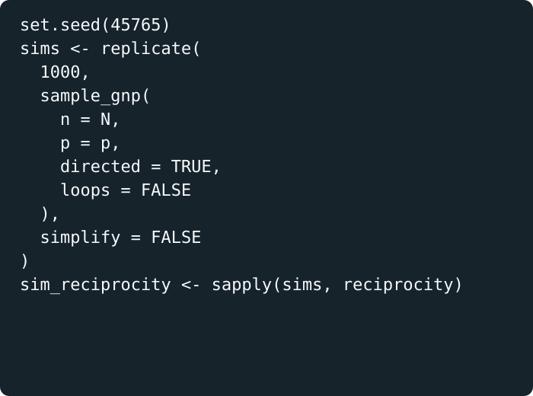
Simulate the reference distribution
What this creates
1,000 plausible networks under the independence baseline
1,000 values of reciprocity
A benchmark for whether observed reciprocity is surprising
This is the step that turns random graphs into an inferential baseline.
Advanced Network Analysis · Random Graphs
13

Slide 14
Observed reciprocity is far outside the ER baseline
Observed reciprocity = 0.510
The random-graph distribution is concentrated near 0.05. The observed network is not just a little more reciprocal—it is on a different scale.
Advanced Network Analysis · Random Graphs
14

Slide 15
The ER baseline fails on several features
Feature
Observed
Random
What it suggests
Edges
243
232
Density is roughly matched
Mutual ties
62
4
Strong reciprocity
Triangles
460
37
Strong local closure
Two-out-stars
383
343
Some sender heterogeneity
Two-in-stars
542
345
Popularity concentration
The comparison tells us which endogenous network processes the next model should include.
Advanced Network Analysis · Random Graphs
15

Slide 16
From discrepancy to model specification
Observed discrepancy
Candidate ERGM term
Interpretation
More edges than expected baseline
edges
Baseline tie propensity
Too much reciprocity
mutual
i → j makes j → i more likely
Too many closed triples
triangles / gwesp
Friends of friends become friends
Too many popular actors
istar / indegree terms
Some actors attract many ties
Too many active senders
ostar / outdegree terms
Some actors send many ties
Advanced Network Analysis · Random Graphs
16

Slide 17
ERGM intuition: add dependence terms
Erdős–Rényi baseline
logit Pr(Yᵢⱼ = 1) = θ_edges
ERGM extension
logit Pr(Yᵢⱼ = 1 | Y₋ᵢⱼ) = θ_edges + θ_mutual Δmutualᵢⱼ + θ_closure Δclosureᵢⱼ + …
The model changes from “all edges are independent coins” to “tie probability changes when adding the edge would create reciprocity, closure, or other structures.”
Advanced Network Analysis · Random Graphs
17

Slide 18
Your turn: Sampson network
Step
Task
Checkpoint
1
Calculate N and p̂
Can you explain what p̂ means?
2
Simulate one directed G(N, p̂) graph
Is its density reasonably close?
3
Simulate 500 graphs
Create a reference distribution
4
Compare reciprocity, closure, and degree features
Which statistics are poorly reproduced?
5
Propose ERGM terms
Each term should address a specific discrepancy
A good specification is not a shopping list. It is a response to what the baseline fails to reproduce.
Advanced Network Analysis · Random Graphs
18

Slide 19
Takeaways
1
A random graph is a baseline model for comparison
2
G(N, p) matches expected density but assumes equal, independent edge probabilities.
3
Repeated simulations give a reference distribution for network statistics.
4
Discrepancies between observed and random networks motivate ERGM terms.
Advanced Network Analysis · Random Graphs
19

