Slide 1
Benchmarking Fluxnova
for Financial and
Agentic Payment
Workflows
Repeatable tests for performance, reliability and correct outcomes
Nicholas Cusato
Research and OCI implementation
Notes:
0:15. This project asks how we can make better decisions about workflow changes using tests other teams can understand and repeat.
Research and OCI implementation: Nicholas Cusato. Fluxnova software: FINOS contributors. Protocol 0.2 is a community proposal.

Slide 2

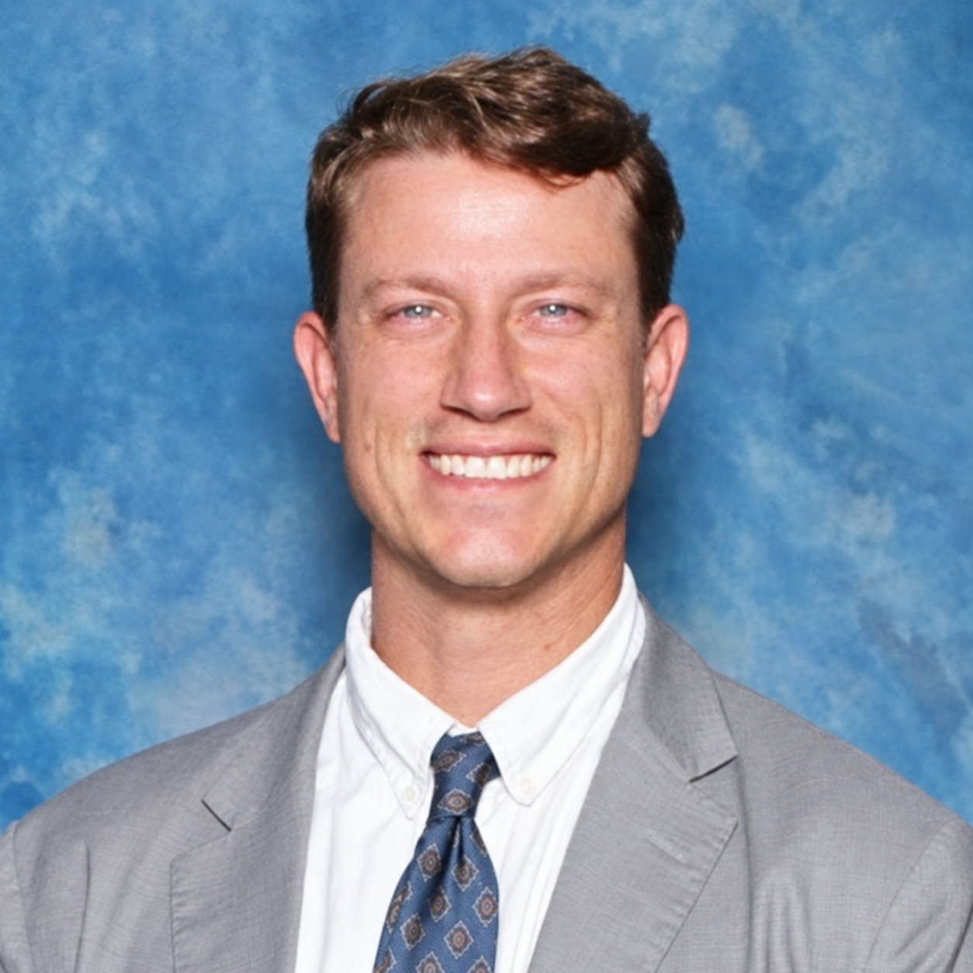
Nicholas Cusato
Senior Cloud Engineer
Oracle Cloud Infrastructure
Financial Services and Insurance
Research and OCI
benchmark implementation
02
Notes:
0:30. I work with Financial Services and Insurance customers at OCI. Much of my work involves benchmarks: helping customers answer price and performance questions with evidence from their own workloads. This project applies that discipline to workflow changes. Portrait supplied by Nicholas Cusato for this presentation.
Research and OCI implementation: Nicholas Cusato. Fluxnova software: FINOS contributors. Protocol 0.2 is a community proposal.

Slide 3

How do we modernize with confidence?
What should we keep?
Where could AI help?
How will we know
it works better?
Illustrative photograph: Edmond Dantès / Pexels
03
Notes:
1:15. A customer told me they are moving from E-Business Suite to Fusion. They already have a lot of process automation, and they want AI to help. They had not identified a particular process in that conversation. But it raises questions many teams face: what should we keep, where could AI help, and how will we know the new process works better? That connects to the question behind this research: how do we evaluate workflow changes using repeatable tests? Our current Fluxnova studies explore underlying patterns through controlled examples; they have not validated that customer migration.
E-Business Suite to Fusion is an application modernization scenario, not a tested Fluxnova migration. Start with Fusion-native capabilities before deciding whether a separate cross-system workflow engine fits. The customer did not identify a specific process or automation count.
Photo: Edmond Dantès, https://www.pexels.com/photo/colleagues-looking-on-laptop-together-4339794/ . License: https://www.pexels.com/license/ . The people pictured do not depict the customer and do not endorse the project.
Research and OCI implementation: Nicholas Cusato. Fluxnova software: FINOS contributors. Protocol 0.2 is a community proposal.

Slide 4
Speed is only part of the answer
“A fast agent that selects an unauthorized tool, duplicates a payment or reaches the wrong final state has failed.”
Nicholas Cusato
Project research POV, version 1.1
04
Notes:
0:15. When we change a workflow, we need to check whether it improved and whether it still produces the right outcome.
Exact quotation from Nicholas Cusato, Performance-Testing POV for FINOS Fluxnova on OCI, version 1.1 (2026), Executive position. Reproduced with the author’s approval. This is a research principle, not a claim about measured live-agent performance.
Research and OCI implementation: Nicholas Cusato. Fluxnova software: FINOS contributors. Protocol 0.2 is a community proposal.

Slide 5
Make workflow changes with evidence
Use repeatable tests to see whether a workflow change improves performance while preserving correct outcomes.
Run a
baseline
Change
one thing
Check
the result
05
Notes:
0:45. We use Fluxnova to run the same test cases before and after a change. That might be the workflow design, a runtime upgrade or a setting. We check how quickly the work finishes, whether it reaches the expected outcome and, in dedicated tests, what happens when something fails. The goal is to give another team a method it can repeat for its own decisions.
This defines the comparison method. A change can help, hurt or make little difference. A customer needs representative cases before using a result for a deployment decision.
Research and OCI implementation: Nicholas Cusato. Fluxnova software: FINOS contributors. Protocol 0.2 is a community proposal.

Slide 6

How the benchmark works
The flow runs in Fluxnova. The benchmark checks the outcome.
Known input
Load runner
Fluxnova
Workers
Tool service
Original input defines
the expected outcome.
PostgreSQL
history
Outcome
checker
Result and
evidence
Hold other conditions steady. Change one factor. Compare outcomes.
Representative path. Each study records its components and deployment.
06
Notes:
1:30. We start with test cases whose expected outcomes are defined in advance. The load runner sends the work into Fluxnova. The workflow and its workers execute it, and we check both the engine record and the effects recorded by the test services. Then we compare the baseline with the changed version. OCI provides the infrastructure for our cloud studies; each study records its particular setup.
The arrows show logical information flow. They are not network connections. The original four-host reference, isolated comparisons and local H2 examples have different environments. Compare within each declared study. Infrastructure details are in the appendix.
CORE: Reusable workflows and golden checks define the basic test vocabulary.
Meaning: These are small building blocks a workflow developer can combine and extend.
Limits: A diagram alone is not a completed performance study. The six basic patterns do not each have a repeated latency comparison.
https://github.com/oci-fsi-pursuits/fluxnova-benchmark-kit/blob/main/docs/reproduce.md
https://github.com/oci-fsi-pursuits/fluxnova-benchmark-kit/blob/main/validation/research-register-20261101/summary.json SHA-256 01e59de5ecd0f40e41c6cc46c71c60e3236a4a90f2fa779995584c9a67936a49
P01: 90,000/90,000 correct and within two seconds; per-run p95 245.7–249.0 ms.
Meaning: This establishes a repeatable reference for this workflow and setup.
Limits: The echo workload contains no payment or live model. This is not maximum capacity or an engine-only microbenchmark.
https://github.com/oci-fsi-pursuits/fluxnova-benchmark-kit/blob/main/docs/campaign-runbook.md
https://github.com/oci-fsi-pursuits/fluxnova-benchmark-kit/blob/main/validation/research-register-20261101/summary.json SHA-256 01e59de5ecd0f40e41c6cc46c71c60e3236a4a90f2fa779995584c9a67936a49
Research and OCI implementation: Nicholas Cusato. Fluxnova software: FINOS contributors. Protocol 0.2 is a community proposal.

Slide 7
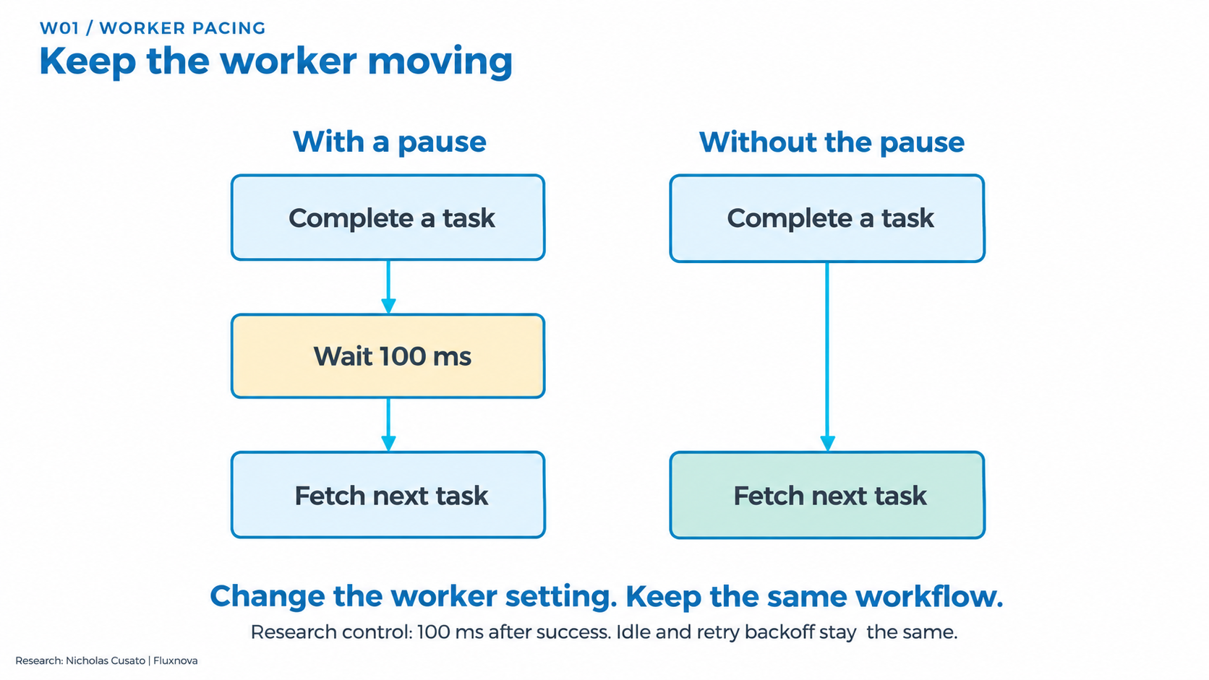
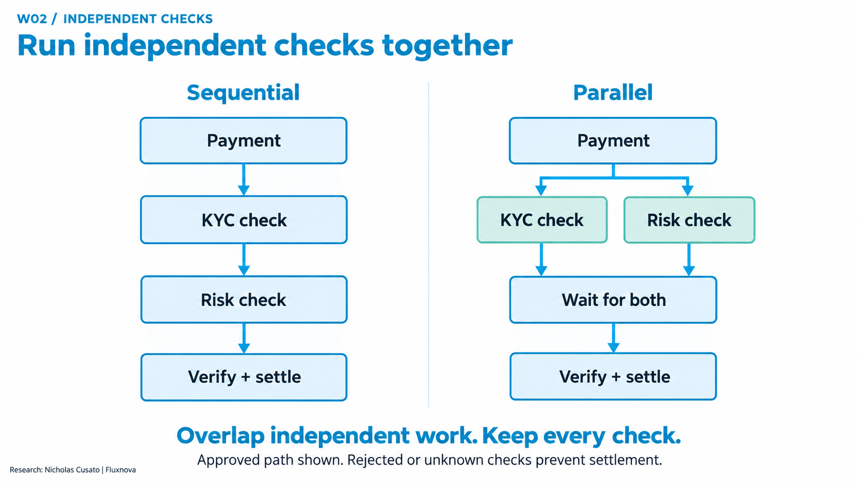
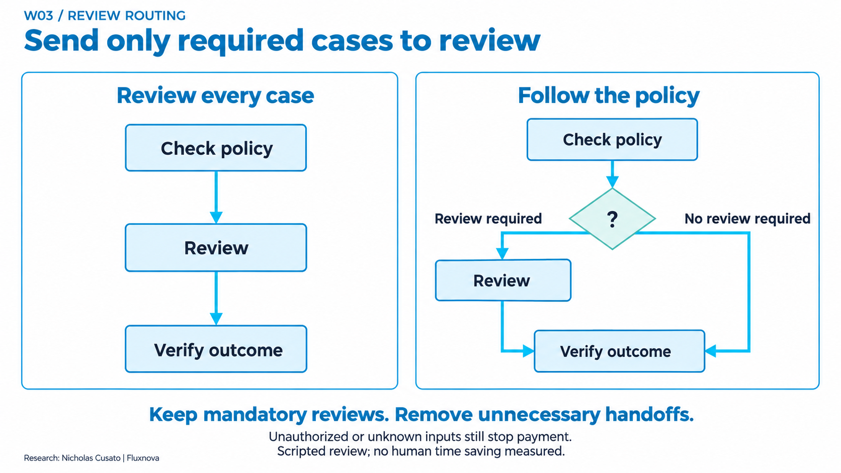
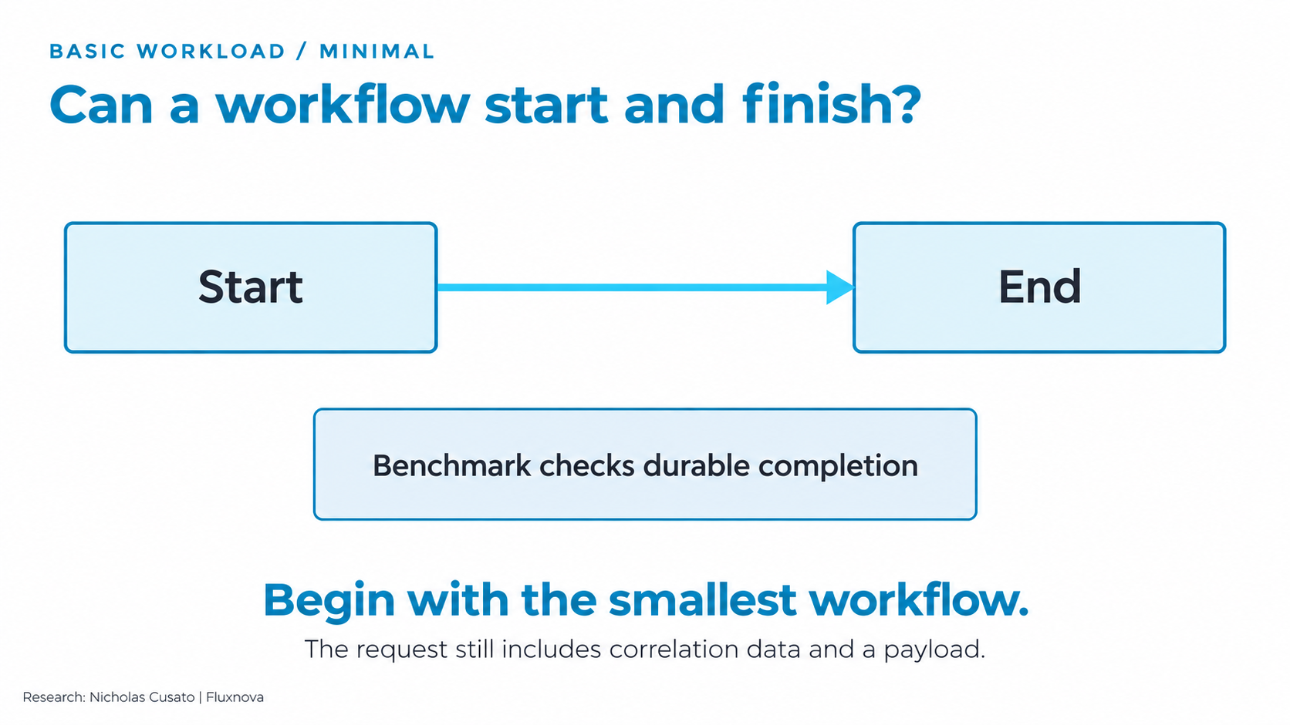
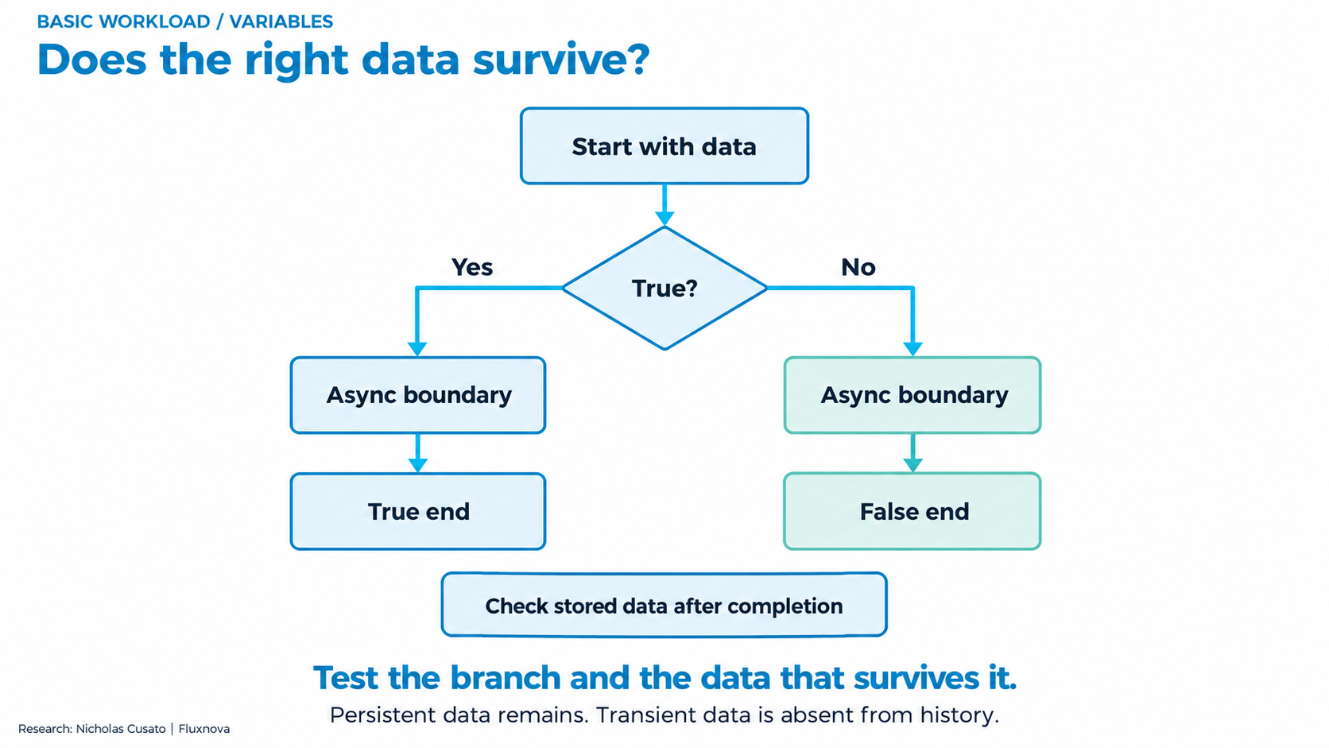
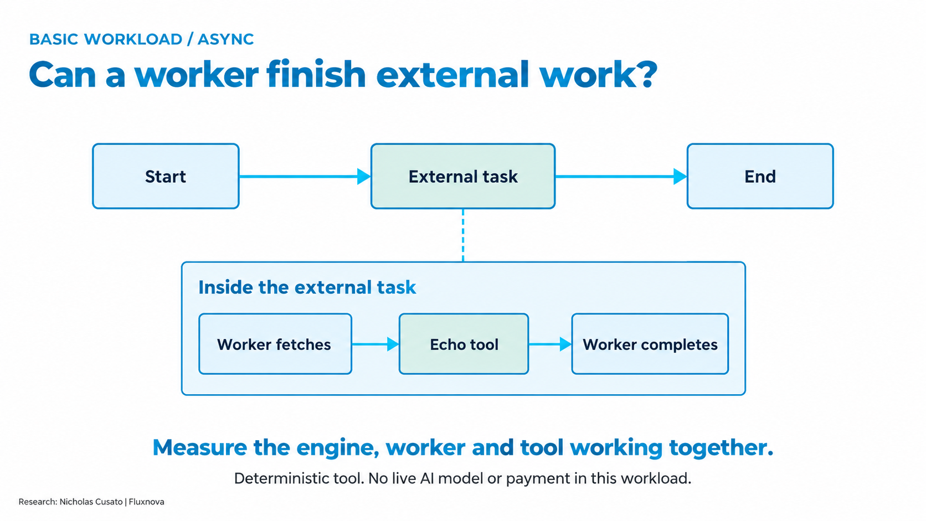
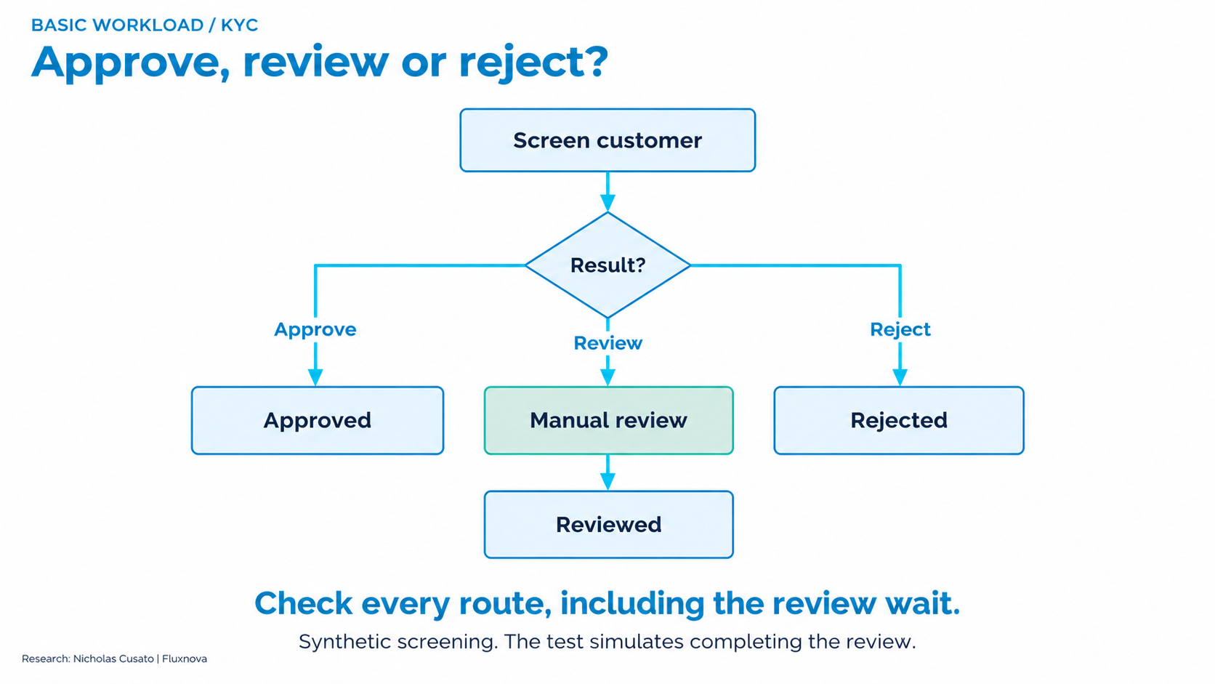
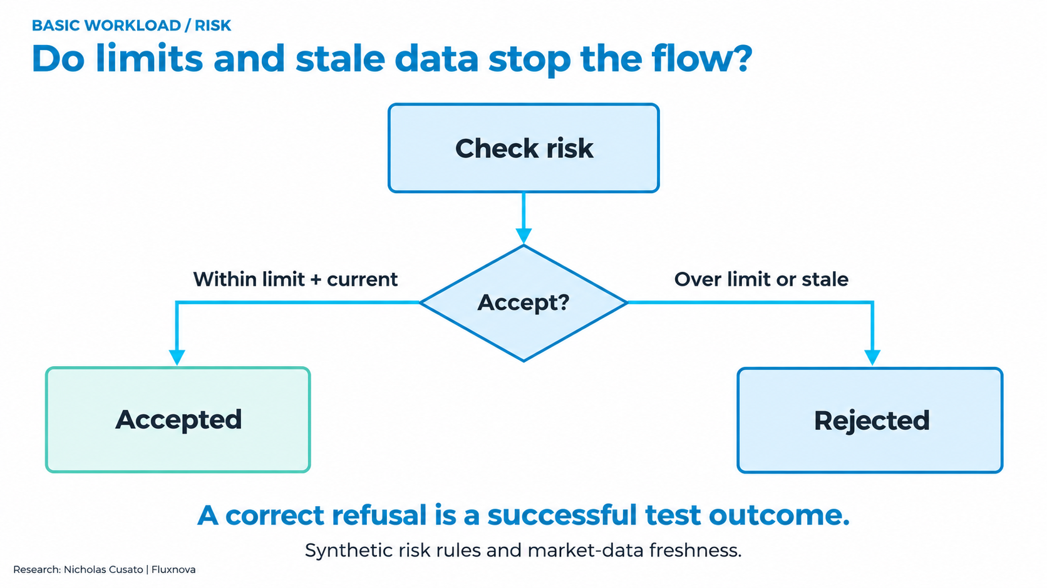
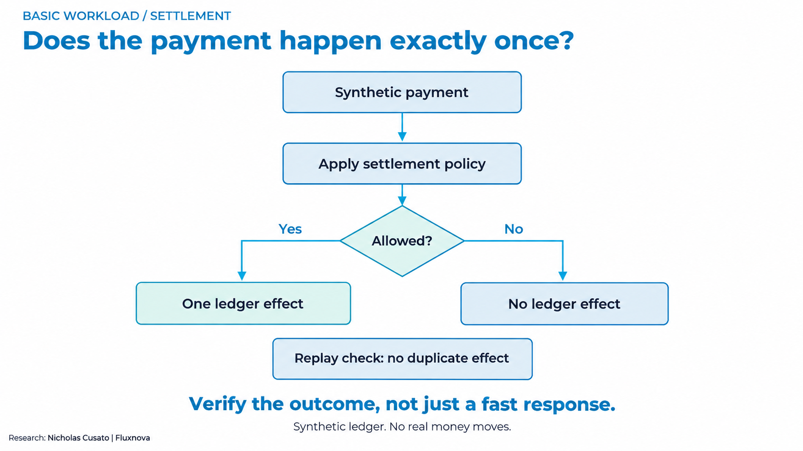

Benchmark research map
Research
6 areas
17 study records
9 workflow diagrams
CORE
Basic flows
W01
Worker pacing
Workflow
design
W02
Parallel checks
W02 mixed
Mixed outcomes
W03
Review routing
D01 Worker pacing
D02 Parallel checks
D03 Review routing
PAY05
FX quotes
FLUXNOVA
Runtime
upgrades
JVM
Java 21 / 25
Confidence
in workflow
changes
RELEASE
Fluxnova releases
Load and
endurance
P01
Reference baseline
D04 Minimal flow
D05 Data / branching
D06 External work
SOAK
Eight-hour run
CAPACITY
Capacity (partial)
FNV06
Events / batches
Events and
recovery
FNV07
Retries / faults
D07 KYC / review
D08 Risk / freshness
D09 Settle / replay
FNV07 timing
Timing (local)
RECOVERY
State recovery
Agent controls
AGENT
Authority checks
Explore the full catalogue
Measurement
OBSERVER
Polling / timing
github.com/oci-fsi-pursuits/
fluxnova-benchmark-kit
Completed, partial and diagnostic evidence
07
Notes:
45 seconds. This map shows the scope of the research. Start with the purpose on the left, point out the six research areas and then the 17 catalogue records. The nine diagram previews on the right are a reusable pattern library, not one diagram per experiment. A single pattern supports several studies. The repository contains readable diagrams, exact conditions, outcomes and reproduction steps. The slide is an invitation to explore; do not read every leaf aloud.
This includes completed comparisons, functional checks, diagnostics and incomplete qualification. The higher-load confirmation stopped. Event/batch resource flags remain. Agent evidence does not establish a measured live-AI benefit.
Source: workloads/benchmark-catalog.json (protocol 0.2, a community proposal). Each study label links to its reproduction guide. Pattern images are unchanged original project assets from docs/assets/workflows. Research and diagram content: Nicholas Cusato. Fluxnova software: FINOS contributors.
CORE: Reusable functional building blocks
Can the engine start, persist data, coordinate external work, route decisions and protect a synthetic payment?
Limits: A diagram alone is not a completed performance study. The six basic patterns do not each have a repeated latency comparison.
https://github.com/oci-fsi-pursuits/fluxnova-benchmark-kit/blob/main/docs/reproduce.md
P01: Completed
Is the external-task/echo path repeatable at the declared load?
Limits: The echo workload contains no payment or live model. This is not maximum capacity or an engine-only microbenchmark.
https://github.com/oci-fsi-pursuits/fluxnova-benchmark-kit/blob/main/docs/campaign-runbook.md
W01: Completed
Does an unnecessary pause after successful work delay later payments?
Limits: The control reconstructs an earlier worker setting. It is not the current default or a customer production baseline.
https://github.com/oci-fsi-pursuits/fluxnova-benchmark-kit/blob/main/docs/w01-worker-pacing.md
W02: Completed
Can independent KYC and risk checks overlap without weakening payment checks?
Limits: Both arms still delivered 1 timely payment/s. This establishes lower latency at this load, not higher maximum capacity or real-provider latency.
https://github.com/oci-fsi-pursuits/fluxnova-benchmark-kit/blob/main/docs/w02-independent-checks.md
W02-MIXED: Completed with deadline misses retained
Does the parallel-check result hold across settlements, refusals and safe stops?
Limits: Equal synthetic coverage is not a customer traffic distribution. The approved-only 32.1% result cannot be applied to this mix.
https://github.com/oci-fsi-pursuits/fluxnova-benchmark-kit/blob/main/docs/w02-mixed-cloud-protocol.md
W03: Completed within the scripted corpus
Can a fixed policy remove unnecessary review tasks while retaining required reviews?
Limits: This is a task-count comparison, not measured human time or a 60% staffing saving. The all-review control is deliberately constrained.
https://github.com/oci-fsi-pursuits/fluxnova-benchmark-kit/blob/main/docs/w03-review-routing.md
PAY05: Completed with retry tradeoff retained
Can parallel requests to three independent quote providers improve timely settlement?
Limits: Sequential runs had zero cached replays. The parallel improvement has a retry tradeoff. Synthetic providers and equal case coverage do not represent a live FX venue or customer distribution.
https://github.com/oci-fsi-pursuits/fluxnova-benchmark-kit/blob/main/docs/pay05-fx-quotes.md
JVM: Completed; earlier stopped study remains separate
Does the newer Java runtime improve this fixed async workflow?
Limits: Five pairs do not prove equivalence, maximum capacity or performance for other workflows. Earlier interrupted observations are not pooled.
https://github.com/oci-fsi-pursuits/fluxnova-benchmark-kit/blob/main/docs/benchmark-standard.md
RELEASE: Completed; earlier stopped study remains separate
Does the engine release change this async workflow at the same load?
Limits: This does not prove statistical equivalence, universal compatibility or production sizing. Native schema changes are part of the declared treatment.
https://github.com/oci-fsi-pursuits/fluxnova-benchmark-kit/blob/main/docs/benchmark-standard.md
SOAK: Completed and accepted
Does this workload stay correct through an eight-hour observation?
Limits: One observation does not establish leak-free operation, maximum capacity or a production availability guarantee.
https://github.com/oci-fsi-pursuits/fluxnova-benchmark-kit/blob/main/docs/campaign-runbook.md
CAPACITY: 16/s confirmation stopped
Does the next offered rate satisfy the complete confirmation series?
Limits: Maximum sustainable capacity remains open. Do not label a discovery rate or partial confirmation as production capacity.
https://github.com/oci-fsi-pursuits/fluxnova-benchmark-kit/blob/main/docs/campaign-runbook.md
FNV06: 45 cells complete; two headroom flags retained
How does completion grow when the same pattern targets more waiting workflows?
Limits: Different routing semantics cannot be ranked as interchangeable implementations. These bursts do not establish arrival-rate capacity, replica scaling or finite ratios when the control interval includes zero.
https://github.com/oci-fsi-pursuits/fluxnova-benchmark-kit/blob/main/docs/fnv06-population-scaling.md
FNV07: Functional subset complete
Do job retry and failure paths preserve the intended effects?
Limits: Shared-host tests do not establish multi-host availability, failover capacity or a managed-database performance advantage.
https://github.com/oci-fsi-pursuits/fluxnova-benchmark-kit/blob/main/docs/fnv07-cluster-jobs.md
FNV07-TIMING: Local qualification complete
Can native job timing records be matched to independently correct outcomes?
Limits: No resource-qualified performance, replica-scaling or capacity claim follows from this local gate.
https://github.com/oci-fsi-pursuits/fluxnova-benchmark-kit/blob/main/docs/fnv07-timing.md
AGENT: Bounded functional and live-model evidence
Can an agent request work while policy, a reviewer and a verifier retain control over payment?
Limits: Live-provider failures and incomplete coverage remain part of the evidence. These workflow performance percentages are not AI quality or agent-productivity claims.
https://github.com/oci-fsi-pursuits/fluxnova-benchmark-kit/blob/main/docs/approval-agent.md
RECOVERY: Bounded failure procedures exercised
Can the declared recovery procedure restore consistent workflow and payment state?
Limits: No general availability SLA, universal RTO/RPO or production certification follows from these cases.
https://github.com/oci-fsi-pursuits/fluxnova-benchmark-kit/blob/main/docs/state-checkpoints.md
OBSERVER: Historical supporting studies retained
How much does the observation method influence reported latency?
Limits: These diagnostics are not interchangeable with payment throughput, agent benefit or the later matched workload studies.
https://github.com/oci-fsi-pursuits/fluxnova-benchmark-kit/blob/main/docs/measurement-contract.md

Slide 8
Three workflow comparisons
W01 Worker pacing
W02 Parallel checks
W03 Review routing
With pause
No pause
Sequential
Parallel
Review all
Policy route
Finish task
Finish task
KYC
KYC
Risk
Policy
Policy
?
Wait 100 ms
Risk
Review
+
Yes
No
Review
Fetch next
Fetch next
Pay
Pay
Verify
Verify
Fetch again after success.
Idle and retry backoff stays.
Overlap independent checks.
Both finish before payment.
Keep required reviews.
Skip unnecessary handoffs.
Synthetic cases. Simplified views of the compared mechanisms.
08
Notes:
60 seconds. These are three examples selected from the full research map.
W01: This changes the worker setting, while the payment workflow remains fixed. The reconstructed control waits 100 ms after success. The changed worker fetches immediately after success and keeps idle/retry backoff.
W02: Independent KYC and risk checks can overlap. Both must complete and satisfy the workflow checks before the synthetic payment proceeds. This diagram explains approved cases. Mixed outcomes have separate results and retained tradeoffs.
W03: A fixed policy sends required cases to review. The review-all control sends every case to a review task. Required reviews and final verification remain. Unauthorized and unknown cases stop payment. Reviews are scripted in this experiment; it measures tasks and correct outcomes, not human time saved.
These native diagrams simplify the original D01, D02 and D03 pictures to remain legible together. They are conceptual views, not complete BPMN exports. Performance and correctness results follow on the next slide.
W01: Does an unnecessary pause after successful work delay later payments?
Reconstructed 100 ms delay after success versus Fetch immediately after success; keep idle/retry backoff
Timely payments rose from 600/1,200 to 1,200/1,200. All 2,400 outcomes were correct.
Limits: The control reconstructs an earlier worker setting. It is not the current default or a customer production baseline.
https://github.com/oci-fsi-pursuits/fluxnova-benchmark-kit/blob/main/docs/w01-worker-pacing.md
W02: Can independent KYC and risk checks overlap without weakening payment checks?
Sequential KYC then risk versus Parallel KYC and risk, with a join before settlement
Observed p95 was 32.1% lower at the median paired change. All 6,000 outcomes were correct and within two seconds.
Limits: Both arms still delivered 1 timely payment/s. This establishes lower latency at this load, not higher maximum capacity or real-provider latency.
https://github.com/oci-fsi-pursuits/fluxnova-benchmark-kit/blob/main/docs/w02-independent-checks.md
W03: Can a fixed policy remove unnecessary review tasks while retaining required reviews?
Review every case versus Route only policy-required cases to review
Review tasks fell from 10 to 4. All four mandatory reviews remained and all 20 expected outcomes passed.
Limits: This is a task-count comparison, not measured human time or a 60% staffing saving. The all-review control is deliberately constrained.
https://github.com/oci-fsi-pursuits/fluxnova-benchmark-kit/blob/main/docs/w03-review-routing.md
Research and diagrams: Nicholas Cusato. Fluxnova software: FINOS contributors.

Slide 9
What the trials taught us
Area | What we learned
Workflow design | W02 observed p95 fell 32.1% at 1/s. Mixed traffic helped settlements and hurt timely refusals.
Review routing | Review tasks fell from 10 to 4. All four mandatory reviews stayed; reviews were scripted.
Runtime / release | Java and Fluxnova upgrades showed small, mixed differences. No broad speedup emerged on the fixed workload.
Load / endurance | Eight hours: 288,000 correct outcomes within two seconds. Maximum capacity remains unqualified.
Events / recovery | 45 event/batch cells completed, with two resource flags. Retry and recovery findings cover specific tested cases.
Agent controls | Functional checks exercised payment authority. A measured live-agent performance benefit remains open.
Measurement | Polling changes when completion is detected. Hold the observation method fixed when comparing.
Each result belongs to its declared workload and environment.
09
Notes:
2:00. The main lesson is that the particular change and workload determine the result. Removing unnecessary worker waiting helped W01 deadlines. Overlapping independent work helped approved W02 payments and FX settlements. Mixed traffic exposed a tradeoff: more timely settlements and fewer timely refusals. W03 retained mandatory review while reducing the task count. Runtime upgrades produced small differences that changed sign across pairs. The soak met its target. Functional and qualification studies provide narrower evidence. We do not combine these populations into a single project speedup or pass rate. Detailed W02, FX and runtime results follow in the hidden appendix.
W01: Timely payments rose from 600/1,200 to 1,200/1,200. All 2,400 outcomes were correct.
Meaning: Avoidable worker waiting can consume the deadline even when the payment logic is unchanged.
Limits: The control reconstructs an earlier worker setting. It is not the current default or a customer production baseline.
https://github.com/oci-fsi-pursuits/fluxnova-benchmark-kit/blob/main/docs/w01-worker-pacing.md
https://github.com/oci-fsi-pursuits/fluxnova-benchmark-kit/blob/main/validation/oci-20261027-w01-comparison/summary.json SHA-256 99dc02ebccc81a518222a1a3d30d95cb2e762a5cade4c8e094f0ad475b4c586c
W02: Observed p95 was 32.1% lower at the median paired change. All 6,000 outcomes were correct and within two seconds.
Meaning: Overlap independent waits while preserving the requirement that both checks finish.
Limits: Both arms still delivered 1 timely payment/s. This establishes lower latency at this load, not higher maximum capacity or real-provider latency.
https://github.com/oci-fsi-pursuits/fluxnova-benchmark-kit/blob/main/docs/w02-independent-checks.md
https://github.com/oci-fsi-pursuits/fluxnova-benchmark-kit/blob/main/validation/oci-20261027-w02-comparison/summary.json SHA-256 14e6669b9800840f6d536fd453dd6cf88949e8c5251ddb1d597974269bf30b41
W02-MIXED: Timely settlements rose from 880 to 1,037 of 1,200; timely refusals fell from 780 to 669 of 1,200. All 6,000 outcomes were correct; 1,648 deadlines were missed.
Meaning: A change can help one outcome class and hurt another. Keep the outcome breakdown.
Limits: Equal synthetic coverage is not a customer traffic distribution. The approved-only 32.1% result cannot be applied to this mix.
https://github.com/oci-fsi-pursuits/fluxnova-benchmark-kit/blob/main/docs/w02-mixed-cloud-protocol.md
https://github.com/oci-fsi-pursuits/fluxnova-benchmark-kit/blob/main/validation/oci-20261028-w02-mixed-comparison/summary.json SHA-256 debdef28ca1bdd207783019f6871f73c02c6a351c9aa14a25172112a0e810e00
W03: Review tasks fell from 10 to 4. All four mandatory reviews remained and all 20 expected outcomes passed.
Meaning: This workflow removes avoidable handoffs for the declared policy and case mix.
Limits: This is a task-count comparison, not measured human time or a 60% staffing saving. The all-review control is deliberately constrained.
https://github.com/oci-fsi-pursuits/fluxnova-benchmark-kit/blob/main/docs/w03-review-routing.md
https://github.com/oci-fsi-pursuits/fluxnova-benchmark-kit/blob/main/validation/local-20261027-w03/summary.json SHA-256 164ffbfb77de296e7b86f73e072a7388ed786edf7830a0e7d4644104a60839e7
PAY05: Timely settlements rose from 668/1,530 to 1,530/1,530. All 3,960 outcomes were correct. Parallel runs retained 910 cached backend replays and zero duplicate payment effects.
Meaning: Overlapping quote waits helps delayed-provider cases. Durable replay handling protects the payment when completion retries occur.
Limits: Sequential runs had zero cached replays. The parallel improvement has a retry tradeoff. Synthetic providers and equal case coverage do not represent a live FX venue or customer distribution.
https://github.com/oci-fsi-pursuits/fluxnova-benchmark-kit/blob/main/docs/pay05-fx-quotes.md
https://github.com/oci-fsi-pursuits/fluxnova-benchmark-kit/blob/main/validation/oci-20261031-pay05-comparison/summary.json SHA-256 34abdc148db7061b12130f77b2db362db14218aabbfc5e1ebfc4063c63ee0e26
JVM: Median paired p95 difference: −0.862 ms, range −1.369 to +0.864 ms. All 180,000 outcomes were correct and within two seconds.
Meaning: The small differences changed sign. This workload did not establish a broad Java 25 performance advantage.
Limits: Five pairs do not prove equivalence, maximum capacity or performance for other workflows. Earlier interrupted observations are not pooled.
https://github.com/oci-fsi-pursuits/fluxnova-benchmark-kit/blob/main/docs/benchmark-standard.md
https://github.com/oci-fsi-pursuits/fluxnova-benchmark-kit/blob/main/validation/research-register-20261101/summary.json SHA-256 01e59de5ecd0f40e41c6cc46c71c60e3236a4a90f2fa779995584c9a67936a49
RELEASE: Median paired p95 difference: +0.126 ms, range −0.552 to +1.055 ms. All 180,000 outcomes were correct and within two seconds.
Meaning: Both releases met this test target. No meaningful speedup or capacity gain was established.
Limits: This does not prove statistical equivalence, universal compatibility or production sizing. Native schema changes are part of the declared treatment.
https://github.com/oci-fsi-pursuits/fluxnova-benchmark-kit/blob/main/docs/benchmark-standard.md
https://github.com/oci-fsi-pursuits/fluxnova-benchmark-kit/blob/main/validation/research-register-20261101/summary.json SHA-256 01e59de5ecd0f40e41c6cc46c71c60e3236a4a90f2fa779995584c9a67936a49
SOAK: All 288,000 measured workflows completed correctly within two seconds.
Meaning: The reference sustained its declared target during this observation.
Limits: One observation does not establish leak-free operation, maximum capacity or a production availability guarantee.
https://github.com/oci-fsi-pursuits/fluxnova-benchmark-kit/blob/main/docs/campaign-runbook.md
https://github.com/oci-fsi-pursuits/fluxnova-benchmark-kit/blob/main/validation/research-register-20261101/summary.json SHA-256 01e59de5ecd0f40e41c6cc46c71c60e3236a4a90f2fa779995584c9a67936a49
CAPACITY: The 16/s confirmation is incomplete. 16/s is not qualified.
Meaning: Three passing observations cannot stand in for a complete five-observation confirmation.
Limits: Maximum sustainable capacity remains open. Do not label a discovery rate or partial confirmation as production capacity.
https://github.com/oci-fsi-pursuits/fluxnova-benchmark-kit/blob/main/docs/campaign-runbook.md
https://github.com/oci-fsi-pursuits/fluxnova-benchmark-kit/blob/main/validation/research-register-20261101/summary.json SHA-256 01e59de5ecd0f40e41c6cc46c71c60e3236a4a90f2fa779995584c9a67936a49
FNV06: All 16,650 measured recipients were correct. 43/45 cells passed the headroom gate; batch/1,000 timing comparisons remain unqualified.
Meaning: Larger finite bursts take longer. Correct final outcomes alone do not qualify every timing comparison.
Limits: Different routing semantics cannot be ranked as interchangeable implementations. These bursts do not establish arrival-rate capacity, replica scaling or finite ratios when the control interval includes zero.
https://github.com/oci-fsi-pursuits/fluxnova-benchmark-kit/blob/main/docs/fnv06-population-scaling.md
https://github.com/oci-fsi-pursuits/fluxnova-benchmark-kit/blob/main/validation/oci-20261101-fnv06-campaign/summary.json SHA-256 ca45d0b42a7a411648113eaea7e18d344a47e3e29c67cb8588c12de22a65b48c
FNV07: Each six-case run produced the expected three completed, two blocked and one waiting outcomes, with 12 exact effects.
Meaning: The fault cases exercise coordination and idempotency without losing the expected business state.
Limits: Shared-host tests do not establish multi-host availability, failover capacity or a managed-database performance advantage.
https://github.com/oci-fsi-pursuits/fluxnova-benchmark-kit/blob/main/docs/fnv07-cluster-jobs.md
https://github.com/oci-fsi-pursuits/fluxnova-benchmark-kit/blob/main/validation/oci-20261101-fnv07/summary.json SHA-256 db8fee68f1c44e57643edf526f369166de1b5906f87974fe9c75b55808b989c9
AGENT: Functional checks exercise the control boundaries. A measured agent-versus-rules benefit remains unestablished.
Meaning: The workflow decides when actions are allowed; a model suggestion is not payment authority.
Limits: Live-provider failures and incomplete coverage remain part of the evidence. These workflow performance percentages are not AI quality or agent-productivity claims.
https://github.com/oci-fsi-pursuits/fluxnova-benchmark-kit/blob/main/docs/approval-agent.md
https://github.com/oci-fsi-pursuits/fluxnova-benchmark-kit/blob/main/validation/research-register-20261101/summary.json SHA-256 01e59de5ecd0f40e41c6cc46c71c60e3236a4a90f2fa779995584c9a67936a49
OBSERVER: Polling and timing settings belong in the experiment contract.
Meaning: Faster detection is not automatically faster execution. Keep the measurement method fixed across arms.
Limits: These diagnostics are not interchangeable with payment throughput, agent benefit or the later matched workload studies.
https://github.com/oci-fsi-pursuits/fluxnova-benchmark-kit/blob/main/docs/measurement-contract.md
https://github.com/oci-fsi-pursuits/fluxnova-benchmark-kit/blob/main/validation/research-register-20261101/summary.json SHA-256 01e59de5ecd0f40e41c6cc46c71c60e3236a4a90f2fa779995584c9a67936a49
Research and OCI implementation: Nicholas Cusato. Fluxnova software: FINOS contributors. Protocol 0.2 is a community proposal.

Slide 10
One recipe, one scorecard
The recipe
The scorecard
Field | W02 example
Baseline | Sequential checks
Change | Parallel checks
Keep fixed | Cases, load, workers and observer
Check | Latency and correct outcomes
Explain | Result, environment and limits
Pattern: what runs
Benchmark type: the question
Study: one fixed comparison
Protocol 0.2 is a community proposal. It is not an adopted FINOS standard.
10
Notes:
1:30. Standardization means a recipe someone else can execute and a scorecard they can assess. A pattern defines the work. A benchmark type defines the question and measurement method. A study records the fixed experiment. The shared contract names the baseline, the one change, fixed conditions, expected outcomes, measurement clock, result, limits and evidence. Catalogue validation checks fields and referenced hashes; it does not certify that an experiment is scientifically valid. See https://github.com/oci-fsi-pursuits/fluxnova-benchmark-kit/blob/main/docs/benchmark-standard.md .
W02: Observed p95 was 32.1% lower at the median paired change. All 6,000 outcomes were correct and within two seconds.
Meaning: Overlap independent waits while preserving the requirement that both checks finish.
Limits: Both arms still delivered 1 timely payment/s. This establishes lower latency at this load, not higher maximum capacity or real-provider latency.
https://github.com/oci-fsi-pursuits/fluxnova-benchmark-kit/blob/main/docs/w02-independent-checks.md
https://github.com/oci-fsi-pursuits/fluxnova-benchmark-kit/blob/main/validation/oci-20261027-w02-comparison/summary.json SHA-256 14e6669b9800840f6d536fd453dd6cf88949e8c5251ddb1d597974269bf30b41
Research and OCI implementation: Nicholas Cusato. Fluxnova software: FINOS contributors. Protocol 0.2 is a community proposal.

Slide 11
The next research questions
01
Customer workflows and live agents
Representative traffic, real dependencies and an agent-versus-rules comparison.
02
Capacity and replica scaling
Complete load confirmation and qualify the resources used by each run.
03
Platforms and databases
Validate other deployment adapters and compare declared alternatives.
04
Cost and independent reproduction
Allocate the full cost per correct outcome and reproduce a study elsewhere.
11
Notes:
0:45. These are the next questions, not promised delivery dates. The current completed studies are usable within their stated boundaries. Customer traffic, richer live-model evaluation, replica scaling, platform/database alternatives and complete allocated cost require their own controlled comparisons. We also want another team to reproduce a study and review the proposed protocol.
CAPACITY: The 16/s confirmation is incomplete. 16/s is not qualified.
Meaning: Three passing observations cannot stand in for a complete five-observation confirmation.
Limits: Maximum sustainable capacity remains open. Do not label a discovery rate or partial confirmation as production capacity.
https://github.com/oci-fsi-pursuits/fluxnova-benchmark-kit/blob/main/docs/campaign-runbook.md
https://github.com/oci-fsi-pursuits/fluxnova-benchmark-kit/blob/main/validation/research-register-20261101/summary.json SHA-256 01e59de5ecd0f40e41c6cc46c71c60e3236a4a90f2fa779995584c9a67936a49
AGENT: Functional checks exercise the control boundaries. A measured agent-versus-rules benefit remains unestablished.
Meaning: The workflow decides when actions are allowed; a model suggestion is not payment authority.
Limits: Live-provider failures and incomplete coverage remain part of the evidence. These workflow performance percentages are not AI quality or agent-productivity claims.
https://github.com/oci-fsi-pursuits/fluxnova-benchmark-kit/blob/main/docs/approval-agent.md
https://github.com/oci-fsi-pursuits/fluxnova-benchmark-kit/blob/main/validation/research-register-20261101/summary.json SHA-256 01e59de5ecd0f40e41c6cc46c71c60e3236a4a90f2fa779995584c9a67936a49
Research and OCI implementation: Nicholas Cusato. Fluxnova software: FINOS contributors. Protocol 0.2 is a community proposal.

Slide 12
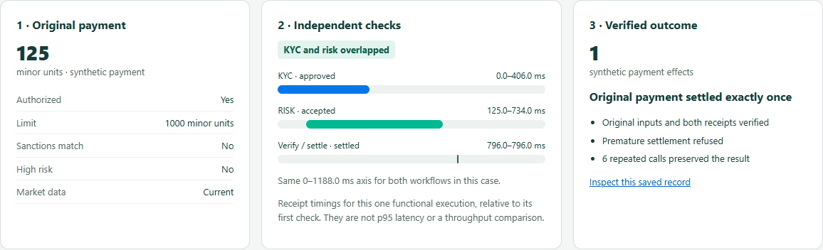
Your first benchmark
A 75-second saved execution walkthrough
Source and run guide
python -m benchlib.cli explain W02
github.com/oci-fsi-pursuits/
fluxnova-benchmark-kit
Recorded functional execution. Local setup and OCI Terraform are documented.
12
Notes:
1:45 including the 75-second video. Before the talk, open recording.html in the adjacent presenter pack. Switch to it now, play the reviewed saved-evidence walkthrough, then return to the closing slide. Fallback: use the saved viewer or this screenshot. The viewer reads recorded local engine executions; it does not initiate a new payment. It is not an installation recording and its individual timings are not the OCI p95.
Start with a source checkout and Python 3.12+. Run python -m benchlib.cli explain W02 to inspect the study. Real execution requires Java 21 and a verified Fluxnova 3.0.1 distribution. The full local runner and viewer commands are in docs/benchmark-standard.md. The reporting demo command generates labelled sample data, not a Fluxnova execution. OCI Terraform provisions the reference infrastructure; other clouds and on premises require adapters and validation.
https://github.com/oci-fsi-pursuits/fluxnova-benchmark-kit/blob/main/docs/getting-started.md
https://github.com/oci-fsi-pursuits/fluxnova-benchmark-kit/blob/main/docs/benchmark-standard.md
https://github.com/oci-fsi-pursuits/fluxnova-benchmark-kit/blob/main/docs/oci.md
W02: Observed p95 was 32.1% lower at the median paired change. All 6,000 outcomes were correct and within two seconds.
Meaning: Overlap independent waits while preserving the requirement that both checks finish.
Limits: Both arms still delivered 1 timely payment/s. This establishes lower latency at this load, not higher maximum capacity or real-provider latency.
https://github.com/oci-fsi-pursuits/fluxnova-benchmark-kit/blob/main/docs/w02-independent-checks.md
https://github.com/oci-fsi-pursuits/fluxnova-benchmark-kit/blob/main/validation/oci-20261027-w02-comparison/summary.json SHA-256 14e6669b9800840f6d536fd453dd6cf88949e8c5251ddb1d597974269bf30b41
CORE: Reusable workflows and golden checks define the basic test vocabulary.
Meaning: These are small building blocks a workflow developer can combine and extend.
Limits: A diagram alone is not a completed performance study. The six basic patterns do not each have a repeated latency comparison.
https://github.com/oci-fsi-pursuits/fluxnova-benchmark-kit/blob/main/docs/reproduce.md
https://github.com/oci-fsi-pursuits/fluxnova-benchmark-kit/blob/main/validation/research-register-20261101/summary.json SHA-256 01e59de5ecd0f40e41c6cc46c71c60e3236a4a90f2fa779995584c9a67936a49
Research and OCI implementation: Nicholas Cusato. Fluxnova software: FINOS contributors. Protocol 0.2 is a community proposal.

Slide 13

A shared way to evaluate workflow changes
Feedback and next workloads
Confidence comes from
a comparison you can repeat.
Bring your workflow.
Keep its required controls.
Share what changed.
GitHub Issues
Benchmark feedback
Research and OCI implementation: Nicholas Cusato
Fluxnova software: FINOS contributors
13
Notes:
0:45. Take a pattern back to your environment, establish a baseline and tell us what your team needs to test next.
The feedback QR opens the repository’s Benchmark feedback issue form. It supports workload suggestions, reproduction problems, interpretation and protocol feedback. A GitHub account is needed to submit an issue. Ask attendees to use synthetic examples and avoid customer data, credentials and private logs. No issue is submitted automatically.
https://github.com/oci-fsi-pursuits/fluxnova-benchmark-kit/issues/new?template=benchmark-feedback.yml
Research and OCI implementation: Nicholas Cusato. Fluxnova software: FINOS contributors. Protocol 0.2 is a community proposal.

Slide 14
D01 · Worker pacing
What runs
The payment graph stays the same. The external worker either sleeps after success or immediately fetches the next task. Idle and retry backoff remain.
W01 shows more payments meeting the deadline for fixed bursts and one worker. It tests worker scheduling, not a redesigned payment process.
Appendix 1
Notes:
Reference slide, hidden from the main 15-minute slideshow. Why wait after a successful task?
The payment graph stays the same. The external worker either sleeps after success or immediately fetches the next task. Idle and retry backoff remain.
Meaning: W01 shows more payments meeting the deadline for fixed bursts and one worker. It tests worker scheduling, not a redesigned payment process.
Executable source: https://github.com/oci-fsi-pursuits/fluxnova-benchmark-kit/blob/main/docs/w01-worker-pacing.md
Diagram is a conceptual explanation, not an exact BPMN export. Original project illustration by Nicholas Cusato; Fluxnova software by FINOS contributors.
Evidence and interpretation:
W01: Timely payments rose from 600/1,200 to 1,200/1,200. All 2,400 outcomes were correct.
Avoidable worker waiting can consume the deadline even when the payment logic is unchanged.
Limits: The control reconstructs an earlier worker setting. It is not the current default or a customer production baseline.
https://github.com/oci-fsi-pursuits/fluxnova-benchmark-kit/blob/main/validation/oci-20261027-w01-comparison/summary.json SHA-256 99dc02ebccc81a518222a1a3d30d95cb2e762a5cade4c8e094f0ad475b4c586c
Research and OCI implementation: Nicholas Cusato. Fluxnova software: FINOS contributors. Protocol 0.2 is a community proposal.

Slide 15
D02 · Parallel checks
What runs
Sequential execution waits for KYC before starting risk. Parallel execution starts both independent checks and joins them before payment. Neither check is skipped.
W02 shows lower observed latency at 1/s. The mixed follow-up shows that benefits depend on the outcome and dependency delays.
Appendix 2
Notes:
Reference slide, hidden from the main 15-minute slideshow. Which checks can safely overlap?
Sequential execution waits for KYC before starting risk. Parallel execution starts both independent checks and joins them before payment. Neither check is skipped.
Meaning: W02 shows lower observed latency at 1/s. The mixed follow-up shows that benefits depend on the outcome and dependency delays.
Executable source: https://github.com/oci-fsi-pursuits/fluxnova-benchmark-kit/blob/main/docs/w02-independent-checks.md
Diagram is a conceptual explanation, not an exact BPMN export. Original project illustration by Nicholas Cusato; Fluxnova software by FINOS contributors.
Evidence and interpretation:
W02: Observed p95 was 32.1% lower at the median paired change. All 6,000 outcomes were correct and within two seconds.
Overlap independent waits while preserving the requirement that both checks finish.
Limits: Both arms still delivered 1 timely payment/s. This establishes lower latency at this load, not higher maximum capacity or real-provider latency.
https://github.com/oci-fsi-pursuits/fluxnova-benchmark-kit/blob/main/validation/oci-20261027-w02-comparison/summary.json SHA-256 14e6669b9800840f6d536fd453dd6cf88949e8c5251ddb1d597974269bf30b41
W02-MIXED: Timely settlements rose from 880 to 1,037 of 1,200; timely refusals fell from 780 to 669 of 1,200. All 6,000 outcomes were correct; 1,648 deadlines were missed.
A change can help one outcome class and hurt another. Keep the outcome breakdown.
Limits: Equal synthetic coverage is not a customer traffic distribution. The approved-only 32.1% result cannot be applied to this mix.
https://github.com/oci-fsi-pursuits/fluxnova-benchmark-kit/blob/main/validation/oci-20261028-w02-mixed-comparison/summary.json SHA-256 debdef28ca1bdd207783019f6871f73c02c6a351c9aa14a25172112a0e810e00
Research and OCI implementation: Nicholas Cusato. Fluxnova software: FINOS contributors. Protocol 0.2 is a community proposal.

Slide 16
D03 · Review routing
What runs
A fixed policy routes required cases to a reviewer. Eligible cases can proceed; unauthorized or unknown cases still stop. Final verification remains.
W03 reduces tasks from ten to four for its constructed cases and preserves all four mandatory reviews. It does not measure human time saved.
Appendix 3
Notes:
Reference slide, hidden from the main 15-minute slideshow. Which cases actually need a reviewer?
A fixed policy routes required cases to a reviewer. Eligible cases can proceed; unauthorized or unknown cases still stop. Final verification remains.
Meaning: W03 reduces tasks from ten to four for its constructed cases and preserves all four mandatory reviews. It does not measure human time saved.
Executable source: https://github.com/oci-fsi-pursuits/fluxnova-benchmark-kit/blob/main/docs/w03-review-routing.md
Diagram is a conceptual explanation, not an exact BPMN export. Original project illustration by Nicholas Cusato; Fluxnova software by FINOS contributors.
Evidence and interpretation:
W03: Review tasks fell from 10 to 4. All four mandatory reviews remained and all 20 expected outcomes passed.
This workflow removes avoidable handoffs for the declared policy and case mix.
Limits: This is a task-count comparison, not measured human time or a 60% staffing saving. The all-review control is deliberately constrained.
https://github.com/oci-fsi-pursuits/fluxnova-benchmark-kit/blob/main/validation/local-20261027-w03/summary.json SHA-256 164ffbfb77de296e7b86f73e072a7388ed786edf7830a0e7d4644104a60839e7
Research and OCI implementation: Nicholas Cusato. Fluxnova software: FINOS contributors. Protocol 0.2 is a community proposal.

Slide 17
D04 · Minimal workflow
What runs
Start and finish a process with the declared correlation data and payload. The checker confirms durable completion.
A useful basic readiness check. Its input still contains data, so it is not a zero-variable engine-overhead benchmark.
Appendix 4
Notes:
Reference slide, hidden from the main 15-minute slideshow. Can a workflow start and durably finish?
Start and finish a process with the declared correlation data and payload. The checker confirms durable completion.
Meaning: A useful basic readiness check. Its input still contains data, so it is not a zero-variable engine-overhead benchmark.
Executable source: https://github.com/oci-fsi-pursuits/fluxnova-benchmark-kit/blob/main/workloads/minimal.bpmn
Diagram is a conceptual explanation, not an exact BPMN export. Original project illustration by Nicholas Cusato; Fluxnova software by FINOS contributors.
Evidence and interpretation:
CORE: Reusable workflows and golden checks define the basic test vocabulary.
These are small building blocks a workflow developer can combine and extend.
Limits: A diagram alone is not a completed performance study. The six basic patterns do not each have a repeated latency comparison.
https://github.com/oci-fsi-pursuits/fluxnova-benchmark-kit/blob/main/validation/research-register-20261101/summary.json SHA-256 01e59de5ecd0f40e41c6cc46c71c60e3236a4a90f2fa779995584c9a67936a49
Research and OCI implementation: Nicholas Cusato. Fluxnova software: FINOS contributors. Protocol 0.2 is a community proposal.

Slide 18
D05 · Variables and branching
What runs
Choose a branch, cross an asynchronous boundary and inspect persisted values. Persistent and transient data have different expected histories.
Correctness requires the right branch and right surviving values. No separate repeated speedup claim belongs to this picture.
Appendix 5
Notes:
Reference slide, hidden from the main 15-minute slideshow. Does the right data survive the chosen branch?
Choose a branch, cross an asynchronous boundary and inspect persisted values. Persistent and transient data have different expected histories.
Meaning: Correctness requires the right branch and right surviving values. No separate repeated speedup claim belongs to this picture.
Executable source: https://github.com/oci-fsi-pursuits/fluxnova-benchmark-kit/blob/main/workloads/variables.bpmn
Diagram is a conceptual explanation, not an exact BPMN export. Original project illustration by Nicholas Cusato; Fluxnova software by FINOS contributors.
Evidence and interpretation:
CORE: Reusable workflows and golden checks define the basic test vocabulary.
These are small building blocks a workflow developer can combine and extend.
Limits: A diagram alone is not a completed performance study. The six basic patterns do not each have a repeated latency comparison.
https://github.com/oci-fsi-pursuits/fluxnova-benchmark-kit/blob/main/validation/research-register-20261101/summary.json SHA-256 01e59de5ecd0f40e41c6cc46c71c60e3236a4a90f2fa779995584c9a67936a49
Research and OCI implementation: Nicholas Cusato. Fluxnova software: FINOS contributors. Protocol 0.2 is a community proposal.

Slide 19
D06 · External task and tool
What runs
Fluxnova creates an external task. A worker fetches it, calls the deterministic echo tool and reports completion. The benchmark observes durable history.
This is the workload behind P01, the runtime/release comparisons and the soak. Their clocks include worker/tool work and observation.
Appendix 6
Notes:
Reference slide, hidden from the main 15-minute slideshow. Can the engine, worker and tool finish together?
Fluxnova creates an external task. A worker fetches it, calls the deterministic echo tool and reports completion. The benchmark observes durable history.
Meaning: This is the workload behind P01, the runtime/release comparisons and the soak. Their clocks include worker/tool work and observation.
Executable source: https://github.com/oci-fsi-pursuits/fluxnova-benchmark-kit/blob/main/workloads/async.bpmn
Diagram is a conceptual explanation, not an exact BPMN export. Original project illustration by Nicholas Cusato; Fluxnova software by FINOS contributors.
Evidence and interpretation:
P01: 90,000/90,000 correct and within two seconds; per-run p95 245.7–249.0 ms.
This establishes a repeatable reference for this workflow and setup.
Limits: The echo workload contains no payment or live model. This is not maximum capacity or an engine-only microbenchmark.
https://github.com/oci-fsi-pursuits/fluxnova-benchmark-kit/blob/main/validation/research-register-20261101/summary.json SHA-256 01e59de5ecd0f40e41c6cc46c71c60e3236a4a90f2fa779995584c9a67936a49
JVM: Median paired p95 difference: −0.862 ms, range −1.369 to +0.864 ms. All 180,000 outcomes were correct and within two seconds.
The small differences changed sign. This workload did not establish a broad Java 25 performance advantage.
Limits: Five pairs do not prove equivalence, maximum capacity or performance for other workflows. Earlier interrupted observations are not pooled.
https://github.com/oci-fsi-pursuits/fluxnova-benchmark-kit/blob/main/validation/research-register-20261101/summary.json SHA-256 01e59de5ecd0f40e41c6cc46c71c60e3236a4a90f2fa779995584c9a67936a49
RELEASE: Median paired p95 difference: +0.126 ms, range −0.552 to +1.055 ms. All 180,000 outcomes were correct and within two seconds.
Both releases met this test target. No meaningful speedup or capacity gain was established.
Limits: This does not prove statistical equivalence, universal compatibility or production sizing. Native schema changes are part of the declared treatment.
https://github.com/oci-fsi-pursuits/fluxnova-benchmark-kit/blob/main/validation/research-register-20261101/summary.json SHA-256 01e59de5ecd0f40e41c6cc46c71c60e3236a4a90f2fa779995584c9a67936a49
SOAK: All 288,000 measured workflows completed correctly within two seconds.
The reference sustained its declared target during this observation.
Limits: One observation does not establish leak-free operation, maximum capacity or a production availability guarantee.
https://github.com/oci-fsi-pursuits/fluxnova-benchmark-kit/blob/main/validation/research-register-20261101/summary.json SHA-256 01e59de5ecd0f40e41c6cc46c71c60e3236a4a90f2fa779995584c9a67936a49
CAPACITY: The 16/s confirmation is incomplete. 16/s is not qualified.
Three passing observations cannot stand in for a complete five-observation confirmation.
Limits: Maximum sustainable capacity remains open. Do not label a discovery rate or partial confirmation as production capacity.
https://github.com/oci-fsi-pursuits/fluxnova-benchmark-kit/blob/main/validation/research-register-20261101/summary.json SHA-256 01e59de5ecd0f40e41c6cc46c71c60e3236a4a90f2fa779995584c9a67936a49
Research and OCI implementation: Nicholas Cusato. Fluxnova software: FINOS contributors. Protocol 0.2 is a community proposal.

Slide 20
D07 · KYC decision and review
What runs
Synthetic screening approves, rejects or creates a review wait. The test simulates completion of that review.
A correct waiting or rejected state can be a passing test. Real screening quality and human working time remain outside this basic fixture.
Appendix 7
Notes:
Reference slide, hidden from the main 15-minute slideshow. Does each screening result reach the right route?
Synthetic screening approves, rejects or creates a review wait. The test simulates completion of that review.
Meaning: A correct waiting or rejected state can be a passing test. Real screening quality and human working time remain outside this basic fixture.
Executable source: https://github.com/oci-fsi-pursuits/fluxnova-benchmark-kit/blob/main/workloads/kyc.bpmn
Diagram is a conceptual explanation, not an exact BPMN export. Original project illustration by Nicholas Cusato; Fluxnova software by FINOS contributors.
Evidence and interpretation:
CORE: Reusable workflows and golden checks define the basic test vocabulary.
These are small building blocks a workflow developer can combine and extend.
Limits: A diagram alone is not a completed performance study. The six basic patterns do not each have a repeated latency comparison.
https://github.com/oci-fsi-pursuits/fluxnova-benchmark-kit/blob/main/validation/research-register-20261101/summary.json SHA-256 01e59de5ecd0f40e41c6cc46c71c60e3236a4a90f2fa779995584c9a67936a49
W03: Review tasks fell from 10 to 4. All four mandatory reviews remained and all 20 expected outcomes passed.
This workflow removes avoidable handoffs for the declared policy and case mix.
Limits: This is a task-count comparison, not measured human time or a 60% staffing saving. The all-review control is deliberately constrained.
https://github.com/oci-fsi-pursuits/fluxnova-benchmark-kit/blob/main/validation/local-20261027-w03/summary.json SHA-256 164ffbfb77de296e7b86f73e072a7388ed786edf7830a0e7d4644104a60839e7
Research and OCI implementation: Nicholas Cusato. Fluxnova software: FINOS contributors. Protocol 0.2 is a community proposal.

Slide 21
D08 · Risk and freshness
What runs
Check a synthetic risk limit and market-data freshness. Accept only when both declared conditions allow it.
An expected refusal is correct work, but it is not a settled payment. Report those populations separately.
Appendix 8
Notes:
Reference slide, hidden from the main 15-minute slideshow. Do limits and stale data prevent the wrong action?
Check a synthetic risk limit and market-data freshness. Accept only when both declared conditions allow it.
Meaning: An expected refusal is correct work, but it is not a settled payment. Report those populations separately.
Executable source: https://github.com/oci-fsi-pursuits/fluxnova-benchmark-kit/blob/main/workloads/risk.bpmn
Diagram is a conceptual explanation, not an exact BPMN export. Original project illustration by Nicholas Cusato; Fluxnova software by FINOS contributors.
Evidence and interpretation:
CORE: Reusable workflows and golden checks define the basic test vocabulary.
These are small building blocks a workflow developer can combine and extend.
Limits: A diagram alone is not a completed performance study. The six basic patterns do not each have a repeated latency comparison.
https://github.com/oci-fsi-pursuits/fluxnova-benchmark-kit/blob/main/validation/research-register-20261101/summary.json SHA-256 01e59de5ecd0f40e41c6cc46c71c60e3236a4a90f2fa779995584c9a67936a49
W02-MIXED: Timely settlements rose from 880 to 1,037 of 1,200; timely refusals fell from 780 to 669 of 1,200. All 6,000 outcomes were correct; 1,648 deadlines were missed.
A change can help one outcome class and hurt another. Keep the outcome breakdown.
Limits: Equal synthetic coverage is not a customer traffic distribution. The approved-only 32.1% result cannot be applied to this mix.
https://github.com/oci-fsi-pursuits/fluxnova-benchmark-kit/blob/main/validation/oci-20261028-w02-mixed-comparison/summary.json SHA-256 debdef28ca1bdd207783019f6871f73c02c6a351c9aa14a25172112a0e810e00
Research and OCI implementation: Nicholas Cusato. Fluxnova software: FINOS contributors. Protocol 0.2 is a community proposal.

Slide 22
D09 · Settlement and replay
What runs
Check policy before the synthetic ledger effect. Repeating an operation must preserve its original result without paying again.
Successful HTTP responses are insufficient: the checker matches amount, beneficiary and effect count to the original intent. No real money moves.
Appendix 9
Notes:
Reference slide, hidden from the main 15-minute slideshow. Is the authorized payment effect exact and unique?
Check policy before the synthetic ledger effect. Repeating an operation must preserve its original result without paying again.
Meaning: Successful HTTP responses are insufficient: the checker matches amount, beneficiary and effect count to the original intent. No real money moves.
Executable source: https://github.com/oci-fsi-pursuits/fluxnova-benchmark-kit/blob/main/workloads/settlement.bpmn
Diagram is a conceptual explanation, not an exact BPMN export. Original project illustration by Nicholas Cusato; Fluxnova software by FINOS contributors.
Evidence and interpretation:
CORE: Reusable workflows and golden checks define the basic test vocabulary.
These are small building blocks a workflow developer can combine and extend.
Limits: A diagram alone is not a completed performance study. The six basic patterns do not each have a repeated latency comparison.
https://github.com/oci-fsi-pursuits/fluxnova-benchmark-kit/blob/main/validation/research-register-20261101/summary.json SHA-256 01e59de5ecd0f40e41c6cc46c71c60e3236a4a90f2fa779995584c9a67936a49
PAY05: Timely settlements rose from 668/1,530 to 1,530/1,530. All 3,960 outcomes were correct. Parallel runs retained 910 cached backend replays and zero duplicate payment effects.
Overlapping quote waits helps delayed-provider cases. Durable replay handling protects the payment when completion retries occur.
Limits: Sequential runs had zero cached replays. The parallel improvement has a retry tradeoff. Synthetic providers and equal case coverage do not represent a live FX venue or customer distribution.
https://github.com/oci-fsi-pursuits/fluxnova-benchmark-kit/blob/main/validation/oci-20261031-pay05-comparison/summary.json SHA-256 34abdc148db7061b12130f77b2db362db14218aabbfc5e1ebfc4063c63ee0e26
AGENT: Functional checks exercise the control boundaries. A measured agent-versus-rules benefit remains unestablished.
The workflow decides when actions are allowed; a model suggestion is not payment authority.
Limits: Live-provider failures and incomplete coverage remain part of the evidence. These workflow performance percentages are not AI quality or agent-productivity claims.
https://github.com/oci-fsi-pursuits/fluxnova-benchmark-kit/blob/main/validation/research-register-20261101/summary.json SHA-256 01e59de5ecd0f40e41c6cc46c71c60e3236a4a90f2fa779995584c9a67936a49
RECOVERY: Evidence covers specific recovery procedures and retained interruptions.
Recovery must reconcile engine state and payment authority, not only restart a process.
Limits: No general availability SLA, universal RTO/RPO or production certification follows from these cases.
https://github.com/oci-fsi-pursuits/fluxnova-benchmark-kit/blob/main/validation/research-register-20261101/summary.json SHA-256 01e59de5ecd0f40e41c6cc46c71c60e3236a4a90f2fa779995584c9a67936a49
Research and OCI implementation: Nicholas Cusato. Fluxnova software: FINOS contributors. Protocol 0.2 is a community proposal.

Slide 23
Independent checks can overlap
32.1%
lower observed p95
at 1 payment/s
6,000 / 6,000
correct and on time
Both checks still finish before payment. Capacity was not measured.
Appendix 10
Notes:
2:00. Tell the role-play: KYC takes 400 ms and risk takes 600 ms in this synthetic workload. A developer can draw them one after another, or start independent checks together and join them. Both arms keep two worker slots. Five matched OCI pairs at 1/s found a median paired observed-p95 reduction of 32.1%, with range 31.8–32.2%. The measured interval includes 100 ms polling. All 6,000 approved payments were correct and within two seconds. The separate mixed study helped timely settlements and hurt timely refusals, so the case mix matters. Diagram: original project asset by Nicholas Cusato, generated and reviewed against the workload; FINOS colors do not imply certification.
Evidence and interpretation:
W02: Observed p95 was 32.1% lower at the median paired change. All 6,000 outcomes were correct and within two seconds.
Overlap independent waits while preserving the requirement that both checks finish.
Limits: Both arms still delivered 1 timely payment/s. This establishes lower latency at this load, not higher maximum capacity or real-provider latency.
https://github.com/oci-fsi-pursuits/fluxnova-benchmark-kit/blob/main/validation/oci-20261027-w02-comparison/summary.json SHA-256 14e6669b9800840f6d536fd453dd6cf88949e8c5251ddb1d597974269bf30b41
W02-MIXED: Timely settlements rose from 880 to 1,037 of 1,200; timely refusals fell from 780 to 669 of 1,200. All 6,000 outcomes were correct; 1,648 deadlines were missed.
A change can help one outcome class and hurt another. Keep the outcome breakdown.
Limits: Equal synthetic coverage is not a customer traffic distribution. The approved-only 32.1% result cannot be applied to this mix.
https://github.com/oci-fsi-pursuits/fluxnova-benchmark-kit/blob/main/validation/oci-20261028-w02-mixed-comparison/summary.json SHA-256 debdef28ca1bdd207783019f6871f73c02c6a351c9aa14a25172112a0e810e00
Research and OCI implementation: Nicholas Cusato. Fluxnova software: FINOS contributors. Protocol 0.2 is a community proposal.

Slide 24
Parallel FX quotes meet more deadlines
Correct settlements within two seconds
1,530 expected
settlements per arm
3,960 / 3,960
correct outcomes
910 cached replays
in the parallel arm
0 duplicate payments
Five pairs. Synthetic providers and delay profiles. Same three workers.
Appendix 11
Notes:
2:00. Three independent quote providers return synthetic quotes. The same selection and authority checks apply after the requests. The chart denominator is 1,530 expected settlements in each arm; overall correctness includes refusals and safe stops as well. All 3,960 measured outcomes were correct. Parallel trials retained 910 cached backend replays compared with zero in the sequential control. Engine optimistic-lock failures reconciled to retries and cached receipts, with no duplicate effects. Explain this as a tradeoff, not free speed. Five matched pairs use 22 cases across three delay profiles at 0.5/s. The primary median paired timely-settlement change is +0.2184/s.
Evidence and interpretation:
PAY05: Timely settlements rose from 668/1,530 to 1,530/1,530. All 3,960 outcomes were correct. Parallel runs retained 910 cached backend replays and zero duplicate payment effects.
Overlapping quote waits helps delayed-provider cases. Durable replay handling protects the payment when completion retries occur.
Limits: Sequential runs had zero cached replays. The parallel improvement has a retry tradeoff. Synthetic providers and equal case coverage do not represent a live FX venue or customer distribution.
https://github.com/oci-fsi-pursuits/fluxnova-benchmark-kit/blob/main/validation/oci-20261031-pay05-comparison/summary.json SHA-256 34abdc148db7061b12130f77b2db362db14218aabbfc5e1ebfc4063c63ee0e26
Research and OCI implementation: Nicholas Cusato. Fluxnova software: FINOS contributors. Protocol 0.2 is a community proposal.

Slide 25
Runtime changes showed little difference
Both comparisons met the same fixed workload target
Separate comparison | Median paired p95 change | Range across five pairs
Java 25 vs Java 21 | −0.862 ms | −1.369 to +0.864 ms
Fluxnova 3.1.1 vs 3.0.1 | +0.126 ms | −0.552 to +1.055 ms
180,000 / 180,000 correct and on time in each study
Small differences changed sign. No broad speedup was established.
Appendix 12
Notes:
1:30. The candidate-minus-control sign is important: negative means lower observed p95. Java changes only the runtime with Fluxnova 3.0.1 fixed. Release changes the engine and its required native database migration with Java 21 fixed. Each uses five pairs of 30-minute measurements after ten-minute warmup at 10/s, with 100 ms observer polling. These are separate cohorts and are never pooled. Each produced 180,000 correct outcomes within two seconds. Small mixed-sign changes do not prove statistical equivalence. Earlier stopped studies and their failures remain separate.
Evidence and interpretation:
JVM: Median paired p95 difference: −0.862 ms, range −1.369 to +0.864 ms. All 180,000 outcomes were correct and within two seconds.
The small differences changed sign. This workload did not establish a broad Java 25 performance advantage.
Limits: Five pairs do not prove equivalence, maximum capacity or performance for other workflows. Earlier interrupted observations are not pooled.
https://github.com/oci-fsi-pursuits/fluxnova-benchmark-kit/blob/main/validation/research-register-20261101/summary.json SHA-256 01e59de5ecd0f40e41c6cc46c71c60e3236a4a90f2fa779995584c9a67936a49
RELEASE: Median paired p95 difference: +0.126 ms, range −0.552 to +1.055 ms. All 180,000 outcomes were correct and within two seconds.
Both releases met this test target. No meaningful speedup or capacity gain was established.
Limits: This does not prove statistical equivalence, universal compatibility or production sizing. Native schema changes are part of the declared treatment.
https://github.com/oci-fsi-pursuits/fluxnova-benchmark-kit/blob/main/validation/research-register-20261101/summary.json SHA-256 01e59de5ecd0f40e41c6cc46c71c60e3236a4a90f2fa779995584c9a67936a49
Research and OCI implementation: Nicholas Cusato. Fluxnova software: FINOS contributors. Protocol 0.2 is a community proposal.

Slide 26
OCI reference deployment
OCI Region
OCI Object
Storage
Resource
Vault
OCI Container
Manager
Registry
Service
Benchmark VCN
Gateway
Private access
Private compute
Internet
SSH
Deploy / SSH
Package egress
NAT
Bastion endpoint
Controller
Support
Private database
Gateway
Temporary sessions
Controller SSH only
Workflow REST
TLS / 5432
Load generator
Fluxnova 3.0.1
PostgreSQL 17.6
Original four-host reference. Other studies use their own declared setups.
26
Notes:
Appendix. Reused original OCI reference architecture. Public copy omits deployed subnet addresses and the region location. Four fixed Compute hosts, managed PostgreSQL and private access describe the original reference only. This is not an autoscaling or production-availability claim.
P01: 90,000/90,000 correct and within two seconds; per-run p95 245.7–249.0 ms.
Meaning: This establishes a repeatable reference for this workflow and setup.
Limits: The echo workload contains no payment or live model. This is not maximum capacity or an engine-only microbenchmark.
https://github.com/oci-fsi-pursuits/fluxnova-benchmark-kit/blob/main/docs/campaign-runbook.md
https://github.com/oci-fsi-pursuits/fluxnova-benchmark-kit/blob/main/validation/research-register-20261101/summary.json SHA-256 01e59de5ecd0f40e41c6cc46c71c60e3236a4a90f2fa779995584c9a67936a49
Research and OCI implementation: Nicholas Cusato. Fluxnova software: FINOS contributors. Protocol 0.2 is a community proposal.

Slide 27
Payment authority and review
Operator workstation
OCI Region
Agent proposes.
Reviewer approves.
Vault
Benchmark VCN
Private compute
Separate identities
Bastion / SSH tunnel
Local driver journal
Support VM | verifier + tools
Bind original intent
Verify reviewer + screening
Reconcile synthetic ledger
Private database
Workflow / review
TLS / 5432
Agent / reviewer
Fluxnova / Tasklist
PostgreSQL 17.6
Screening + review history
Durable engine state
Synthetic payment path. Model proposals require independent authority checks.
27
Notes:
Appendix. Reused payment authority diagram. Policy, review, verifier checks and receipt reconciliation constrain the synthetic effect. Model and human wait time remain separate from the fixed-rate workflow benchmark. Public copy omits deployed addresses.
AGENT: Functional checks exercise the control boundaries. A measured agent-versus-rules benefit remains unestablished.
Meaning: The workflow decides when actions are allowed; a model suggestion is not payment authority.
Limits: Live-provider failures and incomplete coverage remain part of the evidence. These workflow performance percentages are not AI quality or agent-productivity claims.
https://github.com/oci-fsi-pursuits/fluxnova-benchmark-kit/blob/main/docs/approval-agent.md
https://github.com/oci-fsi-pursuits/fluxnova-benchmark-kit/blob/main/validation/research-register-20261101/summary.json SHA-256 01e59de5ecd0f40e41c6cc46c71c60e3236a4a90f2fa779995584c9a67936a49
CORE: Reusable workflows and golden checks define the basic test vocabulary.
Meaning: These are small building blocks a workflow developer can combine and extend.
Limits: A diagram alone is not a completed performance study. The six basic patterns do not each have a repeated latency comparison.
https://github.com/oci-fsi-pursuits/fluxnova-benchmark-kit/blob/main/docs/reproduce.md
https://github.com/oci-fsi-pursuits/fluxnova-benchmark-kit/blob/main/validation/research-register-20261101/summary.json SHA-256 01e59de5ecd0f40e41c6cc46c71c60e3236a4a90f2fa779995584c9a67936a49
Research and OCI implementation: Nicholas Cusato. Fluxnova software: FINOS contributors. Protocol 0.2 is a community proposal.

