Slide 1
On this task, you are going to see two patterns of circles and arrows.
On the left, the circles are connected by arrows in some specific way, making a network.
On the right, the pattern of circles and arrows makes the same network as the one on the left.
However, the circles in the right pattern were randomly moved to new locations,
and the arrows followed these changes (they still connect the same circles).
Thus, the structure of connections between circles remains identical in both networks.
You need to observe the structure of connections to track some of the circles in the networks.
In the left network, one circle is yellow and one is blue.
The corresponding circles in the right network are, however, black.
Your task is to find the two circles in the right network that correspond
to the yellow and to the blue circle in the left network.
Now, try to find the yellow and the blue circle in the right network.
Press SPACE to see the correct answer

Slide 2
How to identify the circles in this example? Notice that in both networks, the blue circle has one incoming arrow, while the yellow circle has one incoming and one outgoing arrow.
Press SPACE to see the next example

Slide 3
This example is more difficult.
The blue circle has one incoming arrow leading from a circle which has two outgoing arrows.
Notice that the yellow circle has also one incoming arrow,
but they lead from a circle that has one outgoing and one incoming arrow.
That’s why both the blue and the yellow circle has its exact corresponding circle in the right network.
Press SPACE to see the correct answer

Slide 4
This example is more difficult.
The blue circle has one incoming arrow leading from a circle which has two outgoing arrows.
Notice that the yellow circle has also one incoming arrow,
but they lead from a circle that has one outgoing and one incoming arrow.
That’s why both the blue and the yellow circle has its exact corresponding circle in the right network.
Press SPACE to continue

Slide 5
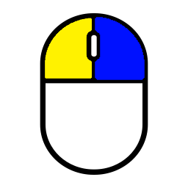
Your response will be correct when you correctly point both the yellow and the blue circle in the network on the right.
There is always just one correct answer – both the blue and the yellow circle has one and only one corresponding circle on the right.
You point the circles by cliking:
the left mouse button = yellow circle the right mouse button = blue circle
When you click on a circle, it briefly changes the color,
whether the choice was correct or not.
You have a limited time to respond.
When only a few seconds are left, a small clock icon is shown as a reminder.
Before the proper test starts, there will be same practice to familiarize the task.
press SPACE to start the TRAINING

