Slide 1
On the left, there is a set of circles connected with arrows in some specific way. On the right, there is the same set of circles and arrows but unfortunately someone mean has changed the locations of the particular circles in this set, and the arrows followed these changes.
One circle in the left set is yellow, and one is blue. The corresponding circles in the right set are, however, black. Your task is to point the yellow and the blue circle in the right set.
Now, try to find the yellow and the blue circle in the right set.
Press SPACE to see the correct answer

Slide 2
On the left, there is a set of circles connected with arrows in some specific way. On the right, there is the same set of circles and arrows but unfortunately someone mean has changed the locations of the particular circles in this set, and the arrows followed these changes.
One circle in the left set is yellow, and one is blue. The corresponding circles in the right set are, however, black. Your task is to point the yellow and the blue circle in the right set.
Notice, that both in the left and the right set, the blue circle has one incoming arrow, while the yellow circle has one incoming and one outgoing arrow
Press SPACE to see the next example

Slide 3
This example is more difficult.
The blue circle has one incoming arrow from a circle which has two outgoing arrows. Notice, that the yellow circle has also one incoming arrow, but from a circle that has one outgoing and one incoming arrow! That’s why both the blue and the yellow circle has its exact corresponding circle in the right set.
Press SPACE to see the correct answer

Slide 4
This example is more difficult.
The blue circle has one incoming arrow from a circle which has two outgoing arrows. Notice, that the yellow circle has also one incoming arrow, but from a circle that has one outgoing and one incoming arrow! That’s why both the blue and the yellow circle has its exact corresponding circle in the right set.
Press SPACE to continue

Slide 5
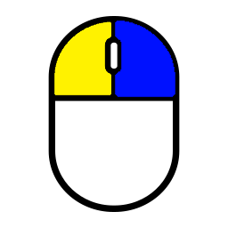
Your answer is correct when you correctly point both the yellow and the blue circle.
Remember, there is always just one correct answer –
both the blue and the yellow circle has only one corresponding circle on the right.
You point the circles by cliking:
left mouse button = yellow circle right mouse button = blue circle
When you click on a circle it briefly changes the color,
whether the choice was correct or not.
You have limited time to give an answer.
When only few seconds are left, a small watch icon is shown as a remainder.
Before the proper task begins, you need to practice,
press SPACE to start the TRAINING

