Slide 1
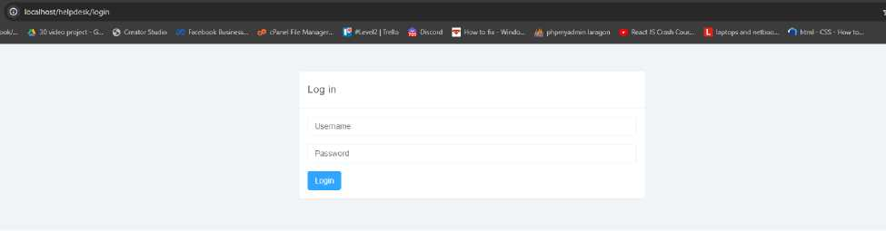
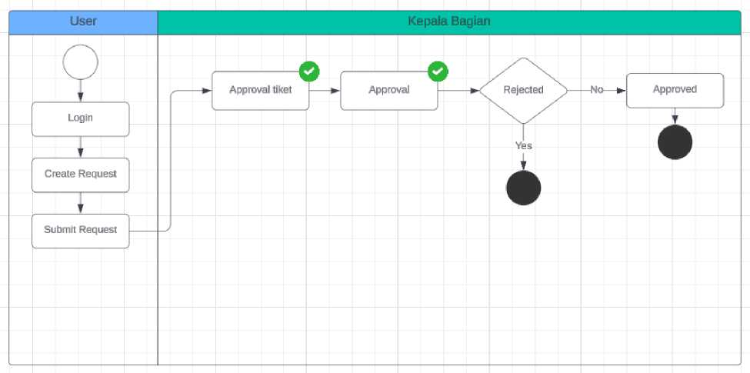
Helpdesk App
Link Local : http://localhost/helpdesk/login
1. Technologies
a. Programming Language
- Minimum PHP version: 7.3.33
- HTML5
- Javascript
- JQuery
- Codeigniter 3=2,3
b. Database
- Mysql
2. Flow Process a. Request
b. Delegation Ticket

Slide 2
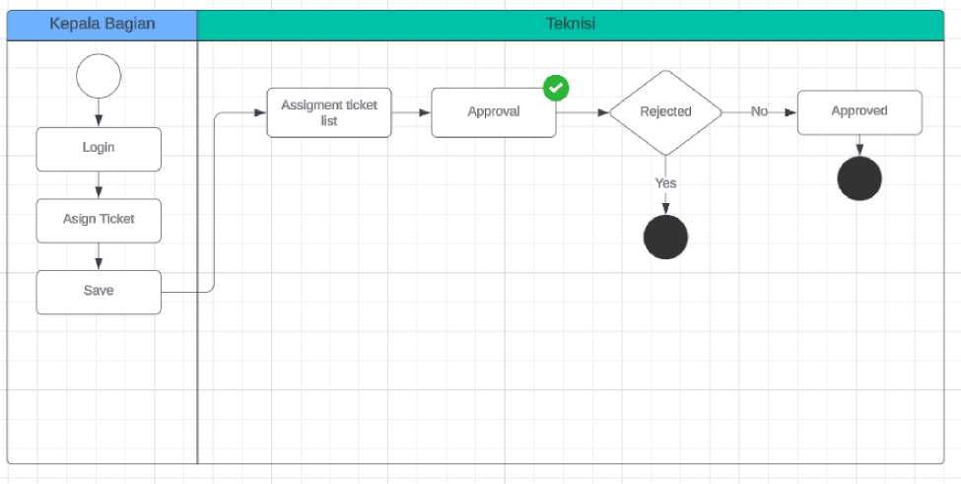
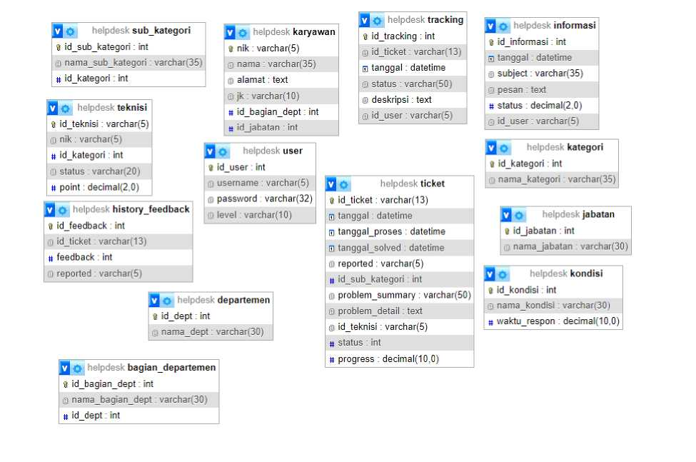
3. ERD
4. Application UI

Slide 3
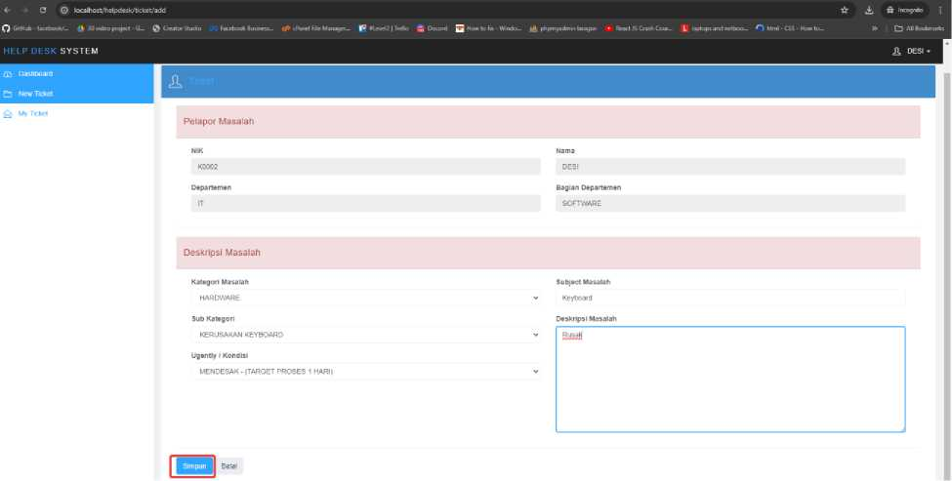
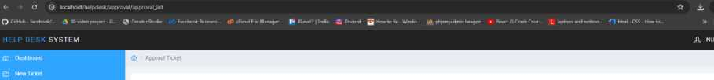

<- GO localhost/helpdesk/myticket/myticket.list |  |  |  | ^ ft Incognito ■
Q GitHufc facrtoook/- d 30 vidro project G_ Q Orator Studio ratebook Was. tfi cPanrl Far Manage*- |* *1 rvri? | Mo fie Dntord Q Ho | v to fa Windo-. t^fk ptipmyodmin tar agon | • Rract IS Crash Cour- L laptops and net | boo.- O Mr | nl - CSS • Hon <o_ » CD All Bookmark
HELP DESK SYSTEM |  |  |  | <0, DESI -
^ My Ticket
No Id Ticket | Tanggal Ticket | Nama Kategon | Nama Sub Kategon | Progress (%) | Status
1 T201612180006 | 2016-12-18 07 00 49 | HARDWARE | KERUSAKAN KEYBOARD | 100 | SOLVED
2 T201612180007 | 2016-12-18 06 09:25 | HARDWARE | KERUSAKAN KOMPONEN MONITOR | 0 | SOLVED
3 T202407I40013 | 2024-07-14 0018 54 | HARDWARE | KERUSAKAN KEYBOARD | 0 | MENUNGGU DISETUJUI
Showing 1 to 3 o»3 tows | 10 ~ records pet page
Feedback
ANDA MEMBERIKAN FEEDBACK NEGATIF ANDA MEMBERIKAN FEEDBACK POSIT1F MENUNGGU STATUS SOLVED DARI TEKNISI
Approval Ticket
 |  |  | s
_ Nama Kategon | Nama Sub Kategori | Status | AKSI
HARDWARE | IIH ill I M ■il'tl I _ | _ MENUNGGU APPROVAL | □ □
HARDWARE | KERUSAKAN KEYBOARD | MENUNGGU APPROVAL | ^ □ □
Showing I lo 2 of 2 lows 10 » reeoras per page

Slide 4
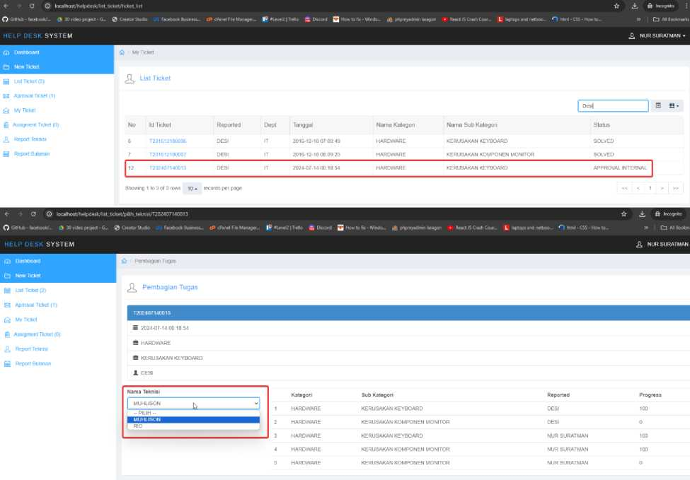

Slide 5
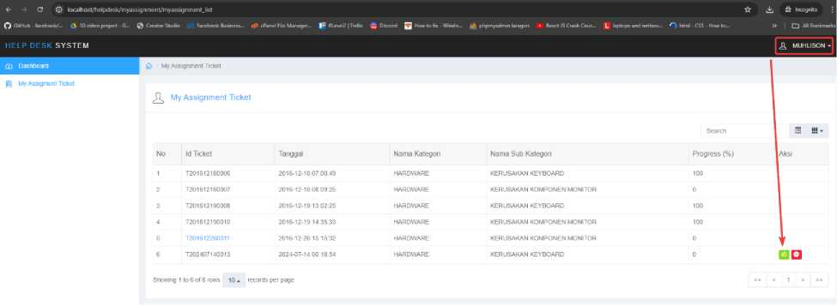
<- • C © lacalhost/helpd«b/list_tkket/tkket_lisi |  |  |  |  |  |  |  | ☆ ± | t Incognito
^ GriHub - Idcrbaok/... ii BO video project - G-_ i | ) Cre | aloiSto*. FecebootBosoew | . cP cParel File Manager,. |® FLevel? | Tieilo Oatoid Q H |  |  | w to Ik - Waldo... ijt phpmyadmir | laragen . Hear. JS Cr«h C«ir... L laptop, and re. | too.. O Mini - CSS - How to— » | □ All Bookman
HELP DESK SYSTEM |  |  |  |  |  |  |  | £ NOR SURATMAN -
CD Dastiboaid | 1ft | My Ticket
Q New Ticket
@ List Ticket (1) | ^ List Ticket
0 Approval Ticket (I)
 |  |  |  |  |  |  |  | Desi | S K-
Q My Ticket |  |  |  |  |  |  |  | 1_1
g Assigment Ticket (0) |  | No Id Ticket | Reported | Dept | Tanggal | Nama Kategori | Nama Sub Kategon | Status
,A, Report Teknisi |  | 6 T201612180006 | OESI | IT | 2016-12-18 07:00:49 | HARDWARE | KERUSAKAN KEYBOARD | SOLVED
|s| Report Buianan |  | 7 T201612180007 | DESI | IT | 2016-12-18 08 09:25 | HARDWARE | KERUSAKAN KOMPONEN MONITOR | SOLVED
 |  | 12 T202407140013 | OESI | IT | 2024-07-14 0018:$* | HARDWARE | KERUSAKAN KEYBOARO | MENUNGGU APPROVAL TEKNISI
 | Showing 1 to 3 of 3 rows 10 - |  | records per page |  |  |  |  | 1««M | 1 » »»
■* O © localho*rt/helpdesk/myassignm*ritfmyBssignm«itJ.st | A A a Incognito ;
O GitHjb - faceboofc/... a 30 vOea project - C- © Creator Studio Factbook Business... clanel File Manage)... I* *Level2 | Fretls jQ Pdrord 2 tofu- WV*Jo_. |£ phproywlmm laragon | * React tSC/adi Co - L la andnetooo. O btoil CSS Howto » CD AllSookmad:
HELP DESK SYSTEM | ^ MUHLISON -
^ £| My Assignment Ticket
My A&sjgment Ticket
My Assignment Ticket
NO | Id Ticket | Tanggal | Nama Kategon | Nama Sub Kategon | Searcn Progress {%)
1 | T201612180006 | 2016-12-18070049 | HARDWARE | KERUSAKAN KEYBOARD | 100
2 | T201612180Q07 | 2016-12-18 08 09:25 | HARDWARE | KERUSAKAN KOMPONEN MONITOR | 0
3 | T201612190006 | 2016-12-19 13 02 2$ | HARDWARE | KERUSAKAN KEYBOARD | 100
4 | T201612190010 | 2016-12-19 14 35-33 | HARDWARE | KERUSAKAN KOMPONEN MONITOR | 100
5 | T201612280011 | 2016-12-28 15 15:32 | HARDWARE | KERUSAKAN KOMPONEN MONITOR | 0
6 | 1 T2Q24Q7140013 1 | 2024-07-14 00 18 54 | HARDWARE | KERUSAKAN KEYBOARD | 0

Slide 6
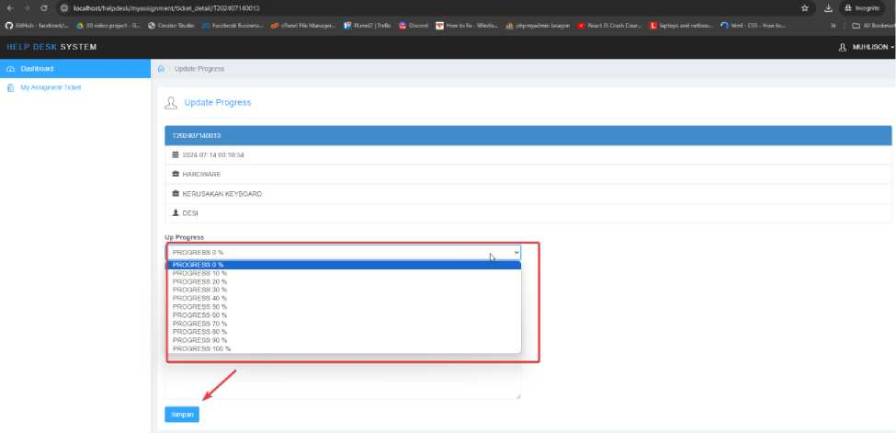
*■ * a © localhost/helpdesk/mytkk | et/rnylickeljisl |  | ☆ .4. ;9r Incognito
o GhHub - facebook/™ 44 30 video project - S... i | 5 Creator Studio Facetxx* Business cP cPanel hie Manager |C JLe*el2 | hello gt Discord Q ‘-cwTofix - Wind*-. phpniyadmin laragon | * React .15 Crash Cow,.. L laptops and netboo,,, O htr | 1*1-CSS-Howto™ » I Cl All Boo
HELP DESK SYSTEM |  |  | & DE
25 Dashboard | fit My Ticket
Q New Ticket
iL My
No Id Ticket
Name Sub Kategori
T202407140013
T202407140013 2024-07-1d 00 18 54
HARDWARE
KERUSAKAN KEYBOARD
PROSES TEKNISI
MENUNGGU STATUS SOLVED DARI TEKNISI
*- -* C © local host/help desk/mytic ket/mytick et _ list |  |  | ☆ Aft Incognito ;
o GtHub - facebook/- 44 30 video project - 6. © Creator Stucfo Facebook Business. cP cfanel file Manager... I* »leve!21 Tre*o ^Discord Q h »to fit - Wndo™ l£ phpmyadmin laragon | ‘ React JS Crash Cow™ L laptops and netboo- O "it | nl-CSS-How to™ | » 1 CJ All Bookmarts
HELP DESK SYSTEM |  |  | DESI -
.. Dii jlibJird
Q New Ticket |  |  | ^_{m}
My Ticket
No Id Ticket
3 T202407140013
Tanggal Ticket 2024-07-14 0018:54
Nama Kategori
HARDWARE
Nama Sub Kategori
KERUSAKAN KEYBOARD
| T202407140Q13 Status SOLVED
Showing 1 to 1 of 1 rows 10. records per page
<- -> G © tocalhost/helpdisk/mytickM/mytickelJist
» c Panel fik Manager- I* <Leve!21T
to fix - Windo- phpmyadmin laragon ► React IS Crash Covr™ L laptops and netboo^, O html • CSS • Howto.
O GitH ub ■ facebodo'... 44 30 video project - G™ ^ OoUiSude Factbock Uusintss-HELP DESK SYSTEM £3 Dash Board a New Ticket
KERUSAKAN KEYBOARD
Feedback
ANDAMEMBERIKAN FEEDBACK POSITIF
5. Features

Slide 7
Admin:
G © localhost/helpdesk/home o GitHub - facebook/... 30 video project - G... 0
HELP DESK SYSTEM
S3 Dashboard Q New Ticket
jj List Ticket (1)
El Aprroval Ticket (1) Q My Ticket H Assigment Ticket (0) TL Report Teknisi jj Report Bulanan
Teknisi
O © localhost/helpdesk/home Q GitHub - facebook/... 30 video project - G... £
HELP DESK SYSTEM S3 Dashboard
6| My Assig ment Ticket
Users
G © localhost/helpdesk/home o GitHub - facebook/... 4S 30 video project - G... 0
HELP DESK SYSTEM
S3 Dashboard 0 New Ticket
Q My Ticket

