Slide 1
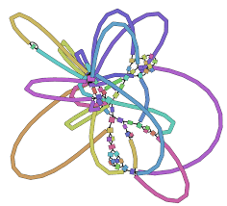
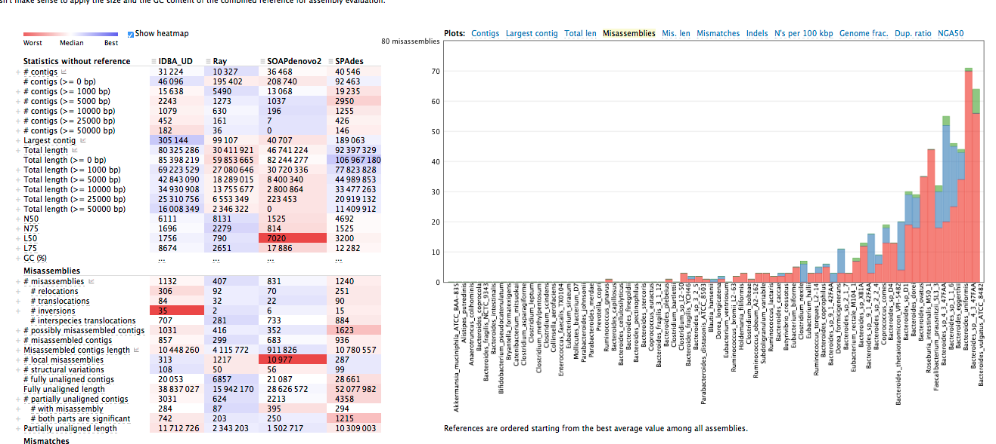
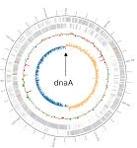
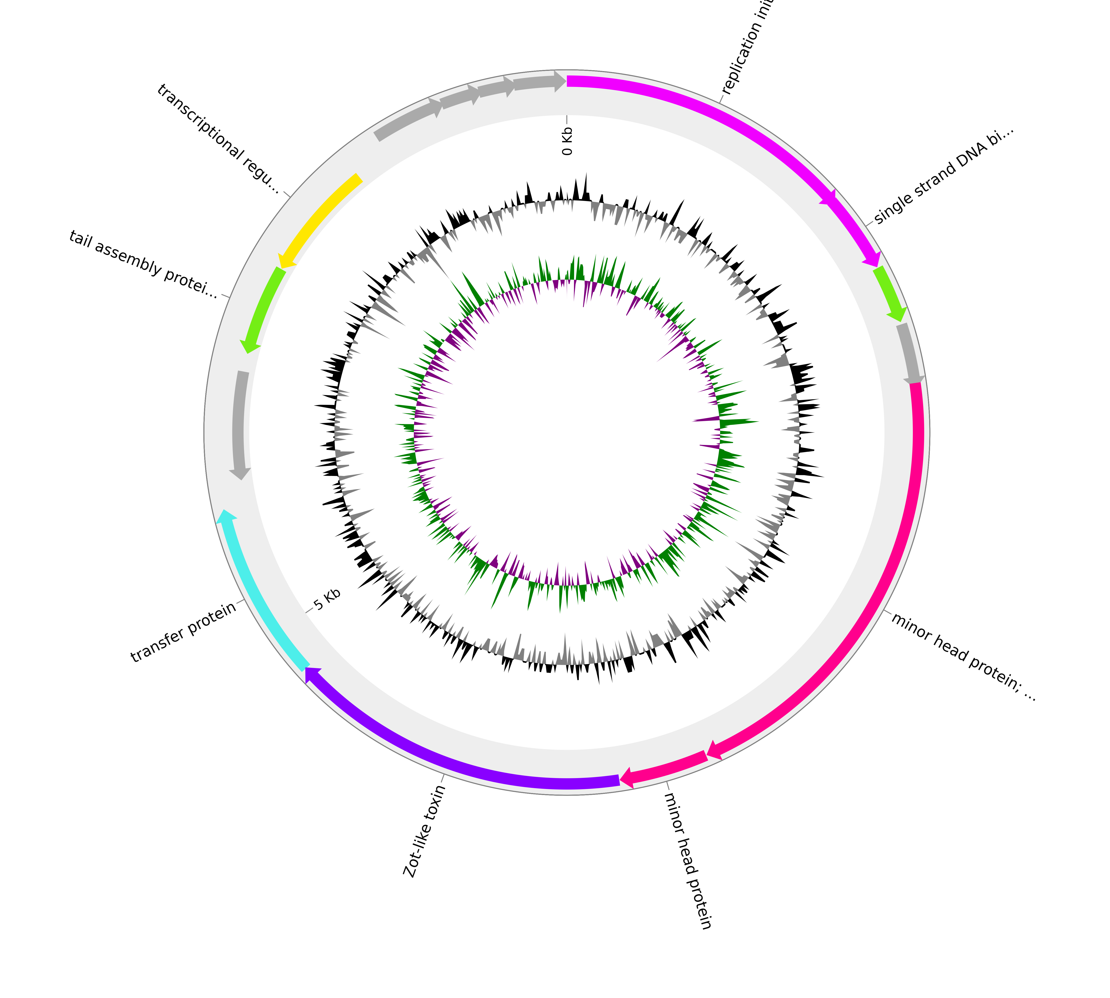
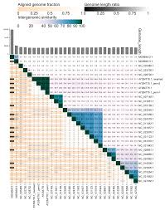
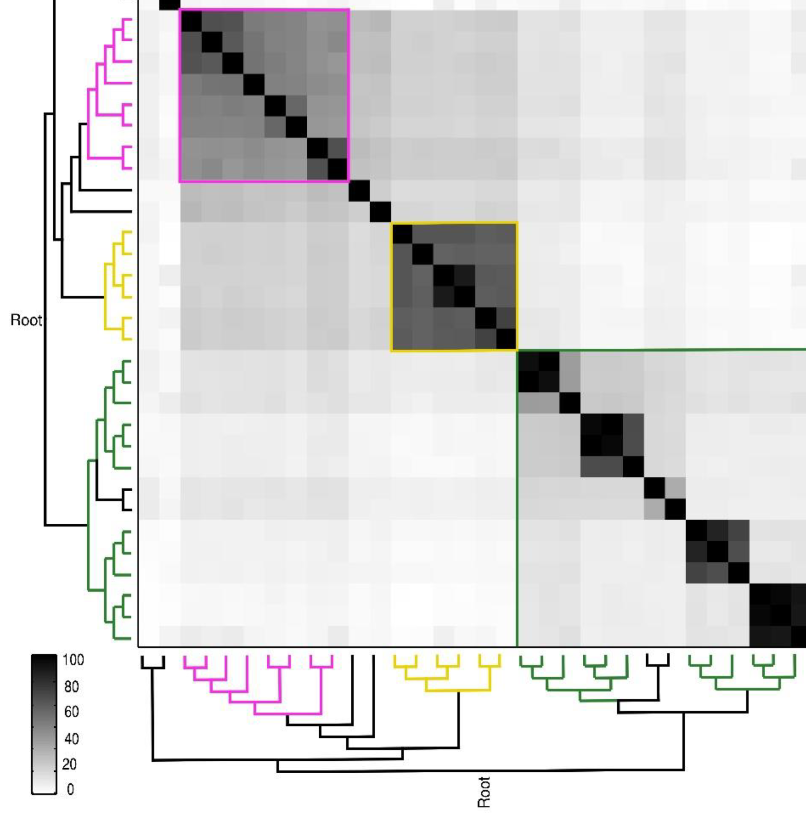
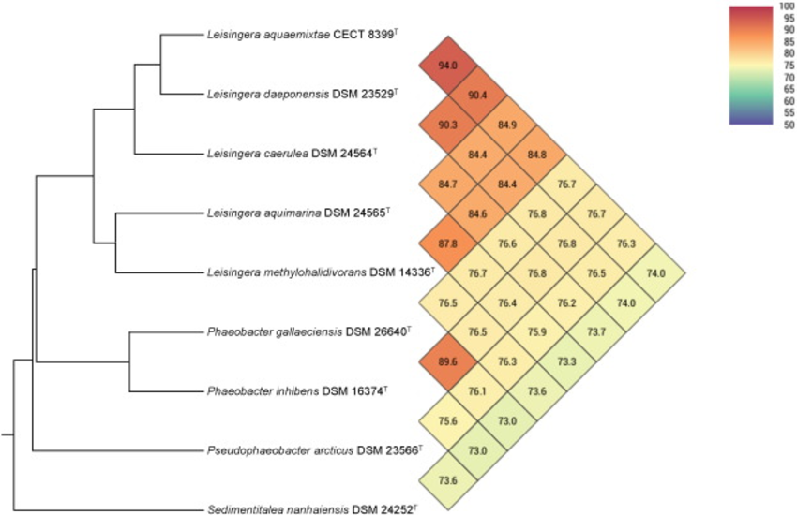
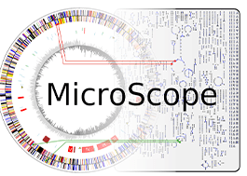
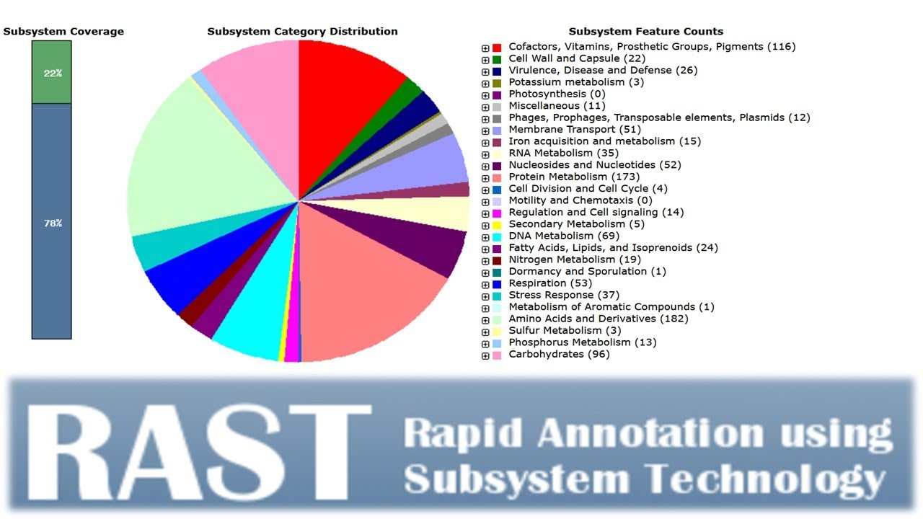
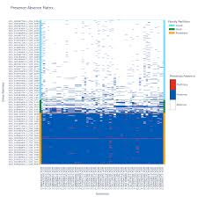
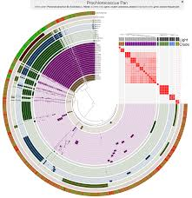
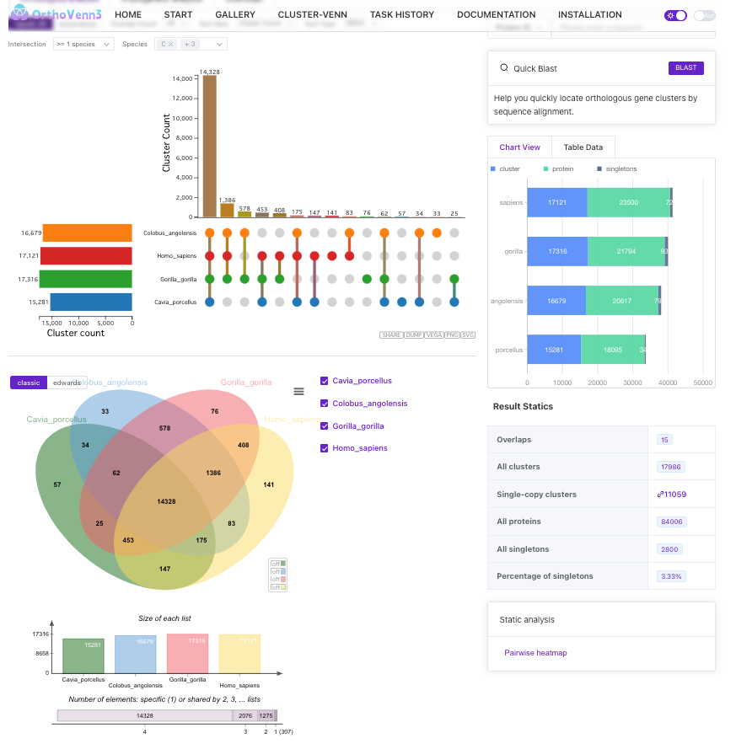
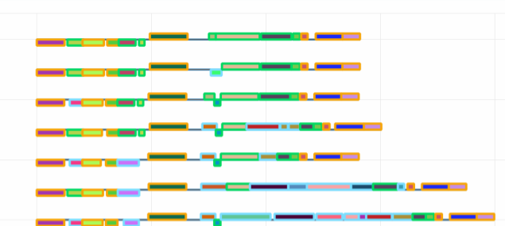
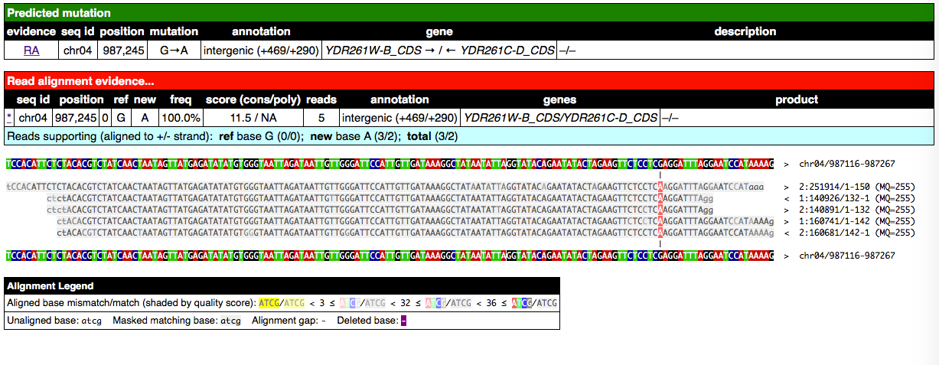
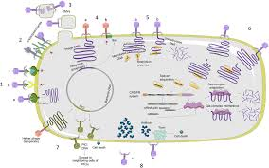
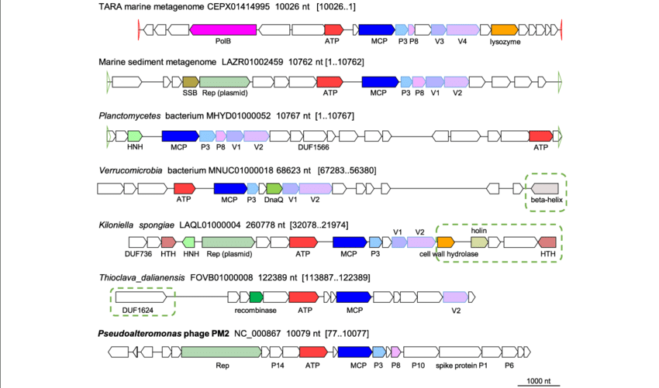
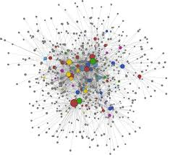
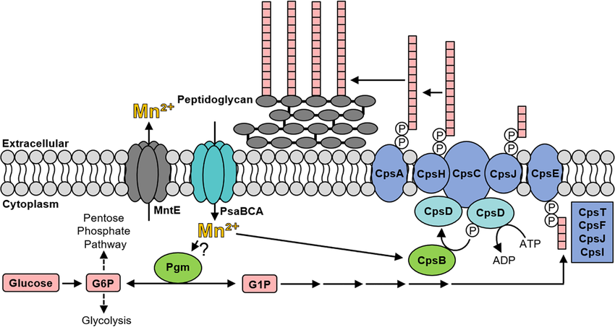
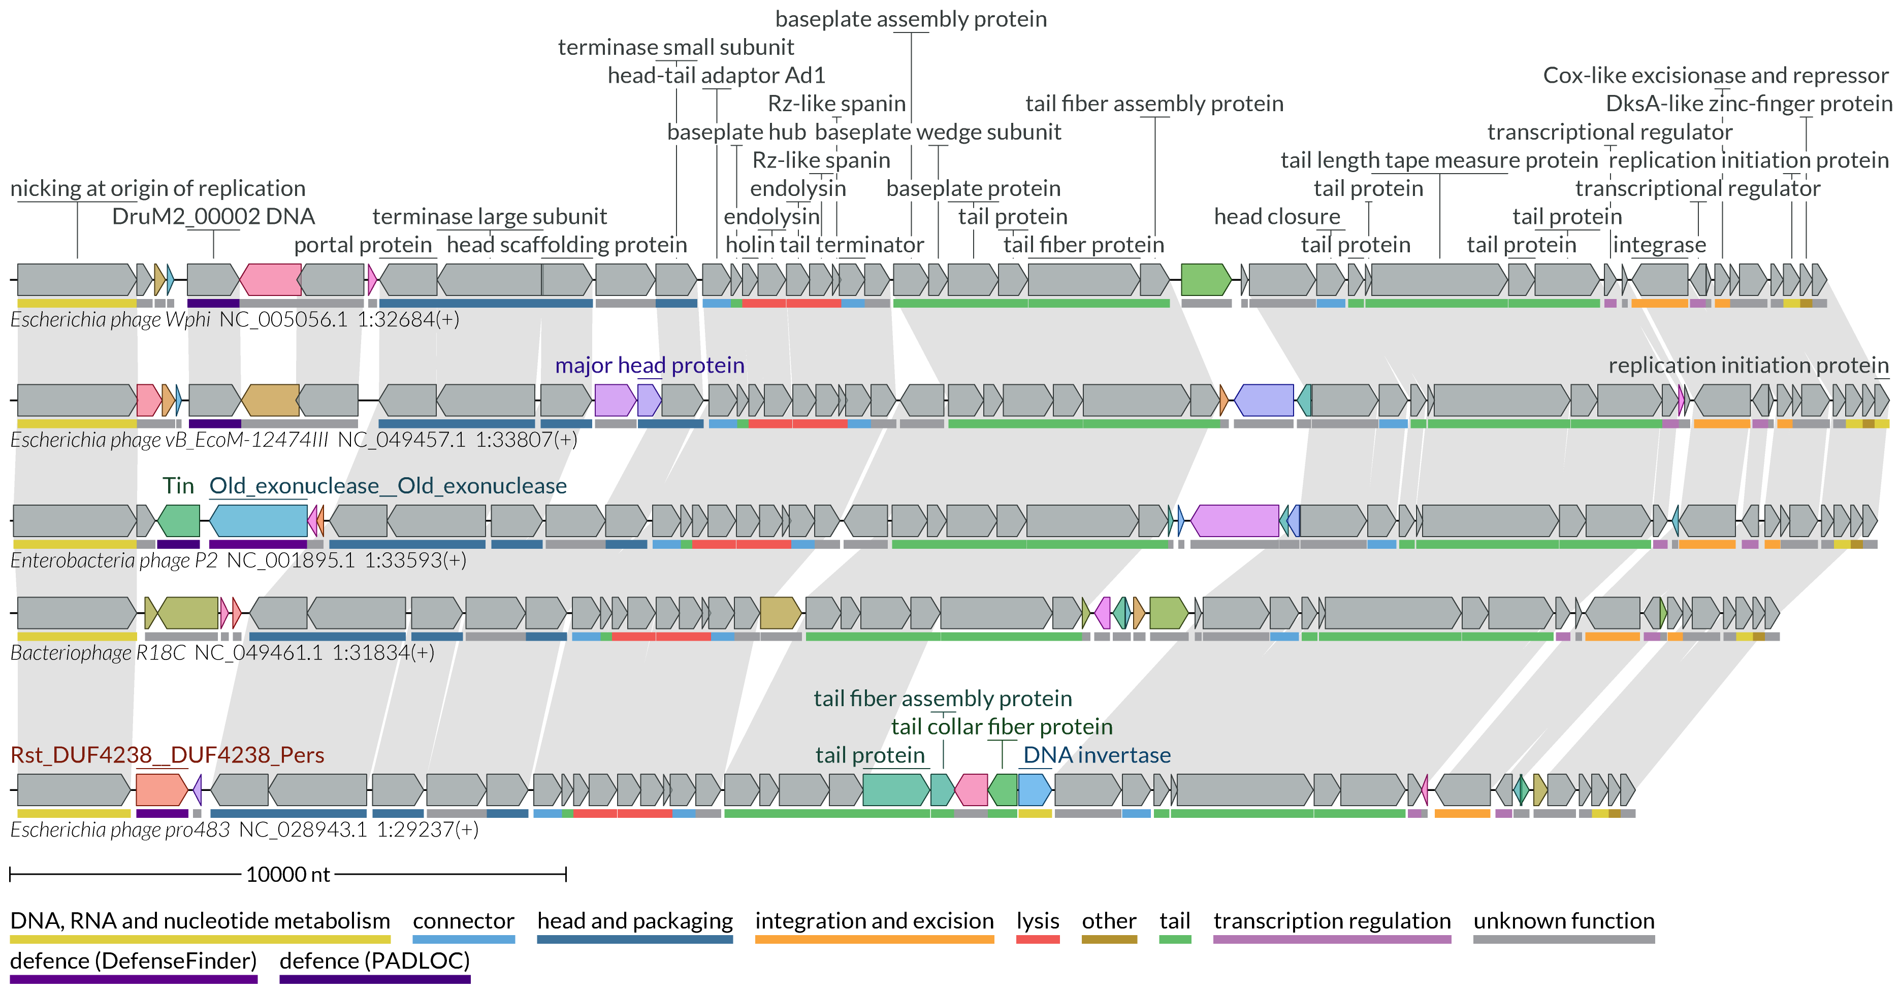
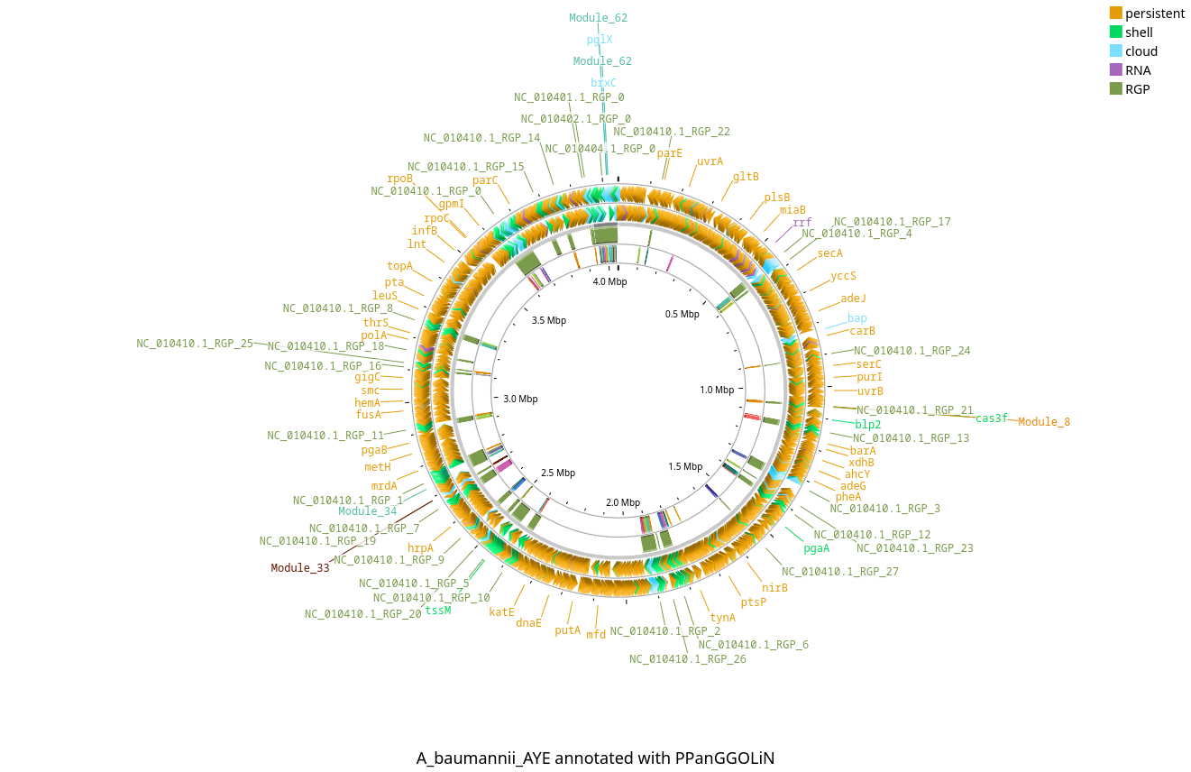
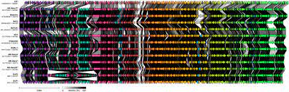
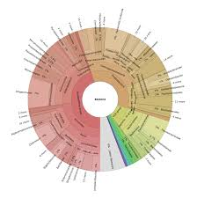
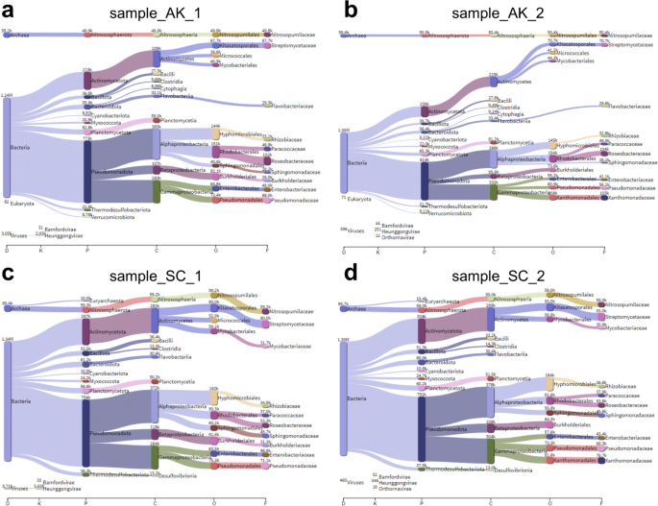
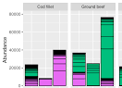
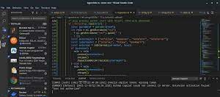
Bacterial and viral genome assembly and quality checking :
Shovill, Skesa, Quast
Chromosome and mobilome annotation :
Bakta, Pharokka, Phold
Phylogeny and taxonomy classification : Average nucleotide indentity (ANI),
OrthoANI, VIRIDIC
Data storage and sharing
Comparative genomic, pangenome analyses, orthology inference, plasticity regions, mutation detection :
PPanGGOLiN, ANVIO’S, Orthofinder, Breseq
Plasmids, phages, PICI, cfPICI, genomic islands, defense mechanisms, social gene detection
and cell wall organisation: SatelliteFinder, geNomad, CapsuleFinder, DefenseFinder, PADLOC, SOCFinder
Genome maps plotting and comparison : Clinker, LoVis4u, Proksee
Metagenomic, metabarcoding, diversity analyses and OTU classification : Kraken2, Krona,
Pavian, R-script developpement

