Slide 1
Population Genetics
BMIF201, Fall 2025
Dr. Luke Jen O’Connor

Slide 2
Population genetics: models of genetic variation and evolution

Slide 3
What is being modeled?
Mutation
Selection
Drift
Linkage/recombination
Migration
Allele frequencies

Slide 4
Unit overview
Most classes: lecture followed by coding-based activity
Today: mutation, drift, Wright-Fisher
L2: natural selection I
L3: population structure and demography
L4: linkage and recombination
L5: natural selection II
L6: topic

Slide 5
Today: Wright-Fisher model
Mutation
Selection
Drift
Recombination
Migration
Allele frequencies

Slide 6
A
CG
Haplotype 1
A
TG
Haplotype 2
T
--
Haplotype 3
Site 1
Site 2

Slide 7
Allele A
A
CG
Haplotype 1
A
TG
Haplotype 2
T
--
Haplotype 3
Allele T

Slide 8

Allele A
A
CG
Haplotype 1
A
TG
Haplotype 2
T
--
Haplotype 3
Allele T
$$variant= \left(site, \left\{allele A, allele T\right\}\right)$$

Slide 9
A
CG
Parent
Mutation
C
CG
Child

Slide 10
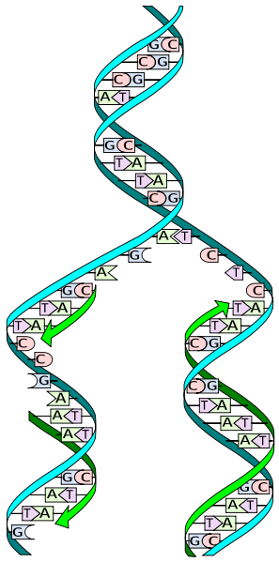
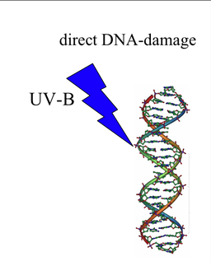
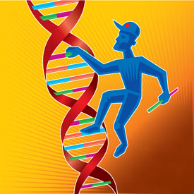
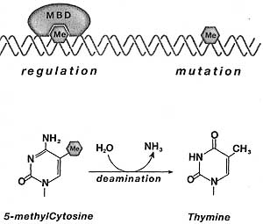
Mutation
Replication fidelity
DNA damage
DNA repair
CpG deamination (C->T/G->A)
Substitutions (e.g. C->T), insertions, deletions, rearrangements

Slide 11
Mutation rate: expected number of mutations per generation per site (or per gene, genome, etc.)
Mutation type | Alleles | Mutation Rate (Human) | Mutation Rate (Bacterial)
Single base substitution | A,T,C,G | ~10⁻⁸ / site / gen (non-CpG) ~10⁻⁷ / site / gen (CpG) ~100 / genome/gen | ~10⁻⁹ / site/ gen 10⁻³ / genome / gen Many / human generation time

Slide 12
Mutations and fitness (more next lecture)
Selective effect of mutation
Deleterious
Neutral
Advantageous
Functional
New mutation
Nonfunctional

Slide 13

Effect of mutation on allele frequencies
Two alleles
2N haplotypes
Mutation rates
$μ$: red->blue
$ν$: blue->red
Mutation

Slide 14
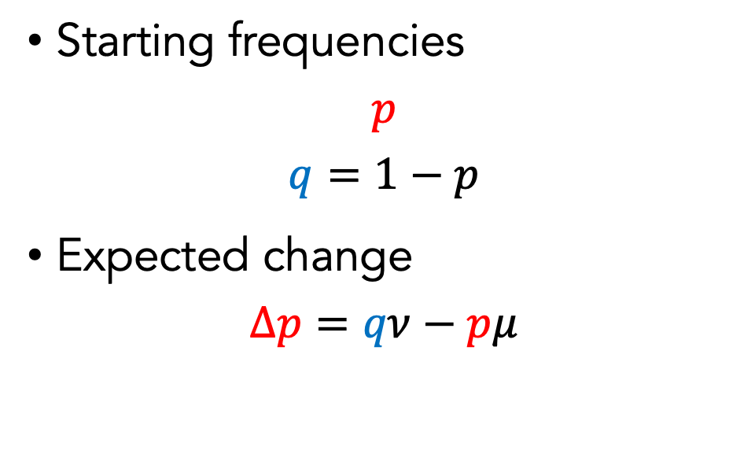
Effect of mutation on allele frequencies
Starting frequencies
$$p$$
$q=1−p$
Expected change
$$Δp=qν−pμ$$
Mutation

Slide 15

“Equilibrium” frequency
$$Δp=q^{∗}ν−p^{∗}μ=0$$
$$\frac{p^{∗}}{q^{∗}}=\frac{μ}{ν}$$
Mutation

Slide 16
Wright-Fisher model of genetic drift
Two alleles
2N haplotypes
Sampling with replacement
One generation
t
t+1

Slide 17
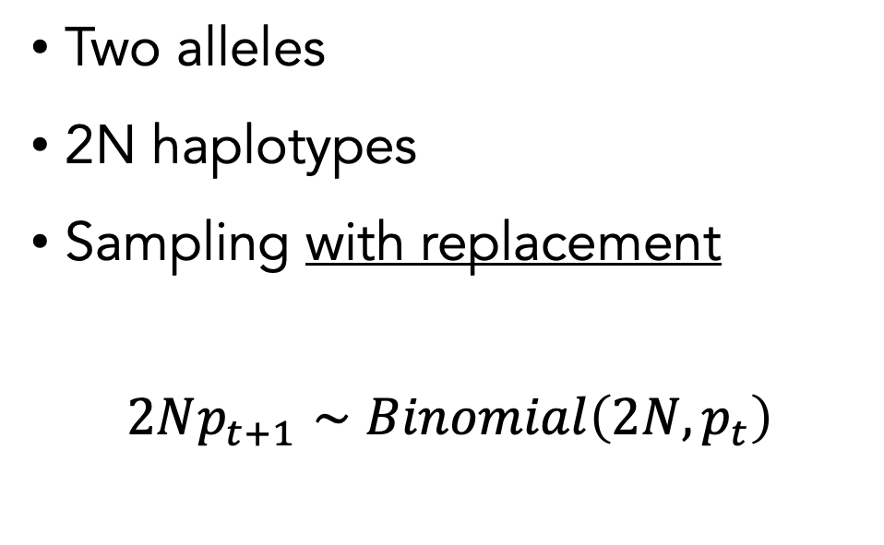
Wright-Fisher model of genetic drift
Two alleles
2N haplotypes
Sampling with replacement
$$2Np_{t+1}∼Binomial\left(2N,p_{t}\right)$$
One generation
t
t+1

Slide 18
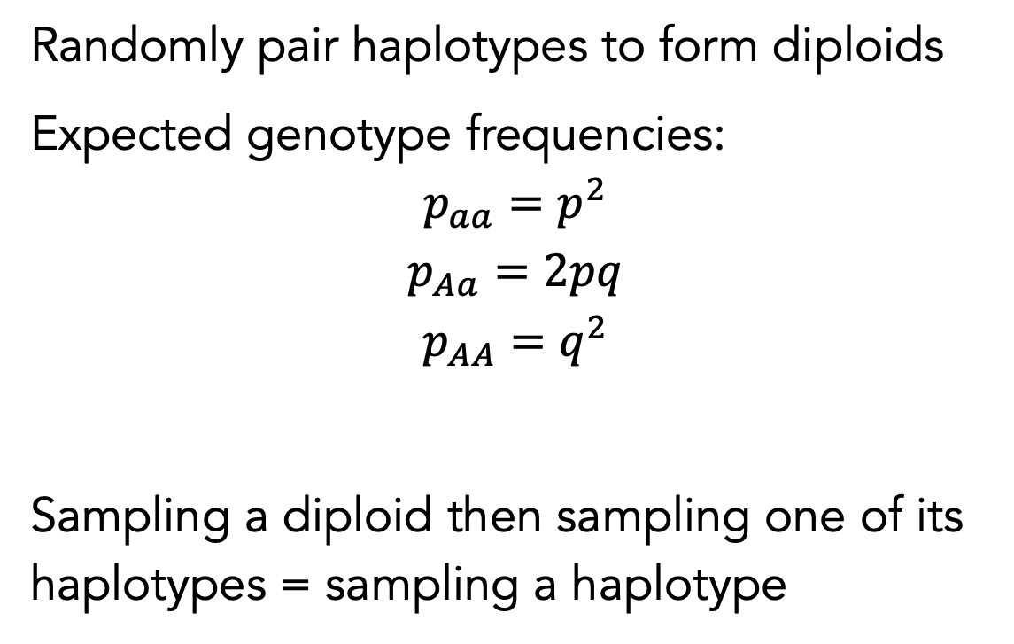
Hardy-Weinberg equilibrium (HWE)
Randomly pair haplotypes to form diploids
Expected genotype frequencies:
$$p_{aa}=p^{2}$$
$$p_{Aa}=2pq$$
$$p_{AA}=q^{2}$$
Sampling a diploid then sampling one of its haplotypes = sampling a haplotype

Slide 19

Wright-Fisher model of genetic drift
Mean:
$$E\left(p_{t+1}|p_{t}\right)=p_{t}$$
One generation
t
t+1

Slide 20

Wright-Fisher model of genetic drift
Mean:
$$E\left(p_{t+1}|p_{t}\right)=p_{t}$$
Variance:
$$Var\left(p_{t+1}|p_{t}\right)=\frac{1}{2N}p_{t}\left(1−p_{t}\right)$$
One generation
t
t+1

Slide 21

Drift: variance in frequency due to sampling
$$Var\left(p_{t+1}|p_{t}\right)=\frac{1}{2N}p_{t}\left(1−p_{t}\right)$$
One generation
t
t+1

Slide 22

Drift is slower in large populations
$$Var\left(p_{t+1}|p_{t}\right)=\frac{1}{2N}p_{t}\left(1−p_{t}\right)$$
One generation
t
t+1

Slide 23
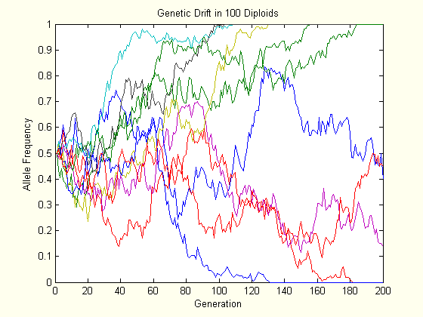
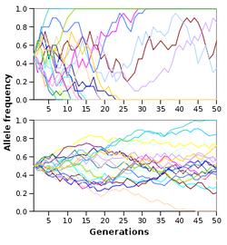
Small N
Large N

Slide 24

Variance due to mutation is normally negligible compared with drift
Drift:
$$\frac{1}{2N}p(1−p)$$
Symmetric mutation:
$$\frac{1}{2N}μ\left(1−μ\right)$$

Slide 25
What happens to alleles over a long period of time?

Slide 26
Without mutation, any allele is eventually fixed or lost due to drift (“absorbing boundaries”)

Slide 27
“Without mutation” = infinite sites
All carriers of an allele inherit it from a common ancestor
A->T
A->T
A->T
T->A
A->T
Infinite sites
Back mutation
Recurrent mutation
Ancestral allele: A Derived allele: T

Slide 28
Fixation events
Fixation probability: probability an allele eventually fixes
Time until fixation: number of generations to fixation, if an allele does eventually fix

Slide 29
Fixation probability under WF
or
Many generations
t=0
t=T

Slide 30
How long does it take for an allele to be fixed, or to be lost?

Slide 31
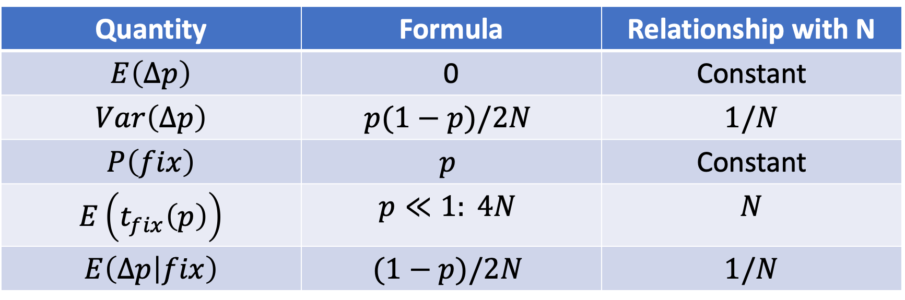
Quantity | Formula | Relationship with N
$$E\left(Δp\right)$$ | 0 | Constant
$$Var\left(Δp\right)$$ | $$p(1−p)/2N$$ | $$1/N$$
$$P\left(fix\right)$$ | $$p$$ | Constant
$$E\left(t_{fix}\left(p\right)\right)$$ | $$p≪1: 4N$$ | $$N$$
$$E\left(Δp | fix\right)$$ | $$(1−p)/2N$$ | $$1/N$$

Slide 32
Quantifying genetic diversity

Slide 33


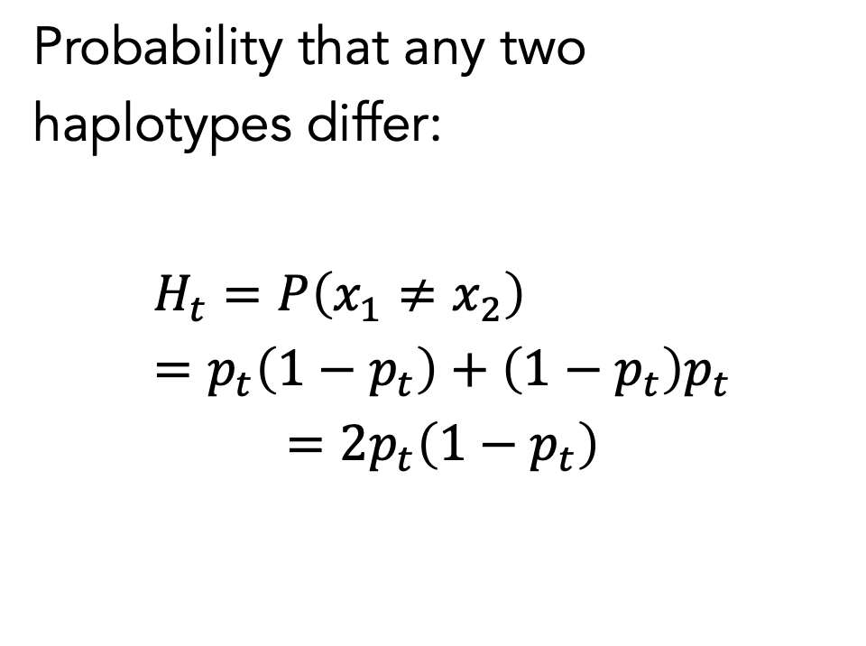
Heterozygosity under WF
Probability that any two haplotypes differ:
$$H_{t}=P\left(x_{1}≠x_{2}\right)=p_{t}\left(1−p_{t}\right)+\left(1−p_{t}\right)p_{t}$$
$$=2p_{t}\left(1−p_{t}\right)$$
$$x_{1}:0 or 1$$
$$x_{2}:0 or 1$$
One generation
t
t+1

Slide 34
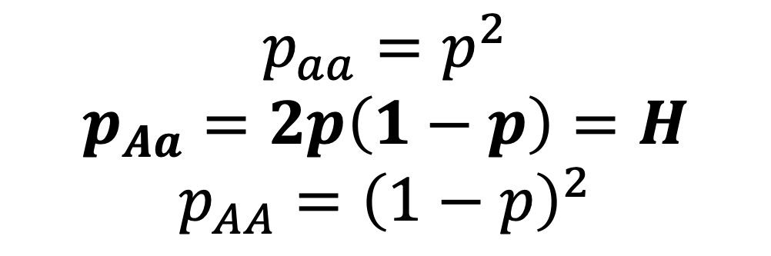

Heterozygosity = proportion of heterozygotes under random mating (“Hardy-Weinberg Equilibrium”)
$$H_{t}=P\left(x_{1}≠x_{2}\right)$$
$$x_{1}:0 or 1$$
$$x_{2}:0 or 1$$
$$p_{aa}=p^{2}$$
$$p_{Aa}=2p\left(1−p\right)=H$$
$$p_{AA}={\left(1−p\right)}^{2}$$
One generation
t
t+1

Slide 35
How does H_{t} change due to drift?
$$H_{t}=P\left(x_{1}≠x_{2}\right)$$
$$x_{1}:0 or 1$$
$$x_{2}:0 or 1$$
One generation
t
t+1

Slide 36

Mutation-drift balance
Mutation: increases heterozygosity, except when $H≈\frac{1}{2}$
Drift: decreases heterozygosity, except when $H=0$
Is there a value of $H$ at which these effects are in balance?

Slide 37

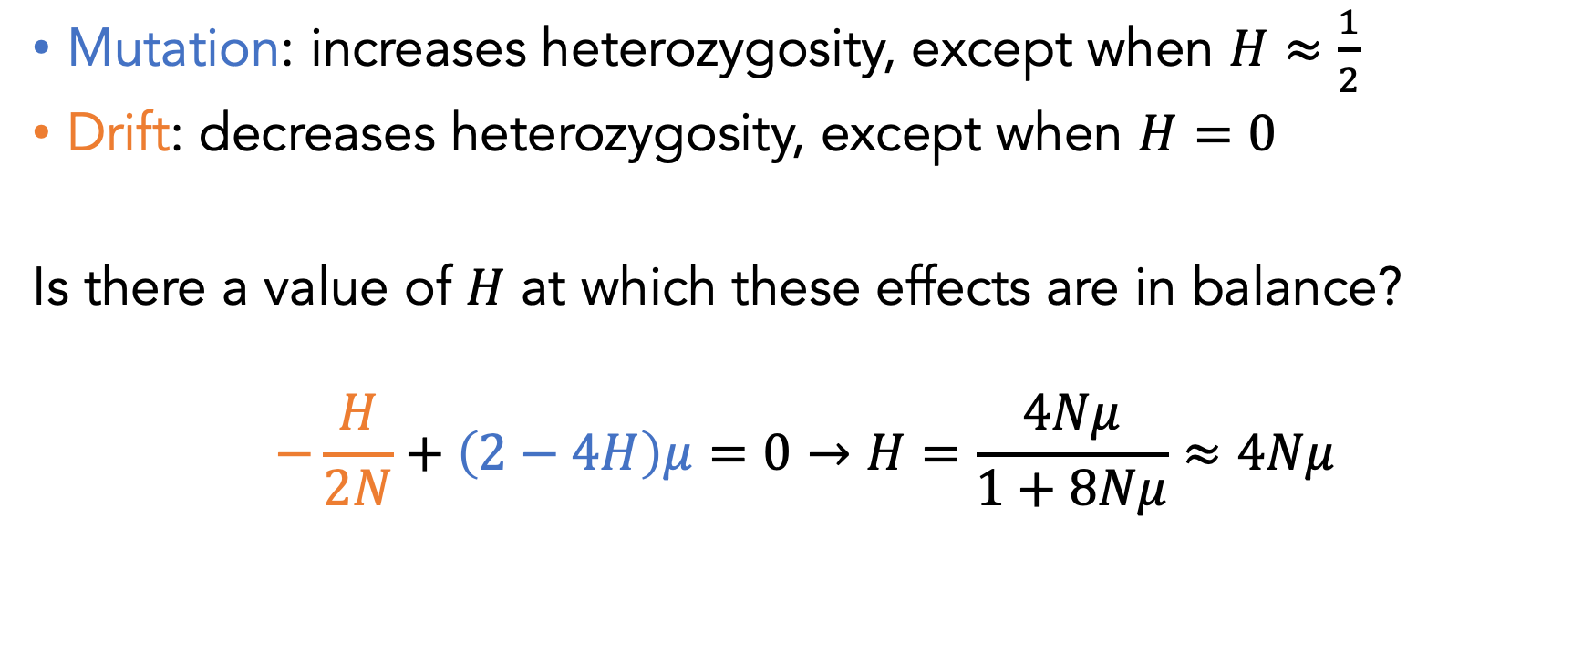
Mutation-drift balance
Mutation: increases heterozygosity, except when $H≈\frac{1}{2}$
Drift: decreases heterozygosity, except when $H=0$
Is there a value of $H$ at which these effects are in balance?
$$−\frac{H}{2N}+\left(2−4H\right)μ=0→H=\frac{4Nμ}{1+8Nμ}≈4Nμ$$
Note: classical result under “infinite alleles” is $\frac{4Nμ}{1+4Nμ}$

Slide 38
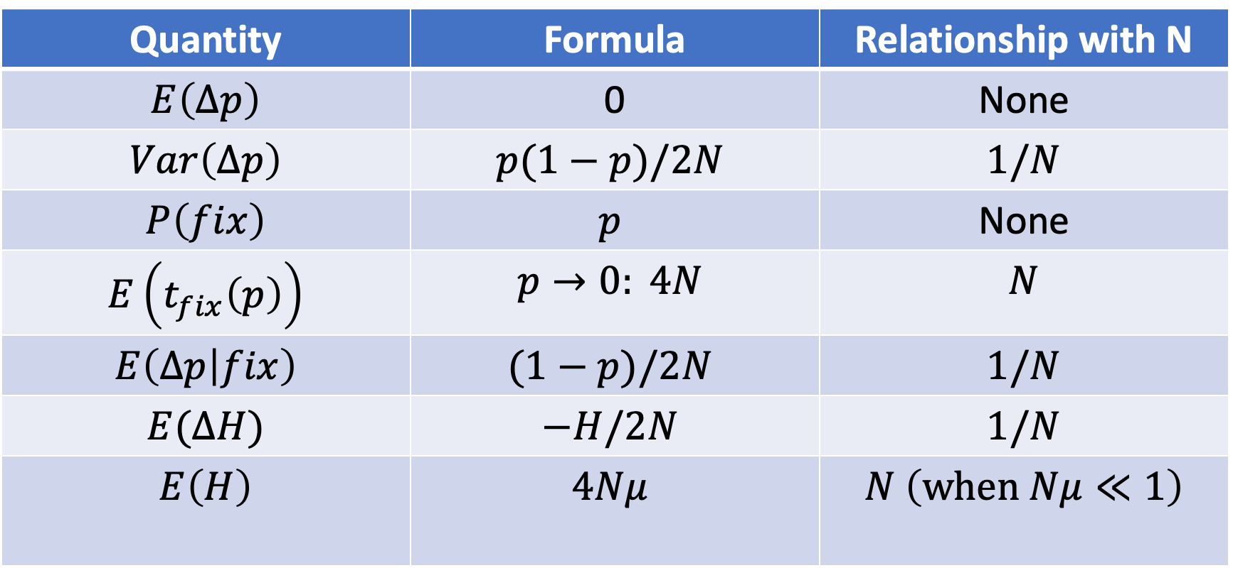
Quantity | Formula | Relationship with N
$$E\left(Δp\right)$$ | 0 | None
$$Var\left(Δp\right)$$ | $$p(1−p)/2N$$ | $$1/N$$
$$P\left(fix\right)$$ | $$p$$ | None
$$E\left(t_{fix}\left(p\right)\right)$$ | $$p→0: 4N$$ | $$N$$
$$E\left(Δp | fix\right)$$ | $$(1−p)/2N$$ | $$1/N$$
$$E(ΔH)$$ | $$−H/2N$$ | $$1/N$$
$$E\left(H\right)$$ | $$4Nμ$$ | $$N \left(when Nμ≪1\right)$$

Slide 39

The site frequency spectrum (SFS)
Fraction of sites with derived allele count $k>0$:
$$E\left(s_{k}\right)=\frac{4Nμ}{k}$$

Slide 40
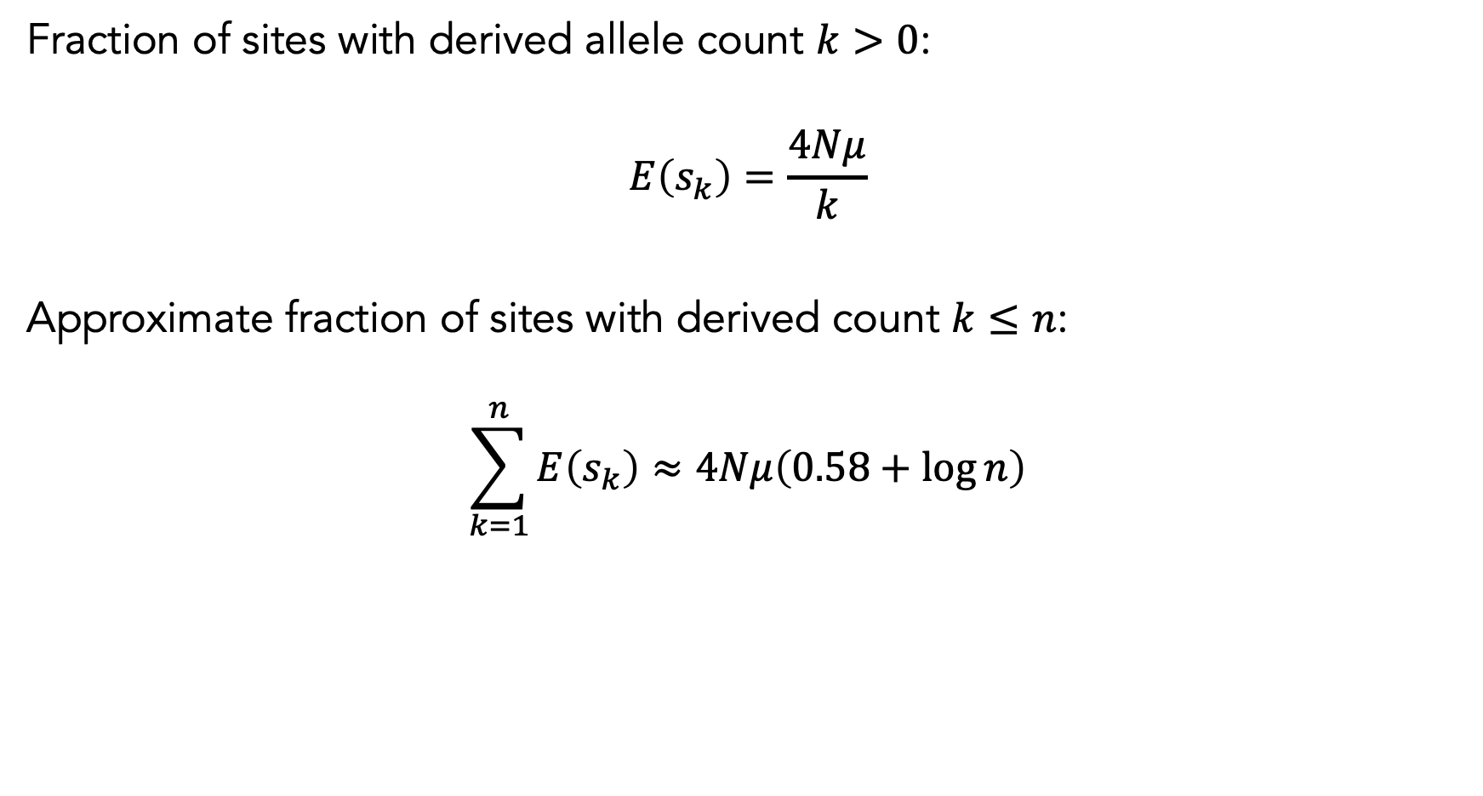
The site frequency spectrum (SFS)
Fraction of sites with derived allele count $k>0$:
$$E\left(s_{k}\right)=\frac{4Nμ}{k}$$
Approximate fraction of sites with derived count $k≤n$:
$$\sum_{k=1}^{n}{E\left(s_{k}\right)}≈4Nμ\left(0.58+log{n}\right)$$

Slide 41
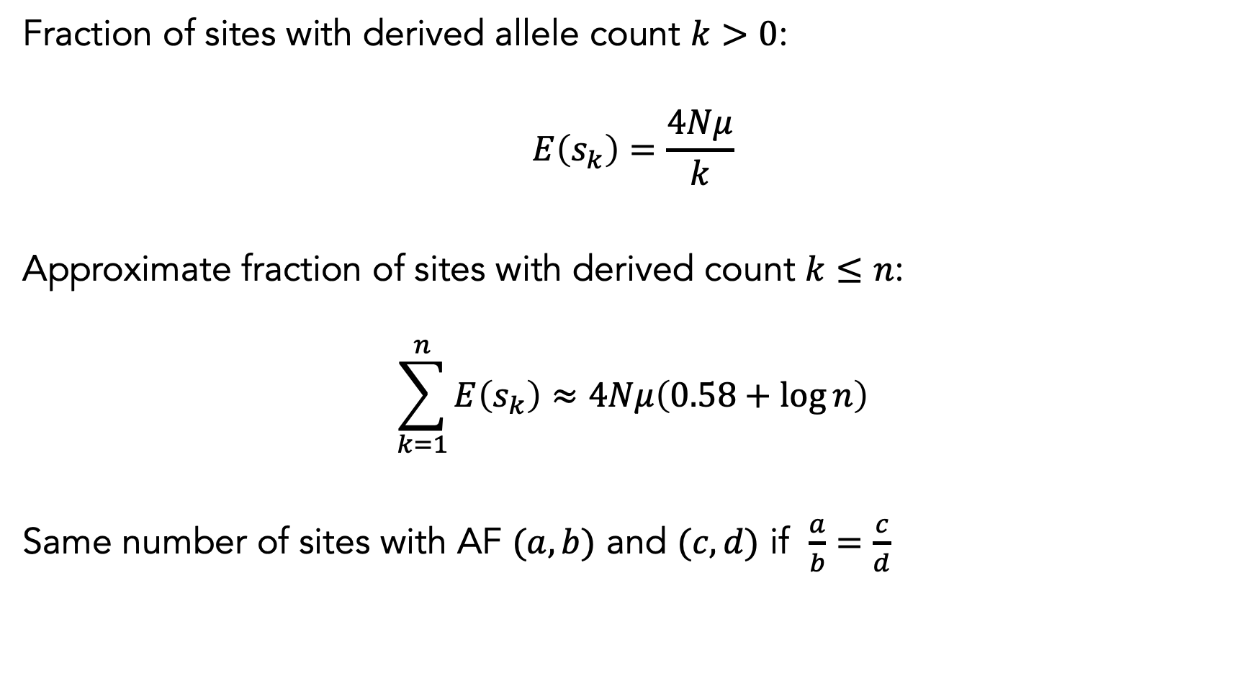
The site frequency spectrum (SFS)
Fraction of sites with derived allele count $k>0$:
$$E\left(s_{k}\right)=\frac{4Nμ}{k}$$
Approximate fraction of sites with derived count $k≤n$:
$$\sum_{k=1}^{n}{E\left(s_{k}\right)}≈4Nμ\left(0.58+log{n}\right)$$
Same number of sites with AF $(a,b)$ and $(c,d)$ if $\frac{a}{b}=\frac{c}{d}$

Slide 42
Recap
Hardy-Weinberg models drift as Binomial sampling
Drift is slower in large populations
Fixation probability and fixation time
Heterozygosity as a measure of diversity
Site frequency spectrum
github.com/oclb/bmif201_2025

