Slide 1
Unit overview
L1: mutation, drift, Wright-Fisher
L2: natural selection I
L3: Today: population structure and demography
L4: linkage, recombination, the coalescent
Today: natural selection II
Frequency-dependent selection
Selection after a bottleneck
Linked selection
L6: topic

Slide 2
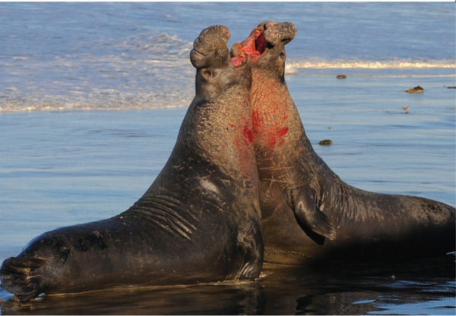
Today’s agenda
Short lecture
In class problem set

Slide 3

Frequency-dependent selection: dominance and recessivity
$$W_{aA}+W_{aA}≠W_{aa}+W_{AA}$$
One generation
t
t+1

Slide 4
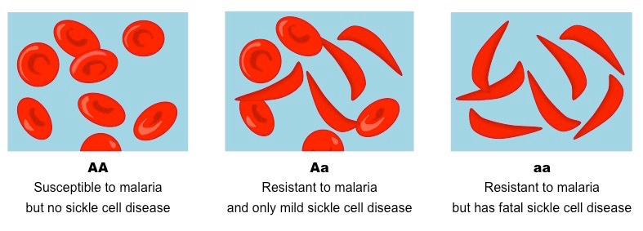
Frequency-dependent selection: balancing selection

Slide 5
Frequency-dependent selection: balancing selection
Population has allele A
Vulnerable to pathogen A
Selection for allele B
Population has allele B
Vulnerable to pathogen B
Selection for allele C
…

Slide 6
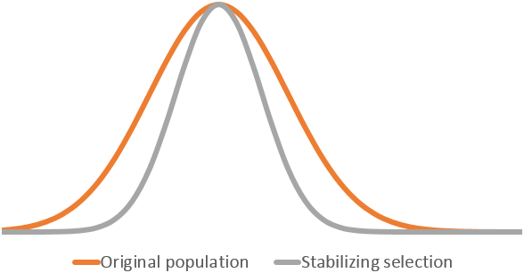
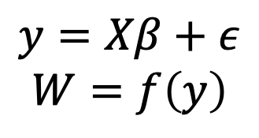
Frequency-dependent selection: stabilizing selection
$$y=Xβ+ε$$
$$W=f\left(y\right)$$

Slide 7
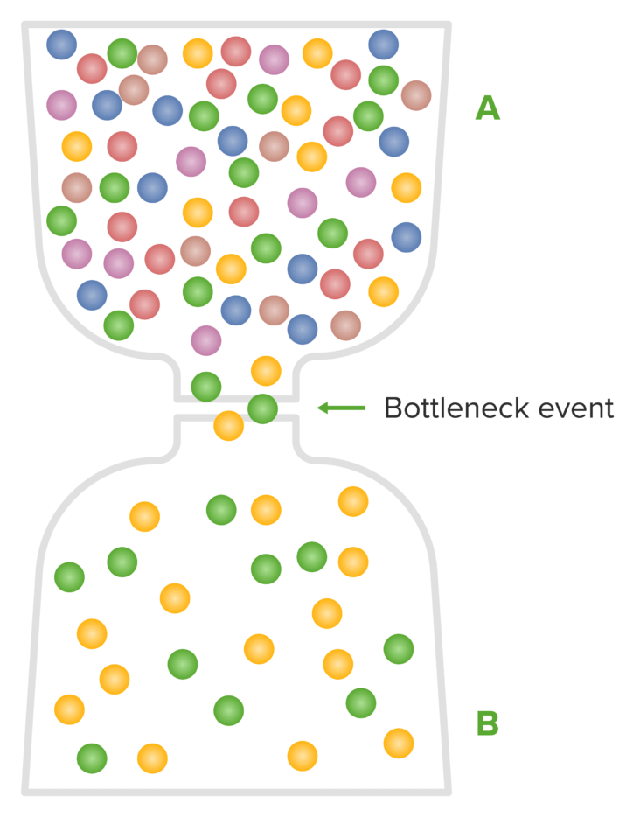
Deleterious alleles after a founder event

Slide 8
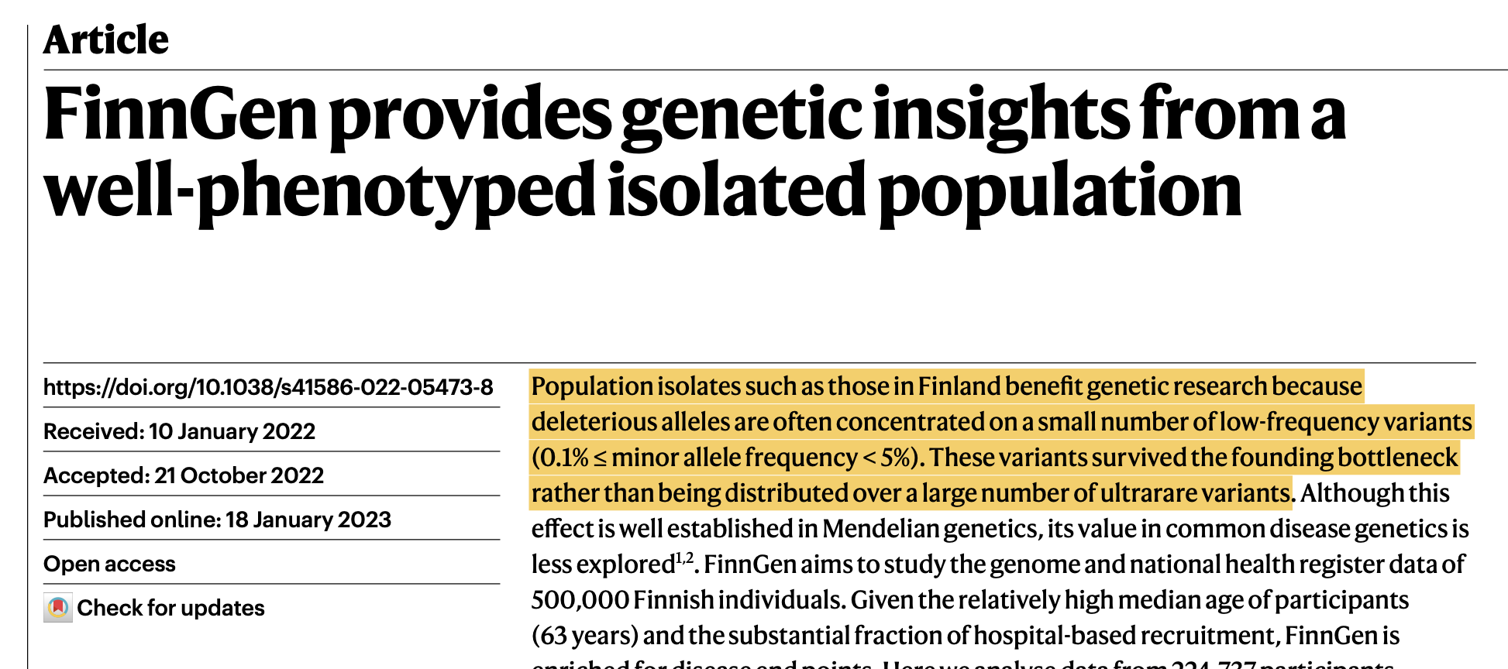
Deleterious alleles after a founder event
Kurki et al., 2024

Slide 9
Recessive alleles after a founder event
What happens to the expected number of homozygotes?

Slide 10
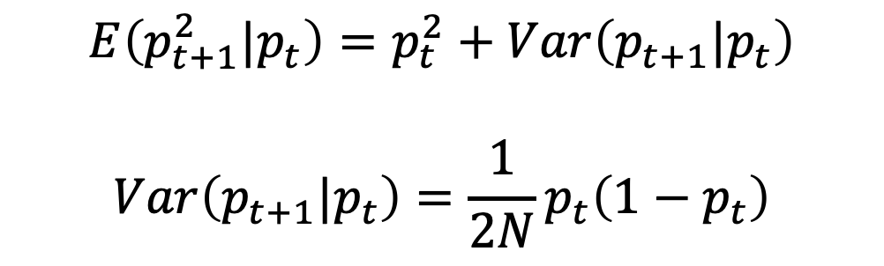
Recessive alleles after a founder event
What happens to the expected number of homozygotes?
$$E\left(p_{t+1}^{2}|p_{t}\right)=p_{t}^{2}+Var\left(p_{t+1}|p_{t}\right)$$
$$Var\left(p_{t+1}|p_{t}\right)=\frac{1}{2N}p_{t}\left(1−p_{t}\right)$$

Slide 11
Effective population size

Slide 12
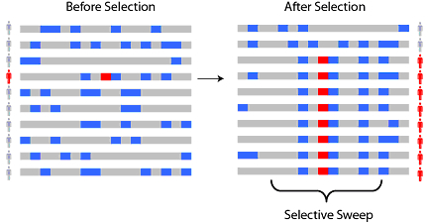
Positive selection

Slide 13
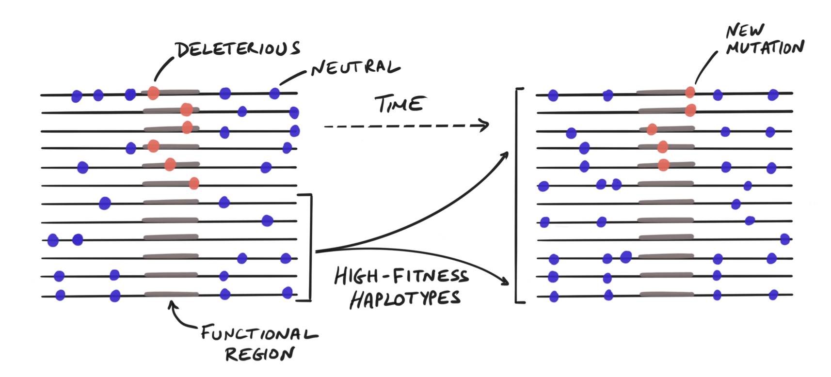
Background selection
Pritchard, 2024

Slide 14
In-class problem set: now or on your own time

