Slide 1
Unit overview
L1: mutation, drift, Wright-Fisher
L2: natural selection I
L3: population structure and demography
Today: linkage, recombination, the coalescent
L5: natural selection II
L6: topic

Slide 2
Today’s agenda
Review problem set from last time
Lecture
Live coding demo (Luke)

Slide 3
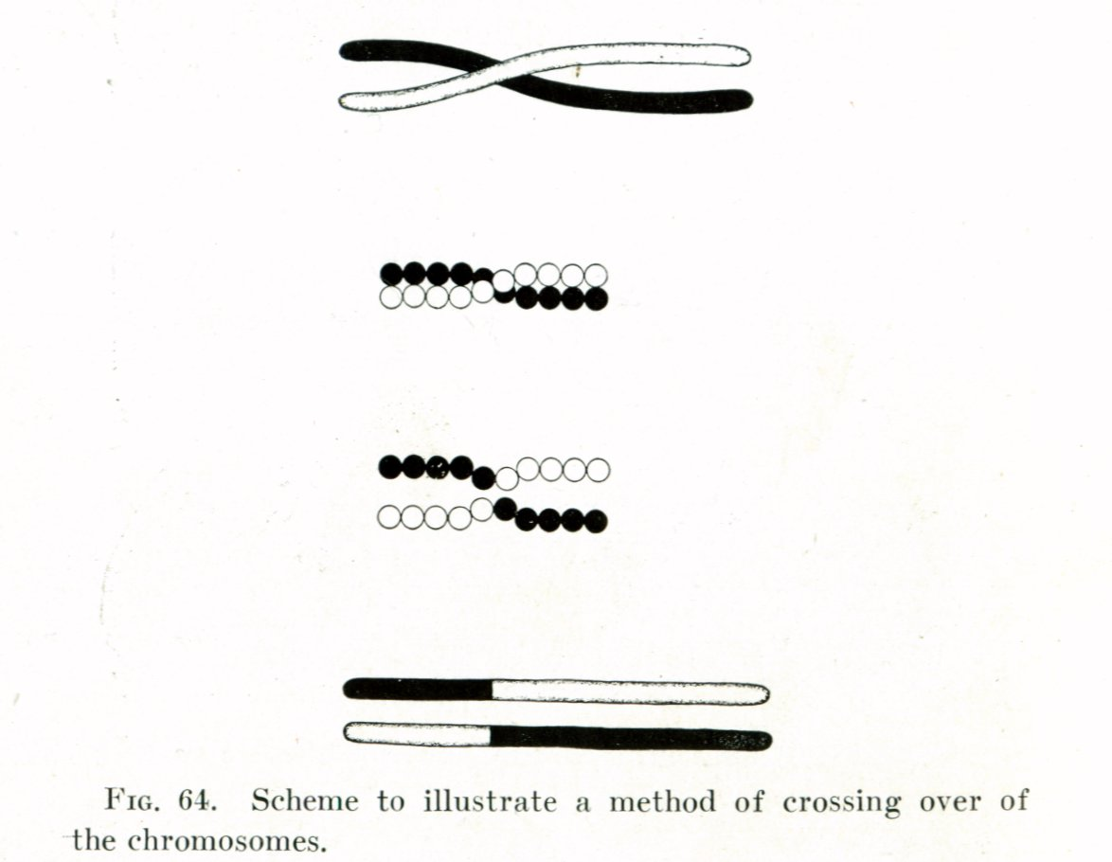
Morgan 1916

Slide 4
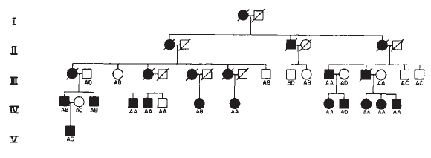
Gusella et al. 1983

Slide 5
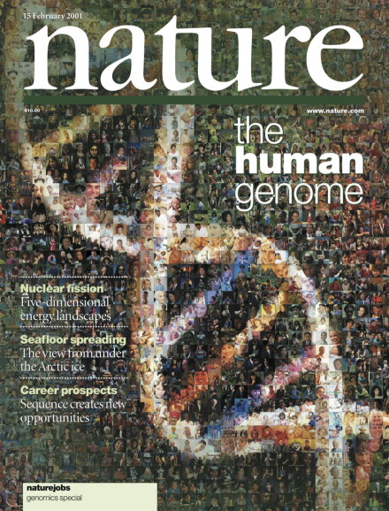

Slide 6
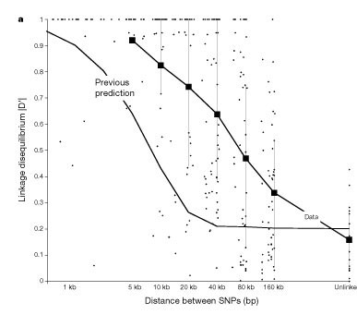
Reich et al. 2001; also see Abecasis et al. 2001

Slide 7
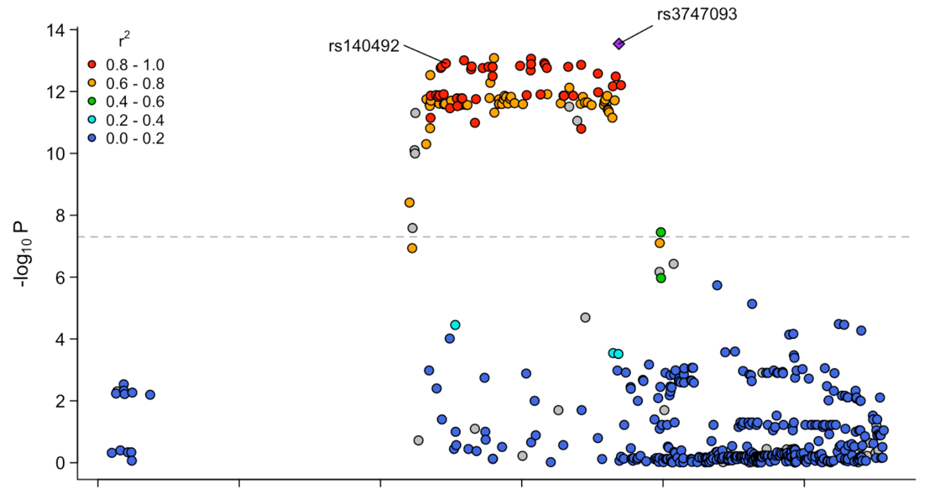

Slide 8
Measuring linkage and LD

Slide 9
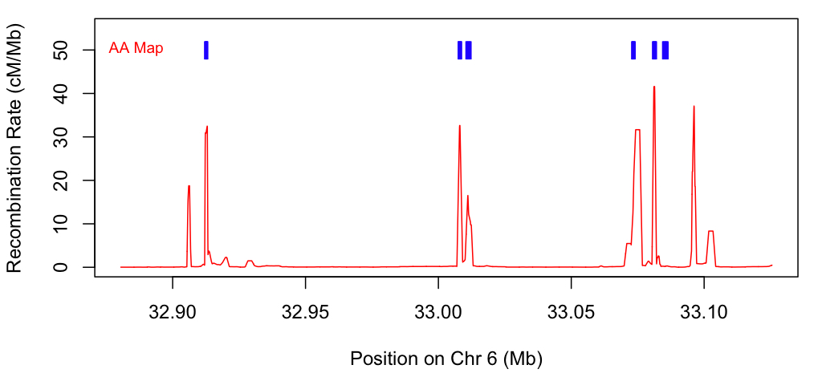
PRDM9 binding sites
1 centimorgan (cM): 1 recombination per hundred generations
Hinch et al. 2011

Slide 10
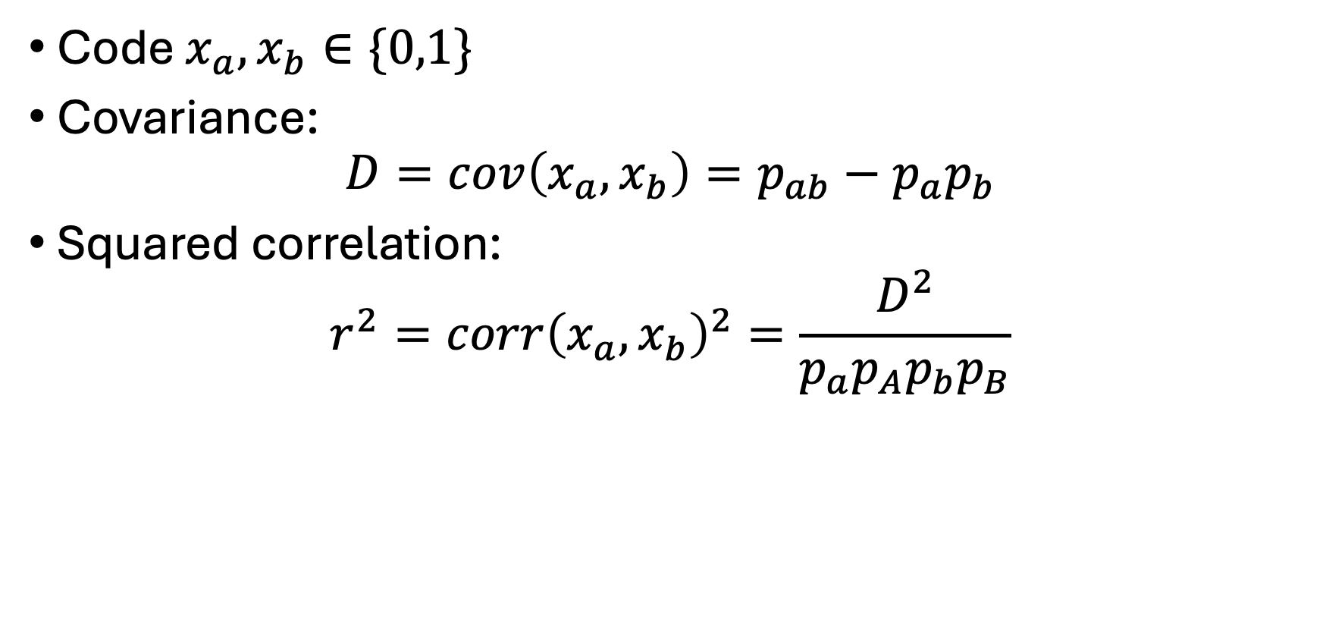
Linkage disequilibrium between alleles a and b
Code $x_{a}, x_{b}∈\{0,1\}$
Covariance:
$$D=cov\left(x_{a},x_{b}\right)=p_{ab}−p_{a}p_{b}$$
Squared correlation:
$$r^{2}=corr{\left(x_{a},x_{b}\right)}^{2}=\frac{D^{2}}{p_{a}p_{A}p_{b}p_{B}}$$

Slide 11
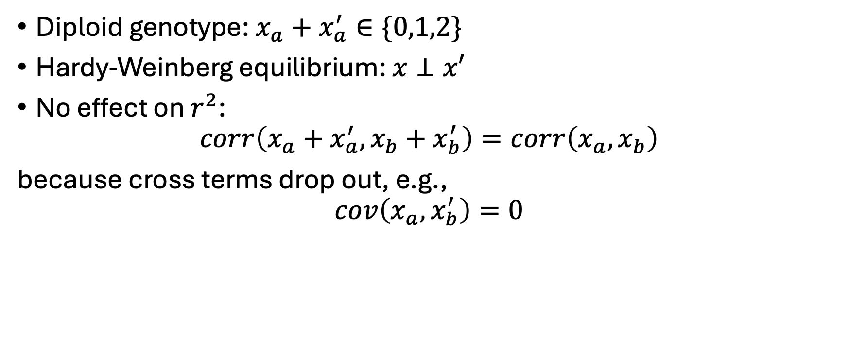
LD between diploid genotypes
Diploid genotype: $x_{a}+x_{a}^{′}∈\{0,1,2\}$
Hardy-Weinberg equilibrium: $x⊥x′$
No effect on $r^{2}$:
$$corr\left(x_{a}+x_{a}^{′},x_{b}+x_{b}^{′}\right)=corr\left(x_{a}, x_{b}\right)$$
because cross terms drop out, e.g.,
$$cov\left(x_{a},x_{b}^{′}\right)=0$$

Slide 12

LD correlation matrix
Genotype matrix, $2N × segregating sites$: $X$
Normalize $X$ to have mean 0, variance 1: $\tilde{X}$
LD matrix: $\frac{1}{2N}{\tilde{X}}^{′}\tilde{X}$

Slide 13
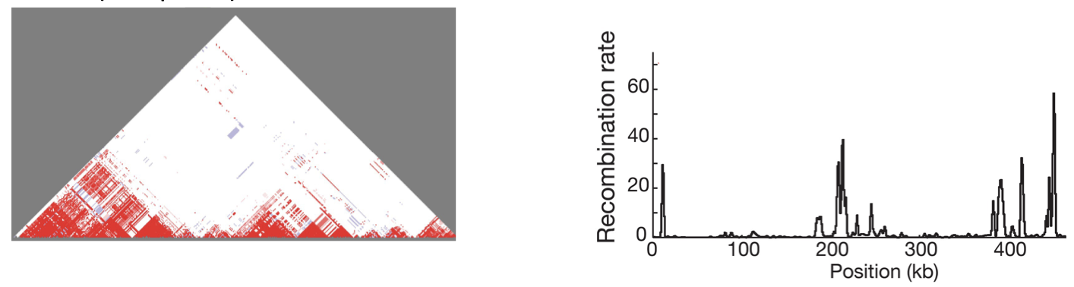
Red: positive correlation
Blue: negative correlation
Pritchard 2024; from HapMap Consortium 2005

Slide 14
What happens to LD over time?
Accumulation due to drift
Breakdown due to recombination

Slide 15
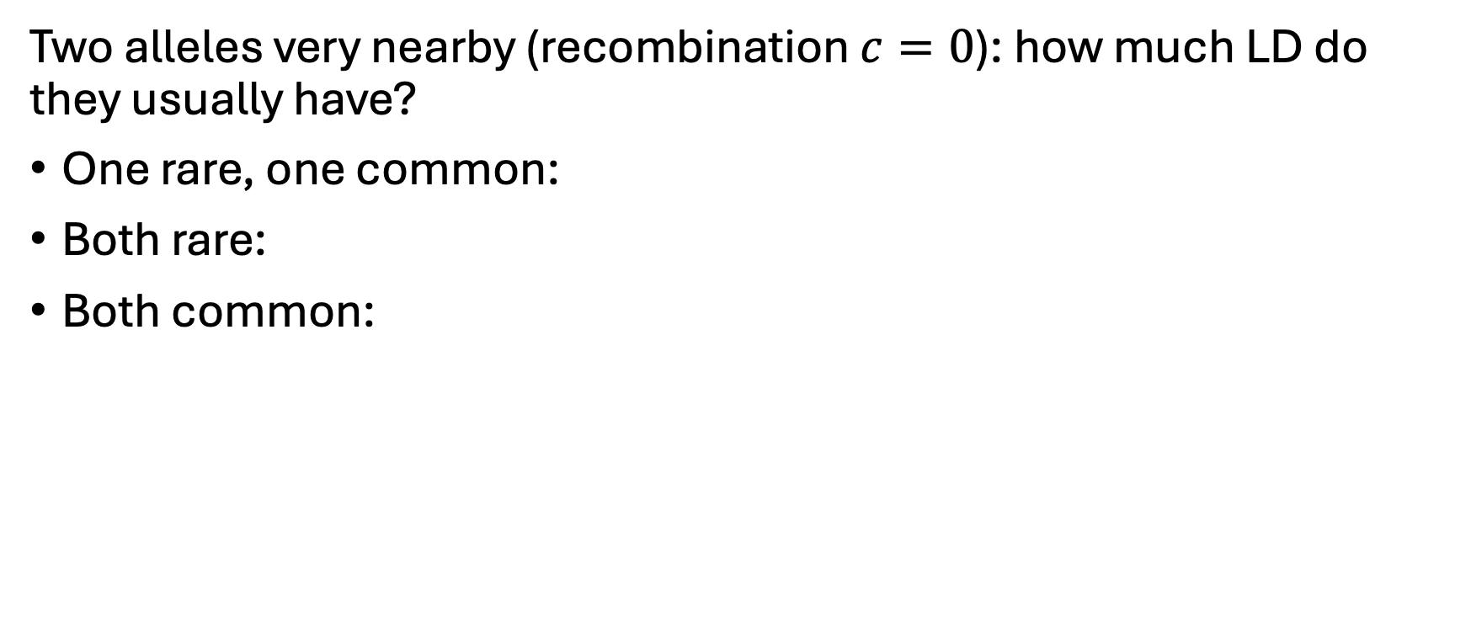
LD and allele frequency
Two alleles very nearby (recombination $c=0$): how much LD do they usually have?
One rare, one common:
Both rare:
Both common:

Slide 16
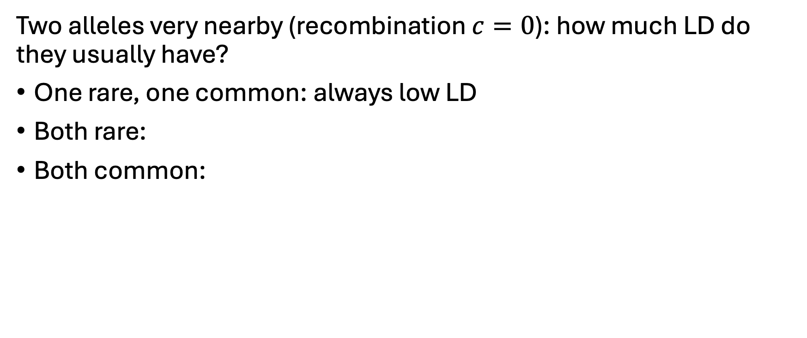
LD and allele frequency
Two alleles very nearby (recombination $c=0$): how much LD do they usually have?
One rare, one common: always low LD
Both rare:
Both common:

Slide 17
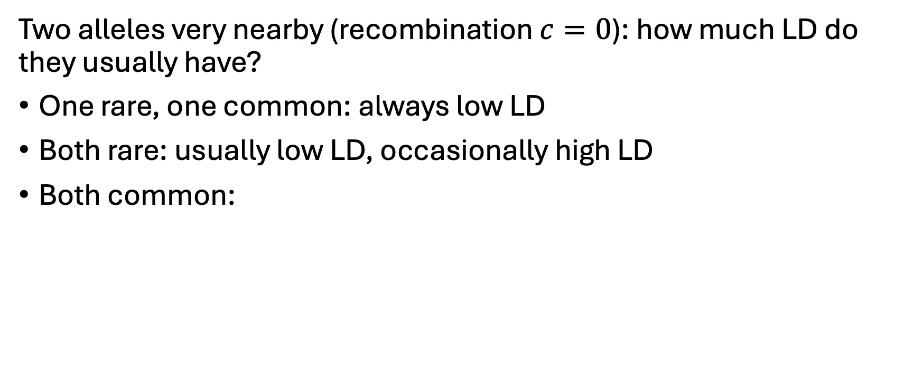
LD and allele frequency
Two alleles very nearby (recombination $c=0$): how much LD do they usually have?
One rare, one common: always low LD
Both rare: usually low LD, occasionally high LD
Both common:

Slide 18
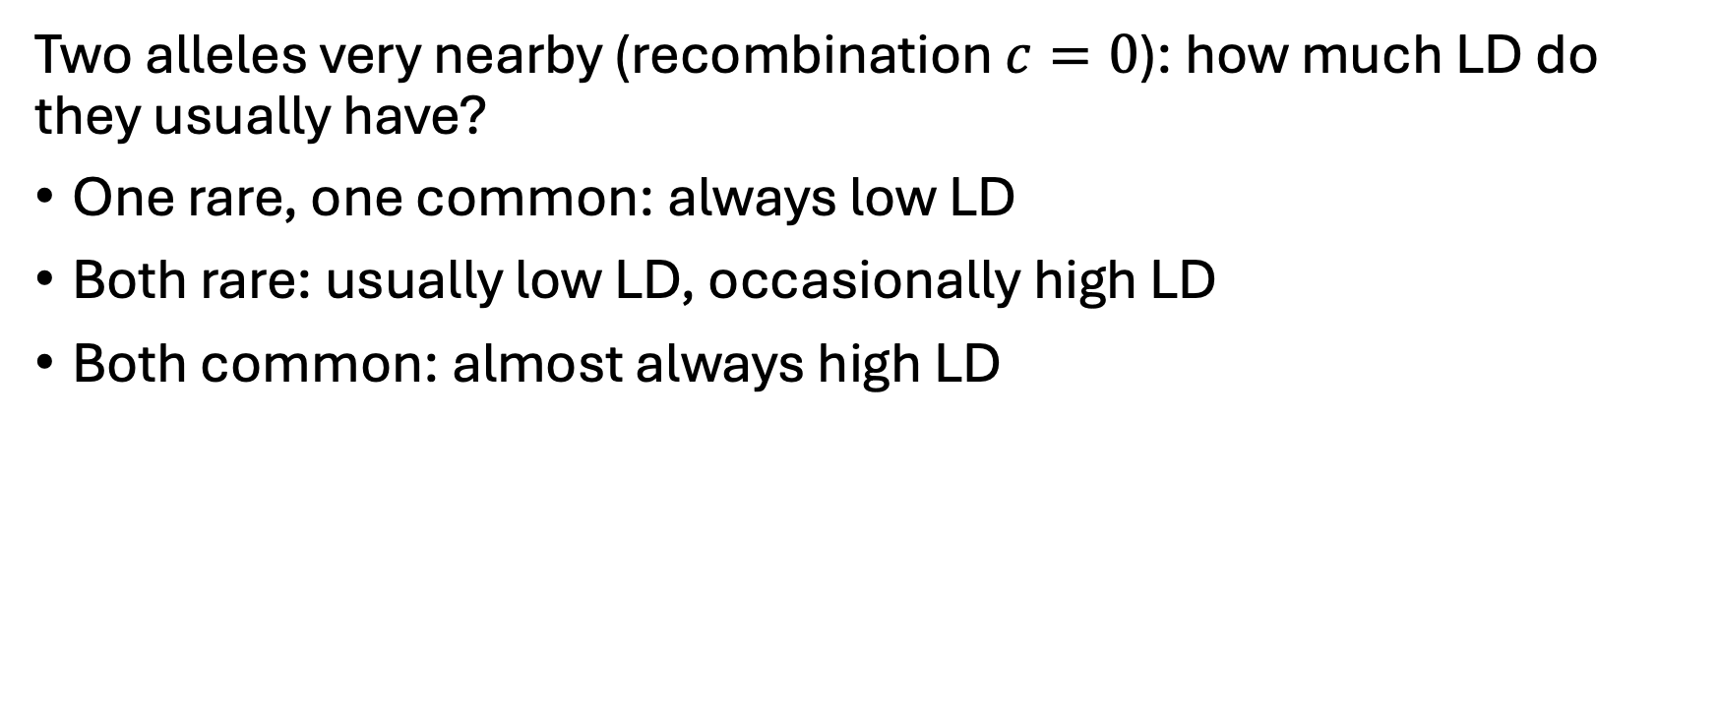
LD and allele frequency
Two alleles very nearby (recombination $c=0$): how much LD do they usually have?
One rare, one common: always low LD
Both rare: usually low LD, occasionally high LD
Both common: almost always high LD

Slide 19
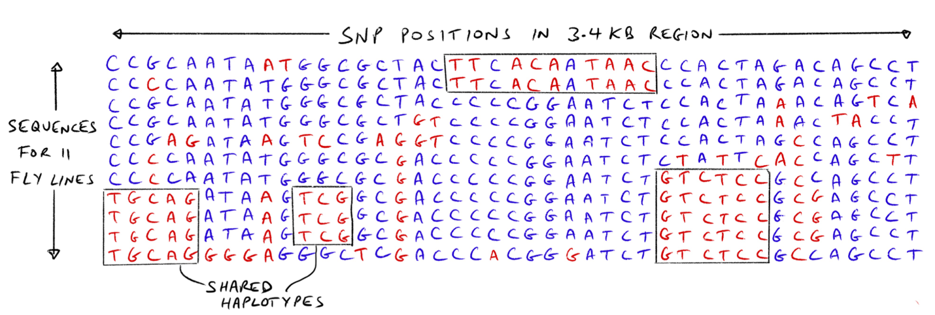
Pritchard 2024; from Kreitman 1983

Slide 20
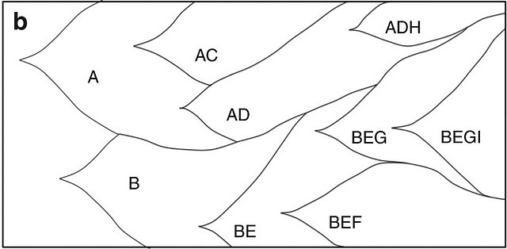
Why are common alleles in high LD?
Peabody et al. 2017

Slide 21
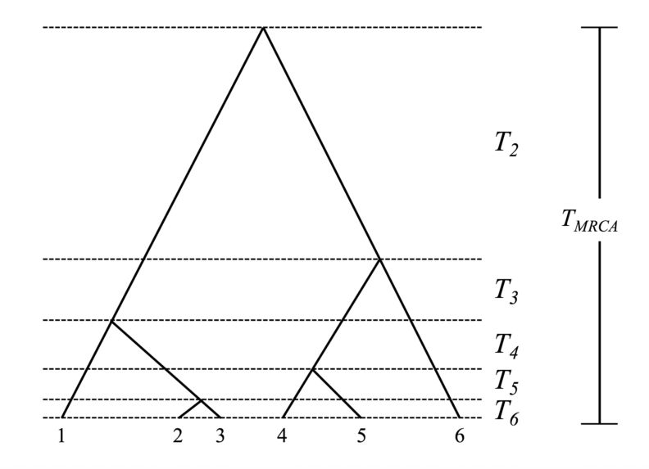
The coalescent

Slide 22
Coalescent perspective on LD
Not many old lineages survive

Slide 23
Coalescent perspective on heterozygosity
Expected coalescence time for two haplotypes ~ heterozygosity

Slide 24
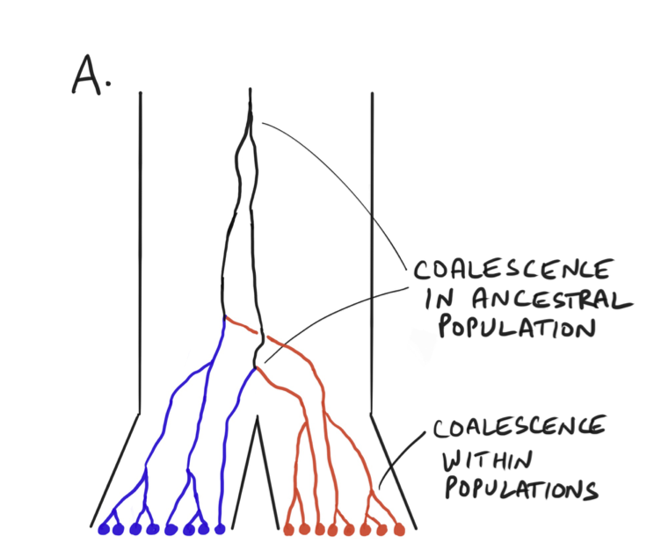
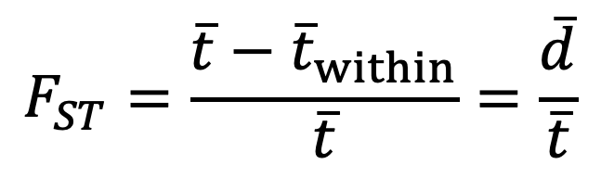
Coalescent perspective on F_{ST}
$$F_{ST}=\frac{\overline{t}−{\overline{t}}_{within}}{\overline{t}}=\frac{\overline{d}}{\overline{t}}$$
d generations ago
Pritchard, 2024

Slide 25
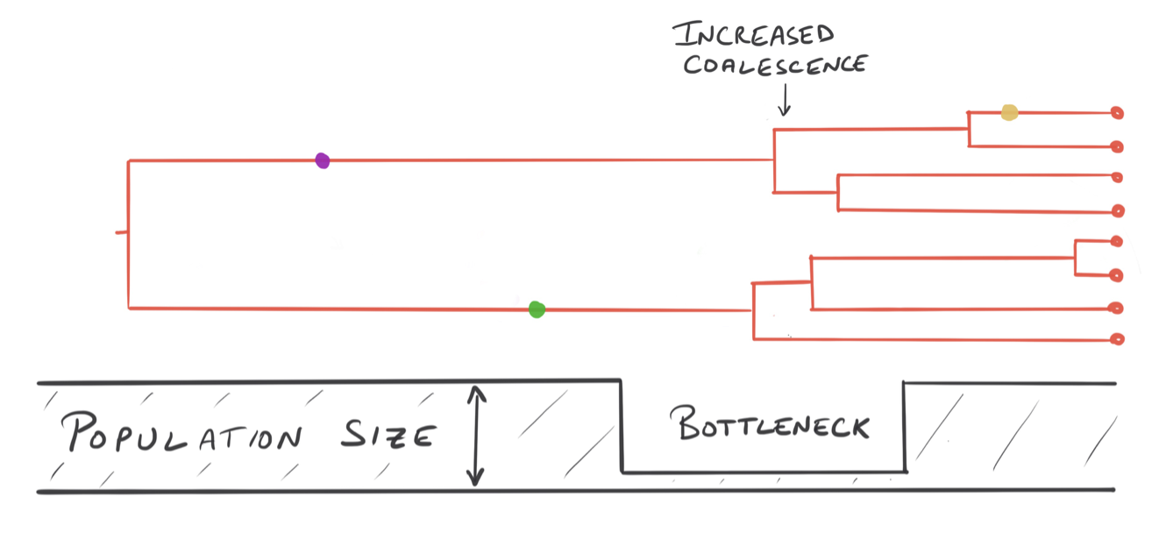
Coalescent perspective on population size
Pritchard, 2024

Slide 26
Coalescent simulation
Forward simulation:
O(N) per generation
O(N) generations until “something happens”
Coalescent simulation:
O(1) per coalescence
O(N) coalescences
However, cannot model selection
msprime and SLiM

