Slide 1
Unit overview
L1: mutation, drift, Wright-Fisher
L2: natural selection I
Today: population structure and demography
L4: linkage and recombination
L5: natural selection II
L6: topic

Slide 2
Today’s agenda
Answers to in-class problem set from last time
Lecture
In class problem set

Slide 3
Mutation
Selection
Drift
Recombination
Migration
Allele frequencies in different groups

Slide 4
Key terminology
Population: individuals being modeled together
Demography: the history of a population
Ancestry: the demography of an individual’s ancestors

Slide 5
Divergence between two populations

Slide 6

Variance follows Pythagorean Theorem
a+b
b
$${\left|\left|a+b\right|\right|}^{2}={\left|\left|a\right|\right|}^{2}+{\left|\left|b\right|\right|}^{2}$$
a

Slide 7

Variance follows Pythagorean Theorem
a+b
b
$${\left|\left|a+b\right|\right|}^{2}={\left|\left|a\right|\right|}^{2}+{\left|\left|b\right|\right|}^{2}$$
a
if $a⋅b=0$

Slide 8


Variance follows Pythagorean Theorem
A+B
B
$$Var\left(A+B\right)=Var\left(A\right)+Var\left(B\right)$$
A
if $Cov\left(A,B\right)=0$

Slide 9

Variance follows Pythagorean Theorem
$$Var\left(A−B\right)=Var\left(A\right)+Var\left(B\right)$$
A
B
A-B

Slide 10
No migration: divergence between two populations = sum of their divergence from source
Source population
Derived population 1
Derived population 2

Slide 11
Source
population
Frequency of allele b
Frequency of allele a

Slide 12
Source
population
Frequency of allele b
Frequency of allele a

Slide 13
Source
population
Frequency of allele b
Frequency of allele a

Slide 14
Source
population
Frequency of allele b
Frequency of allele a

Slide 15
Source
population
Frequency of allele b
Frequency of allele a

Slide 16
Source
population
Frequency of allele b
Frequency of allele a

Slide 17
Source
population
Frequency of allele b
Frequency of allele a

Slide 18
Geometric view
Source
population
Frequency of allele b
Frequency of allele a

Slide 19

Source
population
Derived population
$$Δp$$
Frequency of allele b
Frequency of allele a

Slide 20
Geometric view
$$Δp$$
Frequency of allele b
Frequency of allele a

Slide 21
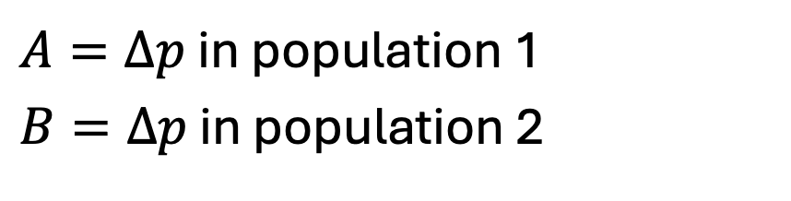
$A=Δp$ in population 1
$B=Δp$ in population 2
Frequency of allele b
Frequency of allele a

Slide 22
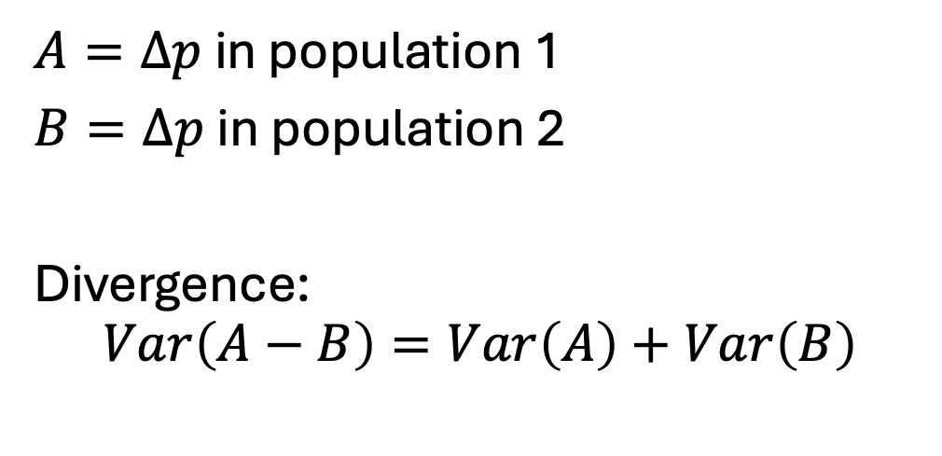



$$A$$
$A=Δp$ in population 1
$B=Δp$ in population 2
Divergence:
$$Var\left(A−B\right)=Var\left(A\right)+Var\left(B\right)$$
$$A−B$$
Frequency of allele b
$$B$$
Frequency of allele a

Slide 23
Understand populations as points in a vector space
Understand divergences as (squared) distances in that space
Understand independence as orthogonality
Frequency of allele b
Frequency of allele a

Slide 24
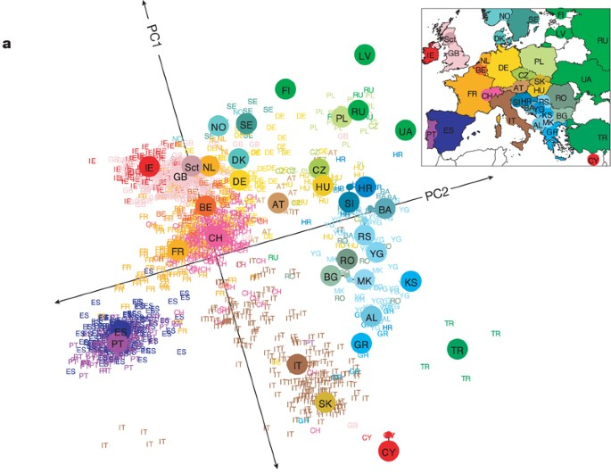
Discrete models are highly unrealistic
Novembre et al., 2008

Slide 25





General model of population structure
Population of samples 1,…,2N
Each sample i has its own genotype, $x_{i}$, and its own frequency, $p_{i}$
$p_{i}$ is a random variable
$$p_{1}$$
$$p_{3}$$
$$p_{4}$$
$$p_{2}$$

Slide 26
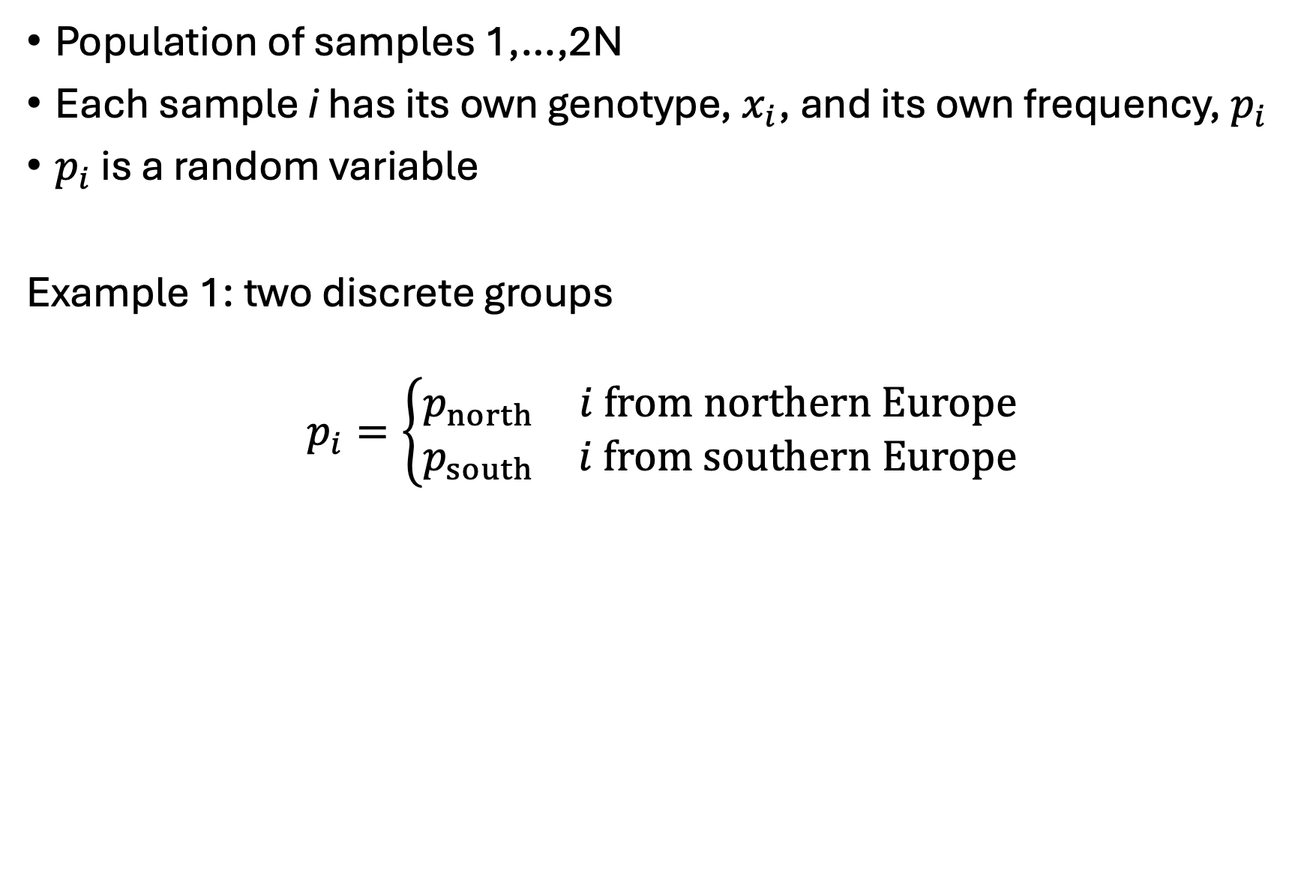
General model of population structure
Population of samples 1,…,2N
Each sample i has its own genotype, $x_{i}$, and its own frequency, $p_{i}$
$p_{i}$ is a random variable
Example 1: two discrete groups
$$p_{i}=\left\{\begin{matrix}p_{north} & i from northern Europe \\ p_{south} & i from southern Europe\end{matrix}\right.$$

Slide 27
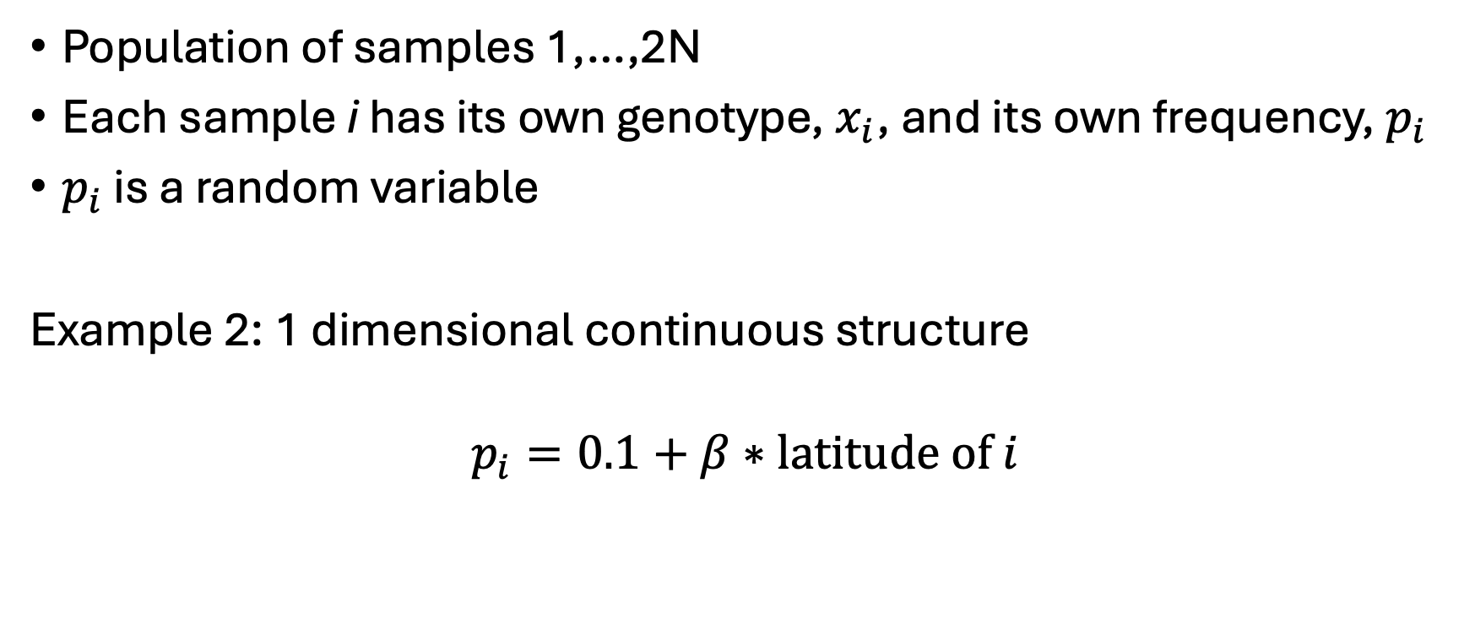
General model of population structure
Population of samples 1,…,2N
Each sample i has its own genotype, $x_{i}$, and its own frequency, $p_{i}$
$p_{i}$ is a random variable
Example 2: 1 dimensional continuous structure
$$p_{i}=0.1+β∗latitude of i$$

Slide 28
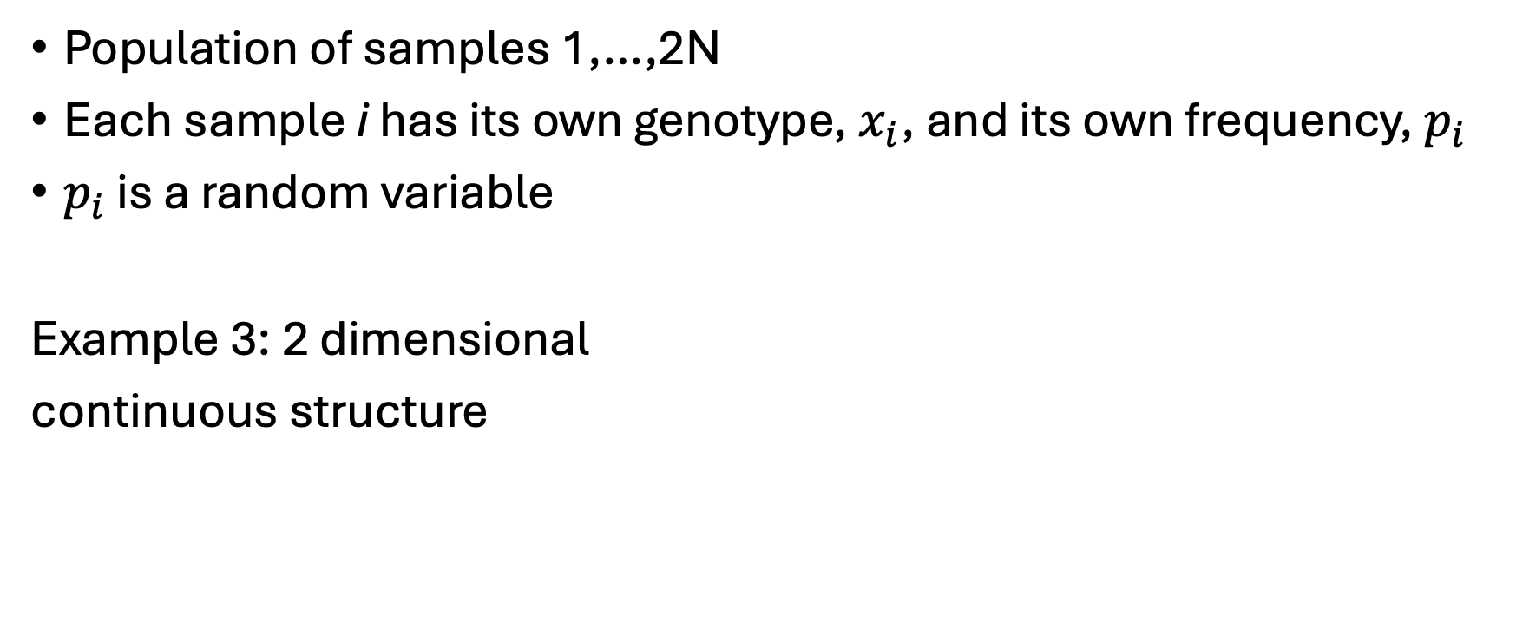
General model of population structure
Population of samples 1,…,2N
Each sample i has its own genotype, $x_{i}$, and its own frequency, $p_{i}$
$p_{i}$ is a random variable
Example 3: 2 dimensional
continuous structure

Slide 29
Fixation index (F_{ST}): divergence normalized by heterozygosity

Slide 30

$F_{ST}=\frac{Var\left(p_{i}\right)}{Var\left(x_{i}\right)}$

Slide 31
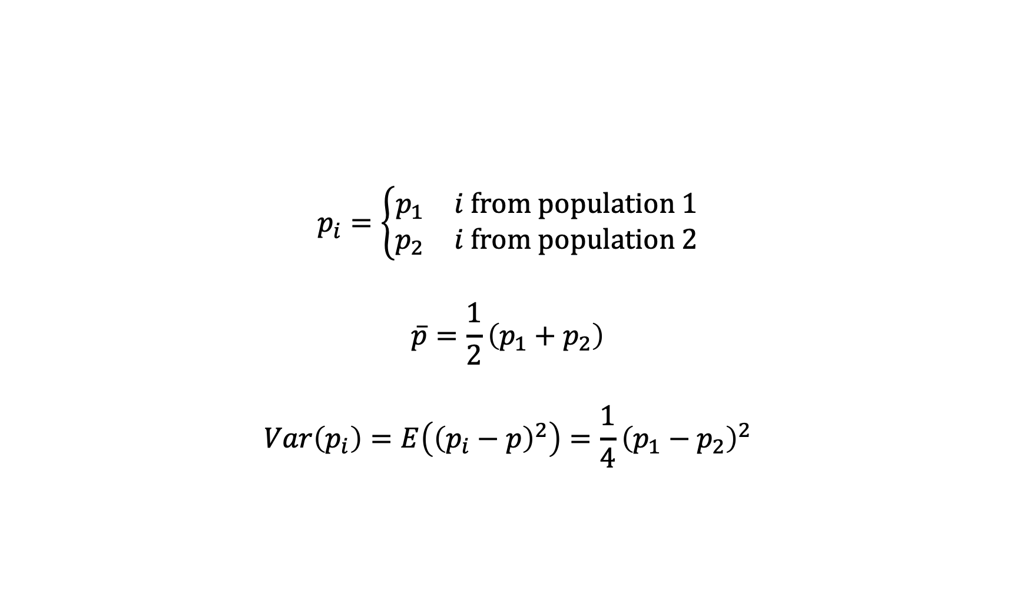
Calculating F_{ST} for a pair of populations
$$p_{i}=\left\{\begin{matrix}p_{1} & i from population 1 \\ p_{2} & i from population 2\end{matrix}\right.$$
$$\overline{p}=\frac{1}{2}\left(p_{1}+p_{2}\right)$$
$$Var\left(p_{i}\right)=E\left({\left(p_{i}−p\right)}^{2}\right)=\frac{1}{4}{\left(p_{1}−p_{2}\right)}^{2}$$

Slide 32
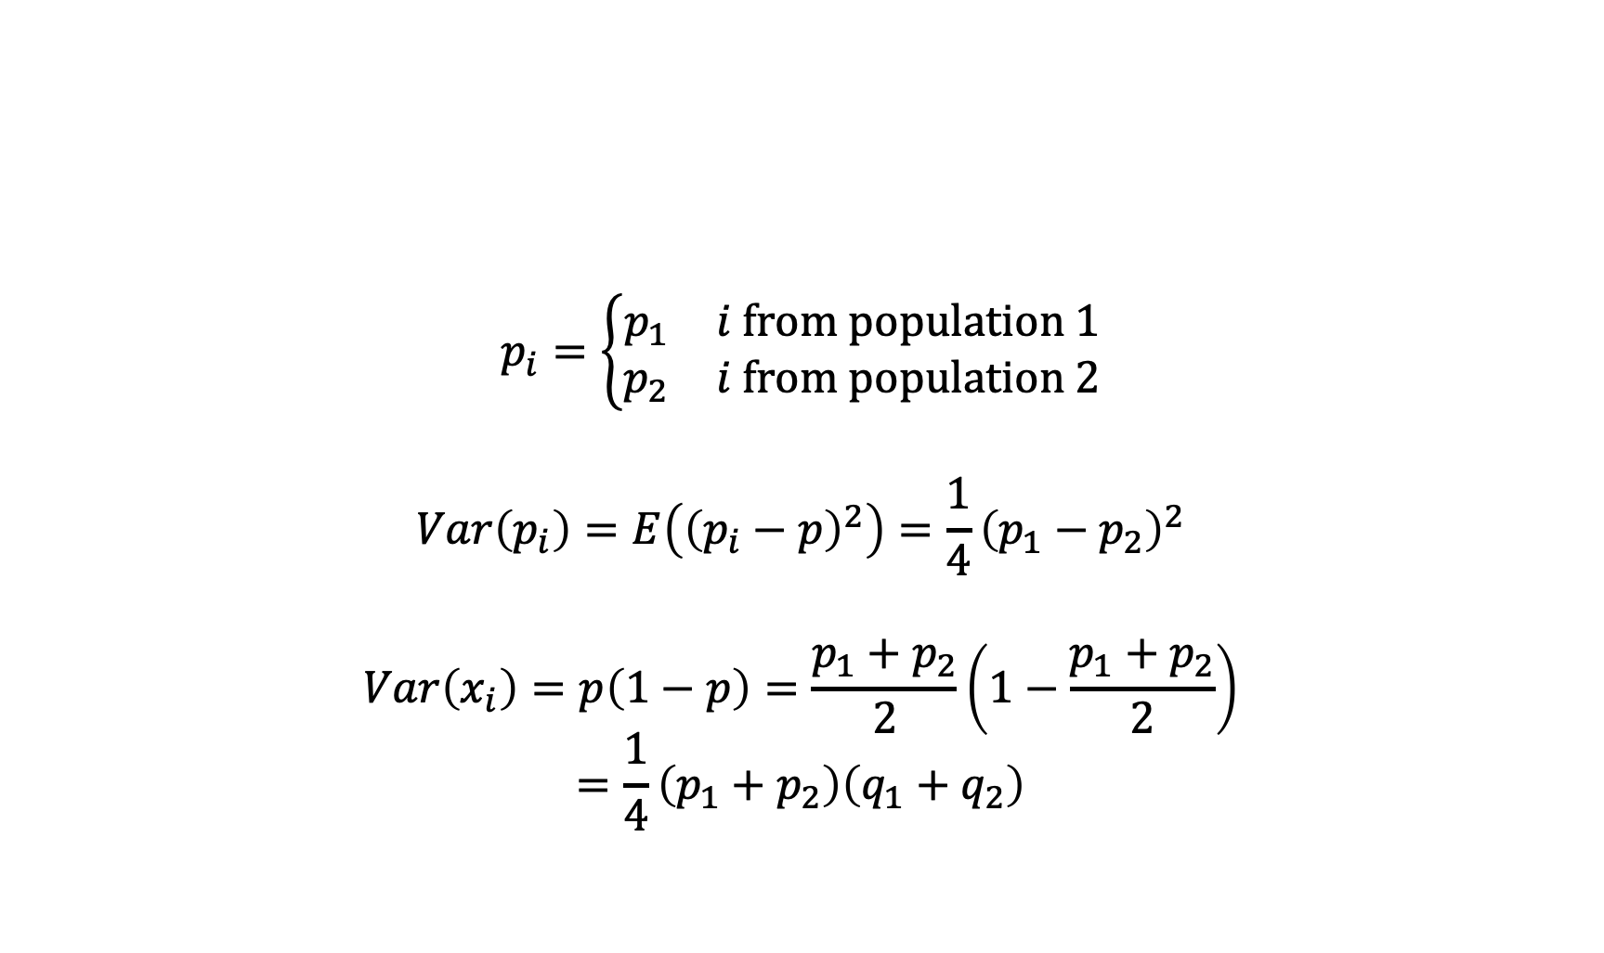
Calculating F_{ST} for a pair of populations
$$p_{i}=\left\{\begin{matrix}p_{1} & i from population 1 \\ p_{2} & i from population 2\end{matrix}\right.$$
$$Var\left(p_{i}\right)=E\left({\left(p_{i}−p\right)}^{2}\right)=\frac{1}{4}{\left(p_{1}−p_{2}\right)}^{2}$$
$$Var\left(x_{i}\right)=p\left(1−p\right)=\frac{p_{1}+p_{2}}{2}\left(1−\frac{p_{1}+p_{2}}{2}\right)$$
$$=\frac{1}{4}\left(p_{1}+p_{2}\right)\left(q_{1}+q_{2}\right)$$

Slide 33
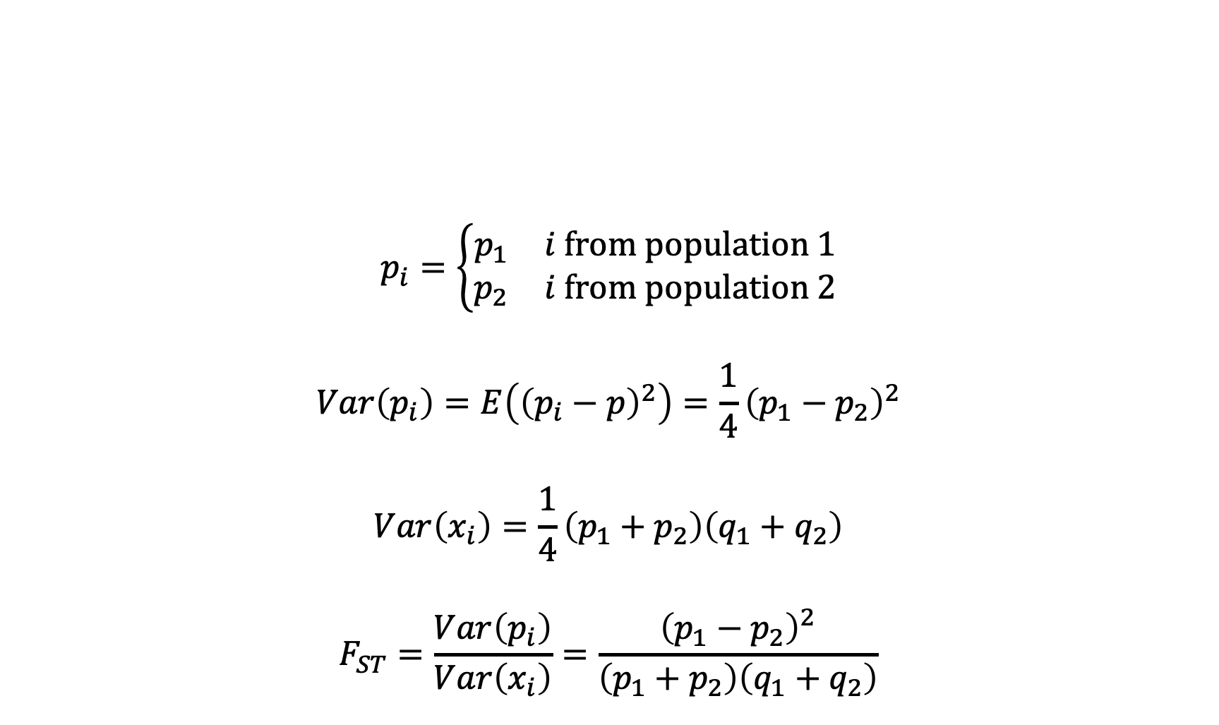
Calculating F_{ST} for a pair of populations
$$p_{i}=\left\{\begin{matrix}p_{1} & i from population 1 \\ p_{2} & i from population 2\end{matrix}\right.$$
$$Var\left(p_{i}\right)=E\left({\left(p_{i}−p\right)}^{2}\right)=\frac{1}{4}{\left(p_{1}−p_{2}\right)}^{2}$$
$$Var\left(x_{i}\right)=\frac{1}{4}\left(p_{1}+p_{2}\right)\left(q_{1}+q_{2}\right)$$
$$F_{ST}=\frac{Var\left(p_{i}\right)}{Var\left(x_{i}\right)}=\frac{{\left(p_{1}−p_{2}\right)}^{2}}{\left(p_{1}+p_{2}\right)\left(q_{1}+q_{2}\right)}$$

Slide 34

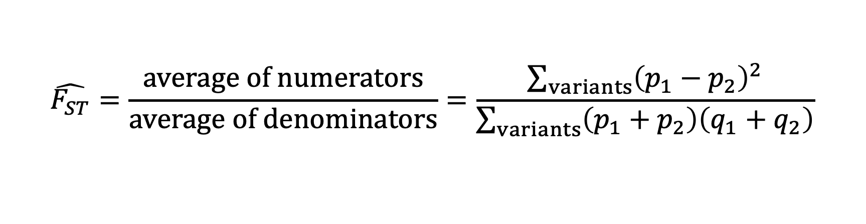
Across multiple sites: “ratio of averages” not “average of ratios”
$$F_{ST}=\frac{Var\left(p_{i}\right)}{Var\left(x_{i}\right)}=\frac{{\left(p_{1}−p_{2}\right)}^{2}}{\left(p_{1}+p_{2}\right)\left(q_{1}+q_{2}\right)}$$
$$\hat{F_{ST}}=\frac{average of numerators}{average of denominators}=\frac{\sum_{variants}{{\left(p_{1}−p_{2}\right)}^{2}}}{\sum_{variants}{\left(p_{1}+p_{2}\right)\left(q_{1}+q_{2}\right)}}$$

Slide 35
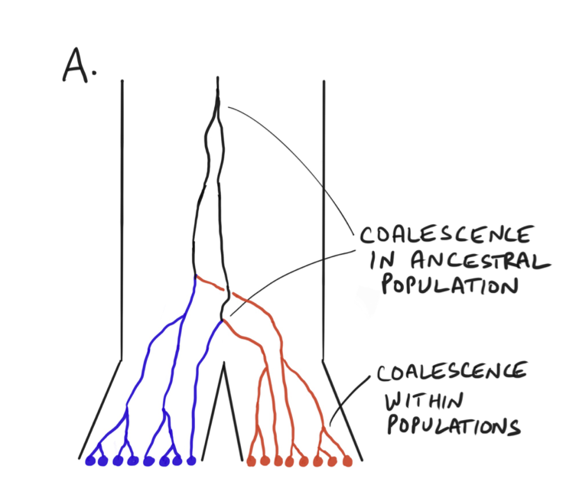
Lecture 4 preview: F_{ST} is a ratio of divergence vs. coalescence times
Pritchard, 2024

Slide 36
Migration: movement of haplotypes between populations

Slide 37
m
1-m

Slide 38

Migration parameterized with a rate matrix
Population 1: sample fraction m from population 2
$$M=\left[\begin{matrix}1−m & m \\ 0 & 1\end{matrix}\right]$$

Slide 39
Migration parameterized with a rate matrix
$$M=\left[\begin{matrix}1−m & m \\ 0 & 1\end{matrix}\right]$$
Population 2: no migration from population 1

Slide 40

Migration parameterized with a rate matrix
$$M=\left[\begin{matrix}1−m & m \\ 0 & 1\end{matrix}\right]$$
$$E\left(p^{\left(t+1\right)}|p^{\left(t\right)}\right)=Mp^{\left(t\right)}$$

Slide 41
With migration: two populations reach “mutation-migration-drift balance”
Derived population 1
Derived population 2

Slide 42
With migration: two populations reach “mutation-migration-drift balance”
Derived population 1
Derived population 2

Slide 43
With migration: two populations reach “mutation-migration-drift balance”
Derived population 1
Derived population 2

Slide 44
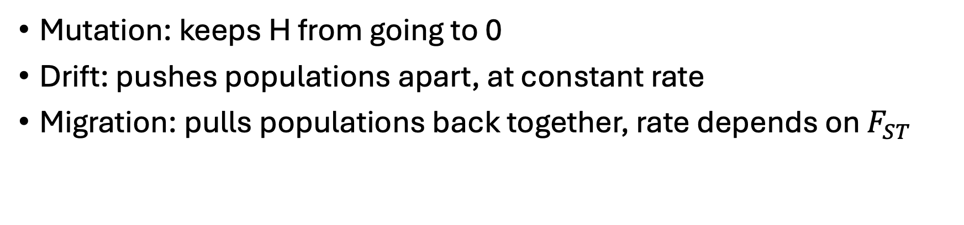
With migration: two populations reach “mutation-migration-drift balance”
Mutation: keeps H from going to 0
Drift: pushes populations apart, at constant rate
Migration: pulls populations back together, rate depends on $F_{ST}$

Slide 45
Estimating population structure with PCA
Novembre et al., 2008

Slide 46
Mean-center genotype matrix X
Standardize columns of X
PCs are top eigenvector(s) of XX’
Make a scatterplot
Avoid overinterpreting it!
Novembre et al., 2008

Slide 47
Caution 1: specific axes are not interpretable
Derived population 1
Derived population 3
Neither PC aligns with any of the three groups, nor their pairwise differences
Derived population 2

Slide 48
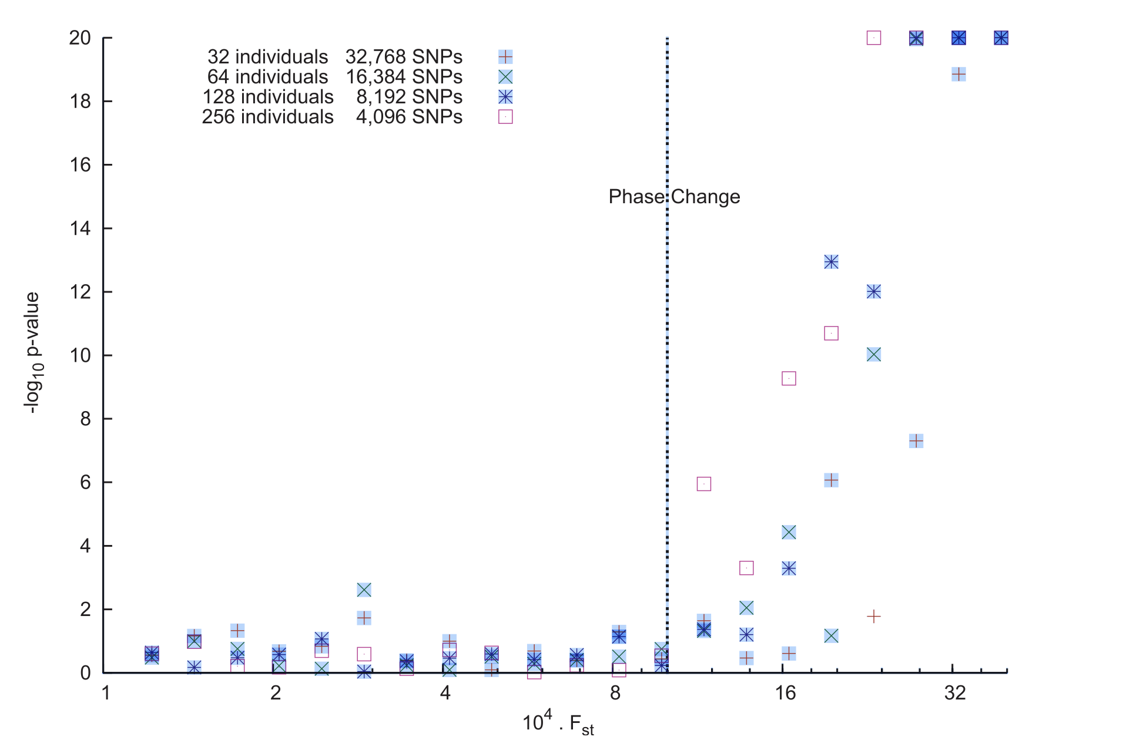
Caution 2: PCs can be total noise, even when structure exists
Patterson et al. 2006

Slide 49
>>cd /local/path/to/repo
>>git pull
>>source bmif201/bin/activate
>>jupyter notebook 03_structure.ipynb

