Slide 1
Adventures in machine learning
Priyanka Raghavan
Steve Hall

Slide 2
Background
One member had just done a course on machine learning (Coursera)
Looked for an opportunity to put this into practice
October 2016: Article in “Leading Edge” magazine on machine learning contest
Geoscience = Data Science + Big Data = machine learning
http://wiki.seg.org/wiki/Facies_classification_using_machine_learning
Challenged readers to build on the naïve solution presented in the article using the code provided in a GitHub repository.
https://github.com/seg/2016-ml-contest/
~40 teams

Slide 3
What was the goal?
Identify facies based on a variety of well data.
Get the best F1 score (a measure of a test’s accuracy).
Learn about basic data science and various machine learning algorithms.
For us, get outside our comfort zones and explore some tools and techniques we don’t encounter in our day-to-day jobs.

Slide 4
What did we have to learn
Machine learning
https://www.coursera.org/learn/machine-learning
Python
Dynamically-typed language emphasizing code readability and brevity.
Widely-considered best language for machine learning
portable, free, mature, more readable, shallower learning curve
scikit-learn machine learning library (http://scikit-learn.org/)
Anaconda
Combination of a Python distribution and package management software.
Jupyter Notebook
Web-based package for creation and sharing of code, equations and visualizations.
GitHub
Git-based version control repository.

Slide 5
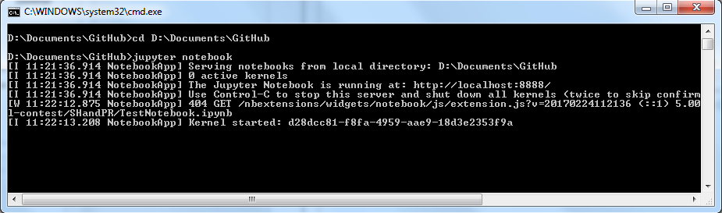
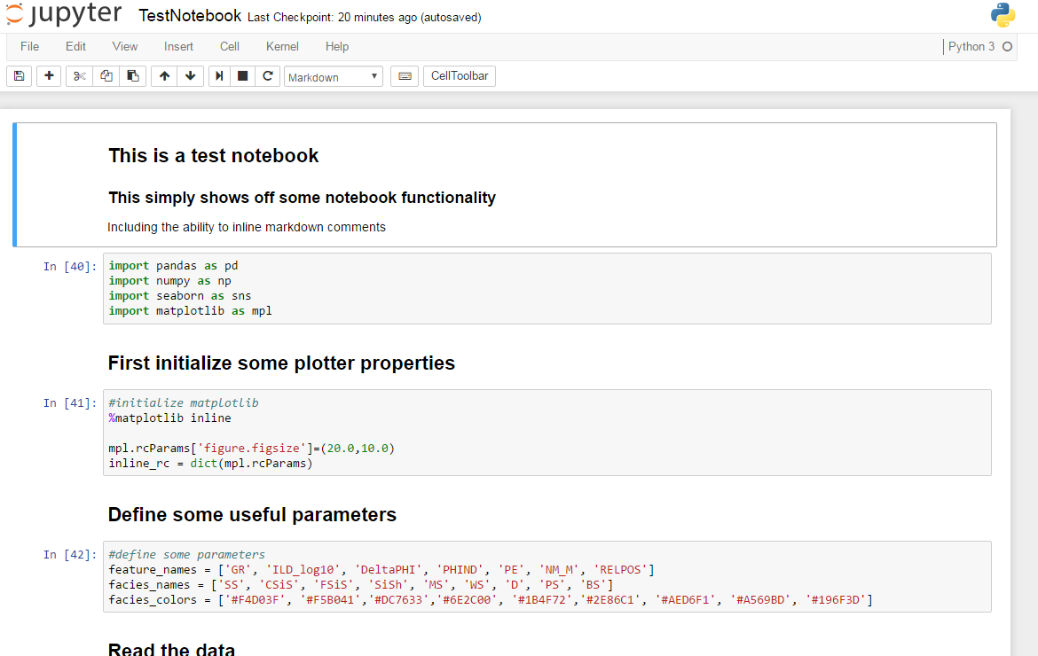
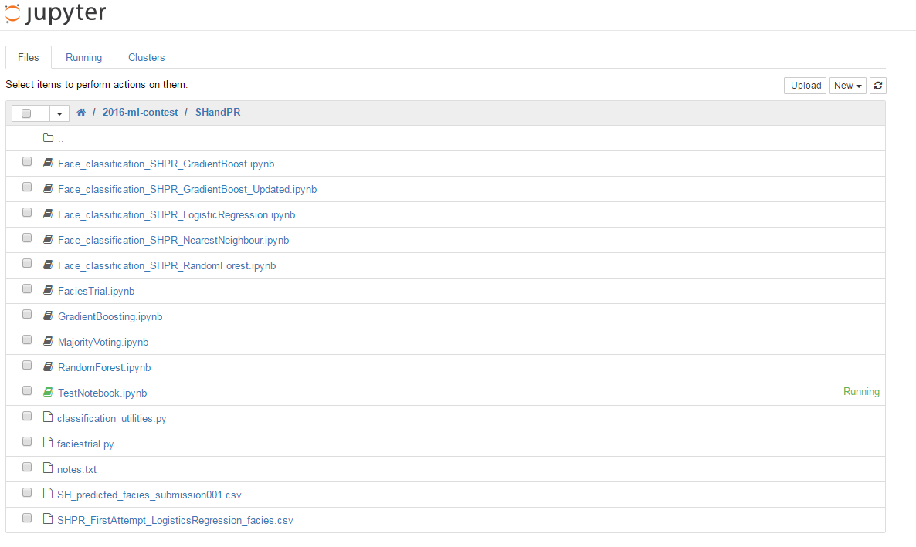
SNAPSHOT of JuPYTER NOTEBOOK

Slide 6
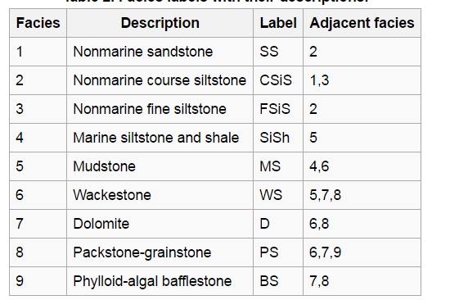
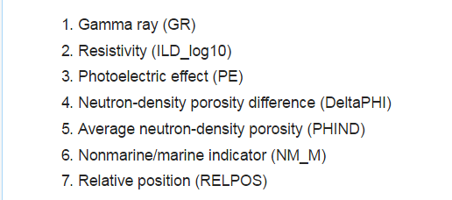
Problem statement
Data set is from University of Kansas Class exercise on the Hugoton and Panoma gas fields
Seven features (five wireline log measurements and two indicator variables) and a facies label at half-foot depth intervals
Train the data set to classify known data correctly, then test the classifier on an “unknown” data set.
Blind wells held back by organizers (not revealed) to finally get an accuracy score (predicting facies correctly)

Slide 7
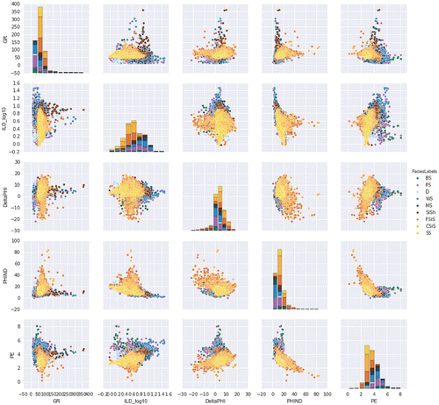
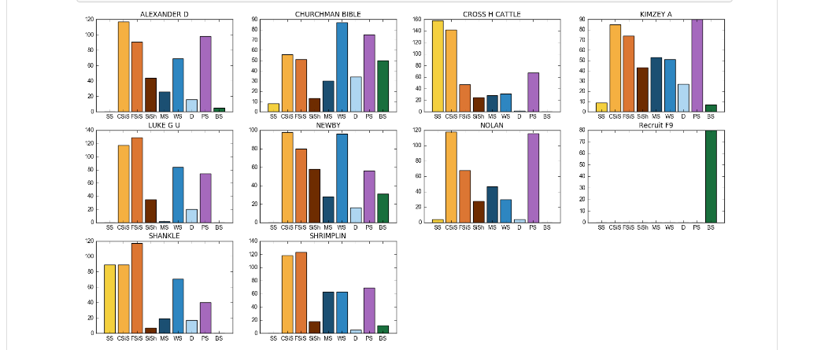
Dataset conditioning
Important step before applying any machine learning algorithm -> TIDY UP THE DATA! (missing data, feature scaling and normalization)
Advantage of Python & Jupyter notebook - able to graph the data relatively simply
Crossplot between various well properties-> seaborn library
Lithological facies per well

Slide 8
What did we attempt?
Algorithms investigated:
Support Vector Machine
Logistical Regression
KNN
Random Forest
Majority Voting
Gradient Boosting
All attempts captured in the following GitHub repository:
https://github.com/oclipa/2016-ml-contest/tree/master/SHandPR

Slide 9
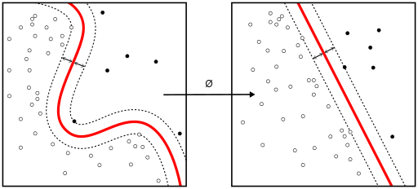
Initial solution: SVM
Support Vector Machines attempt to identify a “hyperplane” along which data can be clearly separated (i.e. classified).
Uses the kernel functions provided by scikit-learn:
http://scikit-learn.org/stable/modules/svm.html#svm-kernels
The initial implementation was provided by the organizers:
https://github.com/seg/2016-ml-contest/blob/master/Facies_classification.ipynb
Tried to modify regularization parameters like C and gamma as described in notebook.
Could not improve on the initially reported result.

Slide 10
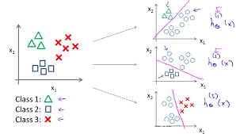
Logistical Regression
Used where the classes to be predicted have a limited or fixed number of discrete values.
Since we have more than two classes (“multiclass”), we used an One vs Rest classifier:
https://github.com/oclipa/2016-ml-contest/blob/master/SHandPR/FaciesTrial.ipynb
Our local tests achieved an F1 value of 0.59 (59%) on data we treated as blind.
The submitted solution achieved an F1 value of 0.484 on the official blind data.
Second lowest in competition! ☹

Slide 11
K Nearest Neighbours
Classifies an object based on a majority vote of its neighbours.
Adjusted parameters based on sklearn documentation.
Training set 60% accuracy only 46% accuracy on our internal blind data.
RANDOM FOREST
Splits the training data into random subsets and models each individually. The final results is a weighted average of the individual results.
Popular approach.
42% accuracy on our internal blind test.
https://github.com/oclipa/2016-ml-contest/blob/master/SHandPR/RandomForest.ipynb

Slide 12
Majority Voting
Compares the results from multiple classifiers and produces a combined result based on how well the classifiers agree with each other.
49% accuracy on our internal blind test.
https://github.com/oclipa/2016-ml-contest/blob/master/SHandPR/MajorityVoting.ipynb
GRADIENT BOOSTING
Iteratively compares the results of multiple classification(decision trees) passes and refines each pass based on where there appear to be weaknesses in the previous pass.
51% accuracy on our internal blind test.
https://github.com/oclipa/2016-ml-contest/blob/master/SHandPR/GradientBoosting.ipynb

Slide 13
Final Entry
In the latest stages of the competition, several teams narrowed in on a strategy initially identified by Paolo Bestagini and subsequently built on by Alan Richardson:
One vs One multiclass strategy using Random Forest
Assumed that there were not abrupt boundaries between facies.
More intelligent of replacement of missing PE values
We took a similar approach, but replaced Random Forest with Gradient Boost
56% accuracy on our internal blind tests; 63% on the official blind data.
1st place! (briefly!)
Finished among top 10 teams
https://github.com/seg/2016-ml-contest/blob/master/SHandPR/Face_classification_SHPR_GradientBoost.ipynb

Slide 14
What did winning team do better? LA Team
Feature extraction based on Paolo Bestagini’s work
Model tuning
Missing values were substituted by mean value of PE in dataset
XGradientBoost classifier (Boosted trees)
Regularization inbuilt to prevent over fitting of data
Parallel processing
Handling missing values and built in cross validation. In Gradient boost, we have to use grid search on test data or cross validation data.
Notes:
Grid search means you have a set of models (which differ from each other in their parameter values, which lie on a grid). What you do is you then train each of the models and evaluate it using cross-validation. You then select the one that performed best.

Slide 15
What can we improve & where next?
Feature selection based on geology
Augmenting of features based on depth done. Perhaps another feature can help in clustering better?
Perhaps “weighting” can be more intelligent. Maybe some features are more important than others
Understand more about GBM parameters
Try neural network algorithm
Notes:
Merge the two slides

Slide 16
LESSONS LEARNt
Random initialization of seed is very important to get good results(Repeat) for clustering algorithms
It is fairly simple to perform and present quite complex scientific functions using Python and Jupyter notebooks.
GitHub provides a good collaboration system, but takes a while to get to grips with (getting out of the TFS mindset).
The GitHub open source community is a good place to experience new languages and tools.

