Slide 1
OCMSystem
Organizational Competitiveness Management System (OCMS)
Manage the competitiveness of:
  the organization and its products;
  the industry.

Slide 2
The problems of the competitive strategy’s formation
Achieving uniqueness of the organization and the product in the market
«Competitive strategy is about being different. It means deliberately choosing a different set of activities to deliver a unique mix of value» (с) M.E.Porter
System approach
The organization’s strategy is based on the system of its’ activities as whole, not any part of it.
Competitive advantage is formed from the system of the organization’s activities as whole.
The competitive value of a particular activity of the organization is inseparable from the whole organizational system.
Organization effectiveness and organization competitiveness are two different things!
Organization effectiveness is the problem of achieving superior values of the effectiveness’ indicators in organization’s particular activities or functions.
Organization competitiveness is the problem of choosing a combination of the organization's activities. The forming of the competitive strategy is the providing high organization’s competitiveness forward looking!

Slide 3
Organizational Competitiveness Management System, OCMS
It is an indispensable assistant to the organization’s Management in:
  the strategy’s and the tactic’s formation for increasing the organization’s and the product’s competitiveness;
  maintaining the competitive advantages of the organization and the product;
  preventing the loss of market share in rapidly changing conditions and during the crisis.
It provides visually and purposefully the opportunity to determine and provide an unique competitive position for organization’s activities.
This Unique mechanism of the quantitative assessment and integrated management of the organization’s and product’s competitiveness – has no analogues in the world!
It provides an opportunity to manage the organization’s competitiveness in all its ongoing activities, meanwhile
  identifying and eliminating «weak points» of the competitiveness;
  reacting urgently on the fast-changing market conditions for avoiding the negative consequences for competitiveness.

Slide 4
1. The purposes OCMS development and implementation
It provides the following reports, as assistance to the management of the organization, to form strategy and tactics of competitiveness management of organization and its products.
Results of a quantitative assessment of organization’s and its products’ competitiveness at all stages of a life cycle, as well as, organization’s business processes;
The list of «weak points» of the organization’s and products’ competitiveness, and analysis of reasons causing such «weak points»;
Risk assessment for the organization’s and products’ competitiveness;
Options of management decisions on improvement of an organization’s and its products’ competitiveness, optimization of competitiveness «weak points».

Slide 5
2. OCMS development and implementation tasks
Defining competitive advantages of the organization and its products, setting the priorities. The process of choosing a standard model;
Quantitative assessment of the products competitiveness at all stages of life cycles with required accuracy, considering the products’ specific features and individual characteristics, as well as individual aspects of any company;
Integrated quantitative assessment of the organization’s competitiveness (taking into consideration the market characteristics, each individual organization’s particular qualities, interlinkages of organization’s business processes , etc.);
The sensitivity analysis (to market changes, internal conditions of organization, etc.);
Identification of «weak points» of the organization’s and its products’ competitiveness;
The analysis of «weak signals» from the organization and the market for identifying potential crises for competitiveness;
Forming reports on organization’s and its products’ competitiveness management.

Slide 6
3. Five accuracy classes of organization and its products
competitiveness assessment
Accu-racy class | Completeness of information about the organization and product, % | Class description | Typical purpose of assessment | Interval of expected accuracy of assessment*
Class 5 | 0 – 2 | The so-called "rough" assessment of competitiveness is accomplished on the basis of a small amount of available information about the company and/or its products. It has low accuracy. | The most generalized score - " better than nothing» | L: от -20% до -50% U: от +30% до +100%
Class 4 | 1 – 15 | Is a transitional assessment between class 5 and class 3. Conceptual assessment. | Conceptual assessment | L: от -15% до -30% U: от +20% до +50%
Class 3 | 10 – 40 | Preliminary assessment of competitiveness. Here is used additional, subsidiary more detailed information about the company and its products | It is used to assess the competitiveness of potential or existing competitors with lack of detailed information about competitors or to assess the competitiveness of a new type of own products at the stage of planning its release | L: от -10% до -20% U: от +10% до +30%
Class 2 | 30 -70 | Is a transitional assessment between class 3 and class 1. Conceptual assessment. | More detailed assessment | L: от -5% до -15% U: от +5% до +20%
Class 1 | 50 -100 | The final, the most accurate assessment of all competitiveness indicators in detail. | The most accurate assessment of the company and its products competitiveness | L: от -3% до -10% U: от +3% до +15%
*L – lower bound of interval, U – upper bound of interval

Slide 7
4. The definition of the standard model of a product/organization
A product standard models is the consumers need and allows you to compare it with real products (for which the competitiveness is estimated)
An organization standard model forms a prototype, that efficiently and successfully functions in a particular market and consistently withstands competition
Product/organization standard models is the basis for the comparison of all product/all organization’s figures and data, involved in the assessment

Slide 8

5. The priority
The priority plays an important role in assessing the organization and products competitiveness. It provides the objectivity of the assessment.
It is necessarily to define for:
all indicators of the organization and its products competitiveness
organization’s business processes
Ways to define the priority:
Different methods of hierarchies analysis
By experts

Slide 9
6. Formulating the assessment and conclusions
on the products competitiveness
Analysis of the company’s external and internal environmental factors, affecting products competitiveness
Defining the list of products
competitiveness parameters
Defining the indicators of products competitiveness
The conclusion on the products competitiveness
Designing measures to improve the products competitiveness,
optimization of "weak" points

Slide 10

7. Forming organizational competitiveness assessment.
Process approach
Objects, resources, information coming from outside or from other companies’ business processes
Business process
Objects, resources, information – the results of this business process, in-coming data to the other organization’s business processes
The out-coming data of the business process (objects, products, information, etc.), in-coming from other organization’s business processes related to this.
Organization’s reports.
Defining business process indicators (cost, technical, organizational, time, etc.))
Forming reports of a business process
Assessment of the partial competitiveness indicators of the business process, its significance
Assessment of the business process competitiveness, its significance in the forming the integrated competitiveness of the organization
Reports on the organization’s competitiveness
Assessment of the generalized measures of the business process competitiveness, its significance

Slide 11
8. Interrelation of the main organiozation’s business processes
with the results of effectiveness and competitiveness assessment
Indicators of the
business process А competitiveness
Business process А –
Financial reporting/management reports
Indicators of the
business process B competitiveness
Business process В – The analysis of economic effectiveness
Performance indicators of the organization’s business processes
Business process С – Organizational Competitiveness Management
Forming the competitiveness reports
(management reports).
Conclusions on competitiveness
Quantitative defining of the competitiveness indicators at all levels, its significance and interrelationships
The analysis of the
competitiveness sensitivity
Forming the competitiveness indicators list
The options of management decisions for the regulation of the competitiveness

Slide 12
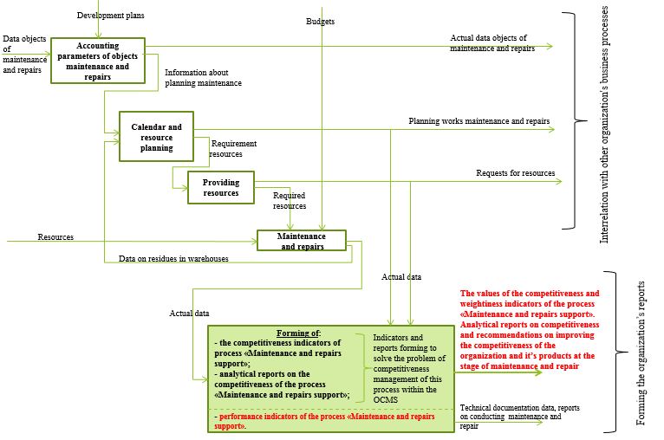
9. Example. Forming conclusions and assessment of the
competitiveness of the business process "Maintenance and repairs support»

Slide 13
10. State regulation of the industry’s competitiveness
The principles of assessment and management of the organization’s and product’s competitiveness, formed in OCMSystem, allow to improve the state regulation mechanisms of the competitiveness of the industry’s organizations and the industry as a whole.
Using these principles, the state regulation of the competitiveness of industry’s organizations and the industry as a whole should be carried out in the following directions:
Improvement of the state regulation system, ensuring the increasing of competitiveness of industry’s organizations and the industry as a whole;
Forming the system of indicators of competitiveness of industry’s organizations and the industry as a whole, taking into account the current challenges of the market;

Slide 14
10. State regulation of the industry’s competitiveness. Continuation
Improvement of the forecasting methodology of the competitiveness of the industry’s organizations and the industry as a whole;
Creating the legislative advantages of regulating the competitiveness of the industry’s organizations and the industry as a whole;
Development of a system of state protectionism and regulation of the country's transition to an innovative way of development and competitiveness of the country.

Slide 15
11. Implementation
Our mechanism of the quantitative assessment of the organization’s and its product’s competitiveness was used for:
Ministry of Industry and Energy of the Russian Federation: in the research work «The Industrial policy development of the Russian Federation for the period up to 2015»;
JSC «TSK FPG Oboronmetkhimprom» - the military-industrial enterprise: the economic research work titled «Development of methods of prices forming and updating for the product “Circuit breaker VA series” which was undertaken in the short term in conditions of uncertainty»;
JSC «Novo-Vyatka» - mechanical plant, Kirov city: the development of the programme of boosting the organization’s competitiveness and its products competitiveness;
OJSC «All-Russian Research Institute for Nuclear Power Plants Operation» (OJSC VNIIAES): Quantitative assessment of the competitiveness of the project VVER-TOI NPP was held in the as a part of the development of the economic model of all stages of the life cycle of VVER-TOI NPP in JSC VNIIAES, 2010-2012.

Slide 16
12. Author’s profile
Ivankova Marina Aleksandrovna
Education:
PhD in economics. FSAEI HE «Russian University of Peoples’ Friendship» (RUDN). Faculty of economics.
Master of engineering and technology. «Computer Science and Engineering». FSFEI HE MSTU «Stankin», Information Technology faculty.
Mathematical education. SAEI «School №91» (former Experimental school-gymnasium №91 REA). Math class.
Contacts:
Web-site: https://ocmsystem.github.io/
E-mail: i-0505@yandex.ru

Slide 17
Thank you for your attention!
We are open to productive cooperation!

