Slide 1
The Analysis of Russian Construction Dry Mix Market
Author: Marina A. Ivankova

Slide 2
Purpose, objectives and object of Research
Research purpose:
Analysis of Russian Construction Dry Mix Market (hereinafter: Market)
Research objectives:
1. Аnalysis of Market dynamics in 2013-2017 in kind and in value tirms;
2. Analysis of Market’s key enter barriers;
3. High-level analysis of Market’s existing distribution model.
Object of the Research:
Modified Construction Dry Mix

Slide 3
What is Construction Dry Mix?
Construction Dry Mix (CDM) is a wide category of materials, which:
contain several components - binders, fillers and various additives modifying the properties;
are intended for different types of construction installation works;
are made at the plant and delivered ready for use to construction sites in special packaging;
appeared on the Russian market in the 1990s. Currently, they are an integral part of the modern construction.

Slide 4
Advantages of СDM
Construction dry mix can be transported simple container, stirred automatically, pumped and applied by machine, thus making work efficiency to 500-600%. Stirring and applying by machine also ensures mortar can be processed and used correctly, avoiding water added too less or much, or other potential mistakes during formulation or inexperienced workers. It can make quality stable and durability longer.
Construction dry mix helps the improvement of industrial structure, modernizes the construction industry, reduces cement waste and project cost.
Construction dry mix as a thermal insulation and environmental friendly material, can contribute to energy saving and emission reduction, which should be promoted on large scale.
Dry mix products provide excellent technical properties to meet the stringent performance requirements which are common in the current construction scenario. The use of dry mix mortar products will be cost effective by reducing the potential construction problems with long-term integrity of structures with a simple materials approach.

Slide 5
Major CDM Manufacturers on Russian market. Market shares
CDM Market shares of manufacturers, which were in Russia in 2015, are shown in kind in Table 1.
Table 1 – CDM Market shares, Russia, 2015
Manufacturer’s name | Market share, %
Knauf | 14.9
UNIS | 8.2
Volma | 6.3
Ceresit | 5.5
Bergauf | 4.9
Starateli | 4.4
Gerkules | 3.3
Weber-Vetonit | 3.2
Оsnovit | 3.0
Кreps | 2.0
Gipsopolimer | 2.0
ЕК | 1.8
Plitonit | 1.3
Forman | 1.3
Others | 37.8

Slide 6
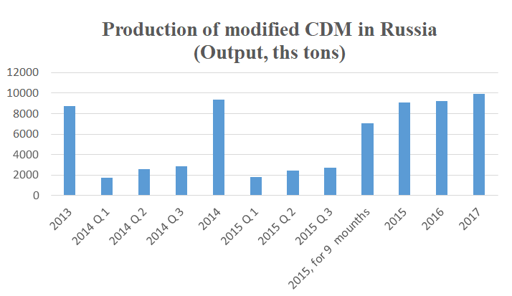
Market dynamics in 2013-2017. Developement of production
The growth of output of CDM is far exceed the growth of output of other construction materials, included concrete, cement and brick.

Slide 7
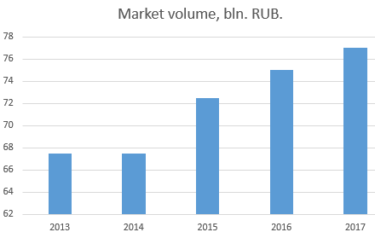
Market dynamics in 2013-2017. Supply, Market’s volume
The volume of CDM, which is supplied to the Market, is equal to the sum of CDM stock balances at beginning of the year and CDM, which was made and brought to Russia during the year.
In 2013-2017 the supply of CDM in Russia increased by 59.6 per cent: from 7.41 mln tons to 11.83 mln tons. The supply dynamics followed the demand dynamics: the supply was increasing annually, except 2016. The maximum growth rate of the indicator was in 2014 - 25.1% on 2013.
Table 2 - Supply of Construction Dry Mix, Russia, 2013-2017
Source: BusinesStat
Parameter | 2013 | 2014 | 2015 | 2016 | 2017
Supply, ths tons | 7,408.95 | 9,268.14 | 11,015.54 | 10,450.18 | 11,825.70
Dynamics, % to previous year | - | 25.1 | 18.9 | -5.1 | 13.2

Slide 8
CDM Market in 2013-2017
In Russia in 2016 the largest volume of CDM production fallen on construction mortars again - their production amounted to 6,203 ths tons with a Market share of 74.7 per cent.
In January-October 2017 the average selling prices of manufacturers for coating, putty, mastic were about 23,975.1 rub./ ton. This indicator is 8.1 per cent, or 1,786.3 rub./ ton, is higher, than the same period of the previous year.
In 2013-2016 the average producer prices for Russian consumers for concrete mixtures increased by 2.3 per cent - from 3,751.3 rub./m³ to 3,836.8 rub./m³.
The highest producer prices were in Siberian Federal District (on 41.9% higher, than the Russia national average). The lowest prices were observed in South Federal District (on -63.9 % lower, than the Russia national average).
In 2016 the volume of Russian exports of mortar and concrete increased by 91 per cent (to 6.7 ths.tons) to the previous year. It was amounted to USD 1,293.5 ths. in value terms.
In 2016 the main countries-suppliers of mortar and concrete in Russia were: South Africa 4,240 tons (+100 % to the previous year), Estonia 3,880 tons, Lithuania 3,744 tons (+14 %) and USA 3,702 tons.

Slide 9
Market’s key enter barriers
High-level competition. Currently, CDM are produced by 250-300 companies, which "occupied" at least 80 % of the Market. More than a half of all production is accounted for by recognized leaders. Regional companies continue to serve the small areas of sales.
Sluggishness in application of CDM’s brands. Construction companies are the main consumers of Construction Dry Mix. Construction is the field, where the most important decision making factor on purchasing the service is reliability. This factor constrains changes in the Market considerably, because builders tend to use these or those mixes and are afraid to change the used brand or brands, when the current brand has an appropriate quality. You can not expect a quick effect: Market is very inert and getting used to a new product will be very long.

Slide 10
Overcoming the Market entrance barriers
Overcoming the barrier of High-level competition. It is difficult to compete with reputable manufacturers of CDM, but it is possible by applying an effective strategy. For example, price competition strategy. You can find your Market share, considering the local conditions of the CDM’s consumption.
Overcoming the barrier of Sluggishness. It is possible in two ways: persuasion by word (well-written advertising texts) and persuasion by deed (direct demonstration of product advantages).

Slide 11
Market distribution model. Choosing the promotion method
Choosing the promotion method is determined by the following factors:
  Number of consumers and their size (volumes of consumption)
  The main channels for obtaining the product information
  Key factors in making product decisions
The main channels for builders to obtain the product information (in descending order of their importance):
  Own experience with DCM (more than 50%)
  Personal connections with colleagues (about 20-30%)
  Product suppliers (10-15%)
  Informational articles in press (5-10%)
Builders decide to purchase a mixture of new brands, typically, if :
      there is no possibility of purchasing a mixture of reputable brands, but it is necessary to purchase it urgently;
      the new brand was recommended by a trusted supplier or another builder (more than 50% of cases);
      the builder want to try CDM of a new brand (there are more than 10-15% of potential innovators among builders)

Slide 12
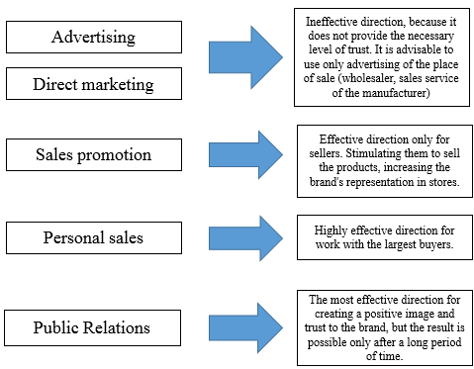
Market distribution model. Promotion directions
To promotion the CDM products on the Market, it is useful to work in the directions, which are shown on Figure 1.
Figure 1 – Promotion directions

Slide 13
Conclusions
The main conclusions can be formulated in the following range:
Analysis of Russian Construction Dry Mix Market in 2013-2017 shows, that this Market is a perspective, ever-growing, and, therefore, all new players will be appearing here - both Russian and foreign.
For successful entering the CDM Market, it is not enough to make a good product. It is necessary to know how to promote it properly.
The barrier of high-level competition is overcoming by developing an effective strategy, considering local Market conditions.
The barrier of sluggishness is overcoming in two ways: persuasion by word and persuasion by deed.
Product promotion is significantly different from the promotion of consumer goods: it is more expedient to shift the emphasis to personal sales, considering the importance of Public Relations.
Promotional activities should be carried out in two ways: increasing the popularity of the product and overcoming the barriers of high competition and sluggishness.

