Slide 1
Russian market of ECG devices (hereinafter: Market)
Marina A. Ivankova

Slide 2
Market Dynamics
2015: domestic production of medical devices in Russia grew by about 10%
2016: the manufacturers’ capacity was 15.5 thousand pieces. There was a positive trend in the volume of production potential: the capacity volume, which was allocated to the production of this product in Russia, increased by 0.4% and accounted to 15.6 thousand pieces. The capacity level of manufacturers was about 41.4% at the end of the year. This indicator increased by 64.77%, compared with the previous period.
2017: the production volume of ECG devices accounted for 6.5 thousand pieces. The lead manufacturer was Volga Federal District. It’s Market share was 82.1% of all manufactured products, which in quantitative terms was 5.3 thousand pieces.
2018: Market volume accounted for 12,660 pcs of ECG devices in kind (10,046 pcs of them were produced in Russia).

Slide 3
Main manufacturers
According to the data for April 2018, about 400 companies are engaged in the production of medical devices in Russia. Main manufacturers are:
Аltonika Ltd,
CJSC «INKART»,
«Monitor» Ltd.,
«Neurosoft» Ltd,
«Medical Computer System» Ltd ,
CJSC «Meditek»
The main Market leaders are CJSC «Izhevsk plant «Axion-holding»» and «Monitor» Ltd. They produce more than 60% of a total production.

Slide 4
Producer Prices, 2018
The average annual Producers’ price of ECG devices was 38.2 thousand rubles/pcs.
In December, Producer prices were estimated at 40.2 thousand rubles/pcs. They decreased by 2.6% relative to June; and increased by 2.28% compared to January.
According to the results of the year, the highest selling prices of ECG devices were recorded in November (46.5 thousand rubles/pcs), the lowest prices were in March (31.3 thousand rubles/pcs).

Slide 5
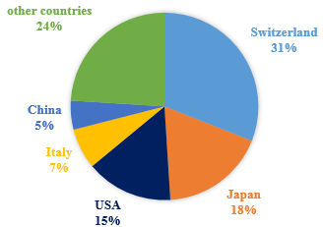
Import of ECG devices
In 2011, Russia’s imports of ECG devices, including accessories and supplies, amounted to $ 17.8 million from 20 countries. The import's volume in value terms increased by 15% compared with 2010.
The structure of Russia’s import of ECG devices in 2011 is shown in Figure 1.
Figure 1. Import of ECG devices in Russia
In 2018, 4,358 pieces of ECG devices were imported in Russia. Most of all, in kind, ECG devices were imported from SCHILLER AG – 842 pcs. or 19.3% of total imports in this year

Slide 6
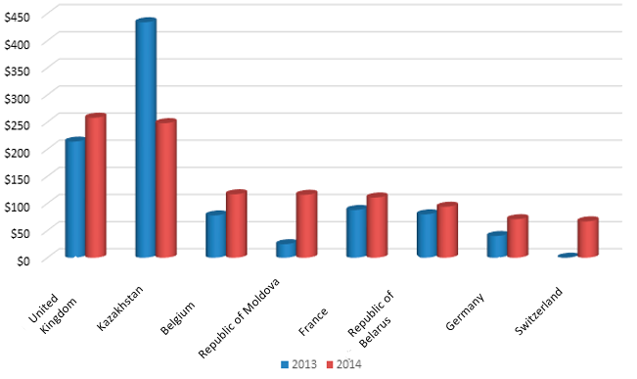
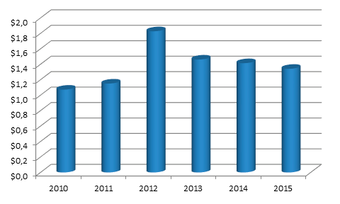
Export of ECG devices (2014-2015)
The main importers of Russian production are: United Kingdom, Kazakhstan, Belgium, Republic of Moldova, France, Republic of Belarus (see Figure 2). The top 10 importers of Russian ECG devices account for more than 89% of Russia’s exports. The main importer of Russian products is the United Kingdom, which accounts for 19% of domestic ECG devices' export .
The largest increase in Russia’s exports in 2015 compared to 2014 was recorded in the Republic of Moldova (+ 364%). The largest decline in supplies among the main importers of Russian ECG devices was recorded in Kazakhstan (-43%).
The export dynamics of Russian ECG devices in 2010-2015 is presented in figure 3.
Figure 2. Export geography of Russian ECG devices for 2010-2015 (thousand US dollars)
Figure 3. Dynamics of export of Russian ECG devices for 2010-2015 (million US dollars)

Slide 7
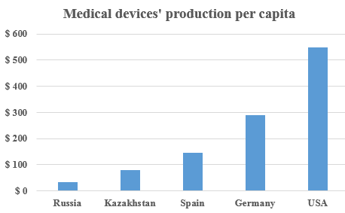
Prospects for entering the Market
Providing the population with medical products in Russia. Comparison with other countries

Slide 8
Prospects for Market entry
In 2016, the Compulsory Medical Insurance (CMI) system can celebrate the anniversary — it is ten years since the government began to update the fleet of medical equipment in public hospitals and clinics. Firstly, in 2006-2010, this updating was conducted within the national project "Zdoroviye" ("Health"), which budget was more than 400 billion rubles; then – within the programme of transition to insurance principles in CMI (2010-2013).
In 2016, almost a quarter of the medical equipment, which were operated in public hospitals and clinics and mostly updated since 2006 as a part of the national project, expired. Neither the Federal budget, nor the Federal Compulsory Medical Insurance Fund had funds for a large-scale renewal of the medical equipment fleet, as in 2006-2010 and 2011-2012.
According to assessment of the "Cardiology" direction of Philips, The service life of such medical equipment does not exceed seven to eight years on average.
According to the assessment of the marketing company "Meditex", the medical equipment share, which useful life was released before the end of 2016, is about 20%. According to the state Research Institute of the health organization, the volume of such equipment is even more — up to 40%.

Slide 9
Market Development
In July 2016, Russian government allocated 15 billion rubles for the development of import substitution in medicine.
In 2014–2018, the government budget expenditures for supporting the medical industry exceeded 21 billion rubles. Industrial Development Fund allocated 2.8 billion rubles more for the industry’s development.

Slide 10
Deterrents of Market development
Registration's delaying of new medical devices, which were developed as part of R&D, when they enter the Market.
Risks of non-compliance with some provisions of rules for granting subsidies by the Ministry of Industry and Trade of Russia
Risks of the failure of meeting deadlines or delay the implementation of the import substitution action plan in the medical industry.
Risks of “formation by the Ministry of Industry and Trade of Russia of unreliable official statistical information” due to the manufacturers’ low discipline.

Slide 11
Forecasts of Market development
In 2018, in order to ensure further industry’s growth, the Ministry of industry and trade of the Russian Federation developed a draft Strategy for the development of the Russian medical industry until 2030. The main objectives of the Strategy are declared the following range:
the increasing of the production of Russian medical products by 3.5 times by 2030;
a tenfold export’s increasing and the registration of at least 100 new Russian-made medical products annually, starting in 2019.
As a measures of industry's supporting until 2030 proposed the following range:
Organizing of clusters, industrial parks, technoparks for consolidation the efforts of small and medium-sized businesses .
Providing state support for development and production of essential types of medical products, their promotion and commercialization.
Accelerating the registration procedure and the launching of the medical products in the Market, in order to achieve the registration of at least 100 units of products per year by 2030.
Abolition zero VAT rate for medical products, in order to level the price competitiveness of domestic medical products, which are made of taxable imported components.
Motivating the foreign business to localize not only production, but also engineering centers, by tax incentives and preferences.
Stimulating the consumption of domestic medical products by: increasing the contractors’ responsibility and forming of requirements specification for tenders "to ensure equality of Russian and foreign players".
Transition to centralized procurement of leasing services, involving the supply of equipment and its maintenance for up to 6 years.

Slide 12
References
http://кардиографы.рф/impex-rus.html
https://publishernews.ru/PressRelease/PressReleaseShow.asp?id=707503
http://www.rusexporter.ru/research/demand/detail/4175/
https://tebiz.ru/mi/rynok-apparatov-ekg-v-rossii
https://www.inkwoodresearch.com/reports/europe-ecg-equipment-market/
https://razvitie.expert/okpd/26.60.12.111

