Slide 1

BSD Router Project diagrams

Slide 2
192.168.12.0/24
2001:db8:12::/64
Router 1
Router 2
192.168.20.0/24
2001:db8:20::/64
Loopback 2
192.168.13.0/24
2001:db8:13::/64
192.168.40.0/24
2001:db8:40::/64
loopback 4
192.168.34.0/24
2001:db8:34::/64
Router 4
Router 3
Admin vlan
Routed vlans
RIP and RIPng domain
EBGP domain
OSPF v2/v3 domain
10.0.0.0/24
TAP,vlan 0
Admin workstation (qemu host)

Slide 3
Router 1
192.168.12.0/24
2001:db8:12::/64
Router 2
192.168.20.0/24
2001:db8:20::/64
Loopback 2
192.168.13.0/24
2001:db8:13::/64
192.168.40.0/24
2001:db8:40::/64
loopback 1
RIP and RIPng domain
EBGP domain
OSPF v2/v3 domain
192.168.34.0/24
2001:db8:34::/64
Router 4
Router 3

Slide 4
Router 1
192.168.12.0/24
2001:db8:12::/64
Router 2
em0: .1
em0: .2
192.168.20.0/24
2001:db8:20::/64
Loopback 1
em1: .1
192.168.13.0/24
2001:db8:13::/64
192.168.40.0/24
2001:db8:40::/64
loopback 1
RIP and RIPng domain
EBGP domain
OSPF v2/v3 domain
em0: .3
192.168.34.0/24
2001:db8:34::/64
em2 : .4
em2 :.3
Router 4
Router 3

Slide 5
R1
em3: . 1
192.168.10.0/24
em3: . 2
em3: . 3
ucarp3: .254
R2
R3
em4: . 2
ucarp4: .254
em4: . 3
10.0.0.0/24
em4: . 4
R4

Slide 6


R5
R6
R2
(RR)
AS64512
AS65535
R1
R3
R4
R7
AS100
AS200
R5
10.0.4.0/24
2001:db8:4::/64
R6
R2
(RR)
. 5
em4
. 5
. 6
. 6
10.0.6.0/24
2001:db8:6::/64
.2
10.0.3.0/24
2001:db8:3::/64
10.0.5.0/24
2001:db8:5::/64
. 1
em6
. 3
em3
em5
10.0.2.0/24
2001:db8:2::/64
. 4
. 7
R1
R3
R4
R7
. 3
em2
. 4
em0: . 1
em0: . 1
10.0.1.0/24
2001:db8:1::/64
10.0.7.0/24
2001:db8:7::/64

Slide 7
10.0.23.0/24
88.88.88.0/24
em0
em1
em2
R1
PPPoE client
R2
BAS (PPPoE server)
LAC (L2TP client)
R3
LNS (L2TP server)
R4
Web server
PPPoE
L2TP
PPP

Slide 8
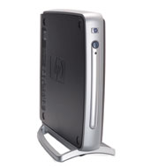
vr0 (fast ethernet)
vr0 (fast ethernet)
PC 1
HP Compaq T5000
Thin client
PC 2
HP Compaq T5000
Thin client

Slide 9
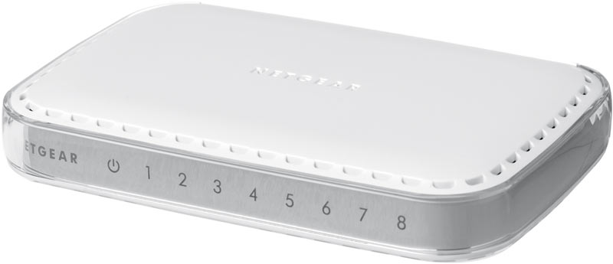
Switch (gigabit)
Netgear GS608 v3
vr0 (fast ethernet)
vr0 (fast ethernet)
PC 1
HP Compaq T5000
Thin client
PC 2
HP Compaq T5000
Thin client

Slide 10
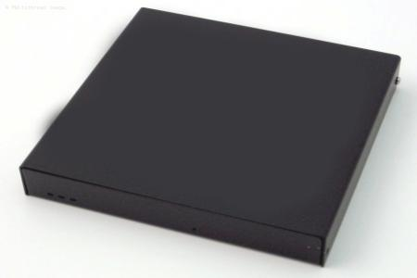
Switch (gigabit)
Netgear GS608 v3
vr0 (fast ethernet)
10.0.1.1
vr0 (fast ethernet)
10.0.2.2
PC 1
HP Compaq T5000
Thin client
PC 2
HP Compaq T5000
Thin client
sis0 (fast ethernet)
10.0.1.254
sis1 (fast ethernet)
10.0.2.254
Router
PC engine WRAP 1e203

Slide 11
R3
- DHCP Server
- Quagga
- ATLQ (shape VPN IPv4 to 64Kb/s)
loopback1
10.0.3.3/24
2001:db8:3::3/64
em1 (.3)
em2 (.3)
RIP
OSPF
10.0.23.0/24
2001:db8:23::/64
10.0.34.0/24
2001:db8:34::/64
R4
- Bird
- mpd
- IPFW (shape VPN IPv6 to 128Kb/s)
- freevrrpd
R2
- Quagga
- mpd
- netflow
em1 (.2)
2 PPTP VPN
(IPv4 and IPv6)
em2 (.4)
em0 (.2), carp (.254)
IPv4 DHCP relay
IPv6 rtavd
em3 (.4), VRRP (.254)
IPv4 DHCP relay
IPv6 rtavd
10.0.12.0/24
2001:db8:12::/64
10.0.45.0/24
2001:db8:45::/64
lagg0 (lacp:em0, DHCP client)
lagg0 (failover : em3, DHCP client)
R1
- Iperf client
- Configs repo
R5
- Iperf server
- bsnmpd
em4 : .12
em4 : .13
em4 : .14
em4 : .11
em4 : .15
192.168.56.0/24
shared-with-host

Slide 12
R1 : DHCP Client
em0 : dynamic
10.0.12.0/24
em0: . 2
R2 : DHCP Relay
em1: . 2
10.0.23.0/24
em1 : .3
R3 : DHCP Server

Slide 13
em1
em4
R3
em2
em0
em2
em1
em4
em3
em5
em3
R2
MLPPP client
R4
em4
R1
client
em1
R6
em4
R7
MLPPP Server
R5
1Mb/s
R3
1Mb/s
R2
MLPPP client
1Mb/s
R4
R6
R1
client
R7
MLPPP Server
R5

Slide 14
em0
em2
em1
em4
em3
em5
R1
R2
R3
R4
R5

Slide 15
R1
mcast source
R2
PIM-DM
R4
mcast receiver
R3
PIM-DM
.1
.2
.2
.3
.3
.4
em0
10.0.12.0/24
em1
10.0.23.0/24
em2
10.0.34.4/24

Slide 16
Tunnel
10.0.24.0/24
10.0.12.0/24
10.0.45.0/24
1.1.23.0/24
1.1.34.0/24
.1
.2
.2
.3
.3
.4
.4
.5
em0
em1
em2
em3
R1
R2
R3
R4
R5

Slide 17
em1
.3
em3
10.0.23.0/24
R3
10.0.35.0/24
em1
.2
em2
10.0.12.0/24
10.0.56.0/24
em0
.1
em0
.2
em4
.5
em4
.6
R2
em2
.2
em3
.5
R5
R1
Multicast source
10.0.45.0/24
R6
Multicast client
10.0.24.0/24
em1
.4
em3
.4
R4

Slide 18
BSDRP2
BSDRP3
bce1
em0
1.1.1.2/24
em0
1.1.1.3/24
bge1
Gi0/5
Gi0/9
Gi0/8
Gi0/6
cisco WS-C3550-12T

