Slide 1
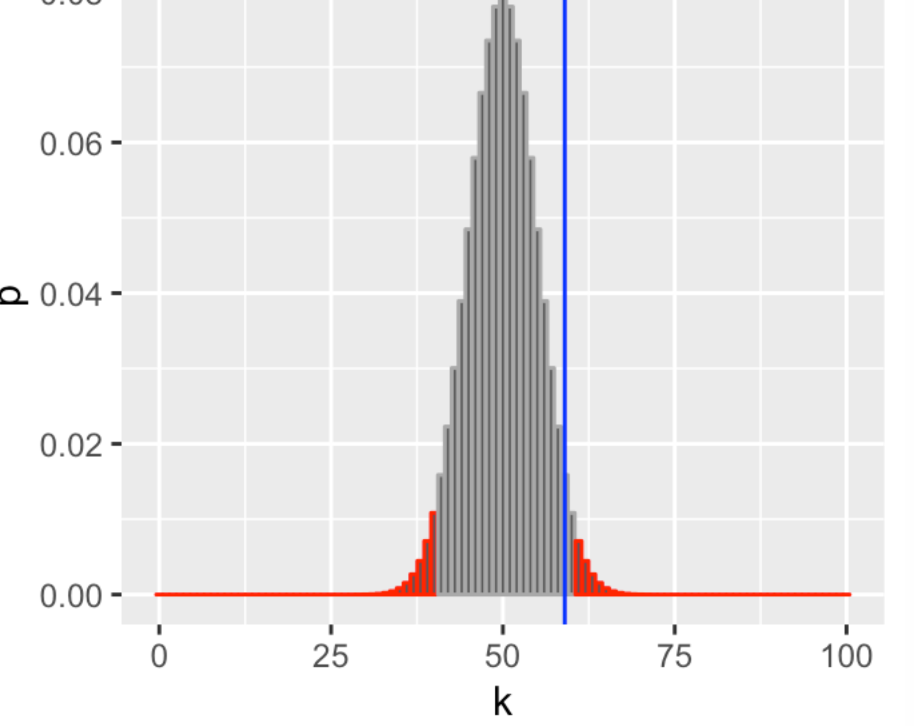
Reject region of level 0.05,
(Calculated using pbinom in R)

