Slide 1
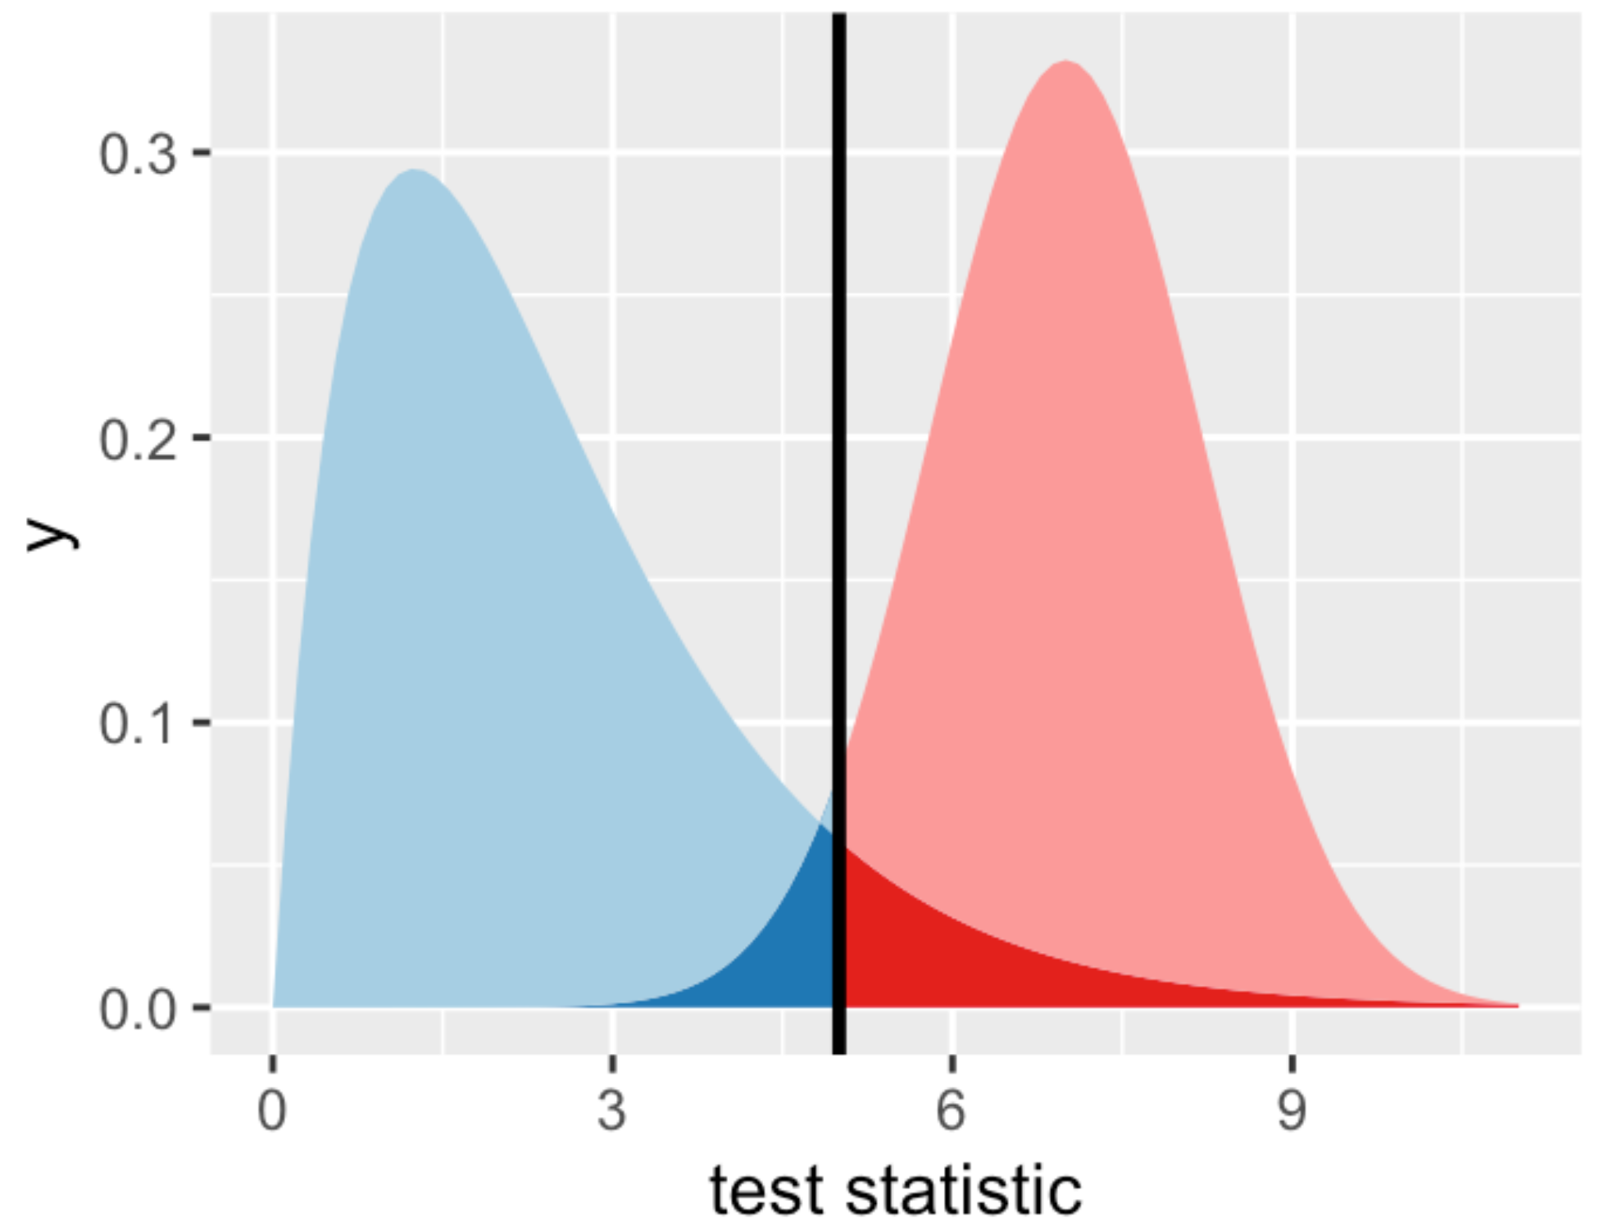
Distribution under the null hypothesis
Distribution under the alternative hypothesis
False positive rate
False negative rate

