Slide 1
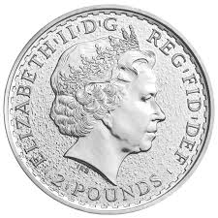
Observe (my experiment):
HHHTHHTHHTTH….
I think my coin is probably fair.
I expect roughly a 1:1 ratio of heads to tails or 50 heads for every 50 tails
Hypothesis: My coin is fair.
Question: Is my coin fair?
Observe (my data):
Heads | Tails
59 | 41
Question: How likely is it that this observation is a fluke?
Question: What is the probability of this event happening, given that my coin was fair?
Maybe my coin is biased? But how do I know?

